Slide 1


History’s Watch by the European Court of Human Rights pierre-olivier de broux
UGent – 25th of November 2015

Slide 2
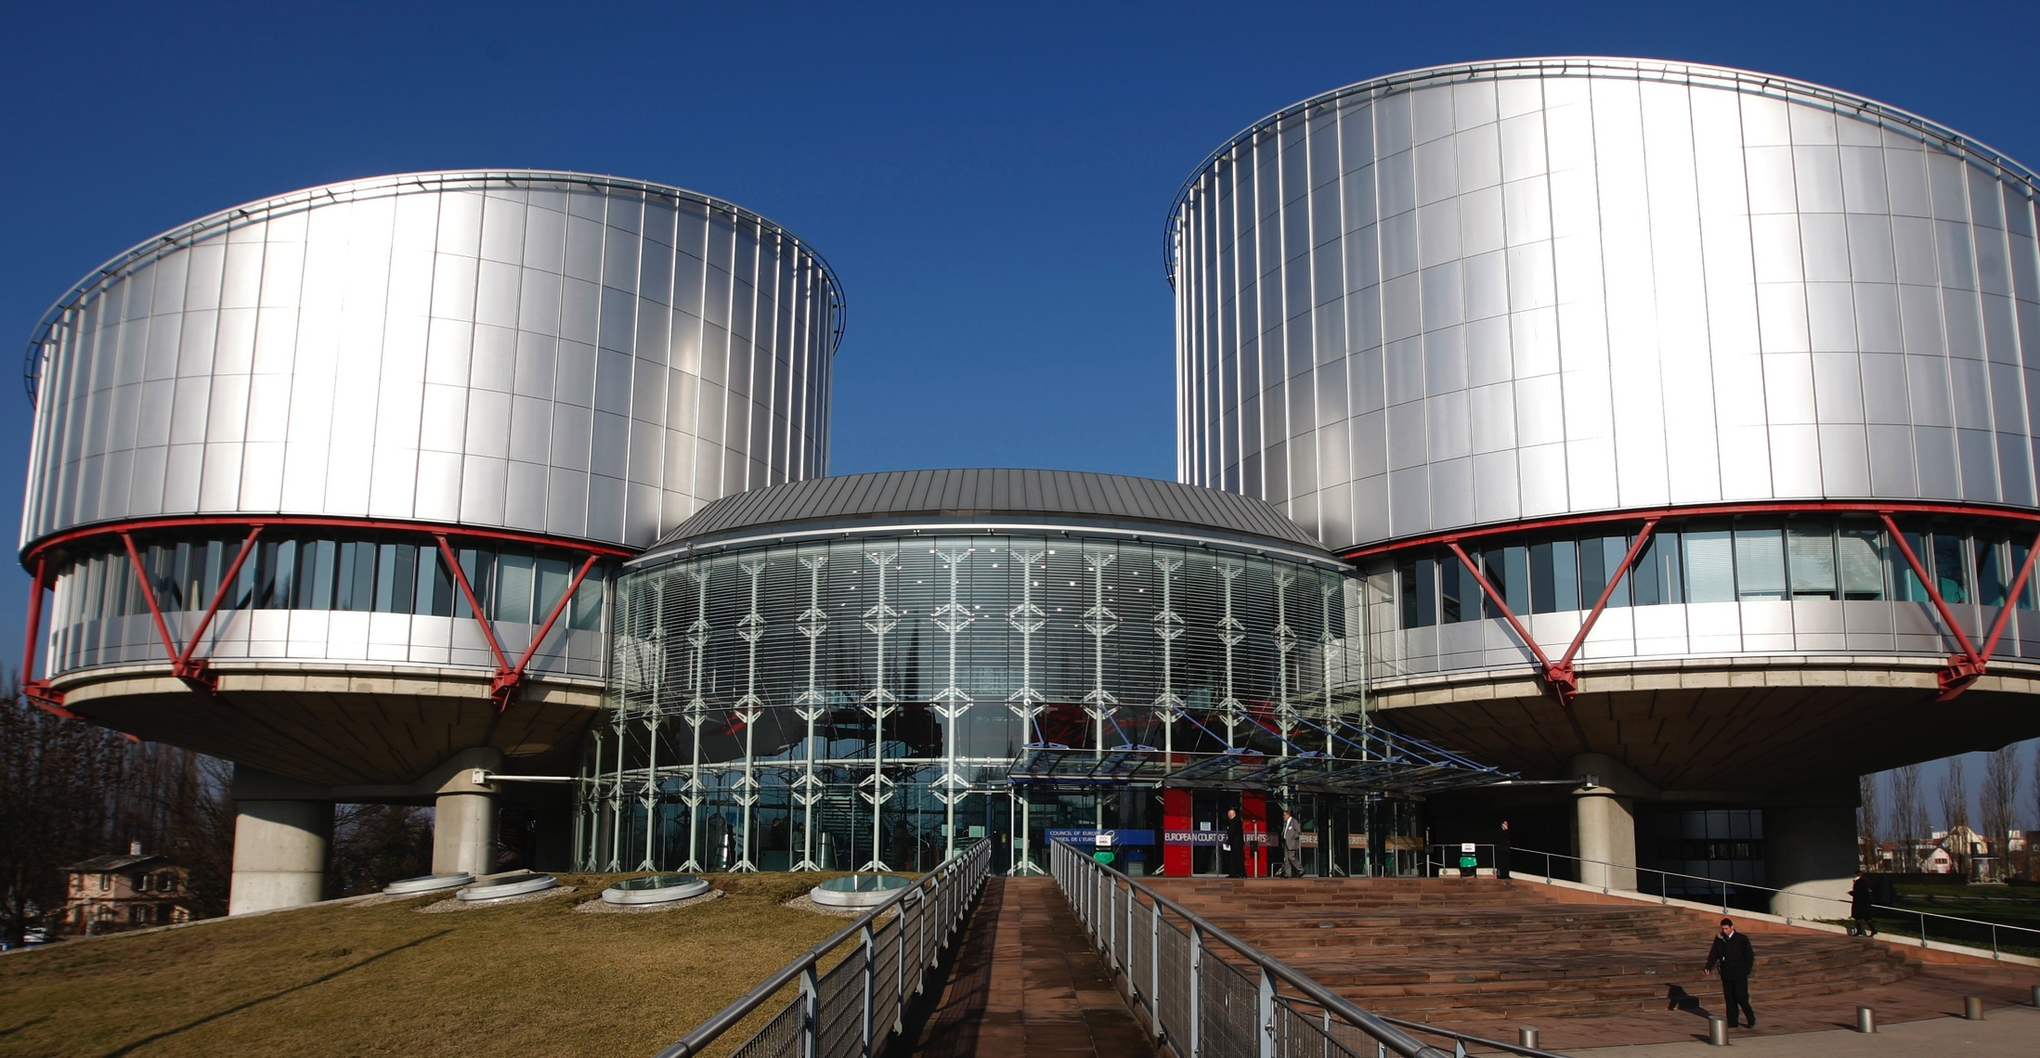
I. Echr offering protection to historical research

Slide 3
I. Echr offering protection to historical research
I. Freedom of expression guaranteeing historical research
Arrest Monnat v. Switzerland, 21.09.2006 :
§57. The Court reiterates that it is an integral part of freedom of expression to seek historical truth, but considers that it is not called upon to settle the issue of the role actually played by Switzerland in the Second World War, which is part of an ongoing debate among historians (…)
§64. The Court further notes that the historical events discussed in the programme in issue had occurred more than fifty years previously. Even though remarks such as those by the applicant are always likely to reopen the controversy among the public, the lapse of time makes it inappropriate to deal with such remarks, fifty years on, with the same severity as ten or twenty years before. That forms part of the efforts that every country must make to debate its own history openly and dispassionately. (…)

Slide 4
I. Echr offering protection to historical research
II. Freedom of expression admits restrictions if necessary in a democratic society
Hate speech,
Genocide denial (with or without specific law: see Garaudy v. France and Witsch v. Germany): “For the Court, the justification for making its denial a criminal offence lies not so much in that it is a clearly established historical fact but in that, in view of the historical context in the States concerned (…), its denial, even if dressed up as impartial historical research, must invariably be seen as connoting an antidemocratic ideology and anti-Semitism (Perincek v. Switzerland, 15.10.2015, §243)
Partial presentation of historical facts, depending of:
  the manner in which the impugned statements were phrased and the way in which they could be construed;
  the specific interest or right affected by the statements;
  the statements’ impact
  the lapse of time since the historical events to which the statements related

Slide 5
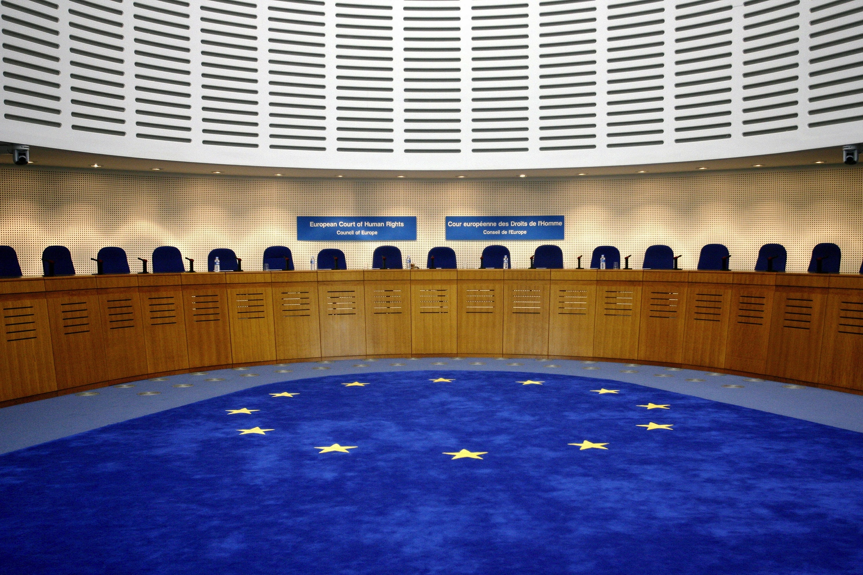
Ii. Echr rejecting protection to historical research

Slide 6
II. Echr rejecting protection to historical research
I. Right to privacy as an obstacle to historical research
BUT
Arrest Putistin v. Ukraina, 21.11.2013
Decision Dzhugashvili v. Russia , 09.12.2014
§32. The Court notes that historical events of great importance which affected the destinies of multitudes of people, as well as the historical figures involved therein and responsible for them, inevitably remain open to public historical scrutiny and criticism, as they present a matter of general interest for society.

Slide 7
II. Echr rejecting protection to historical research
II. Right to information absent of the ECHR
Arrest Janowiec and others v. Russia, 21.10.2013 :
usefullness of article 38 ECHR: “The Court shall examine the case together with the representatives of the parties and, if need be, undertake an investigation, for the effective conduct of which the High Contracting Parties concerned shall furnish all necessary facilities.”
§209 Janowiec : « the Court reiterates that this obligation is a corollary of the undertaking not to hinder the effective exercise of the right of individual application under Article 34 of the Convention. »

Slide 8
II. Echr rejecting protection to historical research
III. A political role interfering with the historical research?
Decision Epstein and others v. Belgium, 08.01.2008
Arrest Janowiec and others v. Russia, 21.10.2013

Slide 9
Concluding remarks

