Slide 1

Under-5 mortality according to migratory origin in France and Belgium.
Some lessons to be learned
Workshop on health and mortality among immigrants and their descendants
in Europe and the US
PhD student: Emmanuel Idohou
Supervisors: P. Bocquier & M. Guillot
Ined – June 2023

Slide 2
Contents
Part I | Methodology & some results for France
Part II | Methodology & some descriptive analyses for Belgium
Part III | Summary

Slide 3
The case of
Part I

Slide 4
Methodology
01
02
03
04
05
06
Data
Eligibility
Sampling
EDP: the largest French sociodemographic panel
Births in the first 4 days of the first month of each quarter
648,040 births in France from 1990 to 2019
Parental origin
Group in six
immigrant categories
Statistical analysis
Masured as mother’s birth place
Sub-Saharan Africa, North Africa, Eastern Europe, other European countries, Asia and others
Weighting using propensity score
Weibull model adjusted for
child and parent’s
socioeconomic factors

Slide 5
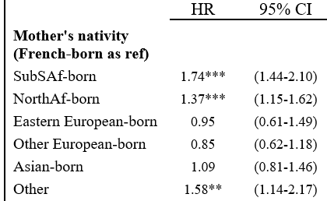
Some results
Results highlight the total effect
of migratory origin
Higher U5M among children of immigrant mothers
(except from Europe and Asia)
Children of Sub-Saharan African mothers have a 1.44 to 2.10
higher risk of U5M, compared to children of French natives
For children of North-African mothers, the risk is 1.15 to 1.62 higher
Source: Author’s calculations based upon Permanent Demographic Sample (EDP), 1990–2019, N = 648,040 children born in France. Analyses are weighted. ***p<0.001; **p<0.01; *p<0.05.

Slide 6


Why are there differences in U5M
Excess U5M
for certain groups
No excess U5M
for certain groups like Asian-born
Healthy Immigrant Effect not passed
on from generation to generation
Better health status
Favourable health behaviors and better SES
Discrimination
Lower SES
Risky health behaviour

Slide 7
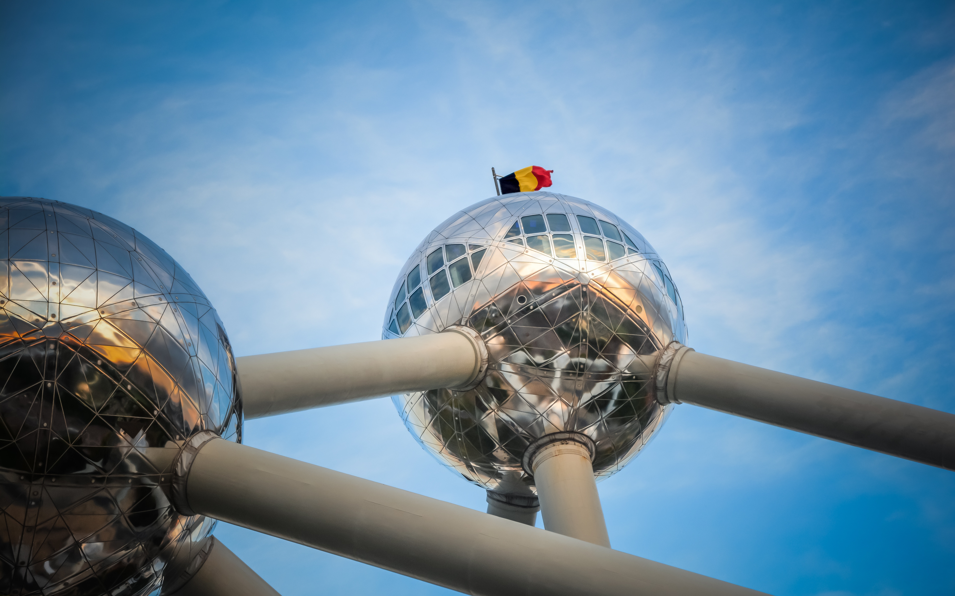
Part II:
The case of Belgium

Slide 8
Methodology
Birth certificate linked to death certificate
Data
From 1998 to 2020:
2 759 641 births, 10 959 deaths under age 5
Coverage
Measured as mother’s region of birth or father’s region of birth or
combination of parents’ region of birth
Parental origin
Descriptive analysis: Compute U5M rates and associated confidence intervals
Statistical analysis

Slide 9
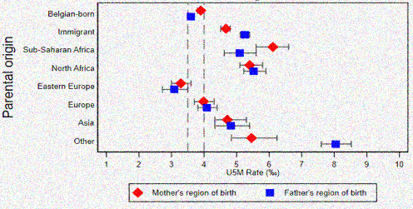
U5M Rate by region of parental origin
Lower U5M rates
among immigrants
from Eastern Europe
When comparing native-born and immigrant-born, a significant difference emerges between these two groups, in favor of the native-born for both fathers and mothers, with a greater disparity for fathers.
Source: Belgian Vital Statistics; author’s calculation

Slide 10
U5M according to parents’ naturalization status and origin (nationality at birth)
Protective effect of naturalization
Nationality of origin & naturalization status | Births (%) | U5MR | 95 CI
Mother
Belgian origin | 1739252 (63.02) | 3.90 | 3.80 | 4.02
Naturalized | 492766 (17.86) | 4.01 | 3.80 | 4.22
Not naturalized ª | 527623 (19.12) | 4.62 | 4.44 | 4.81
Specific subgroups ^{b}
Sub-Saharan Africa
Naturalized | 32423 (1.17) | 6.90 | 6.11 | 7.89
Not naturalized | 60022 (2.17) | 6.01 | 5.42 | 6.69
North Africa
Naturalized | 103927 (3.77) | 5.12 | 4.56 | 5.52
Not naturalized ^{c} | 99795 (3.62) | 5.95 | 5.10 | 6.11
Asia
Naturalized | 64250 (2.34) | 5.55 | 5.00 | 6.22
Not naturalized ^{c} | 74143 (2.69) | 4.72 | 4.22 | 5.24
America-Oceania and other
Naturalized | 7445 (0.27) | 3.71 | 2.61 | 5.49
Not naturalized ^{c} | 15775 (0.57) | 2.80 | 2.02 | 3.71
Nationality of origin & naturalization status | Births (%) | U5MR | 95 CI
Father
Belgian origin | 1665622 (60.36) | 3.61 | 3.53 | 3.74
Naturalized | 482218 (17.47) | 4.21 | 4.01 | 4.43
Not naturalized ª | 611801 (22.17) | 5.32 | 5.12 | 5.51
Specific subgroups
Sub-Saharan Africa
Naturalized | 31607 (1.15) | 5.71 | 4.89 | 6.60
Not naturalized | 42985 (1.56) | 5.43 | 4.82 | 6.21
North Africa
Naturalized | 121443 (4.40) | 5.12 | 4.87 | 5.55
Not naturalized ^{c} | 94764 (3.43) | 5.72 | 5.19 | 6.22
Asia
Naturalized | 69685 (2.53) | 5.22 | 4.66 | 5.70
Not naturalized ^{c} | 64404 (2.33) | 5.22 | 4.60 | 5.84
America-Oceania and other
Naturalized | 4333 (0.16) | 1.72 | 0.79 | 3.58
Not naturalized ^{c} | 13288 (0.48) | 3.41 | 2.62 | 4.63
a: Not naturalized compared to naturalized parents
and those of Belgian origin.
b: restricted to the subgroups with the highest U5M rates.
c: Not naturalized compared only to naturalized parents
Children whose father or mother have been naturalized have lower U5M than those whose parents have not
For some origins, no conclusive protective effect of naturalization of either the father or the mother

Slide 11
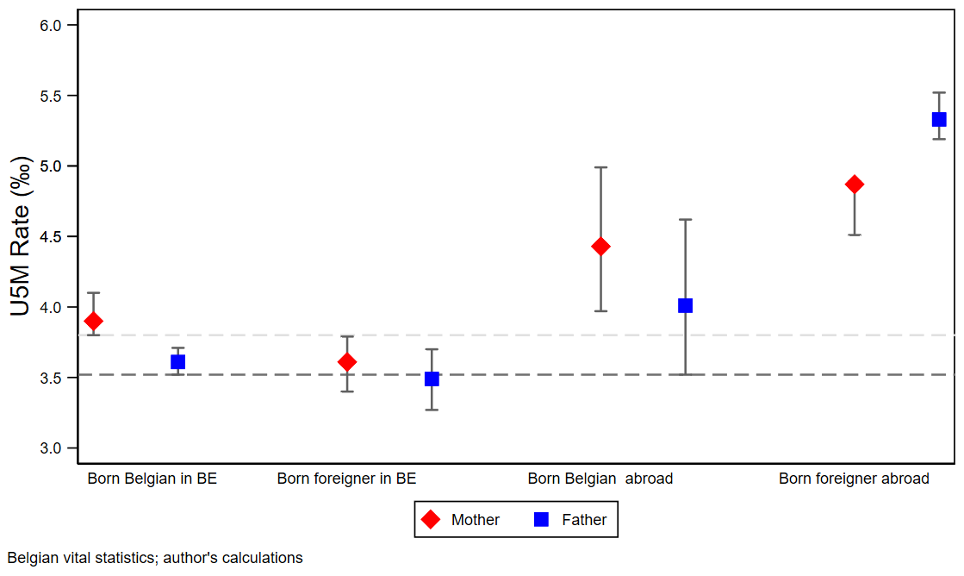
Combined effects of parental origin (region of birth) and their nationality at birth
No difference in U5M between parents born in Belgium with Belgian nationality at birth and those born in Belgium with a foreign nationality at birth
No difference in U5M between parents born in Belgium with Belgian nationality at birth and those born abroad with Belgian nationality at birth
Being an immigrant with a foreign nationality at birth is a combination of factors that adversely affect child’s survival.

Slide 12
Why are there differences in U5M
Excess U5M for some groups
like African and Asian-born
Better U5M rates among immigrants from Eastern Europe
Is the Healthy Immigrant Effect
the result of a selection effect?
Is this the effect of social capital?
Are Asians a specifically vulnerable group like Africans?
Is it discrimination towards migrants from non-European Muslim countries?

Slide 13
III- Summary
Distribution of births:
SSA (5%)
North Africa (7%)
Eastern Europe (1%)
Other Europe (2%)
Asia (3%)
other (1%)
A higher U5M among children of African immigrant mothers
No statistical differences in favour of immigrants from Eastern Europe
Weak integration policy?
Distribution of births:
SSA (4%)
North Africa (6%)
Eastern Europe (5%)
Other Europe (7%)
Asia (3%)
other (2%)
A higher U5M among children of African and Asian immigrant mothers
Better U5M rates among
immigrants from Eastern Europe
Strong integration policy?

Slide 14
Thanks!
Thanks to
Louvain4Migration for funding access to the EDP data and FNRS for funding my research fellowship
Do you have any questions?
emmanuel.idohou@uclouvain.be

