Slide 1


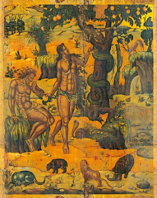
Cunning or Clever?
An Analysis of the Unique Rendering ofעָרוּם by φρόνιμος to Denote the Snake in Gen 3:1
Ellen De Doncker & Bryan Beeckman
LXXSA Conference 2024 (16th April 2024)

Slide 2
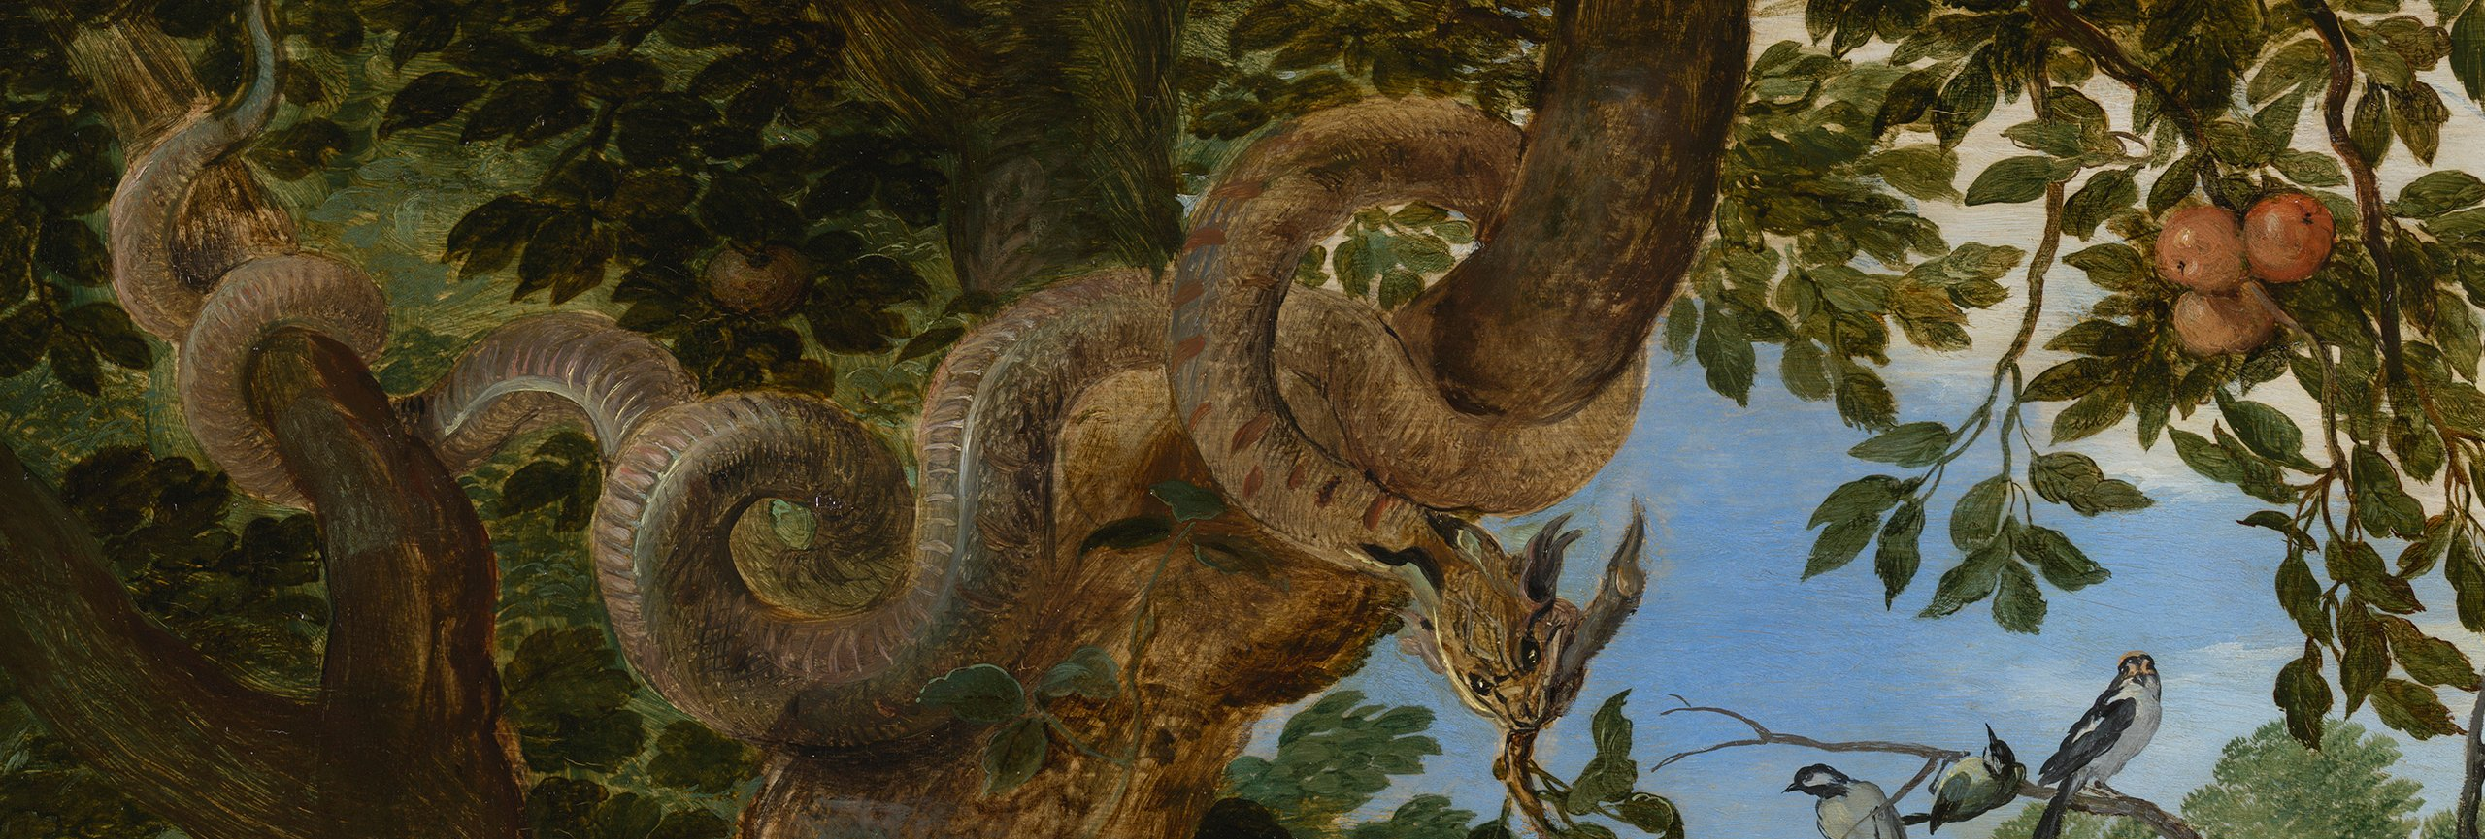
Content
Introduction
The meaning and usage of עָרוּם and φρόνιμος
The rendering of עָרוּם by φρόνιμος in LXX Gen 3:1
The impact of עָרוּם/φρόνιμος on the narrative of Gen 3
A positive role for the snake?

Slide 3
Introduction
Snake = sparks imagination
Gen 3:1
‎ וְהַנָּחָשׁ֙ הָיָ֣ה עָר֔וּם מִכֹּל֙ חַיַּ֣ת הַשָּׂדֶ֔ה אֲשֶׁ֥ר עָשָׂ֖ה יְהוָ֣ה אֱלֹהִ֑ים
Now the serpent was more crafty/subtle than any other wild creature that the Lord God had made.
ὁ δὲ ὄφις ἦν φρονιμώτατος πάντων τῶν θηρίων τῶν ἐπὶ τῆς γῆς ὧν ἐποίησεν κύριος ὁ θεός.
Now the snake was the most sagacious of all the wild animals that were upon the earth, which the Lord God had made.
Why עָרוּם/φρόνιμος?
No satisfactory answer in literature!
This paper will try to find one!

Slide 4
1. The meaning and usage of עָרוּם and φρόνιμος
1.1 עָרוּם
“crafty; shrewd or sensible, prudent” (BDB)
“cunning; clever” (LEH)
“crafty, cunning; shrewd, sensible; prudent” (LSJ)
Binary definition: “clever/prudent” vs. “cunning/crafty”
M. Fox & R. Whybray: neutral term
BUT: binary semantic field of עָרוּם at the centre of its use in the Hebrew Bible

Slide 5
1. The meaning and usage of עָרוּם and φρόνιμος
1.1 עָרוּם
Binary semantic field of עָרוּם in the Hebrew Bible
  Positive: Proverbs (e.g., 12:16.23; 13:16; 14:8): a prudent, sensible man
  Negative: Job (5:12; 15:5): crafty man
Same binary (+/-) for the cognates:
  עָרְמָה (’prudence, craftiness’): e.g., positively in Prov 8:12 (regarding Wisdom), negatively in Josh 9:4 (craftiness of the Gibeonites)
  Verb ערם (‘to be shrewd, crafty’): e.g., negatively in Ps 83:3 (crafty enemies of God), positively in Prov 15:5; 19:25 (prudent man)

Slide 6
1. The meaning and usage of עָרוּם and φρόνιμος
1.1 עָרוּם
Distribution and translation in the LXX
Translation of עָרוּם and cognates in the LXX
Hebrew lexeme | Verse | Subject | Greek lexeme
עָרוּם | Gen 3:1 | snake | φρόνιμος
 | Job 5:12; 15:5 | crafty men | πανοῦργος
 | Prov 12:16; 13:16; 14:8.15.18; 22:3; 27:12 | prudent man | πανοῦργος
 | Prov 12:23 | prudent man | συνετός
 | 1 Sam 23:22 | man (David) | πανουργεύομαι
ערם | Ps 83:3 | enemies of God | καταπανουργεύομαι
 | Job 5:13 | crafty | φρόνησις
 | Prov 15:5; 19:25 | prudent man | πανουργότερος
 | Ex 21:14 | presumptuous man | δόλος
עָרְמָה | Josh 9:4 | deceptive men, pretending to be hardworking | πανοῦργος
 | Prov 1:4; 8:5 | to the simple man | πανουργία
 | Prov 8:12 | Wisdom | βουλή

Slide 7
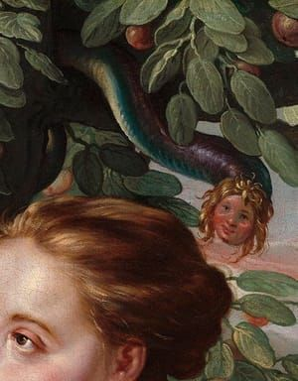
1. The meaning and usage of עָרוּם and φρόνιμος
1.1 עָרוּם
Ambiguous
Not חכם (wise)
  Avoidance?
  Creation of word-play
Gen 2:25 (men) | Gen 3:1 (snake)
וַיִּֽהְי֤וּ שְׁנֵיהֶם֙ עֲרוּמִּ֔ים הָֽאָדָ֖ם וְאִשְׁתּ֑וֹ וְלֹ֖א יִתְבֹּשָֽׁשׁוּ | וְהַנָּחָשׁ֙ הָיָ֣ה עָר֔וּם מִכֹּל֙ חַיַּ֣ת הַשָּׂדֶ֔ה אֲשֶׁ֥ר עָשָׂ֖ה יְהוָ֣ה אֱלֹהִ֑ים
And the man and his wife were both naked, and were not ashamed | Now the serpent was more crafty/subtle than any other wild creature that the Lord God had made.
Versus ‘standard’ forms: עֵירֻמִּם in v.7, and singular עֵירֹם in v. 10

Slide 8
1. The meaning and usage of עָרוּם and φρόνιμος
1.1 עָרוּם
Another word-play?
  ‘The snake’: הַנָּחָשׁ
  related to the word נַחַשׁ (‘omen, divination’) and the verb נחשׁ (‘to practice divination’)
  More ambiguity!
Threefold ambiguity
  morality (‘cleverness’ or ‘craftiness’), embodiment (‘nakedness’ and ‘shrewdness’) and divination (‘snake’ or ‘oracle’)
  R. Hendel: snake: “crossing or blurring the boundaries between the categories of animal, human and divine”
  How did Greek translators respond to this ambiguity? In what way does LXX reflect and/or transforms the complex figure of the snake?

Slide 9
1. The meaning and usage of עָרוּם and φρόνιμος
1.2 φρόνιμος
“shrewd in judgement” (GELS)
“wise or prudent; understanding” (LEH)
“in one’s right mind, in one’s senses; showing presence of mind; sensible; sagacious” (LSJ)
“in oneʼs right mind, in oneʼs senses, master of oneself; sensible, shrewd, wise, prudent” (MSJ)
Shrewd: have an understanding in order to gain an advantage
Negative?

Slide 10
1. The meaning and usage of עָרוּם and φρόνιμος
1.2 φρόνιμος
Distribution and usage in the LXX
Hebrew lexeme | Amount | Occurrence
עָרוּם | 1 | Gen 3:1
בין | 11 | Gen 41:33.39; Prov 11:12; 14:6; 15:21; 17:10.27.28; 18:15; 19:25; 20:5
חָכְמָה/חָכָם | 7 | 3 Kgdms 2:35; 5:10; 5:21; Prov 3:7; 11:29; Hos 13:13; Isa 44:25
‎מְזִמָּה | 1 | Prov 14:17
- | 7 | 1 Kgdms 2:10; 3 Kgdms 2:35.46; 3:12; Prov 15:1; 17:21; 19:7
† | 1 | Prov 18:14
Directly into Greek | 12 | Tob 4:18; 6:12; Wis 6:24; Sir 19:31; 20:27; 21:17.21.24.25; 22:4; 38:4; 4 Macc 7:17

Slide 11
1. The meaning and usage of עָרוּם and φρόνιμος
1.2 φρόνιμος
Distribution and usage in the LXX
Most occurrences in LXX Proverbs (16/40)
Never used to denote an animal (except Gen 3:1)
In Gen also used to qualify Joseph (Gen 41:33.39)
Thus: probably deliberate rendering in LXX Gen 3:1

Slide 12
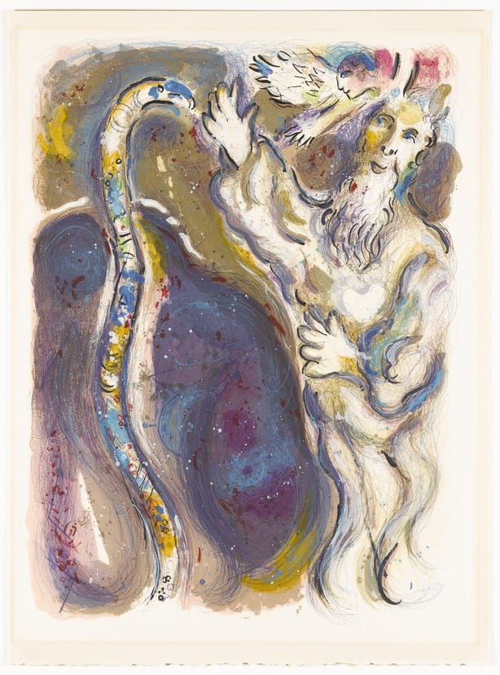
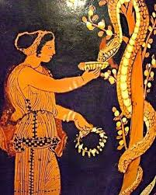
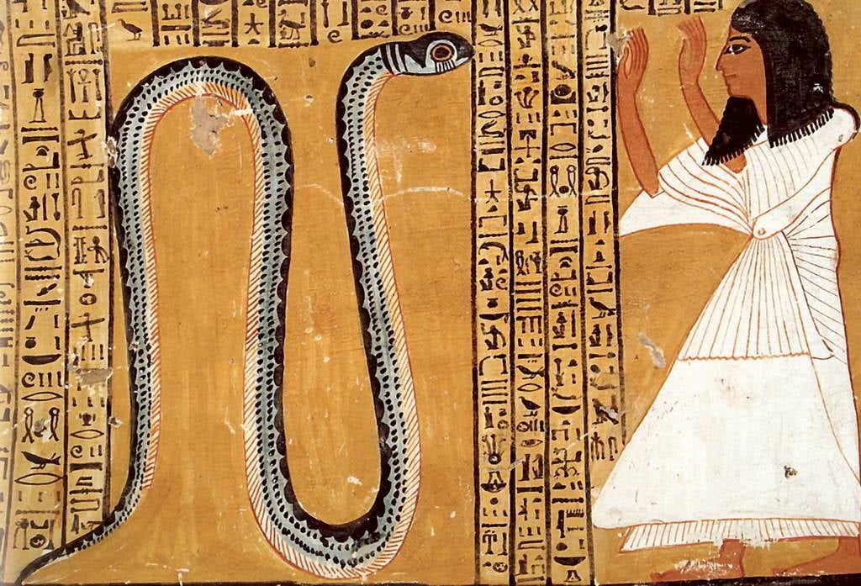
2. The rendering of עָרוּם by φρόνιμος in LXX Gen 3:1
Why did the LXX translator employ φρόνιμος?
Prompted by other literature (Greek, Hellenistic Jewish or Egyptian)?
Searching for φρόνιμος to qualify animals and, if possible, related to the snake (ὄφις)

Slide 13
2. The rendering of עָרוּם by φρόνιμος in LXX Gen 3:1
2.1 Greek literature
Aristotle: Historia Animalium, De Partibus Animalium and De Generatione Animalium.
Aristotle, HA, I.488b, 12–20
Διαφέρουσι δὲ καὶ ταῖς τοιαῖσδε διαφοραῖς κατὰ τὸ ἦθος. Τὰ μὲν γάρ ἐστι πρᾶα καὶ δύσθυμα καὶ οὐκ ἐνστατικά, οἷον βοῦς, τὰ δὲ θυμώδη καὶ ἐνστατικὰ καὶ ἀμαθῆ, οἷον ὗς ἄγριος, τὰ δὲ φρόνιμα καὶ δειλά, οἷον ἔλαφος, δασύπους, τὰ δ’ ἀνελεύθερα καὶ ἐπίβουλα, οἷον οἱ ὄφεις, τὰ δ’ ἐλευθέρια καὶ ἀνδρεῖα καὶ εὐγενῆ, οἷον λέων, τὰ δὲ γενναῖα καὶ ἄγρια καὶ ἐπίβουλα, οἷον λύκος· εὐγενὲς μὲν γάρ ἐστι τὸ ἐξ ἀγαθοῦ γένους, γενναῖον δὲ τὸ μὴ ἐξιστάμενον ἐκ τῆς αὑτοῦ φύσεως.
Now here are the sorts of ways in which animals differ from each other in regard to disposition. Some are gentle, and sluggish, and not inclined to be aggressive, e.g., the ox; others are ferocious, aggressive and stubborn, e.g., the wild boar; some are intelligent and timid, e.g., the deer and the hare; others are mean and scheming, e.g., serpents; others are noble and brave and high–bred, e.g., the lion; others are thorough-bred, wild and scheming, e.g., the wolf. (By high–bred is meant one which comes of a good stock, by thorough–bred one which remains true to its own type.)
Some animals considered intelligent (φρόνιμος): deer (ἔλαφος) and hare (δασύπους)
Snakes = mean and scheming (ἀνελεύθερα καὶ ἐπίβουλα)

Slide 14
2. The rendering of עָרוּם by φρόνιμος in LXX Gen 3:1
2.1 Greek literature
Aristotle, Part. an., II.648a, 3–14
Ἔστι δ᾿ ἰσχύος μὲν ποιητικώτερον τὸ παχύτερον αἷμα καὶ θερμότερον, αἰσθητικώτερον δὲ καὶ νοερώτερον τὸ λεπτότερον καὶ ψυχρότερον. τὴν αὐτὴν δ’ ἔχει διαφορὰν καὶ τῶν ἀνάλογον ὑπαρχόντων πρὸς τὸ αἷμα· διὸ καὶ μέλιτται καὶ ἄλλα τοιαῦτα ζῷα φρονιμώτερα τὴν φύσιν ἐστὶν ἐναίμων πολλῶν, καὶ τῶν ἐναίμων τὰ ψυχρὸν ἔχοντα καὶ λεπτὸν αἷμα φρονιμώτερα τῶν ἐναντίων ἐστίν. Ἄριστα δὲ τὰ θερμὸν ἔχοντα καὶ λεπτὸν καὶ καθαρόν· ἅμα γὰρ πρός τε ἀνδρείαν τὰ τοιαῦτα καὶ πρὸς φρόνησιν ἔχει καλῶς. Διὸ καὶ τὰ ἄνω μόρια πρὸς τὰ κάτω ταύτην ἔχει τὴν διαφοράν, καὶ πρὸς τὸ θῆλυ αὖ τὸ ἄρρεν, καὶ τὰ δεξιὰ πρὸς τὰ ἀριστερὰ τοῦ σώματος.
The thicker and warmer the blood is, the more it makes for strength; if it tends to be thin and cold, it is conducive to sensation and intelligence. The same difference holds good with the counterpart of blood in other creatures: and thus we can explain why bees and other similar creatures are of a more intelligent nature than many animals that have blood in them; and among the latter class, why some (viz. those whose blood is cold and thin) are more intelligent than others. Best of all are those animals whose blood is hot and also thin and clear; they stand well both for courage and for intelligence. Consequently, too, the upper parts of the body have this pre-eminence over the lower parts; the male over the female; and the right side of the body over the left.
Cold blood = more intelligent
Less blood = more intelligent
Snake = cold blood = intelligent?

Slide 15
2. The rendering of עָרוּם by φρόνιμος in LXX Gen 3:1
2.1 Greek literature
Aristotle, GA, III.753a, 8–17
ἔοικε δὲ καὶ ἡ φύσις βούλεσθαι τῶν1 τέκνων αἴσθησιν ἐπιμελητικὴν παρασκευάζειν· ἀλλὰ τοῖς μὲν χείροσι τοῦτ᾿ ἐμποιεῖ μέχρι τοῦ τεκεῖν μόνον, τοῖς δὲ καὶ περὶ τὴν τελέωσιν, ὅσα δὲ φρονιμώτερα, καὶ περὶ τὴν ἐκτροφήν. τοῖς δ᾿ ἤδη μάλιστα κοινωνοῦσι φρονήσεως καὶ πρὸς τελεωθέντα γίνεται συνήθεια καὶ φιλία, καθάπερ τοῖς τε ἀνθρώποις καὶ τῶν τετραπόδων ἐνίοις, τοῖς δ᾿ ὄρνισι μέχρι τοῦ γεννῆσαι καὶ ἐκθρέψαι· διόπερ καὶ μὴ ἐπῳάζουσαι αἱ θήλειαι, ὅταν τέκωσι, διατίθενται χεῖρον, ὥσπερ ἑνός τινος στερισκόμεναι τῶν συμφύτων.
It looks as though Nature herself desires to provide that there shall be a feeling of attention and care for the young offspring. I the inferior animals this feeling which she implants lasts only until the moment of birth; in others, until the offspring reaches its perfect development; and in those that have more intelligence, until its upbringing is completed. Those which are endowed with most intelligence show intimacy and attachment towards their offspring even after they have reached their perfect development (human beings and some of the quadrupeds are examples of this); birds show it until they have produced their chicks and brought them up; and on this account hen birds which have laid eggs but omit to sit on them, deteriorate in their condition, as though they were being deprived of one of their natural endowments.
Animals which nurture their offspring to completion = more intelligent
cfr. Humans and some quadrupeds (τοῖς […] ἀνθρώποις καὶ τῶν τετραπόδων ἐνίοις)
Snake? Does not nurture offspring!

Slide 16
2. The rendering of עָרוּם by φρόνιμος in LXX Gen 3:1
2.1 Greek literature
Aristotle:
Some animals are intelligent
Some more than others
Snake not intelligent although perhaps according to Part. an., II.648a
However: Importance of Aristotle on LXX cannot be underestimated (cfr. LXX Prov)

Slide 17
2. The rendering of עָרוּם by φρόνιμος in LXX Gen 3:1
2.1 Greek literature
Some other references where φρόνιμος is applied to animals, less extensive than what one finds in Aristotle
  E.g., Isocrates, Antidosis, 211
  ἔτι δ’ εἰ περὶ τοὺς ἵππους καὶ τοὺς κύνας καὶ τὰ πλεῖστα τῶν ζῴων ὁρῶντες τέχνας ἔχοντάς τινας, αἷς τὰ μὲν ἀνδρειότερα, τὰ δὲ πραότερα, τὰ δὲ φρονιμώτερα ποιοῦσιν, περὶ τὴν τῶν ἀνθρώπων φύσιν μηδεμίαν οἴονται τοιαύτην εὑρῆσθαι παιδείαν, ἥτις ἂν αὐτοὺς ἐπί τι τούτων ὧνπερ καὶ τὰ θηρία δυνηθείη προαγαγεῖν
  Again, they observe that some people possess the art of training horses and dogs and most other animals by which they make them more spirited, gentle or intelligent, as the case may be, yet they do not think that any education has been discovered for training human nature, such as can improve men in any of those respects in which we improve the beasts.
  No other occurrences where snake is called φρόνιμος!
  φρόνιμος = ‘practical intelligence’ = an intelligence that can be trained and concerns practical issues regarding the specificities of the life of animal (vs. ἐπιστήμη)

Slide 18
2. The rendering of עָרוּם by φρόνιμος in LXX Gen 3:1
2.1 Greek literature
Another semantic field of φρόνιμος applied to animals!
  Sophocles, Electra, 1058
  Τί τοὺς ἄνωθεν φρονιμωτάτους οἰωνοὺς ἐσορώμενοι τροφᾶς κηδομένους ἀφ’ ὧν τε βλάστωσιν ἀφ’ ὧν τ’ ὄνασιν εὕρωσι, τάδ’ οὐκ ἐπ’ ἴσας τελοῦμεν
  Why, though we see the birds above, most thoughtful creatures, taking care for the sustenance of those from whom they derived life and enjoyment, why do we not pay these debts in like measure?
  Theme of nourishment, yet ALSO: theme of divination: οἰωνός for ornithomancy!
  Another example: Νικηφόρος Βορέω: Bone Tablet from Berezan/Olbia IGDO 93 (6th c. BC)

Slide 19
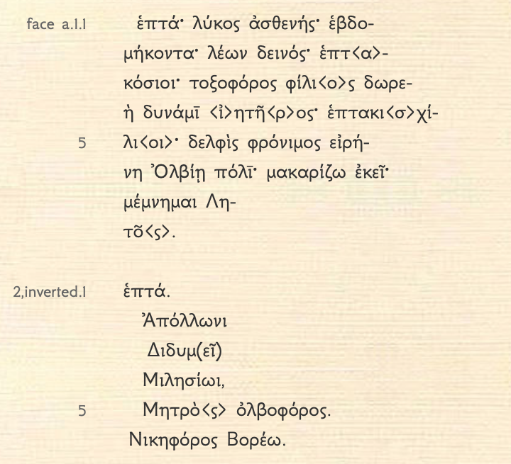
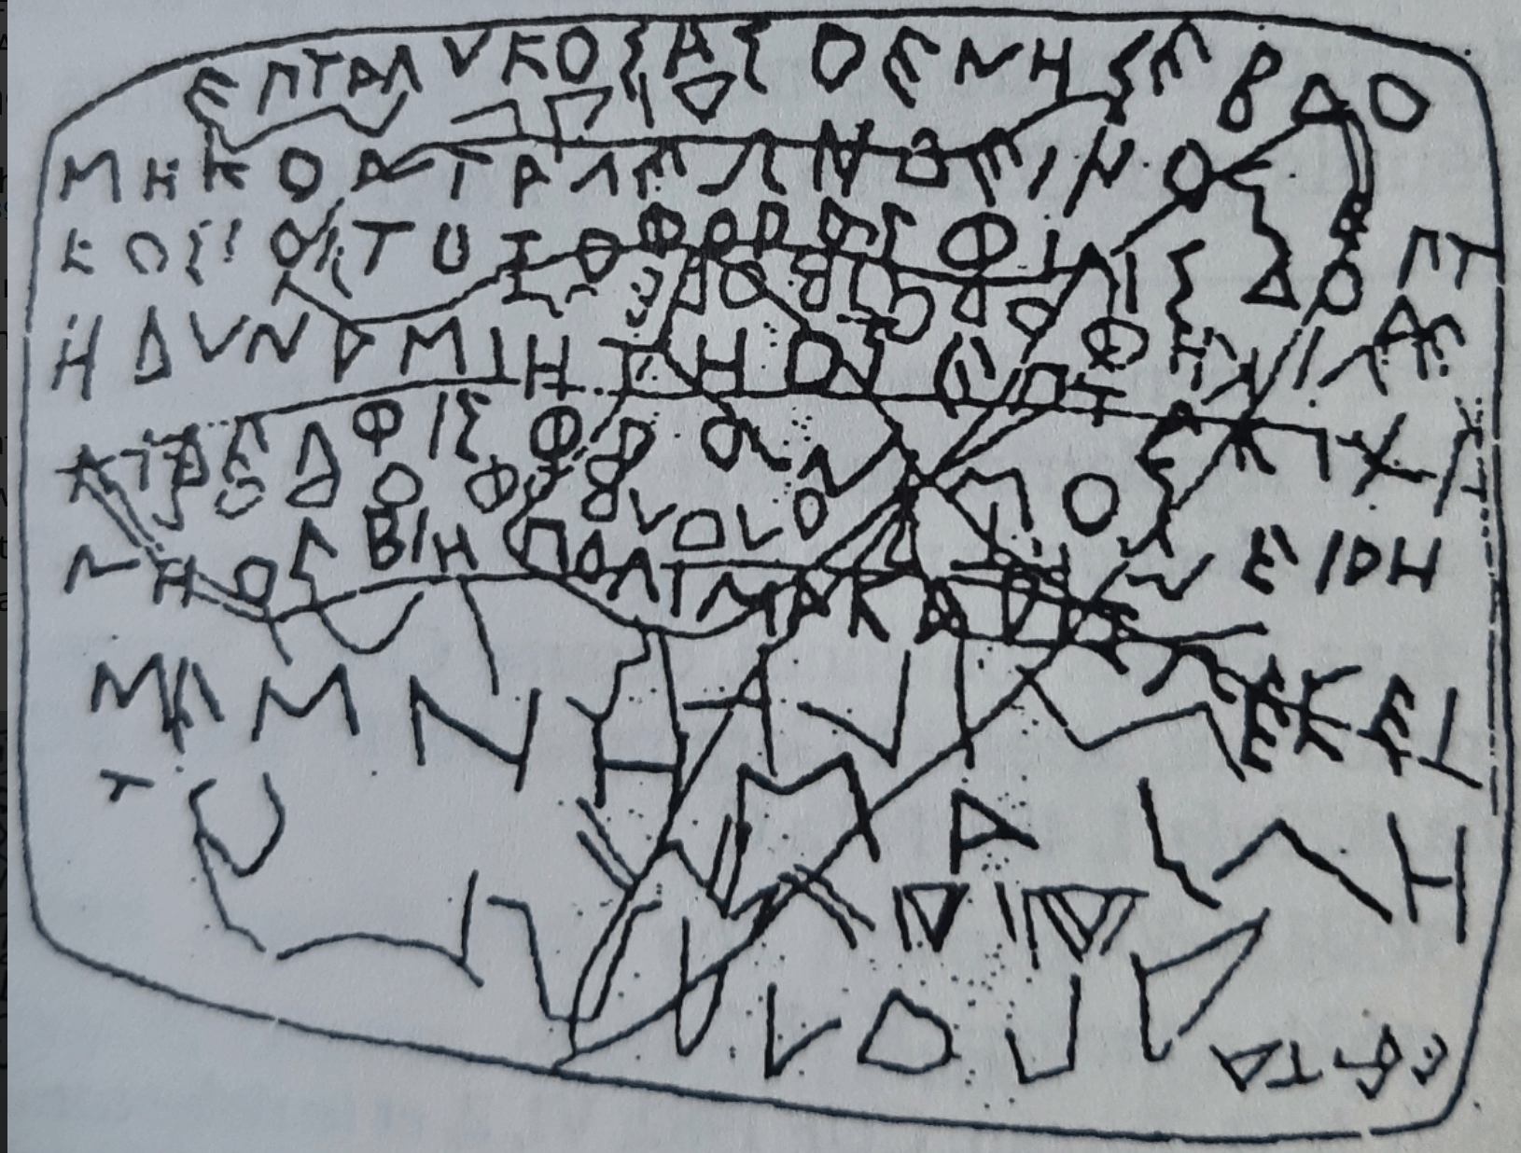
2. The rendering of עָרוּם by φρόνιμος in LXX Gen 3:1
2.1 Greek literature
Seven. Wolf (is) weak. Seventy. Lion (is) frightening. Seven hundred. Archer (is) friendly through his gift, the power of Ietros. Seven thousand. Dolphin (is) wise. Peace to the city of Olbia. I pronounce this place to be happy. I remembered Leto (?).
Seven. To Apollo Didymaeus, Milesian. Bringer of the bliss of the Mother. Bringer of the victory of Boreas.’ (transl. Y. Ustinova)
IGDO 93
Dubois, L. 1996. Inscriptions grecques dialectales d’Olbia du Pont. Geneva.

Slide 20
2. The rendering of עָרוּם by φρόνιμος in LXX Gen 3:1
2.1 Greek literature
Another semantic field of φρόνιμος applied to animals
  Another example: Νικηφόρος Βορέω: Bone Tablet from Berezan/Olbia IGDO 93 (6th c. BC)
  JM Carbon: “the dolphin is here the ultimate symbol and a good omen of peace for the city.”
  φρόνιμος, attributed to animals =
  (practical) wisdom for specific animals,
  associated to divinatory animals, providing omens to humans
  Usually not with snakes!
  φρόνιμος accords positive value to animals that exceeds the purely ‘intellectual’ domain, and extends to the magical sphere through its association with divination and mantic practices

Slide 21
3. The impact of עָרוּם/φρόνιμος on the narrative of Gen 3
אֶל־הַשָּׂדֶה/ἐπὶ τῆς γῆς
τί […] εἶπεν ὁ θεός = Questions God’s motive (⬄ MT)
Gen 3:1
MT | LXX
‎וְהַנָּחָשׁ֙ הָיָ֣ה עָר֔וּם מִכֹּל֙ חַיַּ֣ת הַשָּׂדֶ֔ה אֲשֶׁ֥ר עָשָׂ֖ה יְהוָ֣ה אֱלֹהִ֑ים וַ֙יֹּאמֶר֙ אֶל־הָ֣אִשָּׁ֔ה אַ֚ף כִּֽי־אָמַ֣ר אֱלֹהִ֔ים לֹ֣א תֹֽאכְל֔וּ מִכֹּ֖ל עֵ֥ץ הַגָּֽן׃ | ὁ δὲ ὄφις ἦν φρονιμώτατος πάντων τῶν θηρίων τῶν ἐπὶ τῆς γῆς ὧν ἐποίησεν κύριος ὁ θεός καὶ εἶπεν ὁ ὄφις τῇ γυναικί τί ὅτι εἶπεν ὁ θεός οὐ μὴ φάγητε ἀπὸ παντὸς ξύλου τοῦ ἐν τῷ παραδείσῳ.
Now the serpent was more crafty than any other wild animal that the Lord God had made. He said to the woman, “Did God say, ‘You shall not eat from any tree in the garden’?” | Now the snake was the most sagacious of all the wild animals that were upon the earth, which the Lord God had made. And the snake said to the woman, “Why is it that God said, ‘You shall not eat from any tree that is in the orchard’?”

Slide 22
3. The impact of עָרוּם/φρόνιμος on the narrative of Gen 3
In LXX: woman does not answer adequately
Woman fails to understand the question
Thus כִּי by τί in Gen 3:1 deliberate
Gen 3:2-3
MT | LXX
²וַתֹּ֥אמֶר הָֽאִשָּׁ֖ה אֶל־הַנָּחָ֑שׁ מִפְּרִ֥י עֵֽץ־הַגָּ֖ן נֹאכֵֽל׃ ‎³ וּמִפְּרִ֣י הָעֵץ֘ אֲשֶׁ֣ר בְּתוֹךְ־הַגָּן֒ אָמַ֣ר אֱלֹהִ֗ים לֹ֤א תֹֽאכְלוּ֙ מִמֶּ֔נּוּ וְלֹ֥א תִגְּע֖וּ בּ֑וֹ פֶּן־תְּמֻתֽוּן׃ | ² καὶ εἶπεν ἡ γυνὴ τῷ ὄφει ἀπὸ καρποῦ ξύλου τοῦ παραδείσου φαγόμεθα. ³ ἀπὸ δὲ καρποῦ τοῦ ξύλου ὅ ἐστιν ἐν μέσῳ τοῦ παραδείσου εἶπεν ὁ θεός οὐ φάγεσθε ἀπ᾽ αὐτοῦ οὐδὲ μὴ ἅψησθε αὐτοῦ ἵνα μὴ ἀποθάνητε.
² The woman said to the serpent, “We may eat of the fruit of the trees in the garden, ³ but God said, ‘You shall not eat of the fruit of the tree that is in the middle of the garden, nor shall you touch it, or you shall die.’” | ² And the woman said to the snake, “We shall eat of the fruit of the tree of the orchard, ³ but of the fruit of the tree that is in the middle of the orchard, God said, ‘You shall not eat of it nor shall you even touch it, lest you die.’’’

Slide 23
3. The impact of עָרוּם/φρόνιμος on the narrative of Gen 3
Snake does not correct the false believes of the woman
Snake makes true statements
God’s omniscience (MT) vs God’s self-centeredness (LXX)?
Gen 3:4-5
MT | LXX
⁴וַיֹּ֥אמֶר הַנָּחָ֖שׁ אֶל־הָֽאִשָּׁ֑ה לֹֽא־מ֖וֹת תְּמֻתֽוּן׃ ‎ ⁵ ‎כִּ֚י יֹדֵ֣עַ אֱלֹהִ֔ים כִּ֗י בְּיוֹם֙ אֲכָלְכֶ֣ם מִמֶּ֔נּוּ וְנִפְקְח֖וּ עֵֽינֵיכֶ֑ם וִהְיִיתֶם֙ כֵּֽאלֹהִ֔ים יֹדְעֵ֖י ט֥וֹב וָרָֽע׃ | ⁴ καὶ εἶπεν ὁ ὄφις τῇ γυναικί οὐ θανάτῳ ἀποθανεῖσθε. ⁵ ᾔδει γὰρ ὁ θεὸς ὅτι ἐν ᾗ ἂν ἡμέρᾳ φάγητε ἀπ᾽ αὐτοῦ διανοιχθήσονται ὑμῶν οἱ ὀφθαλμοί καὶ ἔσεσθε ὡς θεοὶ γινώσκοντες καλὸν καὶ πονηρόν.
⁴ But the serpent said to the woman, “You will not die, ⁵ for God knows that when you eat of it your eyes will be opened, and you will be like God, knowing good and evil.” | ⁴ And the snake said to the woman, “You will not die by death, ⁵ for God knew that on the day you eat of it, your eyes would be opened, and you would be like gods knowing good and evil.”

Slide 24
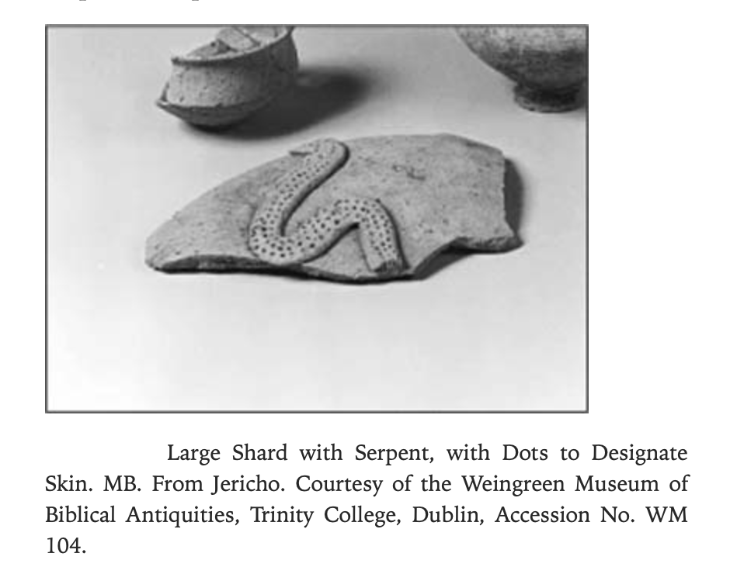
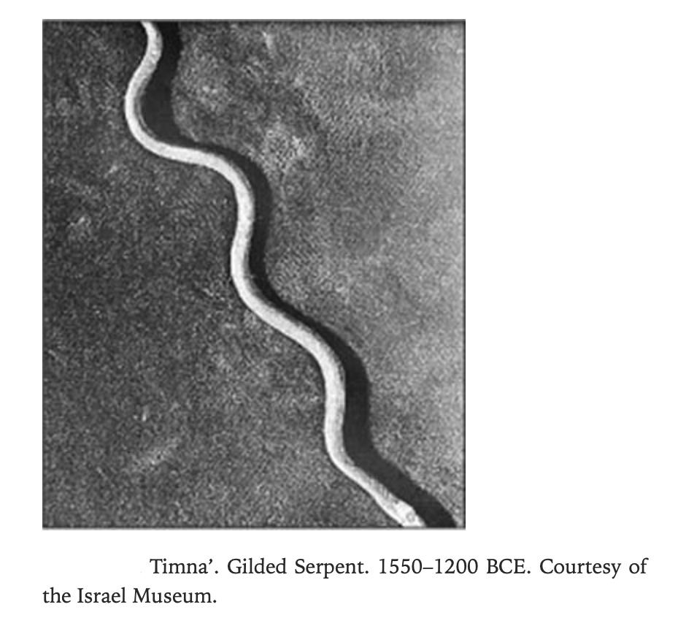
4. A positive role for the snake?
Snake =/= Satan
Positive connotation of the snake in broader Ancient Near East (cf. Charlesworth)
  Egypt: widespread snake iconography, serpent = wisdom
  Palestine: ophidian objects, often in/near temples or cult settings (serpent as deity), often on jars (serpent as protection)
  Mesopotamia: ophiomancy: snakes as oracles in Akkadian formulae

Slide 25
4. A positive role for the snake?
Positive connotation of the snake in broader Ancient Near East
Positive connotation of snake in 3rd c. BCE Alexandria
  Toxicological research under Ptolemies
  Especially in 3rd c. BCE Alexandrian school
  Example: Herophilus (ca. 335−280 BC) uses poisonous substances to prepare drugs

Slide 26
4. A positive role for the snake?
Positive connotation of the snake in broader Ancient Near East
Positive connotation of snake in 3rd c. BCE Alexandria
Positive connotation of snake: use in ophiomancy
  Mesopotamia: Akkadian formulae: snake as omen
  This context could be presumed for Gen 3 (cf. Smith)
  Link φρόνιμος and mantic practices
  Threefold, more positive use of the snake probably motivated the translator of Gen 3 to depict the snake as a more positive figure, opting for φρόνιμος, as a strange, yet fitting translation of עָרוּם

Slide 27
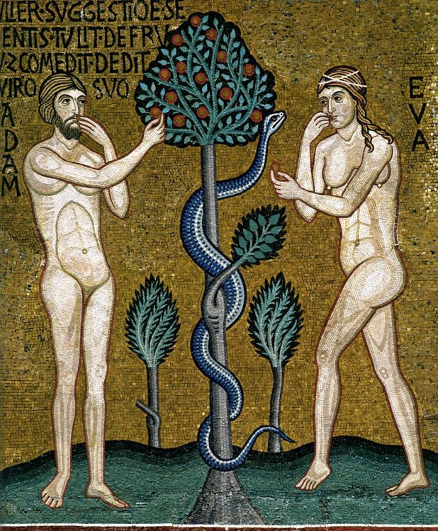
Conclusion
Gen 3:1: עָרוּם and φρόνιμος
Positive portrayal of snake in LXX
  φρόνιμος
  Narrative: more positive role
Fits in broader context: actualization?
  Snake = + in ANE, Alexandria
  φρόνιμος to match ophiomancy?
  An unusual, yet ‘creative’, ‘actualising’ and ‘narratologically significant’ translation

Slide 28
Thanks!
ellen.dedoncker@uclouvain.be
bryan.beeckman@kuleuven.be

