Slide 1

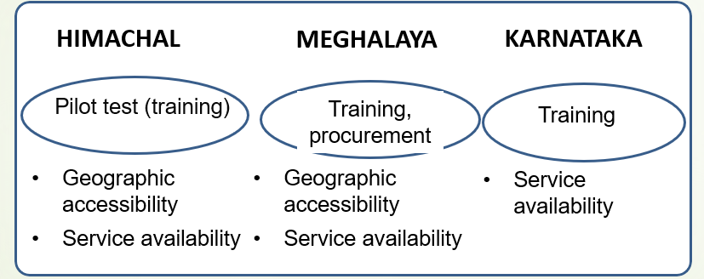
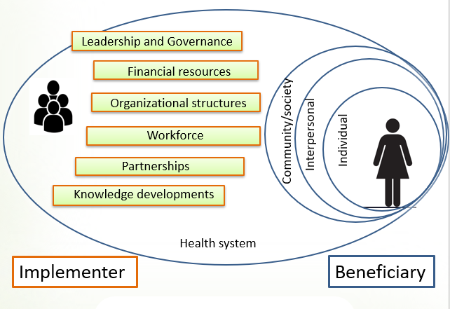
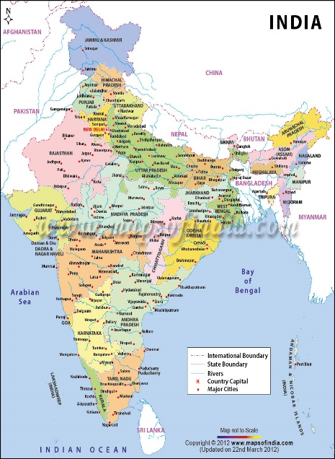

Dsouza JP¹, Van den Broucke S^{1,} Dhoore W,¹ Pattanshetty S²
¹Université Catholique de Louvain, Belgium , ²Manipal Academy of Higher Education, Manipal, India
Health promotion for cervical cancer in India:
Why is it a challenge and what can be done?
A multi-contextual approach
Introduction
Results
With an age standardized incidence rate of 14.7/100,000 person years, cervical cancer is the second most common cancer among Indian women¹
Only 22.3% of Indian women have ever undergone examination of cervix²
Various factors promote uptake of cervical screening³
The Government of India has developed operational guidelines for cervical cancer screening under the National Program for Prevention and Control of Cancer, Diabetes, Cardiovascular diseases and Stroke (NPCDCS)⁴
The States of India are tasked with the implementation of the NPCDCS screening guidelines but encounter specific challenges.
Existing strategies for cervical screening
Aims
Challenges to implementation
To asses the state of implementation of primary prevention and screening of cervical cancer in India.
To explore specific challenges to cervical cancer screening.
To assess women’s knowledge and opinions on cervical cancer and screening.
Methods
The study took place in three different States (Himachal, Maghalaya and Karnataka). Two to three districts in each state were selected to participate in the study.
State and district program managers and implementers were interviewed to asses the state of implementation of strategies for prevention and screening of cervical cancer.
Women aged 30-59yrs were randomly selected from the participating districts and interviewed to assess their knowledge and opinion on cervical cancer and screening.
Data from program managers and implementers on existing strategies were triangulated and content analyzed, Encountered challenges to cervical cancer prevention and screening were classified using the dimensions of the Public Health Capacity Framework⁵
Knowledge and utilization of screening services provided by beneficiaries was used to assess the effects of the programs.
Discussion
The National Program for cervical cancer is in its initial phase of implementation in all three the participating States (i.e., training or pilot testing).
Health system related challenges to implementation as experienced by implementers at state and district level include problems with resources, organizational structures in the form of accessible and affordable services, trained workforce, and involvement of associated stakeholders.
Individual challenges to implementation of the program include low health literacy among the population.
The overall poor uptake of cervical screening by beneficiaries suggest that strategies to improve the utilization of screening services must be developed.
In addition to targeted strategies for families and communities to enhance participation in cervical cancer screening, there is a need for context specific implementation plans that take beneficiary characteristics and specific determinants of screening participation into account.
Integrated strategies involving NGOs and other stakeholders and making use of available facilities could improve screening coverage.
References
Bray, F., Ferlay, J., Soerjomataram, I., Siegel, R. L., Torre, L. A., & Jemal, A. (2018). Global cancer statistics 2018: GLOBOCAN estimates of incidence and mortality worldwide for 36 cancers in 185 countries. CA: a cancer journal for clinicians, 68(6), 394-424
Sheet, I. F. (2017). NFHS-4 (National Family Health Survey-4). International Institute for Population Studies..
Aswathy, S., Quereshi, MA, Kurian, B., & Leelamoni, K. (2012). Cervical cancer screening: Current knowledge and practice among women in a rural population of Kerala, India. The Indian journal of medical research , 136 (2), 205.
National Programme for Prevention and Control of Cancer, Diabetes, Cardiovascular Disease and Stroke. [Accessed July 15, 2018]. Available from:http://www.nrhmhp.gov.in/sites/default/files/files/NCD_Guidelines.pdf.
Aluttis, C., Van den Broucke, S., Chiotan, C., Costongs, C., Michelsen, K., & Brand, H. (2014). Public health and health promotion capacity at national and regional level: a review of conceptual frameworks. Journal of public health research, 3(1).

