Slide 1
The caused motion construction revisited:
theoretical and cross-linguistic perspectives
Françoise Gallez¹ & Sabine De Knop²
¹ Université catholique de Louvain
² Université Saint-Louis Bruxelles
francoise.gallez@uclouvain.be
sabine.deknop@usaintlouis.be

Slide 2
Introduction
Caused Motion Construction (CMC) = favorite way of expression in German
belongs to creative ways of expression
especially in press articles:
Der Pilot startet die Zeitmaschine in die Zukunft
(lit. ‘The pilot starts the time machine into the future’)
Der Traum schickt den alten Mann in ein Leben in Reichtum
(lit. ‘The dream sends the old man in a life of wealth’)
Ronaldo köpft Portugal ins Finale
(Lit. ‘Ronaldo heads Portugal into the final.’)
Need for more differentiated description of CMC

Slide 3
Aims of our presentation
A. Goldberg's definition of caused motion construction (CMC)
B. Several suggestions for extension
  CMC vs. causative C
  Formal structure
  Status of OBL
  Semantics of CMC: actual, non-actual, subjective motion
C. Not only descriptive perspective, but also
cross-linguistic challenges for translation issues
Based on analysis of CMC-exs in German
Data: collection from the DeReKo (IDS Mannheim) + some examples from German press (Ph.D. Gallez fc.)

Slide 4
A. Definition of English CMC
(Goldberg 1995, 2006)

Slide 5
A. Definition of English CMC
(Goldberg 1995, 2006)
e.g. Maria urges her daughter to bed
“the causer argument directly causes the theme argument
to move along a path designated by the directional phrase;
that is, ‘X causes Y to move Z’.” (Goldberg 1995: 152)

Slide 6
B. Several suggestions for extension​
  CMC vs. causative C
  Formal structure
  Status of OBL
  Semantics of CMC: actual, non-actual, subjective motion

Slide 7
1. CMC vs. Causative C (CC)
CMC and CC share similar syntax and semantics:
e.g. CC: Maria puts the baby in the pram
=> Goldberg (2006: 35): no necessity to distinguish between CMC and CC

Slide 8
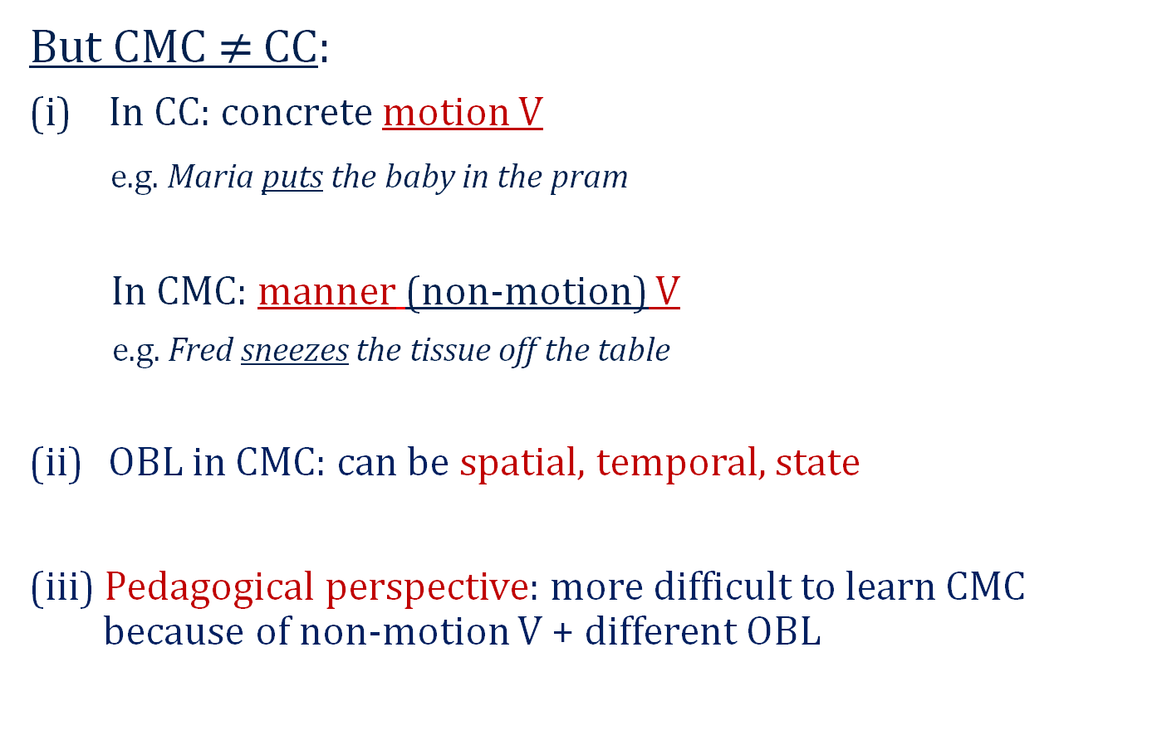
1. CMC vs. Causative C (CC)
But CMC $≠$ CC:
In CC: concrete motion V
e.g. Maria puts the baby in the pram
In CMC: manner (non-motion) V
e.g. Fred sneezes the tissue off the table
OBL in CMC: can be spatial, temporal, state
(iii) Pedagogical perspective: more difficult to learn CMC because of non-motion V + different OBL

Slide 9
2. Formal structure of CMC
‘X causes Y to move Z’ (Goldberg 1995: 152)
e.g. He laughed the poor guy out of the room.
    Frank sneezed the tissue off the table.
OBL = ‘to Z’ → PP expresses a goal and not additional element to be moved
2 Events combined in one construction: causing and motion event
=> formal structure ‘X causes Y to move to Z’.

Slide 10
Status of OBJ
Selected object
Object of CMC = direct object
Er schneidet die Zwiebel in die Schüssel.
(Lit. ‘He cuts the onion into the bowl’)
Unselected object
→ Object of CMC ≠ direct object
Er hat das Buch geschrieben. → He has written the book
Er hat das Buch in die Tonne geschrieben. → He didn’t write the book
(Lit. ‘He has written the book into the bin’)
(a. o. Goldberg & Jackendoff 2004)​
Notes:
cf. Goldberg en parle en 2004, donc ce ne serait pas une des extensions à la définition, mais une précision relative à nos exemples.
but in both cases: object = figure of the motion

Slide 11
3. The oblique argument
(i) Syntactic realization of OBL:
Prepositional phrase
Die Turbine bläst die Touristin ins Wasser/ins Meer.
(Lit. 'The turbine blows the tourist into the water/into the sea’)
Particle of phrasal verb
Die Turbine bläst die Touristin weg.
(Lit. ‘The turbine blows the tourist away’)
Notes:
[ˈt3ː^{r}baɪn]

Slide 12
3. The oblique argument
(ii) Morphosyntactic case-marking of OBL:​
Der Kritiker schrieb das Buch in die_{ACC} Tonne [PP + Accusative]
​(Lit. ‘The critic/reviewer wrote the book into the bin')
≠
Der Kritiker schrieb das Buch in der_{DAT} Bretagne [PP + Dative]​
(Lit. ‘The critic/reviewer wrote the book in Brittany')
DIRECTION LOCATION
Accusative Dative
Notes:
ajouter Der Kritiker schrieb den Text in das Heft/an die Tafel/...?

Slide 13
3. The oblique argument
(iii) Semantics of OBL: spatial, temporal, state
Goldberg's (1995; 2006) CMC → spatial/local
e.g. Sam showed him into the livingroom (1995: 162)
But: in German CMCs→ greater variety in realization
of OBL (Dalmas & Gautier 2013; Dewell 2011)

Slide 14
3. The oblique argument
Local OBL:
1. Der Fußballer köpft den Ball ins Tor.
(lit. 'The soccer player heads the ball into the goal’)
2. Der Fußballer köpfte eine Ecke von Marcel W. ins Tor.
(lit. 'The soccer player headed a corner by Marcel W. into the goal')
Temporal OBL: (time is motion, Grady 1997).
3. Der Fußballer köpft das Team in die nächste Saison.
(lit. 'The soccer player heads the team into the following term')
State OBL: (change is motion, Grady 1997).
4. Der Fußballer köpft das Team zum Erfolg.
(lit. 'The soccer player heads the team to (the) success')

Slide 15
3. The oblique argument
More examples
Der Pilot startet die Zeitmaschine in die Zukunft [temp]
(lit. ‘The pilot starts the time machine into the future’)
Der Mann startet die Zeitmaschine in die Steinzeit [temp]
(lit. ‘The man starts the time machine into stone age’)
Maria singt das Kind in den Schlaf (Dalmas & Gautier 2012) [state]
(lit. ‘Maria sings the child into sleep’)
Der Traum schickt den alten Mann in ein Leben in Reichtum
(lit. ‘The dream sends the old man in a life of wealth’) [state]

Slide 16
4. Semantics of the CMC as a whole
CMCs express motion (transfer, change) events
a. actual motion: Frank sneezed the tissue off the table.
b. non-actual motion: (Blomberg 2017; Brandt 2013; Özçaliskan et al. 2017)
- more abstract events
- no transfer or change
- measurement or quantity visually perceived as dynamic motion → nominal dimensions
  Die Firma erstreckt ihre Tätigkeit ins Ausland.
  (Lit. ‘The company stretches its activity into foreign countries’)
→ Motion V

Slide 17
4. Semantics of the CMC as a whole
c. Subjective motion: (Langacker 2006: 25)
→ no motion verb, but whole event perceived as
motion through visual or mental scanning
  Sie trinken ihren Freund unter den Tisch.
  (Lit. ‘They drink their friend under the table.’)
  Sie prügeln den Obdachlosen ins Krankenhaus.
  (Lit. ‘They beat the homeless person into the hospital.')

Slide 18
4. Semantics of the CMC as a whole
Motion-Result Continuum
(1) Er hustet den Schaum vom Cappuccino.
Lit. ‘He caughs the foam off the cappuccino.’
(2) Ronaldo köpft Portugal ins Finale.
Lit. ‘Ronaldo heads Portugal into the final.’
(3) Er wurde ins Krankenhaus geprügelt.
Lit. ‘He was hit/beaten into the hospital.’
(4) Er wurde ins Koma geprügelt.
Lit. ‘He was hit/beaten into the coma.’
(5) Er wurde krankenhausreif geprügelt.
Lit. ‘He was hit/beaten ‘mature’ for the hospital’.
CMC
Metaphorical CMC
Resultative CMC (metonymy)
Resultative CMC
(State)
Resultative C
Motion
Result

Slide 19
To summarize ...
Complex interplay between
- constructional meaning (actual/non actual motion, result),
- verb meaning (concrete, metaphorical),
- meaning of arguments (concrete, metaphorical, metonymic).

Slide 20
C. Cross-linguistic challenges for translation issues GE>FR

Slide 21
C. Cross-linguistic challenges for translation issues GE>FR
No one-to-one constructional equivalence
→ Privileged constructions and lexicalization patterns
German → CMC + manner salience
Die Mutter singt das Kind in den Schlaf. (Dalmas & Gautier 2012)
(Lit. ‘The mother sings the child into the sleep‘)
French → resultative construction
La mère endort l’enfant (en chantant).
(Lit. ‘The mother puts the child to sleep (by singing)')
→ telic construction
La mère chante pour endormir l’enfant.
(Lit. 'The mother sings to put the child to sleep')
(Dalmas & Gautier 2012)

Slide 22
C. Cross-linguistic challenges for translation issues GE>FR
Translation Studies (Delisle et al: 1999)
Recategorization
GE: Sie ist eine leidenschaftliche Tänzerin.
EN: *She is a passionate dancer. => She has a passion for dancing.
“Chassé-croisé” (‘interchange')
GE: Er rannte aus dem Haus.
FR: Il sortit de la maison en courant.
EN: He ran out of the house.
Two separate translation procedures
CxG : one framework (form/meaning/use)
Notes:
Recategorization is the change of the word class or part of speech of a word or phrase with a semantic equivalent
With interchange (Delisle et al. 1999), the translator swaps two lexical items with respect to form and function, thereby switching their respective parts of speech

Slide 23
C. Cross-linguistic challenges for translation issues GE>FR
Some more examples from OPUS corpora
German (CMC) | French (OTHER CONSTRUCTIONS)
Seit vier Jahren ... weint sich meine Frau in den Schlaf. Lit. ‘My wife has been crying herself to sleep for four years' | Et, depuis quatre ans, ma femme s'endort en pleurant. [RESULTATIVE] Lit. ‘And, for the past four years, my wife falls asleep while crying'
(…) die Armen werden das nächste Mal in die Steinzeit zurückgebombt. Lit. ‘(…) the poor will be bombed back to the Stone Age next time’ | (…) quels pauvres hères il souhaite ramener à l'âge de la pierre à coups de bombes. [VERB FOR GOAL + PREPOSITIONAL PHRASE] Lit. ‘(…) which poor he wants to bring back to the Stone Age with bombs'
Du hast mich meistens unter den Tisch gefeiert. Lit. ‘You used to party me under the table’ | (…) tu faisais plus la fête que moi. [NO MOTION EXPRESSION + DIFFERENT SYNTAX] Lit. ‘(…) you were partying more than I was’
Notes:
2E CAS = chassé-croisé

Slide 24
Concluding remarks
Our presentation has shown
CMC is more complex
more fine-grained analysis of CMC needed
importance of typological aspects, CMC favorite
in Germanic languages
More fine-grained analysis can lead to:
better understanding/description of abstract CMC and numerous possible instantiations
New avenues for applied issues (teaching/learning/translation)

Slide 25
Thank you for your attention!

