Slide 1
Rankean scholarly persona and German Jewish Historians in Wilhelminian Germany
Geneviève WarlanD
Université catholique de louvain, Belgium

Slide 2
Historiography in Wilhelminian Germany (Rüdiger vom Bruch)
Reputierte Wissenschaft: high consideration in the public space and in governmental circles
Politische Wissenschaft: methodological controversies inside the historical discipline (Schäfer-Gothein; Lamprecht: definition and status of the Kulturgeschichte)
Protestantische Wissenschaft: superiority of Protestant scholarship; exclusion of scholars from other confessions (Catholic and Jews)
Nationale Wissenschaft: patriotism; insistence on Prussian traditions and hegemony in the Reich
Wissenschaftliche Wissenschaft: search for objectivity, accurate set of methods, and source criticisms

Slide 3
A good historian: skills and virtues
(Hermann Paul)
Scholarly persona as a repertoire of skills (abilities or techniques related to specific tasks and projects) and virtues (qualities ingrained in human beings orientated towards goods).
Epistemic skills: knowledge of Latin, old German, and of modern languages; use of the critical methods; diplomatic; heuristic; ….
Epistemic virtues: discipline, willingness, curiosity, accurateness, ….
Social skills and virtues: fidelity to a master (Schülerschaft), networking, reliability, …
Political skills and virtues: fidelity to the Reich, patriotism, freedoms’ defense, …
Moral skills and virtues: honesty, fidelity to his own faith, ….

Slide 4
Main questions and hypotheses concerning Jewish scholars in the Reich
Even all citizens of the German Reich were endowed with the same civil rights, confessional belonging did unofficially influence the recruitment of civil servants; this applied in particular to appointed university professors, whose choice by the Faculty members had to be confirmed by the Education Ministry (Kultusministerium).
Main questions: which kind of skills and virtues did the Jewish scholars cultivate in order to pursue a scientific career? How were these skills and virtues adjusted to the repertoire of qualities required to be a good historian in Wilhelminian Germany?
Main hypothesis: German Jewish scholarly persona as partly a contestation and partly an adaptation to the dominant Prussian scholarly persona
German Jewish history writing went beyond the national frame and/or focused on methodology (search for new interpretation's frames in historiography and for ways of avoiding conflicts on viewing Prussian politics)
German Jewish history doing (historian’s conduct): survival strategies to overcome obstacles in a not very friendly environment: Schülerschaft, networking, learning of foreign languages, emigration, ….

Slide 5
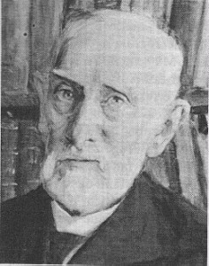
Ernst Bernheim (1850-1942)
Studies in Berlin, Heidelberg and Strasburg. Full professorship in Greifswald (1889).
Lehrbuch des historischen Methode (1889; 6 editions and translation in 4 languages).
Einleitung in die Geschichtswissenschaft (1905; several editions).
Special interest in methodology and in philosophy of history, in legal and constitutional history with a focus on conflicts between secular and religious authorities, as well as in cultural history and history of ideas.
President of the Gesellschaft für Hochschulpädagogik (1912-)
http://kulturportal-west-ost.eu/biographien/bernheim-ernst-2

Slide 6
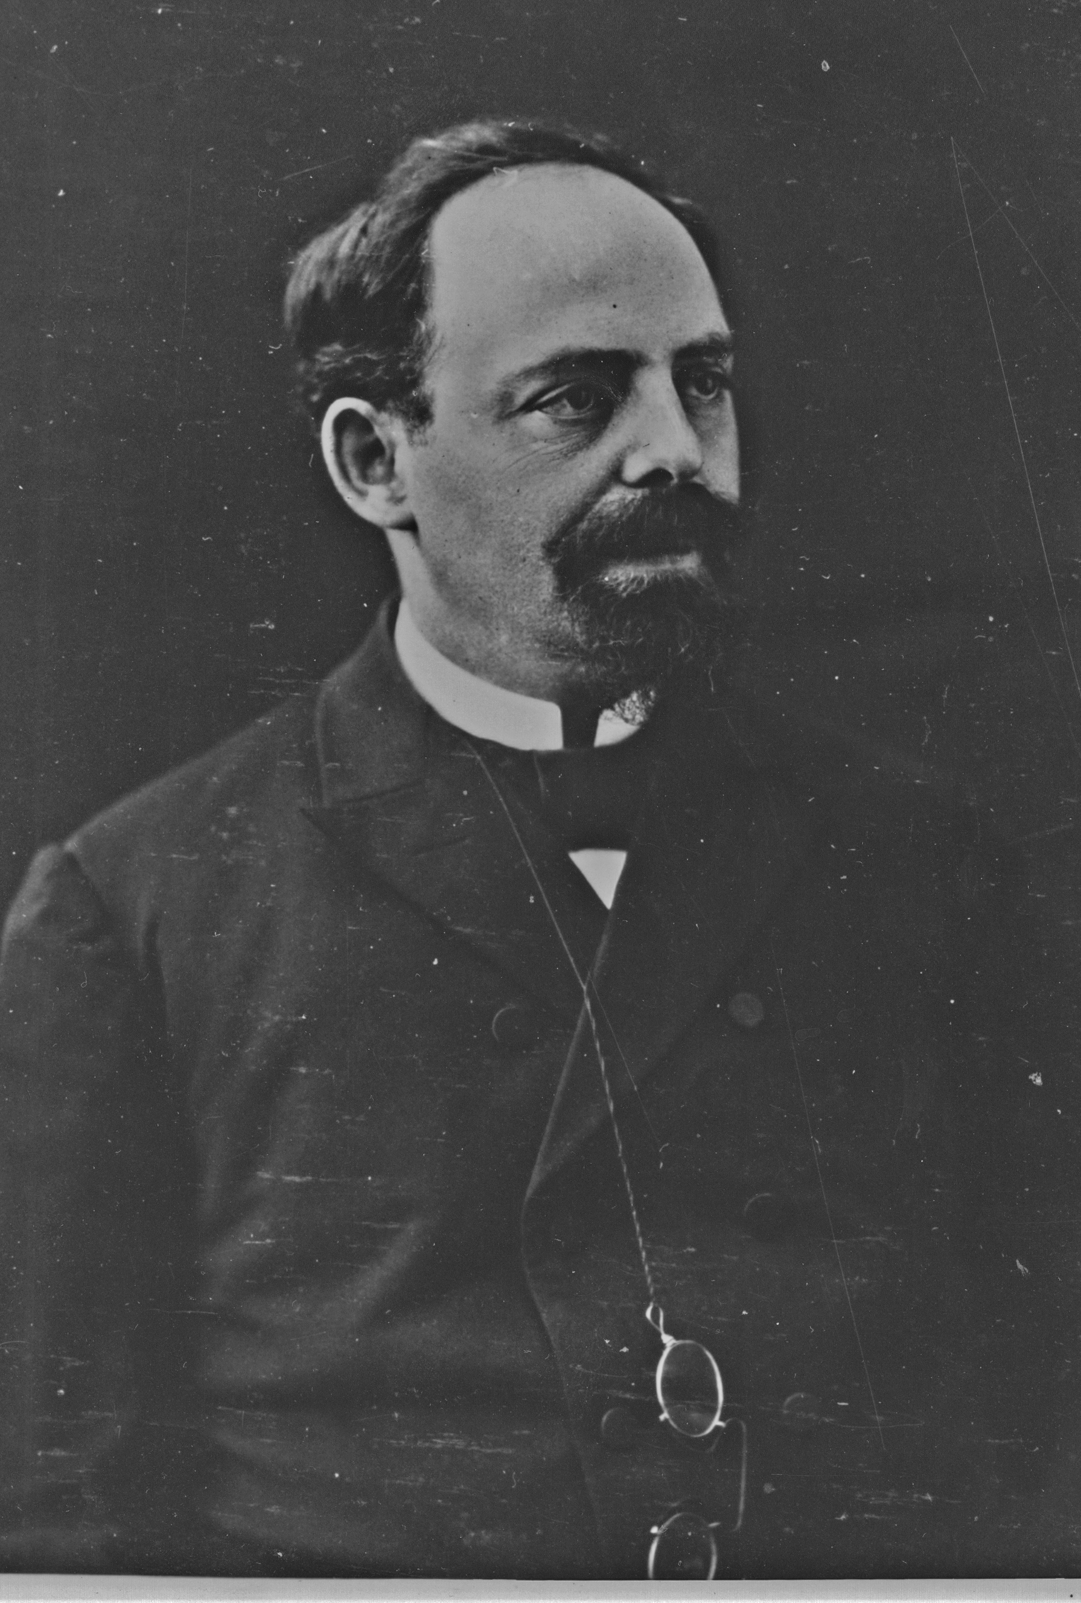
Martin Philippson (1846-1916)
Studies in Bonn and Berlin. Full professorship in Brussels (1879). Return to Berlin (1890): Privatgelehrter and founder of the Gesellschaft zur Förderung der Wissenschaft des Judentums (1902).
Heinrich IV. und Philipp III. Die Begründung des französischen Übergewichtes in Europa. 1596-1610, 3 vol., 1870-76.
Geschichte des Preußischen Staatswesens vom Tode Friedrichs des Großen bis zu den Freiheitskriegen, 2 vol., 1880-82.
Neueste Geschichte des jüdischen Volkes, 1907-11, 3 vol.
His major topics were diplomatic and political history in Western Europe, religious matters which transcended the frontiers (religious wars, counterreformation) and Jewish history.
Photothèque du Musée Juif de Belgique. Inv. MJB- 04879

Slide 7
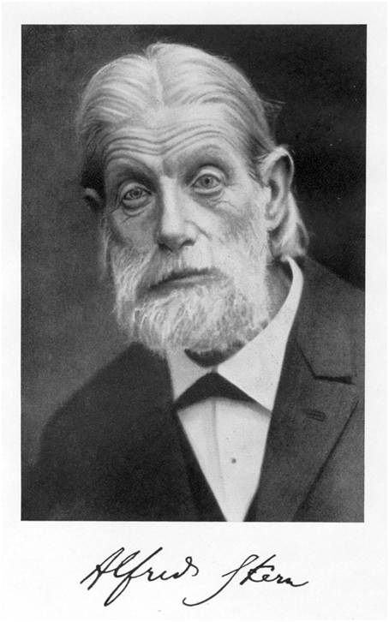
Alfred Stern (1846-1936)
Studies in Heidelberg, Berlin and Gottingen. Full professorship in Bern (1878) and then in Zürich (1887).
Milton und seine Zeit (2 vol., 1877/79); Das Leben Mirabeaus, 2 vol., 1889.
Geschichte Europas seit den Verträgen von 1815 bis zum Frankfurter Frieden von 1871 (10 vol., 1894-1925, 2ed., 1913-1928).
Focus on revolutionary times (peasants‘ revolt in South Germany in the 16th, English Revolution of the mid-17th, French Revolution at the end of the 18th) and on political and religious freedoms.
https://upload.wikimedia.org/wikipedia/commons/e/ea/Alfred_Stern.png

Slide 8
The unwritten law of Jews’ exclusion from public office
“Ein Jude hat in Deutschland keine Hoffnung als Historiker in der akademischen Laufbahn bis zum Ordinariat zu gelangen“ (Alfred Stern to Eduard Winkelmann, 27.3.1887, in Schmitz, Alfred Stern (1846-1936), Ein europäischer Historiker gegen den Strom der nationalen Geschichtsschreibung, Hannover, Wehrhahn Verlag, 2009, p. 131).
„Ich war zweimal zum Ordinariat vorgeschlagen, in Münster u. Königsberg: beide Male scheiterte meine Ernennung an letzter Stelle an meiner jüdische Abstammung. Ich kann diese mit völliger Sicherheit sagen, da ich es aus dem Mund des damaligen Ministers Dr. Falk selbst erfuhr. Ich fragte ihn dann, wie es sich bei einer meiner dritten Vorstellung gestalten würden: er erwiderte es würde sicher sein möglichste thun, um dann meine Ernennung durchzusetzen. Eine solche Antwort belegt dass ich nicht zu verlieren habe. Im September 1878, unmittelbar darauf erhielt ich die Berufung hierher [in Brüssel], die sehr ehrenvoll für mich war […]“ ( Philippson‘s letter to Hermann Usener, a former colleague in Bonn, 7 Juni 1882).
“In Erlangen ist für alte Geschichte Schöne da, sonst Hegel; ob der letztere eine aufstrebende Kraft neben sich gern haben würde, bezweifle ich lebhaft; auch ist für die lutherische Universität Erlangen ihre Konfession nicht gerade günstig“ (UBG, Briefwechsel Weiszäcker-Bernheim, Ms 1558, Nr. 6, quoted in Ogrin, Ernst Bernheim (1850–1942). Historiker und Wissenschaftspolitiker im Kaiserreich und in der Weimarer Republik. Steiner, Stuttgart 2012, p. 26).

Slide 9
German Jewish scholars’ career’s perspectives in Wilhelminian Germany
The three historians’ conduct mirror three possible career's paths :
The standard one: Privatdozent, Extraordinarius, Ordinarius, including sometimes a long waiting time….
Emigration to obtain a full professorship in a foreign country.
The Privatgelehrterdasein, independent scholar (or the ewiger Privatdozent).
If these 3 paths belonged to the world of possibilities for all German scholars (because of the huge number of PD), 2 and 3 concerned much often German Jewish scholars.
Virtues of German Jews scholars in order to obtain a full professorship: clear-mindedness, patience, perseverance, flexibility, ….

Slide 10
German Jewish scholars in the Rankean tradition
During their studies, Bernheim, Philippson and Stern managed to take part to Ranke’s seminar in Berlin
Focus on primary sources, exhaustiveness, criticism and search for objectivity : all ‘Rankean’ skills
Sensitivity for methodology (especially Bernheim who belongs to the precursors in that field)
Mainly political and diplomatic history in case of Philippson and Stern
Unlike the borussian historians (Droysen, Sybel, Treitschke), continuity with Ranke’s narrative framework: international politics and European national history (the popes, France, England)

Slide 11
Crossing the borders and European common goods: open mindedness as an intellectual disposition
In his inaugural lesson at the University of Brussels on the Importance historique du Moyen âge, Philippson presented the history of the European civilization as an alliance between the German spirit (characterized by its impetuousness and by ethnic and cultural diversity), the classic Greek spirit (which tends to harmony) and the Christian spirit (made of transcendence, deepness, discipline, but also fanaticism and repentance). Three main principles of European society appeared in the Middle Ages: a common (Christian) vision of human being, State authority and self-governance (mainly in the cities).
„Trotz der lebensvollen Mannichfaltigkeit der einzelnen Erscheinungsformen die europäische Menschheit auch im neunzehnten Jahrhundert eine Gemeinschaft bildet, die gleichsam dieselbe Luft politischer, wirtschaftlicher, künstlerischer und wissenschaftlicher Ideen atmet“ (Alfred Stern, Geschichte Europas, vol. 1, p. VII). (liberalism)
Bernheim’s reconstruction of the history of historiography is also embedded in the European context.

Slide 12
Writing for educated people
Scholarly persona and writing of books for the Bildungsbürgertum using the criteria of scientific research.
The changes are in the form (style, less footnotes).
Stern’s narrative in his Geschichte Europas: to take a neutral stand and to take into account the history of all countries.
Philippson’s eagerness to publish books designed to educate people, not only his Jewish fellows like with his history of Judaism, but also the whole German Bildungsbürgertum: biographies on contemporaries (Kaiser Friedrich III., Max von Forckenberg); monographs on religious wars, Reformation and Counterreformation.

Slide 13
The typical German Jewish scholarly persona in Wilhelminian Germany was….
A man who had particular virtues like patience, perseverance, sociability, reliability, flexibility to overcome the obstacles linked with his confession.
A man doted with skills like languages’ command, outstanding scientific abilities, networking competences, …
A man looking for epistemic goods (objectivity, condemnation of ‘methodological nationalism’), political goods (political and religious freedom, State’s secularization), and moral goods (honesty with respect to the others and to oneself…).
Sample to extend; shortcuts; forschende Hypothese….

