Slide 1

TB and conflicts
The case of South-Kivu, DRC
Emmanuel ANDRE, MD

Slide 2
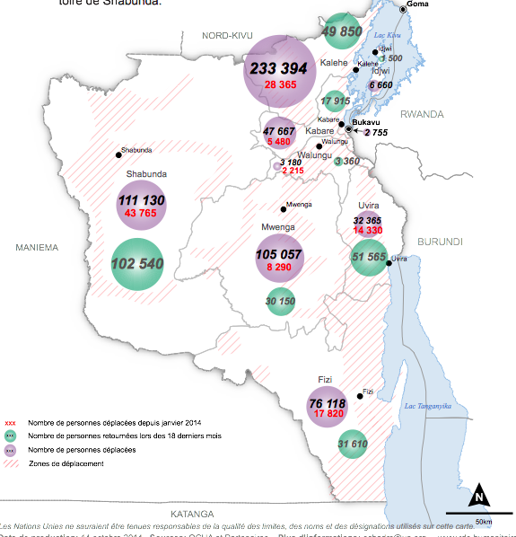
South-Kivu
10% of the population is internally displaced due to conflicts
Source : OCHA

Slide 3
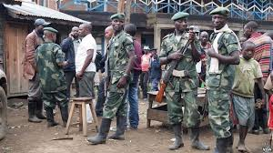
Intense presence of official army and several armed groups
This military presence is linked to different forms of violence impacting local comunities (sexual violence +++, internal displacements, …)
Access to health services can become challenging for populations
Quality of health services is impacted
Emmanuel ANDRE

Slide 4
Actions undertaken to overcome these difficulties
Actively involve military authorities and health services inside activities targentting the whole province (TB REACH project)
    Active screening involving TB patients themselves
    Access to Xpert MTB/Rif technology
Work with the military authorities to better identify health issues inside the military population
      Baseline observation
      Qualitative study
      Xpert screening
      Prevalence survey
Emmanuel ANDRE

Slide 5
1. Baseline observation (2009 – 2011 NTP data)
TB and HIV notifications similar between the medium-size military hospital and the tertiary provincial reference hospital
HIV infection among TB cases higher in military population than in the reference hospital (60% vs 36%)
Over 50% of TB cases in military facilities are lost of follow-up
55% of militaries (20-40 years old) tested for HIV are positive
O. Rusumba^{1,2}, C. Maisin¹, R. Chirimwami¹, E. André⁵ . UCBukavu 2012

Slide 6
2. Behavioural study
Method : semi-structured interviews, 14 individuals in military camp
Results :
HIV
13/14 (93%) reported unprotected sexual intercourses with multiple partners.
10/14 did not consider getting tested for HIV in the future.
5/14 reported to use condoms to light the fire or clean their shoes.
3/14 believed that HIV testing has a negative impact on health
TB
9/14 reported to know someone who had the disease
8/14 did not know that TB was a curable disease
7/14 considered prolonged cough a sign of TB
2 considered hemoptysis was the only symptom of TB
O. Rusumba^{1,2}, C. Maisin¹, D. Kikobya², D. Kalumuna³, R. Chirimwami¹, Z. Kashongwe⁴, M. Delmée⁵ and E. André⁵ . Union TB Conference 2013.

Slide 7
3. Analysis of Xpert screening program
Method
During a 3 year period (2011 – 2013), 468 samples from soldiers clinically suspected of pulmonary TB and a negative smear result were tested with GeneXpert MTB/Rif. HIV status of patients were recorded when available.
Results:
30 patients (6%) tested positive for TB, with a proportion decreasing from 16% (year 1) to 2,25% (year 3).
Among TB-positive patients,
8 (27% (95%CI 14 – 46%)) were Rifampicin resistant.
HIV test results were available for 25% (116/468) of the patients,
HIV prevalence among all patients tested for TB was 19% (95%CI 12 – 27%).
HIV prevalence among TB positive patients was 71% (95%CI 40 – 90%)
E Andre,¹ J-P Chirambiza,² E Musafiri,² D Kalumuna,² D Bahati Rusumba,³ D Kikobya,³ J Creswell,⁴ O Le Polain De Waroux^{5 .}

Slide 8
4 . Prevalence survey
Method
Between May 7 and May 11, 2014, a cross-sectional, observational survey was done to map prevalence of TB in a military camp in Bukavu, South-Kivu, DRC. 4296 persons were included from 2672 households.
TB screening was performed using a first step verbal screening (cough > 15 days). Symptomatic patients were tested with smear microscopy and GeneXpert MTB/Rif assay.
Results:
6 incident pulmonary TB cases were identified through microscopy and/or NAAT.
Prevalence of bacteriologically confirmed pulmonary TB is estimated at 4090 (95%CI: 3488-4692),
Socio-economic characteristics of TB patients
TB cases were less likely to have formal education (75.8% vs. 81.4%, P<0.001),
TB cases were less likely to have access to electricity (90.5% vs. 95.5%, P<0.001)
TB cases were less likely to have access to mobile phones (78.9% vs. 84.8%, P<0.001).
Risk factors
Exposition to indoor smoking (62.4% vs. 42.5%, P<0.001),
Recent missions outside the main city (32.3% vs. 23.1%, P<0.001).
Geleyn C, Bisimwa B, Bahati Rsumba, Chirambiza JP, Kikobya D, André E, Kashongwe Z, Callens S. Submitted for ECCMID 2015

Slide 9
Conclusions
Military communities should be integrated in health programs and innovations
Permits better understanding and access to affected communities
Improves quality of health service to this vulnerable group
Emmanuel ANDRE

Slide 10
Special thanks to
National TB Program – DRC
Dr G. Bakaswa
Prof Z. Kashongwe
Dr. D. Kalumuna
E. Mulume
JP Cirambiza
R Nyota
…
Military hospital Bukavu
Dr D. Kikobya
Dr. O. Rusumba
UCLouvain
Prof. M. Delmée
Ugent
Prof. S. Callens
C. Geleyn
TB REACH
VLIR-UOS
Emmanuel ANDRE

