Slide 2
Old Greek of Numbers & Deuteronomion is not affected by Alexandrian’s milieu: translation of « sea »
Montreal - June 2024
Simon NAVEAU
FNRS-F.S.R. researcher
UCLouvain (BE)

Slide 3
« Septuagint of the Pentateuch:
« What about its anchorage in the production milieu?
  3rd century BC
  Alexandria, Egypt
UCLouvain, Belgium, Centre d’étude de la Septante:
  Gen, Ex, Lev: dr. Camilla Recalcati
  Num, Deut: Simon Naveau
Simon NAVEAU

Slide 4


יָם sea θάλασσα
=
Westward

Slide 5



« the sea » יָם θάλασσαν « west »
P.M. Bogaert, « L’orientation du parvis du sanctuaire dans la version grecque de l’Exode (Ex., 27,9-13 LXX) », L’Antiquité classique 50 (1981) 79-85.
Ex 27,9 south לִפְאַת נֶגֶב־תֵּימָנָה πρὸς λίβα
Ex 27,11 north לִפְאַת צָפֹון πρὸς ἀπηλιώτην east
Ex 27,12 ‘sea’ לִפְאַת־יָם κατὰ θάλασσαν ‘sea’ = ?
Ex 27,13 east לִפְאַת קֵדְמָה מִזְרָחָה πρὸς νότον south
south
west
north
east
west
north
east
south
Translation technique: milieu
Egyptian influence? Y e s

Slide 6

“The clans of the Gershonites were to camp behind the tabernacle on the west…”
Num 3,23 מִשְׁפְּחֹת הַגֵּרְשֻׁנִּי אַחֲרֵי הַמִּשְׁכָּן καὶ οὗτοι Γεδσὼν ὀπίσω τῆς σκηνῆς
sea = w יַחֲנוּ יָמָּה παρὰ θάλασσαν παρεμβαλοῦσιν,
Num 3,29 מִשְׁפְּחֹת בְּנֵי־קְהָת יַחֲנוּ οἱ δῆμοι τῶν υἱῶν Καὰθ παρεμβαλοῦσιν
south עַל יֶרֶךְ הַמִּשְׁכָּן תֵּימָנָה ἐκ πλαγίων τῆς σκηνῆς κατὰ λίβα south
Num 3,35 וּנְשִׂיא בֵֽית־אָב καὶ ὁ ἄρχων οἴκου πατριῶς
לְמִשְׁפְּחֹת מְרָרִי צוּרִיאֵל τοῦ δήμου τοῦ Μεραρὶ Σουριὴλ
בֶּן־אֲבִיחָיִל עַל יֶרֶךְ הַמִּשְׁכָּן υἱὸς Ἀβιχάιλ ἐκ πλαγίων τῆς σκηνῆς
north יַחֲנוּ צָפֹנָה παρεμβαλοῦσιν πρὸς βορρᾶν north
Num 3,38 וְהַחֹנִים לִפְנֵי הַמִּשְׁכָּן קֵדְמָה καὶ οἱ παρεμβάλλοντες [ - ]
לִפְנֵי אֹֽהֶל־מֹועֵד κατὰ πρόσωπον τῆς σκηνῆς τοῦ μαρτυρίου
east מִזְרָחָה ἀπʼ ἀνατολῆς east
מֹשֶׁה וְאַהֲרֹן וּבָנָיו Μωυσῆς καὶ Ἀαρὼν καὶ οἱ υἱοὶ αὐτοῦ
west
west
south
south
Merary
Gershon
Moses, Aaron
Qahat
north
north
east
east
Translation technique: literality
Egyptian influence? no
Simon NAVEAU

Slide 7

“When you blow an alarm, the camps on the east side shall set out…”
Num 10,5 וּתְקַעְתֶּם תְּרוּעָה καὶ σαλπιεῖτε σημασίαν,
וְנָסְעוּ הַמַּחֲנֹות הַחֹנִים καὶ ἐξαροῦσιν αἱ παρεμβολαὶ αἱ παρεμβάλλοῦσαι
קֵדְמָה ἀνατολάς
Num 10,6 וּתְקַעְתֶּם תְּרוּעָה שֵׁנִית καὶ σαλπιεῖτε σημασίαν δευτέραν,
וְנָסְעוּ הַמַּחֲנֹות הַחֹנִים καὶ ἐξαροῦσιν αἱ παρεμβολαὶ αἱ παρεμβάλλουσαι
תֵּימָנָה λίβα
[καὶ σαλπιεῖτε σημασίαν τρίτην,
καὶ ἐξαροῦσιν αἱ παρεμβολαὶ αἱ παρεμβάλλουσαι
--- παρὰ θάλασσαν
καὶ σαλπιεῖτε σημασίαν τετάρτην,
καὶ ἐξαροῦσιν αἱ παρεμβολαὶ αἱ παρεμβάλλουσαι
--- πρὸς βορρᾶν]
תְּרוּעָה יִתְקְעוּ לְמַסְעֵיהֶם σημασίᾳ σαλπιοῦσιν ἐν τῇ ἐξάρσει αὐτῶν.
east
east
south
south
δυσμή
ἑσπέρα
ζόφος...
west
north
Translation technique: literality
Egyptian influence? no

Slide 8

יָם Sea θάλασσα

Slide 9

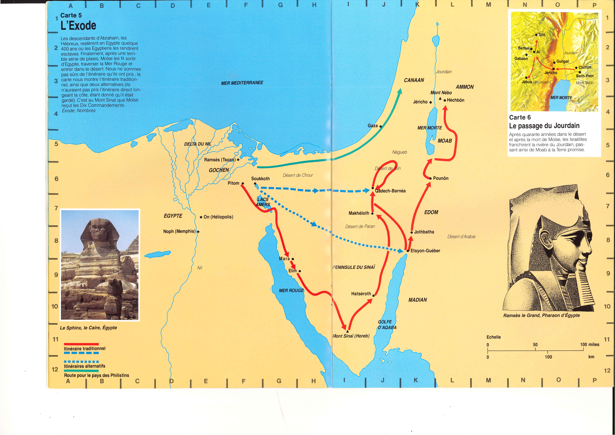

Red Sea יַם־סוּף θάλασσα ἐρυθρά
Mediterranean Sea יָם־הגָּדוֹל ἡ θάλασσα ἡ μεγάλη
יָם הָאַחֲרֹון ἡ θάλασσα ἡ ἐσχάτη – ἡ θάλασσα ἡ ἐπὶ δυσμῶν
Dead Sea יָם־הַמֶּלַח ἡ θάλασσα ἡ ἁλυκή
יָם הָעֲרָבָה θάλασσα Ἀραβά
Lake of Tiberias יָם־כִּנֶּרֶת θάλασσα Χενέρεθ
Lake of Tiberias
Mediterranean Sea
Dead Sea
Alexandria
Araba
Red Sea

Slide 10
Red Sea
sea of the rushes יַם־סוּף θάλασσα ἐρυθρα red sea
Occurrences (Torah): Ex 10,19 ; 13,18 ; 15,4.22 ; 23,31
Num 14,25 ; 21,4 ; 33,10.11
Deut 1,40 ; 2,1 ; 11,4
Egypt: c̆wfy => סוף (reed/ rush)
« The very Green »
Greek literature: in general (TLG) Hérodote, Pindare…
Egyptian greek papyri 1! occ. (3^{d} ACN)
Translation technique: target language
Egyptian influence? no
Simon NAVEAU

Slide 11
Dead Sea
the sea of the salt יָם־הַמֶּלַח ἡ θάλασσα ἡ ἁλυκή the salty sea
the sea of the Araba יָם הָעֲרָבָה θάλασσα Ἀραβά the Arabian sea
Deut 3,17 וּגְבֻל מִכִּנֶּרֶת ὅριον Μαχανάραθ
וְעַד יָם הָעֲרָבָה יָם הַמֶּלַח καὶ ἕως θαλάσσης Ἀραβά θαλάσσης ἁλυκῆς
And the border from Kinnereth up to the Sea of Arabah, i.e. the Sea of the Salt
Occurrences (Torah): יָם־הַמֶּלַח Num 34,3.12
יָם הָעֲרָבָה Deut 3,17; 4,49
Simon NAVEAU

Slide 12
Dead Sea
the sea of the salt יָם־הַמֶּלַח ἡ θάλασσα ἡ ἁλυκή the salty sea
Occurrences (Torah): יָם־הַמֶּלַח Num 34,3.12
Transliteration? μαλακός “soft”; √μελάγ- “of black”; μαλάχη “mauve”
Greek litterature papyrus no
ἡ θάλασσα νεκρή (1 occ. Aristote)
νεκρή "dead"
ἁλμυρώδης "of saline appearance"
ἀσφαλτῖτις "of bitumen"
ἡ θάλασσα ἡ ἁλυκή no
Translation technique: literality Egyptian influence? no
Simon NAVEAU

Slide 13
Dead Sea
the sea of the Araba יָם הָעֲרָבָה θάλασσα Ἀραβά the Arabian sea
Occurrences (Torah): יָם הָעֲרָבָה Deut 3,17; 4,49
Transliteration Ἄραψ / Ἄραβος
Greek literature Ἄραψ
general literature and paypirus yes but…
… what does it refer to?
θάλασσα Ἀραβά no
Translation technique: transliteration
Egyptian influence? no
Simon NAVEAU

Slide 14
Mediterranean Sea
the big sea יָם־הגָּדוֹל ἡ θάλασσα ἡ μεγάλη the big sea
the last sea יָם הָאַחֲרֹון ἡ θάλασσα ἡ ἐσχάτη the last sea
ἡ θάλασσα ἡ ἐπὶ δυσμῶν the sea at the sunset
Simon NAVEAU

Slide 15
Mediterranean Sea
the big sea יָם־הגָּדוֹל ἡ θάλασσα ἡ μεγάλη the big sea
Occurrences (Torah) יָם־הגָּדוֹל Num 34,6.7
Egypt “the big green” – “the very green”
Greek litterature ἡ ἐντὸς θάλασσα / ἡ ἔσω θάλασσα “the inland sea”
παρʼ ἡμῖν θάλασσα “the sea at us”
ἡ θάλασσα ἡ μεγάλη
Translation technique: literality
Egyptian influence? no
Simon NAVEAU

Slide 16
Mediterranean Sea
the last sea יָם הָאַחֲרֹון ἡ θάλασσα ἡ ἐσχάτη the last sea
ἡ θάλασσα ἡ ἐπὶ δυσμῶν the sea at the sunset
Occurrences (Torah) Deut 11,24 ἡ θάλασσα ἡ ἐσχάτη
אַחֲרֹון – ἔσχατος orאַחֲרִית – ἔσχατος (100x)
Egypt “the-Sea-that-lays-behind-the-people-of-the-North
[(= the Greeks) ”
Greek littérature ἡ θάλασσα ἡ ἐσχάτη
Occurrences (Torah) Deut 34,2 ἡ θάλασσα ἡ ἐπὶ δυσμῶν
Egypt geogr.: at the North
at the Sunset
Greek litterature ἡ θάλασσα ἡ ἐπὶ δυσμῶν
Translation technique: literality
Egyptian influence? no
Simon NAVEAU

Slide 17
Red [Sea] – Deut 1:1
These are the words that Moses spoke to all Israel beyond the Jordan — in the wilderness,
on the plain opposite Suph between Paran and Tophel, Laban, Hazeroth, and Di-zahab.
בָּעֲרָבָה מֹול סוּף πρὸς δυσμαῖς πλησίον τῆς ἐρυθρᾶς
in the plain opposite Suph at the Sunset, near the Red [Sea]
in the Arabah opposite Suph
Alexandria
Suf?
Translation technique: free - target
Egyptian influence? no

Slide 18
Lake of Tiberias
the Sea Kinnereth יָם־כִּנֶּרֶת θάλασσα Χενέρεθ the Sea Kinnereth
Occurrence (Torah) Num 34,11
Egypt kennarout or qasanarṯ
Greek literature in general (TLG) no
Egyptian greek papyri no
Translation technique: transliteration
Egyptian influence? no
Simon NAVEAU

Slide 19
Lake of Tiberias
the Arabah also, with the Jordan and its banks, from Chinnereth down to the sea of the Arabah, the Dead Sea, with the lower slopes of Pisgah on the east. (NRSVCE)
Deut 3,17 מִכִּנֶּרֶת Μαχανάραθ
Greek literature in general (TLG) no
Egyptian greek papyri no
Translation technique: bad transliteration
Egyptian influence? no
Simon NAVEAU

Slide 20
Some conclusions…

Slide 21
Summary
Sea Hb Gr Egypt Gk lit. Gk Eg. Pap. Tr. tech. Eg. Infl.
Red Sea יַם־סוּף θάλασσα ἐρυθρά ✗ ✓ 1 trsl-g no!
Med. Sea יָם־הגָּדוֹל ἡ θάλασσα ἡ μεγάλη ✓ ✗ ✗ lit-h no
יָם הָאַחֲרֹון ἡ θάλασσα ἡ ἐσχάτη ✓ ✗ ✗ lit-h no
ἡ θάλασσα ἡ ἐπὶ δυσμῶν ✗ ! ✗ ✗ trsl no!
Lake of Genn. יָם־כִּנֶּרֶת θάλασσα Χενέρεθ ✓ ✗ ✗ trlt no
Dead Sea יָם־הַמֶּלַח ἡ θάλασσα ἡ ἁλυκή ✗ ✗ ✗ lit-h no
יָם הָעֲרָבָה θάλασσα Ἀραβά ✗ ~ ~ trlt no
Deut1,1 בָּעֲרָבָה מֹול סוּף πρὸς δυσμ. πλησ. τῆς ἐρυθρ. ✗ ! trsl no !
Translation technique: diversity!
Egyptian influence? No! On the contrary
Simon NAVEAU

Slide 22
Thank you

