Slide 1



Black minds within Belgian (de-)colonisation and discrimination
Burundian, Congolese and Rwandan Cultural elites in Belgium (1945-1975)
Romain Landmeters Intellectuals at the margins 24.05.2019

Slide 2
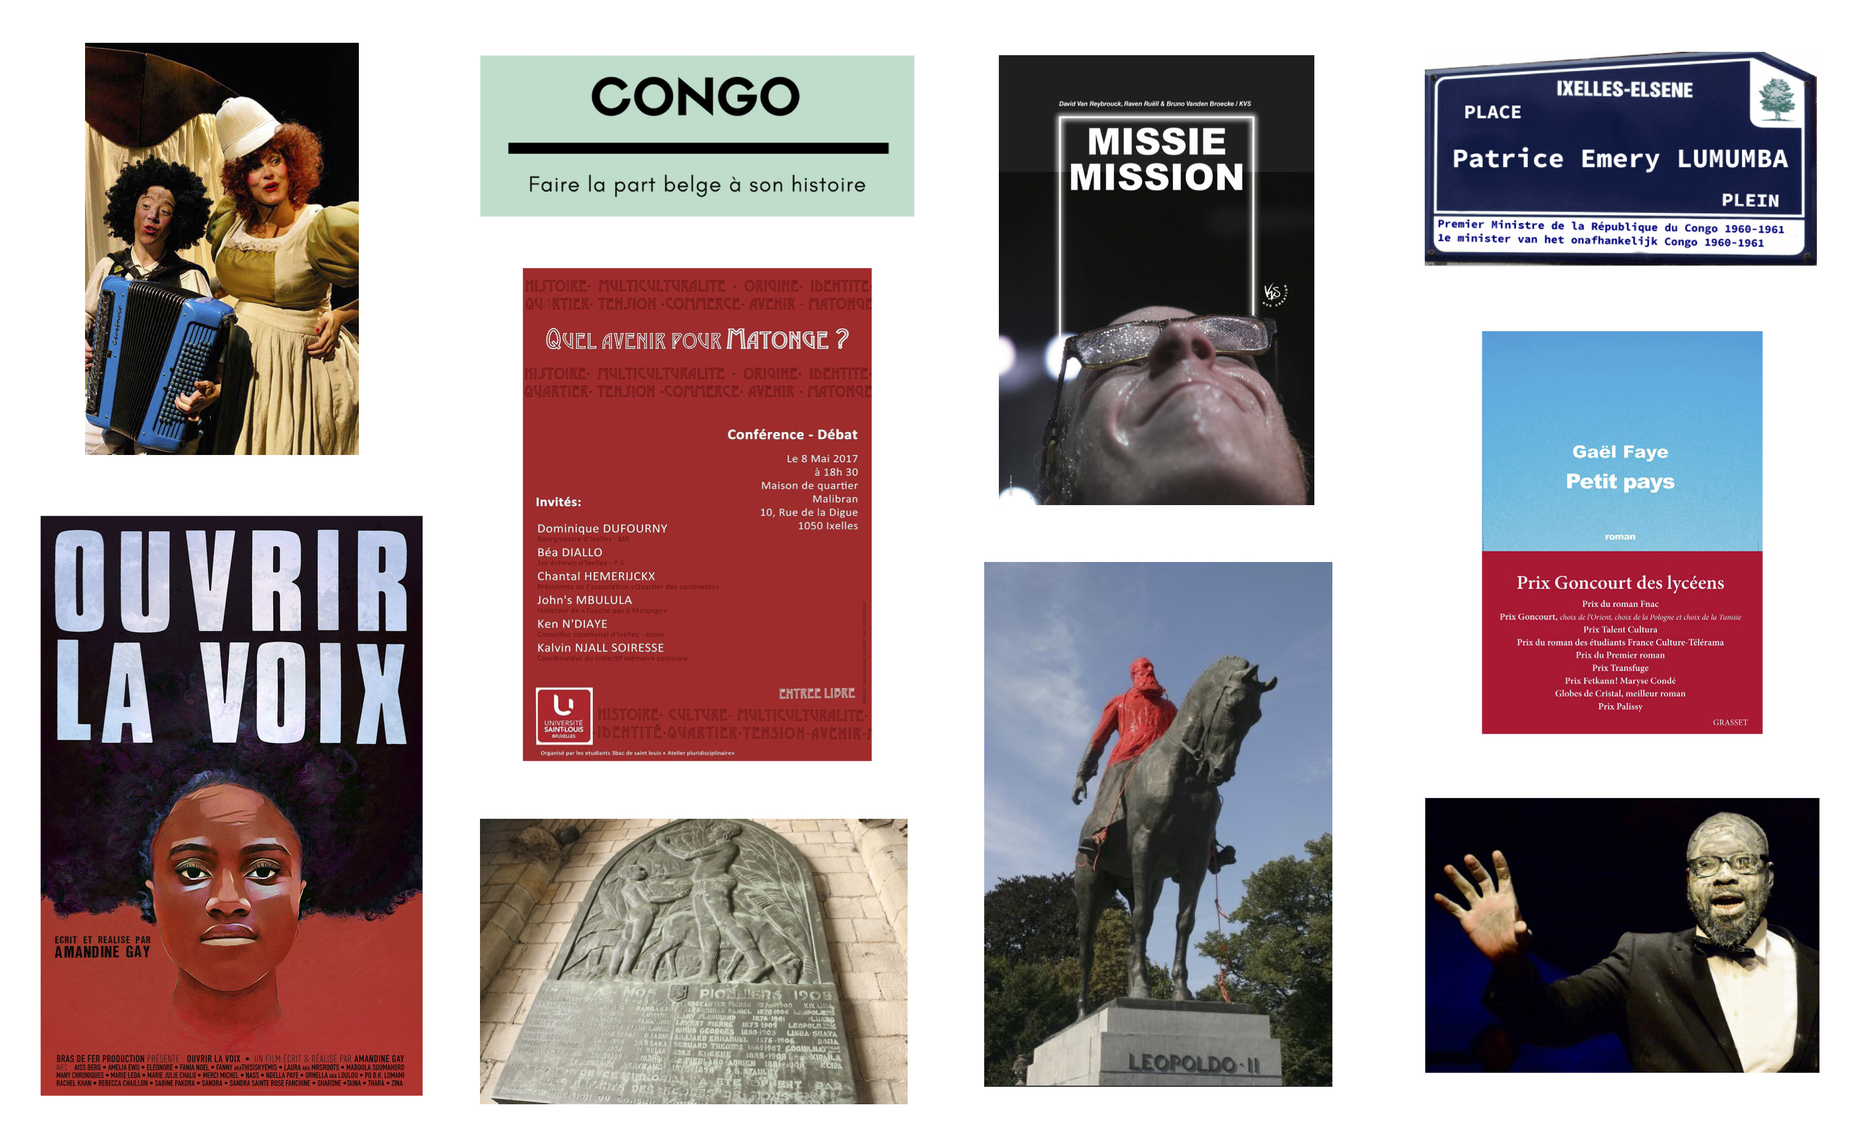
Romain Landmeters |Black Minds within Belgian (de)colonisation and discrimination… | Intellectuals on the margins |24.05.2019

Slide 3
Romain Landmeters |Black Minds within Belgian (de)colonisation and discrimination… | Intellectuals on the margins |24.05.2019
The unemployment rate among Afro-descendants in Belgium is four times higher than the rate among Belgians, even though 60% of them have a higher education degree.
A large majority, 91% of the Afro-descendants interviewed, consider that colonial history should be taught in schools and 74% of them think the colonial question is not discussed enough or is hidden in public debate.
Source : Sarah Demart, Bruno Schoumaker, Marie Godin et Ilke Adam, « Des citoyens aux racines africaines : un portrait des Belgo-Congolais, Belgo-Rwandais et Belgo-Burundais », Bruxelles, Fondation Roi Baudouin, 2017.

Slide 4
« My modest ambition was also to retrace in a way the daily life of these Congolese from Belgium, to reconstruct their "chronicles". I wanted to give a name to these Congolese ... I asked myself so many questions: What did the Belgians think, what did they say about blacks and Congolese? What did the Congolese think, what did they say about whites and Belgians? »
Romain Landmeters |Black Minds within Belgian (de)colonisation and discrimination… | Intellectuals on the margins |24.05.2019
Source : Zana Aziza Etambala, Présences congolaises en Belgique, 1885-1940. Exhibition – éducation – émancipation – paternalisme, vol. 1, Leuven, Katholieke Universiteit Leuven, 1989, p. 6 (Thèse de doctorat en lettres, philosophie, groupe d’histoire moderne, dir. : Eddy Stols & Jean-Luc Vellut). [my translation]

Slide 5
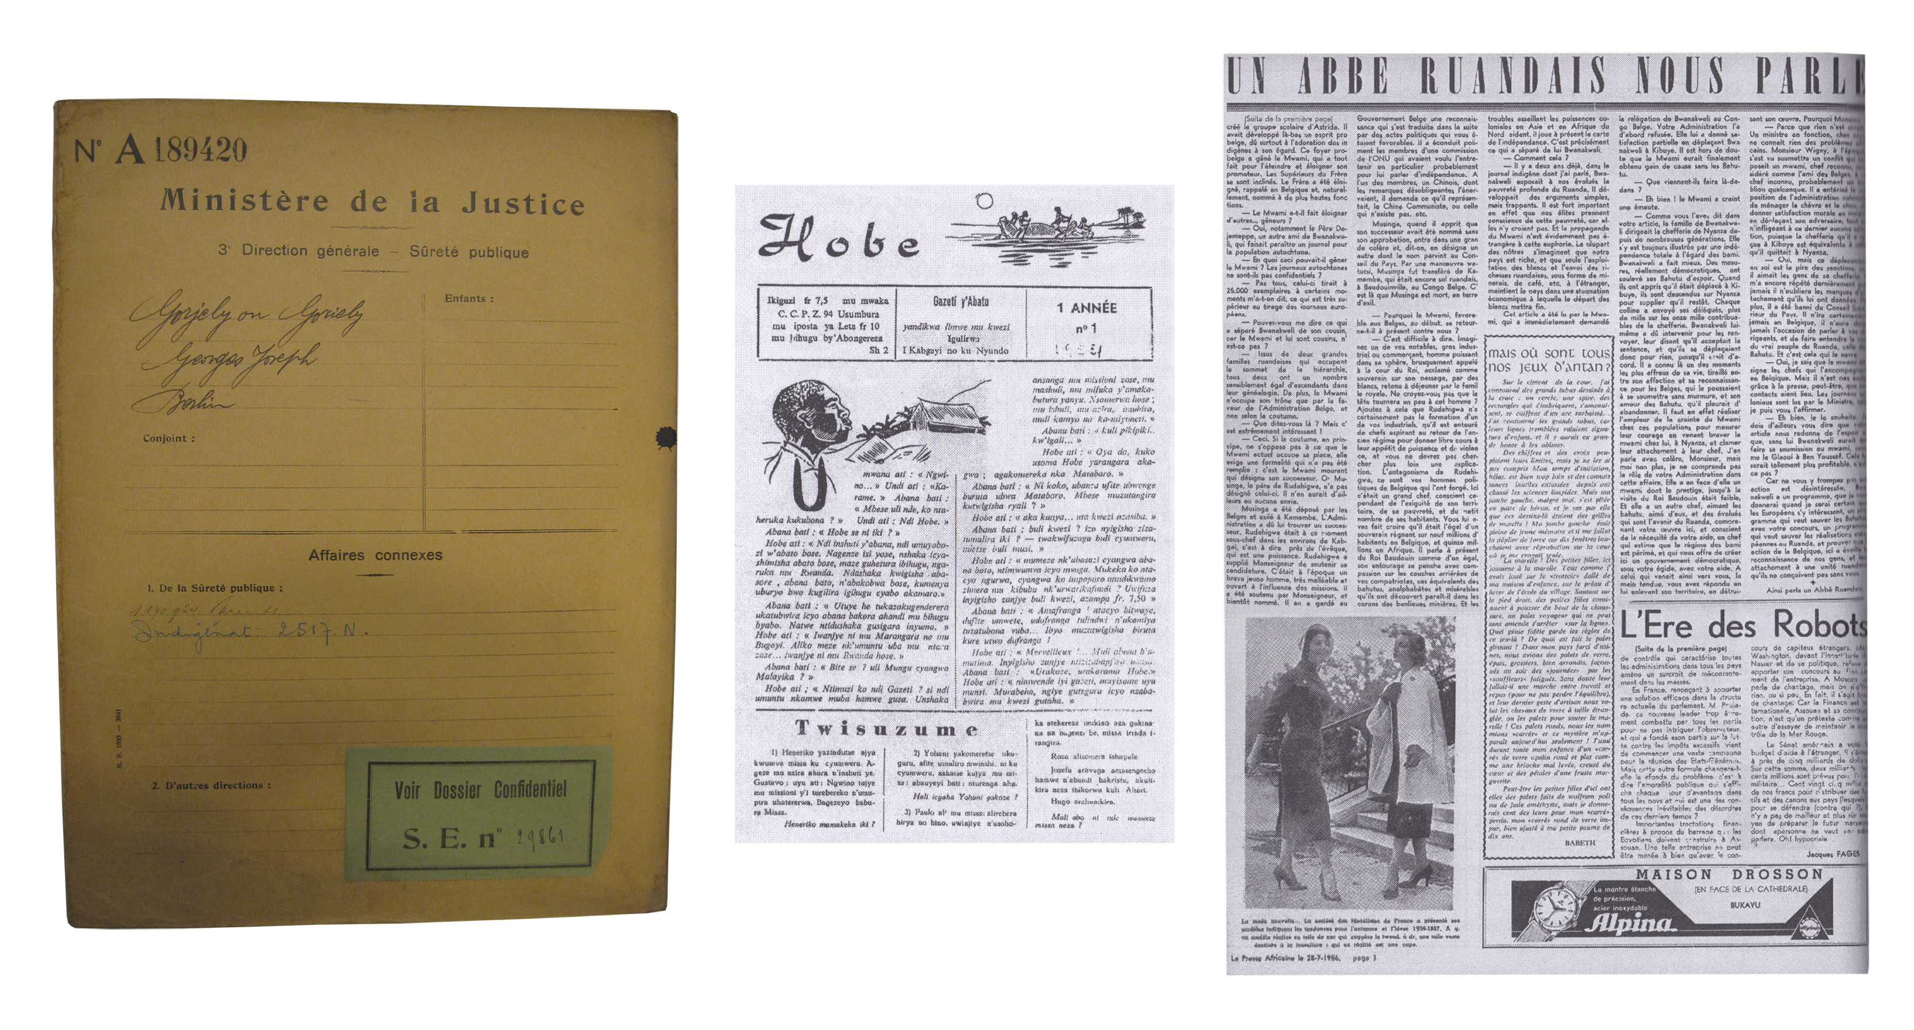
Romain Landmeters |Black Minds within Belgian (de)colonisation and discrimination… | Intellectuals on the margins |24.05.2019
Sources

Slide 6
« Focus on the experiences and points of view of the colonized, pay attention to the multiple strategies deployed in the face of colonial domination (resistances, transactions, reciprocal instrumentalizations) or on the mobilities and circulations (of people, of ideas, of goods, of practices of power) implies to cross scales and tools of analysis which few preconceived ideas can resist. There is no doubt that these are fundamental tools to reflect on the colonial genealogies of racist discrimination and current inequalities, as well as the resonance effects of this past in a series of neo and postcolonial contexts. But, we repeat, such projects require better links between the world of research and that of education, involving means and political will »
Romain Landmeters |Black Minds within Belgian (de)colonisation and discrimination… | Intellectuals on the margins |24.05.2019
Source : A. Lauro & R. Landmeters, « Manger végétal ou colonial ? Les (vrais) enjeux de l’histoire de la colonisation », dans Eduquer, tribune laïque. Publication de la Ligue de l’Enseignement et de l’Education permanente asbl, n° 133, 2017, p. 15-19.

Slide 7
Thank you for you attention… and your questions !
Romain Landmeters |Black Minds within Belgian (de)colonisation and discrimination… | Intellectuals on the margins |24.05.2019
romainlandmeters@usaintlouis.be

