Slide 1


THE NOTION OF RESPONSIBILITY: INJUNCTIONS AND MOVEMENTS
From free will to free market
ULAVAL– Québec
June 16th 2021
1
Notes:
Laura

Slide 2
Many many thanks for the invitation!
ACKNOWLEDGEMENTS
Soon, a return to normality and conviviality !

Slide 3
FOREWORD :
THE CONFERENCE AND THE RAISED FIST
1. State interference in research
programmes and the dissemination of
their results
2. Under-funding of universities
3. Imposition of private sector logic
(competition, management, “bullshit jobs”...)
4. Student demands and tyranny of social media
5. Polarised discussions (e.g. Cancel culture)
6. Frontal attack from the inside against
committed research (“islamogauchisme”)
A committed act for social justice
The future of critical thinking compromised?
4
Notes:
Laura

Slide 4
We Can’t say anything
anymore !
DISCRIMINATION
Social sciences must
be neutral !
VULNERABILITY
Fed up with the
tyranny
of minorities !
SOCIAL EXCLUSION

Slide 5

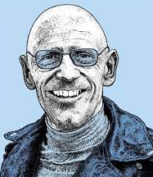
INTRODUCTION
“ The notion of responsibility is specifically used in the elaboration of a new neoliberal art of governing ”
Autocontrol
Self-government
Governmentality
➔ Neoliberal context
➔ Influence of market mechanisms
➔ Individual responsibility
➔ Everybody is "entrepreneur" of his/her self
Emilie Hache
2007
Responsibility = technique of government

Slide 6
Two-part presentation
01
02
Responsibility for acts of transgression
(“classical” view)
Responsibility at the heart of the execution of
sentences
6
Notes:
Nathalie

Slide 7

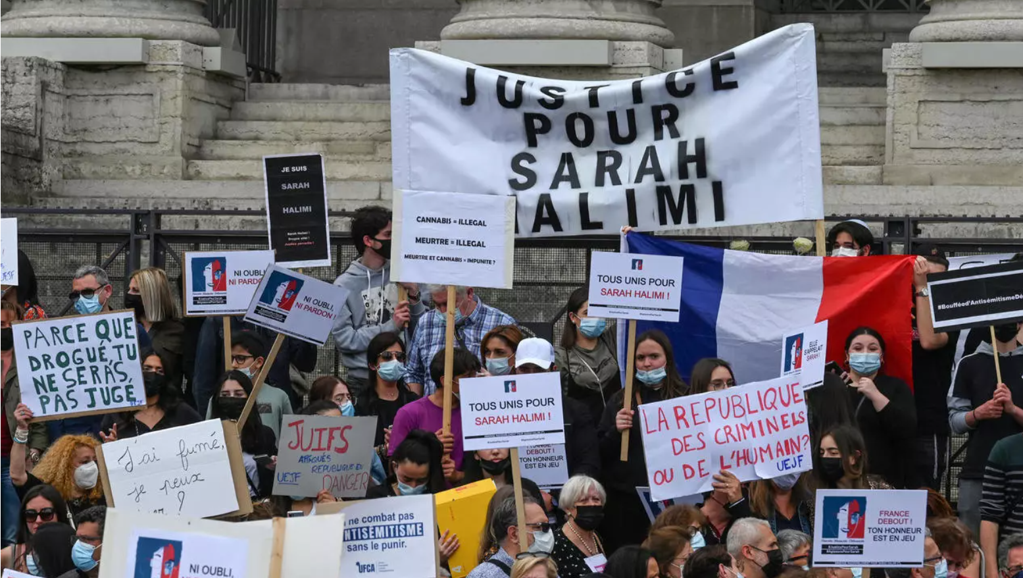
1.
THE INDIVIDUAL RESPONSIBLE FOR HIS/HER
ACTIONS
BUT…
Unconditional popular
desire for extended
individual responsibility
- Moral and mental accountability
- Rationality of the person
- Capacity of choice
- Free will
- Awareness of one's own actions
EX: Sarah HALIMI Case (France)

Slide 8
CONTEXT
MENTAL HEALTH
Public responsibility
- Budgetary restrictions
- Alternative practices in decline
- Relational therapies supplanted
by neuroscience
- Decline of psychoanalysis
- Material austerity, budget cuts and
lack of investment
- Privatization of the sector (commodification
of care)
Welfare state
Same debate about the criminal responsibility
of MINORS in a context of AUSTERITY
11

Slide 9
PENAL POPULISM (since the 1980’s)
➔ Socio-political complex that operates at different level
RELATIONSHIP BETWEEN CRIMINAL JUSTICE EXPERTS AND POLITICAL REPRESENTATIVES
COLLUSION BETWEEN ELECTORAL AND CRIMINAL POLICY
  Development of law enforcement pressure groups
  Amplification of 'tough on crime' speech through social networks
  Political support for these protests (even from governments)
Knowledge no longer guides the decision
Some research is no longer funded
The rhetoric of individual responsibility overwhelms any conception
⬇
  ➔ POPULISM AS A MODE OF GOVERNMENT THAT DECOLLECTIVISES SOCIAL REACTION
8
Notes:
Nathalie

Slide 10
2 .
THE INDIVIDUAL RESPONSIBLE DURING
HIS/HER PUNISHMENT
Model where individuals are
"activated”
Logic that begins upon entry into prison and continues in the community
(ex: "The responsible prisoner"
M. BOSWORTH)
“ Penal reforms today tend to make perpetrators responsible for the execution of their sentences and not only for their actions ”
However
The convict is caught up in a complex dynamic (multiple sentences, progressive
control...)
RESPONSIBILITY ➔
- Process (cannot be decreed but is manifested and built up gradually)
- Ability to manage the turning points in one's trajectory
- Ability to deal with the intertwining of the sentence with personal life
- Ability to manage transitions
Françoise
DIGNEFFE
2004

Slide 11
➔⬅Visions of responsible convict (persistant model)
Behavioral vision of responsibility (in line with psychology paradigm)
Responsibility reducible to demonstration
Relation to the notion of personal development
« Situational Penalty »
Justice occupied by systemic interests (self-referential)
Mechanical vision of the person
Abandon of correctional ideals
Accountability of professionals

Slide 12
And now ?
The system based on individual responsibility for punishment is well established and has been operating without much change since the 1990s
NOTHING NEW…
- Recidivism
- Mass incarceration
- Radical intolerance to the risk of crime
- Penal populism
… BUT SOME FEARS
3 observations on the current situation …
(next slides)
2021

Slide 13

Massive increase in the number of sentences taking place in the community
A.
Penalty is everybody’s
business
(everyone’s)
Everyone, everywhere
can be a gatekeeper
➔
M. PHELPS: Mass probation, Mass supervision
The majority of convicts serve their sentences in the community
Development of distance government with technological assistance and delegation
Extension of surveillance and dissemination in the social space

Slide 14
Technologies reshape the territories of freedom and constraint
B.
Convergence
of normalization
between prison
and community
➔
Technology is involved at all levels of the judicial and penal process
Prison can be virtual
Rehabilitation is prepared in 3D
The future lies in the deterritorialization of prison and probation
No space is beyond control

Slide 15
New market opportunities are expanding in the penal field
C.
Creating a punitive
consumer society
➔
The absence of a penological
project for prisoners and the
self-centered management policy
leave the field clear for
commercialization
A new capitalist penal utilitarianism is organized at the level of the convicted person
Captives are consumers like everyone else
This goes far beyond the privatization
of prisons and their management
Probation is becoming more and more privatized

Slide 16
CONCLUSION TOWARDS A CAPITALIZATION OF
RESPONSIBILITY ?
$
INDIVIDUALISING POPULISM THAT DISEMPOWERS THE COLLECTIVE
THE “RESPONSIBLE ME" AS CAPITAL TO BE EXPLOITED
THE CONVICT AS CONSUMER
THE STATE WITHDRAWS FROM THE GAME, PAYS LESS AND LESS FOR SANCTIONS AND DELEGATES MORE AND MORE TO THE PRIVATE SECTOR
REGIMES OF RESPONSIBILITY ALLOW THE TECHNOLOGISATION AND DETERRITORIALISATION OF PUNISHMENT

Slide 17
What about social Justice ?
NEED FOR COLLECTIVE SOLIDARITY
2 DIMENSIONS (Nancy FRAZER)
1. REDISTRIBUTION : fight against socio-economic injustice
2. RECOGNITION : fight against symbolic injustice

Slide 18
THANK YOU !
marie-sophie.devresse@uclouvain.be

