Slide 1


Low-frequency Noise in Polysilicon Source-Gated Transistors
Qi Chen¹, Valeriya Kilchytska¹, Léopold Van Brandt¹, Eva Bestelink², Radu A. Sporea², Denis Flandre¹
¹ ICTEAM, UCLouvain, Louvain-la-Neuve 1348, Belgium
²ATI, University of Surrey, Guildford, United Kingdom
Surrey, 19th September, 2024
Symposium on Schottky Barrier MOS 2024 "The Schottky barrier transistor for neuromorphic applications"

Slide 2
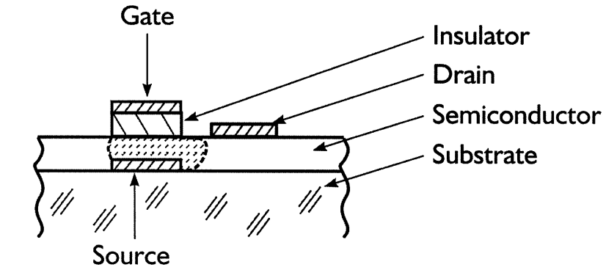
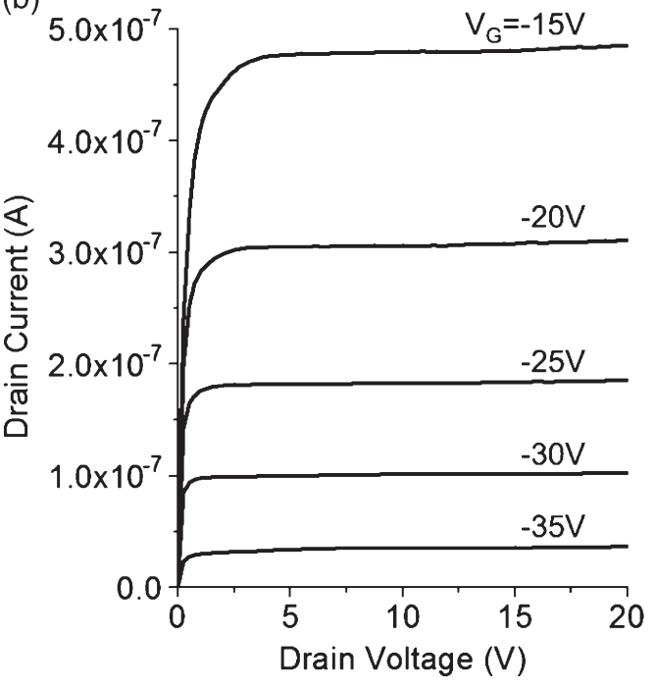
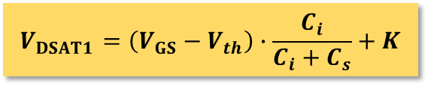

Polysilicon Source-gated Transistors (SGT)
Advantages
Low saturation voltage
High intrinsic gain
Reduced short-channel effects
Applications
Amplifiers
Drive circuit for displays
J. M. Shannon et al., IEEE Electron Device Lett., 2003.
Trade-off
Lower current output for the same gate bias and device dimensions due to the Schottky barrier
$$V_{DSAT1}=\left(V_{GS}−V_{th}\right)∙\frac{C_{i}}{C_{i}+C_{s}}+K$$
$$V_{DSAT2}=V_{GS}−V_{th}$$
Why polysilicon?
Balanced cost and electrical characteristics for thin-film large-area circuit applications
Radu A. Sporea et al., IEEE Trans. Electron Devices, 2010
Low-frequency Noise in Polysilicon Source-Gated Thin-Film Transistor
2

Slide 3
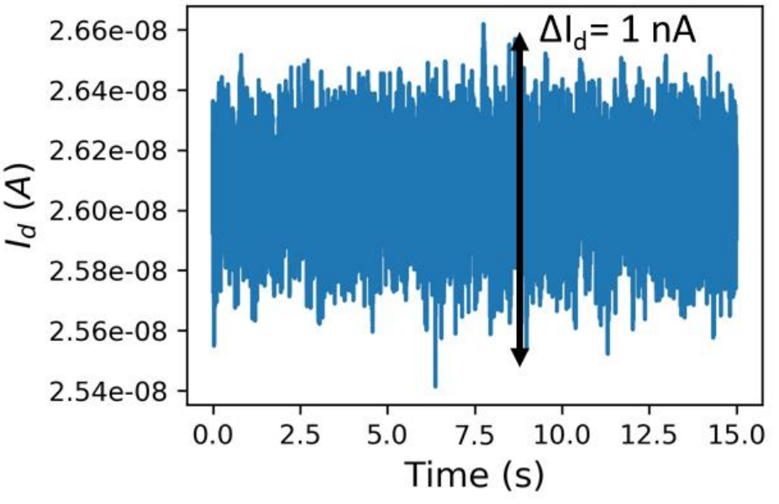
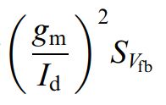
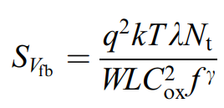

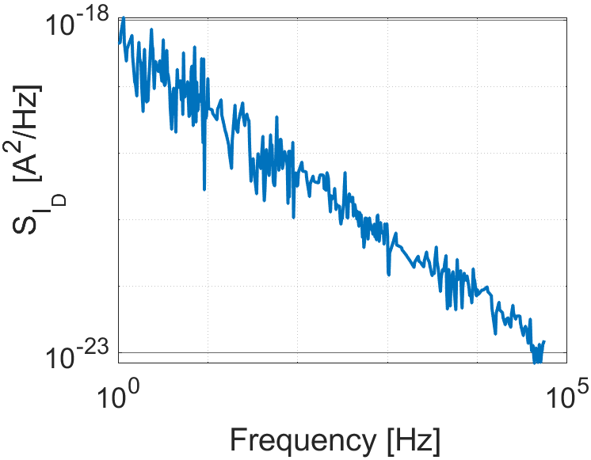
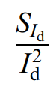
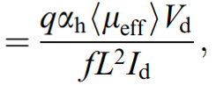
Low-frequency Noise (LFN) in conventional transistors
Physical origin of low-frequency noise traps
Low-frequency noise models
McWhorter model (Carrier Number Fluctuation (CNF) model)
Angeliki Tataridou, PhD Dissertation, 2022.
Trap density
with
Hooge model (Carrier Mobility Fluctuation (CMF) model)
Hooge parameter
G. Ghibaudo et al., Microelectron. Reliab., 2002
Low-frequency Noise in Polysilicon Source-Gated Thin-Film Transistor
3
Notes:
As the downsizing of the geometrical dimensions, Low Frequency Noise has become an important concern for nanoscale transistors.

Slide 4
Objective and Outline
Towards a better understanding of the behavior of low-frequency noise in polysilicon SGT
TCAD simulation and DC measurements
LFN in thin-film transistor (TFT) configuration
LFN in SGT configuration
Conclusions and perspectives
LFN in subthreshold region
LFN in above-threshold region
Low-frequency Noise in Polysilicon Source-Gated Thin-Film Transistor
4

Slide 5
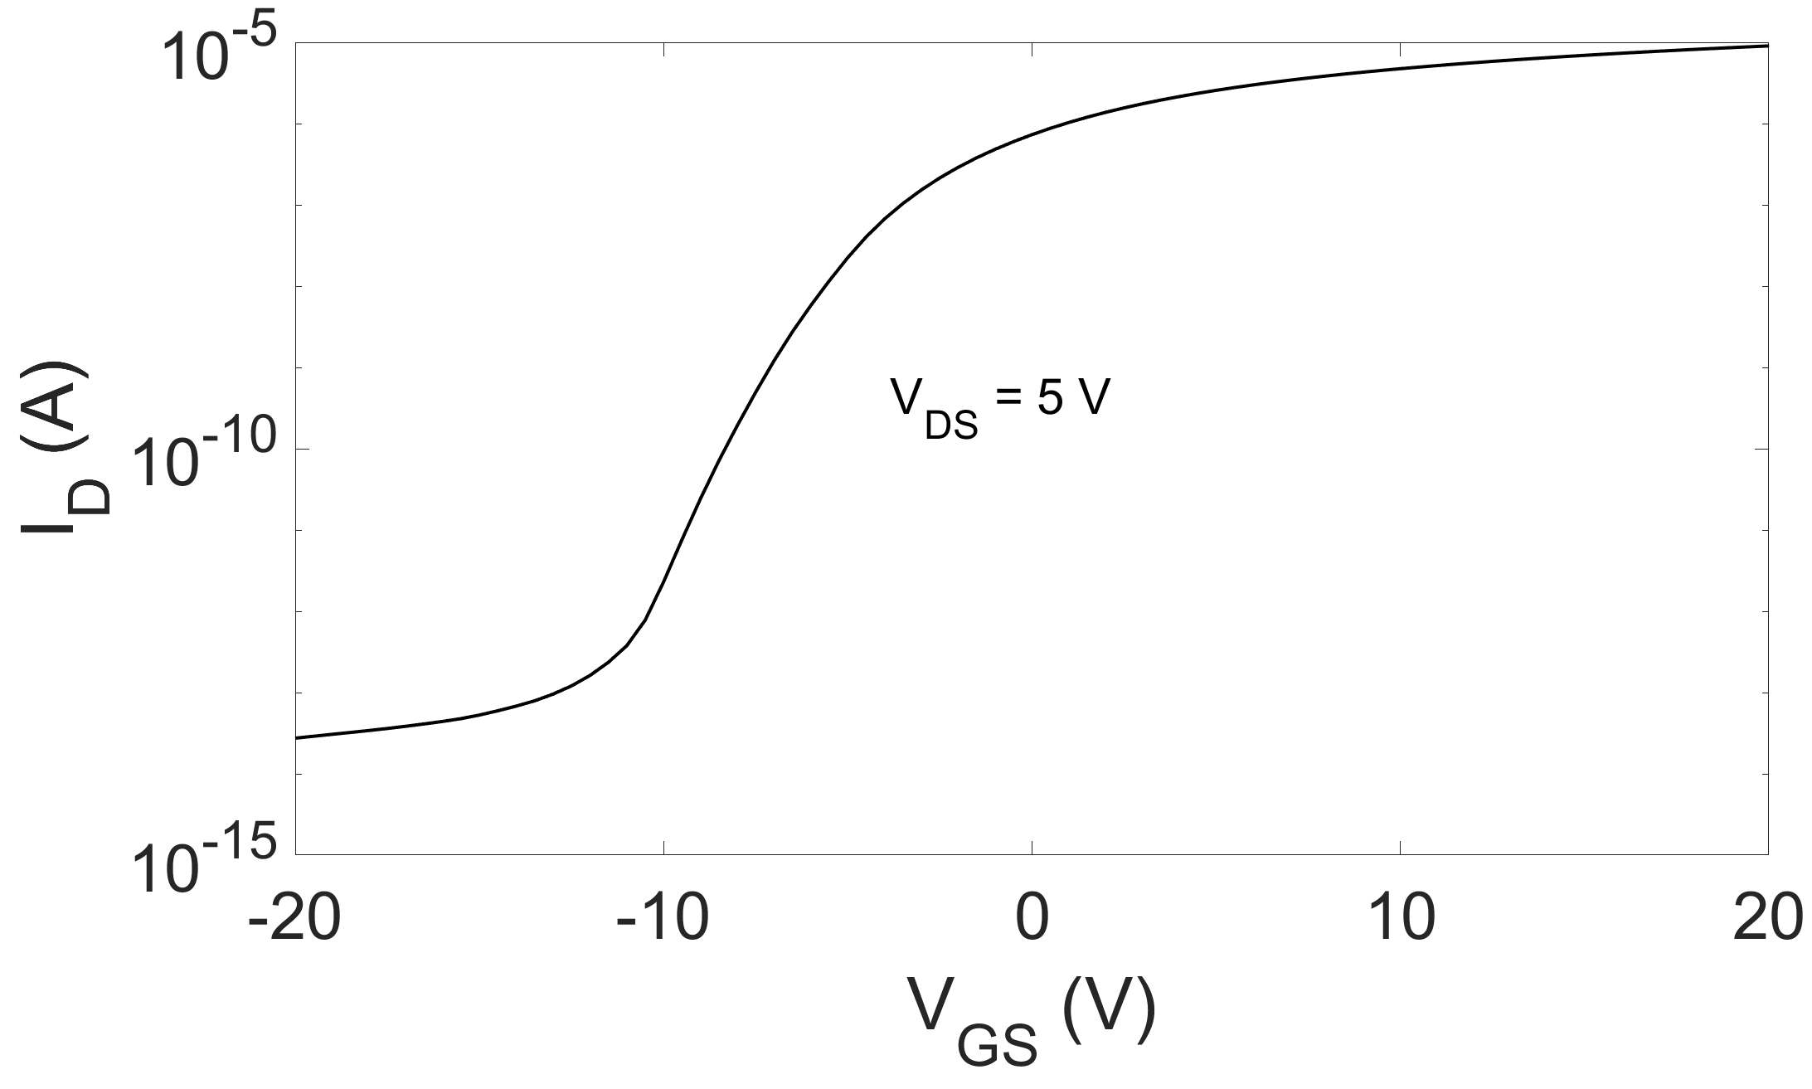
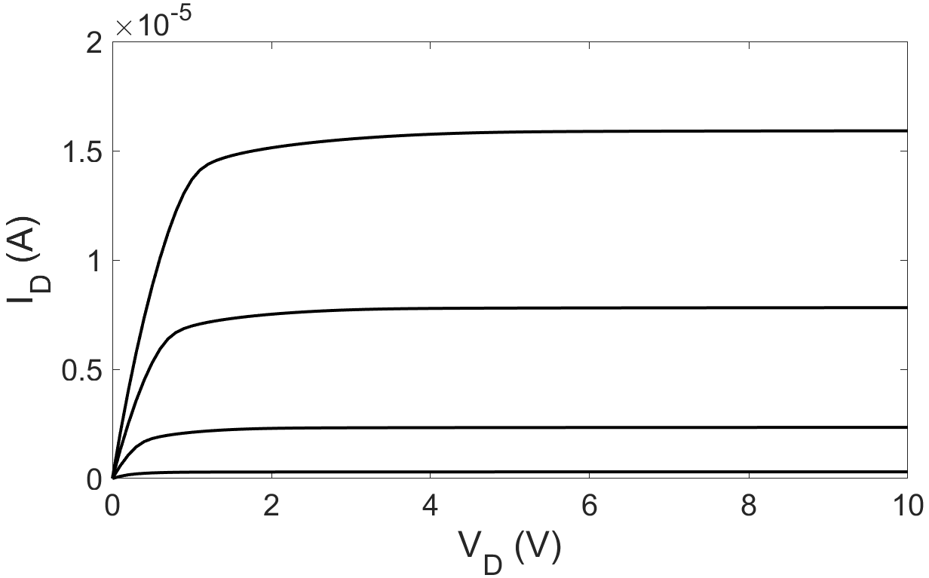
1.1. TCAD Simulations
Schematic simulated device structure
Simulated IV characteristics
Schottky Source with field plate
Insulator
I_{barrier}
I_{ch}
N-type Polysilicon
OhmicDrain
Insulator
Doping Dose = 0.5 ×10¹² cm⁻²
Gate
Key parameters used in simulations
Parameter | Value
Schottky barrier height | 0.35 eV
Polysilicon Mobility | 20 cm·V⁻¹s⁻¹
Polysilicon Permittivity | 11.7
Fixed charge density Q_{f} | 4×10¹¹ cm⁻²
Acceptor defect density D_{it} | 1×10¹² cm⁻³
Doping Dose = 0.5 ×10¹² cm⁻²
V_{GS} ranges from 0 to 20 V, 5V per step
Low-frequency Noise in Polysilicon Source-Gated Thin-Film Transistor
5

Slide 6
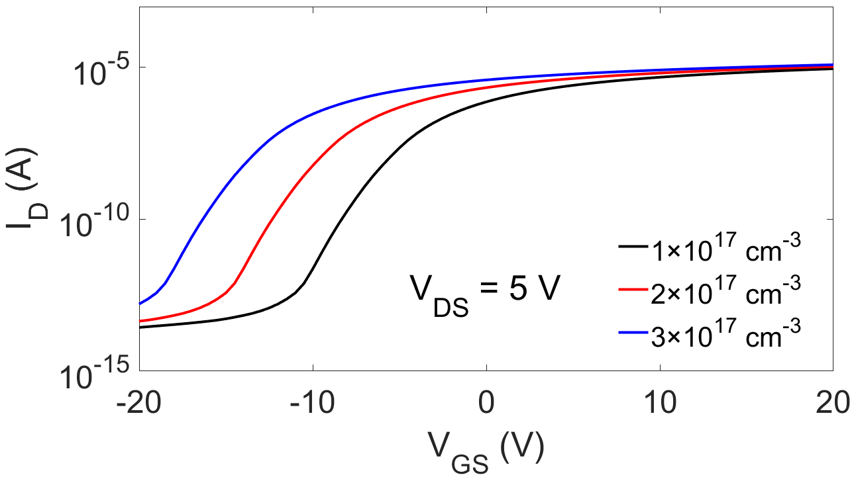
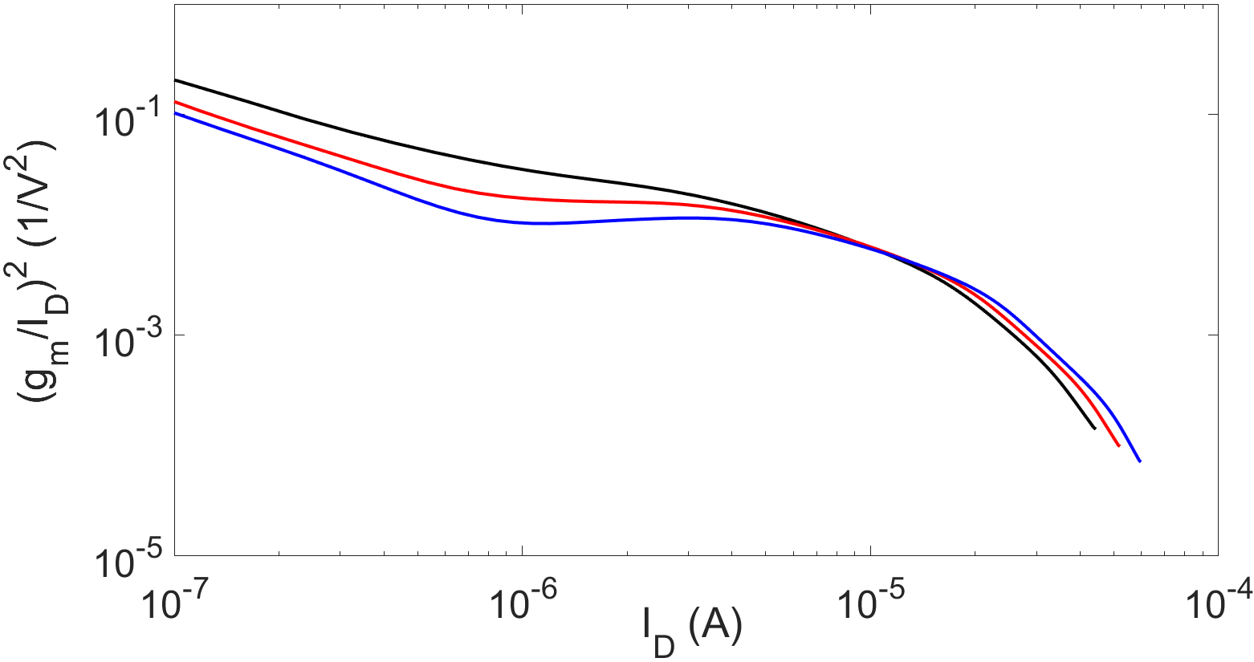
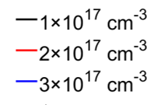

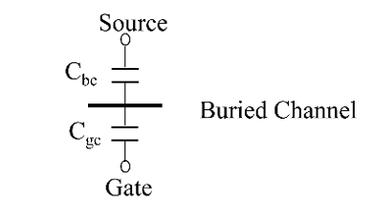
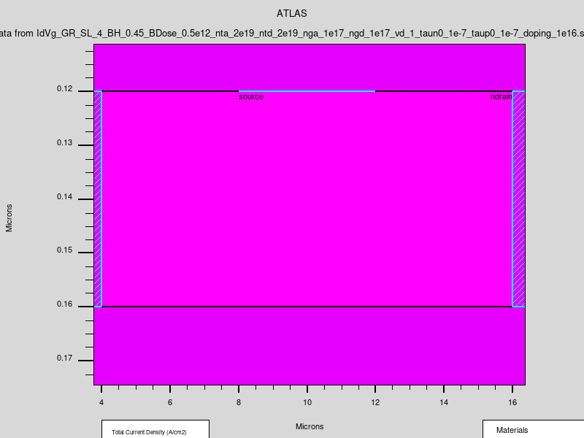
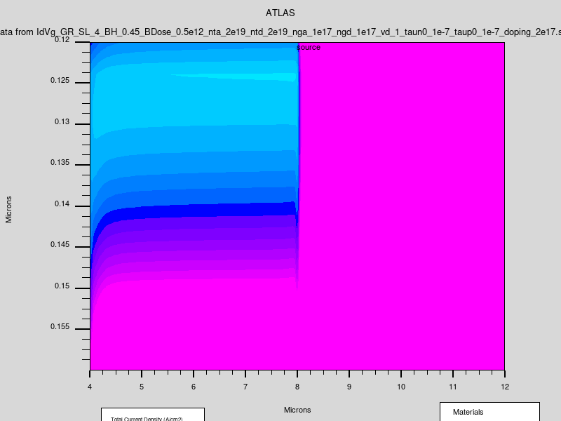
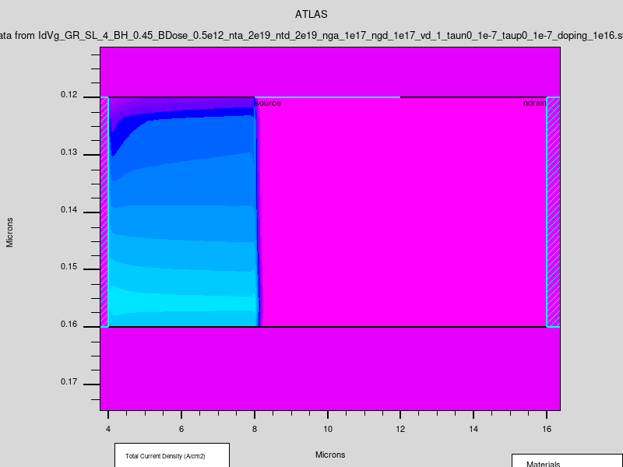
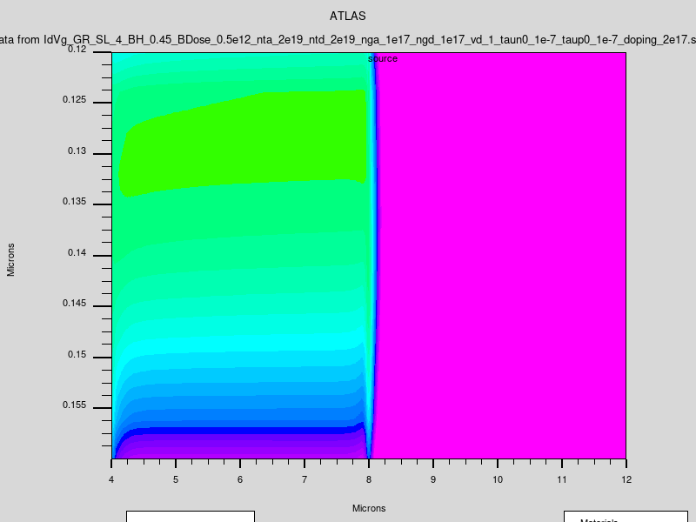
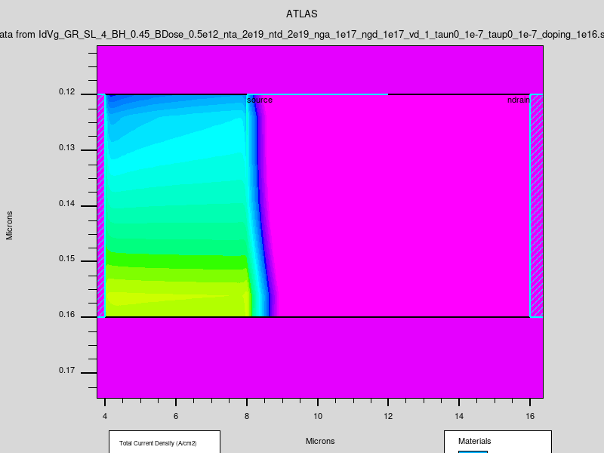
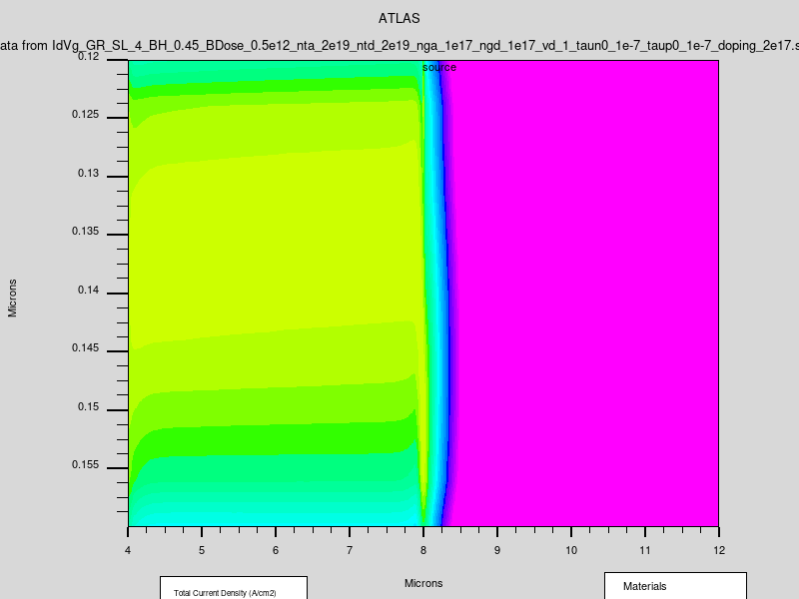
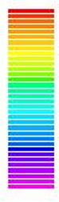
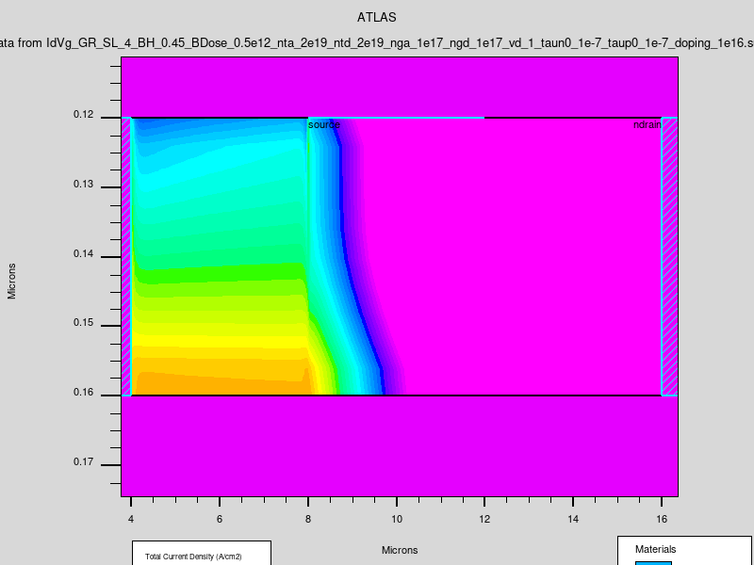
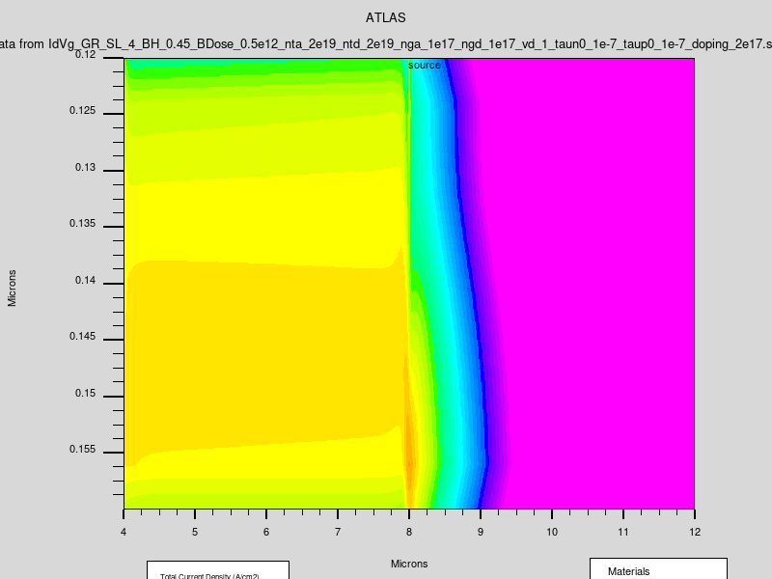
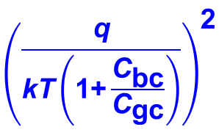
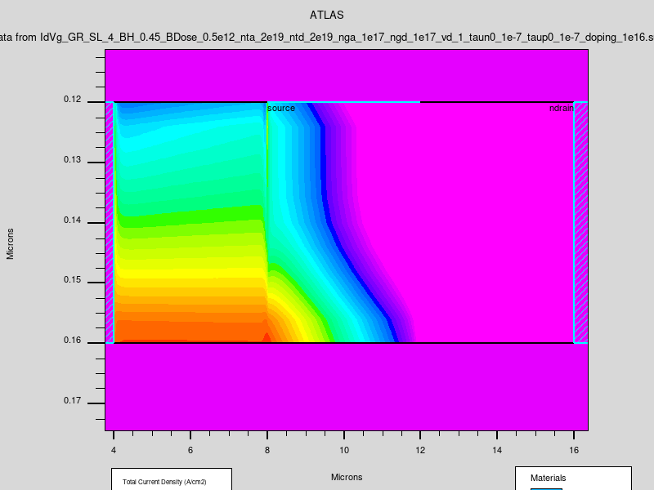
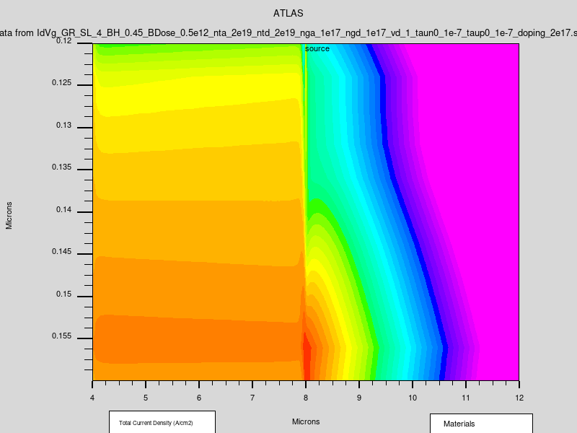
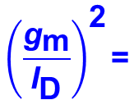
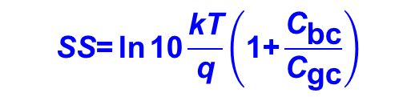
1.1. TCAD Simulations
Transfer and (g_{m}/I_{D})² curves at different doping concentrations
Decreased doping concentration
Decreased doping concentration
Variation of current densities
SS model for accumulation-mode
device
Source Region
Channel
Source Region
Channel
V_{GS} –V_{T} = -6 V
1e17 cm⁻³
2e17 cm⁻³
V_{GS} –V_{T} = -4 V
Log (Current Density) (A/cm²)
4
$$\text{SS}\text{=}\text{ln}{\text{10}\frac{\text{kT}}{\text{q}}\left(\text{1+}\frac{{\text{C}}_{\text{bc}}}{{\text{C}}_{\text{gc}}}\right)}$$
V_{GS} –V_{T} = -2 V
3
V_{GS} –V_{T} = 0 V
2
$${\left(\frac{{\text{g}}_{\text{m}}}{{\text{I}}_{\text{D}}}\right)}^{\text{2}}\text{=}$$
V_{GS} –V_{T} = 2 V
1
0
Low-frequency Noise in Polysilicon Source-Gated Thin-Film Transistor
6
Notes:
Short expression

Slide 7
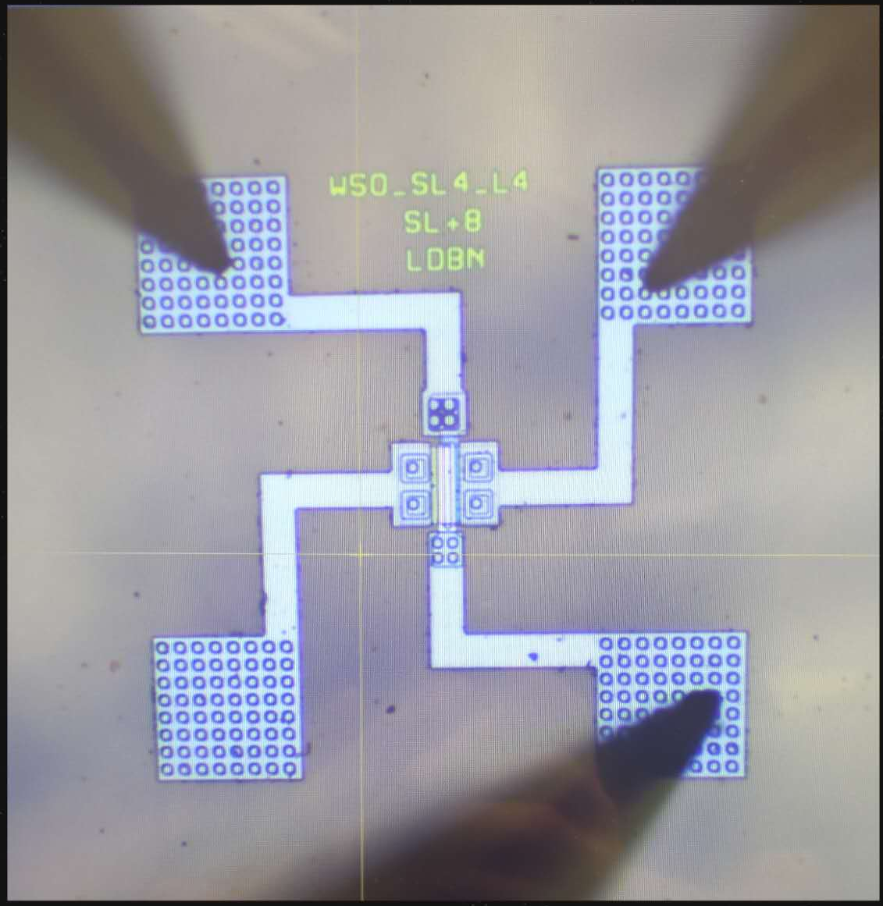
1.2. Device structure
Schematic of the measured device and measurement configurations
SGT configuration
Drain
TFT configuration
Source
field plate
Source
Drain
Schottky
Contact
Insulator
120 nm
Source
Length
Channel
Length
Ohmic
Contact
40 nm
N-type Polysilicon
Insulator
300 nm
Gate
Bulk doping dose: 0.5 ×10¹² cm⁻² & 1.5 ×10¹² cm⁻²
Radu A. Sporea et al., IEEE Trans. Electron Devices, 2010
Low-frequency Noise in Polysilicon Source-Gated Thin-Film Transistor
7

Slide 8
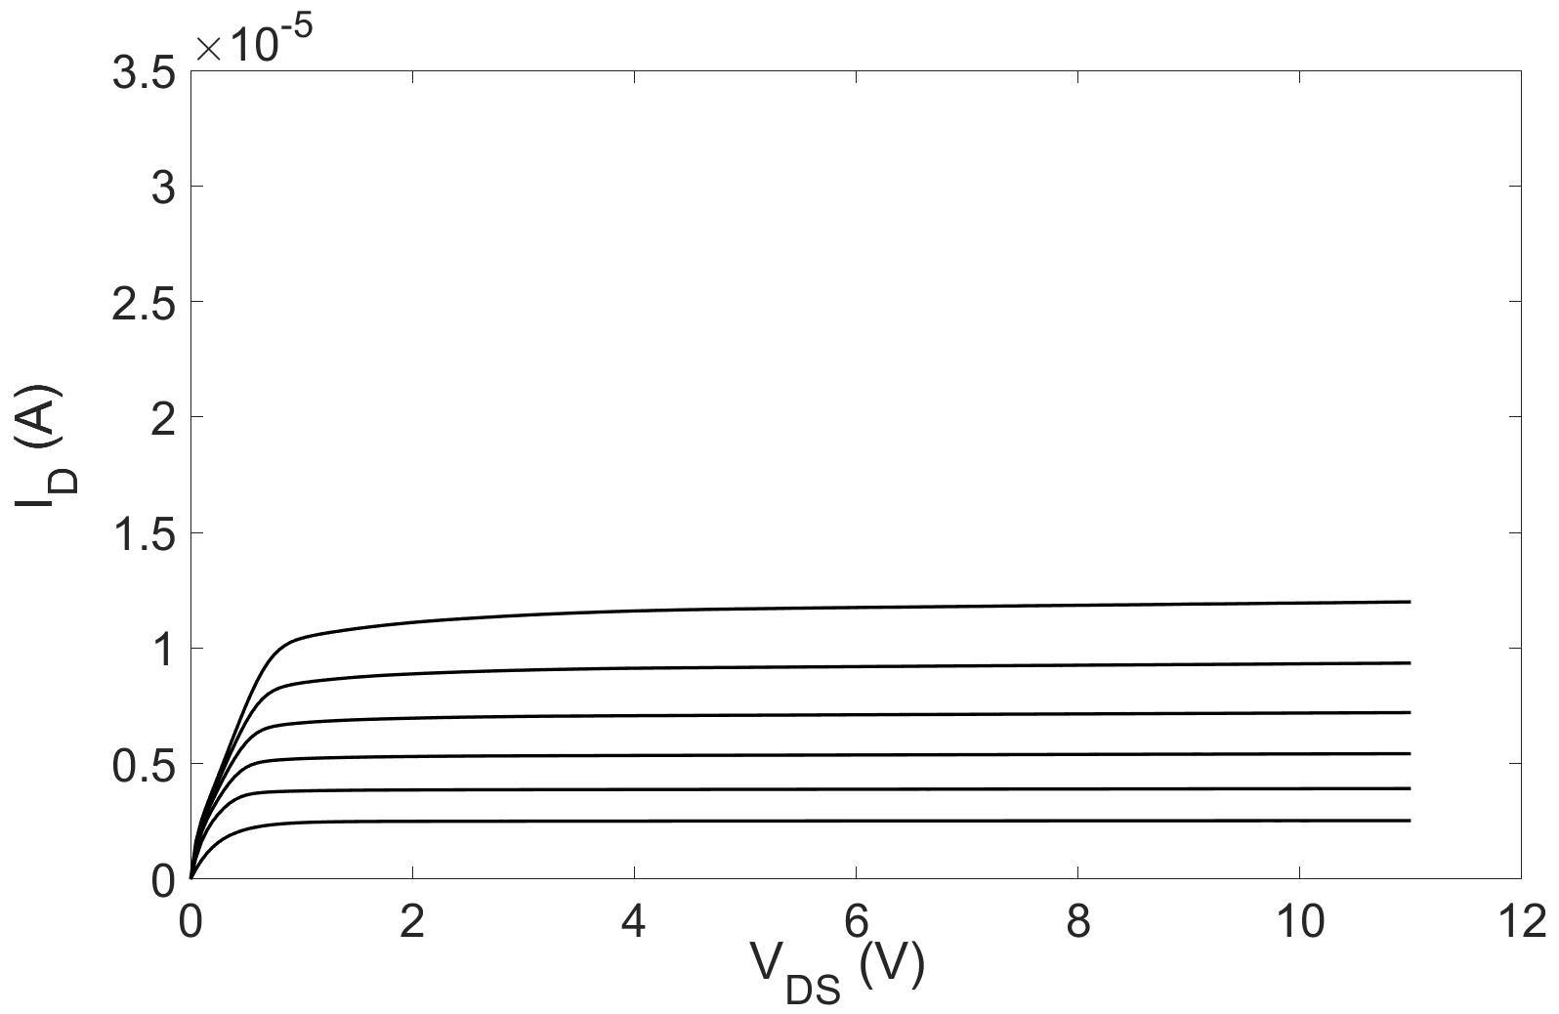
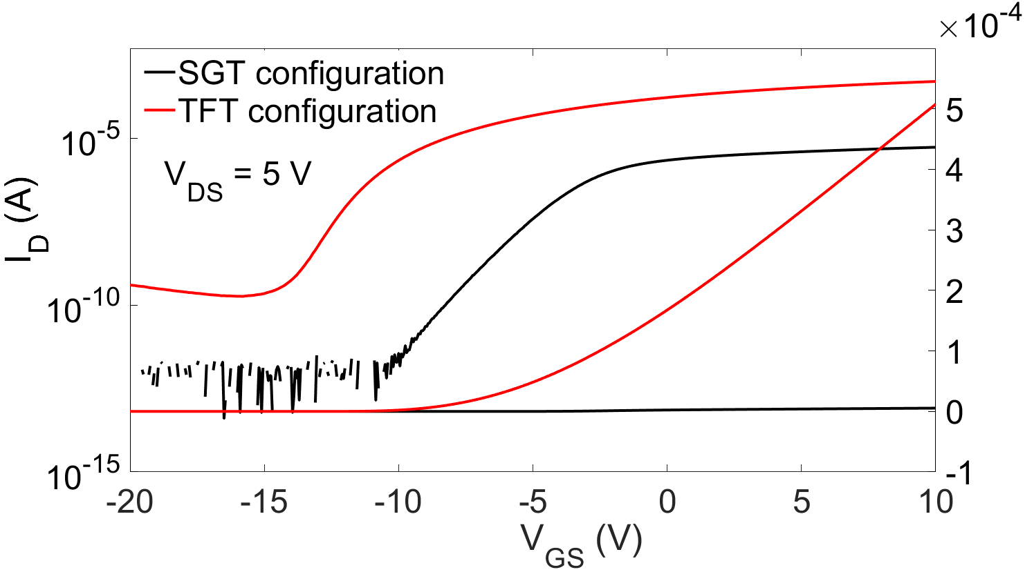
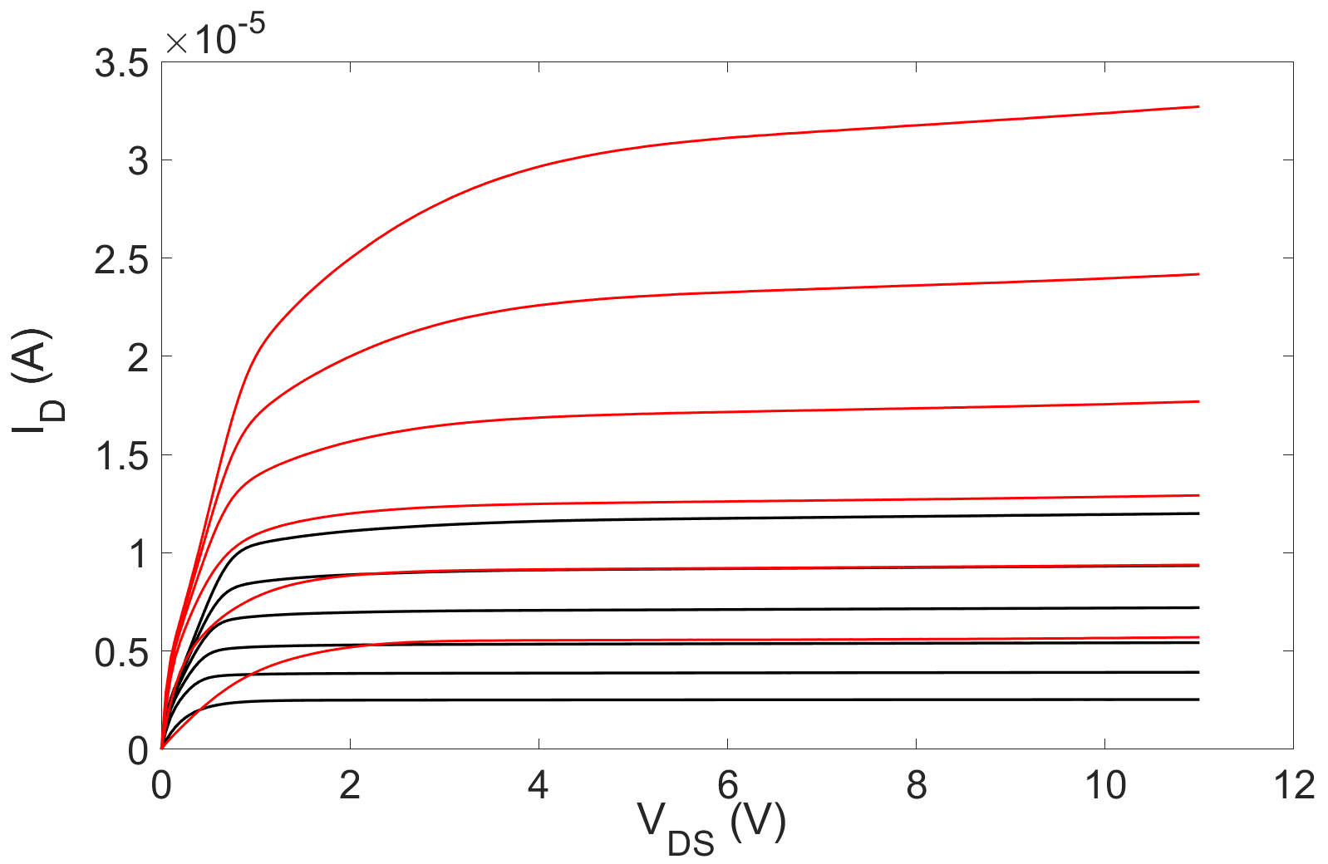
1.2. IV measurements
Transfer curves of SGT and TFT configurations
Output curves of SGT and TFT
V_{GS} ranges from 20 to 0 V, -4V per step
measurement bias points @ V_{D} = 5 V
V_{GS} ranges from 20 to 0 V, -4V per step
Doping Dose = 0.5 ×10¹² cm⁻²
Source Length = 4 um Channel Length = 4 um
On-state current increases by two orders of magnitude in TFT configuration
Typical SGT output curves with smaller saturation voltages and lower output conductance compared to the TFT configuration
Low-frequency Noise in Polysilicon Source-Gated Thin-Film Transistor
8
Notes:
Extracted mobility μ = 53 cm·V⁻¹s⁻¹ SGT SS = 0.8 V/dec TFT SS = 1.1 V/dec
The bevaior off-state and subthreshold region is dominated by the channel like in the FET. The negative bias stress normally yields a negative threshold voltage shift of the thin film transistors due to the additional positive charges trapped in the gate dielectrics or at channel/gate insulator interface.

Slide 9
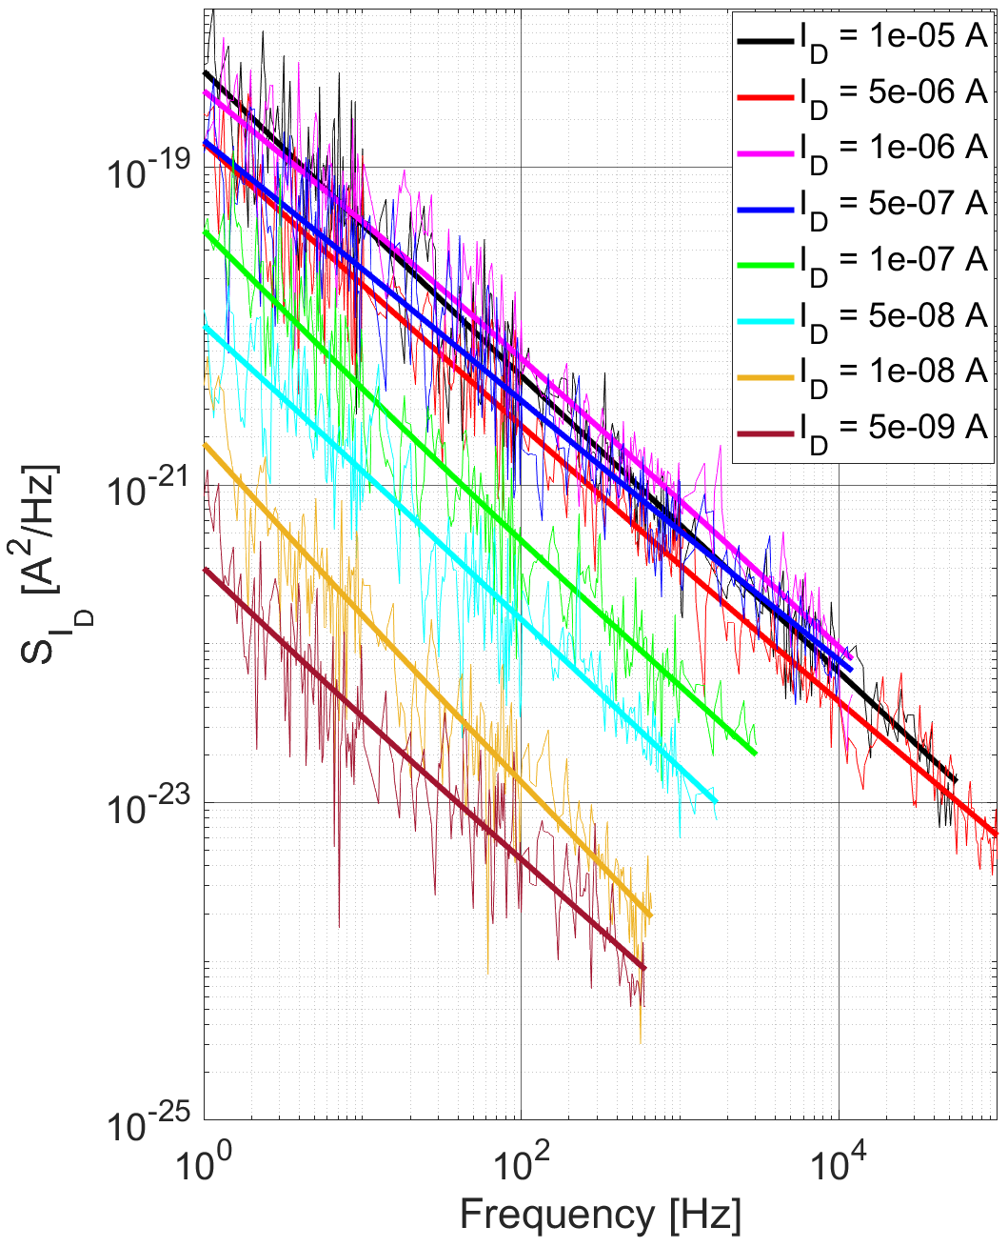
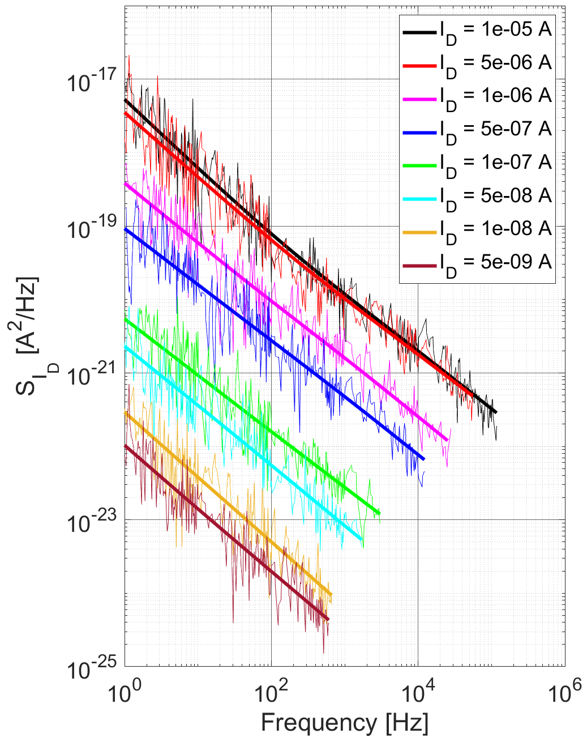
2. LFN in TFT configuration
Power spectral density (PSD) S_{Id} under different doping and fixed current in TFT configuration
Source Length = 4 um Channel Length = 4 um
Doping Dose = 0.5 ×10¹² cm⁻²
Doping Dose = 1.5 ×10¹² cm⁻²
V_{D} = 5 V
V_{D} = 5 V
f ⁻¹
f ⁻¹
f ⁻¹
The LFN noise behavior are confirmed with the PSD approximately proportional to 1/f
PSD increases with gate voltage in
subthreshold region
V_{D} = 5 V
Low-frequency Noise in Polysilicon Source-Gated Thin-Film Transistor
9

Slide 10
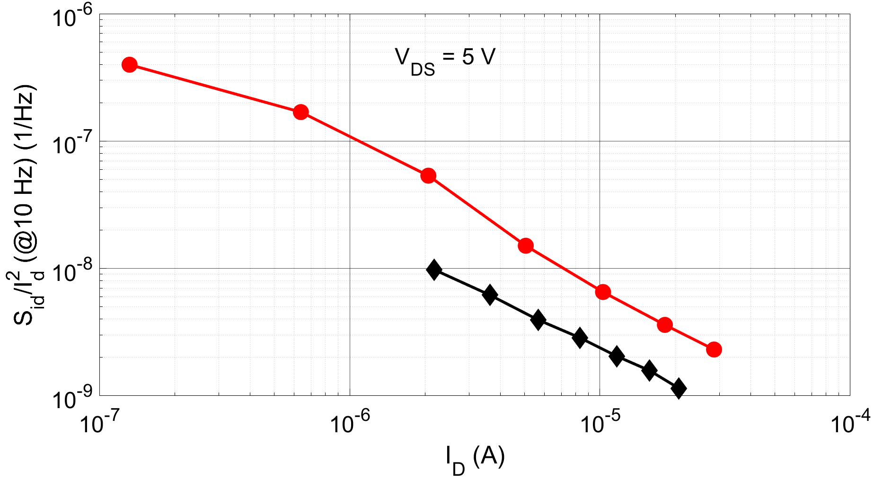

2. LFN in TFT configuration
Normalized S_{id} versus I_{D} of TFT configuration
Carrier Mobility Fluctuation (CMF) model
I_{D}⁻¹
G. Ghibaudo et al., Microelectron. Reliab., 2002
I_{D}⁻¹
PSD varies as the reciprocal of I_{D} indicating that the noise in subthreshold region originates from
carrier mobility fluctuation, as in previous reported polysilicon transistors.
A. Mercha, et al., Journal of Applied Physics, 2001
Low-frequency Noise in Polysilicon Source-Gated Thin-Film Transistor
10

Slide 11

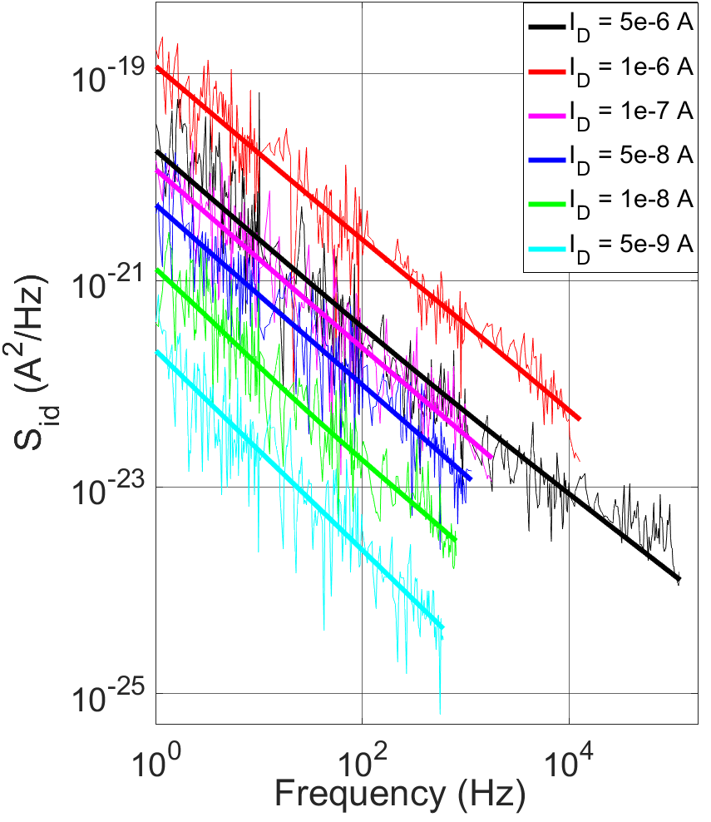
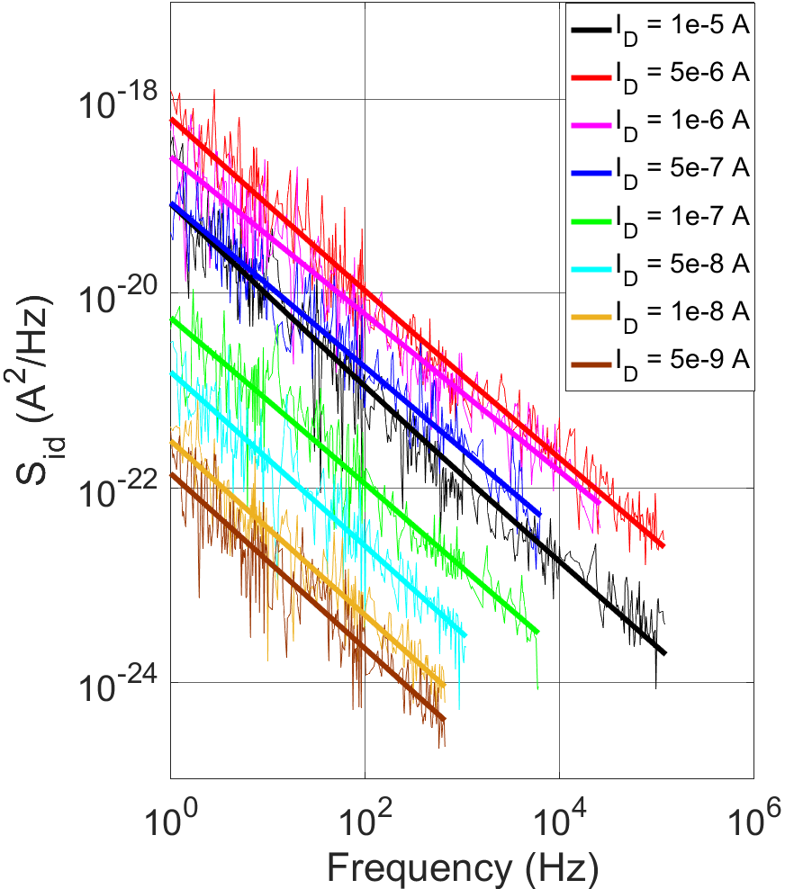
3.1 LFN in the subthreshold region of SGT configuration
Power spectral density (PSD) S_{Id} in the subthreshold region of SGT configuration without BF2 implant
Source Length = 4 um Channel Length = 4 um
Doping Dose = 0.5 ×10¹² cm⁻²
Doping Dose = 1.5 ×10¹² cm⁻²
f ⁻¹
f ⁻¹
The LFN noise behavior are confirmed with the PSD approximately proportional to 1/f
PSD increases with gate voltage in
subthreshold region
V_{D} = 5 V
V_{D} = 5 V
Low-frequency Noise in Polysilicon Source-Gated Thin-Film Transistor
11

Slide 12
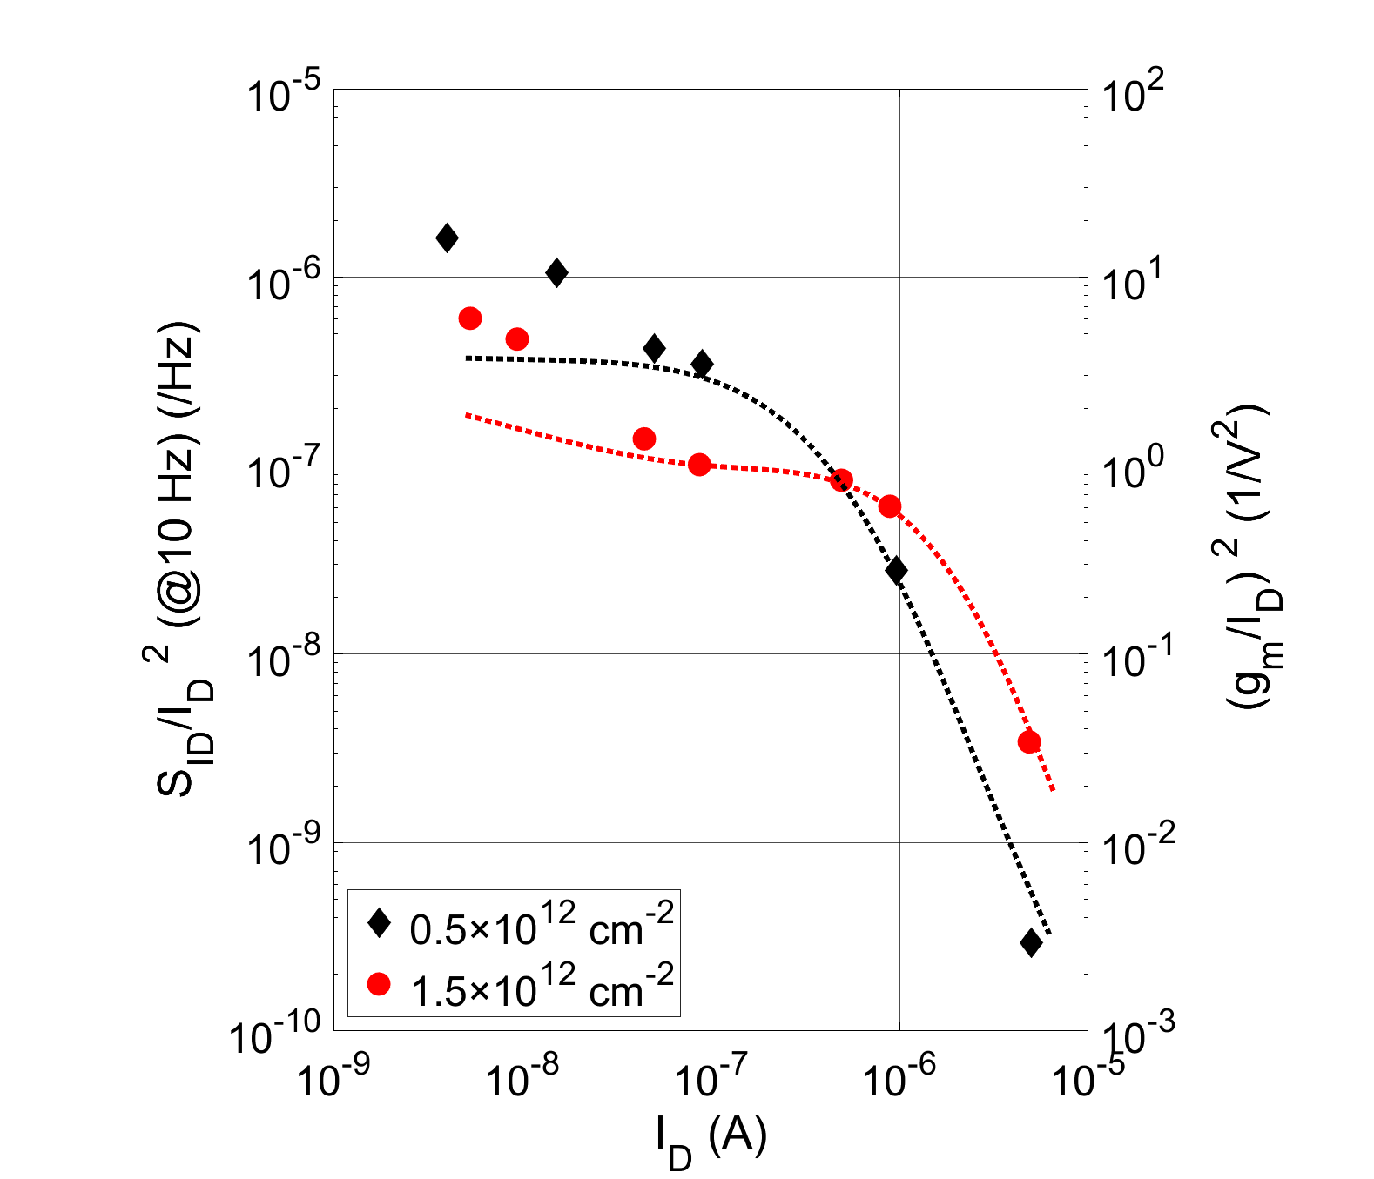
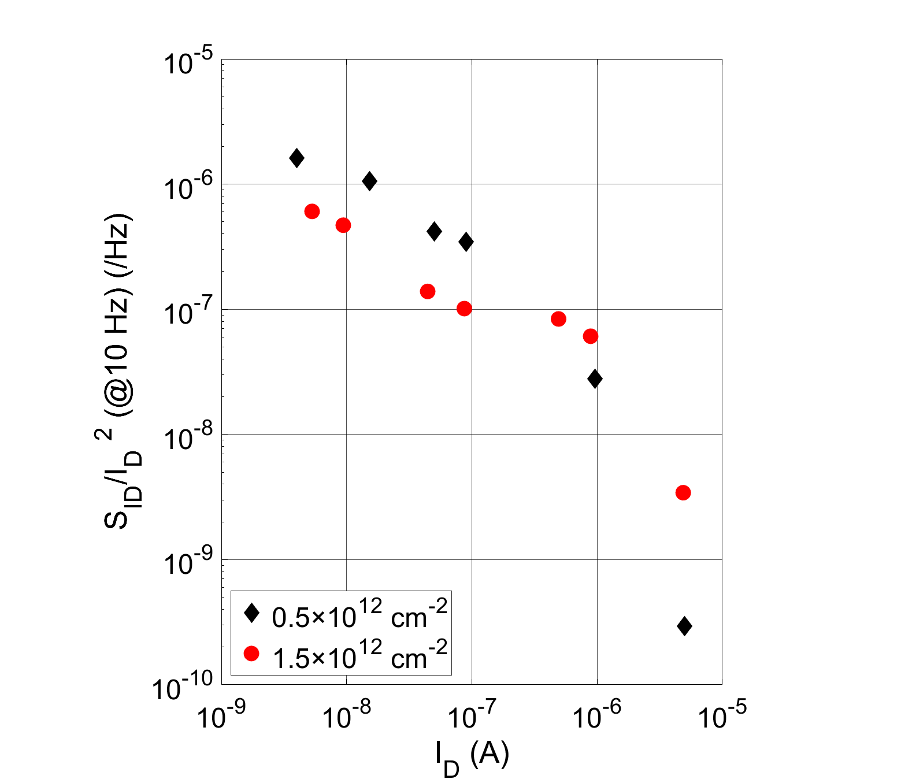
3.1. LFN in the subthreshold region of SGT configuration
Carrier Number Fluctuation (CNF) model
Normalized S_{id} and (g_{m}/I_{D})² versus I_{D}
I_{D}⁻¹
V_{D} = 5 V
The normalized PSD at low I_{D} are proportional to I_{D}⁻¹, indicating the domination of CMF model
The normalized PSD at high I_{D} are proportional to (g_{m}/I_{D})², indicating the domination of CNF model
Low-frequency Noise in Polysilicon Source-Gated Thin-Film Transistor
12
Notes:
N_{t} ~ 2.46 × 10¹⁹ eV/cm³

Slide 13
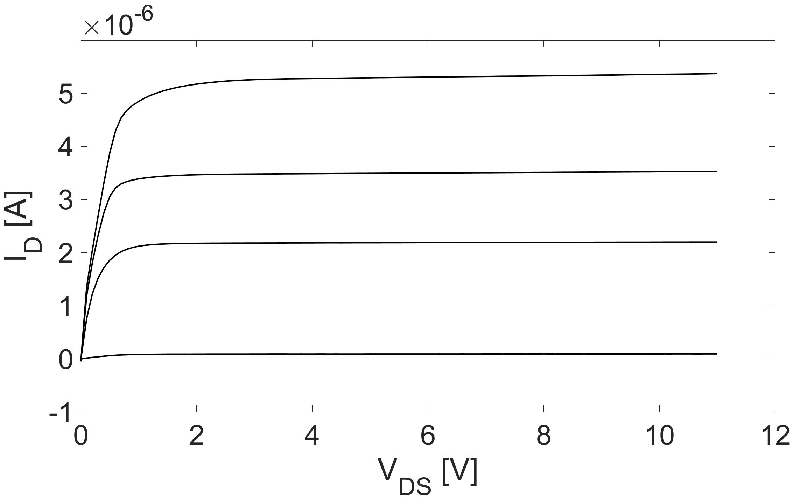
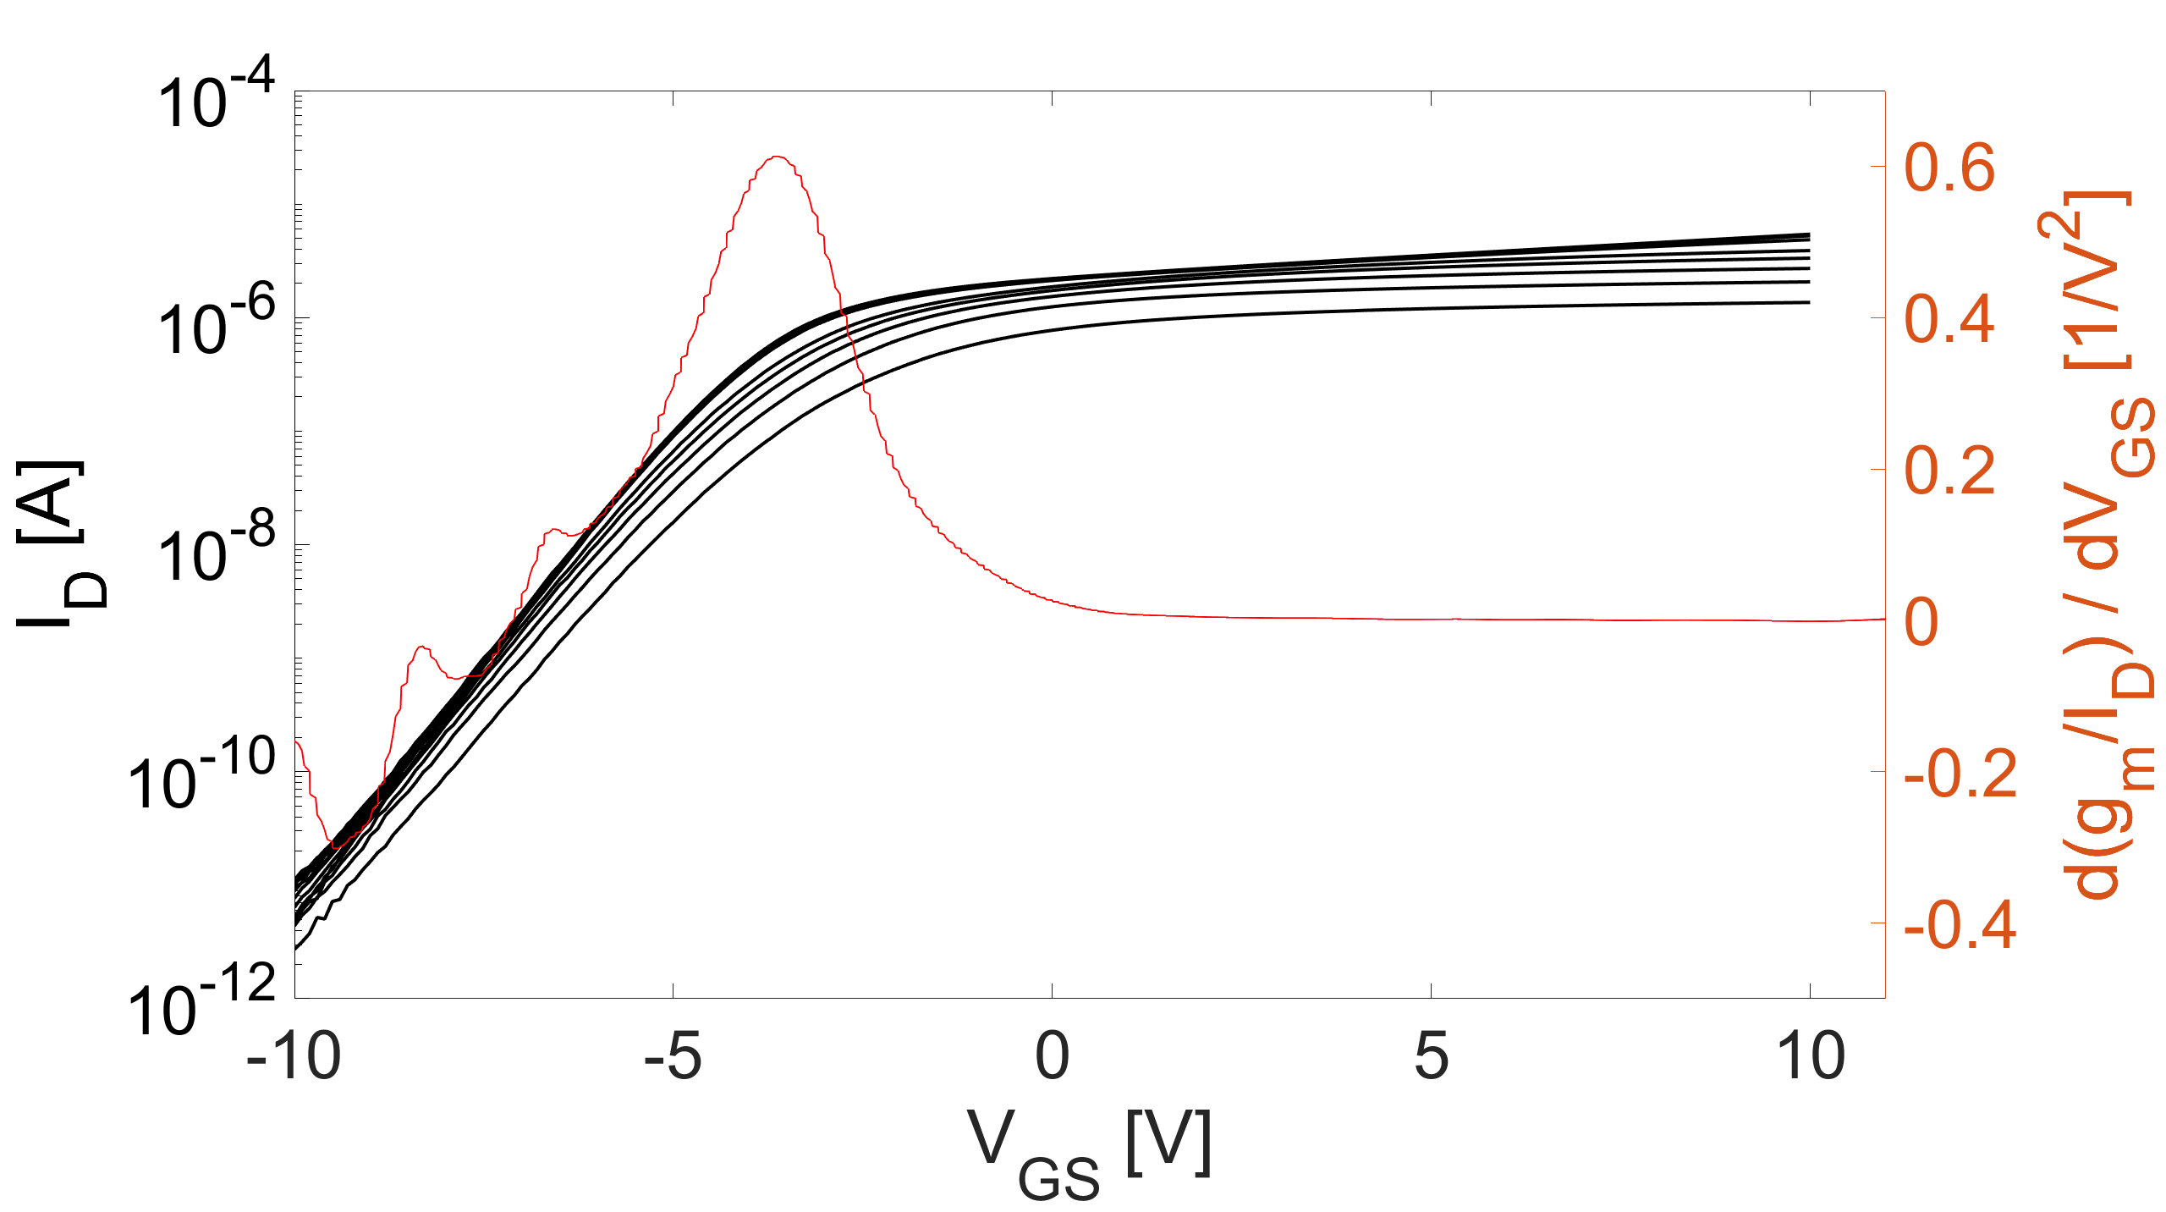
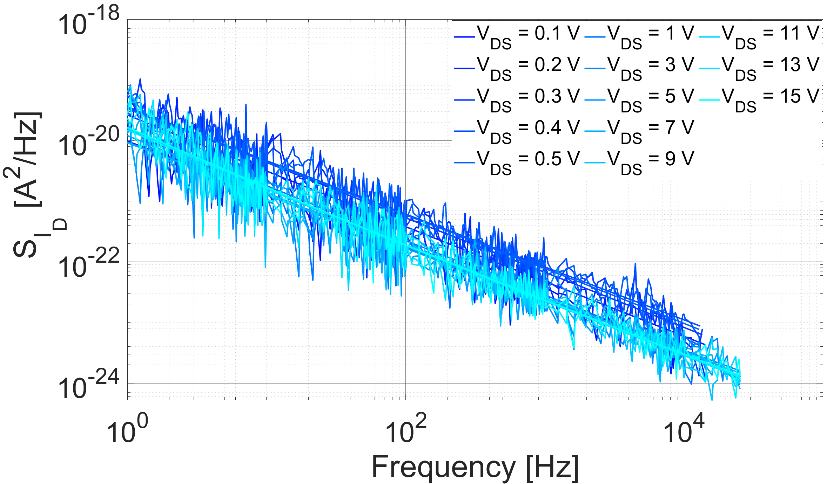
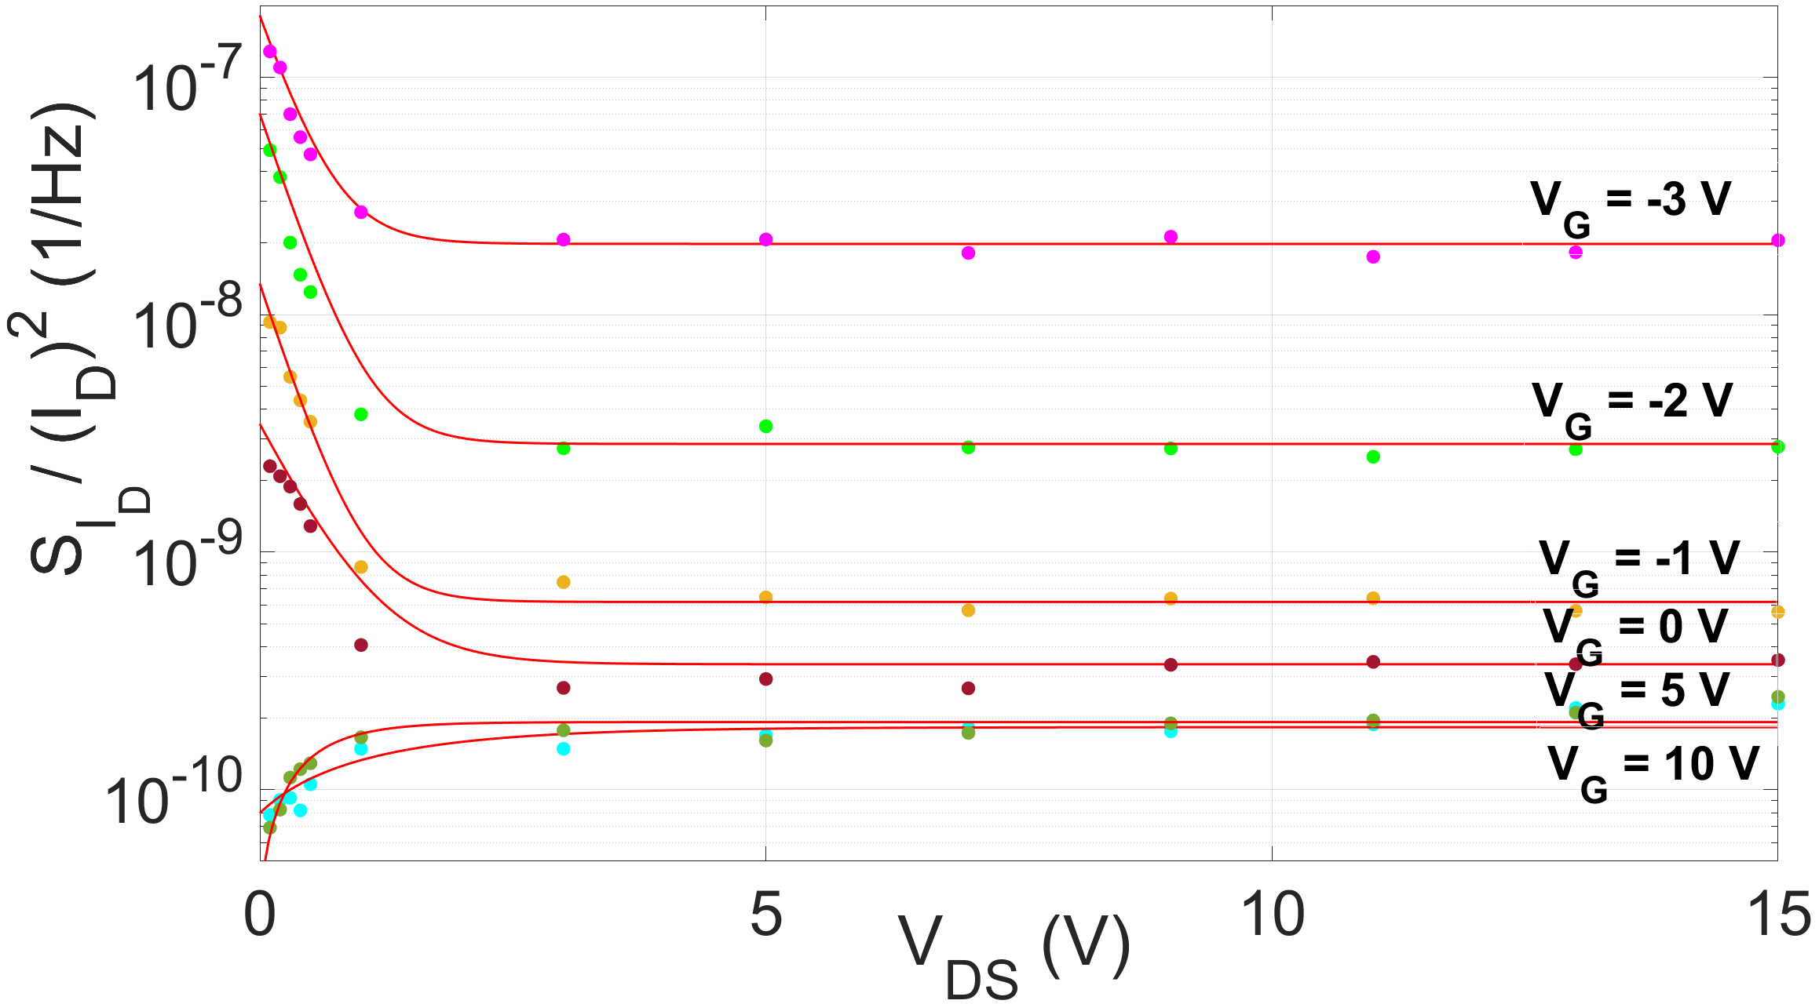
3.2. LFN in the above-threshold region of SGT configuration
Without BF2 implant
V_{GS} = 10 V
Source Length = 2 um
V_{GS} = 5 V
V_{DS} ranging from 0.1 to 15 V
Channel Length = 10 um
V_{GS} = 0 V
measurement bias points @ V_{GS} = 0 V
V_{GS} = -5 V
V_{TH} ≈ -3.6 V
Linear
Saturation
f = 10 Hz
1/f
V_{GS} = 0 V
Low-frequency Noise in Polysilicon Source-Gated Thin-Film Transistor
13
Notes:
PSD lower than the case with BF2 implant due to less defects induced by implant

Slide 14
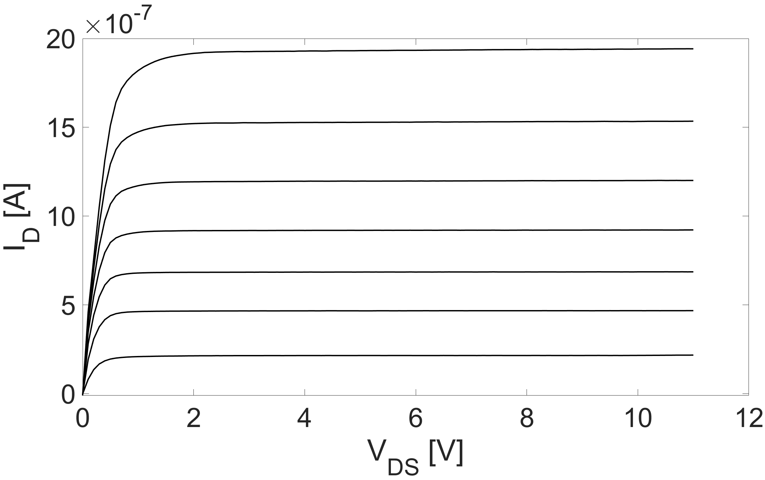
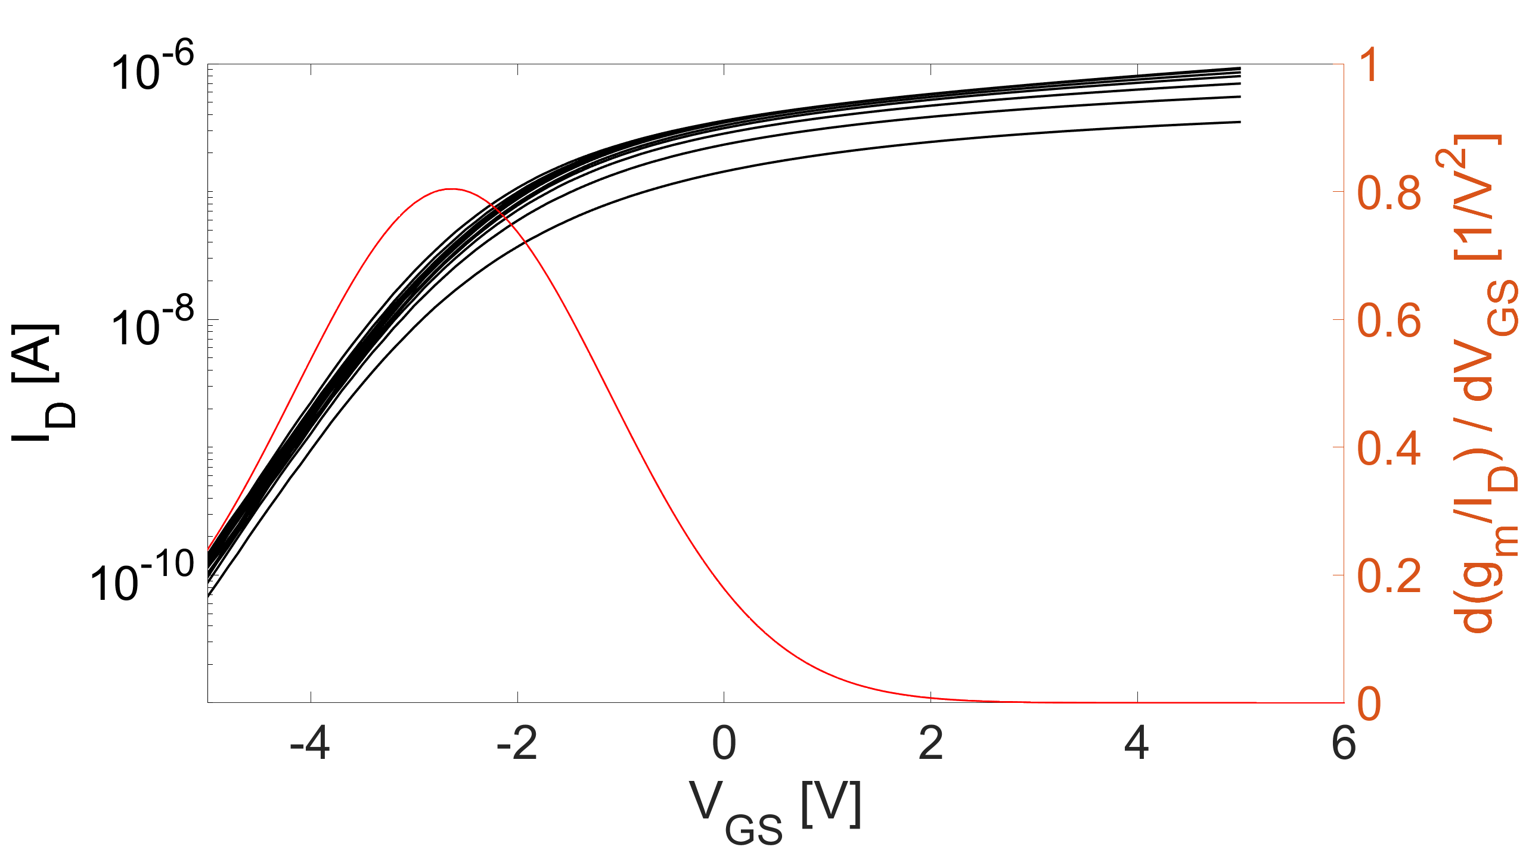
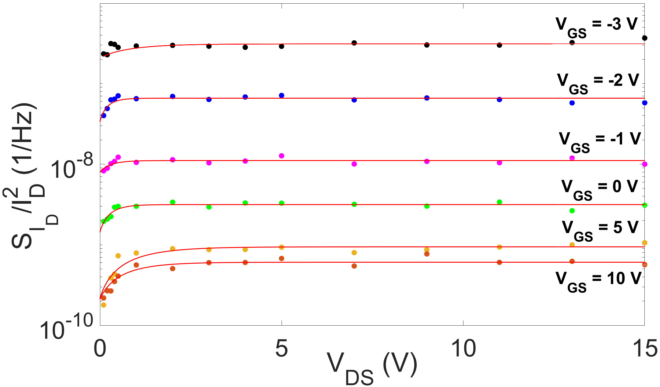
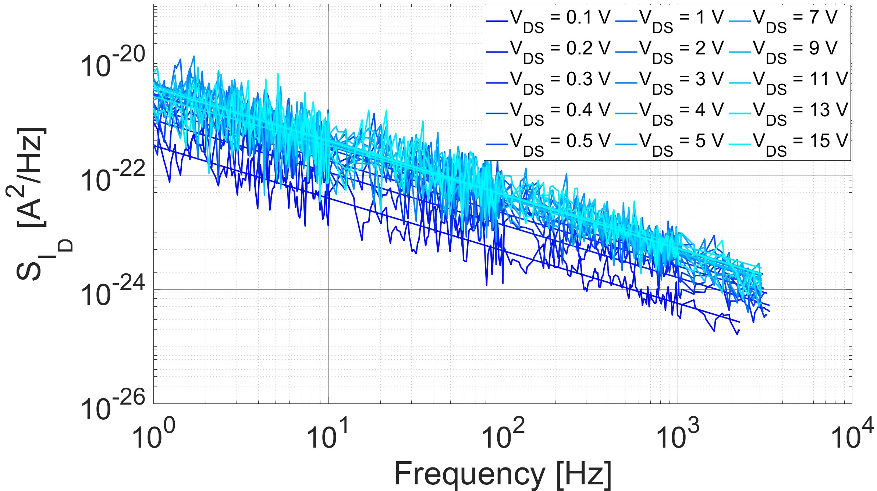
3.3. LFN in the above-threshold region of SGT configuration
Source Length = 2 um
Channel Length = 10 um
V_{DS} ranging from 0.1 to 15 V
With BF2 implant
measurement bias points @ V_{GS} = 0 V
V_{TH} ≈ -2.6 V
V_{GS} increases from -2 to 10 V, 2 V per step
Linear
Saturation
f = 10 Hz
1/f
V_{GS} = 0 V
14
Low-frequency Noise in Polysilicon Source-Gated Thin-Film Transistor

Slide 15
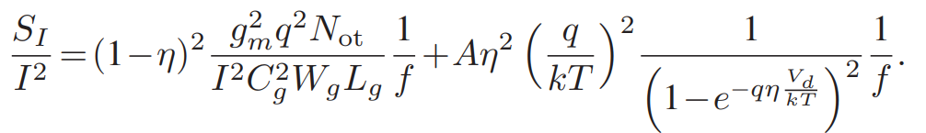
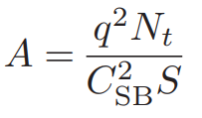


3.3. LFN model for Schottky barrier transistors
A LFN model for Schottky diodes:
CMF model
with and
Nicolas Clément et al., IEEE Trans. Electron Devices, 2012
What are different for SGTs:
In saturation region
ηV_{d}
PSD no longer depends on the drain voltage, but on the gate voltage in the saturation region!
Low-frequency Noise in Polysilicon Source-Gated Thin-Film Transistor
15

Slide 16

3.3. Dependence of LFN on gate voltage
The normalized PSD as a function of gate voltage V_{GS}
PSD in the saturation region decreases less with gate voltage than that in the linear region
No significant variation of PSD between SGT-saturation and FET-saturation
LFN has negligible dependence on V_{DS} at low V_{GS}
Source Length = 2 um
Channel Length = 10 um
With BF2 implant
f = 10 Hz
16
Low-frequency Noise in Polysilicon Source-Gated Thin-Film Transistor

Slide 17

3.4. Dependence of LFN on source length
Dependence of polysilicon SGT LFN on source length
PSD decreases with increasing source length
PSD in the saturation region decreases more than that in the linear region ？
V_{GS} = 3 V
Channel length = 10 um
With BF2 implant
f = 10 Hz
Low-frequency Noise in Polysilicon Source-Gated Thin-Film Transistor
17

Slide 18








3.5. Dependence of LFN on temperature
T = 30 ℃
T = 50 ℃
T = 70 ℃
V_{GS} ranging from 0 to 5 V
V_{GS} ranging from 0 to 5 V
V_{GS} ranging from 0 to 5 V
V_{DS} ranging from 0.1 to 15 V
V_{DS} ranging from 0.1 to 15 V
V_{DS} ranging from 0.1 to 15 V
Low-frequency Noise in Polysilicon Source-Gated Thin-Film Transistor
18

Slide 19

3.5 Dependence of LFN on temperature
Different normalized PSD as functions of V_{DS}
V_{GS} = 5 V
f = 10 Hz
T increases from 30, 50 to 70 ℃
PSD decreases with increased temperature
Low-frequency Noise in Polysilicon Source-Gated Thin-Film Transistor
19

Slide 20
4. Conclusions and perspectives
LFN of polysilicon SGT in subthreshold region
The variation of buried channel position with gate voltages in high doping case causes a second plateau in the (g_{m}/I_{D})²
Configuration | LFN Model
TFT | CMF
SGT | CMF for low I_{D} in subthreshold region
 | CNF for high I_{D} in subthreshold region
LFN of polysilicon SGT in above-threshold region
The LFN has a dependence on V_{DS} in linear region
For saturation region, V_{GS} dependence dominates the LFN
No evident difference of LFN between the SGT-saturation region and the FET-saturation region
Understanding of the physical LFN behavior and modification of LFN model for on-going work of SGT
Low-frequency Noise in Polysilicon Source-Gated Thin-Film Transistor
20

Slide 21

Thank you !
Symposium on Schottky Barrier MOS 2024 "The Schottky barrier transistor for neuromorphic applications"
21

