Slide 1
Green public procurement and the circular economy
Intra-Belgisch Platform CE - GT barrières juridiques - WG juridische belemmeringen 28 June 2024

Slide 2

Agenda
At the European level
  Hard law
  Soft law
At the Member States level
Main obstacles to achieving a circular economy in public procurement with the use of GPP
Conclusions and policy recommendations

Slide 3
At the European level – hard law
The Classic Directive, the Utilities Directive and the Concession Directive
The Energy Efficiency Directive (Article 7) – to be transposed by 11 October 2025
The Batteries Regulation (Article 85) – in application since 18 February 2024 (+ delegated acts needed)
The Packaging and Packing Waste Regulation (Article 63) – decision by EP, 1st reading, on 24 April 2024
The Construction Products Regulation (Article 83) – decision by EP, 1st reading, on 10 April 2024
The Ecodesign for Sustainable Products Regulation (Article 65) – awaiting publication in the EU Official Journal

Slide 4
At the European level – soft law
Commission working documents – extract of the overview
 | Category | Subcategory | SM | SC | TS | AC | CPC
1 | Road transport | Purchase, lease or rental of cars, LCVs and L-category vehicles | Yes | No | Yes | Yes | No
 |  | Procurement of mobility services | Yes | Yes | Yes | Yes | Yes
 |  | Purchase or lease of heavy duty vehicles | Yes | No | Yes | Yes | No
 |  | Outsourcing of public road transport services | Yes | Yes | Yes | Yes | Yes
 |  | Procurement of post, courier and moving services | Yes | Yes | Yes | Yes | Yes
2 | Road lighting and traffic signals | Preliminary assessment | No | No | No | No | Yes
 |  | Design and/or installation team | No | Yes | No | No | Yes
 |  | Energy efficient lighting equipment | No | No | Yes | Yes | Yes
 |  | Low light pollution lighting equipment | No | No | Yes | Yes | Yes
 |  | Good quality and durable lighting equipment | No | No | Yes | Yes | Yes
 |  | Purchase of traffic signals | No | No | Yes | Yes | Yes

Slide 5
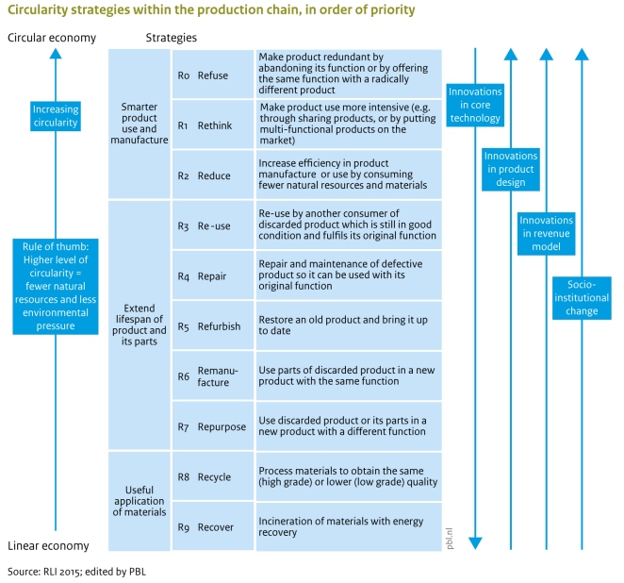
At the European level – soft law
POTTING et al., Circular economy: measuring innovation in the product chain. Policy report, January 2017, p. 5, available on: https://www.pbl.nl/uploads/default/downloads/pbl-2016-circular-economy-measuring-innovation-in-product-chains-2544.pdf

Slide 6
At the European level – soft law
Example of the road lightning and traffic signals GPP clauses
Circularity | Clause | Subcategory
R0: Refuse | CPC1. Preliminary assessment of existing lighting infrastructure and installation of dedicated metering | Preliminary assessment
R1: Rethink | TS13. Reparability | Good quality and durable lighting equipment
R2: Reduce | TS12. Product lifetime, spare parts and warranty | Good quality and durable lighting equipment
R2: Reduce | AC3. Extended Warranty | Good quality and durable lighting equipment
R2: Reduce | TS1. Life cycle cost (LCC) | Purchase of traffic signals
R2: Reduce | TS2. Product lifetime, spare parts and warranty | Purchase of traffic signals
R2: Reduce | AC1. Lowest life cycle cost | Purchase of traffic signals

Slide 7
At the European level – soft law
Example of the road lightning and traffic signals GPP clauses
Circularity | Clause | Subcategory
R2: Reduce | AC2. Extended warranty | Purchase of traffic signals
R4: Repair | TS13. Reparability | Good quality and durable lighting equipment
R4: Repair | TS12. Product lifetime, spare parts and warranty | Good quality and durable lighting equipment
R6: Remanufacture | CPC7. Commitment to waste recovery and transport to suitable sites | Good quality and durable lighting equipment
R7: Reproduce | CPC7. Commitment to waste recovery and transport to suitable sites | Good quality and durable lighting equipment
R8: Recycle | TS11. Waste recovery | Good quality and durable lighting equipment
R8: Recycle | CPC7. Commitment to waste recovery and transport to suitable sites | Good quality and durable lighting equipment

Slide 8
At the European level – soft law
Example of the road lightning and traffic signals GPP clauses
Circularity | Clause | Subcategory
R9: Recover | TS11. Waste recovery | Good quality and durable lighting equipment
R9: Recover | CPC7. Commitment to waste recovery and transport to suitable sites | Good quality and durable lighting equipment

Slide 9
At the Member States level - overview
Belgium
  Important update: MVOO-criteriatool (mvoocriteria.be) (launched in May 2024)
Italy
  New public procurement code in 2023 - art. 57, § 2
  ‘Criteri Ambientali Minimi’ – TS and CPC = mandatory
The Netherlands
  Comply or explain – art. 2.114 of the public procurement act
  Sustainable Public Procurement Webtool (mvicriteria.nl)
Spain
  Division of competences between the State and the Autonomous Communities
  Ambitious and pragmatic regulations (comply or explain)
  Several texts make direct link between GPP and the circular economy

Slide 10
At the Member States level – Italy

Slide 11
At the Member States level – Spain
Example
In the Basque Country, Article 84, § 3 of Act 10/2021, of 9 December 2021, on Environmental Administration in the Basque Country, on GPP probably inspired Article 20, paragraph 3 of the Asturias Environment Act, because it contains the same idea:
“In the drafting of the specifications of administrative clauses and specific technical prescriptions for the execution of works contracts, the percentages of by-products, secondary raw materials, recycled materials or materials from preparation processes for reuse to be used for each of them shall be indicated. The minimum percentage of use of such materials shall be 40 %, unless for justified technical reasons this percentage must be reduced.” (we underline)

Slide 12
Main obstacles to achieving a circular economy in public procurement with the use of GPP
Lack of training, information, knowledge and/or competences
Multitasking
Lack of long-term vision
Sometimes reluctance from the Inspectorate of Finance – price criteria v. quality criteria
Lack of budget
Lack of monitoring and/or control of the performance of GPP clauses
Not enough private actors – lack of competition
Legal uncertainty while innovating in circular economy
Dispersal of rules relating to public procurement

Slide 13
Conclusions and policy recommendations
Procedural guidelines aligned with what can be procured
Training and workshops about the existing tools to public purchaser
Training operational staff to better inform the public purchasers
Encourage interaction between public purchasers with basic skills and expert
Organisation of knowledge sharing
Workshops and meeting with economic operators
Involving all the relevant stakeholders to develop a solid policy around a product group / operation as a whole
If AC = price → verifiable minimum requirements (irregularity + special penalty)
Going beyond the first EU mandatory clauses with a preference for the comply or explain (/!\ division of competences)
In the SM: “circular economy approach”
Raising the issue of LCC at EU level
Developing even more the MVOOcriteria-tool (incl. special penalty clause, bonus clause and review clause)
Asking feedback from the users of the standard clause (most used, most effective, difficulties, improvment)

Slide 14
Thank you for your attention!
Steven Van Garsse (steven.vangarsse@uhasselt.be)
Jonas Voorter (jonas.voorter@uhasselt.be)
Alexander Verschave (alexander.vershave@uhasselt.be)
Maëlle Rixhon (maelle.rixhon@uhasselt.be)

