Slide 1


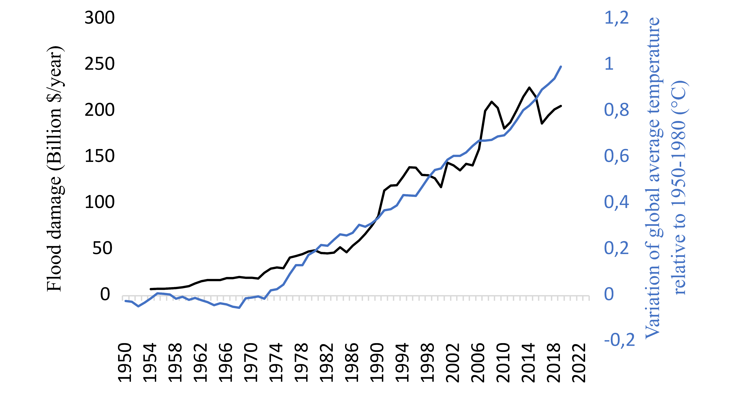
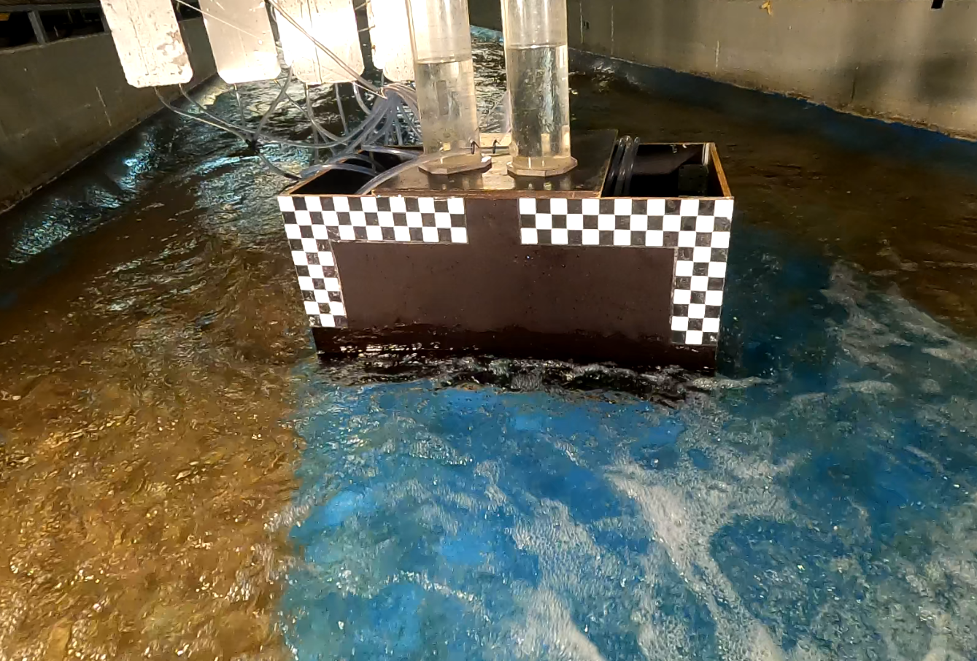
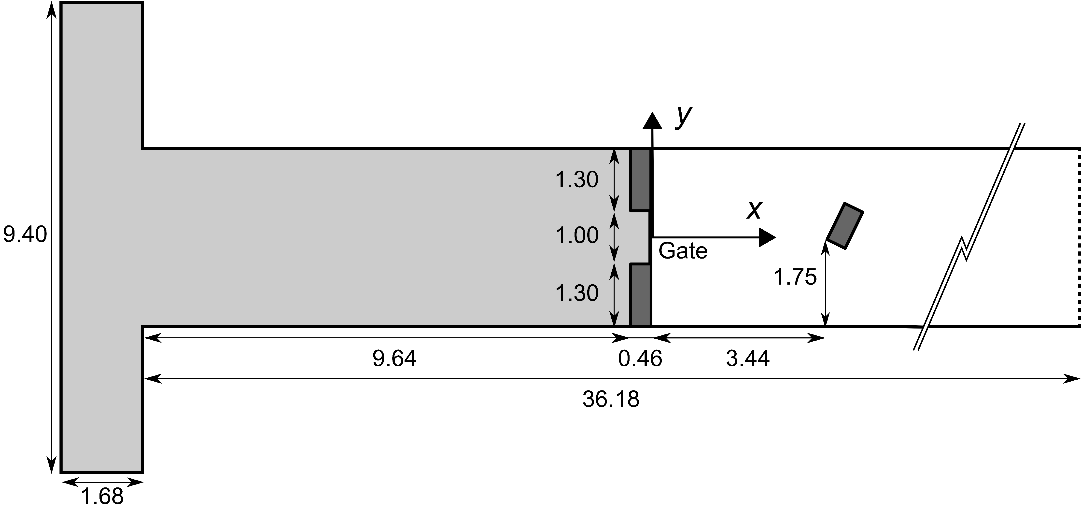
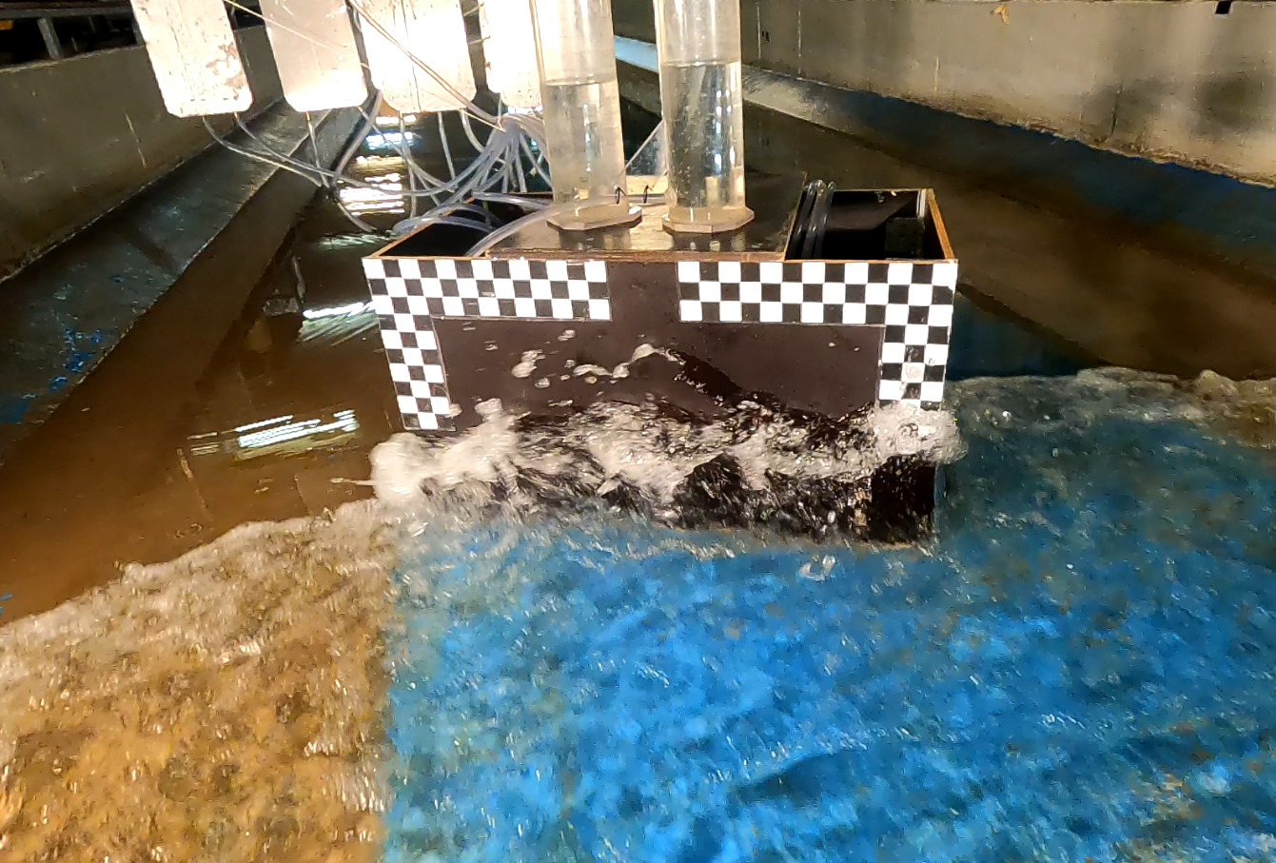
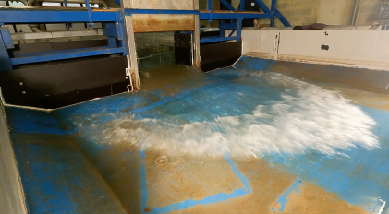

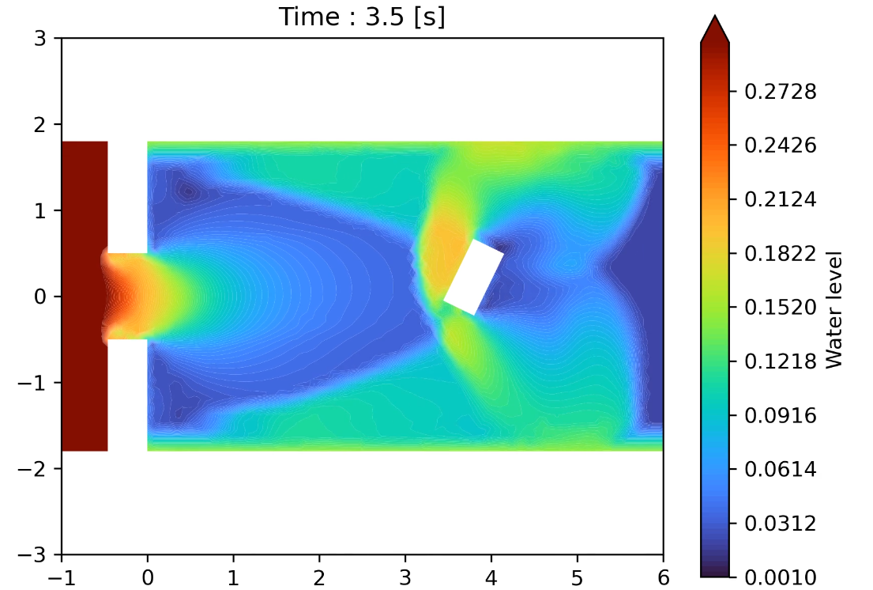
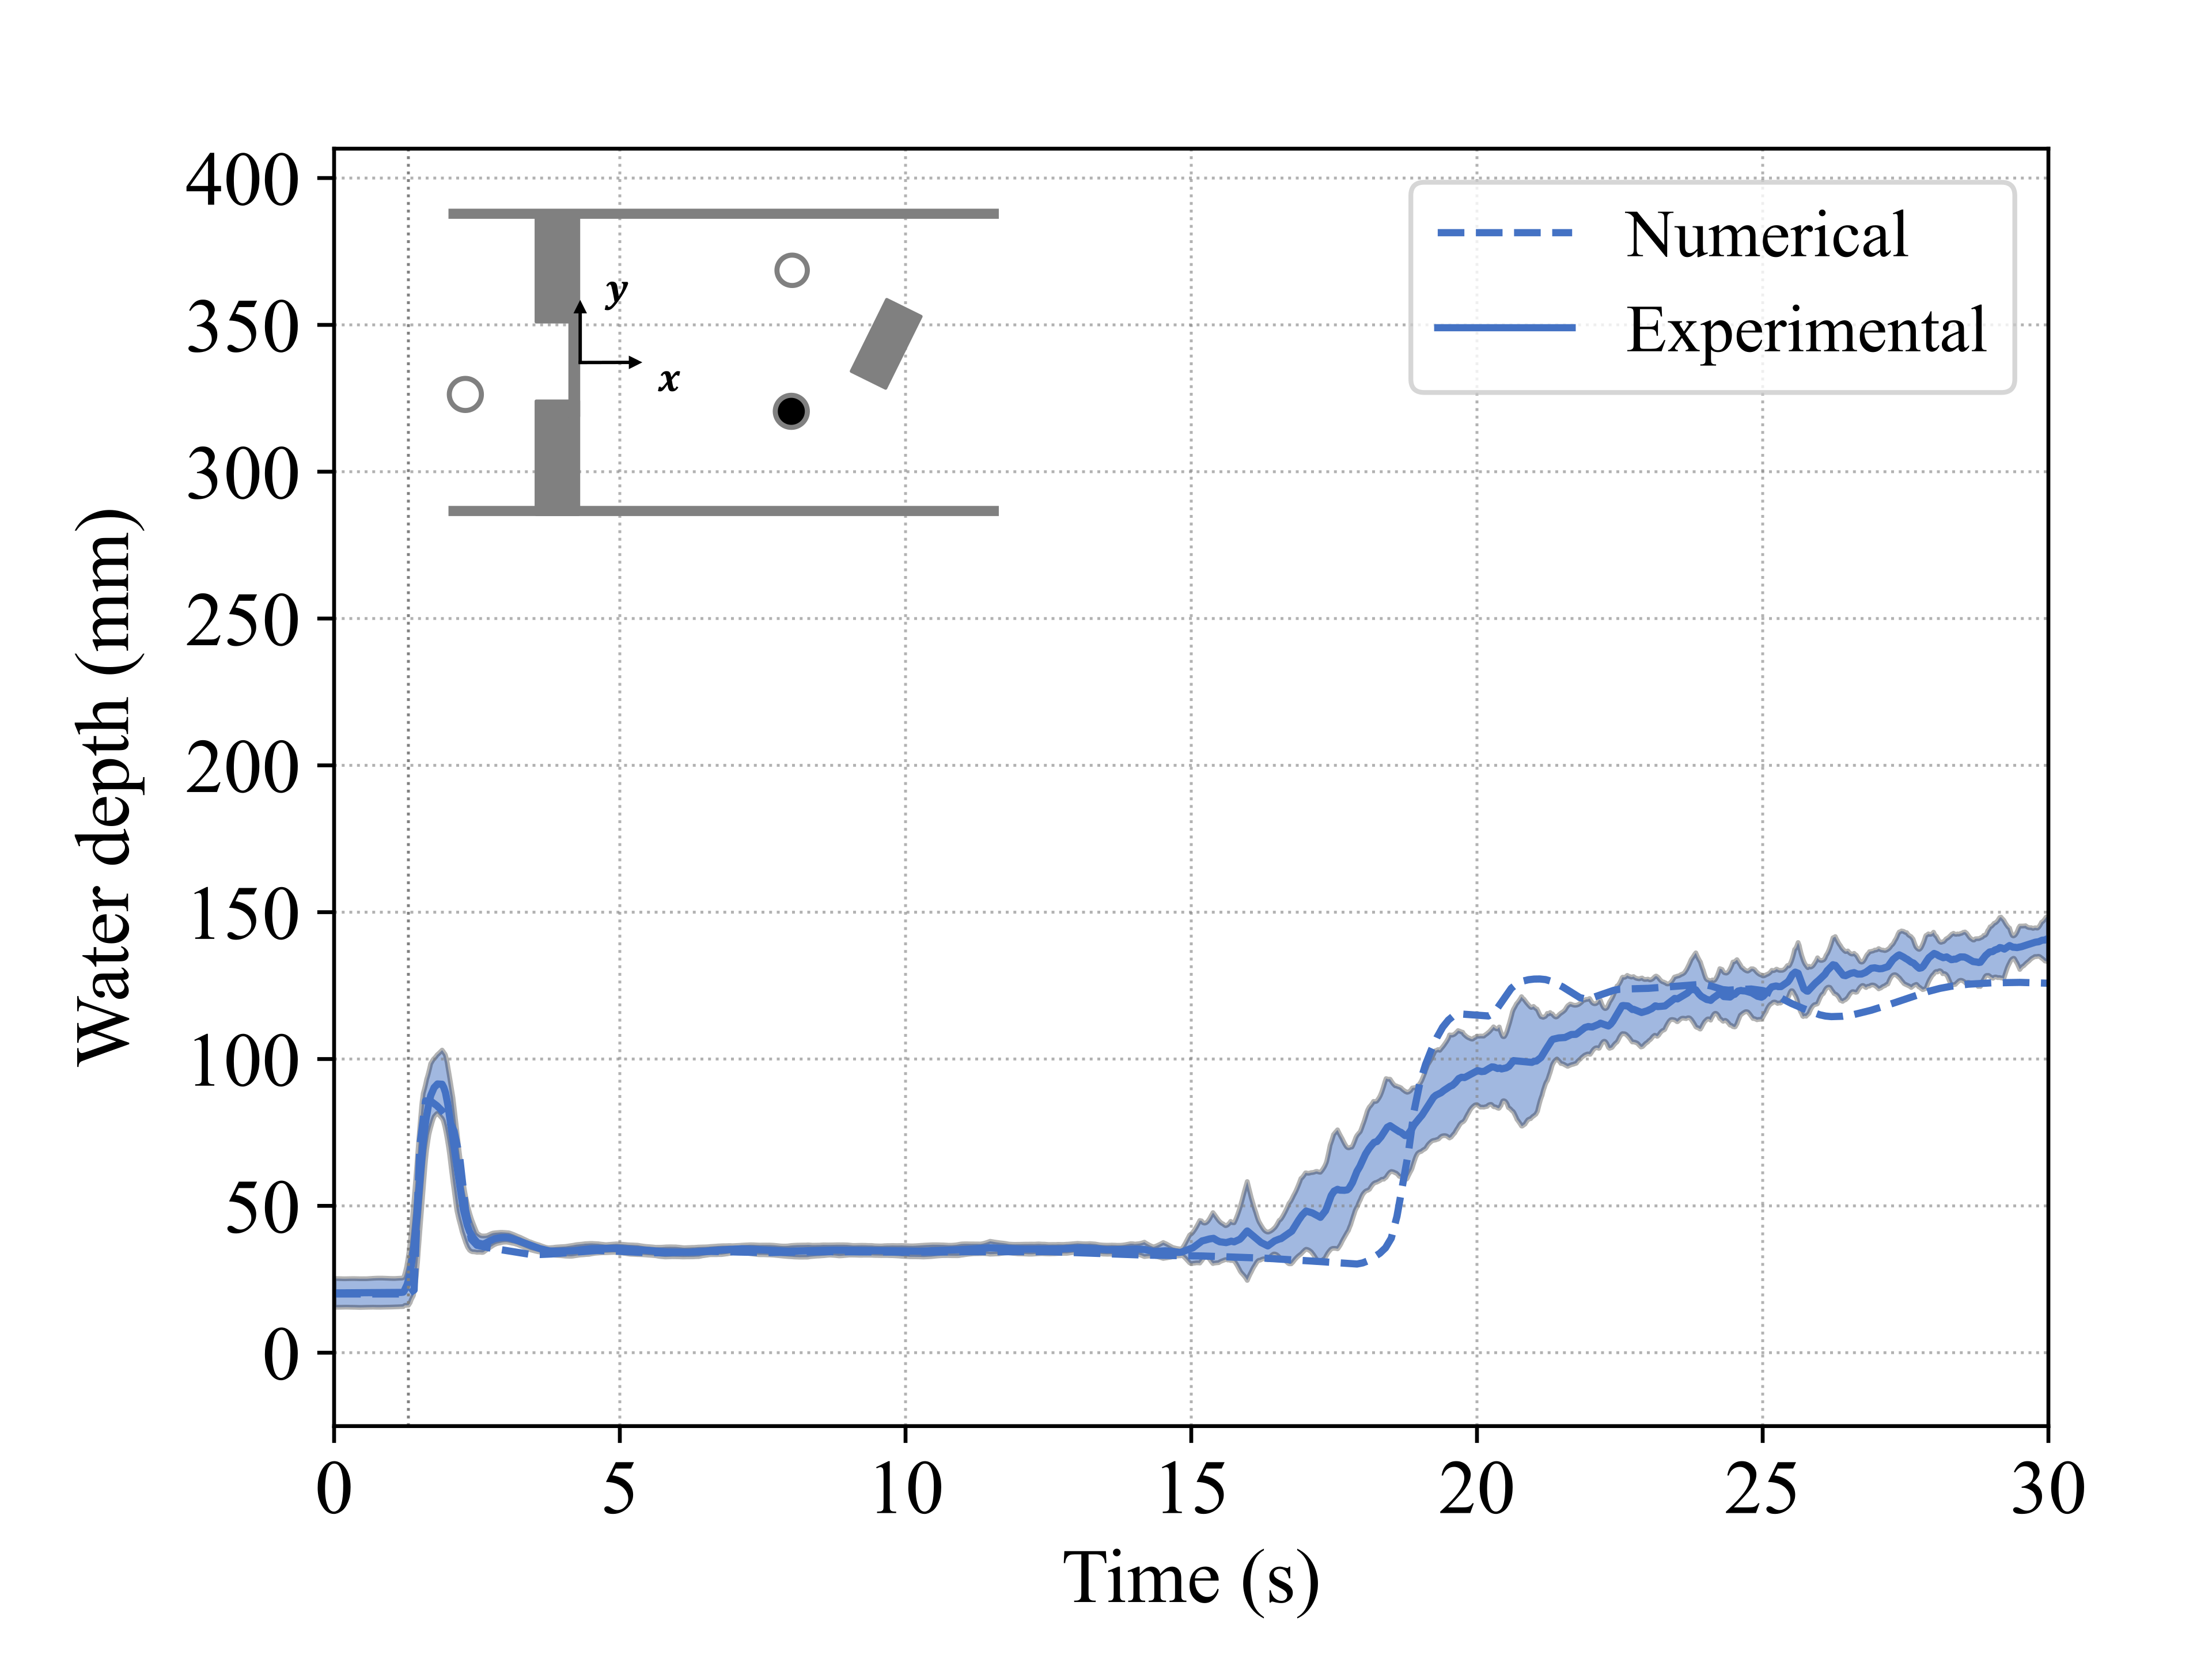
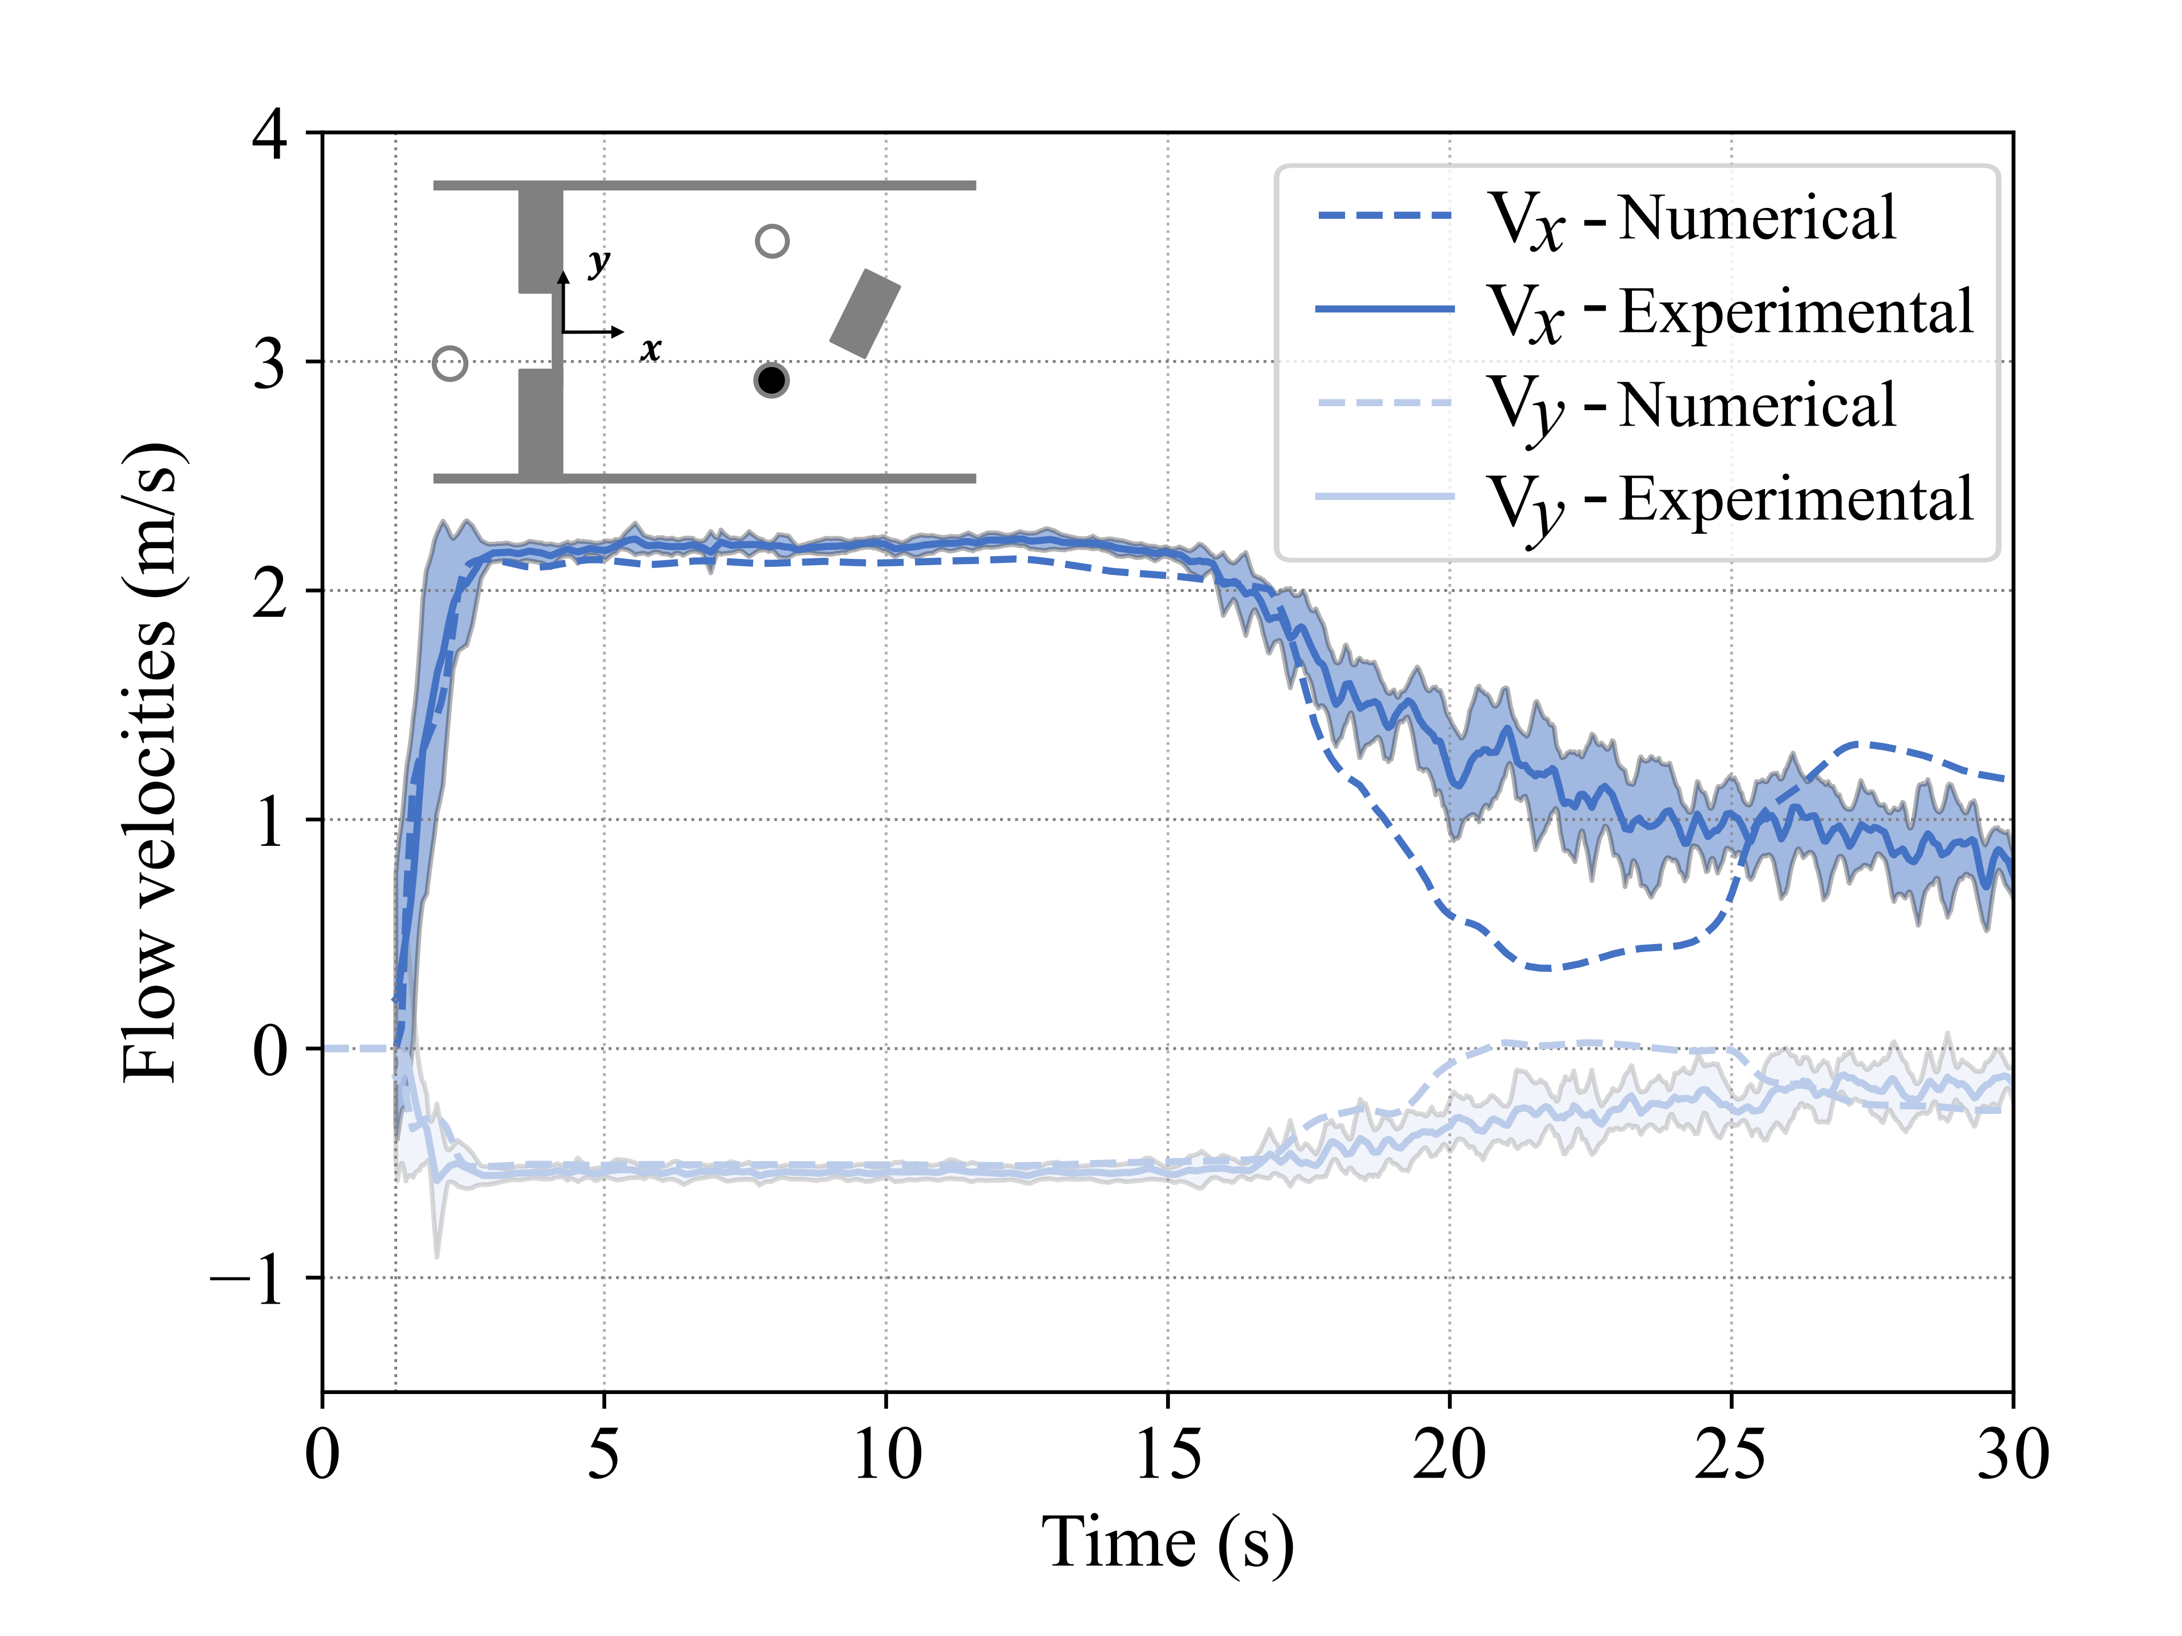
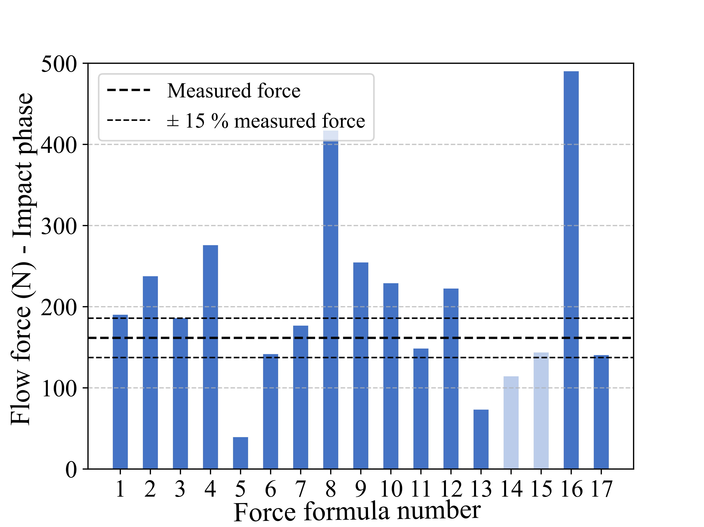
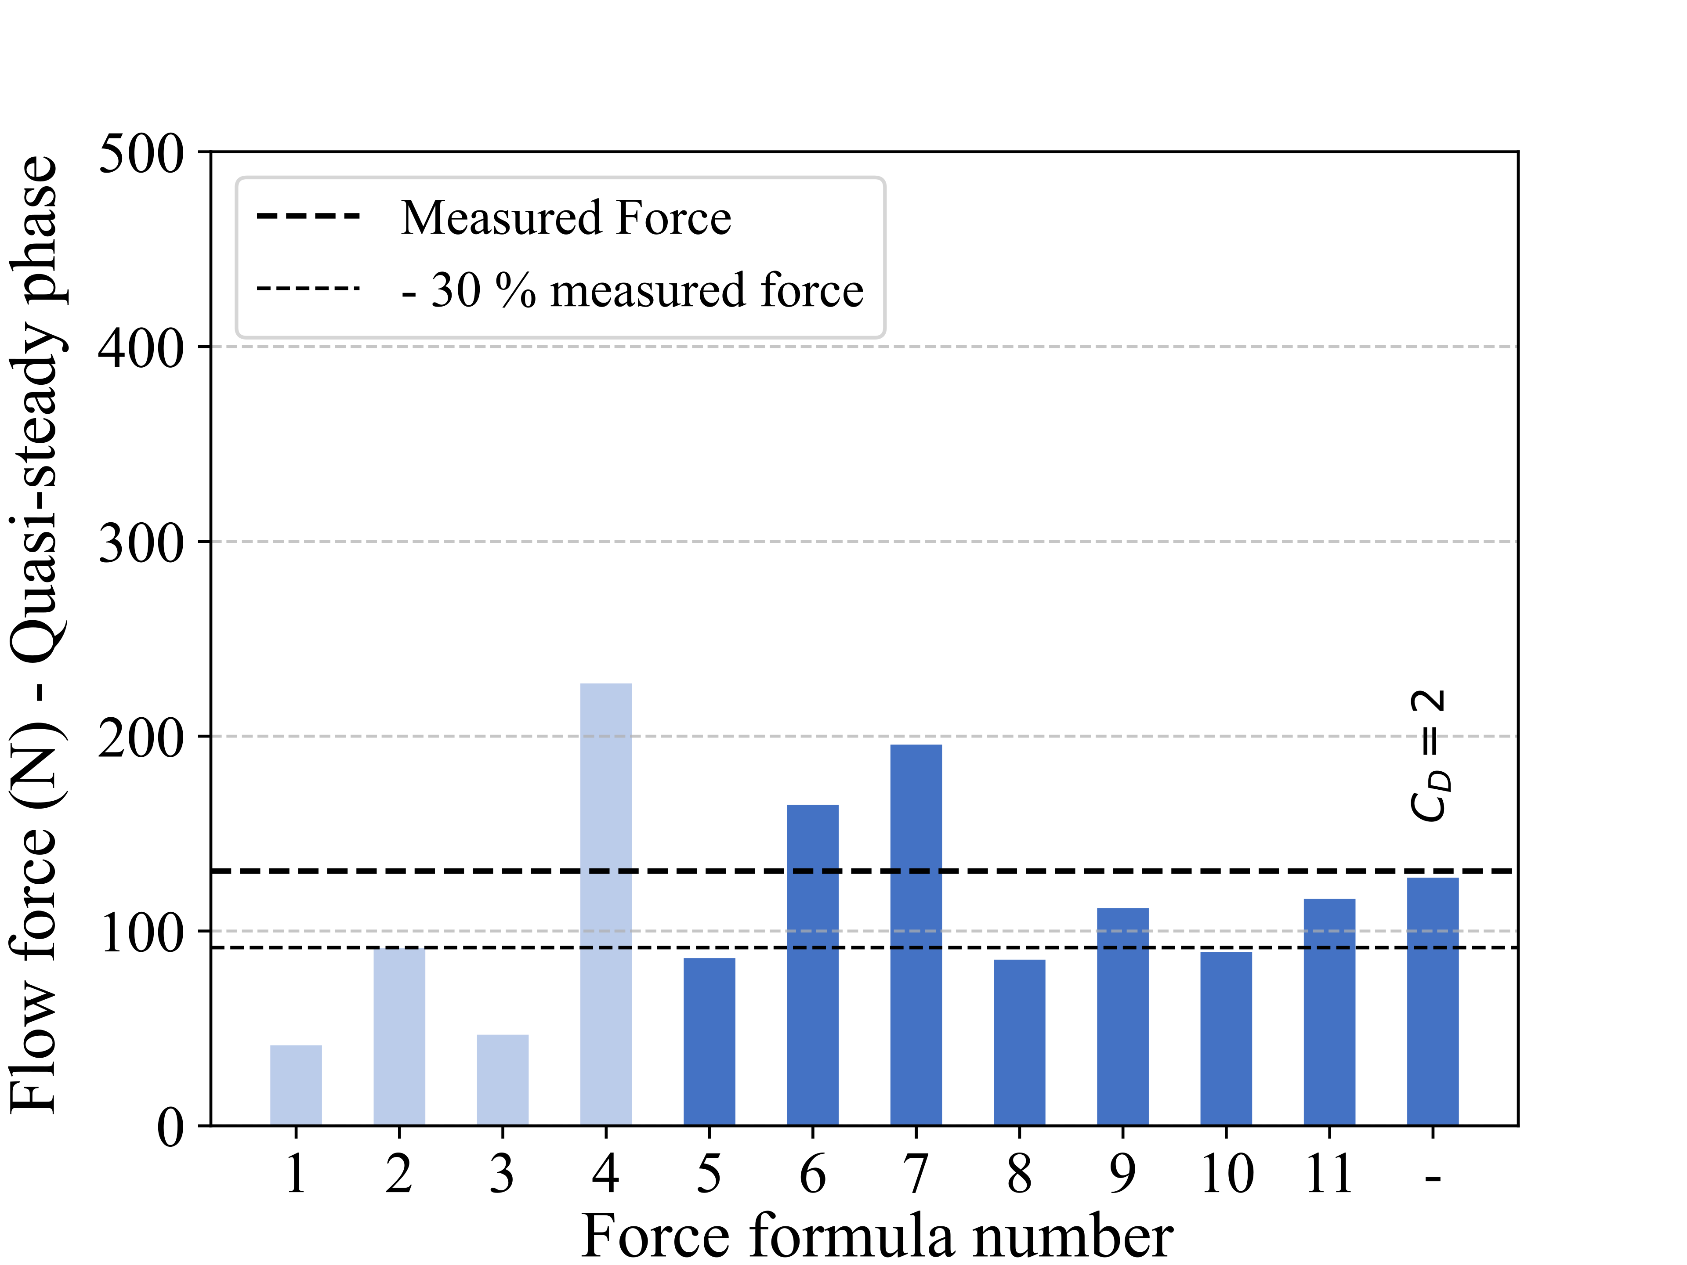
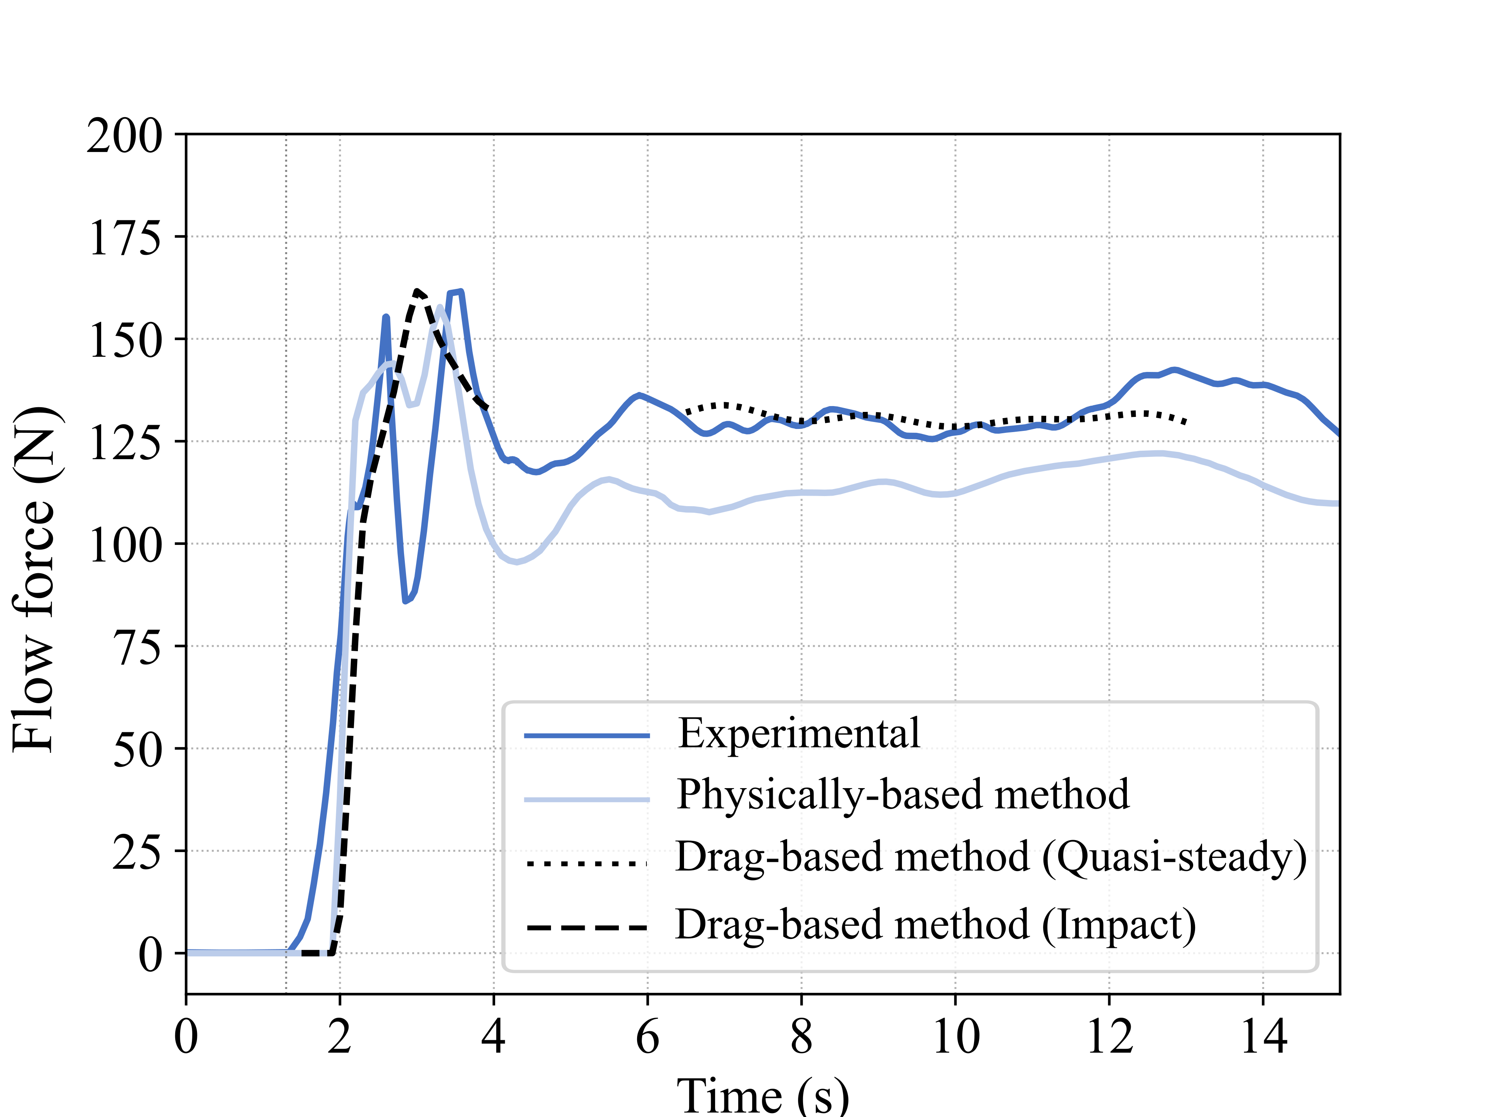



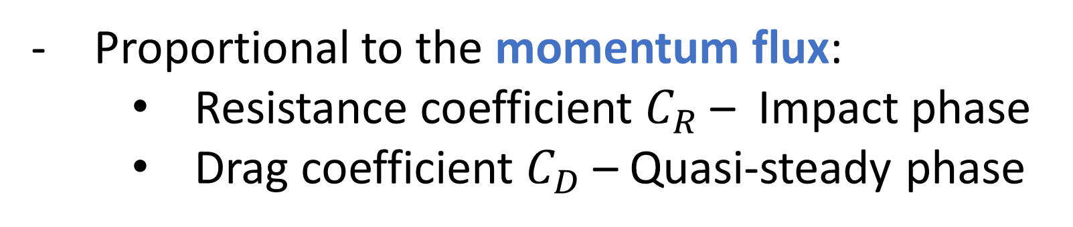
Evaluation of the hydrodynamic forces on an isolated building induced by a dam-break flow
Ryckmans Charles - Soares-Frazão Sandra
01 Context
02 Objectives
01
02
The extreme flood event that struck Belgium in July 2021 (39 casualties and €350 million in damage) highlighted a critical issue:
What causes flood damage?
Hydrostatic force
Hydrodynamic force
Debris impact
Scour
Non-physical actions
- Determine how to compute the flow force exerted on a building based on water deth and flow velocities.
Focus on flow force
- Due to global warming, the intensity and frequency of floods are expected to increase.
- Assess the ability of a 2D numerical model to accurately estimate this force.
- Buildings in Belgium are not designed to withstand flooding.
→ Builwise launched the FLOOD project, aiming to study how to construct buildings to enhance their resilience to flooding.
Quasi-steady phase
03 Experimental Setup
03
Water depth: 40 cm
Water depth: 2 cm
Dam break flow
Miniature building
Impact phase
04 Numerical model
Dimensions in m.
Measurements: water depth, flow velocities and pressures on the building.
05 Force computation
04
05
Watlab numerical simulation tool:
0.27
N° | Authors | Date
1 | Morison et al. | 1950
2 | Cumberbatch | 1960
3 | Cross | 1967
4 | Dames & Moore | 1980
5 | Fenton & Rien. | 1982
6 | Tanimoto et al. | 1984
Impact phase
Developed at UCLouvain
0.21
N° | Authors | Date
7 | Kaplan et al. | 1995
8 | Ramsden | 1996
9 | Asakura et al. | 2002
10 | Fujima et al. | 2009
11 | Armanini et al. | 2011
12 | Robertson et al. | 2013
N° | Authors | Date
13 | Mana. & Mizu. | 2013
14 | Foster et al. | 2017
15 | OCDI (1)
16 | OCDI (2)
17 | ASCE
Solving the 2D shallow-water equations
Water depth (m)
Finite-volume scheme
0.15
Unstructured mesh
0.09
06 Results
0.03
06
Quasi-steady phase
N° | Authors | Date
1 | Qi et al. | 2014
2 | Ikeya et al. | 2017
3 | Bahmanpour et al. | 2017
4 | Sturm et al. | 2018
5 | Harish et al. | 2022
N° | Authors | Date
6 | Raju and Singh | 1975
7 | Qi et al. | 2014
8 | Ikeya et al. | 2015
9 | Xie and Chu | 2019
10 | Harish et al. | 2022
11 | Mostefaoui | 2024
1. Validation of the numerical model for accurate estimation of water depth and velocities.
→ Drag-based approach
The building is either included or excluded from the mesh.
The time evolution of the force is calculated from the numerical results using two approaches:
A. Physically based
- Sum of the hydrostatic force and the momentum flux.
2. Application of the existing force formulations using numerical results.
- Refined mesh including the building.
B. Drag-based
Proportional to the momentum flux:
    Resistance coefficient $C_{R}$ – Impact phase
    Drag coefficient $C_{D}$ – Quasi-steady phase
Coarse mesh without representing the building.
3. Validation of the numerical model for accurate estimation of flow forces using both approaches.

