Slide 1
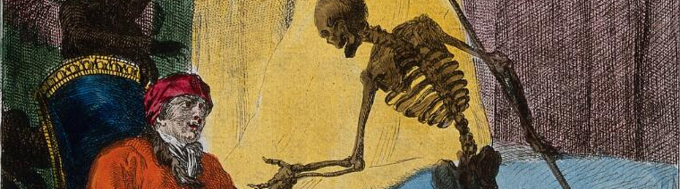



Statistics on violent causes of death from the 19th to the 21st century: challenges and contribution of the contemporary press
Audrey Plavsic
PhD student DEMO, UCLouvain
Notes:
Hello everyone, thank you for being here. I’m here to talk to you about the statistics on violent causes of death in Belgium, presenting you some challenges we can meet and what we can do with the unconventional data source contemporary press.

Slide 2
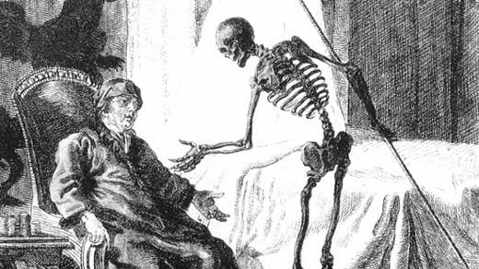
Plan
- Data collection
Aggregated data
Individual data
Use of the contemporary press
Notes:
Here is the plan of this presentation.
First I will tell you some words about the data collection, then we’ll see what we can do with the aggregated data and the individual data, and finally what use we can make of the press

Slide 3
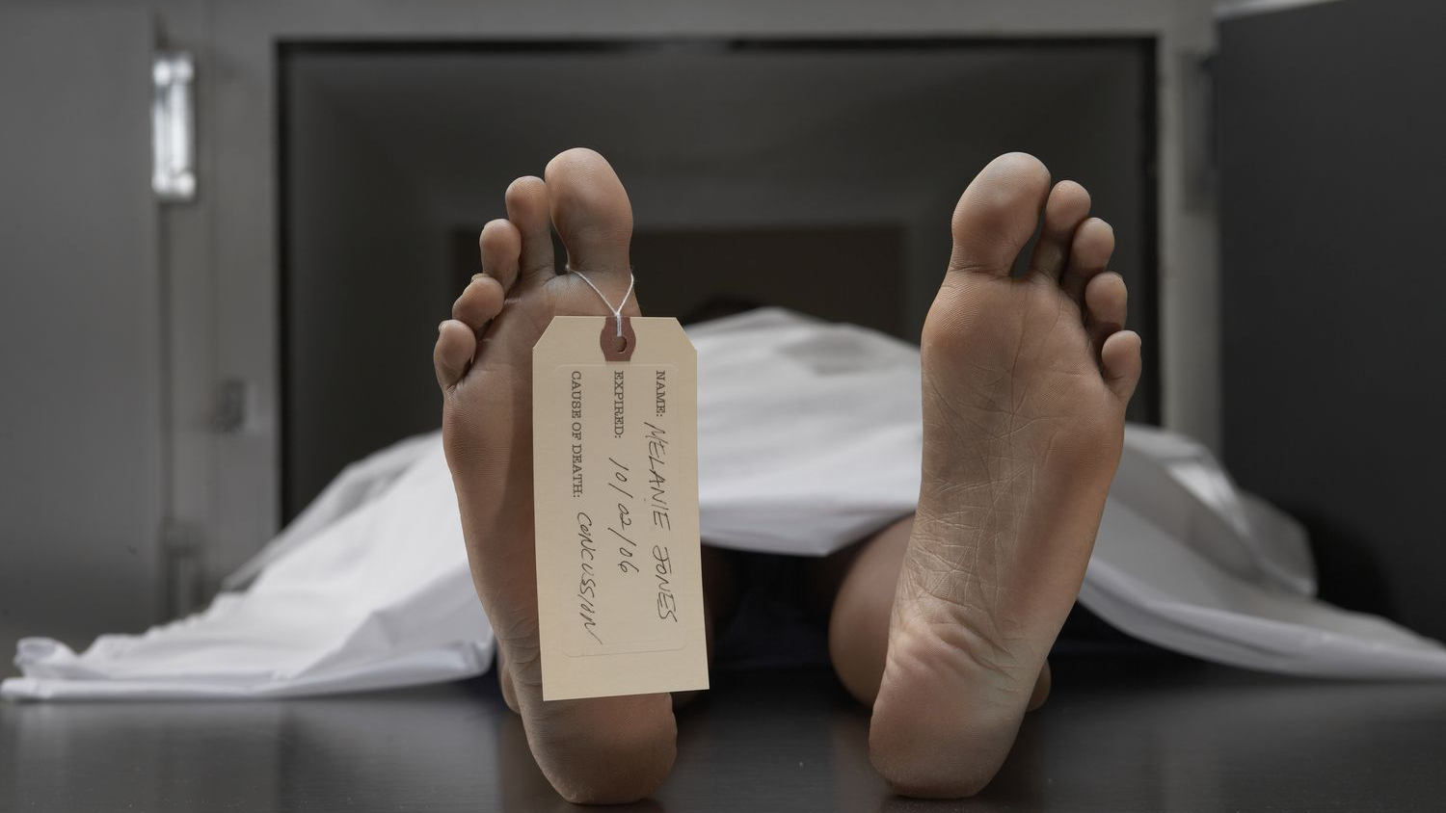
Data collection
Notes:
Let’s start with some challenges in the data collection.

Slide 4



External causes of death
= violent mortality
Homicides
Suicides
Accidents
Doubtful cases
?
Notes:
I work with external causes of death, which we also call violent mortality. It includes homicides, suicides, accidents, and doubtful cases for the death that do not clearly fall into one of the other 3 categories.

Slide 5
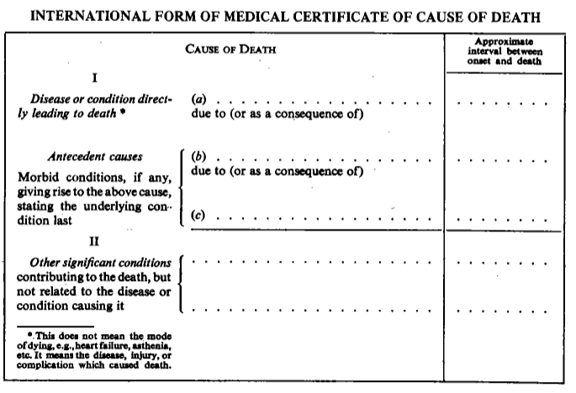
Medical certificate of cause of death
blablabla
I. sequence of events leading up to the death, working backwards from the direct cause of death in a)
II. other notable disorders that contributed to the death
5
Notes:
When someone dies, a doctor must certify the death and fill out a cause of death certificate, indicating the direct cause and the antecedent causes of the death.
To do this, they must choose from a list called the International Classification of Diseases, also known as the ICD.

Slide 6
Challenges with the data
Evolution of the International Classification of Diseases (ICD)
  179 categories in 1900 (ICD-1) to 17000 in 2019 (ICD-11)
Evolution of diagnosis methods (technology…)
Changes in medical terminology
Evolution of the population
Geographical changes in the country
Use broad rubrics and regroup data into comparable categories
Notes:
Some of the challenges we face with the data when we want to study long term trends are related to the fact that ICD evolved over time, going from 179 categories in the first version of 1900 to 17.000 categories in the latest version of 2019.
Over time diagnosis methods also evolve, with technology enabling better diagnoses.
There are also changes in medical terminology,
the population is changing,
as are geographical boundaries within the country.
That’s why we have to use broad rubrics and regroup data into comparable categories, which is a huge work.

Slide 7
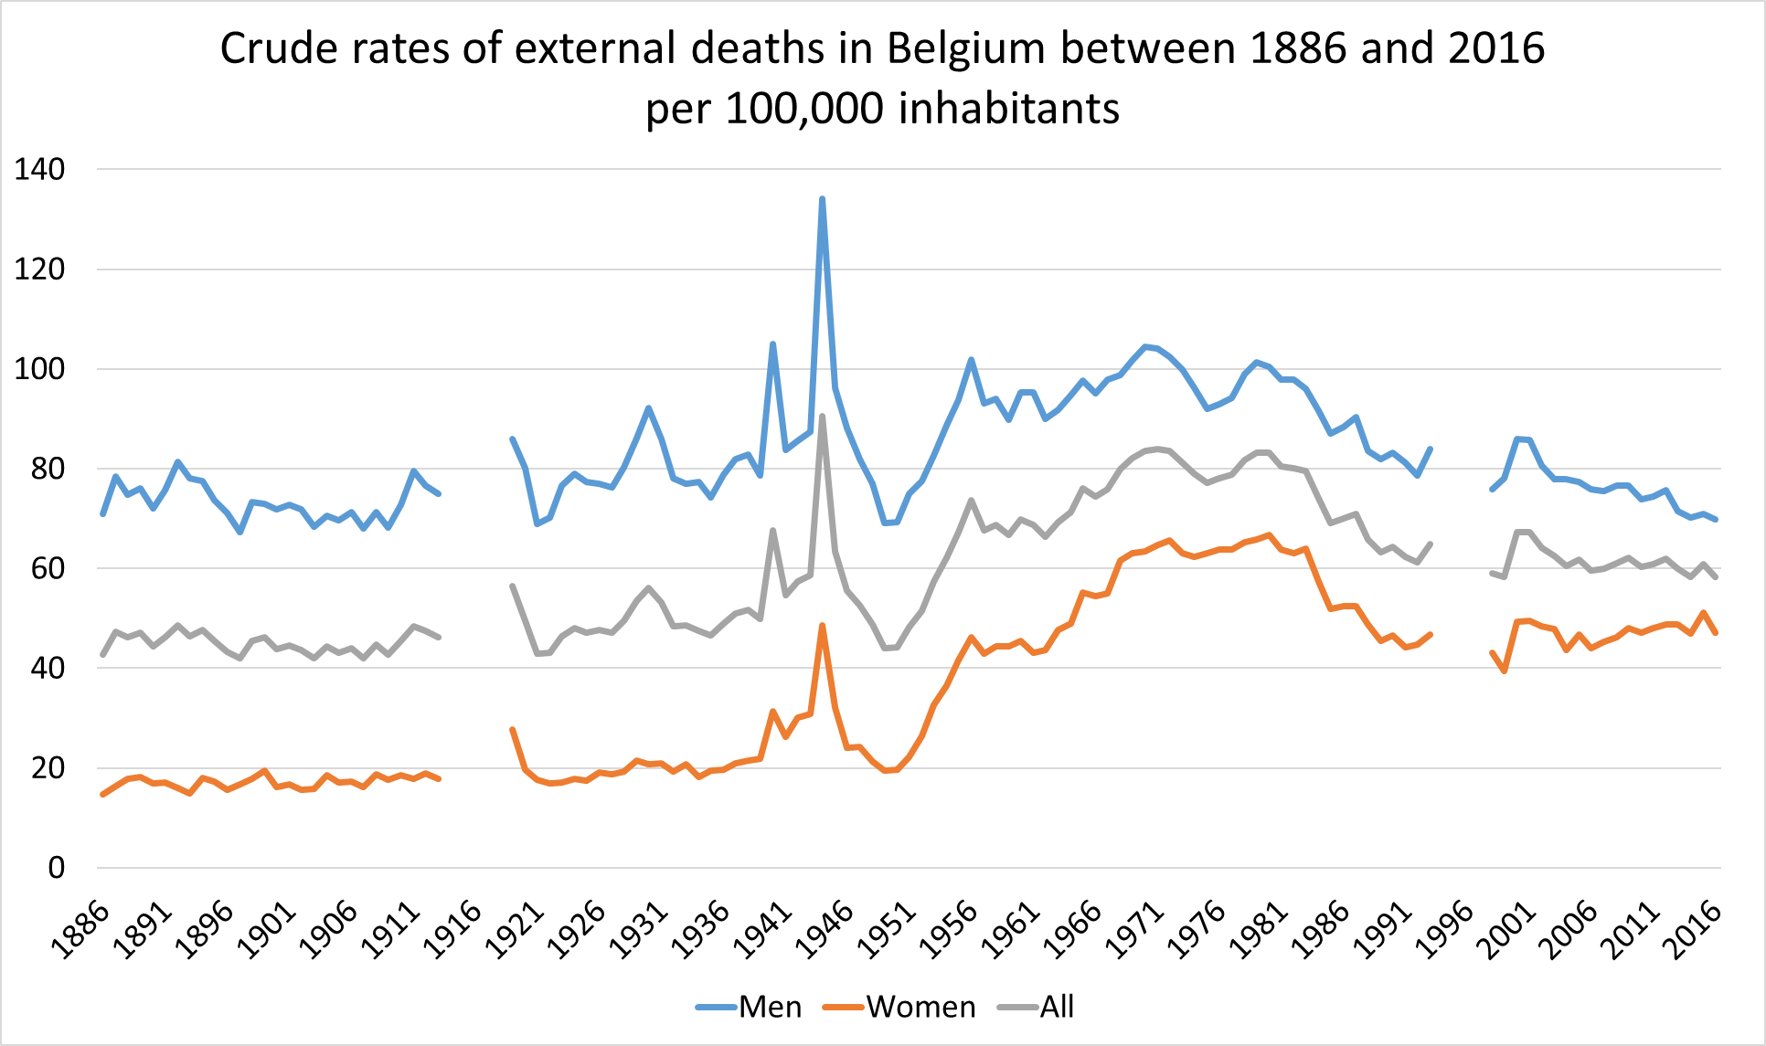
Example of impact : Major trends in external mortality
1)
2)
3)
5)
1st World War
Economic crisis
2^{d} World War
Complications of medical and surgical care introduced
ICD-7
ICD-8
ICD-9
ICD-10
4)
6)
7)
8)
(Plavsic & Van Cleemput, 2020)

Slide 8
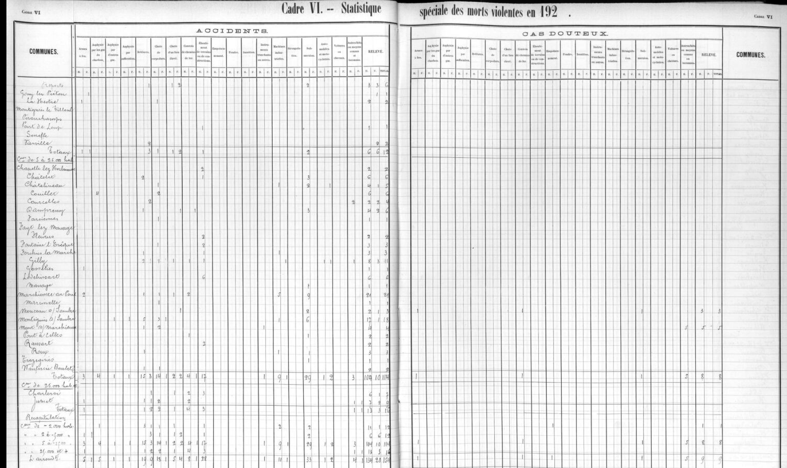
Aggregated data
Notes:
Now let’s talk about the aggregated data

Slide 9

Aggregated data
Notes:
Here is what we find in the register of the population and civil status movements. These documents are digitalised by the state archives of Belgium. Here we have a part of a table showing special statistics on violent deaths in 1921.

Slide 10
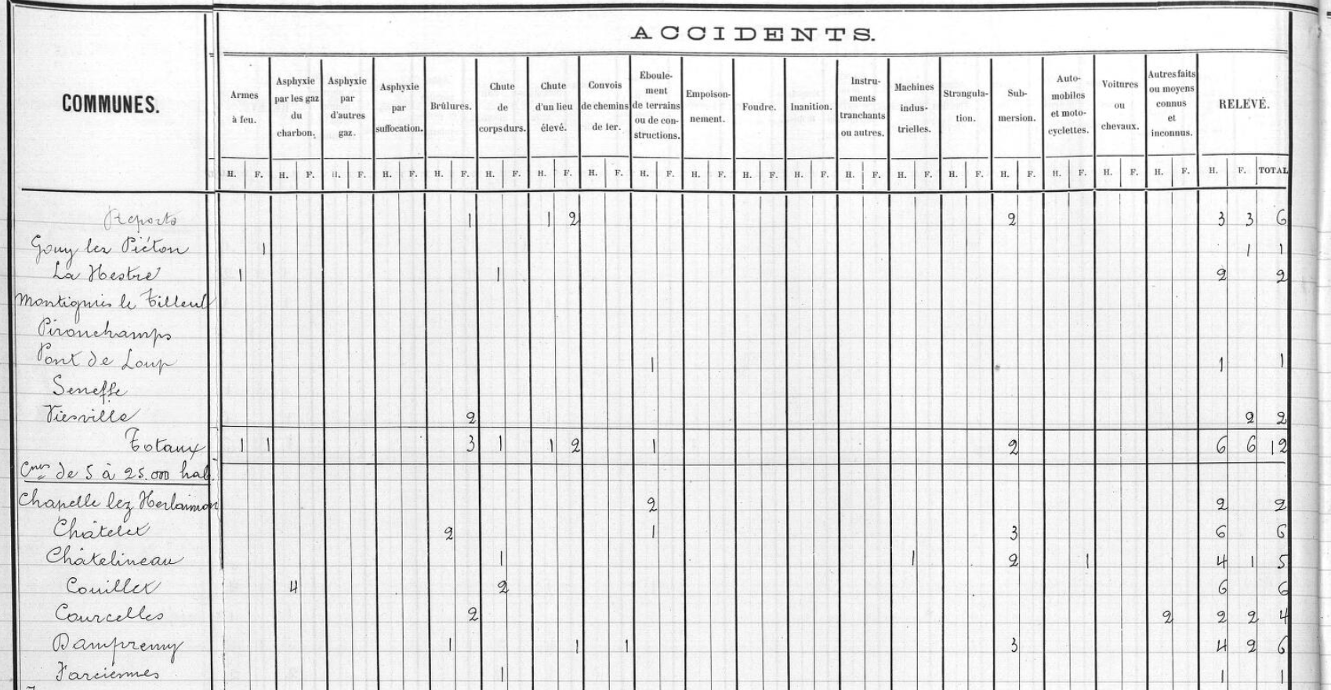
Notes:
Zooming in, you can see all the ways people can die in accidents. On the other side of the table are the municipalities. Let’s take an example: among accidental deaths in 1921, we see that in Châtelet we have 2 men died of burns. Remember this example, we’ll come back to it later.

Slide 11
External mortality among all death in Belgium (1886-2016)
(Plavsic & Van Cleemput, 2020)
Notes:
When we compile all the aggregated data, after a great deal of encoding and harmonisation work, we can obtain this kind of graph, showing, in this example, the proportion of violent deaths among all deaths in the country.

Slide 12
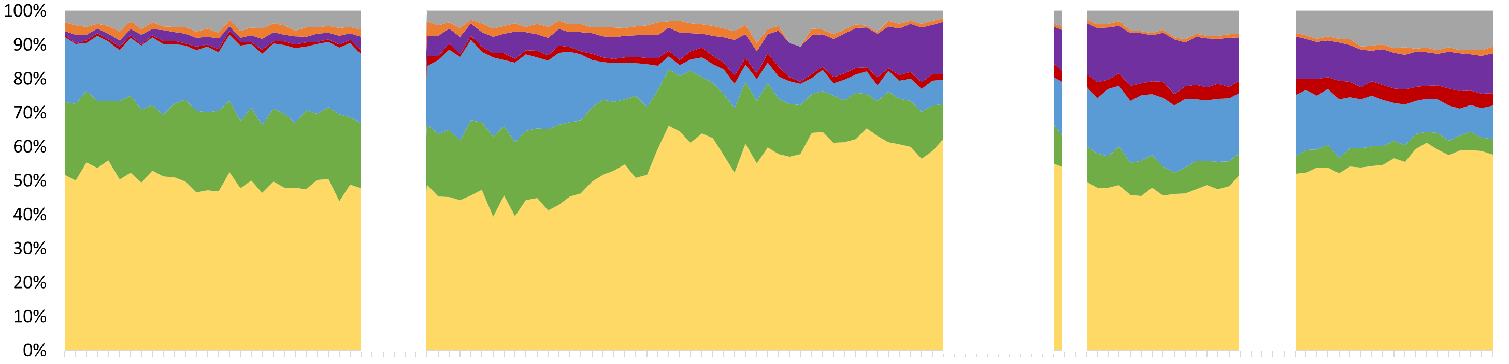
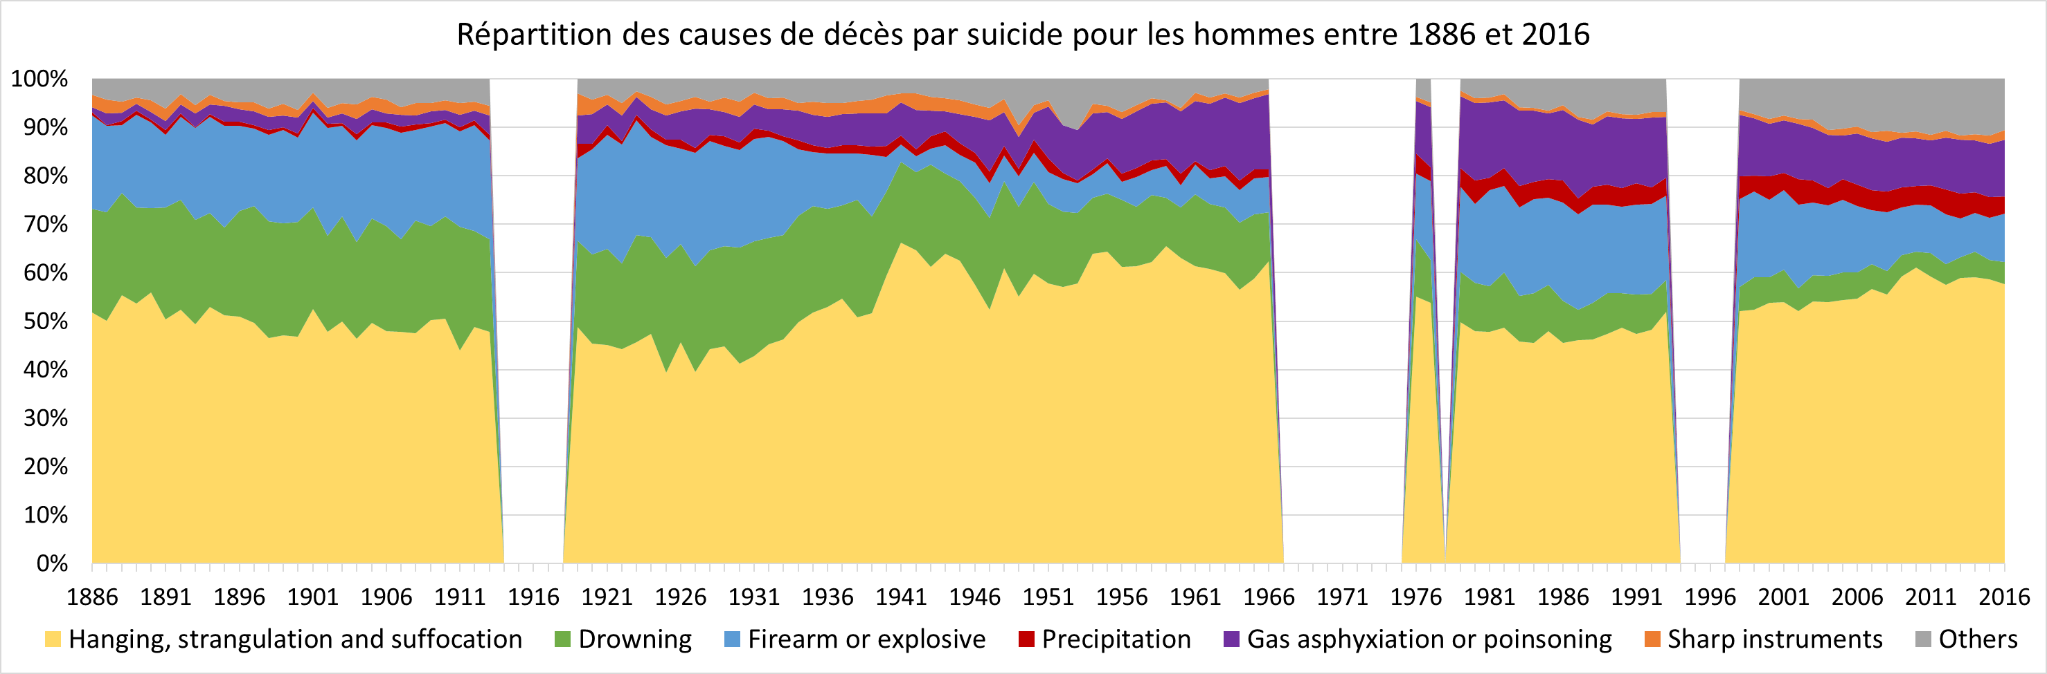
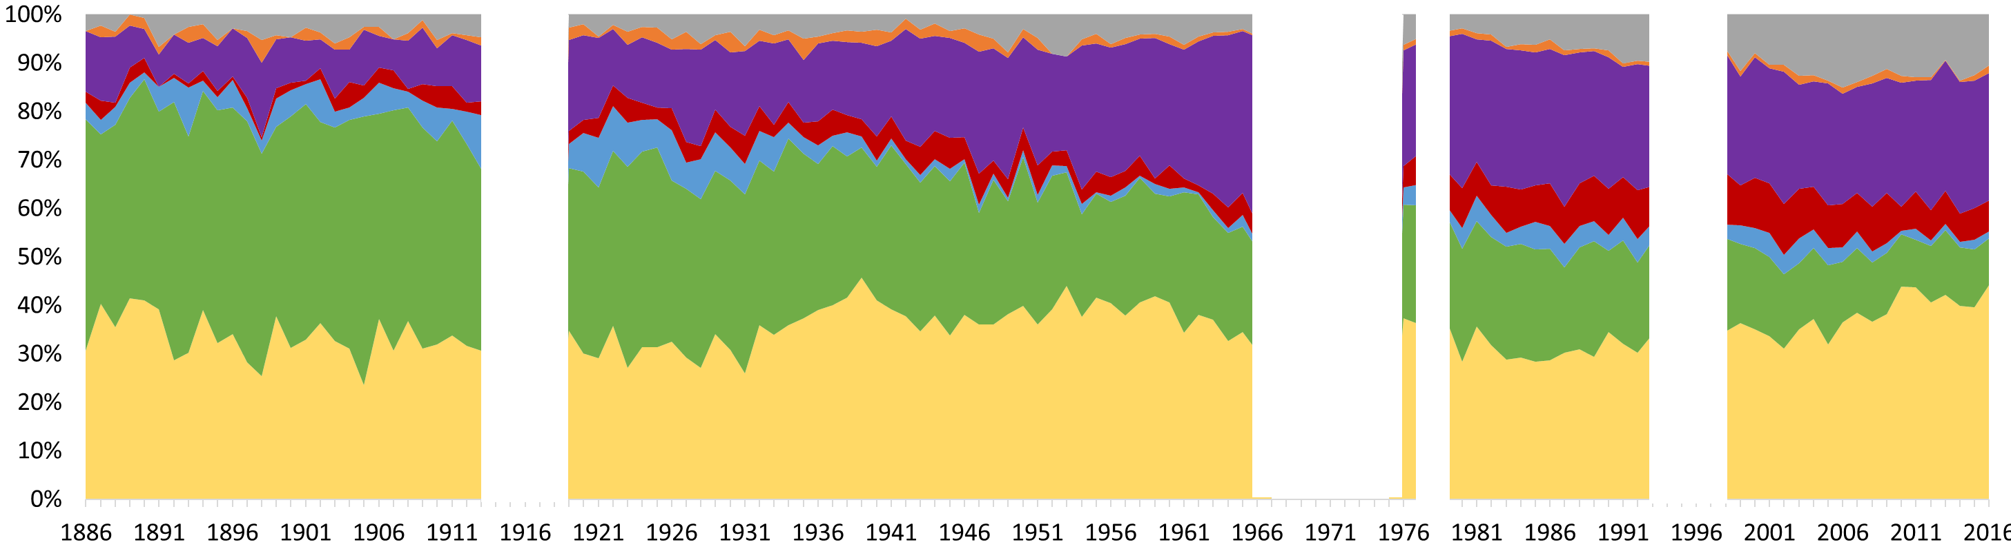
Distribution of suicides by cause in Belgium (1886-2016)
WOMEN MEN
(Plavsic & Van Cleemput, 2020)
Notes:
We can also use precise causes of death, in this example for suicides, where we can see the evolution of the different means of suicide for men and women.

Slide 13
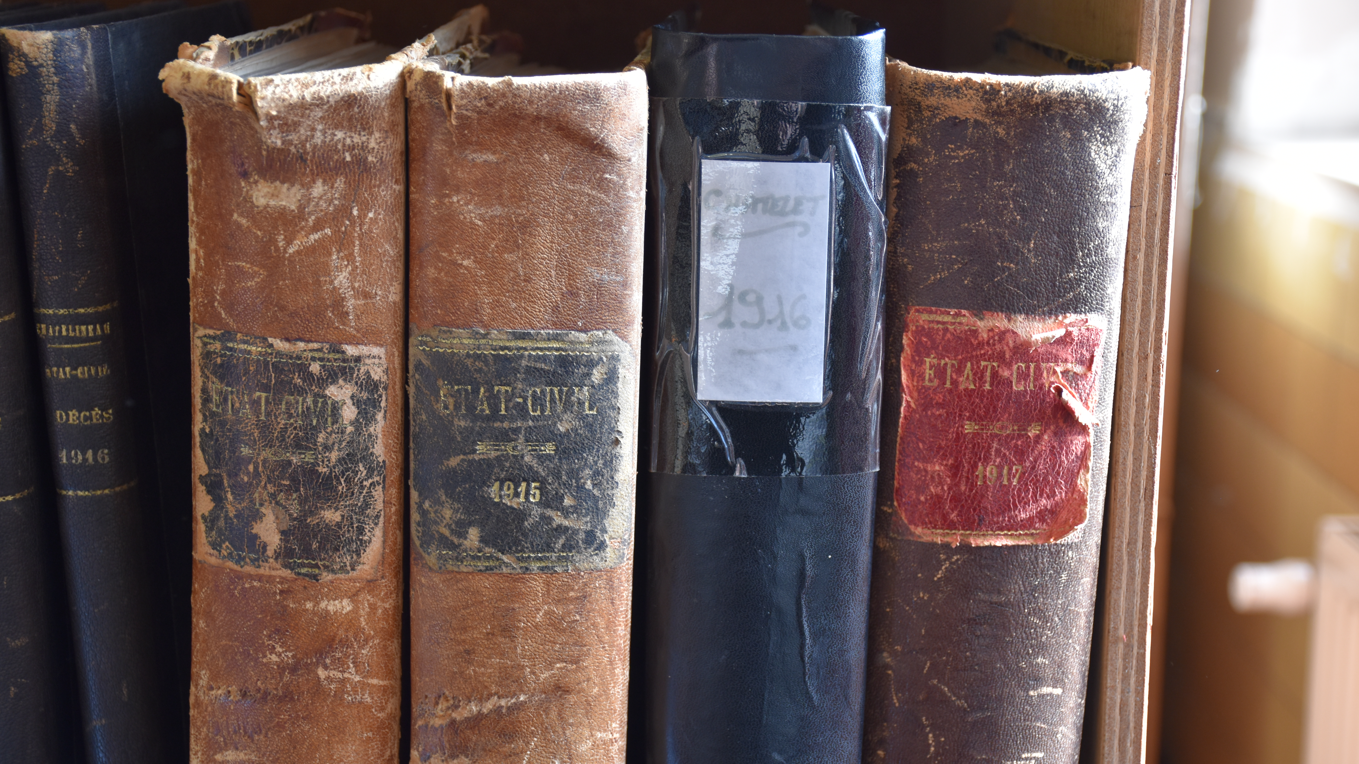
Individual data: the example of Châtelet
Notes:
Now that we’ve seen a few examples of what we can do with aggregated data, let’s look at individual data, with the city of Châtelet

Slide 14
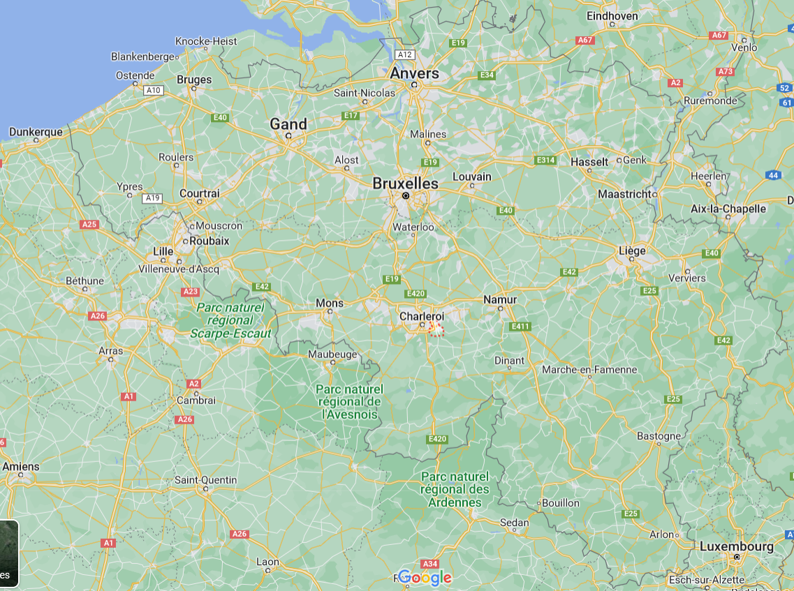
Châtelet
Notes:
Châtelet is a small town near Charleroi, in Wallonia, which currently has a population of around 35,000 inhabitants.

Slide 15
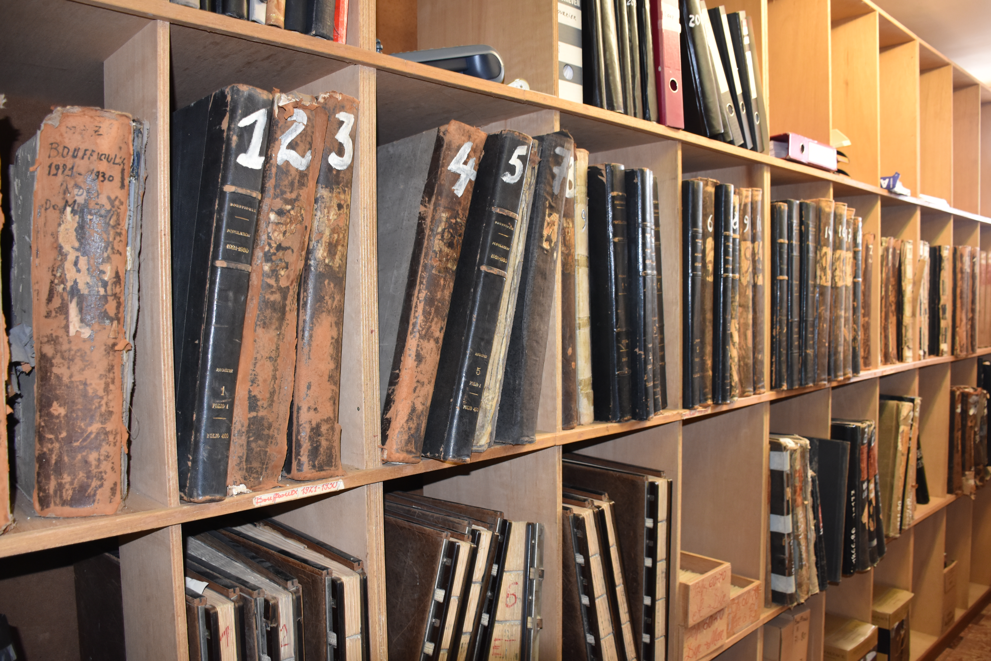
Why Châtelet ?
Exhaustive archives kept in good condition
Civil status documents, including death certificates
Registers of causes of death
Possible link between the information about every death
= identity, date of birth, marital status and address of the deceased + cause of death
Notes:
Why did we choose this place?
Because it has exhaustive archives that are kept in really good condition
They have civil status documents, including death certificates, as well as registers of causes of death.
All that enables us to link all the information concerning each person who died in this municipality.
We have information such as identity, date of birth, marital status, address and cause of death.

Slide 16
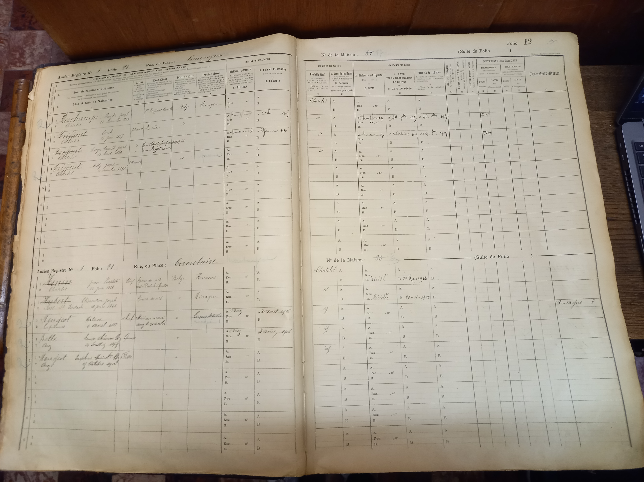
Population register
Notes:
Let’s start with the population register…

Slide 17
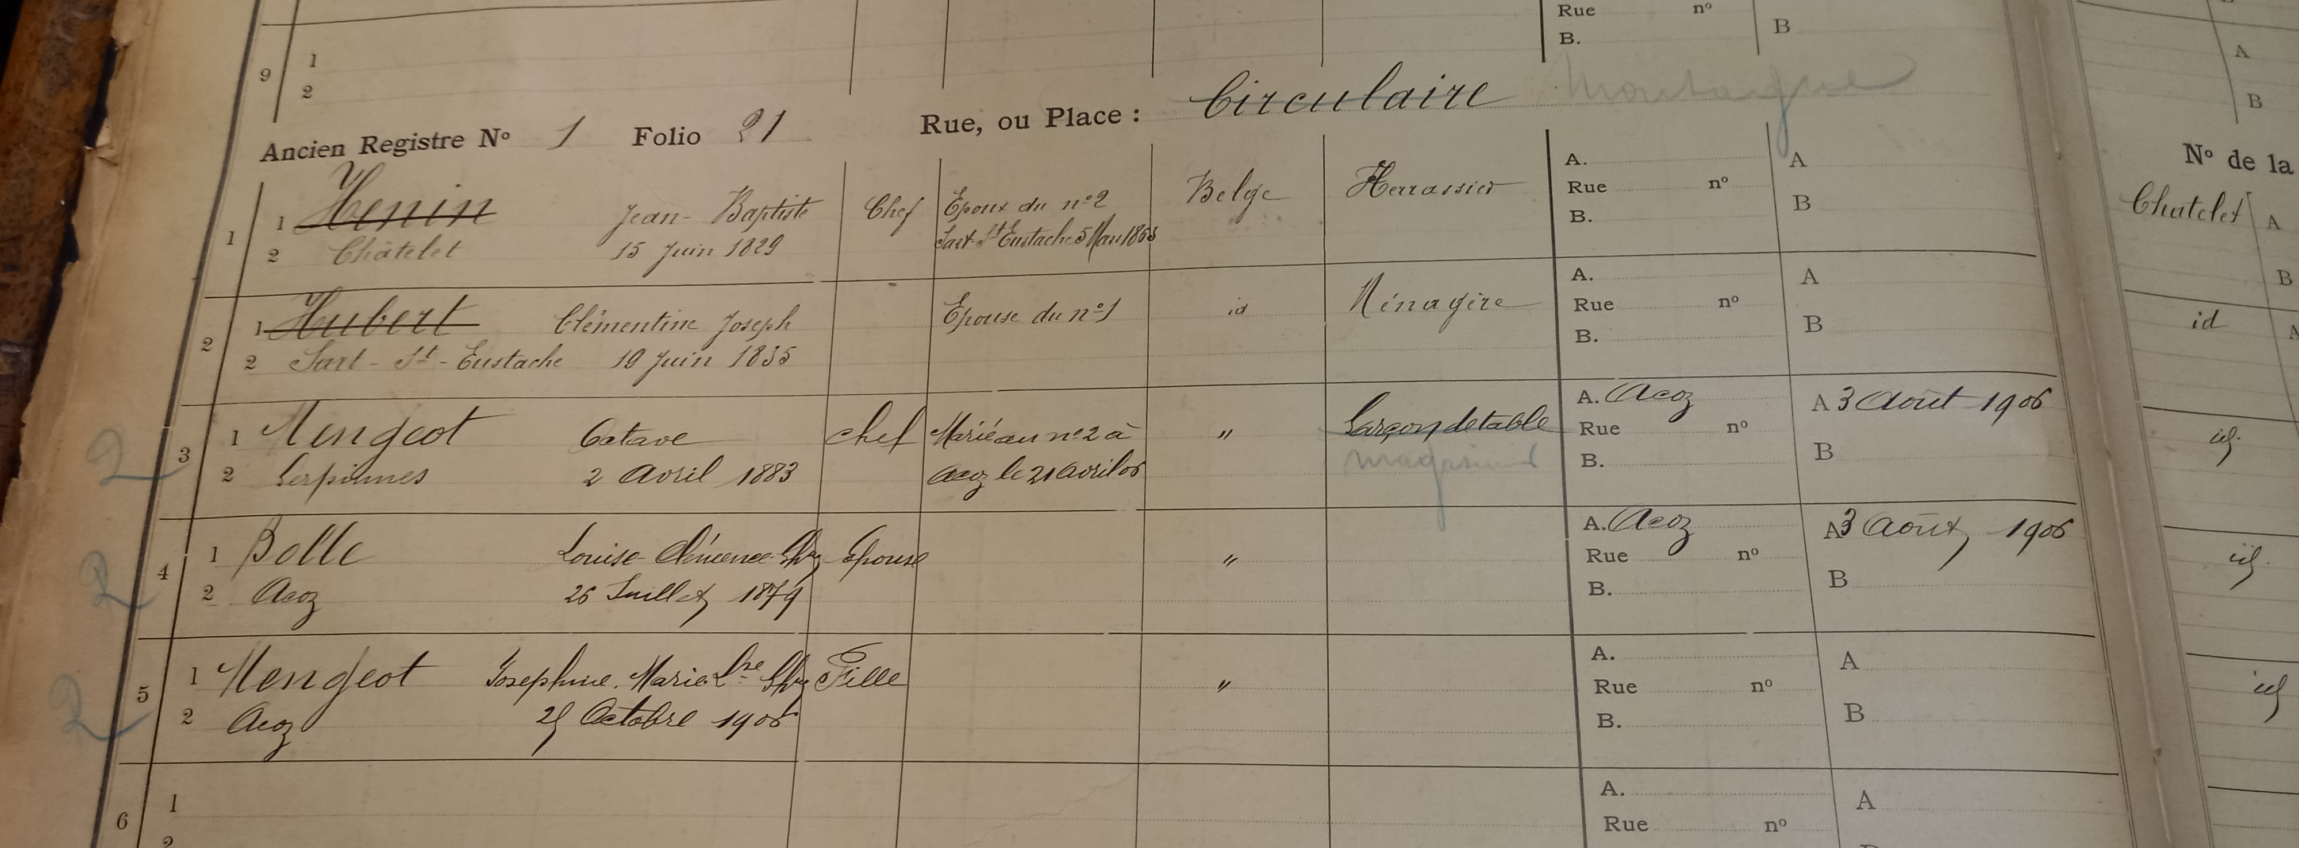
In the population registers:
Members of the household and link between them
Professions
Marital status
Date of birth...
Notes:
in which we have information about all the people living at some address, with their profession, marital status, date of birth, other addresses…

Slide 18
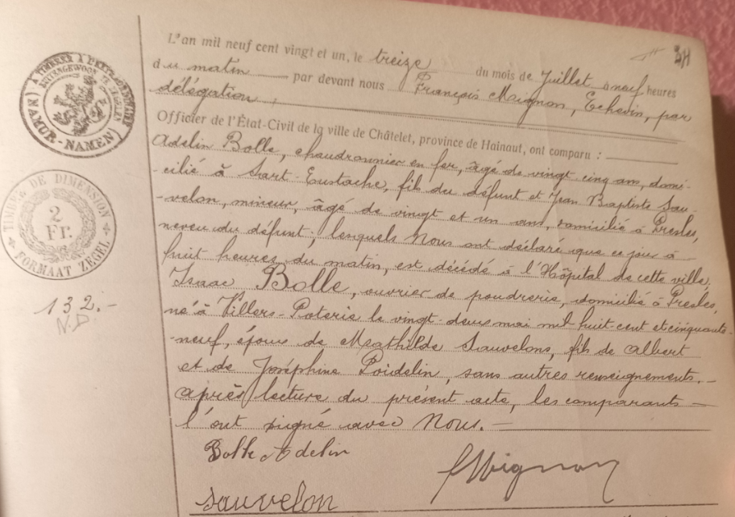
Death certificates
Isaac Bolle
Worker in a powder factory
Died on the 13th of july
Notes:
Here is an example of a death certificate, in 1921. You can see that a man called Isaac Bolle, who was a worker in a powder factory was declared dead by his son and his nephew on the 13th of July. We also have the name of his wife and his parents, but no information about the way he died.

Slide 19
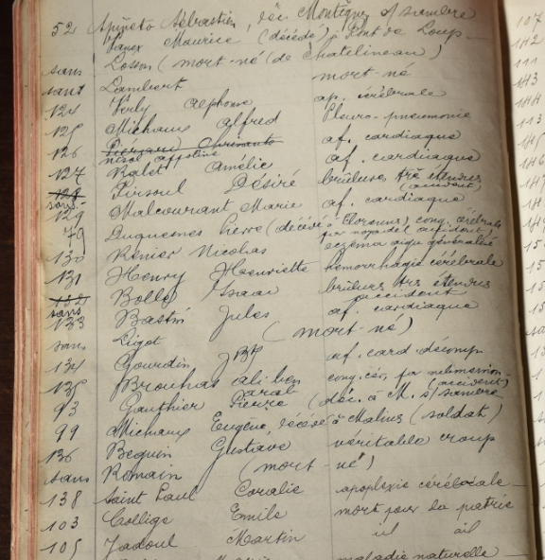
Registers of causes of death
Pirsoul Désiré
Bolle Isaac
very extensive burns (accident)
Notes:
To find that information, we must look at the register of causes of death. Here, we see that Isaac Bolle and another man named Désiré Pirsoul died of very extensive burns in an accident.

Slide 20
Notes:
Remember earlier when we saw that in 1921 2 men died because of burns in Châtelet? Here they are!

Slide 21
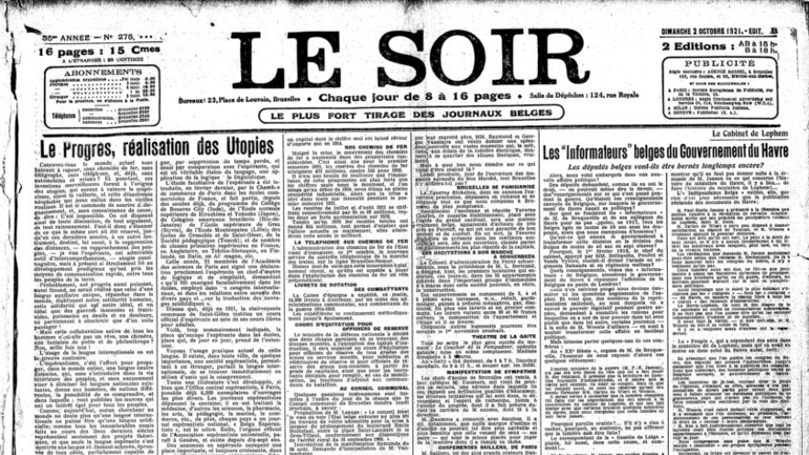
Use of the contemporary press
Notes:
Can we learn something more about that case? We wondered whether the press could provide us with additional information.

Slide 22

BelgicaPress
135 Belgian newspapers, mostly published daily
1814-1979
Notes:
So we used Belgicapress, a database with 135 digitalised Belgian newspapers, between 1814 and 1979.

Slide 23
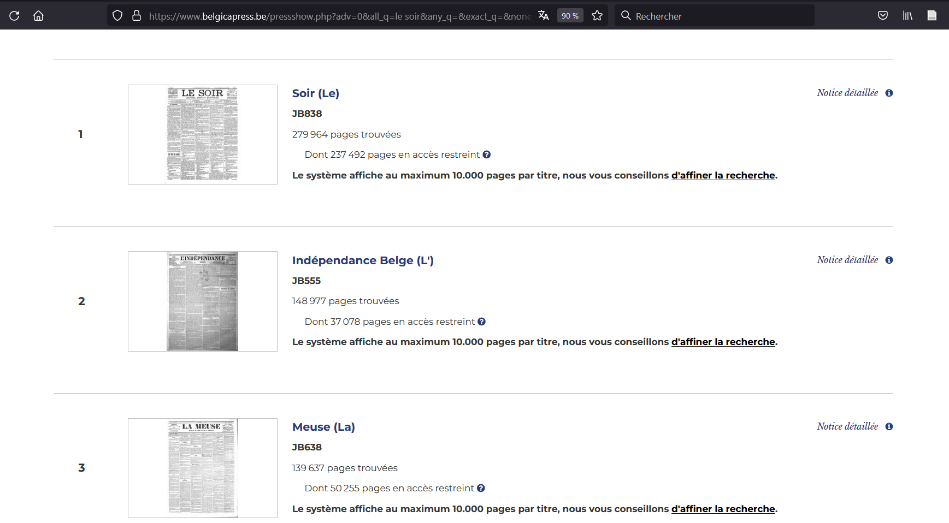
Notes:
Here is the kind of result we have when we run a query, with many pages in different newspapers.

Slide 24
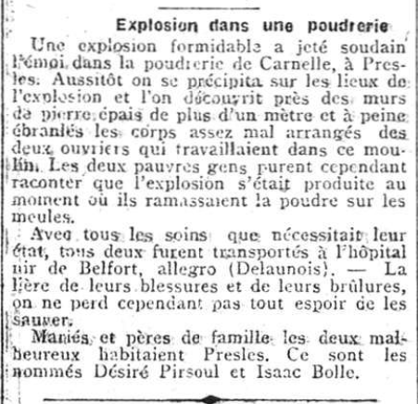
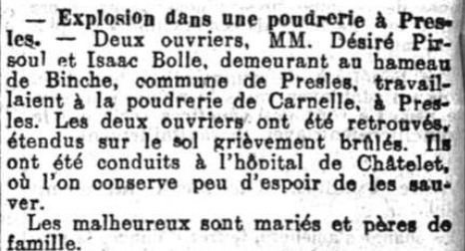
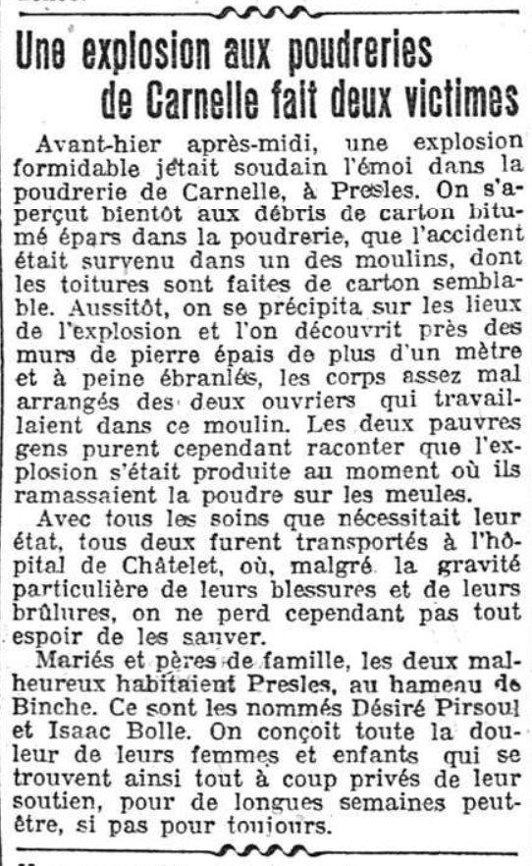
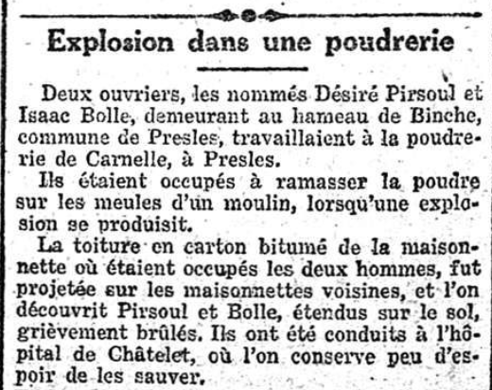
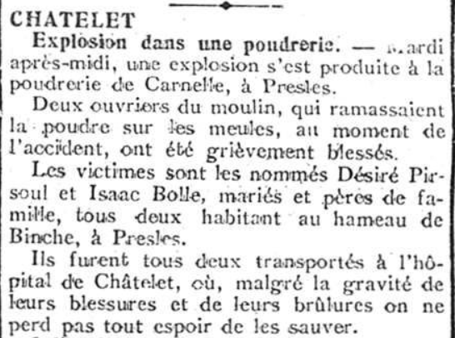
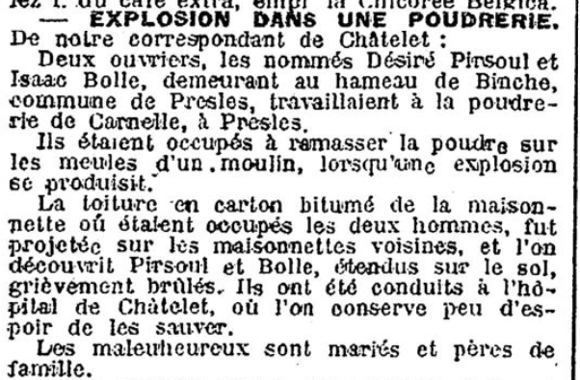
La Libre Belgique, 9/7/1921, p.2
Le Courrier de l’Escaut, 9/7/1921, p.3
Vers l’Avenir, 8/7/1921, p.3
Le Soir, 8/7/1921, p.3
La Gazette de Charleroi, 7/7/1921, p.3
Le Journal de Charleroi, 8/7/1921, p.2
Notes:
We tried to find our 2 men deceased because they got burned in an accident and found this:
many articles talking about an explosion, the victims, their families, the circumstances…

Slide 25

Using the press in another field: the femicides
Notes:
So we wondered: could we use the press to study other research field? And we tried to look for what we now call femicides.

Slide 26
Other example of the use of the press: the femicides
Why we should be interested in this subject
In the 19th and 20th century
In the 21st century
Notes:
I will first show you why we should be interested in this particular subject, then we’ll see what we can do with the press of the 19th and 20th centuries, and how we can use it for the current period.

Slide 27
Homicide mortality rate per 100.000 inhabitants in Belgium (1886-2016)
35
22,3
9,2
(Plavsic & Van Cleemput, 2020)
Notes:
If we observe the long-term homicide trends in Belgium, we see that the overall trend is downwards for men, while the number of women dying murdered is globally stable. This is a sign that we’ve figured out how to reduce de violence against men, but still not against women. We know that around 85% of murdered women die at the hands of a family member, within the household. That’s why we need a study of femicide, to understand how we can act to prevent such deaths.

Slide 28
Femicides in the press (19th and 20th century)
Researches “drame familial”, “crime passionnel”…
1000 cases from 1880 to 1968 in 3 newspapers
Study of society’s perception of domestic violence and how it’s changing
Analysis on the terms used to describe the perpetrator, the victim and the event
→ Particular interest in this subject and emergence of the first (and rare at the time) feminist comments
Notes:
We decided to search for the terms “drame familial” and “crime passionel” in the Belgicapress digitalised newspapers.
We found 1000 cases of murdered woman between 1880 and 1968.
Those articles can be used to study the society’s perception of domestic violence and how it’s changing.
We can also make an analysis on the terms used to describe the perpetrator, the victim, the event, and the circumstances. This is a work in progress with some historian colleagues.
We noticed that there is a particular interest in this subject, and even found the emergence of the first but still rare at the time feminist comments about women being killed.

Slide 29
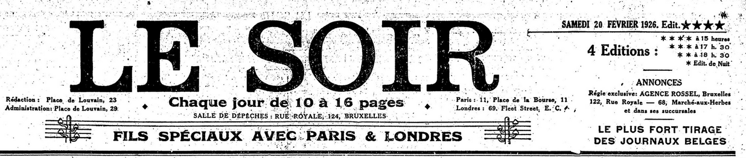
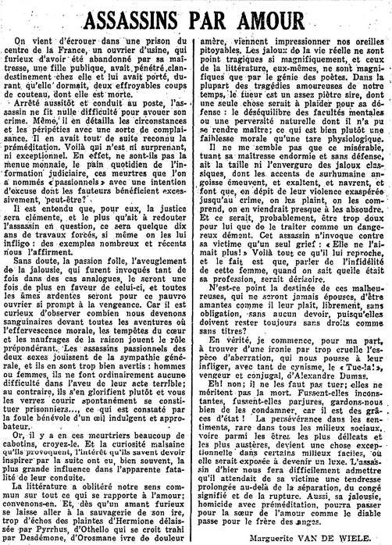
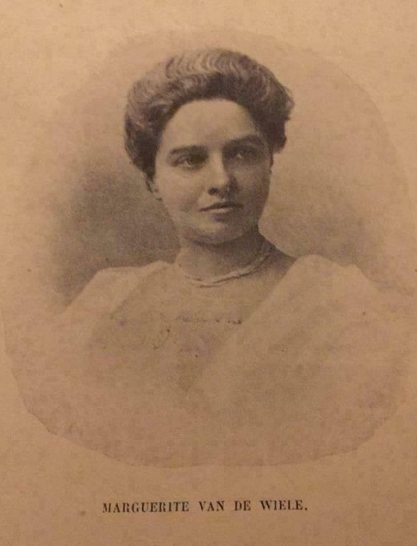
Marguerite Van de Wiele
(1857-1941)
Belgian writer and journalist
Feminist
Notes:
Here is an example of an article written in 1926 by Marguerite Van de Wiele, a feminist writer and journalist, saying men have to stop killing women. It was on the first page

Slide 30
Femicide data in Belgium in the 21st century
New law against femicide voted in June 2023
define and take action against these gender-based murders by collecting and analysing quantitative and qualitative data
highlighting these murders and the profile of the people involved
improve care for victims and training for those working in the field
But: lack of official data about femicide
Notes:
What about the current data on femicides?
In June this year, a new law against femicide was voted in Belgium. The goal is to define and act against these gender-based murders by collecting and analysing quantitative and qualitative data, in order to shed light on these murders and the profile of the people involved. The ultimate aim is to improve prevention and care for victims, as well as the training for professionals in the field.
The big problem is that there is no official data on femicide in Belgium.

Slide 31
Femicides in the press in the 21st century
Feminist NGO’s → website with press articles (Blog Stop Feminicide)
On this basis: research of articles + database
177 cases from 2017 to 2023
Lot of information about the people, the facts, circumstances, and prosecution
= Reliable source of data?
Notes:
Some feminist associations have set up a website with press articles on femicides.
Following this example, we researched articles and build up a database.
We found 177 cases over the last 7 years.
The articles are very rich in information about the people, the facts, and the prosecution of the perpetrator.
But we wonder whether the press is a reliable source of data?

Slide 32
Press data vs prosecutor’s offices data
Neither is designed for statistical purpose
Justice databases are recent, and integration with police databases not yet fully complete
Comparison:
  Few missing cases in both databases (95% match)
  → Press = reliable data source on this topic
Notes:
We decided to compare the press data with the data from the prosecutor’s offices, by requesting an extraction.
It is important to know that neither is designed for statistical purposes.
Justice databases are recent, and the integration with police databases is not yet fully complete.
In this comparison, we found only a few cases missing from either database, with a 95% concordance between the 2.
As a conclusion, we can therefore say that the press is a reliable data source on this subject, so maybe it is for others too.

Slide 33

audrey.plavsic@uclouvain.be

