Slide 1

Memory and Future Thinking
Memory Study Association Conference 2026, Buenos Aires
Chair: William Hirst
Presenters: Nawël Cheriet, Loïc Fierens, Nazike Mert, Jeremy Yamashiro

Slide 2



Is Peace about the Future and War about the Past?
The Weight of Collective Emotions in Shaping Peace and War Attitudes Across the European Youth
Fierens, L., the collaborators of the PEACE project, Bouchat, P.
loic.fierens@uclouvain.be

Slide 3
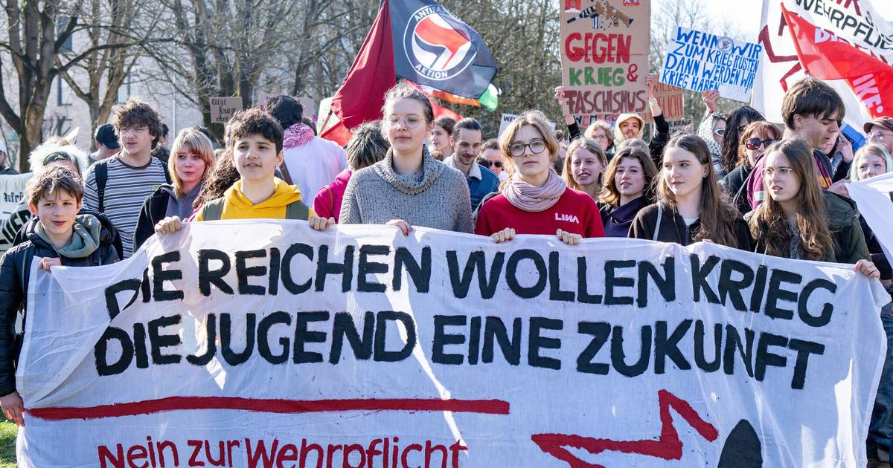
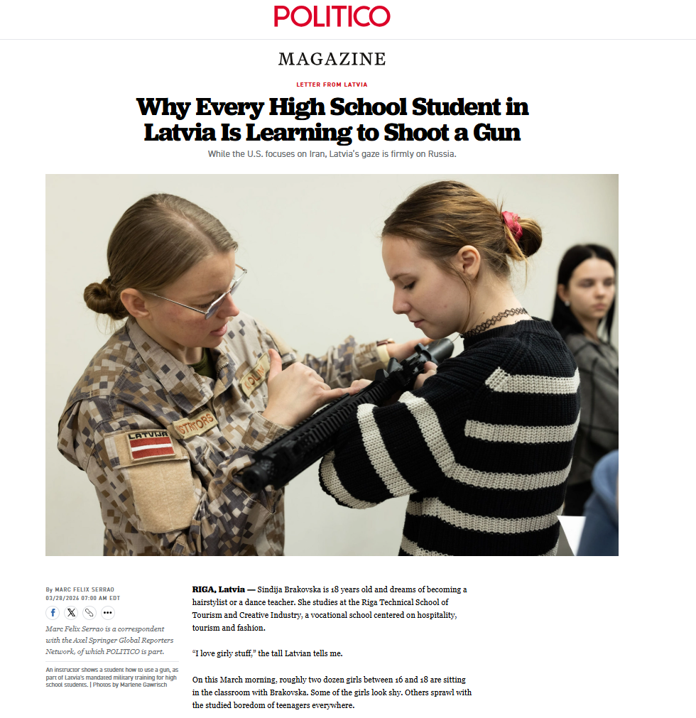

Slide 4
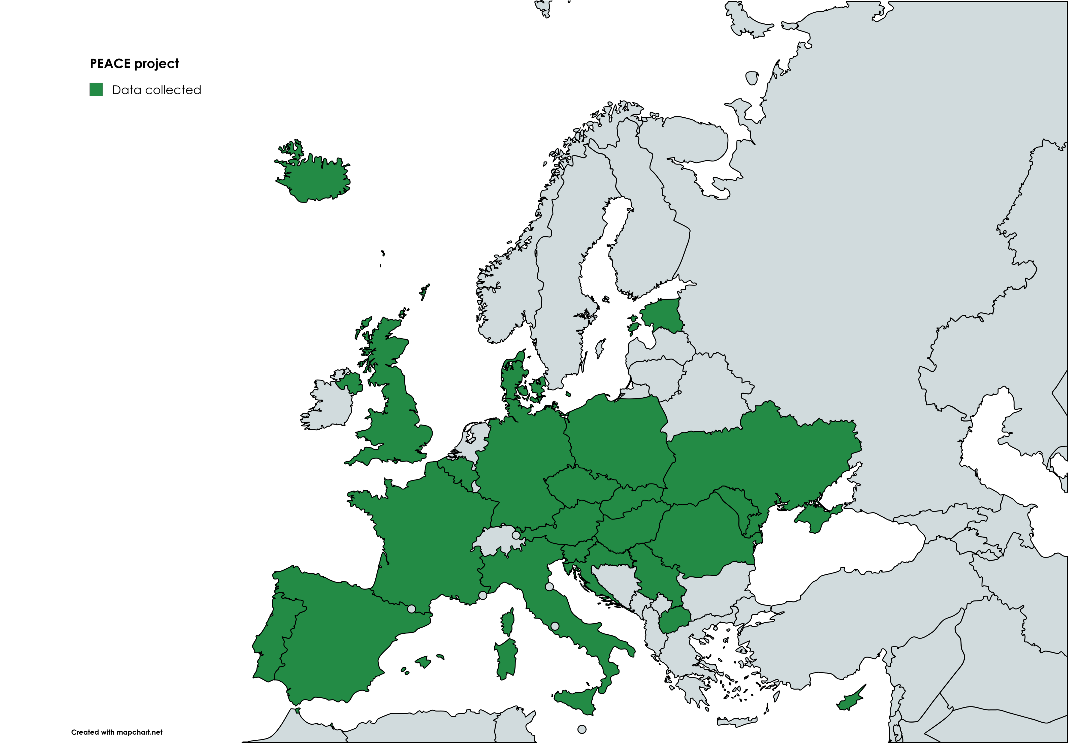
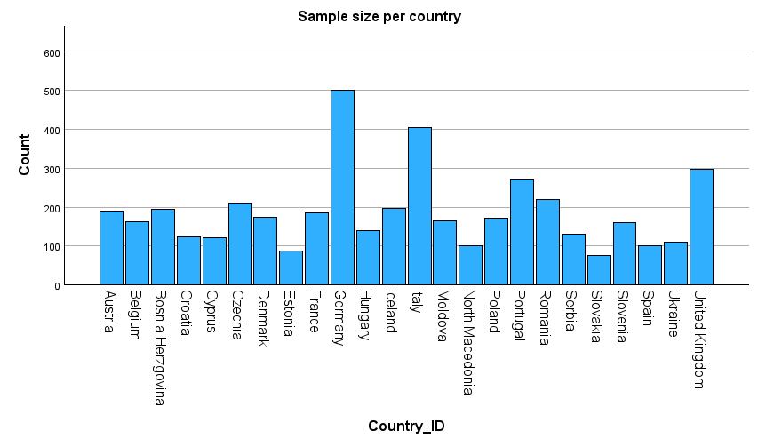
PEACE project

Slide 5
Research question
How do collective emotions about the past and the future interplay with attitudes towards peace and war ?
Collected past emotions: ashamed or proud
Collective future emotions: fearful or hopeful
[exploration: the role of intertemporal trajectories - decline or progress]

Slide 6
Theoretical predictors of attitudes
Tripartite model of attitudes (Rosenberg and Hovland, 1960)
Cognitive level: ideology predict peace and war attitudes (Bizumic et al., 2013; Van Der Linden et al., 2017)
  More equalitarian (SDO) should be more pro-peace
  More conservatist (RWA) should be more pro-war
Affective level: collective emotions about the past and the future should affect individuals’ attitudes towards peace and war
Behavioural level: military conscription affects war attitudes (Hadar & Häkkinen, 2022; Häkkinen & Kaarkoski, 2024; Sederholm et al., 2025)

Slide 7
Hypotheses (pre-registered)
Pro-peace attitudes are predicted by
  Social dominance orientation (SDO) (-)
  Shame for the collective past
  Hope for the collective future
  Sense of collective progress
Pro-war attitudes are predicted by
  Right-wing authoritarianism (RWA)
  Pride for collective past
  Fear for the collective future
  Sense collective decline

Slide 8
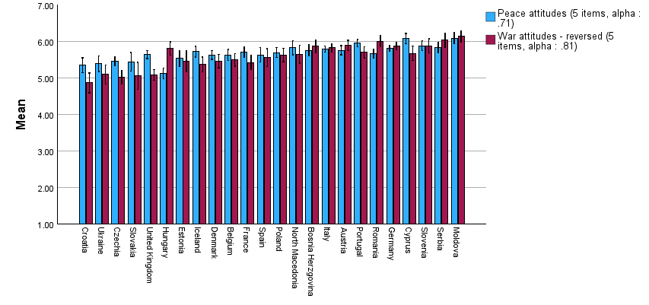
Peace and War attitudes
APWS (Bizumic et al., 2013; Van der Linden et al., 2017): bidimensional scale
General peace attitudes
  Our country's first priority should be world peace
  We must devote all our energy to securing peace throughout the world
  I believe that peace is extremely important
  Peace brings out the best qualities in a society
  In general, I am not too concerned about peace in the world
General war attitudes
  There is no conceivable justification for war
  War is sometimes the best way to solve a conflict
  War is a futile struggle resulting in self-destruction
  Under some conditions, war is necessary to maintain justice.
  Although war is terrible, it has some value.
Notes:
Hungary: interesting case: anti-war but no so convinced about peace (Orban effect? But low alpha for peace!

Slide 9
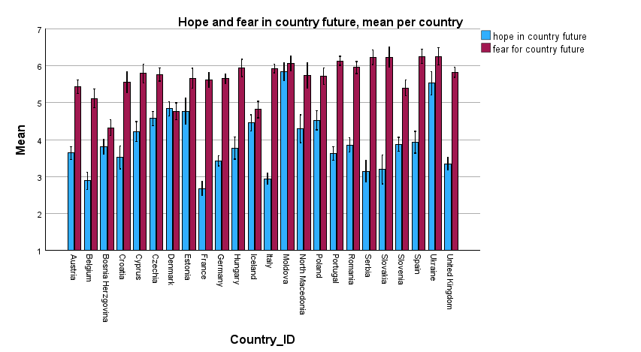
A fearful (and sometimes hopeful) future
Notes:
EU integration as driving higher hope (Moldova + Ukraine)
Interesting: general trends towards antithetic emotions BUT not always!

Slide 10
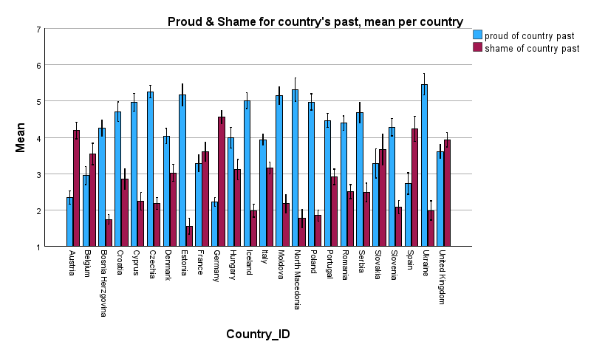
A contrasted past
Notes:
Interesting: Italy

Slide 11
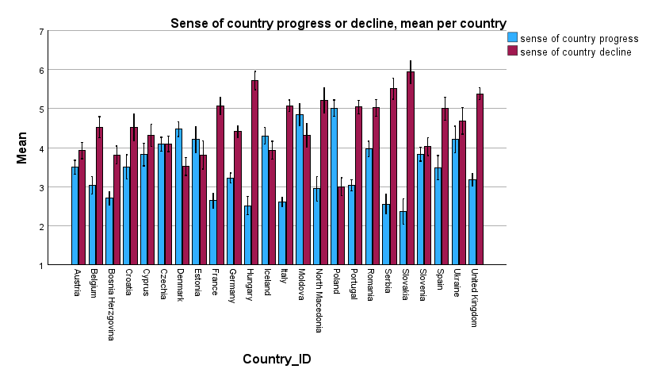
Intertemporal collective trajectory

Slide 12
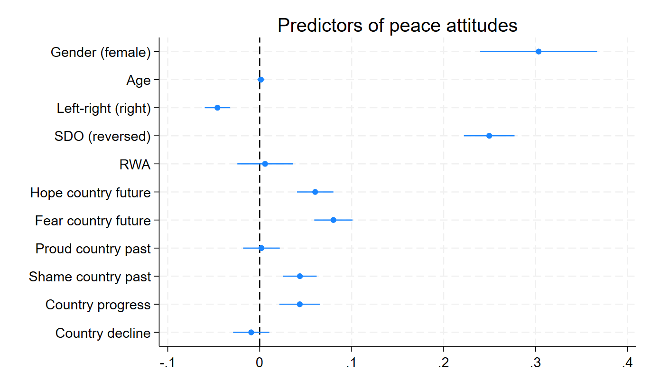
Peace attitudes: predictors
Notes:
SDO: strong predictor
Future emotions
Hope: YES
FEAR: ALSO YES ?! (because values being threatened?)
Shame: YES
Progress: YES

Slide 13
Peace attitudes: effect size
21,6% variance explained by the model

Slide 14
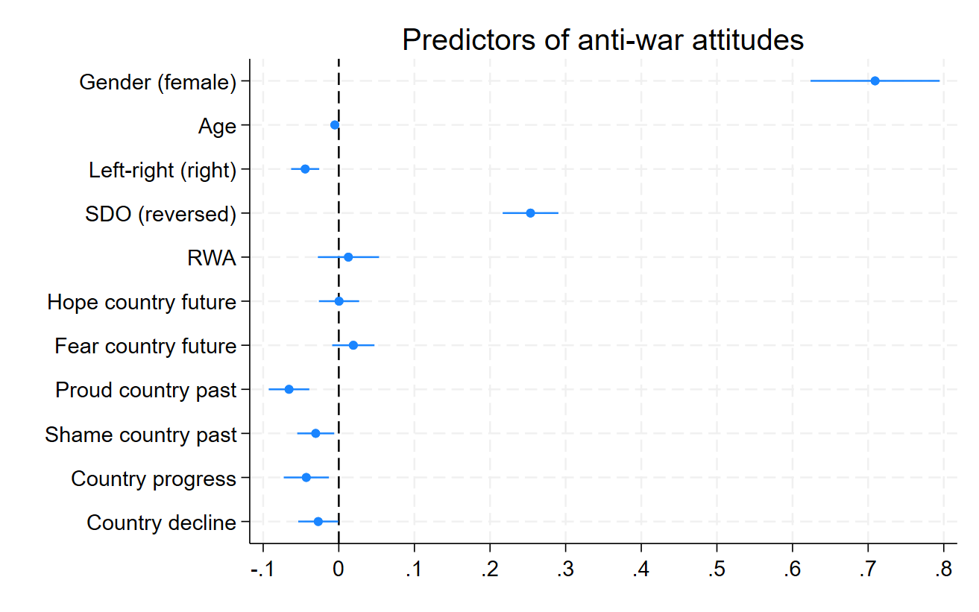
War attitudes: predictors

Slide 15
War attitudes: effect size
19,88% variance explained by the model

Slide 16
Discussion
Peace and war attitudes are separated constructs
SDO (not RWA) and political orientation are central predictors
Pro-peace // with future-oriented emotions (fear, hope) and believes (progress) and shame of the national past
Pro-war // with past-oriented emotions (proud)
Gender differences is least explained by our model for anti-war attitudes
Notes:
Pro-peace and anti-war are two separated constructs
peace seems more future future-oriented (and shame) whereas pro-war is partly driven by past-oriented emotions
RWA seems to fade away compared to equalitarian values to predict anti-war attitudes
Fear of the national future seems associated with pro-peace attitudes across the European youth
At the same time, belief in future progress for one’s country leads to higher pro-peace attitudes
Ideologies and political orientation are a central factor
Gender differences is least explained for anti-war attitudes, reflecting a gender-gap still present across the European youth → check for countries with female in the army for a longer time?
Future-oriented emotions can partly bridge the gap between right and left-leaning citizens

Slide 17
Any question, remarks, suggestion ?
Contact: loic.fierens@uclouvain.be
Notes:
Norms: do you think people should defend your country in case of war
Around Europe anti-war and pro-peace attitudes are the norm
Between countries differences are subtle for attitudes, but more pronounced for behavioural intentions
Memory of WWII are significantly associated, 82 years later with:
general war attitudes (small effect)
norms of collective defence (moderate effect)
perceived control on defence behaviours (small)
Way forward: attitudes regarding specific conflict

Slide 18
Peace and War attitudes
General peace attitudes
  Our country's first priority should be world peace
  We must devote all our energy to securing peace throughout the world
  I believe that peace is extremely important
  Peace brings out the best qualities in a society
  In general, I am not too concerned about peace in the world
General anti-war attitudes
  There is no conceivable justification for war
  War is sometimes the best way to solve a conflict
  War is a futile struggle resulting in self-destruction
  Under some conditions, war is necessary to maintain justice.
  Although war is terrible, it has some value.
APWS (Bizumic et al., 2013; Van der Linden et al., 2017): bidimensional scale

Slide 19

Internal consistency
APW_peace: alpha per country
APW_war: alpha per country
Country | Cronbach's Alpha
Austria | .734
Belgium | .774
Bosnia Herzegovina | .806
Croatia | .773
Cyprus | .673
Czechia | .671
Denmark | .678
Estonia | .745
France | .749
Germany | .708
Hungary | .597
Iceland | .749
Italy | .729
Moldova | .659
North Macedonia | .661
Poland | .737
Portugal | .712
Romania | .721
Serbia | .646
Slovakia | .767
Slovenia | .711
Spain | .765
Ukraine | .700
United Kingdom | .756
Country | Cronbach's Alpha
Austria | .709
Belgium | .727
Bosnia Herzegovina | .830
Croatia | .840
Cyprus | .738
Czechia | .820
Denmark | .841
Estonia | .833
France | .831
Germany | .788
Hungary | .771
Iceland | .846
Italy | .791
Moldova | .565
North Macedonia | .792
Poland | .812
Portugal | .847
Romania | .803
Serbia | .853
Slovakia | .872
Slovenia | .878
Spain | .806
Ukraine | .725
United Kingdom | .825

Slide 20
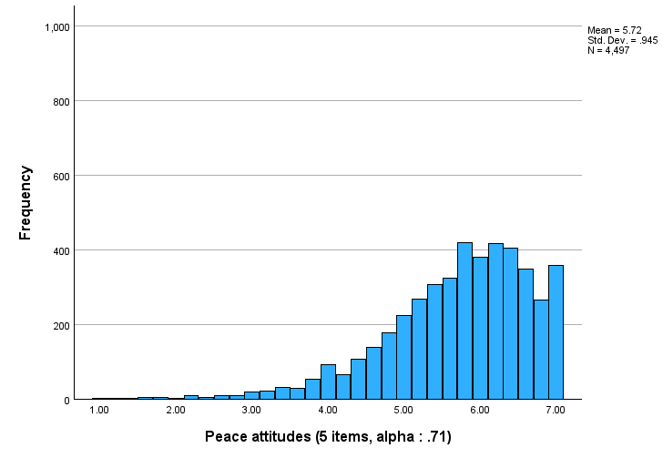
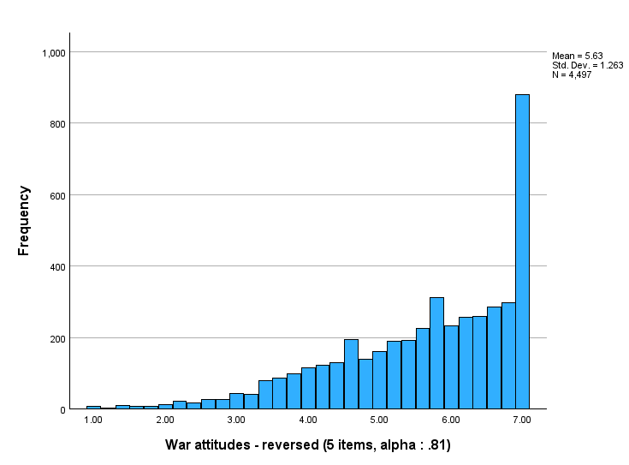
Global trend towards peace and anti-war

Slide 21
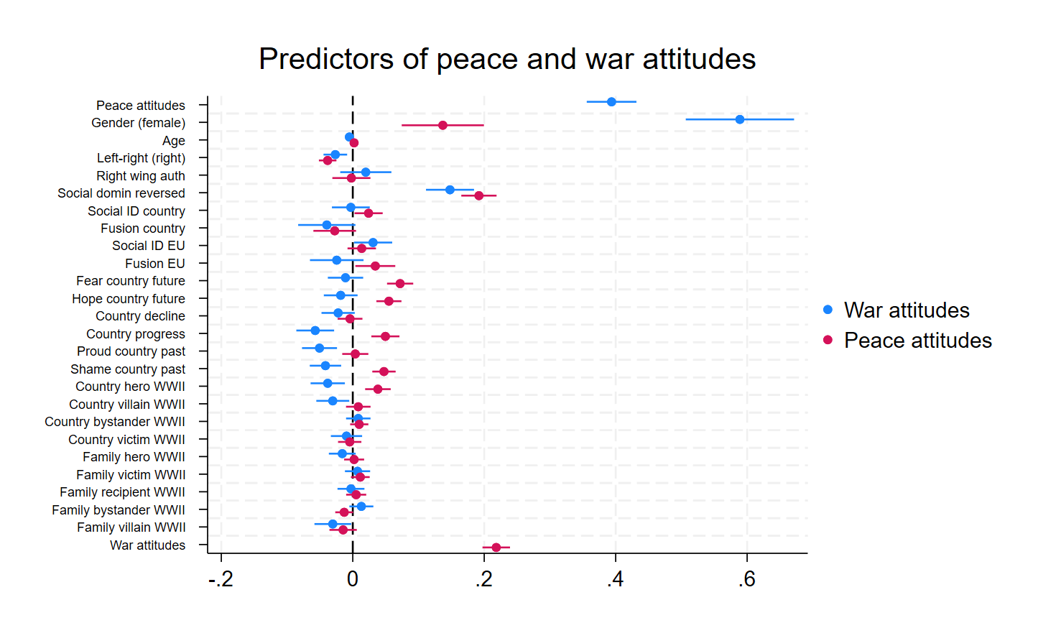
Anti-peace
Pro-war
Pro-peace
Anti-war
Notes:
Refaire avec seulement les variables des hypotheses!
!! All centred around the group-mean
Seeing more one’s country as a hero: pro-peace and anti-war
Seeing more one’s country as a villain: anti-war
Social roles of WWII
Hero (country) + villain (country and family) = higher pro-war attitudes
Modest contribution
Potential double effect
Heroic justification (war can be justified to bring about peace)
Villain identity management (war can be justified as such)
Level 2 effect: mean of country-villain and country-hero drives up the anti-militarism
1) Victorious justification (Bobowik et al., 2014)
BUT also, villain justification through identity management → if we were villain/ashamed then war is sometimes necessary
Works both at the collective and familial level
Peace attitudes are more future oriented
EU fusion prompts higher peace-attitudes
Paradox? Progress, shame, and hero are predicting opposite direction (pro-war and pro-peace)
Peace attitudes are predicted by a sense of progress
Progress in future
Shame of the past
Heroization of country in wwii
Both by fear and hope
Fusion at the EU level
Left and equalitarian between social groups
Non-anti-war attitudes
- Sense of collective progress
Heroization of the past
Shame & proud of the past
Family as villain

