Slide 1

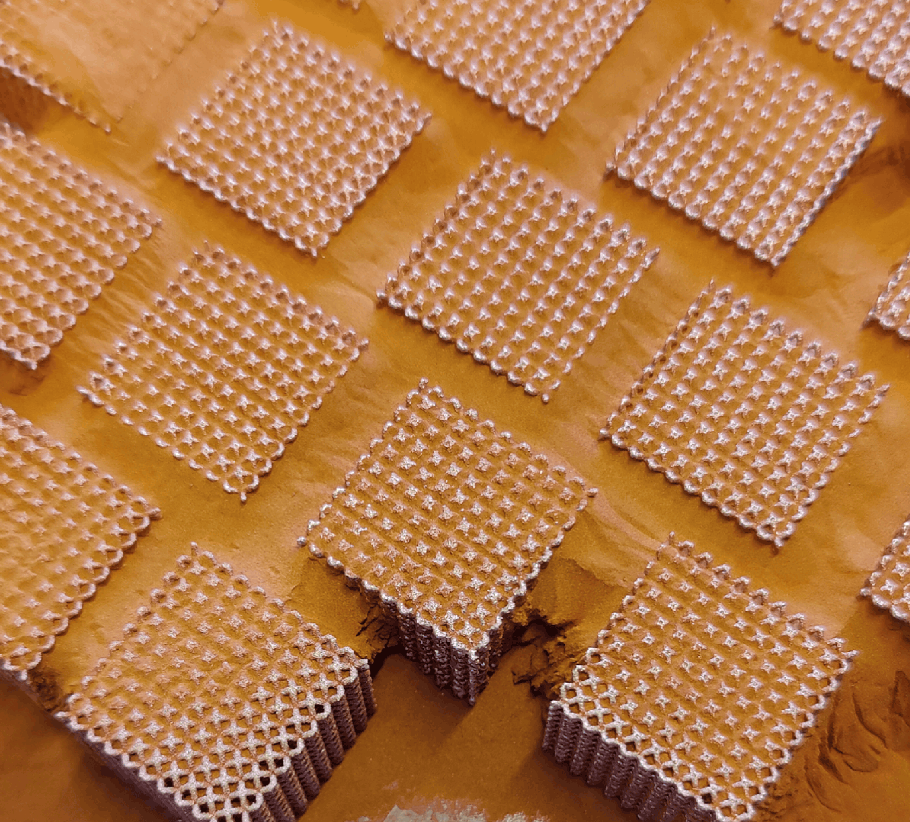
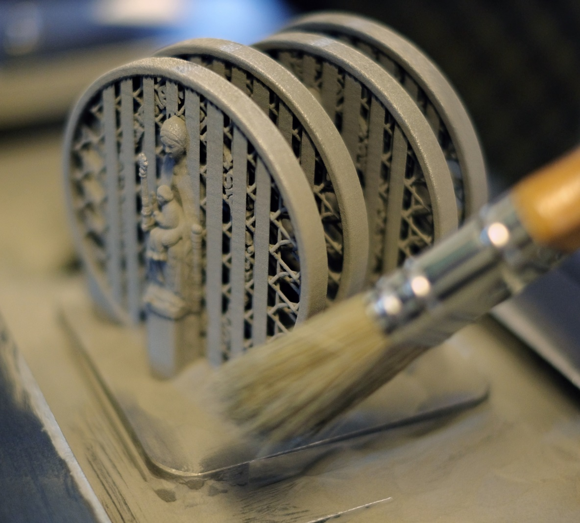
EMMC 2026
Dimensional accuracy and compression behaviour of copper LPBF lattices
Digital Volume Correlation characterization
  Frederik Vanherf
  Joint PhD researcher at KU Leuven and UC Louvain
  AM group KU Leuven and IMAP UC Louvain
  Dr Michel Smet - KU Leuven
  Mohammed Farag - UC Louvain
  Prof Brecht Van Hooreweder - KU Leuven
  Prof Aude Simar - UC Louvain
  frederik.vanherf@kuleuven.be
Notes:
Structure:
Introduction: LPBF, lattices, heat transfer devices ➔ problem statement
Mat and methods: discuss setup LMQ – UCS 2 mm samples – (brief) scanning strategies: contour mode, I2O, O2I, H+C – DVC (CT-scan, Deben and Instron compression)
Results:
Show top and side images and PV optim (RD and VF).
RD and VF in function of fo and cm.
Varying beam compensation

Slide 2
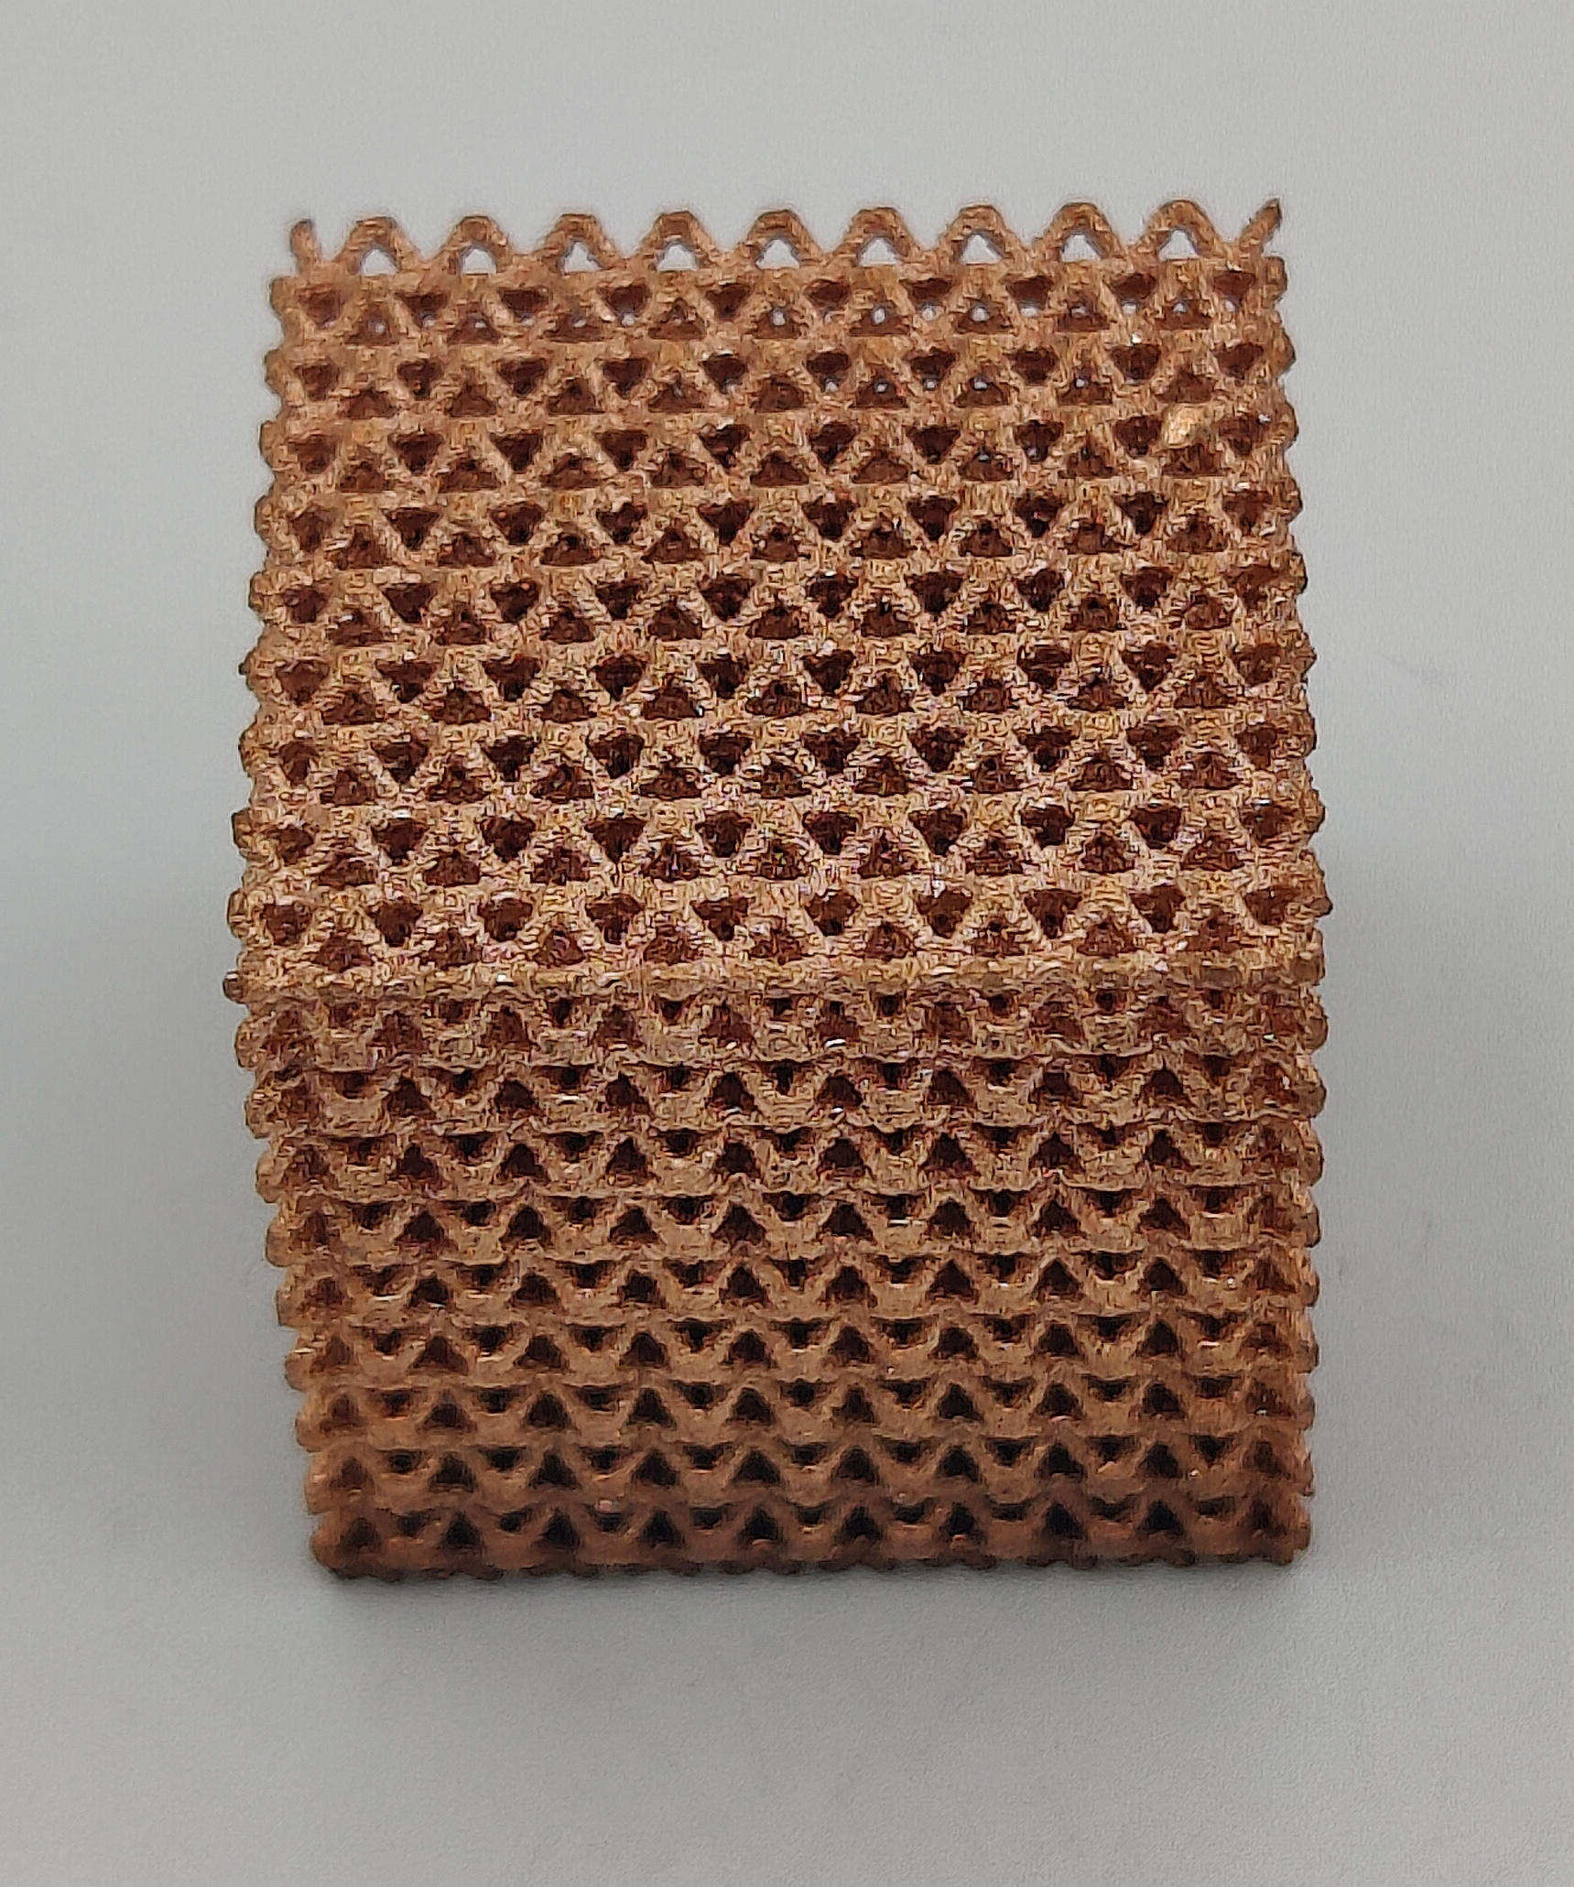
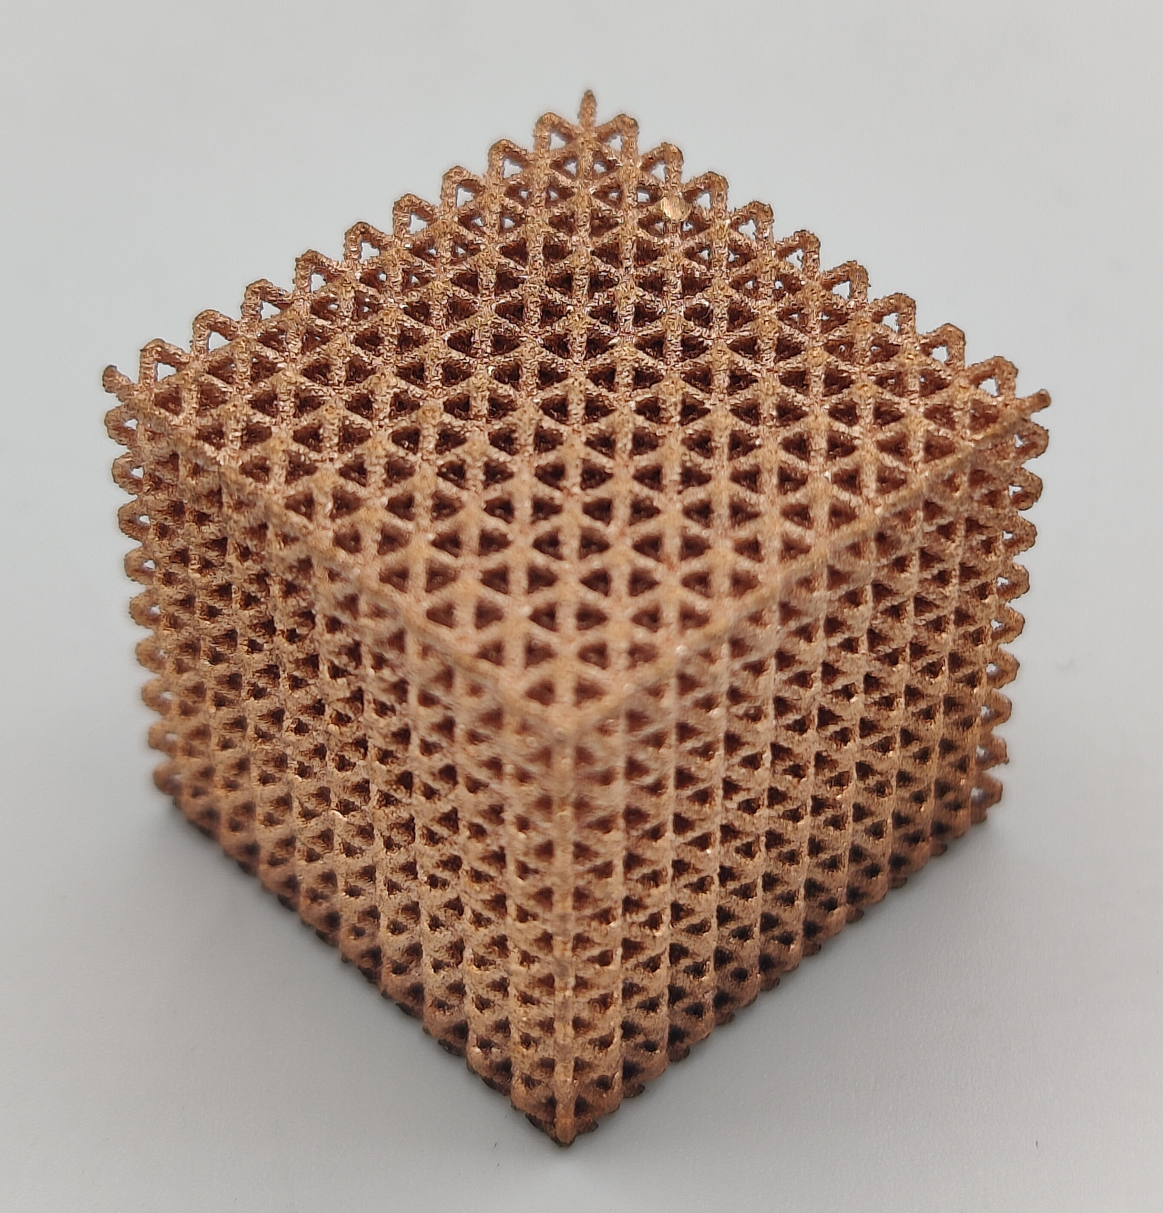
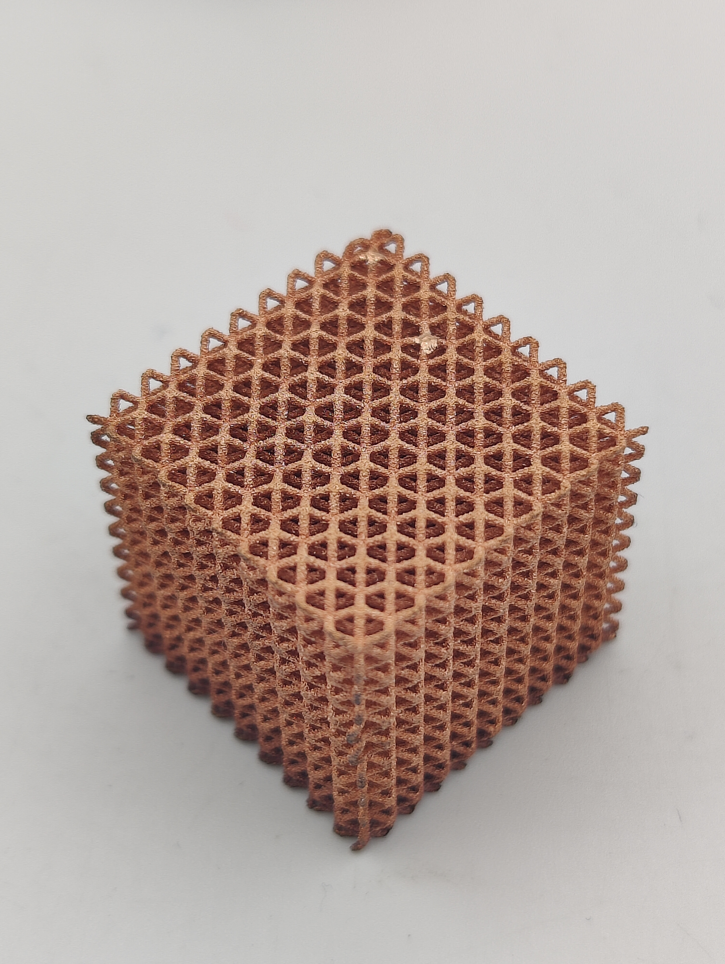
Content
Introduction
Local deviation and porosity distribution
Experimental
Adapted contour scanning
Results
Manufacturing limit
Conclusions
Strain localizations during compression

Slide 3
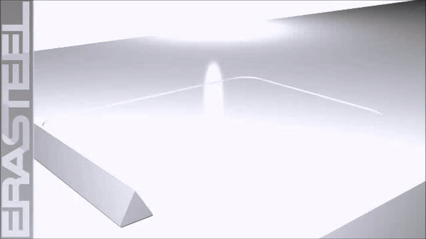
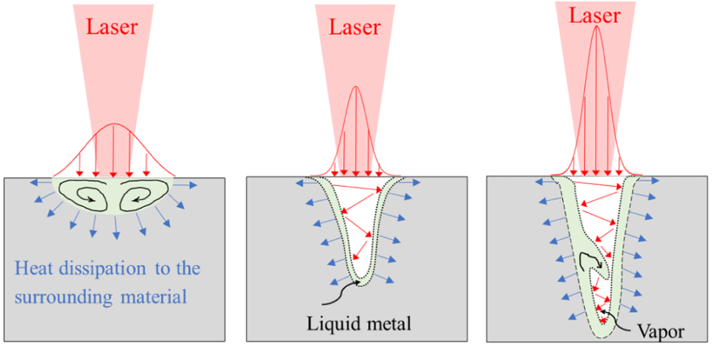
Laser Powder Bed Fusion of pure copper
[ 1 ]
High thermal and electrical conductivity
Preheating (300 °C)
Challenging
➔ Solution
Low absorption for IR-laser (1080 nm)
Keyhole mode
[1] Jadhav, S. D. et al., Laser-based powder bed fusion additive manufacturing of pure copper, Additive Manufacturing, 2021

Slide 4
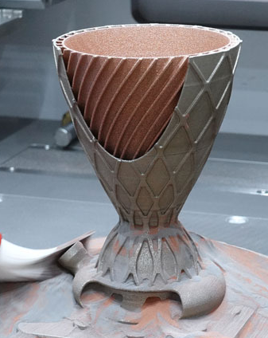
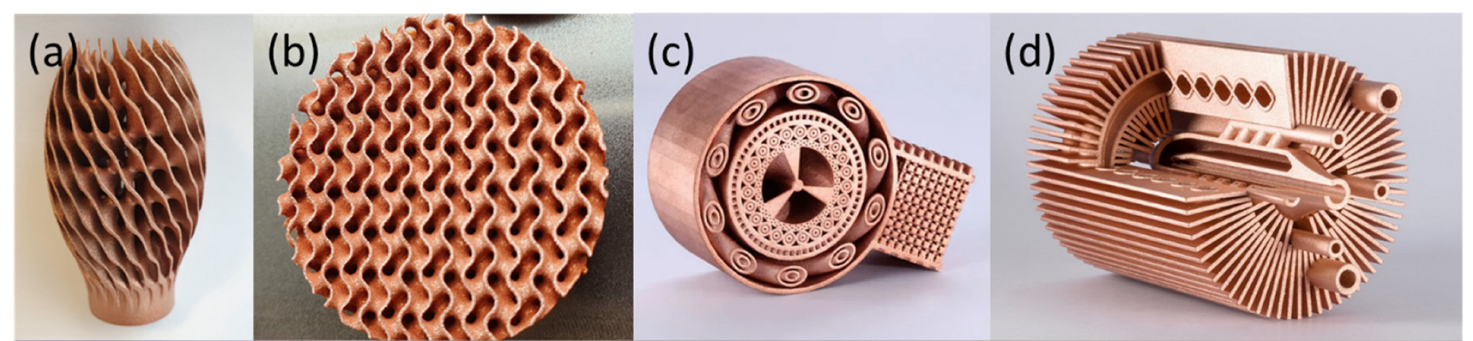
Lattices and applications
Lightweighting
Enhance surface area/volume
Locally optimized heat sinks
Energy absorption capabilities [3]
Integration in multi-material components [4]
[2]
[4]
[2 ]Kang et al., Green laser powder bed fusion based fabrication and rate-dependent mechanical properties of copper lattices, Materials & Design, 2023
[3] Choong et al, Recent Advances in the 3D Printing of Pure Copper Functional Structures for Thermal Management Devices, In Technologies, 2023
[4] Fraunhofer IGCV, Available online: https://www.igcv.fraunhofer.de/en/research/competences/multi-material.html, 2026
Notes:
Multi-material is long-term goal of my research

Slide 5
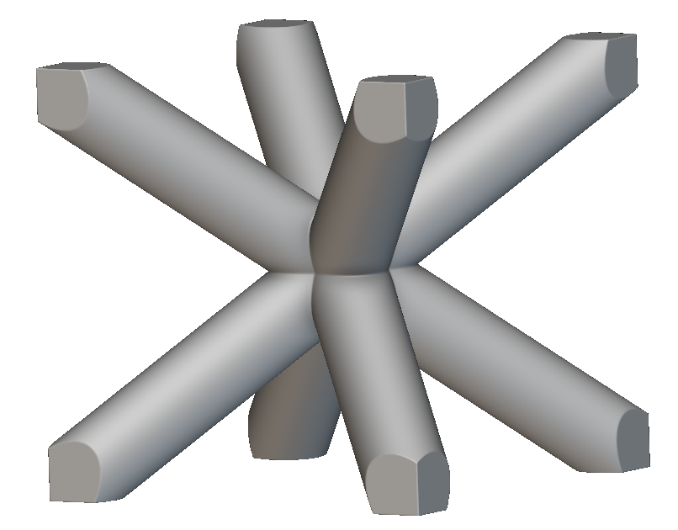
Research goals
Improve dimensional accuracy
1
2
Identify manufacturing resolution
3
Understand compressive behaviour

Slide 6
Experimental
Laser parameter optimisation
Regular quasi-static compression
LPBF of lattices
Scanning strategies
In-situ CT scans
DVC
CT-scan
Adapted contour mode
(a)
(b)
Multi-contour (a) vs Contour plus infill (b)
Local deviations
Manufacturing limit
Porosity distribution

Slide 7
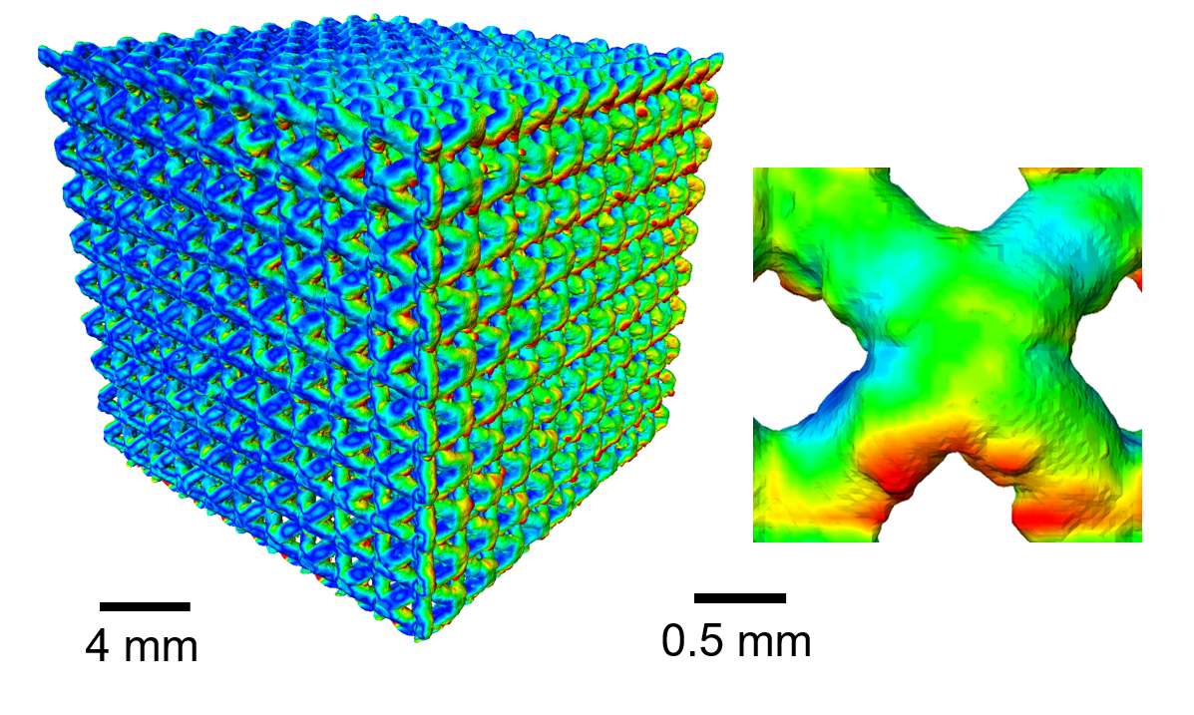
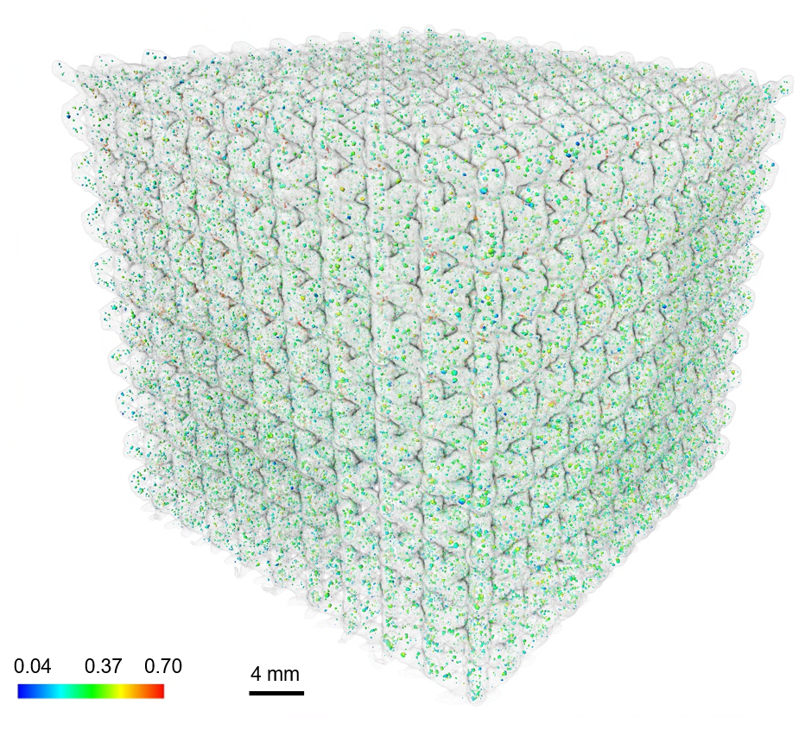
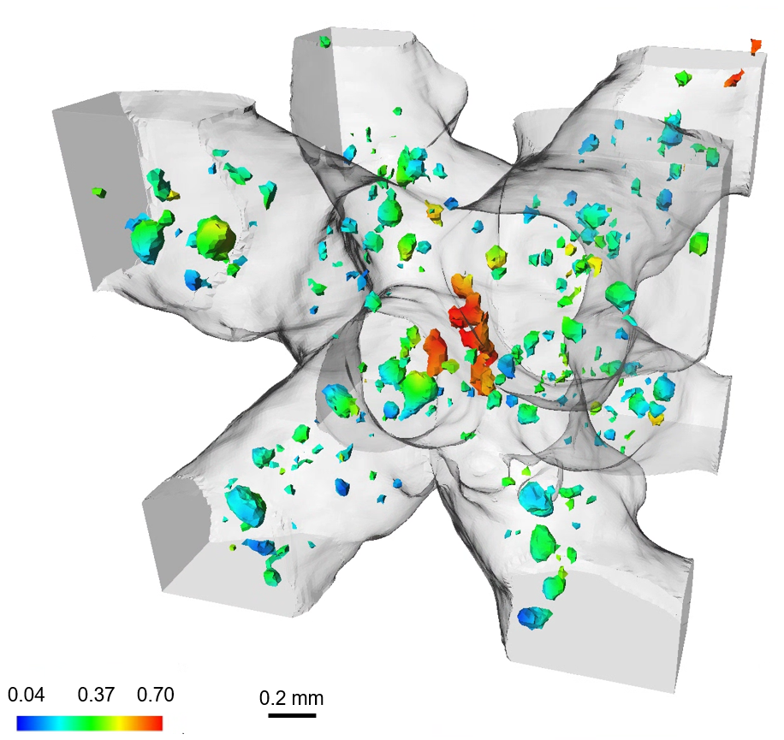

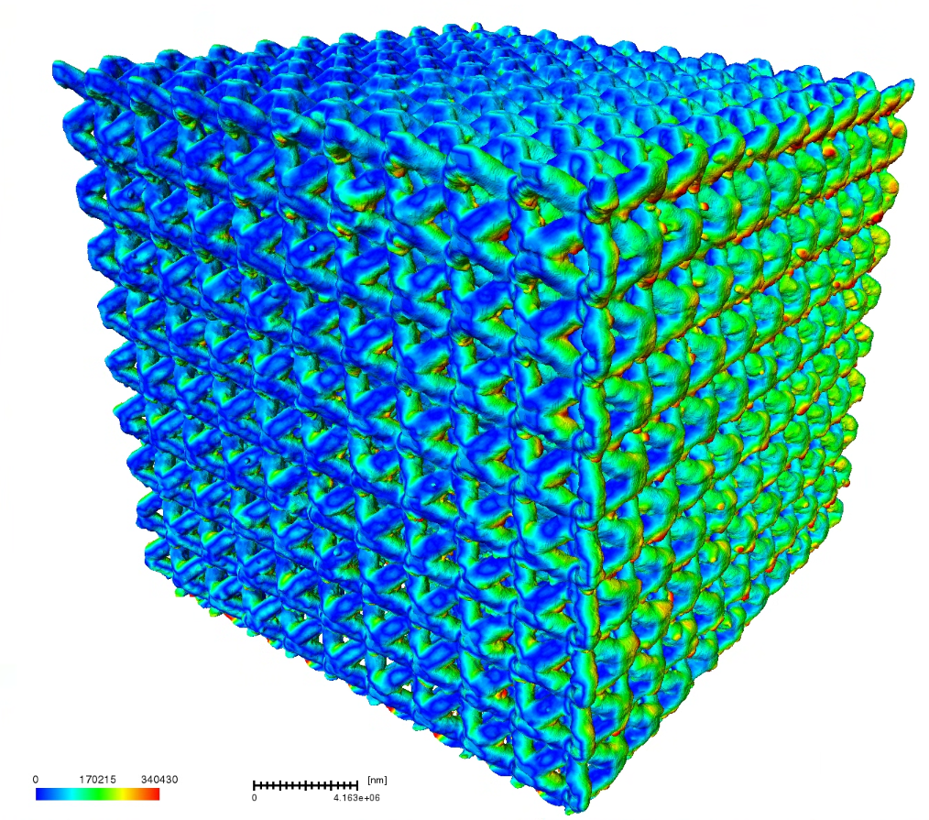
Local deviation
Designed volume fraction: 25 %
Porosity distribution
0.5 mm
0 0.15 0.30
0.04 0.37 0.70
Deviation from CAD model (mm)
Pore distance to surface (mm)

Slide 8
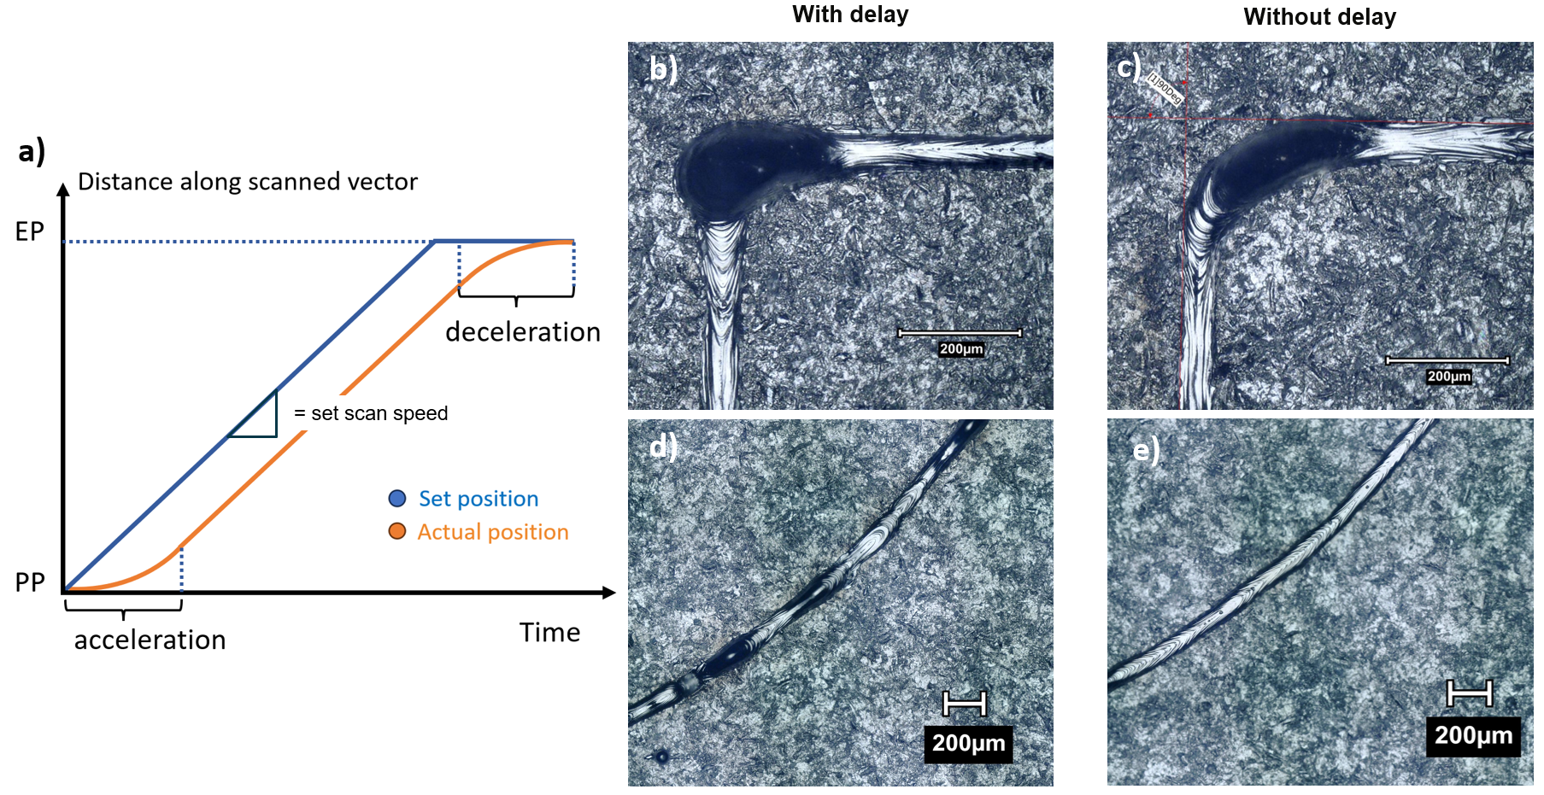
Adapted contour mode
Delay time: 0.6 ms
Scan speed: 1000 mm/s
Notes:
Shorter discussion here!

Slide 9
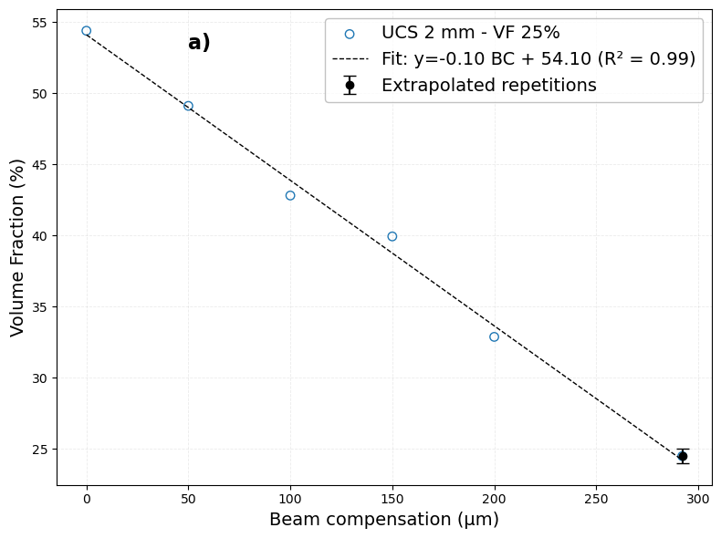
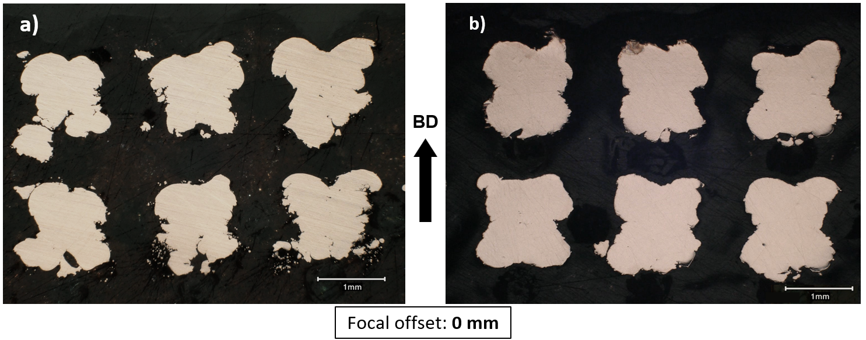
Adapted contour mode
Reducing offset and CAD thickness
With scanner delay
Adapted contour mode
Volume fraction: 52.5 %
Volume fraction: 46.5 %
- 6 %
Notes:
Volume fraction will always be higher than designed

Slide 10
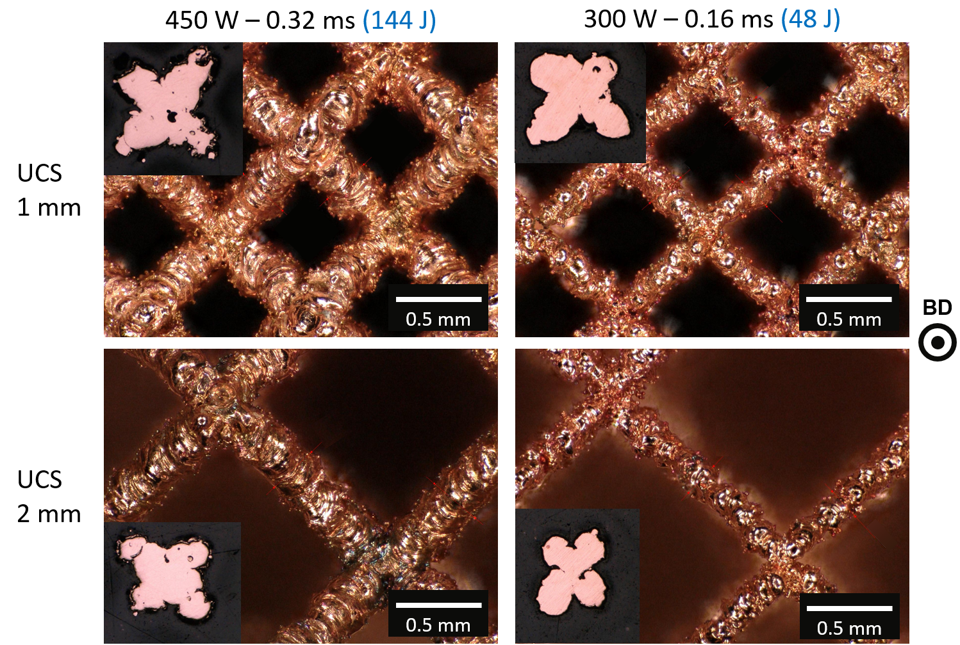
Manufacturing limit – Point scan BCC
 | High energy | Low energy
UCS 1 mm | 290 ± 21 µm | 201 ± 31 µm
UCS 2 mm | 293 ± 9 µm | 181 ± 15 µm

Slide 11
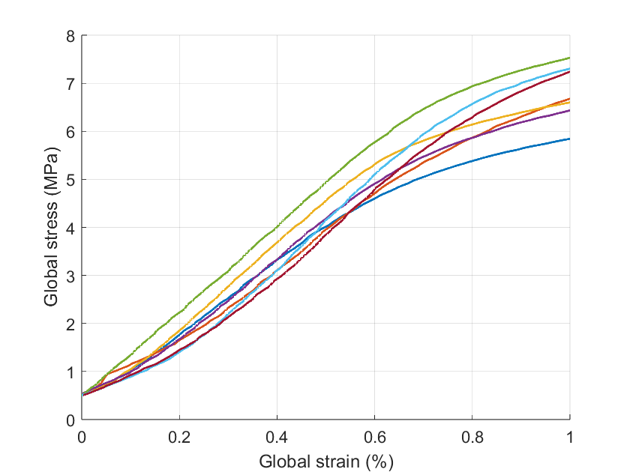
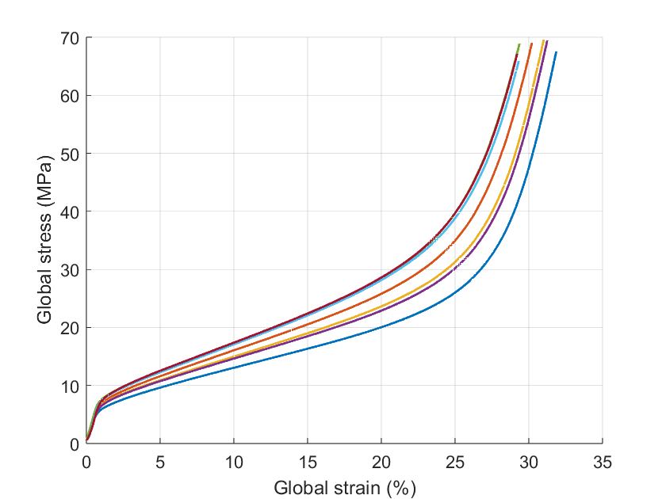
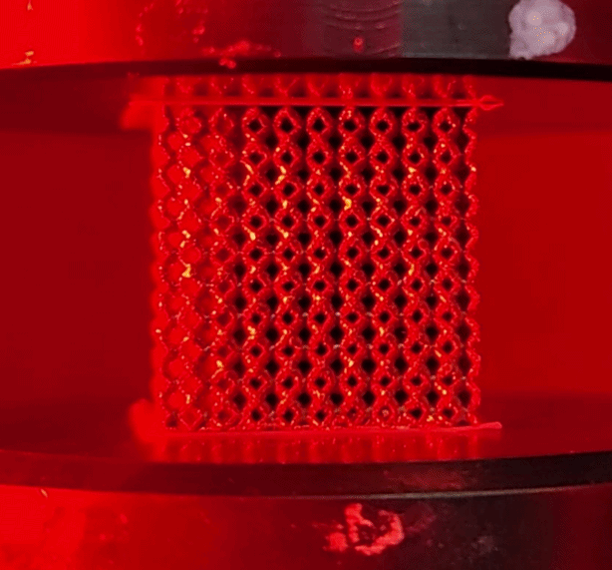
Regular quasi-static compression
Bending-dominated
Designed volume fraction: 14 %
10 x 10 x 10 Unit cells (2 mm)
All with adapted contour mode

Slide 12
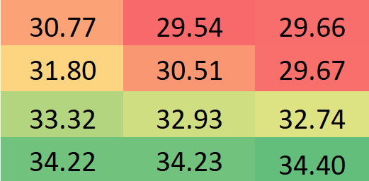
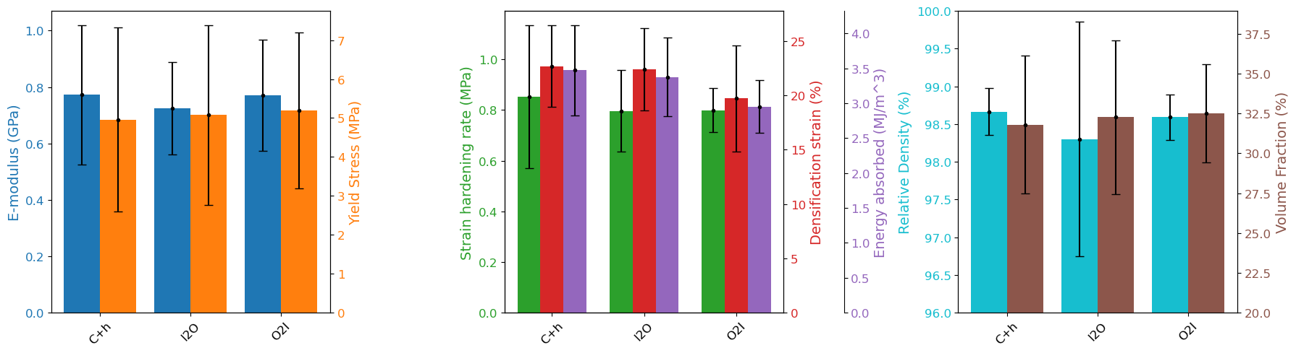

Mechanical properties
Measured VF (designed VF = 14 %)
Baseplate Y-position
C+h
I2O
O2I
Baseplate X-position

Slide 13
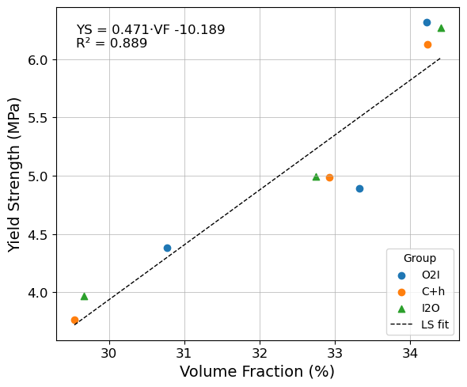
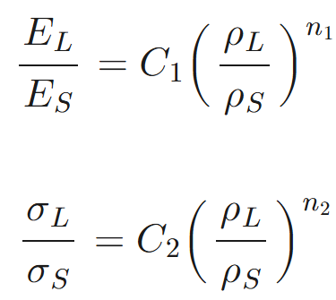
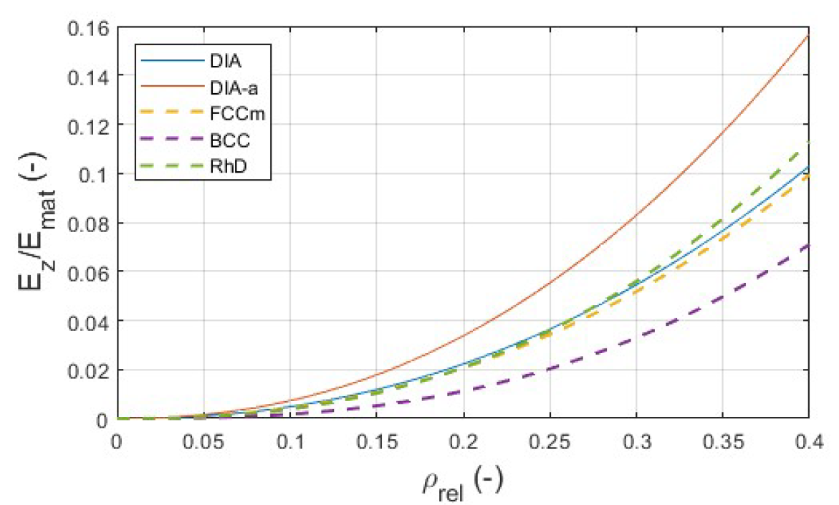
Mechanical properties
Gibson-Ashby relations [6]:
Geometry dependent
Material dependent
[7]
[6]Gibson L.J., Ashby M.F. Cellular Solids: Structure and Properties. Cambridge University Press; Cambridge, UK, 1997.
[7] Celik B.B. et al., Tailoring mechanical fatigue behaviour of LPBF-produced metal lattice structures while maintaining high manufacturability, Procedia CIRP, 2024.
Notes:
More VF variation than expected

Slide 14
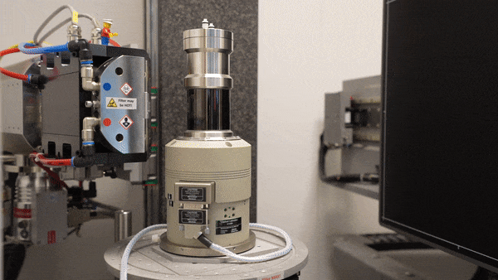
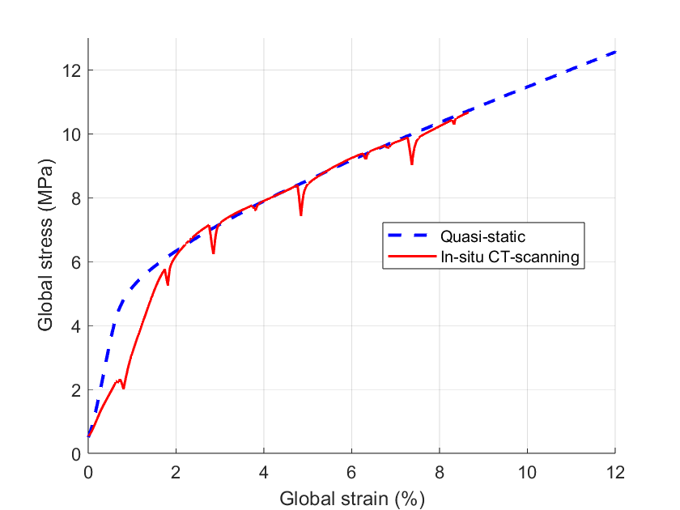
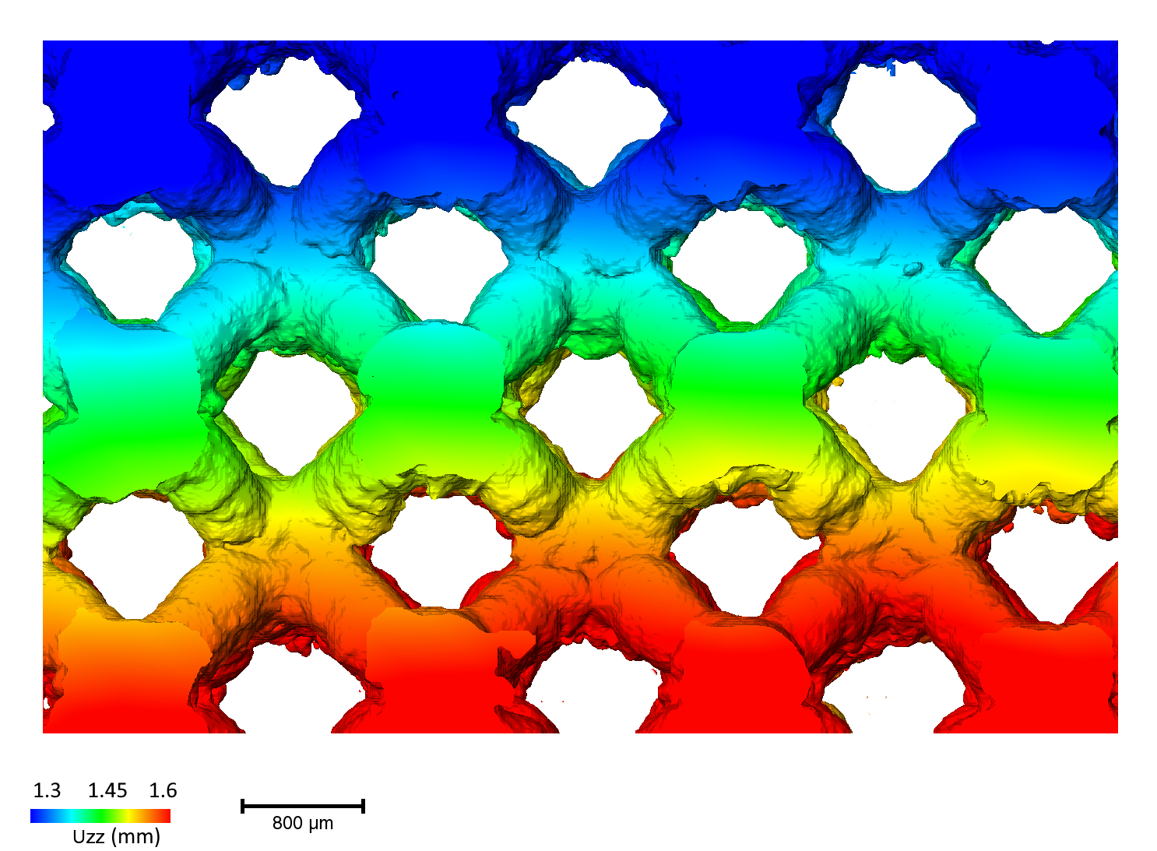
In-situ CT scans
Incremental DVC

Slide 15
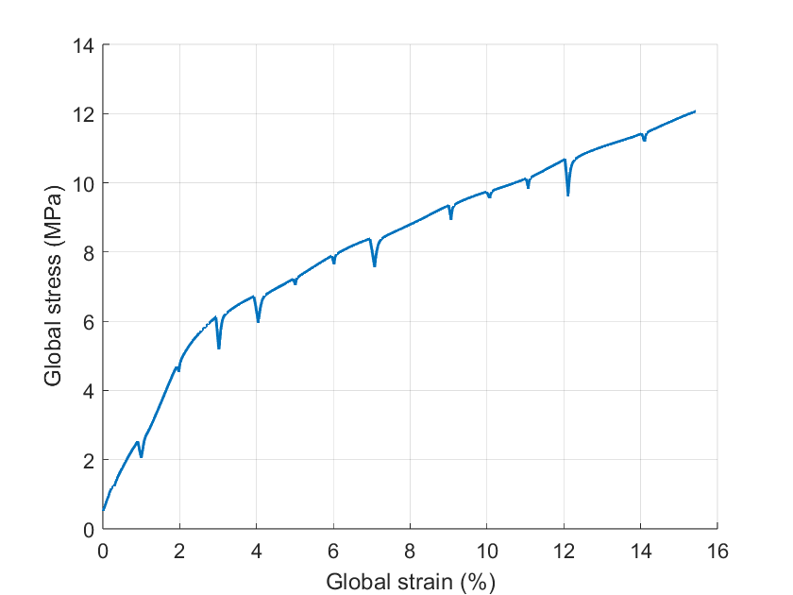
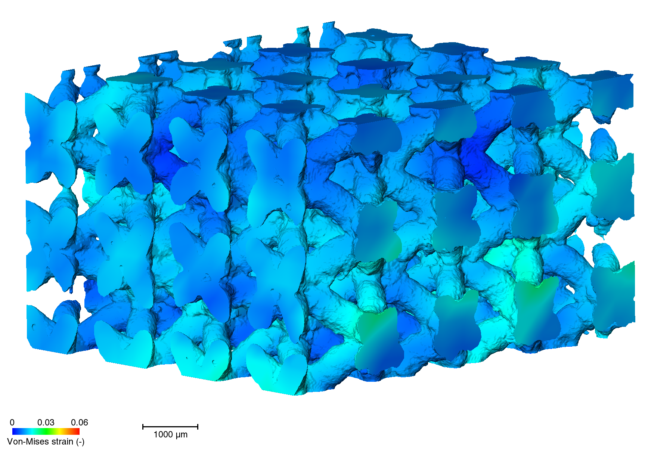
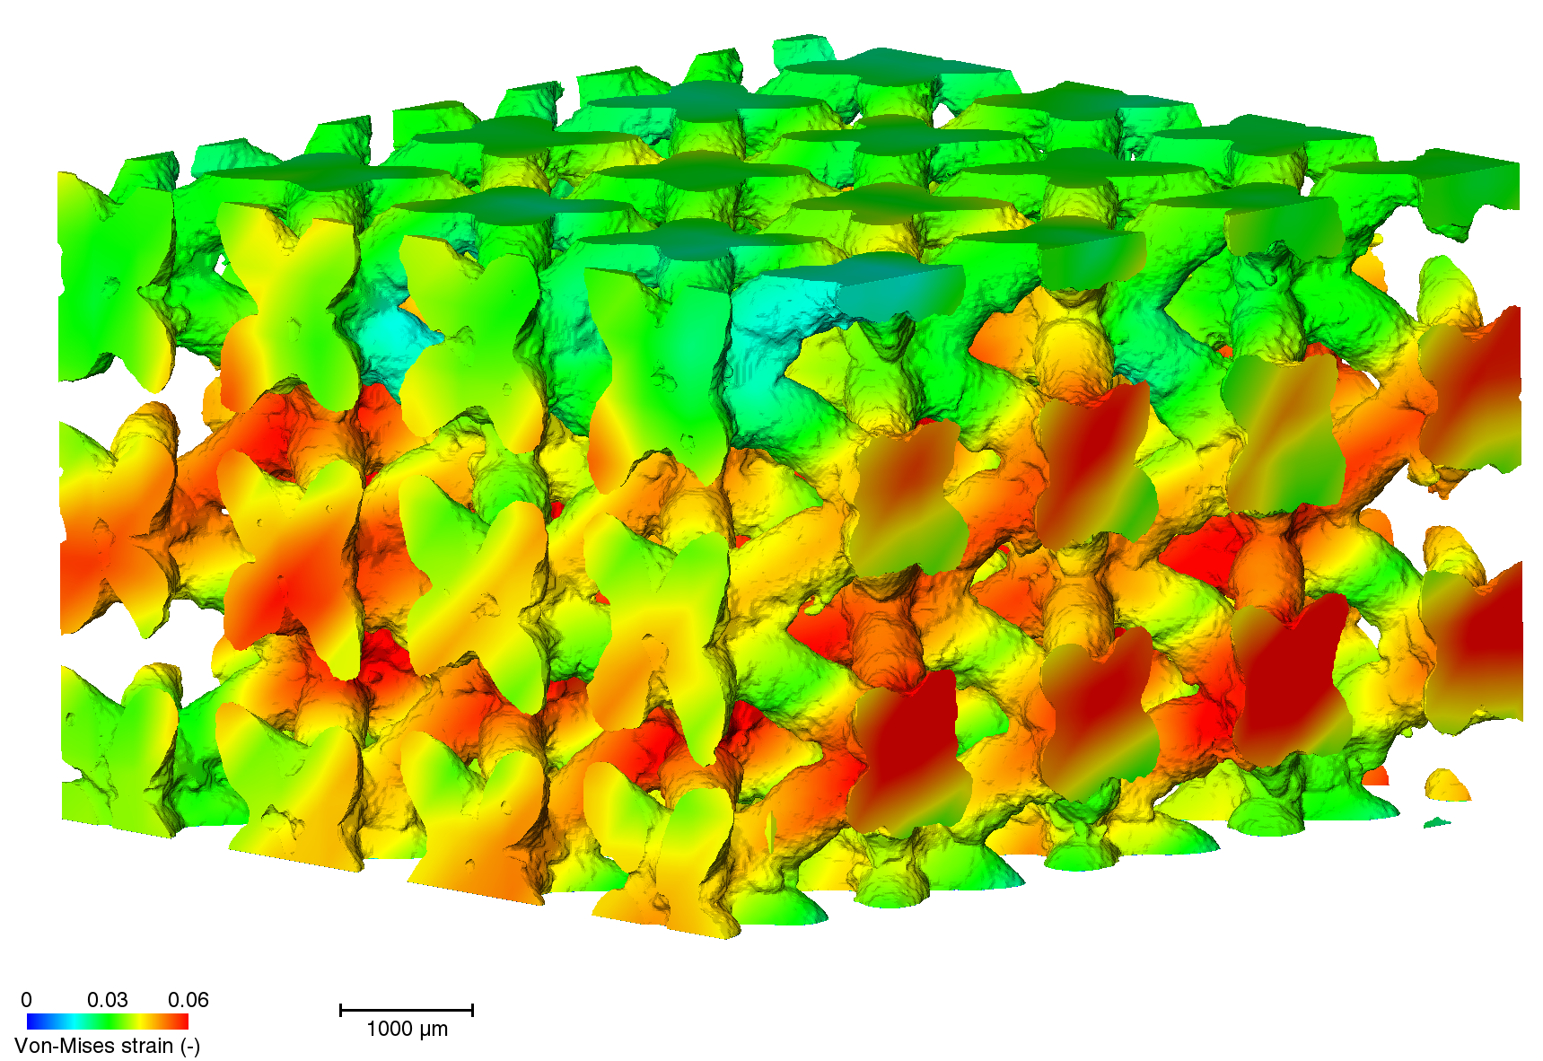
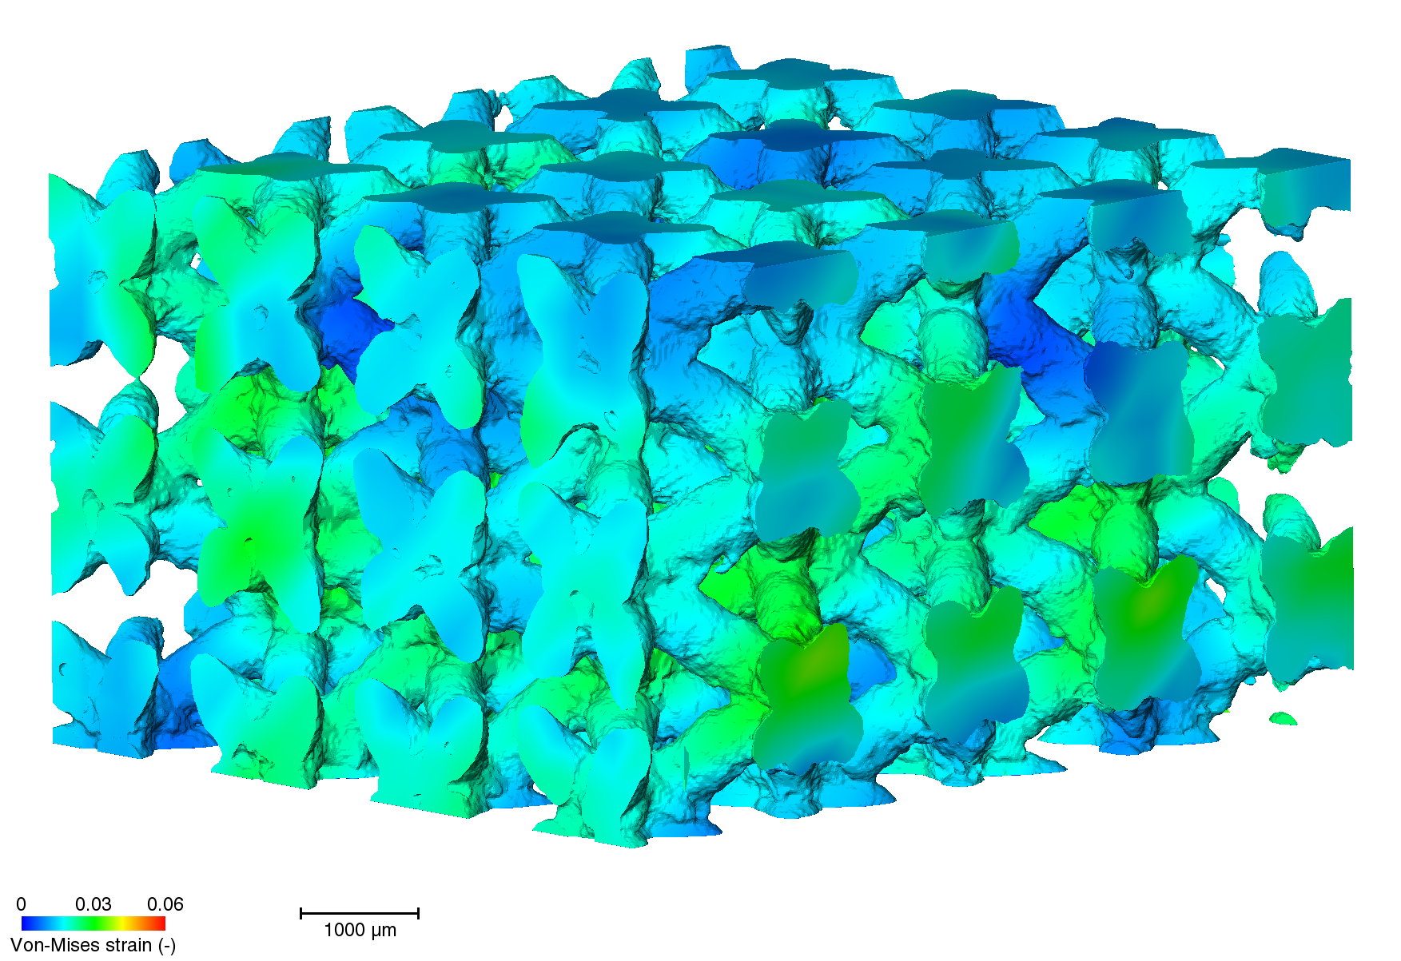
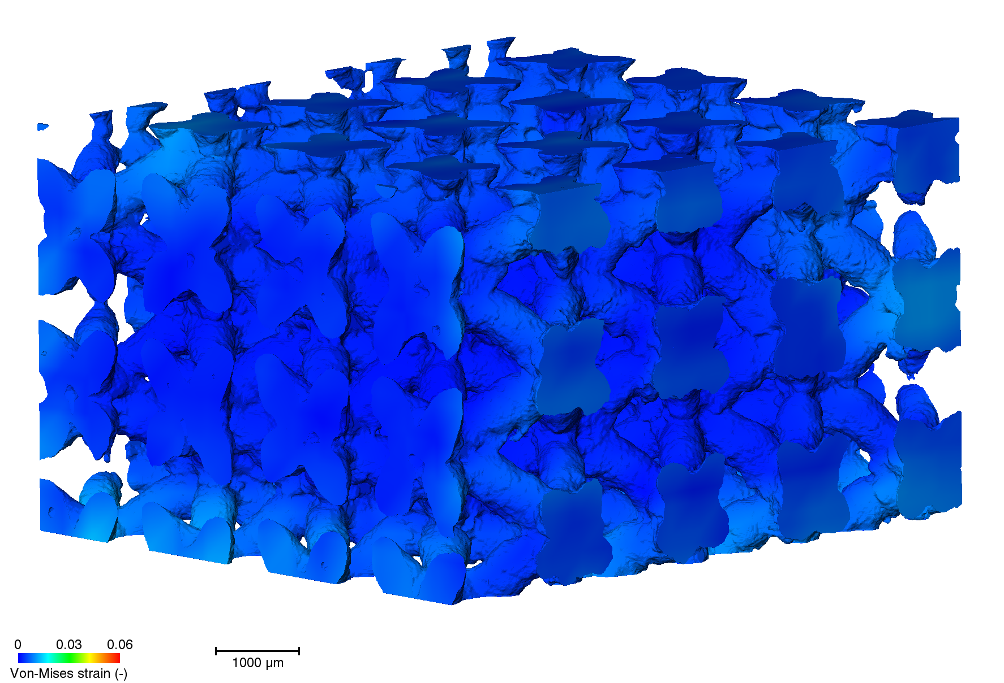
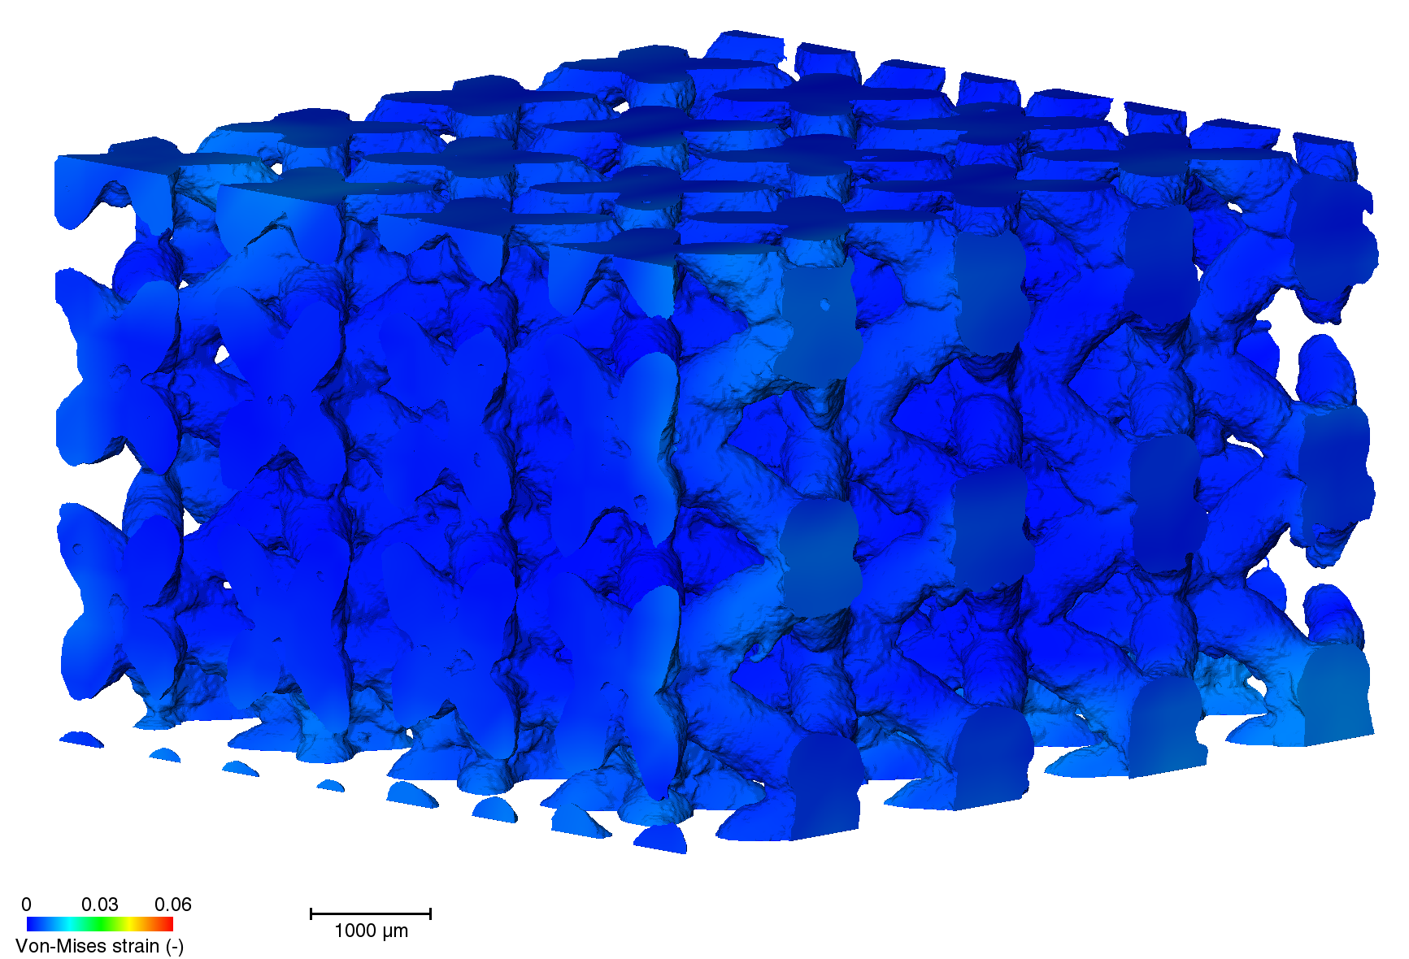
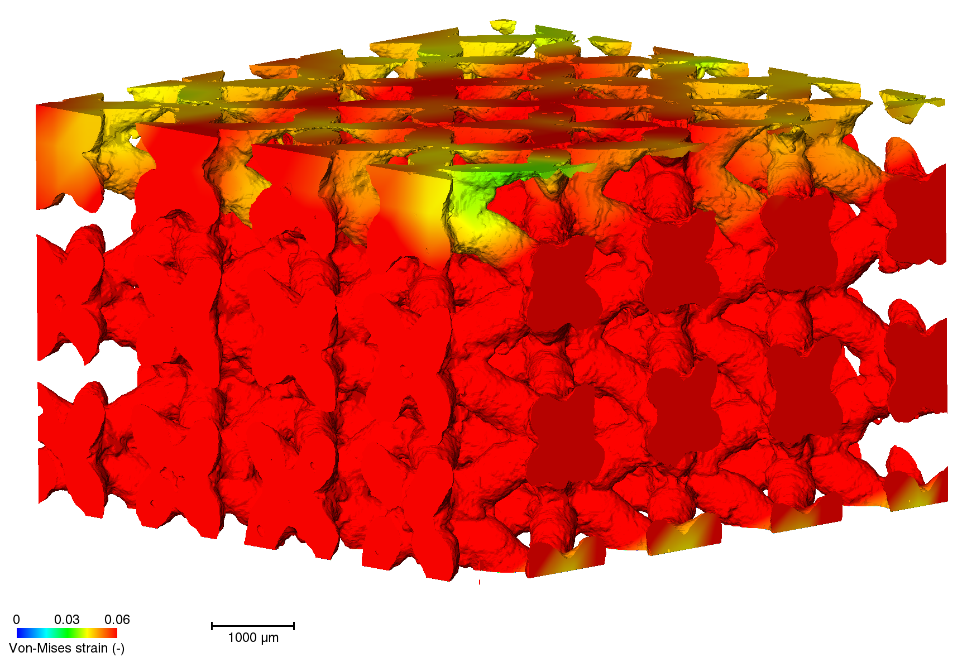
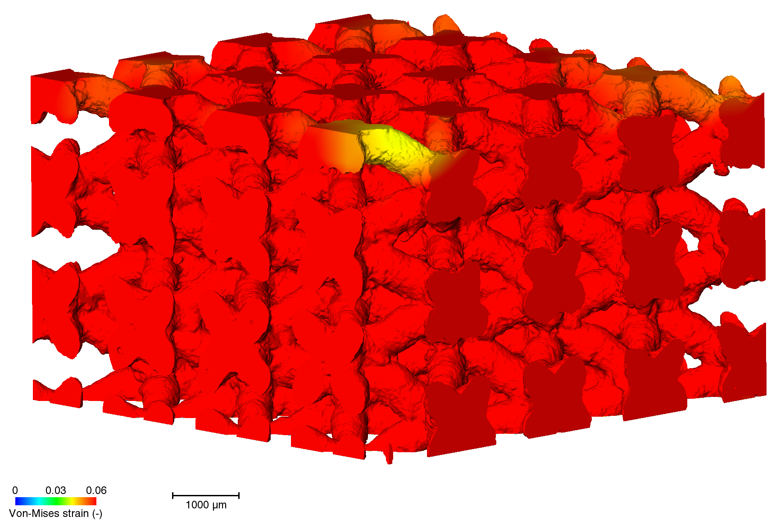
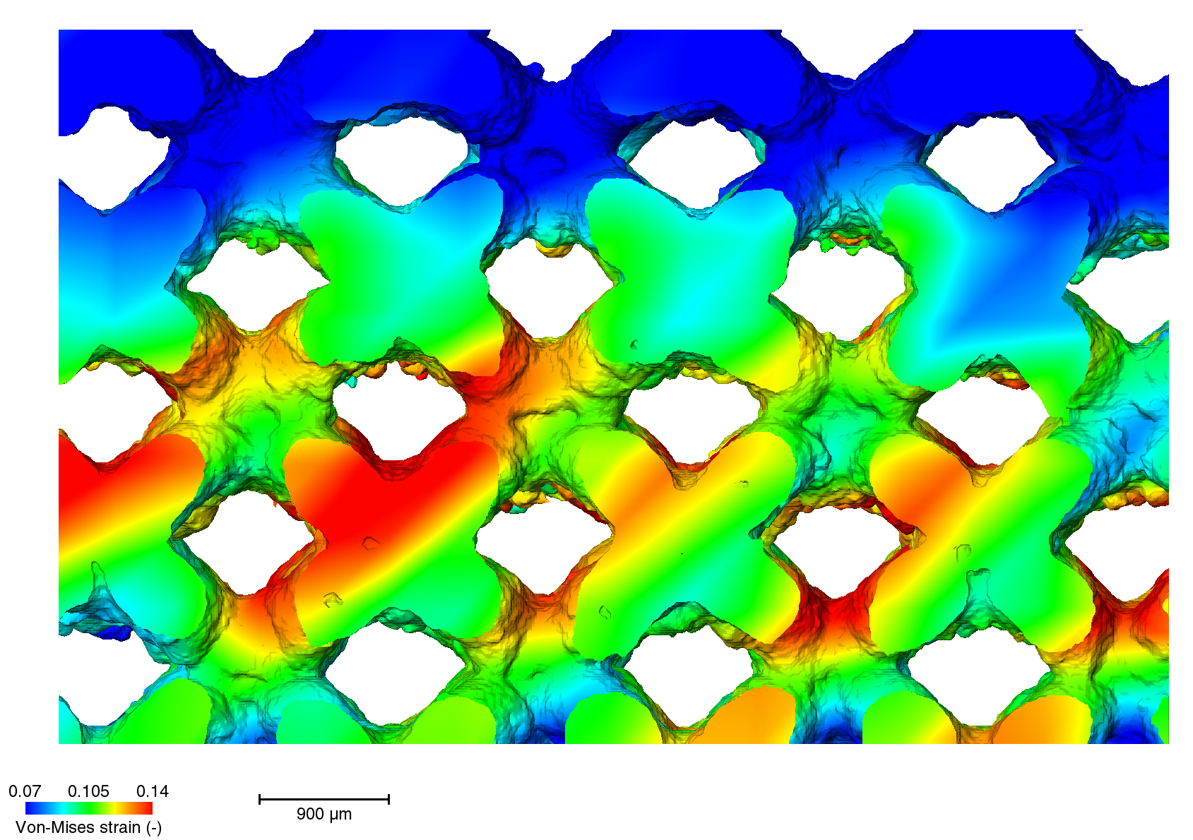
Incremental DVC
Scanning strategy: contour + hatch
Strain accumulation
Low High
Notes:
s5

Slide 16
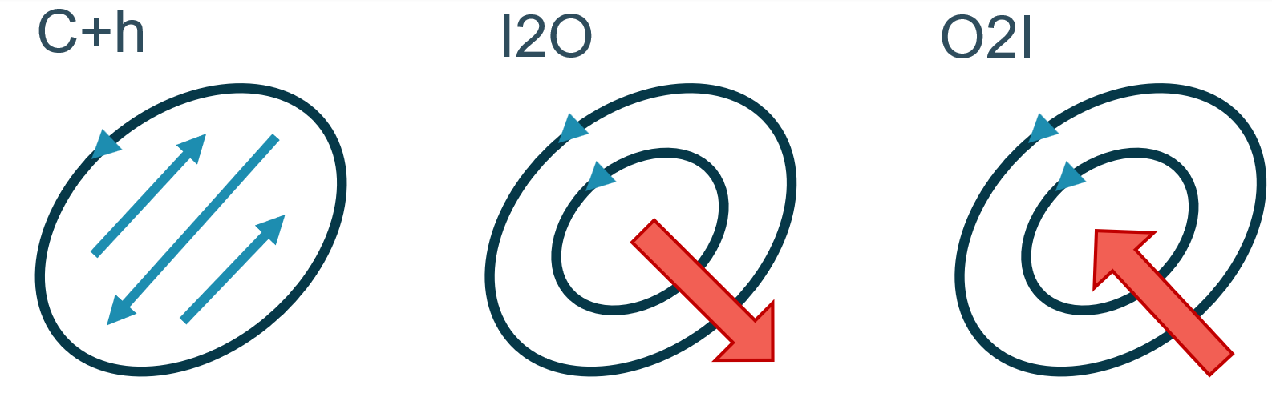
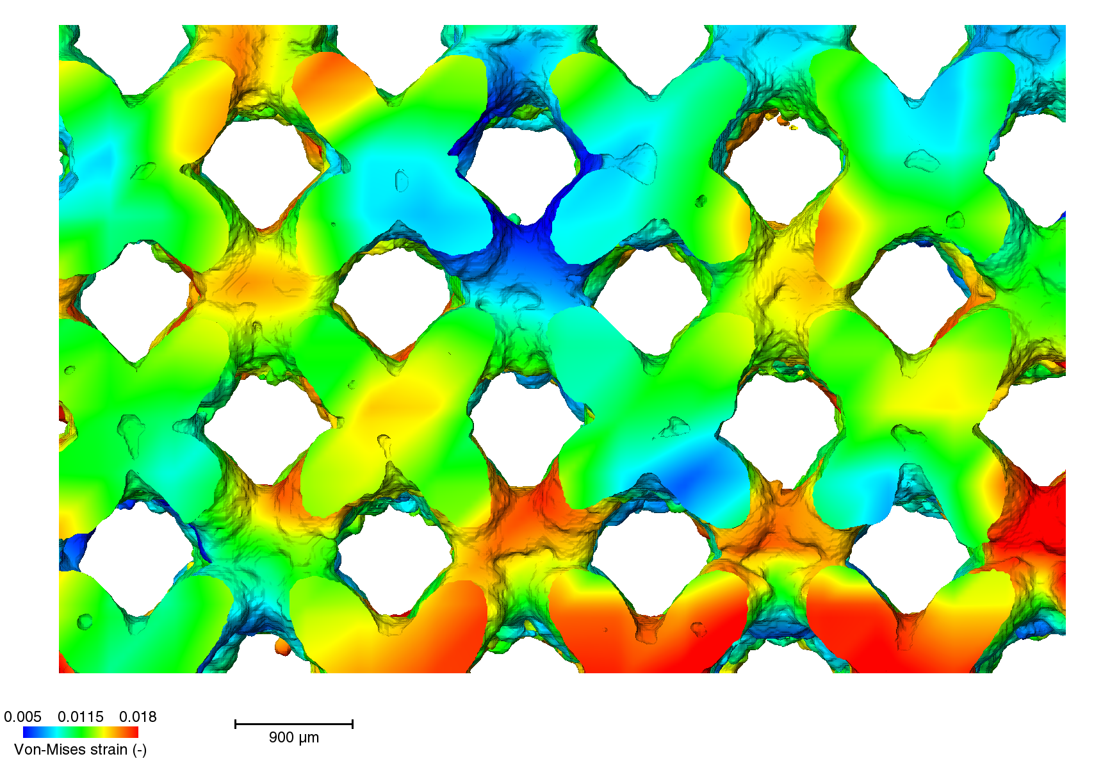
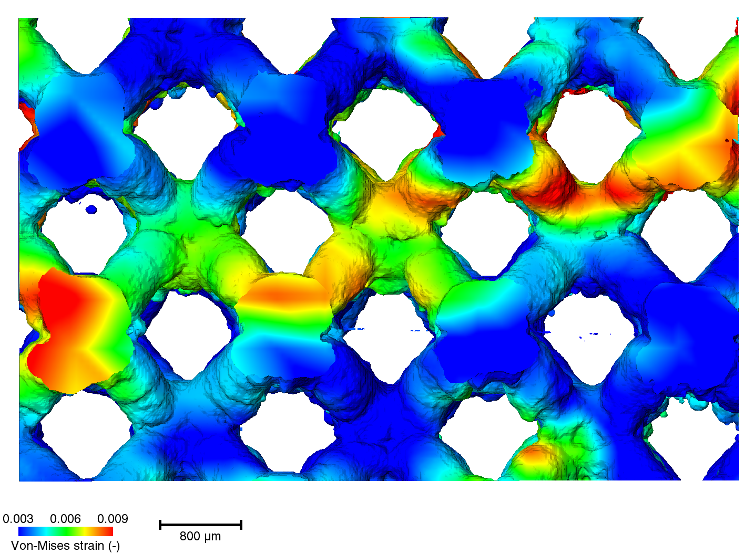
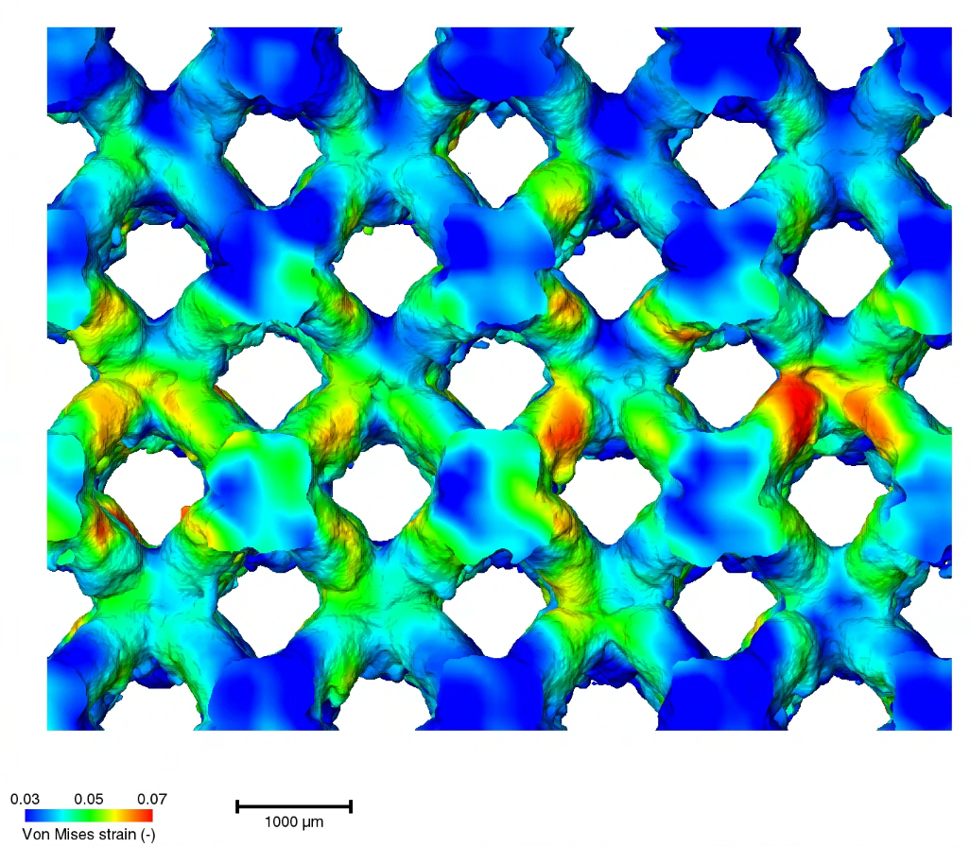

Incremental DVC
Scanning strategies comparison
Contour + hatch
Inner to outer contour
Outer contour to inner
Low High
Notes:
s5

Slide 17
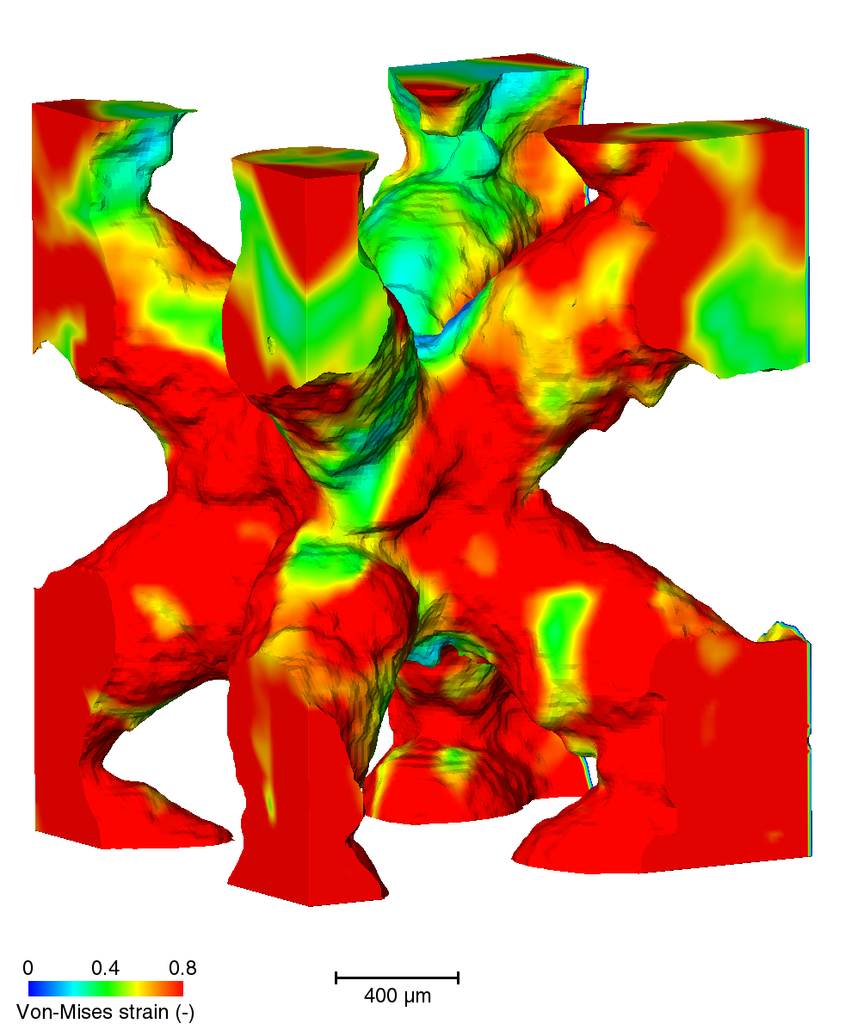
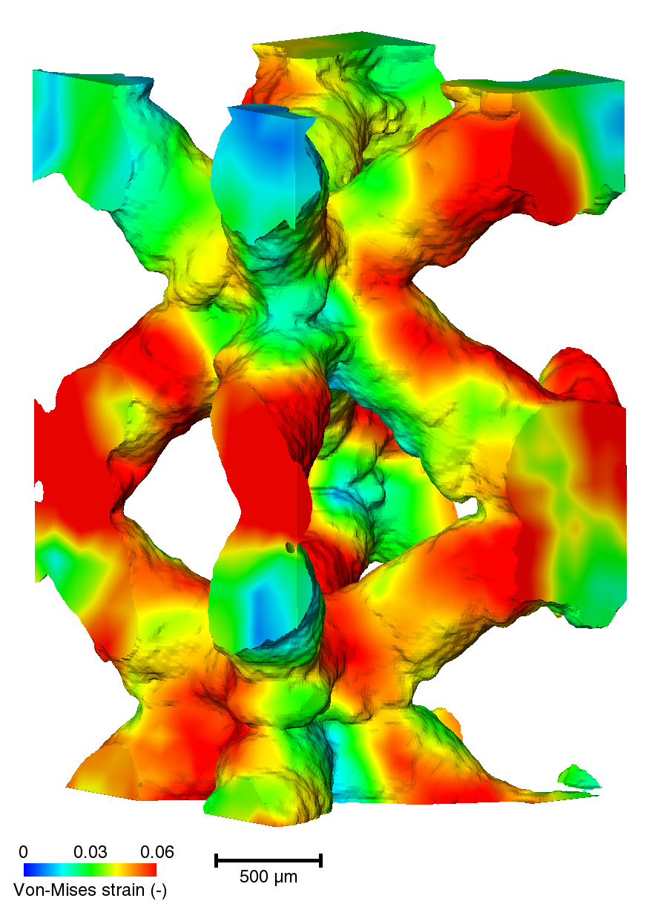
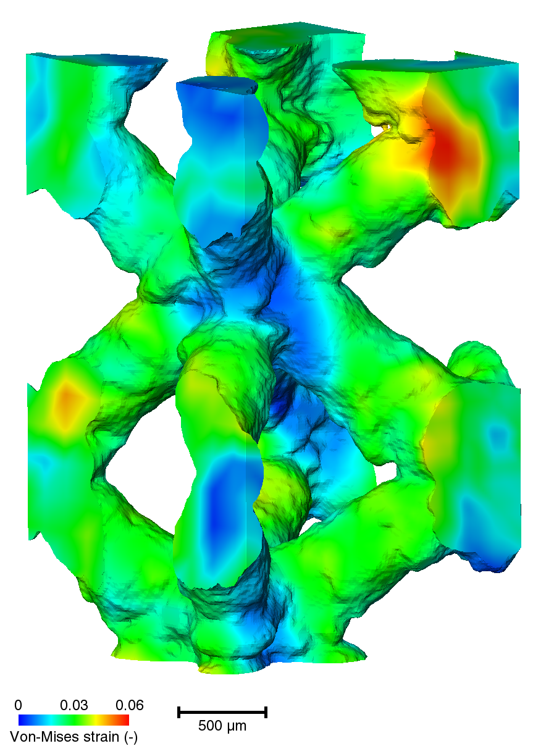
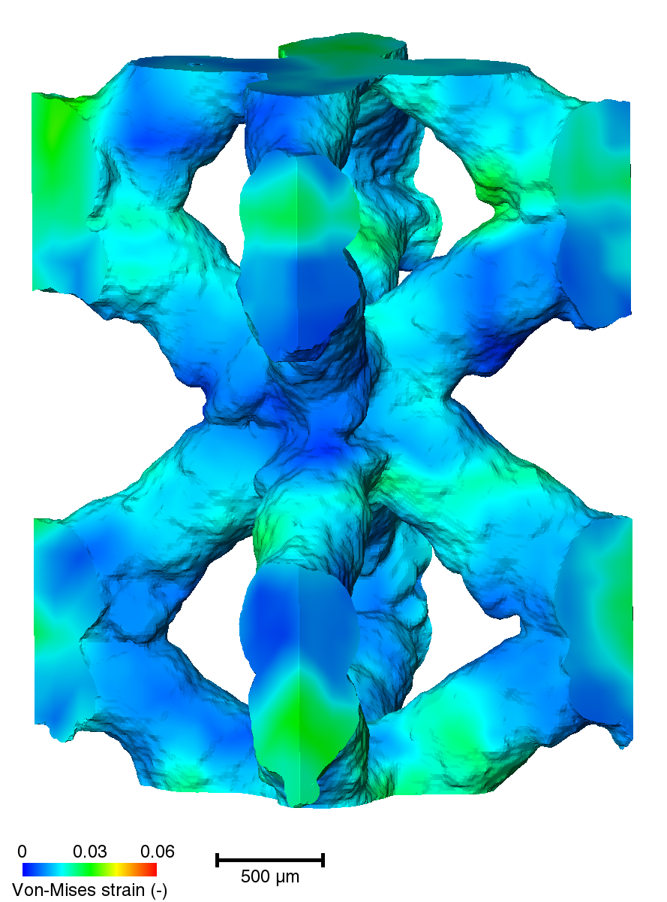
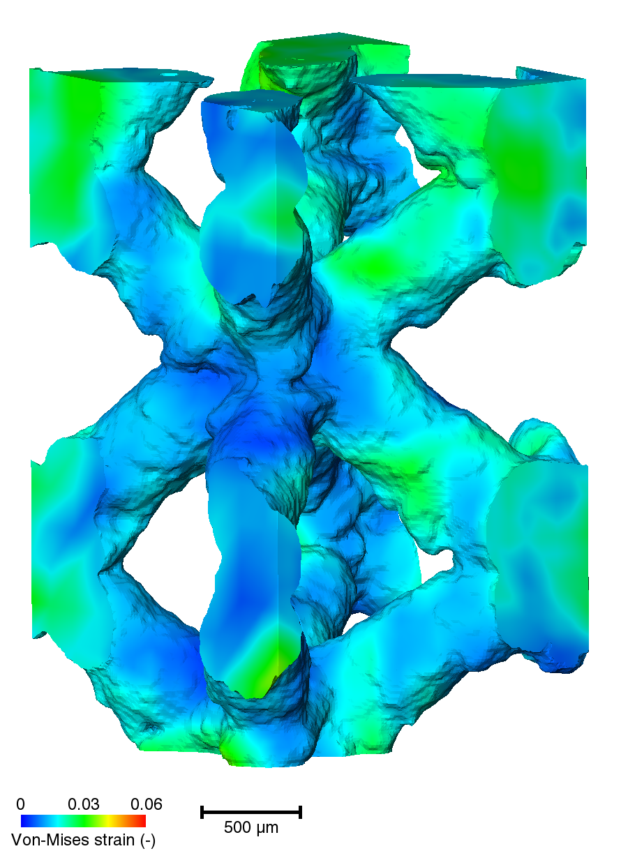
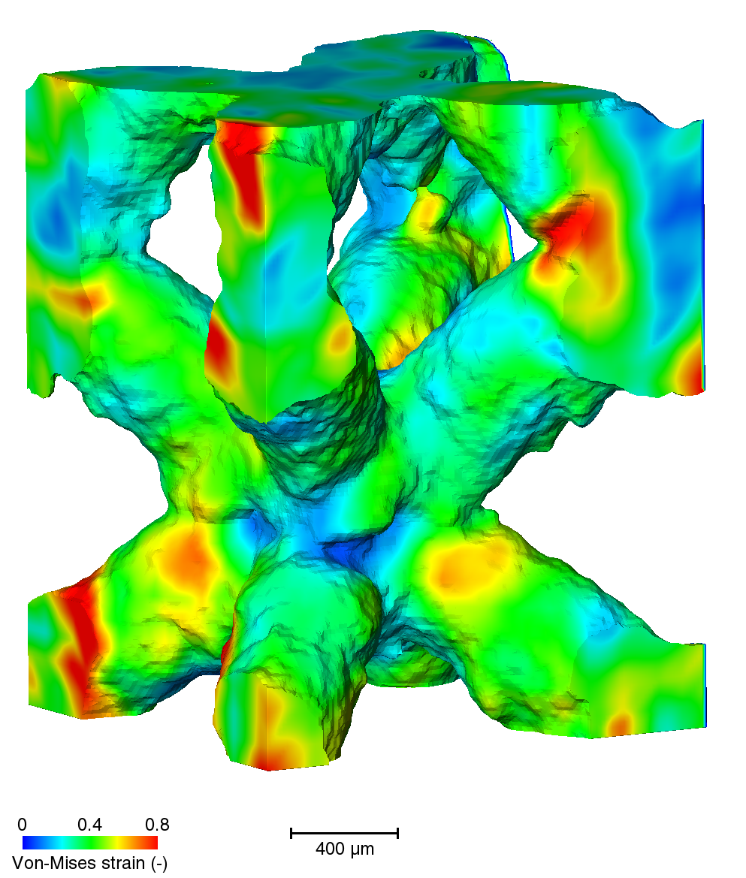
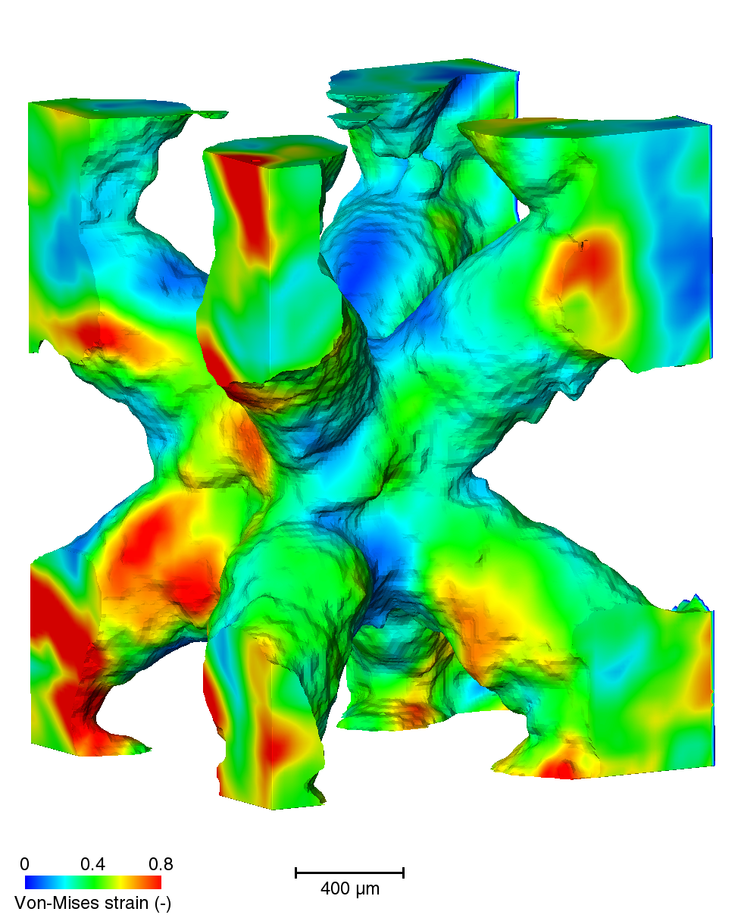
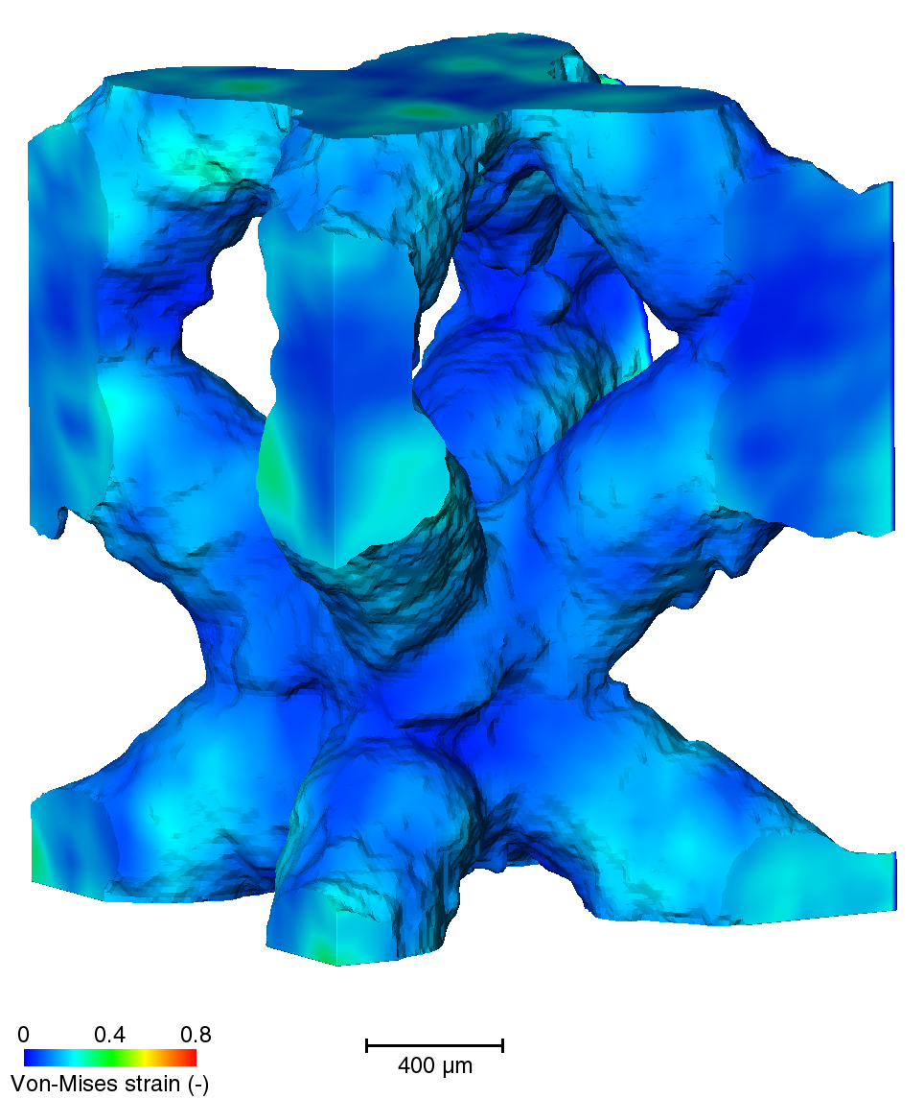







Incremental DVC
Scanning strategies at UC scale
Contour + hatch
Outer contour to inner
Without adapted contour mode
Low High
Notes:
S2 no cm

Slide 18







Incremental DVC
Scanning strategy: Point-scan
Min-max – side views
Low High
Notes:
S2 no cm

Slide 19
Conclusions
Deviation from CAD
Dimensional accuracy is challenging for copper because of deep and irregular melt pools
Adapted contour mode can improve irregularities and reduce volume fraction deviation
Point-scan lattices:
identify minimum manufacturing limit
Strain localisations
Compressive mechanical properties are unlikely to be affected by the scanning strategy
DVC visualised strain localisations, dominated by strut bending
200 µm
➔ scanning strategy does not seem to affect strain behaviour
  Contact me: frederik.vanherf@kuleuven.be

Slide 20



Laser parameter optimisation
Backup slides:
Built Volume Fraction (%)
Relative Density (%)
Notes:
Move to appendix

Slide 21

Manufacturing limit – Point scan BCC
Notes:
Optional

Slide 22


Segmenting the stress strain curve
ISO 13314 [5]
Densification strain
Elastic strain
Elastic strain
[5] ISO 13314 - Mechanical testing of metals - Ductility testing - Compression test for porous and cellular metals. (n.d.).
Notes:
Maybe move to appendix

Slide 23


Incremental Digital Volume Correlation (DVC)
Large strain: mesh is successively deformed by the displacement field at each step
Iterative solve of a linearized correlation equation to find best displacement vector
[8] Thermo scientific, Reference Guide Avizo 3D, Global DVC approach, 2026
Notes:
Move to appendix
Poor texture could be linked to pure copper not having microstructures
When using the DVC global approach, the mesh size results from a trade-off between spatial resolution and measurement uncertainties, often limiting DVC to highly contrasted materials. By adding to the traditional DVC problem (gray-level conservation) a second mechanical problem based on the elastic assumption (equilibrium gap [1]), the displacements that are not mechanically admissible at the scale of the element size (eg. high frequency noise) will be penalized. The new parameter "regularization length" defines the size in which the material is approximated by the linear elastic model and applies the penalization. By properly tuning the regularization length, this procedure can lower the measurement uncertainties and improve the spatial resolution
The resolution of a FE-based DVC problem consists in solving the equation: f(x) = g(x + u(x))
for all position vectors x, where f is the reference image, g the deformed image, and u the sought displacement field. Solving this equation is equivalent to minimizing the correlation residual η=f-g, which should be close to imaging noise. Assuming the conservation of the optical flow between the images, this problem can be linearized and expressed as a matrix inversion problem [5]
with M being the problem matrix, δu the sought increment of displacement at the considered increment, and b the second member (depending of the image gradient of f and of the correlation residual η). M being constant, the resolution of the DVC problem consists in successive update of the second member b after each iteration. The algorithm converges when the displacement increment norm |δu| is smaller than a certain tolerance fixed by the user (usually 1-3 voxels), which means the displacement field u(x) has been correctly measured.
To validate that the algorithm converged to a meaningful value of the displacement field, it is recommended to check the correlation residuals image, η=f-g. The results are deemed trustworthy when the standard deviation of the residuals is limited to the image noise. A non-uniform residual image or a pack of high residuals in the residual histogram indicate that the solution could be improved. Residual maps are presented in the tutorial associated with this module.

Slide 24





Incremental DVC
Scanning strategy: contour + hatch
Constant range – 3D
Min-max – side view
Low High
Notes:
s5

Slide 25










Incremental DVC
Scanning strategy: Inner contour to outer
Constant range – 3D
Min-max – side view
Low High
Notes:
s6

Slide 26

Incremental DVC
Scanning strategy: outer contour to inner
Low High
Notes:
s4

Slide 27





Incremental DVC
Scanning strategy: without adapted contour mode
Constant range – 3D
Min-max – side view
Low High
Notes:
S2 no cm

