Slide 1
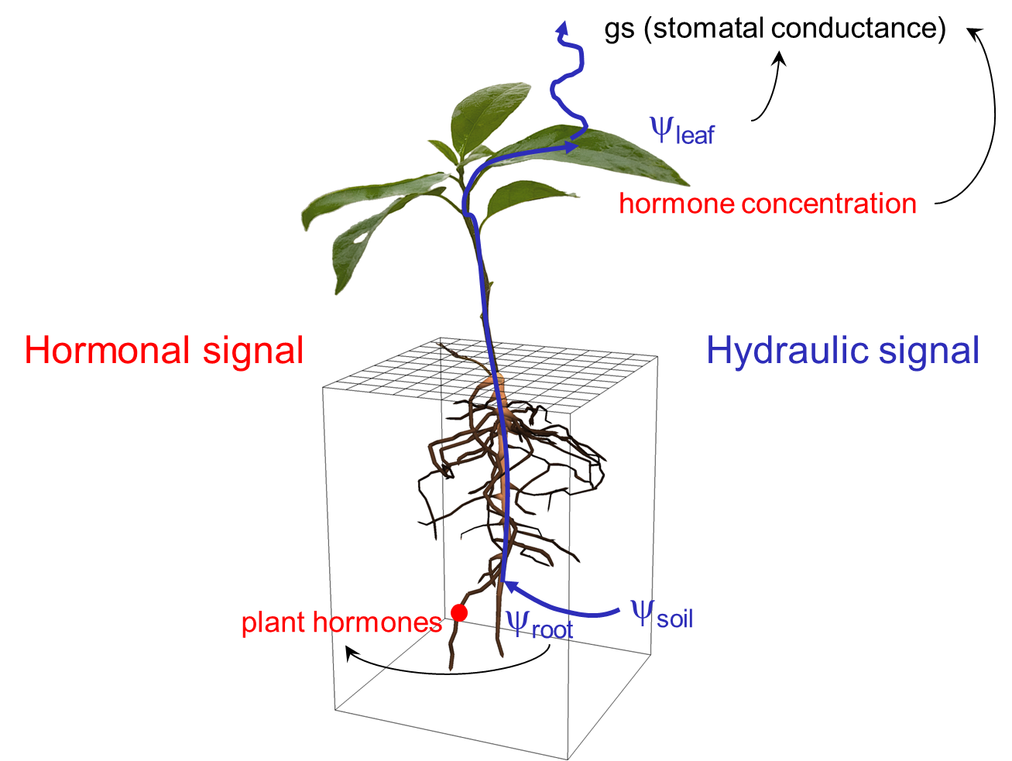
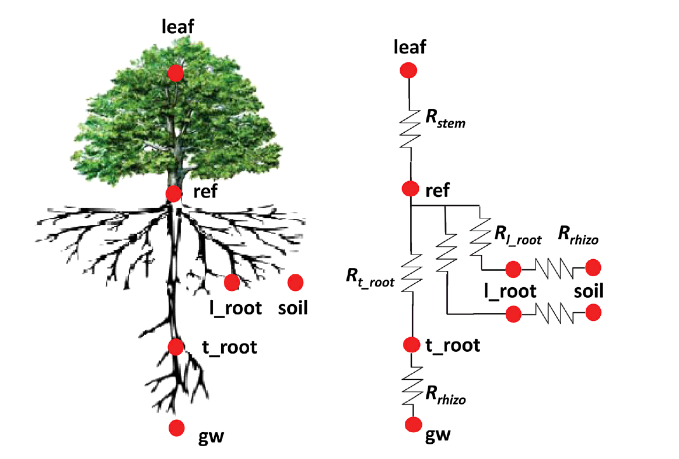
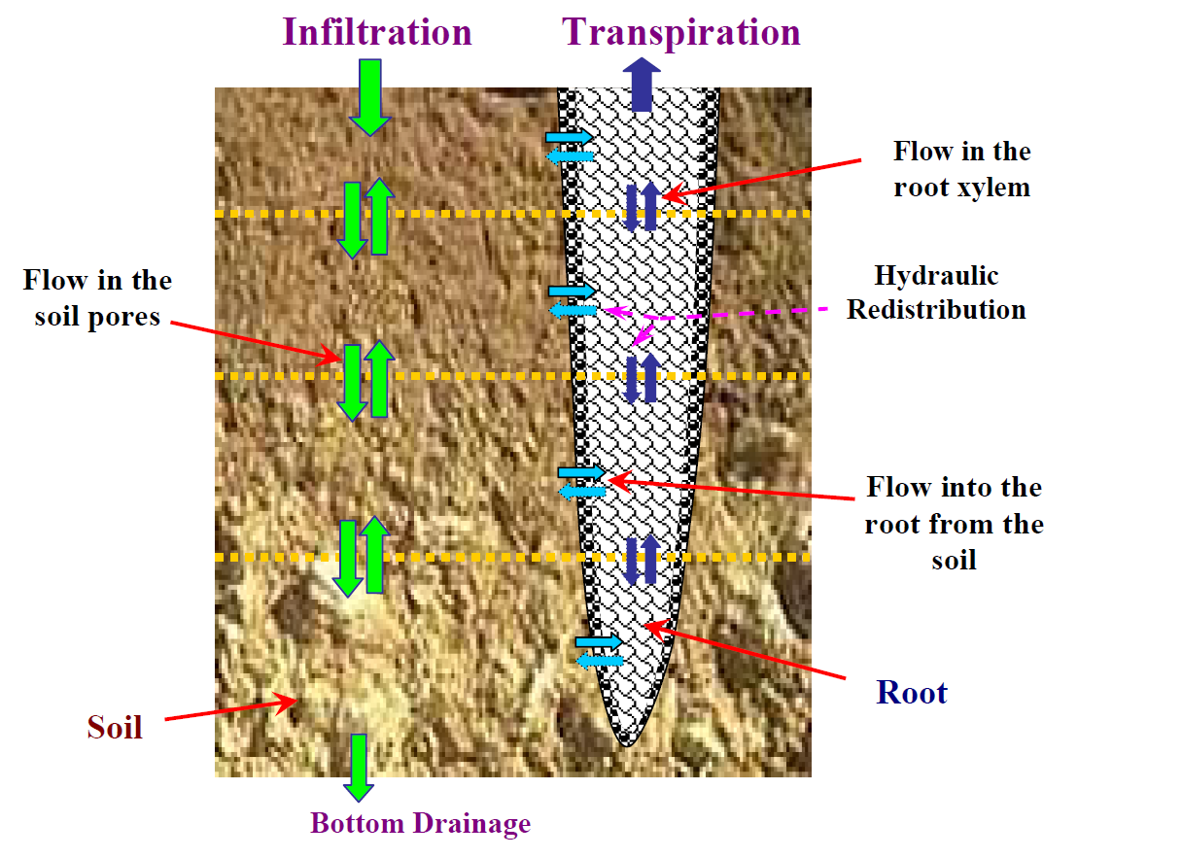
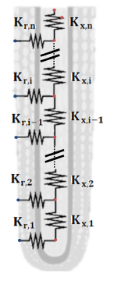
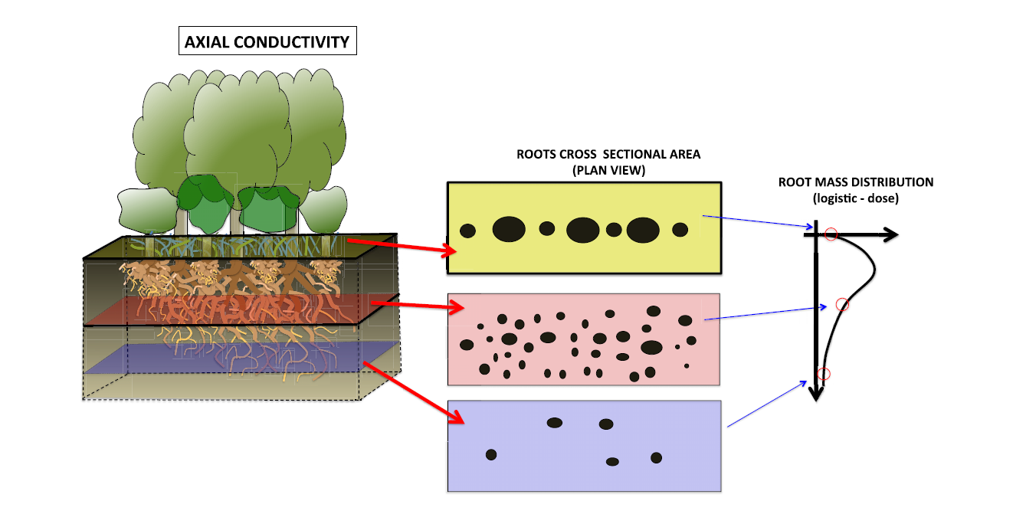
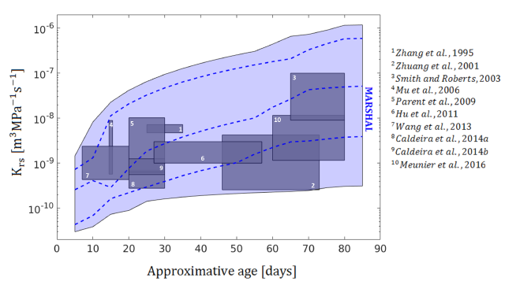
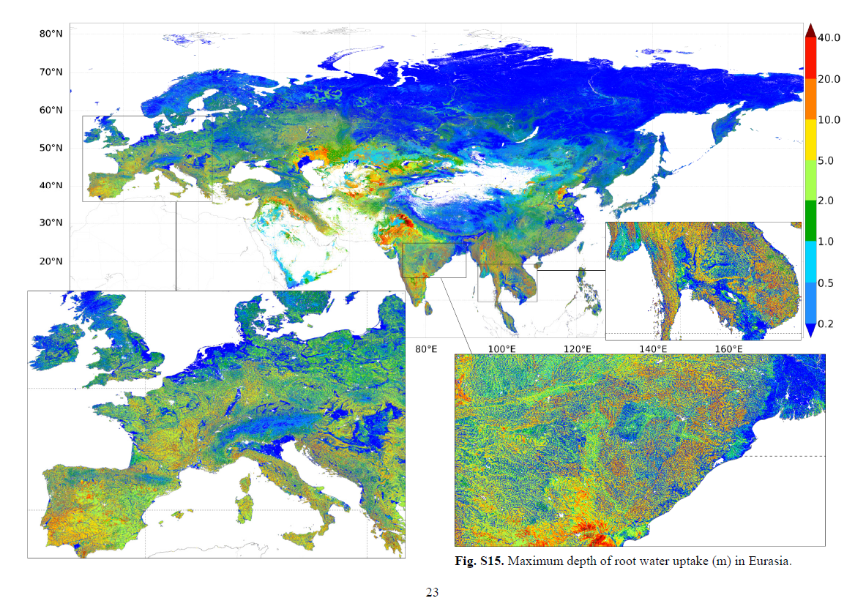
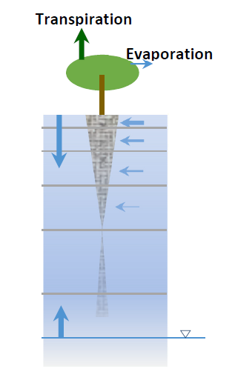
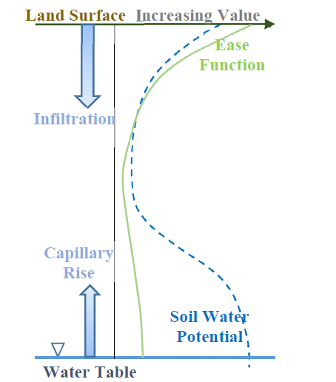
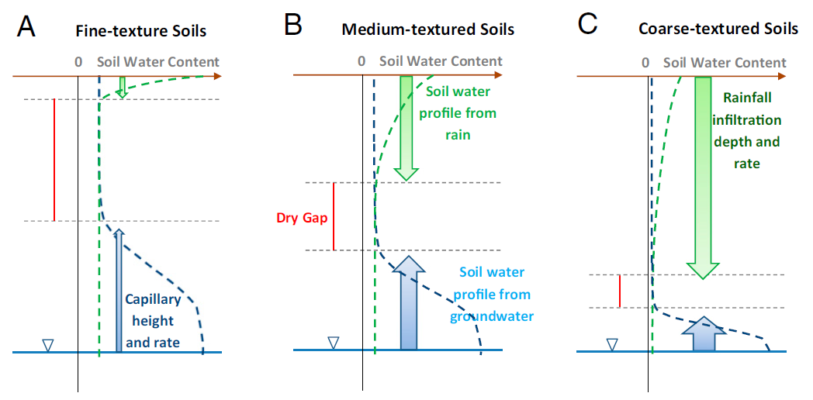
Linking functional structural plant models with root water uptake models in earth system models.
Jan Vanderborght¹, Valentin Couvreur², Mathieu Javaux^{2,1}, Andrea Schnepf¹, Felicien Meunier³, and Mauro Sulis⁴.
¹Agrosphere, IBG-3 Forschungszentrum Jülich, ² UC Louvain, ³Unversity Ghent, ⁴Luxembourg Institute of Science and Technology
Introduction
Functional-structural plant models (FSPMs) link the structure and properties of the plant to root water uptake functions. There is a large scale gap between water flow towards a single root segment and the exchange processes between the land surface and the atmosphere that are represented in earth system models (ESM). Different approaches exist to bridge this scale gap.
Functional structural plant models:
Full 3-D architecture
Root segment hydraulic properties
3-D water flow model
Other controls (e.g. Hormonal control) can be implemented
Parallel network models:
Parallel roots resistances connected to reference node
1-D to 3- water flow in soil
Direct (simple) solution of flow in root system is possible.
Big root models:
Root segments at different depths are connected in series
Coupled differential equations to describe flow in soil-root system
Impact of resistance losses due to axial flow can be accounted for.
Amedu and Kumar , HESS 2008
Doussan et al., Ann. Bot., 1998
Javaux et al., VZJ, 2008.
Huber et al., Plant Soil, 2014.
Gou and Miller, Ecohydrology, 2014
Manoli et al., AdvWR 2015
Nimah and Hanks, SSSAProc, 1973
Couvreur et al., HESS, 2012
Use functional structural plant models to parameterize RWU parameters in ESM
Mainly for parallel network models
Dynamics and genetic variability of RWU parameters can be represented
Quijano and Kumar , WRR 2015
Meunier, PhD Thesis, 2017.
Use of parallel network model to simulate global root distributions as a function of groundwater table depth and soil type
Fan et al., PNAS, 2017
Questions for future model intercomparison studies:
What is the effect of model concepts on the simulated relations between soil state variables and fluxes by ESMs?
How can parameterization be linked to root architecture and root hydraulic properties?
Do we need to consider (seasonal) root growth and dynamic adaptation of root development to environmental conditions?

