Slide 1


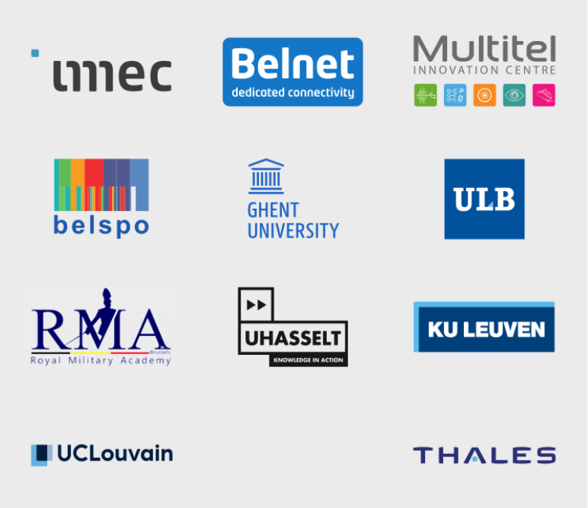
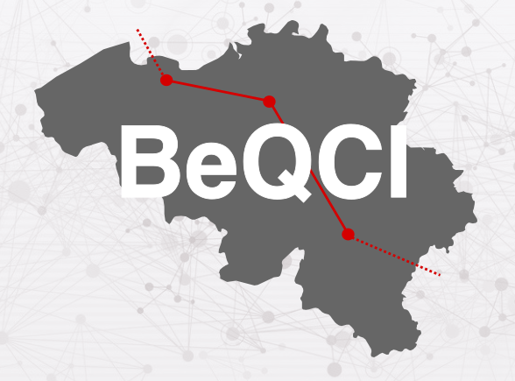
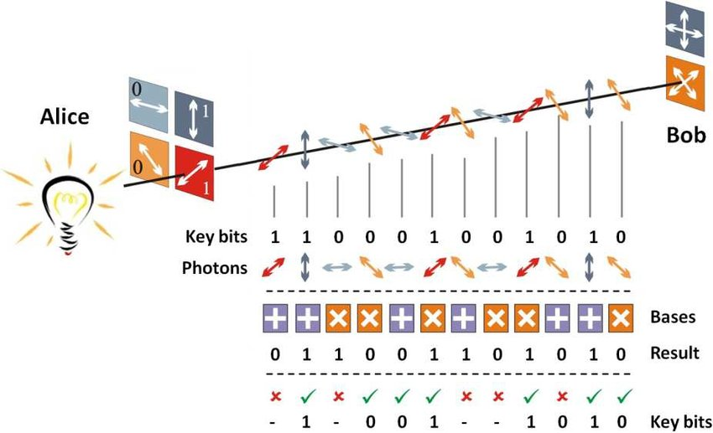
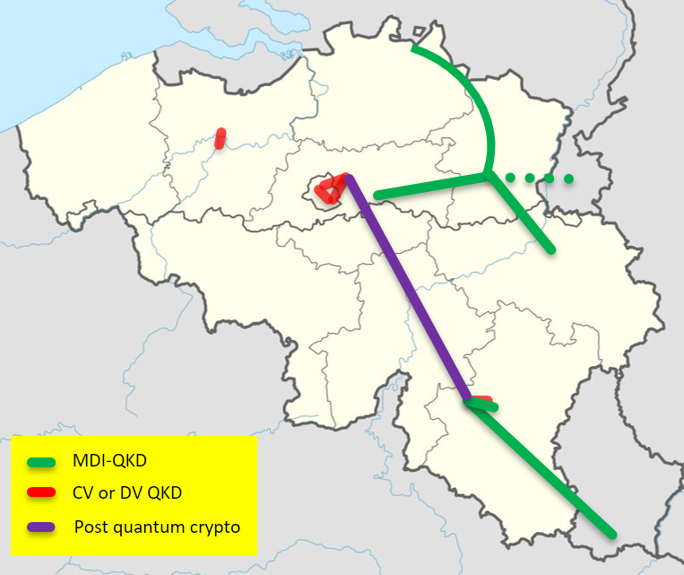
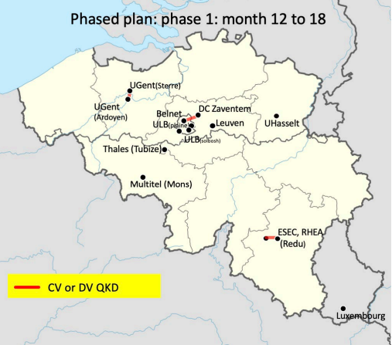
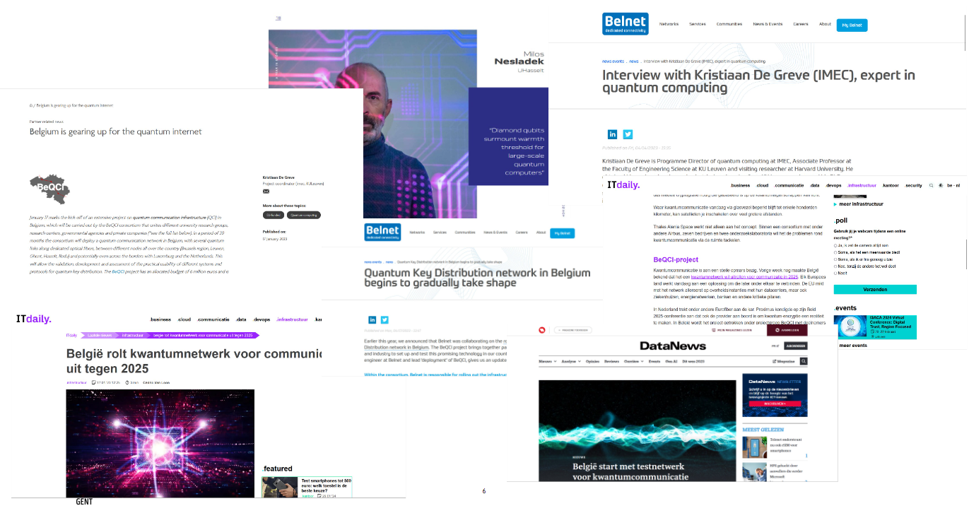


BeQCI
Background and challenges
The Project and Challenges
Consortium presentation
BeQCI: Belgium’s QCI project aims to deploy the first quantum key distribution (QKD) network in Belgium, leveraging world-leading expertise. This initiative addresses deployment challenges and fosters EU collaboration. The consortium, including research centers, industry partners, and universities, emphasizes workforce training and knowledge dissemination.
Our challenge is to make Quantum key distribution “easy” to exploit for achieving much better security of existing businesses
Technical Challenges: Current QKD systems face limitations due to high costs, inadequate long-distance communication, and security weaknesses in the entire communication chain.
Financial Challenge: The high cost and specialized knowledge required for deploying a Quantum Communication network hinder industrial investment. This project seeks 100% public funding to stimulate market demand and enable future industrial investment by identifying market needs through use cases.
Description and main innovation
Description
Quantum key distribution
Addressing the impending threat of quantum computing, the European Commission initiated the EuroQCI initiative to establish a secure quantum communication infrastructure.
BeQCI, Belgium's response to this initiative, aims to deploy various Quantum Key Distribution (QKD) technologies, including DV-QKD, MDI-QKD, CVQKD, and satellite QKD, addressing the limitations of existing systems.
Through use cases involving federal public services, hospitals, banks, and research centers, BeQCI seeks to understand market demand and demonstrate the reliability and benefits of QKD for future cross-border links.
Quantum Key Distribution (QKD) stands as a cornerstone of secure communication, employing the transmission of photons with random quantum states through fiber optic cables to form encryption keys. At the receiver's end, each photon navigates a random path through a beam splitter into a collector, culminating in the creation of an encryption key. This key undergoes rigorous error correction and privacy amplification processes to fortify security against potential eavesdropping attempts.
Quantum key distribution is a way of distributing secure cryptographic keys through an untrusted network, without risking that the information slips away. Why? That is due to 2 principles :
Heisenberg’s uncertainty principle : Certain pairs of properties cannot be precisely measured simultaneously in quantum systems.
No-Cloning Theorem : It's impossible to create an exact copy of an unknown quantum state.
Work packages
Work package 1 : Project management and coordination (IMEC)
Work package 2 : Deployment of a QKD infrastructure in Belgium (Belnet)
Work package 3 : Use cases (IMEC)
Work package 4 : Selected research lines towards the future deployment of larger scale quantum network (ULB)
Work package 5 : Dissemination and training (UGent)
Work package 6 : cooperation and coordination with other national-QCI projects and regional (Belgian) cybersecurity initiatives (UHasselt)
Free-Space Quantum Key Distribution - Scientific Figure on ResearchGate. Available from: https://www.researchgate.net/figure/BB84-protocol-basic-scheme_fig11_309731586 [accessed 12 Feb, 2024]
Achievements
Phase 1 60% done :
3 QKD systems delivered: ​
          1 pair CV-QKD LuxQuanta ​
      1 pair DV-QKD ID-Quantique
      1 pair DV-QKD Think Quantum
      First link of CV-QKD about to be deployed in Gent
BeQCI Events :
Cyberwal (official event)
ITF world (demo booth and presentation)
QCI days Vienna (Elevator pitch)
Press releases
Contact details
Karel Dumon :
Karel.Dumon@imec.be
Giacomo Carrara :
Giacomo.carrara@Ugent.be
Dries Van Thourhout :
Dries.VanThourhout@UGent.be
Baptiste de Wasseige :
Baptiste.dewasseige@UCLouvain.be
A gateway has been developed and tested to enable secure communication between systems, ensuring interoperability and addressing availability concerns
This project was funded within the DIGITAL-2021-QCI-01 Programme that has received funding from the European Union’s Horizon 2020 research and innovation programme under Grant Agreement No 101091730.
Notes:
Background & challenges :
- Belgium has world-leading expertise in quantum key distribution (QKD), the surrounding photonics technologies, cryptography and cybersecurity. Yet, no actual QKD links were demonstrated in the country thus far.
- addressing current limitations of QKD deployment: high cost, limited distance, and security limitations of various forms (security of some novel QKD protocols, security of the complete communication chain, authentication).
- The Be-QCI consortium consists of research centers, an internet provider, several industrial partners and a series of universities
- deploy a quantum network in Belgium
- dates : 2023 – mid 2025
- The project is funded by the EU to a ratio of 50%. The remaining 50% is entirely funded by a public authority: the Belgian Federal Science Policy Department (BELSPO).
- challenge : financial obstacle : Indeed, the cost and knowledge required to deploy and develop a Quantum Communication network is too high for industrial investment at this moment, especially given the unknown market for QKD in the very near future. It is one of the aims of this project to acquire a better view (via uses cases) of the market's needs on this topic. Therefore 100% public funding is needed to initiate the development and stimulate a clear market demand to enable industrial investment in the field.
- challenge : satellite QKD : link with IntUQKD (mini presentation)
- main risks : challenges (?) : Quantum terminal component failures due to environments // Lack of having enough expertise to establish different components of networks, especially the QKD modules // inter-operating LUX-BE and BE-NL network // Difficulty to acquire QKD systems // Changes in the technical personnel involved in the program
IMEC: Leader in nano-electronics and digital technologies. Unique microchip technology combined with ICT expertise. Creates innovations in healthcare, smart cities, and energy. Strong experience in European projects.
Belnet: National research network providing high-quality infrastructures and services. Stimulates international cooperation in research and education. Offers connectivity, security, cloud, and mobility services.
RHEA Group: Major player in cybersecurity and quantum communications. Provides engineering services and security solutions. International presence across Europe and North America.
Universiteit Gent: Hosts photonics and quantum research groups. Expertise in integrated photonics and quantum information theory. Contributes to quantum optics and quantum key distribution.
COSIC (KU Leuven): Research group focused on cryptography and cryptanalysis. Expertise in symmetric and post-quantum cryptography. Actively involved in NIST post-quantum cryptography competition.
Université Libre de Bruxelles: Hosts groups with expertise in quantum communication and photonics. Internationally recognized for quantum information theory. Contributes to developing novel QKD algorithms and protocols.
UHasselt: Engaged in quantum technology research, particularly in quantum sensing. Expertise in quantum memories and single photon sources. Involved in EU Quantum Flagship projects.
Royal Military Academy (RMA): Conducts research in cryptography and steganography for defense. Expertise in developing cryptographic algorithms and solutions. Supports military intelligence services in cybersecurity.
MULTITEL: Private research center specializing in applied photonics and network engineering. Expertise in optical aspects of quantum cryptography. Involved in railway certification and cybersecurity projects.
UC-Louvain: Hosts ICTEAM engaged in cybersecurity research. Expertise in formal verification and cybersecurity. Coordinator of Walloon strategic innovation initiative CyberWal.
Thales: Supplier of communication systems and sensors for defense sectors. Develops cryptographic solutions and cybersecurity products. Involved in NATO programs and cryptographic suite development.
Description & main innovation:
- We will make use of various QKD technologies (DV-QKD, MDI-QKD, CVQKD, and satellite QKD)
- QKD link to Luxembourg, a neighbor country, and preparation of further cross-border links with the Netherlands, France and Germany
- quick description of the different work packages
- main innovation = Quantum key distribution
Achievements:
3 QKD systems already delivered: ​
1 pair CV-QKD LuxQuanta (Spain)​
1 pair DV-QKD ID-Quantique (Swiss – Non-27EU) ​
1 pair DV-QKD Think Quantum (Italy)
A gateway has been developed and tested to enable secure communication between systems, ensuring interoperability and addressing availability concerns

