Slide 1

Scientific Careers and Work/Life Interference
Bernard Fusulier (FNRS – U. de Louvain)
Pascal Barbier (U. Paris 1 Panthéon-Sorbonne)
Farah Dubois-Shaik (U. de Louvain)

Slide 2
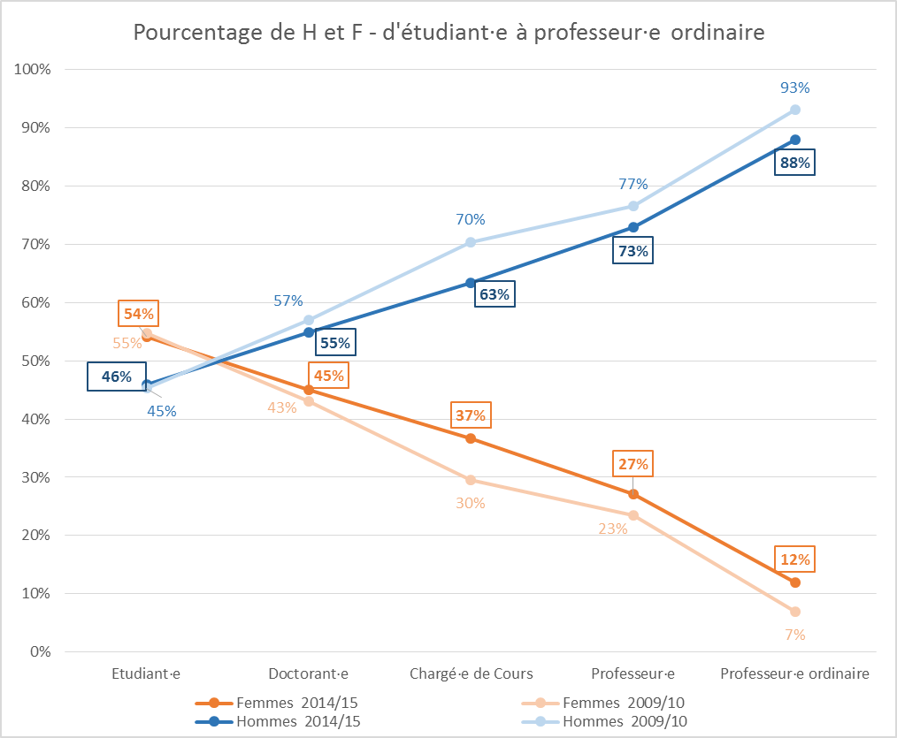
Leaky pipeline and Glass Ceiling

Slide 3
Inter related phenomena
Masculine habitus (Bourdieu, 1984)
Matilda effect (Rossiter, 1995; Fassa et al., 2012)
Old boys’ clubs (Case, Richley, 2012)
Sticky floor (Booth, Francesconi and Frank, 2003)
Gendered Organization (Acker, 1990)
And the work/family interference (our focus)

Slide 4
A traditional normative referential
Men of sciences
In a social field (Bourdieu): a space of struggles for access to scientific recognition and positions
An ethos, which requires demonstrating a vocation and total investment in a professional career in a greedy institution (Coser)
Based on the « myth of separate worlds » (Kanter): work and family

Slide 5
… combined with a new ideology
The Excellence in a Productive-Competitive Regime
In terms of productivity, competitivity, mobility and accountability
And the increase of precariousness for many researchers
The figure of the scientist as « lonely heroes and heroines »

Slide 6
In consequence
Researchers under high pressures
A male-centric organizational model expecting total, impassioned engagement with work and a dissociation from family time
Negative work/family interference playing as a hidden filter in the career
More significant for women than for men
But depending on configurational supports (configurations of professional life and private life)

Slide 7
Driving questions
What are career relationships among postdocs in academia?
We have sought to understand how researchers entered academic research, the gratifications they consider they currently benefit from (resulting from their activity and employment status), the type of engagement they agree to in work and in their scientific field, the types of relationship existing between their professional activity and private life (in particular family life)
Gender difference And variations between women

Slide 8
Our qualitative empirical corpus
Semi-directed interviews :
in 2010-2011 with eighteen male and female post-docs research fellows of the National Fund for Scientific Research in Belgium (FNRS) (11 women and 7 men)
+ in 2011-2012, 30 FNRS postdocs (14 women and 16 men)
+ in 2013-2014, 16 FNRS postdocs (11 women and 5 men)
(+ in 2014-2015, sixteen female newly FNRS tenured researchers)

Slide 9
Four types of career relationships among FNRS post-doctoral research fellows
Engaged
Optimistic
Ambivalent
Distant

Slide 10
Engaged
A life priority, exclusive of other strong involvements
  Intense engagement aimed at “giving yourself every chance” and thus to being totally available for work
  Extra-professional activities are thus relegated to second place
  Men and women but observed among unmarried female researchers, or else cohabiting with a male or female researcher, or having prolonged experience in the academic field but childless.

Slide 11
Example
Flavie, a 30 year old female researcher in psychology. Single and childless, her daily life is entirely rhythmed by research, from Monday to Sunday, and only leaves room for a few odd moments of leisure. Thus the sport of climbing, which she loves and practices Sunday midmornings is wedged in between research activities, before and after. She feels she needs that Sunday work to finish up what she couldn’t do during the week. The same applies to her “holiday” time, which she uses (at Christmas, for example) to write a research project or carry out activities calling for long periods of concentration, like drafting articles. This commitment to work is linked to a vision of scientific work: it is likened to a form of leisure. Flavie works the same way at the laboratory or at home, benefiting from the freedom of her activity to advance, whatever the circumstances (school holiday periods, weekends, etc). For her, obtaining a stable post is a horizon which cannot be limited by private life, overflows of work into daily life never appear as sacrifices. She moreover considers that parentality is rather incompatible with a researcher’s activity.

Slide 12
Optimistic
Similar expectations towards work and private life
    A high idea of research and its requirements
    Scientific work is seen as an activity reconcilable with private life
    Optimism means that familial involvement is not lived as a brake on involvement and professional productivity
The presence of children appears as a career advantage because it ensures a structure, avoiding bad habits and inducing greater efficiency
But professional and family configurations providing favourable supports. On the family side, the possibility of ensuring an assumption of shared responsibility for the children between the researcher, the partner and the family entourage; use of collective services; have a domicile near the work place, etc.

Slide 13
Example
Mathilde, a 38 year old female researcher, mother of two children explains that she can count on her parents to take care of her children whenever she only gets home from work at 8 p.m., due to managing her laboratory “cultures” – which happens regularly. That is also the case of Christelle, 30 years old with one daughter, who benefits from the availability of her husband, a secondary school teacher. He takes care of their daughter every evening, thereby allowing Christelle to attend meetings at her laboratory or participate in the group life characterizing the end-of-day.

Slide 14
Ambivalent
A similar incapacity “to do what needs to be done for work” and “to do what needs to be done for the family”
    Claim an ideal of investment in work similar to that of the engaged and the optimists
    But that ideal is constrained by sacrifices which increase the cost of the scientific career on personal, social and family levels
    The ambivalents are exclusively women in our sample: the material living conditions which are lacking among the ambivalents.

Slide 15
Example
Blandine, a 32 year old female researcher mother of two. Her husband is heavily invested in his career activity as an independent veterinary surgeon. He works a lot; evenings, weekends and ‘on-call periods’ prevent his being very flexible and involved in parental and domestic work from a temporal point of view. Blandine in turn takes full responsibility for family life: caring for children, dropping them off at daycare and school, preparing meals, etc These tasks are described by Bénédicte as routine and servile and she complains at seeing her husband benefiting from just the happy moments with her daughters. Beyond her husband’s professional constraints, in her eyes that is due to his “not very modern” vision of family life: she should do everything - in the name of the children’s needs and the primacy of her husband’s career. Certainly he recognizes that Blandine does more. But, at the same time, he think’s that that’s justified by the flexible character of Blandine’s work. While he recognizes constraints inherent in his wife’s activity, particularly involving international mobility, for the time being he refuses to entertain the possibility of Blandine’s travelling abroad.

Slide 16
Distant
Taking a distance because the illusio has been weakened
  Researchers continue to play the game, to the extent they feel they can go along with
  But the game seems to have lost its substance
  This means placing oneself at a distance from the ordinary requirements of scientific work: competition, temporal availability, uncertainty and precariousness.
  Distanciated researchers no longer tolerate relegating their private life to the service of professional life.
  At home research is secondary compared to other projects, and the hypothesis of a professional reconversion is at the centre of their relation to the future

Slide 17
Example
Aude 33 year old, single with one child, formerly engaged and now become distant. While testifying to the intense pleasure she obtains in research activity, and of a deep respect for the FNRS institution (her only employer to date), Aude today takes her distance from work in concrete ways in her daily life (she dis-activates Thunderbird weekends or stays away from the computer). Moved by a desire to make the most of her son, her distance also appears as a form of protective shield given her fears of not obtaining a tenured post in academic research. Consequently, she turns to the private sphere and refuses to look ahead - from a professional point of view. This distance seems all the more satisfactory as she has a research background that is just as attractive to public research as to private.

Slide 18
Synthesis
Interference between professional life and private life was an important dimension in the development of relationships to the scientific career of postdoctoral researchers (engaged, optimistic, ambivalent and distant)
Our study underlines the importance of the configurational supports that researchers find (or don’t find) both in their professional environment (a supportive senior, access to a carrier network, a well published article, benevolent colleagues…) and in their private milieu (few conjugal or family constraints, or strong support from parents and partner, easy access to services, living near the work place…).
An ambivalent relationship to their career is still expressed by young mothers and it is linked to deficient support configurations which may play themselves out in very concrete aspects of daily life, such as regularly going to pick up a child at the end of daycare because the husband is not available (or doesn’t make himself available), in being subjected to the disapproving glances of colleagues who stay late at the laboratory, or in being subjected to the remarks of the daycare centre entourage and employees on the benefits of family time.

Slide 19
For concluding
Nothing surprising!
Still the "greedy" (male) model of academic research and its dissociation of work/family accommodation
It truly is harder to be both woman/mother and scientist than it is to be a man/father and scientist
Still the configuration of professional and personal life that allow more successful navigation of the system put all the burden on the woman and none on the organization or the institution
So, what are your ideas on institutional/organizational changes needed to support women no matter their "luck" at marrying a supportive husband, having family to assist and/or other private supports ?

Slide 20
Thank you very much for your attention
Pascal Barbier pascal.barbier@univ-paris1.fr
Farah Dubois-Shaik farah.shaik@uclouvain.be
Bernard Fusulier bernard.fusulier@uclouvain.be

