Slide 1
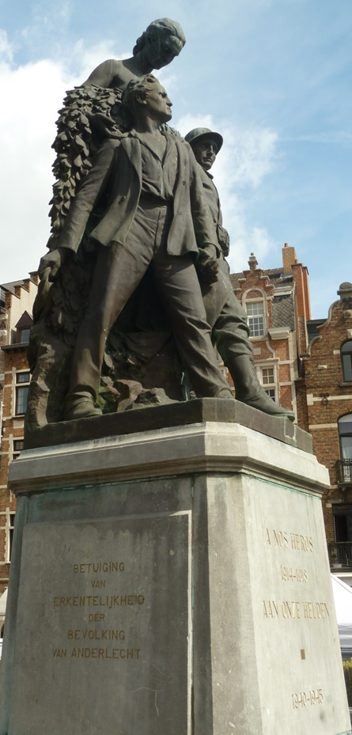

Memory of the fallen in an occupied capital city
Brussels, 1918-1940
Emmanuel Debruyne
Commemoration & Heritage, KrakÓw, 2 June 2023

Slide 2
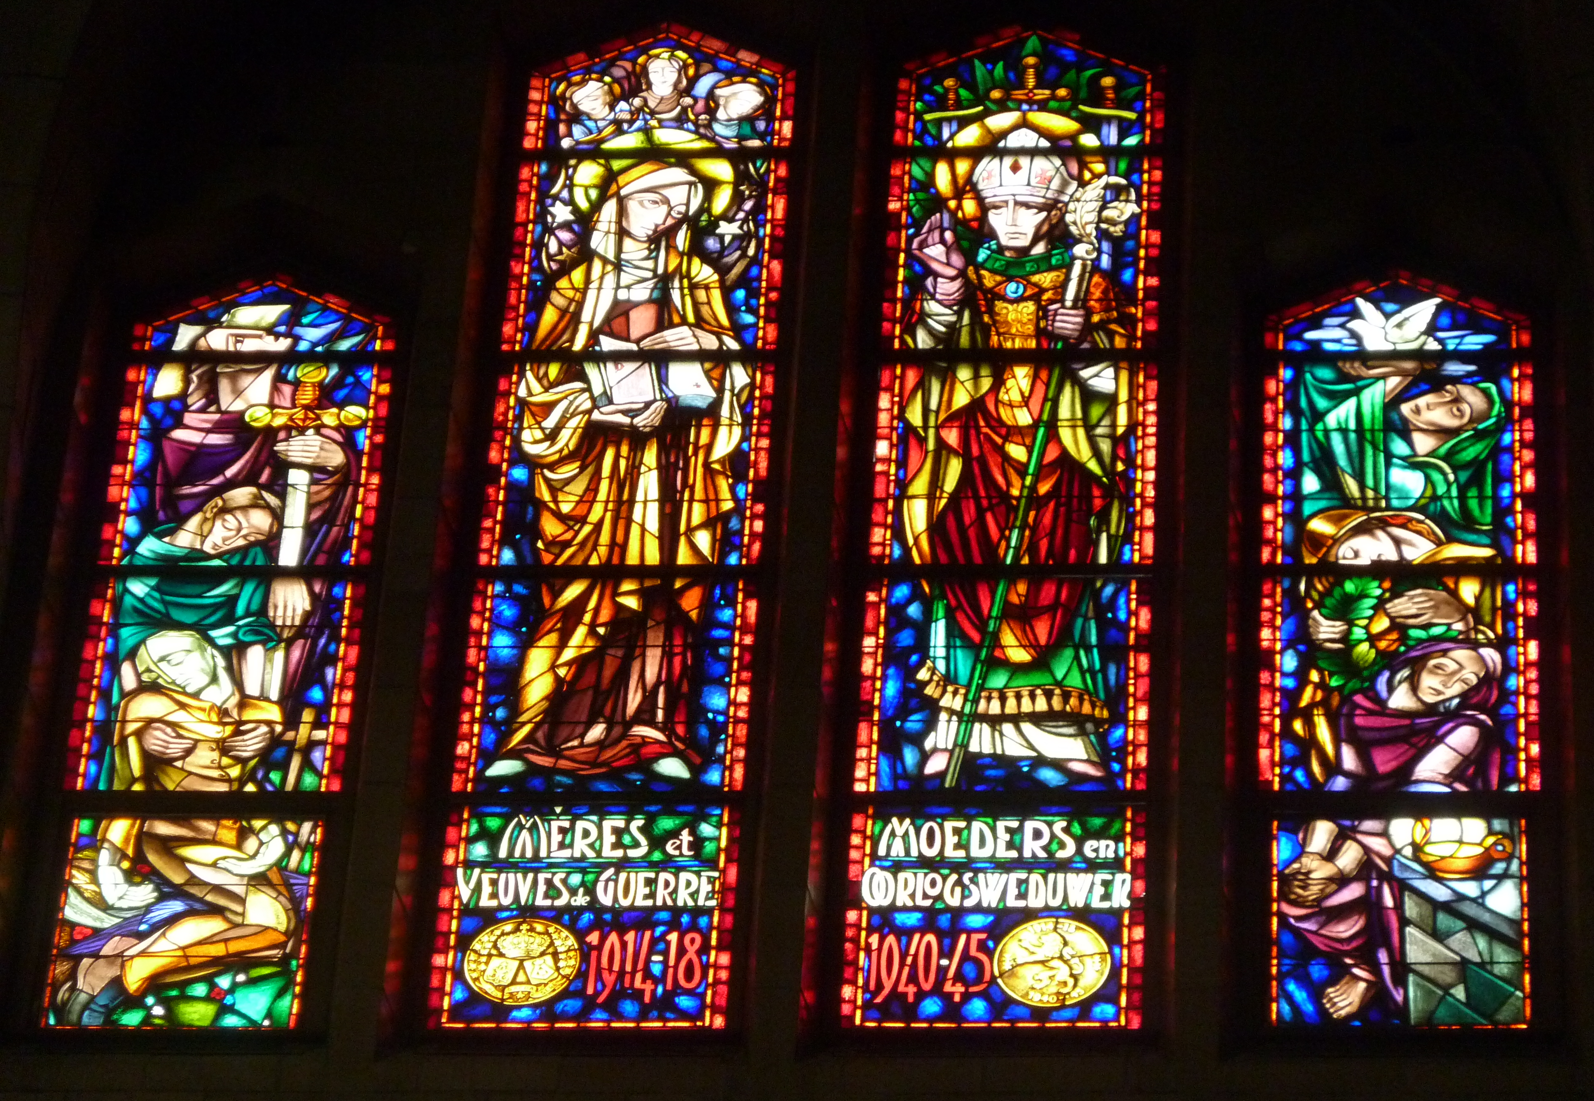
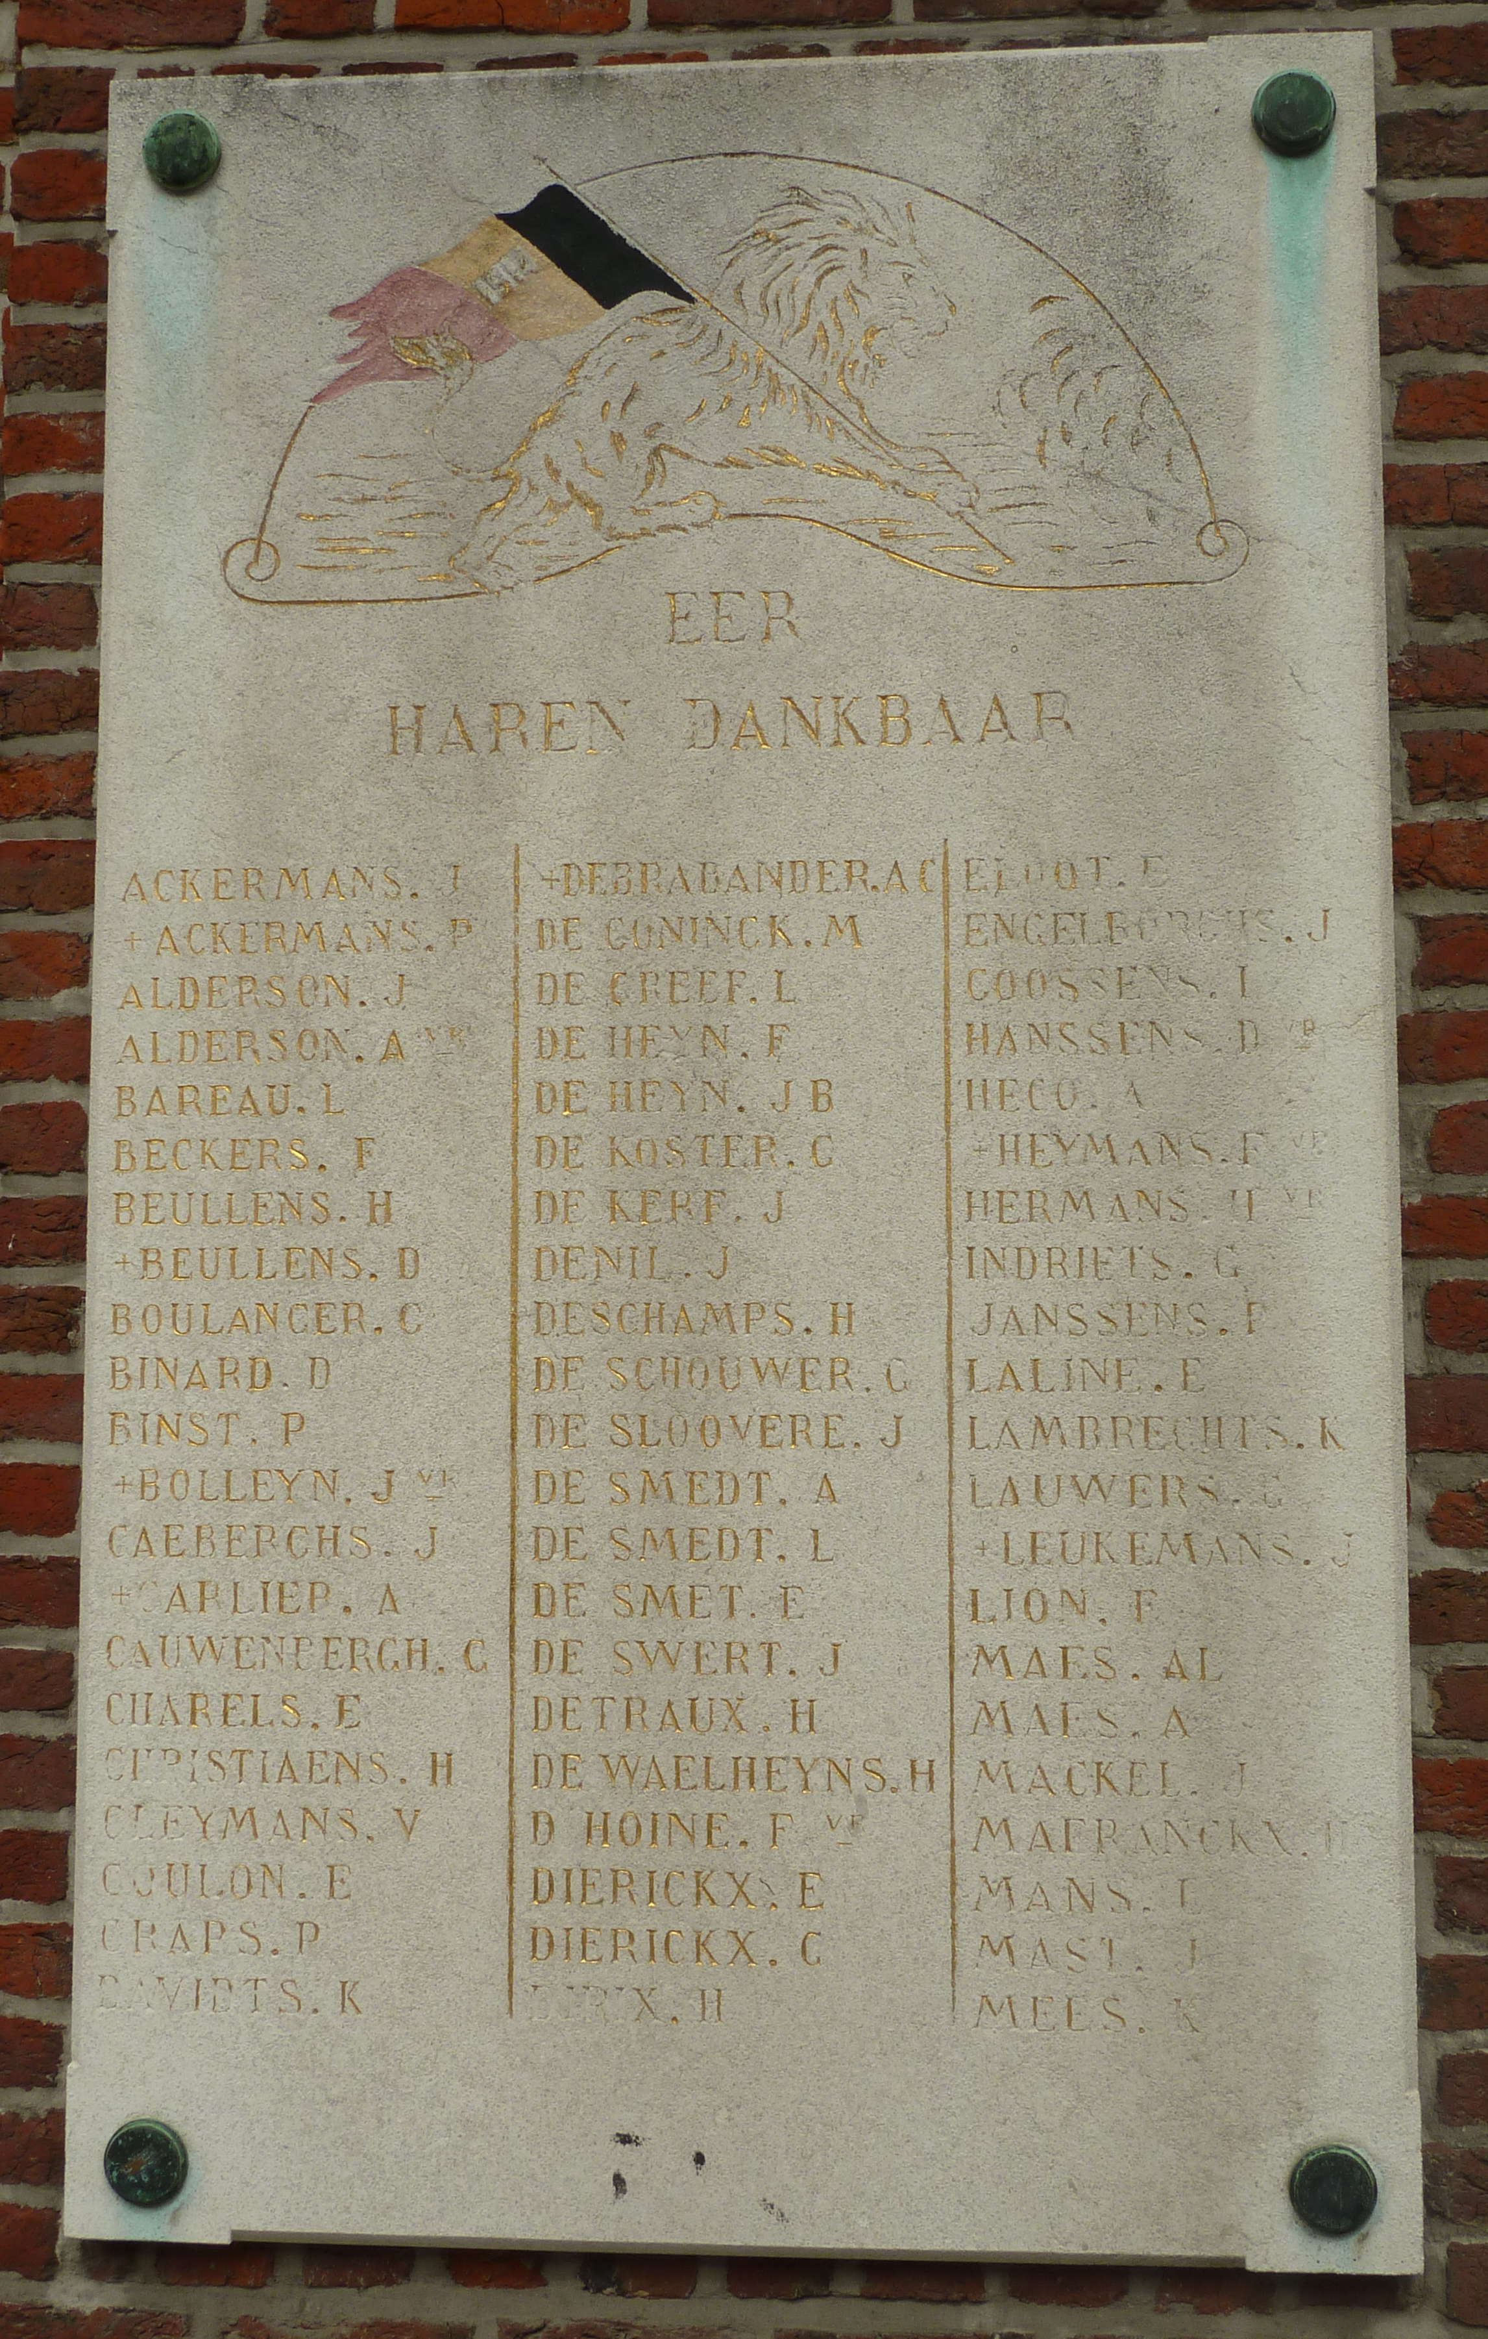
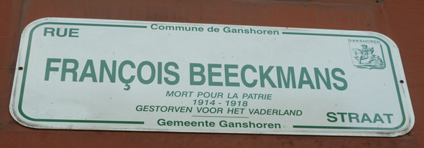
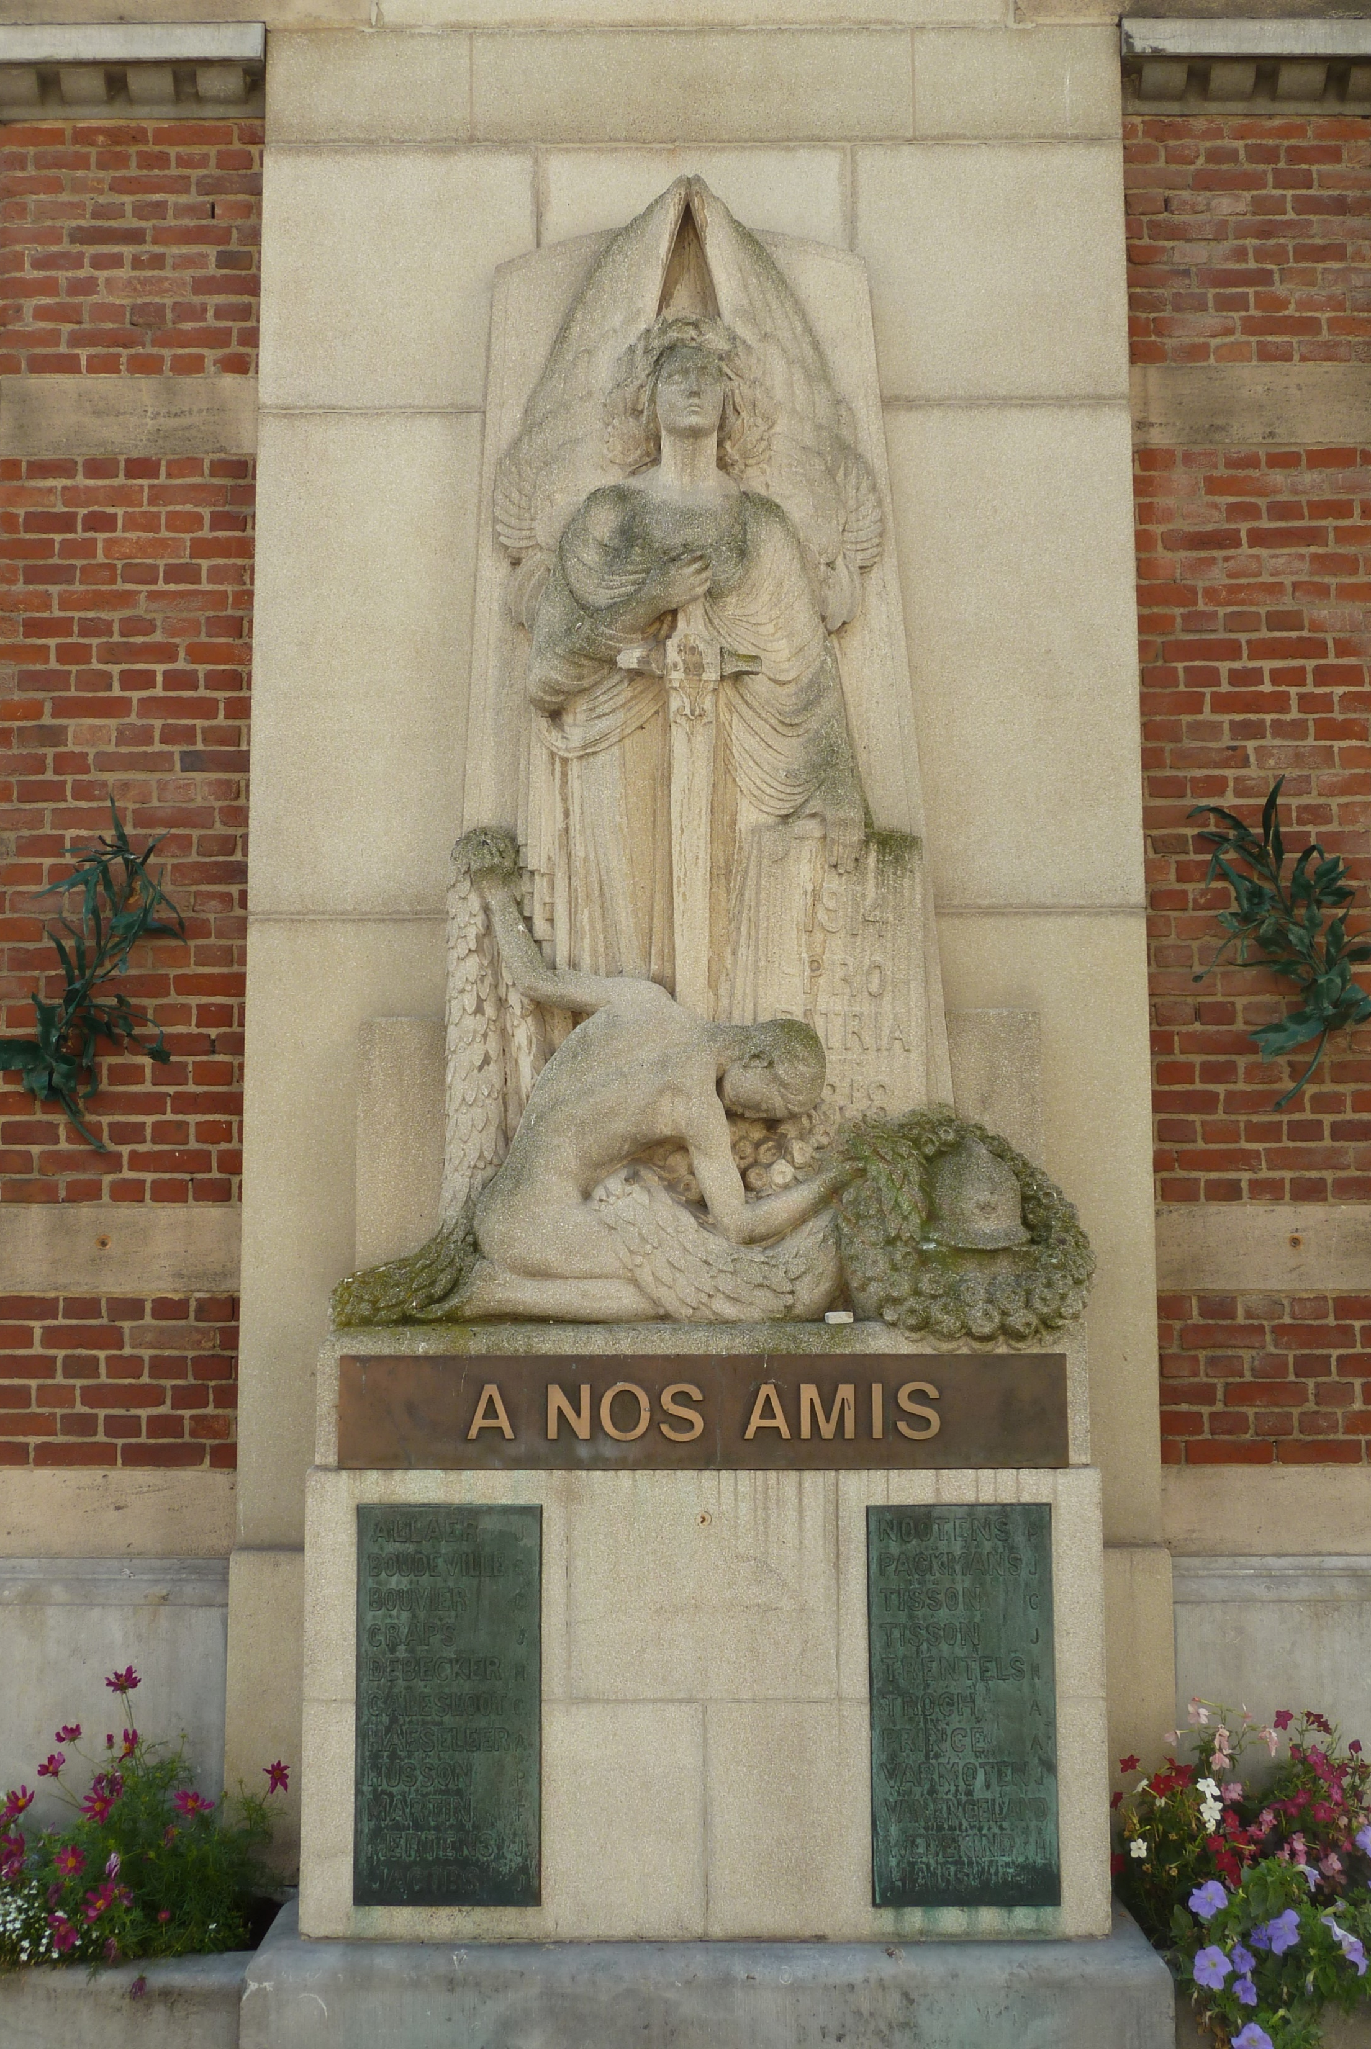
Memory of the fallen in an occupied capital city
- Brussels, 1918-1940
624 WW1 traces of memory.
At least 517 still exist in 2023.

Slide 3
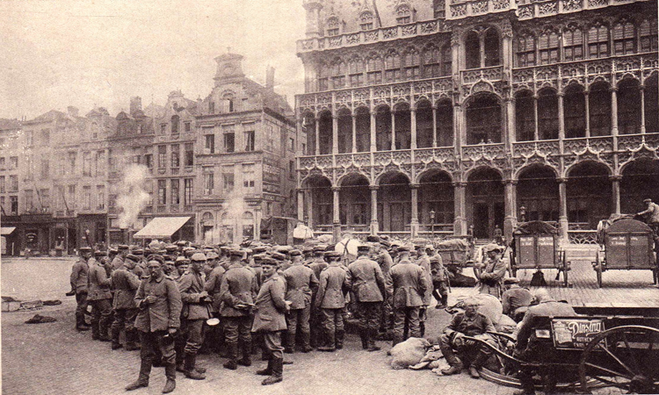
Memory of the fallen in an occupied capital city
- Brussels, 1918-1940
1914-1918 in Brussels = 4 years of German military occupation
A memory of the fallen shaped by 3 dynamics:
1) A Belgian city in full expansion
2) A European capital city
3) An occupied city

Slide 4
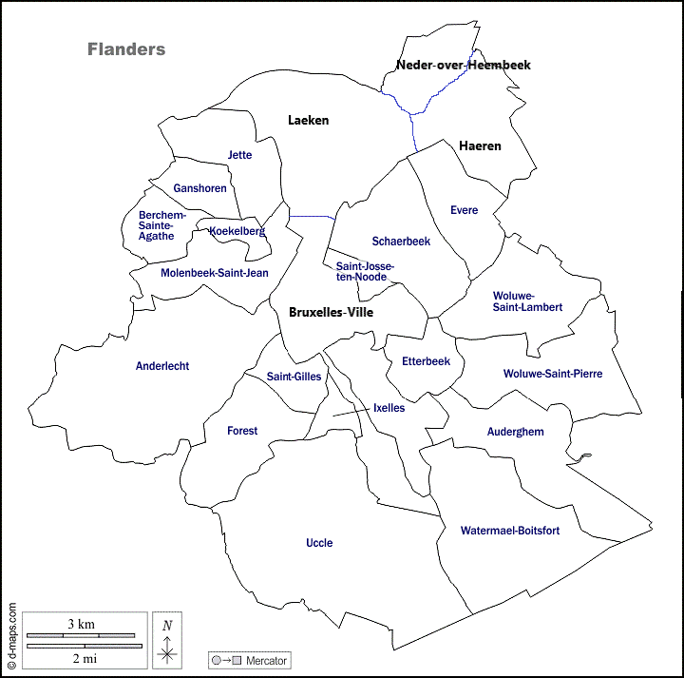
1. A Belgian city in full expansion
Communal autonomy
  fragmentation of the commemoration
“I am not imbued with parochialism, but I believe that there are enough widows in our municipality for us to pay a heartfelt tribute to their loved ones.”
Jules Navarre, alderman of Molenbeek, November 1920.

Slide 5
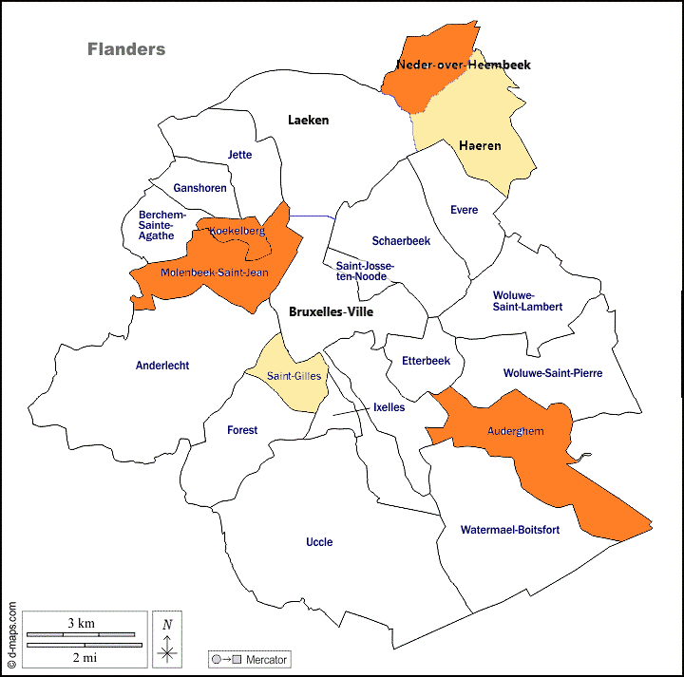
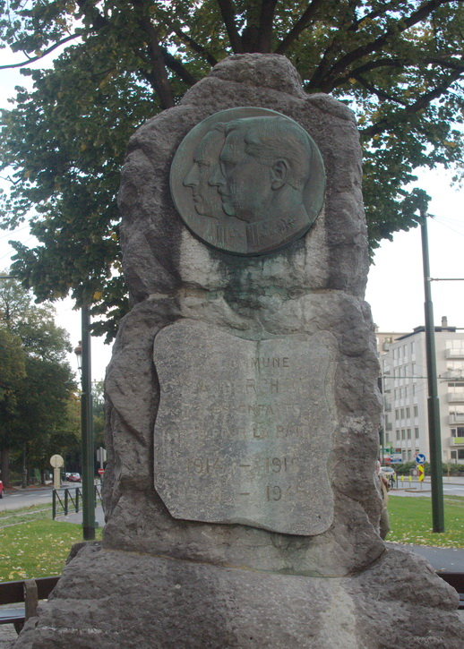
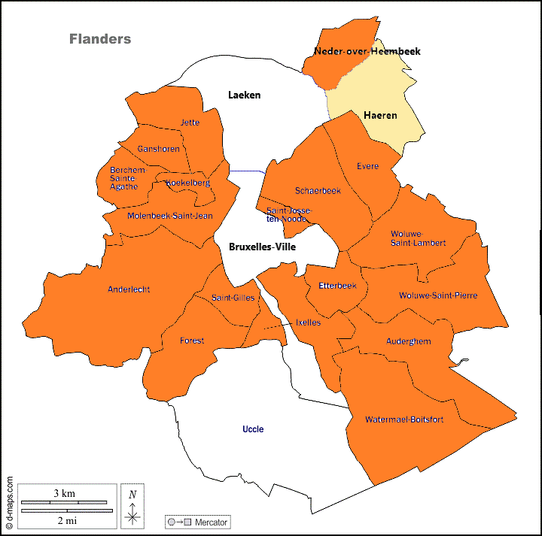
1. A Belgian city in full expansion
Rapid erection of multiple municipal memorials
The first municipal war memorial in the Brussels agglomeration was inaugurated in Auderghem, on 18 May 1919.
Municipal memorials at the end of 1919
Municipal memorials at the end of 1923

Slide 6
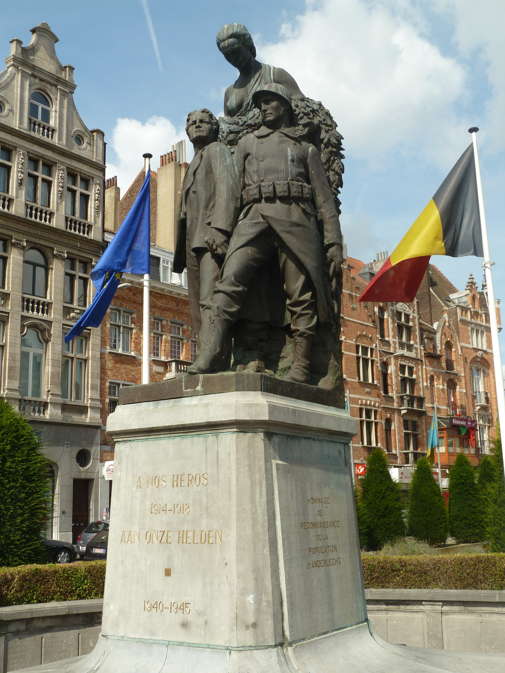
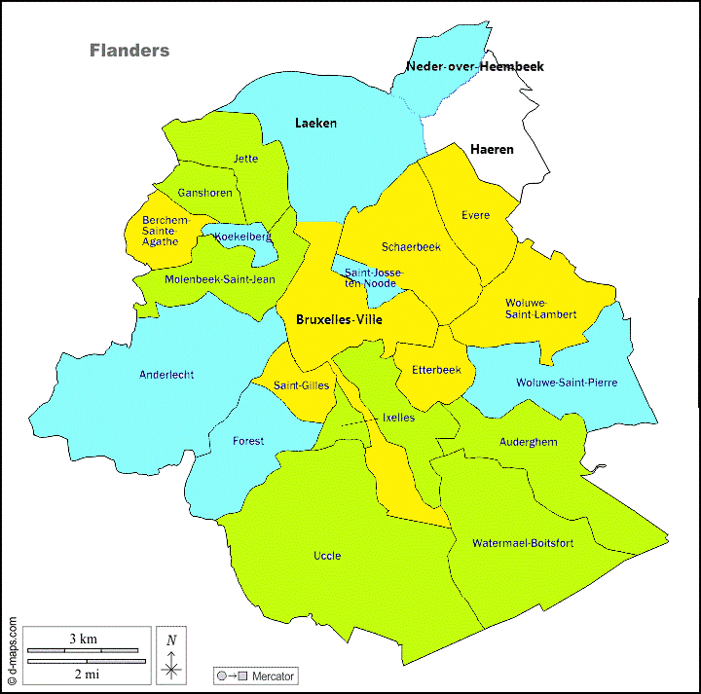
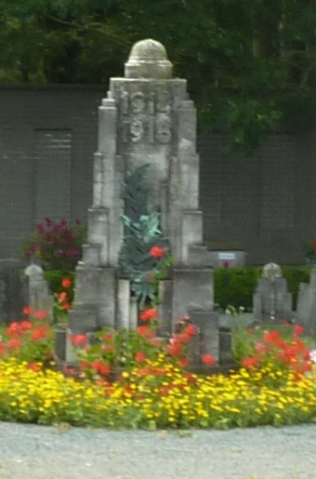
1. A Belgian city in full expansion
The municipal war monuments: on the public highway and/or in the municipal cemeteries
Municipal war monuments:
Blue: on the public highway
Yellow : in the cemetery
Green : on the public highway AND in the cemetery
War memorial of Anderlecht
(public highway)
War memorial of Ganshoren (municipal cemetery)

Slide 7
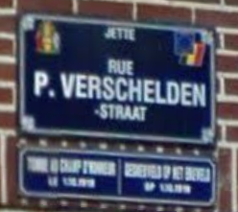
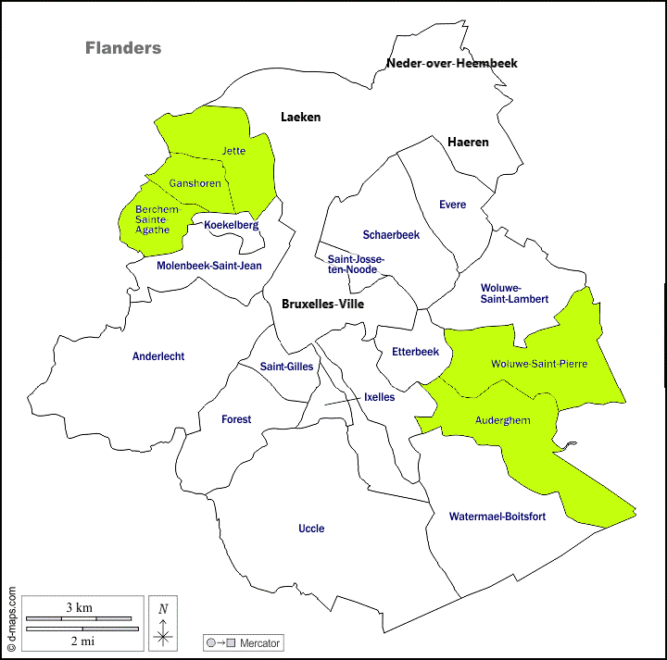
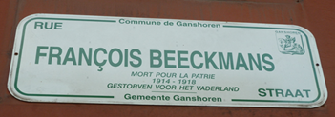
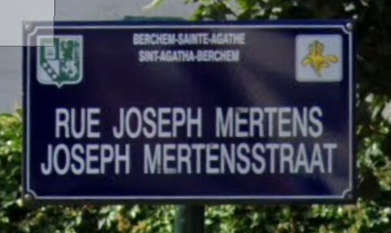
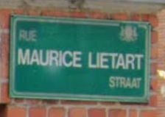
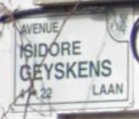
2. A European capital city
Systematic and individualized tributes in the street names

Slide 8
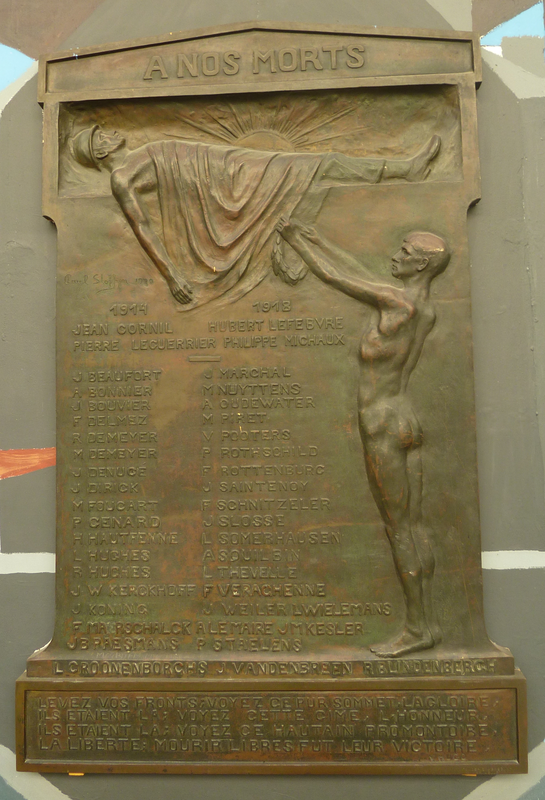
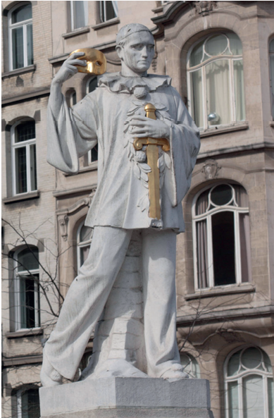
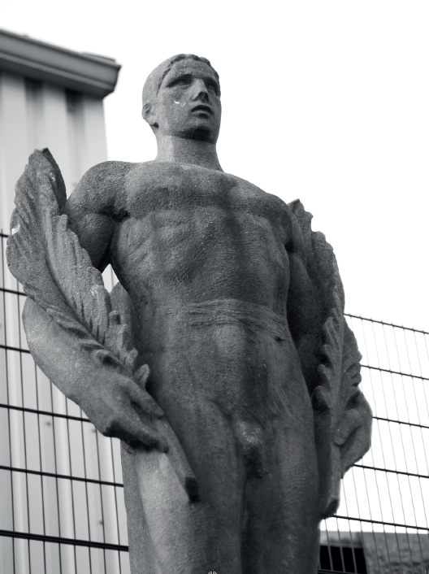
1. A Belgian city in full expansion
« Grassroots » traces of memory
War memorial of the secondary school Victor Horta (Saint-Gilles)
War memorial to the showmen
(Anderlecht) © Vincent Vandendriessche
War memorial of the footballclub Daring (Molenbeek) © Vincent Vandendriessche

Slide 9
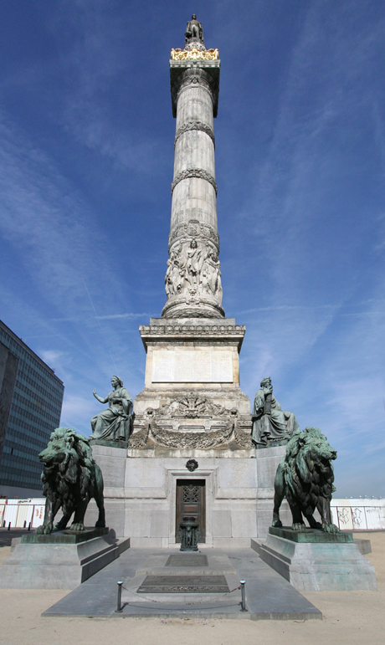
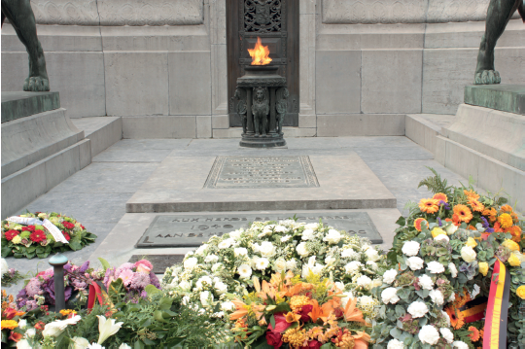
2. A European capital city
The Column of Congress, commemorating the independence, the constitution and the monarchy, Brussels-City
The unborn monument and the unknown soldier
Vault of the Unknown soldier, under the Column of Congres,
Brussels-City © Vincent Vandendriessche

Slide 10
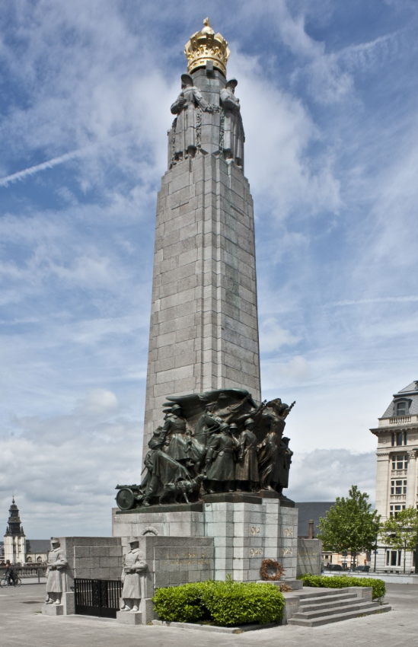
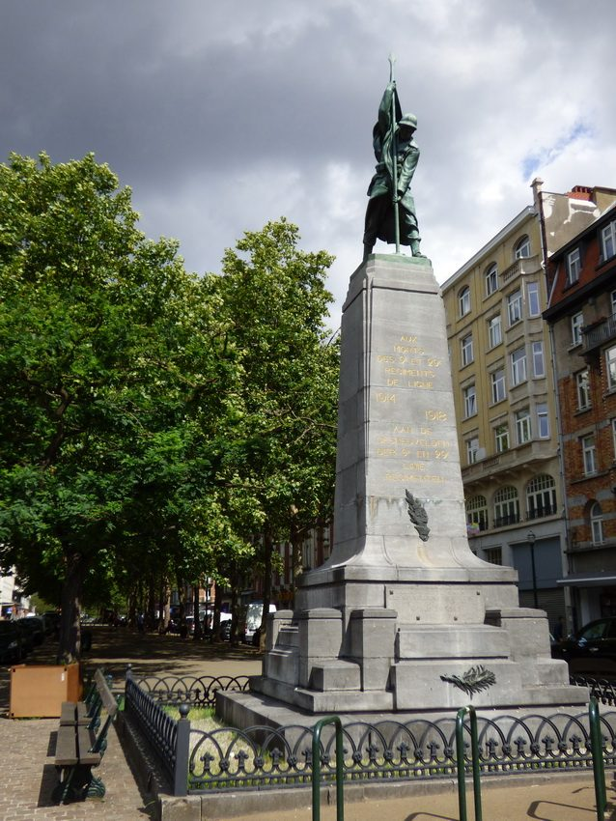
2. A European capital city
Monument to the Belgian Infantry, Brussels
A central garrison city and a gravity centre for military Belgium
Monument to the 9th Line Infantry Rgt,
a unit garrisoned in Brussels

Slide 11
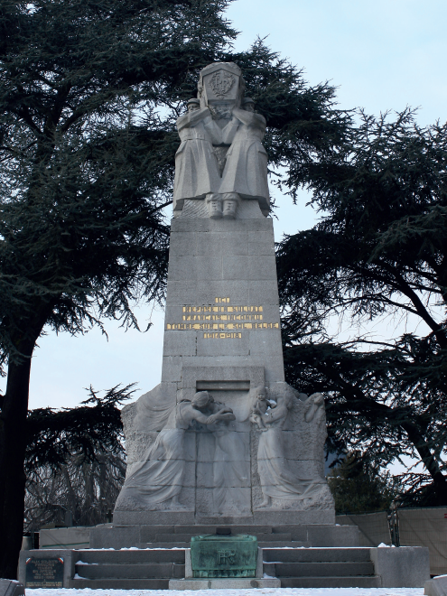
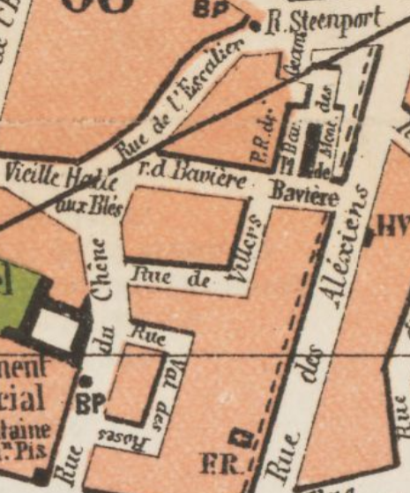
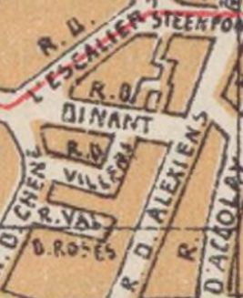
2. A European capital city
Westernisation of the geographical imaginary through the tribute to the fallen
Monument to the Unknown Poilu, Laeken
© Vincent Vandendriessche
Extracts of maps of Brussels, 1882 (left) and [1921] (right)

Slide 12
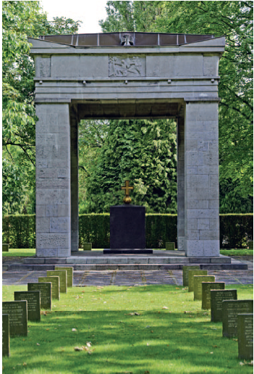
3. An occupied city
German war memorial, cemetery of Brussels, Evere
Some Germans finally stayed: the dead ones

Slide 13
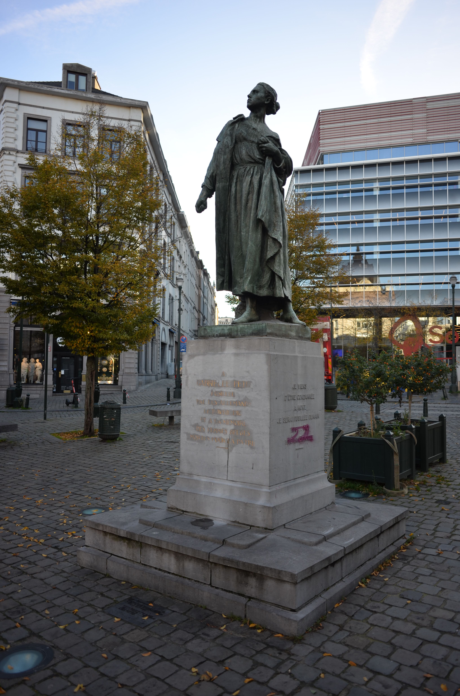
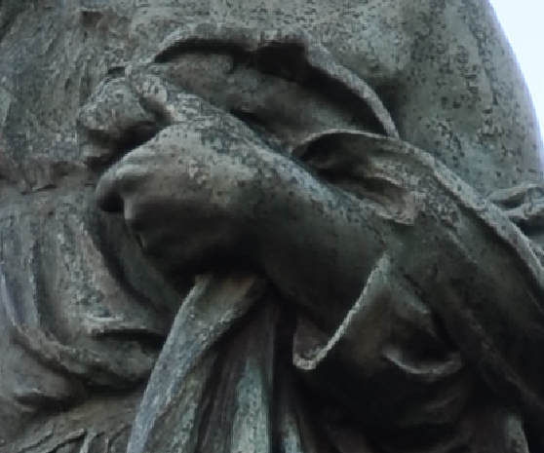
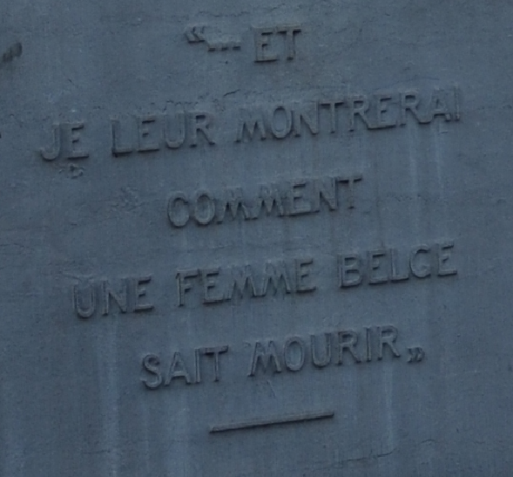
3. An occupied city
The heroic dimension of the occupation: the executed resistance fighters
"... and I will show them how
a Belgian woman knows how to die".
Gabrielle Petit
Headband torn off
Monument to Gabrielle Petit, Brussels

Slide 14
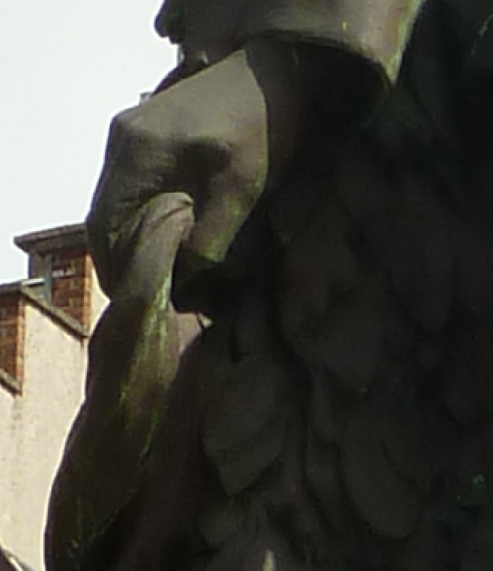
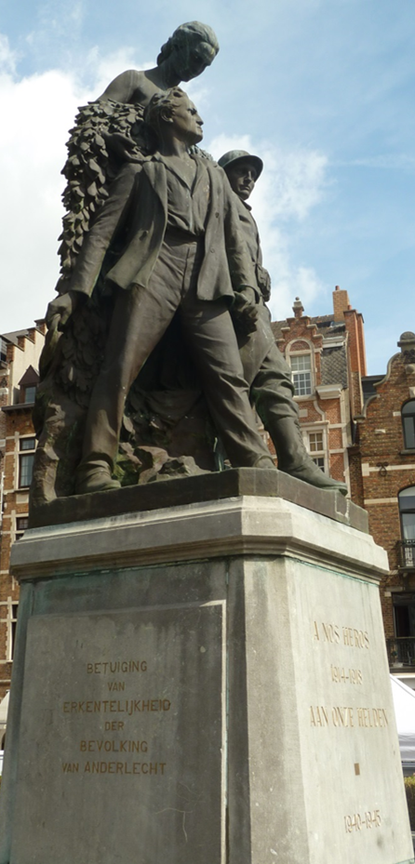
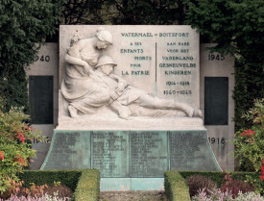
3. An occupied city
The heroic dimension of the occupation: the executed resistance fighters
Oscar Hernalsteens, executed resistance fighter, among the fallen soldiers
War memorial of Watermael-Boitsfort
Headband torn off
War memorial of Anderlecht

Slide 15
Conclusion
War memorial of Anderlecht
Memory of the fallen in Brussels
Particularistic patriotic memories
Integration of the occupation in the national narrative
Westernisation of the geographical imaginary

Slide 16
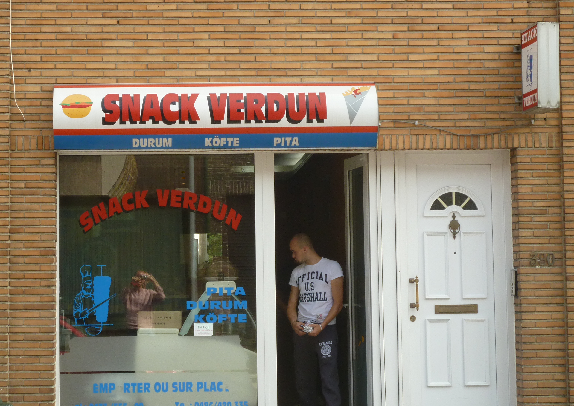
Same memory, other story…

Slide 17
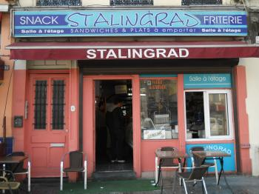
Other memory, same story…

