Slide 2
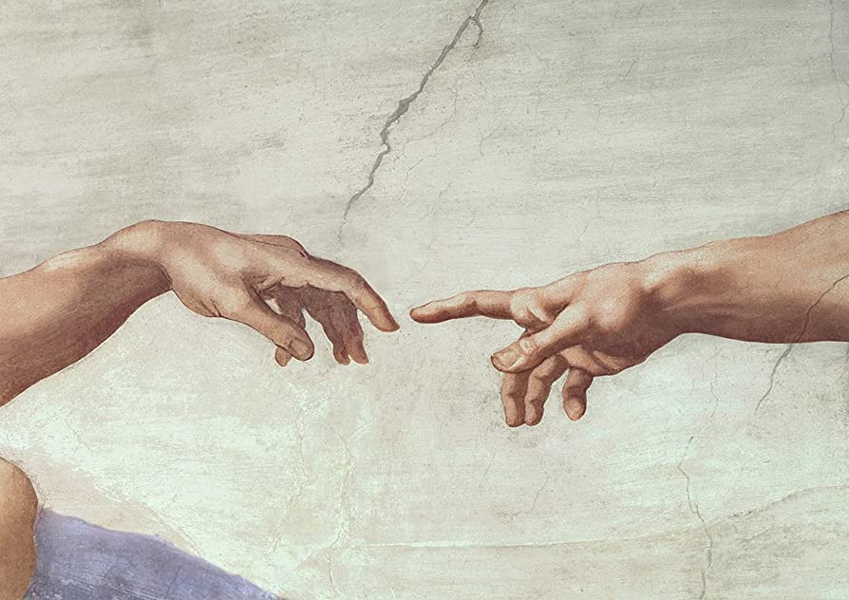
“E’ stata la mano di Dio”
God’s Hand in the Septuagint
Ellen De Doncker EABS Jerusalem 29 March 2023

Slide 3
Overview
Introduction: God’s hand(s)
« With mighty hand and outstretched arm »
  Singular « mighty hand »
  Double formula: « mighty hand & outstretched arm »
God’s hand outside of the formula
Conclusion

Slide 4
Introduction

Slide 5
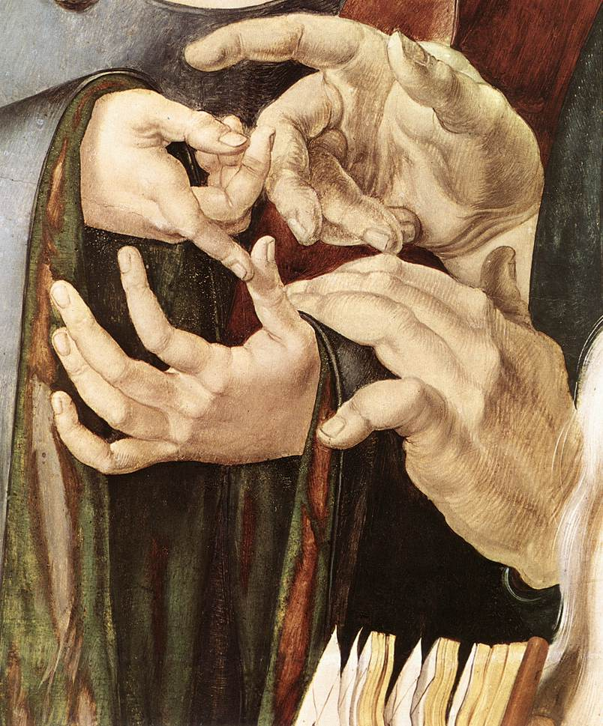
Introduction: God’s hand(s)
God’s hands = God’s might?
  Targumim, modern translations
  Also physical understanding, e.g. Ex 7:17
Different terms used in HB:
  Right hand יָמִין; Hand יָד; Hand palm כַּף
  We focus on yad
  God’s yad: 200x HB
  No mention of divine left hand
  « mighty hand » : topos of ANE;
  connected with exodus in Pentateuch
God’s hand: threefold division
  « with mighty hand »
  « with mighty hand and outstretched arm »
  singular occurrences outside formula
Albrecht Dürer, Christ among the Doctors, 1506

Slide 6
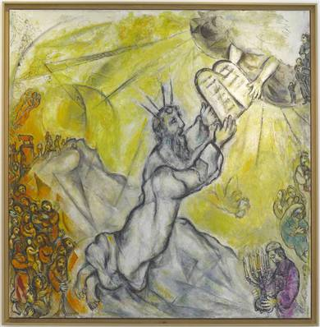
Introduction: God’s Hands
Goal: how is God’s hand translated in LXX-Pentateuch?
  Avoidance?
  If avoidance, is this anti-anthropomorphism?
    Anthropomorphism?
    the attribution of human-like body parts to God and, by extension, the attribution of human-like emotions and activities
    Fritsch, 1943: LXX avoids at times anthropomorphisms
    = anti-anthropomophic tendency
Marc Chagall, Moïse recevant les tables de la loi, 1960

Slide 7
“With mighty hand and outstretched arm”

Slide 8

The « mighty hand–formulae »
“Mächtigkeitsformel”
Two forms:
    references containing only the mighty hand of God: ביד הזקה / בהזק יד
    “expanded formula”: references joining the mighty hand to the outstretched arm motif :ביד הזקה ובזרוע נטויה.
Deuteronom(ist)ic formula
Translation in LXX?
  Two major differences:
  lxx-Ex 6,1 and 32,11 God’s hand (mt), but instead refer to God’s arm;
  lxx-Deut 3,24; 6,21; 7,8; 9,26.29(lxx^{B}) God’s mighty hand and arm, (mt: only God’s mighty hand)
Auguste Rodin, La main crispée, 1885

Slide 9
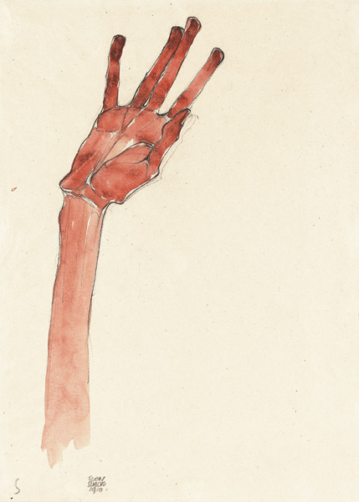
1. “mighty hand”
LXX = MT
  Translated literally : χείρ κραταιά
  Most of the time
LXX =/= MT
  LXX + : “outstretched arm” (βραχίων ὑψηλός )
  “expansion”
  ALL verses in LXX-Deuteronomy have the long formula “with mighty hand and outstretched arm”
  lxx-Deut 3,24; 6,21; 7,8; 9,26.29(lxx^{B})
      A case study: LXX Deut 3,24
Egon Schiele, Raised Red Hand, 1910

Slide 10
1. “mighty hand”
LXX =/= MT: + “outstretched hand”: Deuteronomy 3,24
  Hand: translated literally : χείρ κραταιά
  Variants:
  « with mighty hand and outstretched arm »
  « with might and strength »
  « with your mighty hand »
Double translation: 1 word -> 2 words as equivalent
  Avoidance of God’s physical height?
  But: δύναμις
Outstretched hand: not double translation
  « expansion »
  Harmonisation -> Deut 4:34, 5:15, 7,19; 11,2; 26,8
Possessive suffix
  Avoidance?
  Only present in LXX Deut 9:26
lxx | mt | SamP | DSS: 4Q314
Κύριε κύριε, σὺ ἤρξω δεῖξαι τῷ σῷ θεράποντι τὴν ἰσχύν σου καὶ τὴν δύναμίν σου καὶ τὴν χεῖρα τὴν κραταιὰν καὶ τὸν βραχίονα τὸν ὑψηλόν | אֲדֹנָי יְהוִה, אַתָּה הַחִלּוֹתָ לְהַרְאוֹת אֶת-עַבְדְּךָ, אֶת-גָּדְלְךָ, וְאֶת-יָדְךָ הַחֲזָקָה | אדני יהוה אתה החלת להראות את עבדך את גדלך ואת ידך החזקה | אדני יהוה אתה החלת להראת אתׄ[ עבדך את גדלך ואת ]ידך החזקה

Slide 11
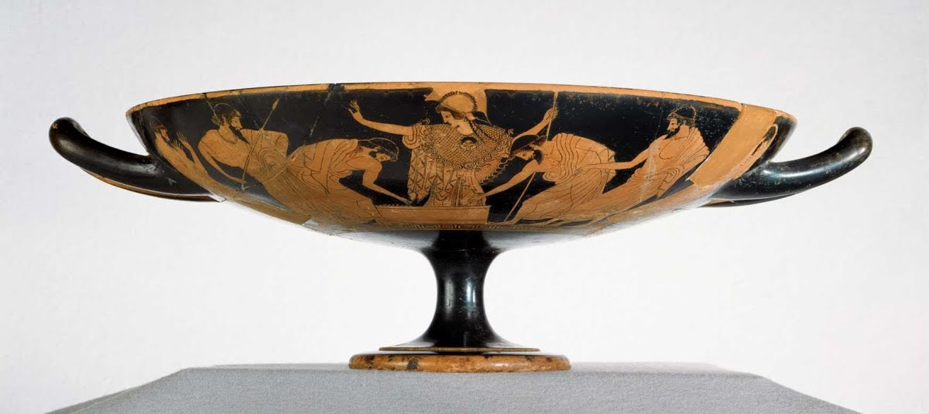
1. “mighty hand”
LXX =/= MT: + “outstretched hand”
The same process of expansion takes place in the other verses with plusses
LXX: care for unity, also in (not) rendering personal pronouns
LXX: attests growth of formula, stage in uniformisation
Subtle distinction between God’s mighty hand and human hands in expansion:
  lxx - Deut 34,12: “mighty hand” attributed to Moses -> MT & lxx: only “mighty hand” (τὴν χεῖρα τὴν κραταιάν), only verse with no expansion in LXX-Deuteronomy!
Cup found at Douris (5th c. BCE): Athena with outstretched arm

Slide 12
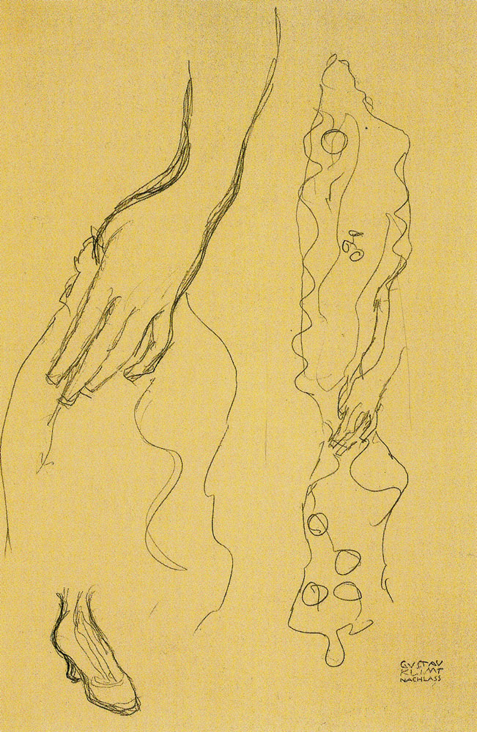
2. “with outstretched arm”
LXX = MT
  Translated literally : βραχίων ὑψηλός
  LXX has never a minus, only expansion
  Very often occurrence of double formula
  Minor variants attest the same formulaic growth in LXX
    A case study: Deut 26:8 as further expansion
LXX =/= MT
  LXX : “outstretched arm” instead of “mighty hand”
  MT-Ex 6,6: only occurrence of single “outstretched arm”; lxx-Ex 6,1b; 32,11
      A case study: LXX-Ex 32,11
G. Klimt, Study of Left Hand, Shawl and Shoe, 1916

Slide 13
2. “with outstretched arm”
LXX = MT : Deut 26,8 as case study
  Translated literally : βραχίων ὑψηλός
  Minor variants
  Plus αὐτὸς
  Plus ἐν ἰσχύι μεγάλῃ
  Harmonisational expansion
  But with which verse?
    Deut 4,23? (Dogniez & Harl ): καὶ ἐξήγαγέν σε αὐτὸς ἐν τῇ ἰσχύι αὐτοῦ τῇ μεγάλῃ ἐξ Αἰγύπτου
    Deut 9,29? (Tov): ἐξήγαγες ἐκ γῆς Αἰγύπτου ἐν τῇ ἰσχύι σου τῇ μεγάλῃ καὶ ἐν τῇ χειρί σου τῇ κραταιᾷ καὶ ἐν τῷ βραχίονί σου τῷ ὑψηλῷ
    Also strong parallel with Ex 32,11: ἐξήγαγες ἐκ γῆς Αἰγύπτου ἐν ἰσχύι μεγάλῃ καὶ ἐν τῷ βραχίονί σου τῷ ὑψηλῷ
  Perhaps no strict link, rather sign of further expansion through link with “might and strength”
lxx | mt | SamP
καὶ ἐξήγαγεν ἡμᾶς κύριος ἐξ Αἰγύπτου αὐτὸς ἐν ἰσχύι μεγάλῃ καὶ ἐν χειρὶ κραταιᾷ καὶ ἐν βραχίονι αὐτοῦ τῷ ὑψηλῷ καὶ ἐν ὁράμασιν μεγάλοις καὶ ἐν σημείοις καὶ ἐν τέρασιν | וַיּוֹצִאֵנוּ יְהוָה, מִמִּצְרַיִם, בְּיָד חֲזָקָה וּבִזְרֹעַ נְטוּיָה, וּבְמֹרָא גָּדֹל--וּבְאֹתוֹת, וּבְמֹפְתִים | ויוציאנו יהוה ממצרים ביד חזקה ובזרוע נטויה ובמראה גדול ובאתות ובמפתים

Slide 14
2. “with outstretched arm”
LXX =/= MT : Ex 32,11 as case study
  Not translated literally: βραχίων ὑψηλός instead of God’s hand
  Further variants
  Preposition ἔναντι for God’s face?
  Translation θυμοῖ ὀργῇ for God’s nose?
  Variants of possessive pronoun
  LXX focusses on idiomatic expression, no avoidance
  God’s arm instead of God’s hand
  Also in SamP and 4Q22, Targum Neofiti, Peshitta
  lxx^{A}, SamP and 4Q22 without possessive pronoun – lxx^{B}, T^{N} and Peshitta with possessive pronoun
    Konkel: different stages in transmission of formula, MT oldest, then lxx^{B}, T^{N} and Peshitta
    lxx^{A}, SamP and 4Q22 without possessive pronoun: rare! Even further evolution?
lxx | mt | SamP | Hexapla | DSS: 4Q22
καὶ ἐδεήθη Μωυσῆς ἔναντι κυρίου τοῦ θεοῦ καὶ εἶπεν Ἵνα τί, κύριε, θυμοῖ ὀργῇ εἰς τὸν λαόν σου, οὓς ἐξήγαγες ἐκ γῆς Αἰγύπτου ἐν ἰσχύι μεγάλῃ καὶ ἐν [lxx^{B} τῷ] βραχίονί [lxx^{B} σου τῷ] ὑψηλῷ; | וַיְחַל מֹשֶׁה, אֶת-פְּנֵי יְהוָה אֱלֹהָיו; וַיֹּאמֶר, לָמָה יְהוָה יֶחֱרֶה אַפְּךָ בְּעַמֶּךָ, אֲשֶׁר הוֹצֵאתָ מֵאֶרֶץ מִצְרַיִם, בְּכֹחַ גָּדוֹל וּבְיָד חֲזָקָה | ויחל משה את פני יהוה אלהיו ויאמר למה יהוה יחר אפך בעמך אשר הוצאת ממצרים בכח גדול ובזרוע נטויה | Ο. θυμοῖ ὀργῇ/ θυμωθήσεται ὀργή | [ ו ]⟦ ⟧[ ] ‏י֯[ח]ל֯ משה אתׄ[ פנ]יׄ [יהוה אלהיו ויאו]מׄר למ[ה ]יהוה יחר א[פך] ‎ ‏בעמך֯ אשרׄ ה֯ו֯צ[את מארץ מצרים בכח גדול ו]בזרוע חזק[ה. ]

Slide 15
Outside of the formula

Slide 16
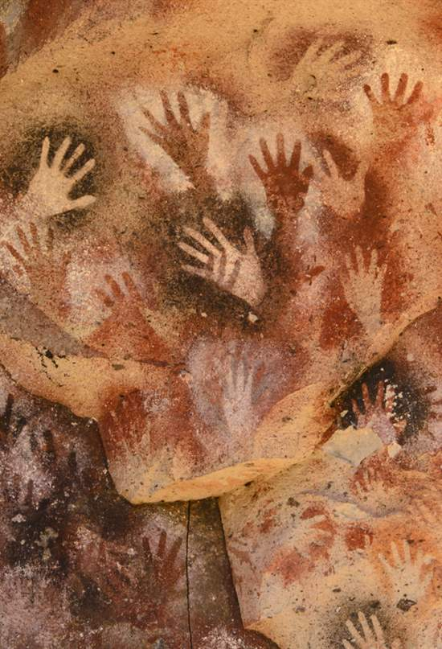
Outside of the formula
Also here: God’s hand is generally translated literally
Same tendency towards uniformity:
  E.g. Ex 3,20; 6,8; 7,5: choice for ἐκτείνω while no unity in MT
Some variants:
Fritsch views minus in LXX Ex 16,3; 24,11 as anti-anthropomorphic omission (Ex 6,1 & 32,11 see before!)
  Ex 16,3 as case study
Word mt | Occurrences | Word lxx
Hand (יָד) | Gen 49,24 ; Ex 3,20 ; 6,1(2x).8 ; 7,4.5.16 ; 9,3.15 ; 13,3.9.14.16 ; 14,31 ; 15,17 ; 16,3 ; 24,11 ; 32,11 ; Num 11,23 ; 14,30 ; Deut 2,15 ; 3,24 ; 4,34 ; 5,15 ; 6,21 ; 7,8.19 ; 9,26 ; 11,2 ; 26,8 ; 32,39.40.41 ; 33,3 | Hand (χείρ) Minus in Ex 6,1; 16,3; 24,11; 32,11 Plus in Ex 15,6
La cueva de las manos

Slide 17
Outside of the formula
LXX =/= MT: Ex 16,3 as case study
God’s hand : “by God”
  Fritsch: “deliberate avoidance of anthropomorphism”
  ביד is usually rendered by the more literal (ἐν) χειρί
  Sollamo: when ביד is used as a semipreposition -> LXX Exodus: Multiple equivalents (literal, single prepositions as διά or ἐν, or dative)
    rendering in v. 16,3 = unique: preposition ὐπό + gen. appears only here as counterpart for ביד
    Good Greek: Ex. Plato, Euthydemus, 303a : ὥσπερ πληγεὶς ὑπὸ τοῦ λόγου (“as if I were smitten/knocked out by the word/discourse”).
    verb πλήσσω fits well : violent death, reminds of the πληγή (“plague”)
  Minus as part of free translation that aims at idiomatic, fluent Greek that conveys the content to the public
lxx | mt | SamP | dss (4Q11)
καὶ εἶπαν πρὸς αὐτοὺς οἱ υἱοὶ Ισραηλ Ὄφελον ἀπεθάνομεν πληγέντες ὑπὸ κυρίου ἐν γῇ Αἰγύπτῳ | וַיֹּאמְרוּ אֲלֵהֶם בְּנֵי יִשְׂרָאֵל מִי-יִתֵּן מוּתֵנוּ בְיַד-יְהוָה בְּאֶרֶץ מִצְרַיִם | ויאמרו אליהם בני ישראל מי יתן מותנו ביד יהוה בארץ מצרים | ‏ [ ויאמרו אלהם בני ישראל מי ]י֯תׄןׄ מׄו֯תׄנׄו֯ ב֯[יד יהוה בארץ מצרים ] ‎

Slide 18
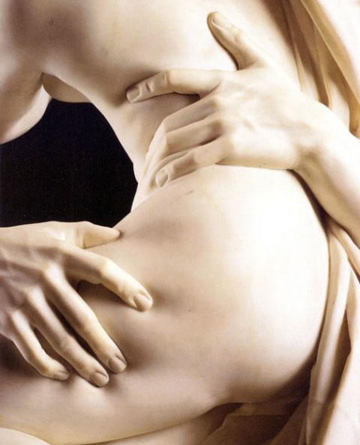
Outside of the formula
LXX = MT: Num 11:23 as a special case
Literal translation of God’s hand: most of the time
One case where translation shows some avoidance: Num 11:23
Rhetorical question, expecting contrasting reply
  MT/SamP: “Will the hand of the Lord be shortened (תקצר)?”
  LXX: “Will the hand of the Lord not suffice (ἐξαρκέσει)?”
Other occurrences of קצר: always translated by ‘shortness’ (στενοχωρέω, σμικρύνω, ὀλιγότης, ὀλιγόω
  shows that the translator was well acquainted with the significance of קצר
  Why here not a more literal translation?
Hand as sexual euphemism in ANE
  Ugarit, the deity is described as a supersized deity, with a supersized membrum virile, using the Ugaritic yd as a euphemism
  in the Gilgamesh-epos, Ishtar begs Ishullanu to “stretch forth the ‘hand’ and pet our vulva” (Akkadian expression: qātam šusû);
  in Qumranic Hebrew, ‘hand’ is used for the male member
  Biblical Hebrew, the ‘hand’ functions as a euphemism for the male sex (e.g., Song 5,4; Isa 57,8.10)
    “short hand” of God: possibly negative connotations regarding His virility
    preceding verse Num 11:22 uses twice the verb ἀρκέω -> v. 23 functions as reply
lxx | mt | SamP
καὶ εἶπεν κύριος πρὸς Μωυσῆν Μὴ χεὶρ κυρίου οὐκ ἐξαρκέσει; | וַיֹּאמֶר יְהוָה אֶל-מֹשֶׁה, הֲיַד יְהוָה תִּקְצָר | ויאמר יהוה אל משה היד יהוה תקצר
Bernini, Il ratto di Proserpina, 1622

Slide 19
Conclusion

Slide 20
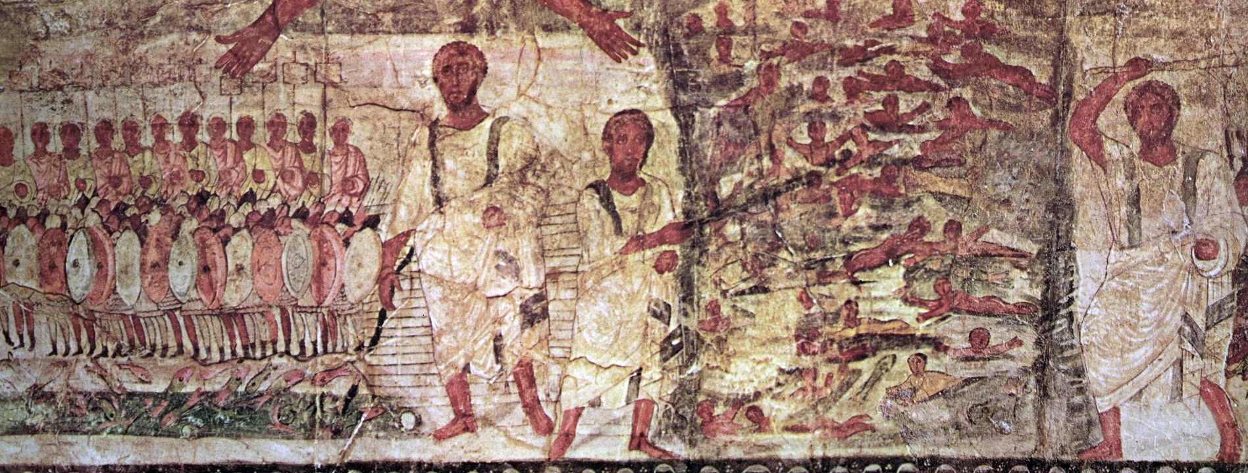
Conclusion
Instances where lxx deliberately avoids God’s hand or arm: very few:
  Num 11:23, God’s hand translated literally, but context altered
  subtle distinction between God’s mighty hand and human hands in Deut 34,12: no expansion
  No anti-anthropomorphism present, contrast with Hexapla/Targumim
An other tendency appeared more clearly: tendency to uniformise certain expressions:
  harmonizing expansion
  LXX attests growth
Translator shows great care and sensibility towards the context and content of the verse he translates
These findings need to be placed amongst evaluation of other anthropomorphisms in LXX-Pentateuch

Slide 21

Thank you!

