Slide 1

Measuring and Understanding Diversity Shifts Among Journalists in French-Speaking Belgium (2012-2023)
Dr. Grégoire Lits & Dr. Olivier Standeart
Observatory for Research on Media and Journalism, University of Louvain, Belgium
(UCLouvain, ORM)
April 12 2024, Sheffield

Slide 2
Media pluralism
Content diversity
News-diversity
Diversity in the newsroom
Measuring news-diversity
  News diversity is a sign of a healthy news
  ecosystem in liberal democracies
  However difficult to asses
  Multi-dimensional
(Ducan & Reid 2013, Hendrickx et al. 2022, etc…)

Slide 3
  “One day a well-known Muslim preacher died in Molenbeek. We didn't know him, but thousands of people were in the streets to pay their respects; we had a trainee who was more connected to this milieu than we were, because he was originally from this community. So we covered the event. We realised that we were out of step with most of the city.
  We were still a bit 'in our own backyard'. We were told we lacked openness. And it's true, we don't reflect the image of Brussels society. We recruited people from universities, in the usual way of sorting CVs, which favours self-interest.”
  "
  (Dec. 2023, Female senior editor working for a local news media of the city of Brussels)

Slide 4
Measuring newsroom-diversity in Belgium (from 2012 to 2024)
First survey in 2012 realised by the Belgian Association of professional journalists (AJP) in collab. with sociologists from the university of Liège.
After that three university led surveys have been conducted
(Raeymaeckers et al. 2013 ; Standaert et al. 2016, Vanhaelewyn 2023)
This paper present a replication of the 2012 seminal survey in order to study the evolution of newsroom diversity in Belgium in 2023 (funded by AJP).
  + a new set of questions about attitudes and perception towards diversity in general and in the workplace.
  + a qualitative survey with senior editors in 12 Belgian newsrooms.

Slide 5
Research questions
RQ1: Has newsroom diversity evolved since 2012 ? If yes, in what ways?
  H1 -> We will observe almost no evolution
RQ2: What are the perceptions of diversity in general and diversity on their workplace amongst Belgian journalists?
  H2 -> We will observe different attitudes towards diversity amongst men and women, and amongst older and younger journalists and amongst journalists and editors.

Slide 6
Sample
 | 2012 AJP Survey | 2023 ORM Survey
Pop. | 2393 press card holders | 2250 press card holders
Resp. | 649 (27%) | 538 (23,9%)
Dirtsibution | Online, by email | Online, by email
-> applying of a weight coefficient for gender and age.

Slide 7
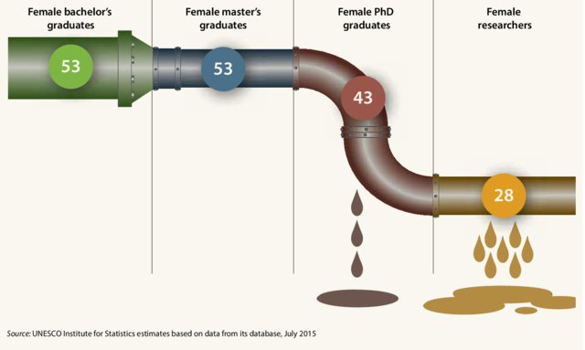
Finding 1: Gender –> The leaky pipeline
From : Huyer S. et al. 2018

Slide 8
Highlight 1 – The leaky pipeline
Regarding gender diversity (35% of women)
The 'leaky pipe' metaphor was proposed in the 1990s (Alper 1993, Pell 1996) and developed in the years 2000 to 2010 (in particular Blickenstaff 2005) to analyse gender discrimination in scientific and academic careers, especially in the STEM fields (science, technology, engineering and mathematics).
It compares career progression within a sector of activity to a pipe made up of holes through which women, or people from minority groups, selectively evaporate as they advance in their careers.

Slide 9
Finding 1 – The leaky pipeline
Regarding gender diversity (35% of women)

Slide 10
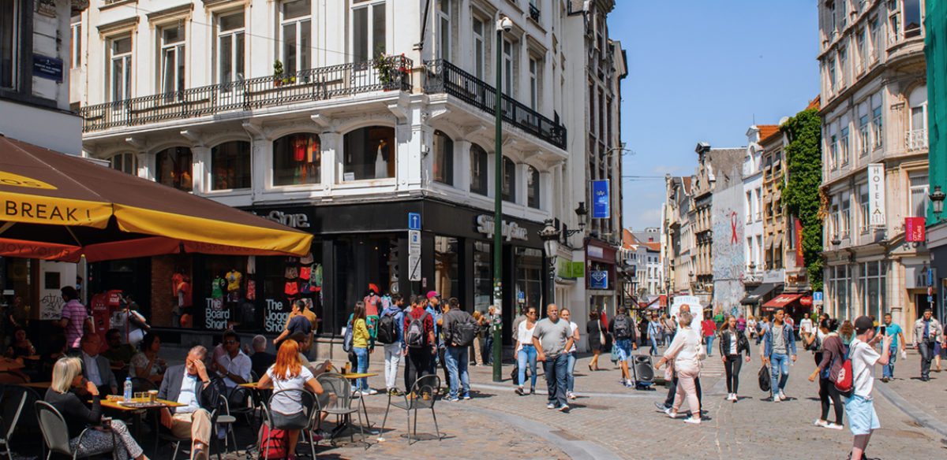
Highlight 2 – A relative decline in diversity of origin
Regarding diversity of origin

Slide 13
Highlight 3 – Attitudes toward diversity
We used different scales
  Measuring attitudes toward gender diversity in the workplace
  (2 items Gender mindset scale: Schudson et al. 2022).
  A measure of attitudes toward diversity in general in society
  (7 items Pro-Diversity Beliefs Scale – PDBS : Van Knippenberg et al. 2007 ; Kauff et al. 2019)
  A measure of the perception of whether or not the company in which the journalist mainly works is diverse.
  (7 items scale adapted from Kauff et al. 2019)

Slide 14
Most journalists have very high « pro-diversity beliefs » and « pro-gender-diversity beliefs ».
Interesting differences appears when assessing the state of diversity of their workplace.

Slide 15
 | Gender (Men) | Age (40 +) | Managerial position (Yes)
The media I work for is diverse in terms of the age of its journalists. | + |  | +
The media I work for is diverse in terms of the gender of its journalists.
The media I work for is diverse in terms of the cultural background of its journalists |  | + | +
The media I work for is diverse in terms of social background. |  | + | +
The media I work for should put in place a recruitment strategy to diversify the profile of its journalists. | - | - | -
The media I work for should be putting in place a recruitment strategy aimed at recruiting journalists from minority backgrounds. | - | - | -

Slide 16
Takeaway messages
Diversity in newsrooms has been on the agenda in Belgium for ten years, but the situation has not evolved much.
The leaky pipeline phenomenon prevents the achievement of gender parity in the Belgian newsroom (is it a specificity of the Belgian newsroom?). It's not a question of recruitment, it's a question of retention.
Part of the reasons for this (non-)evolution could be linked to the perception among journalists in decision-making positions that newsrooms are already diversified.

Slide 17
Thank you !
Contact : gregoire.lits@uclouvain.be ;
olivier.standeart@uclouvain.be
https://sites.uclouvain.be/orm/

