Slide 1
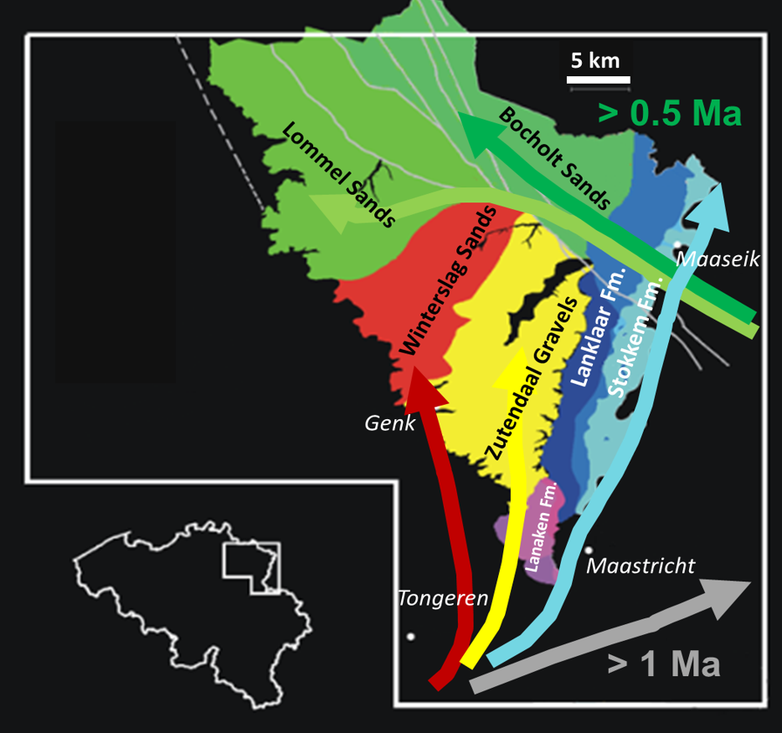
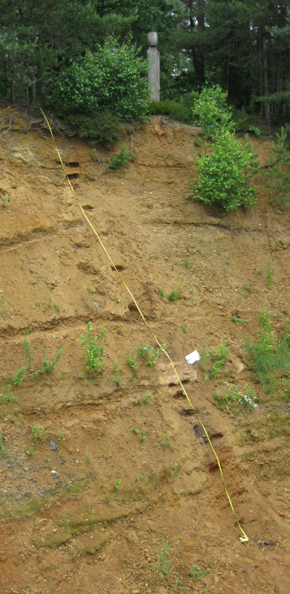
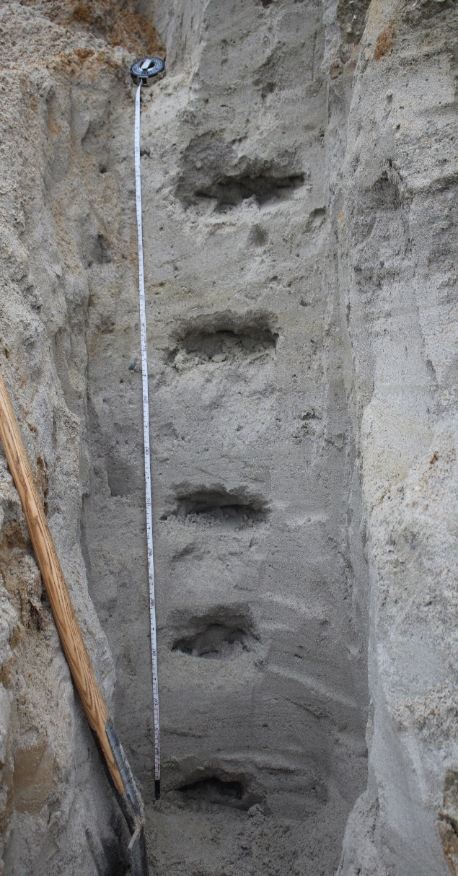
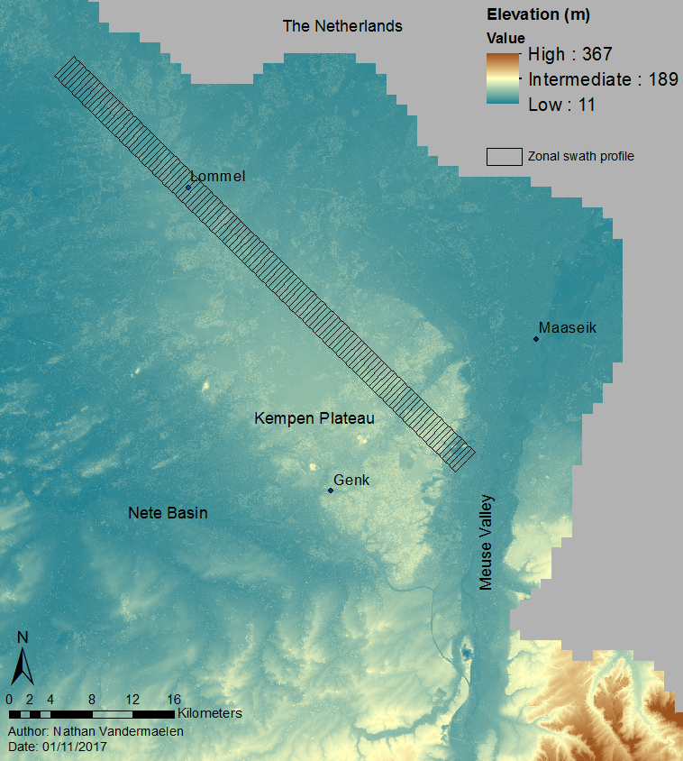
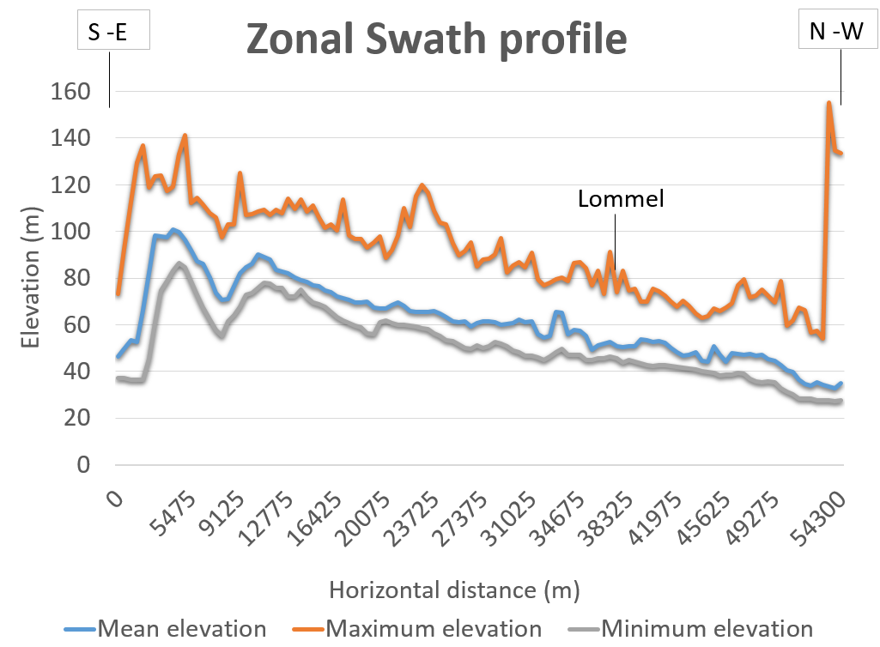
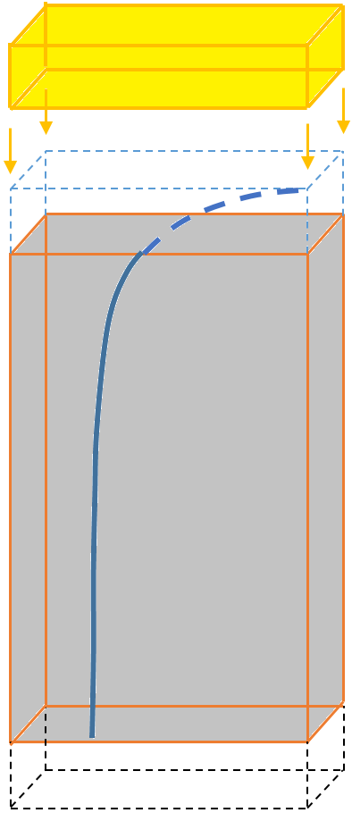
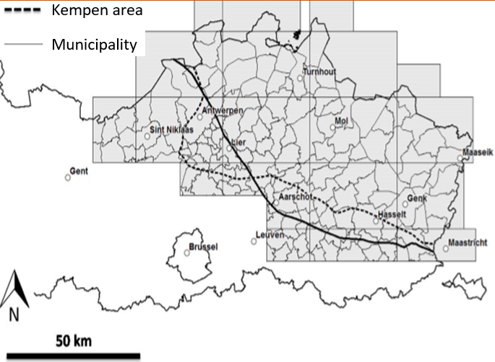
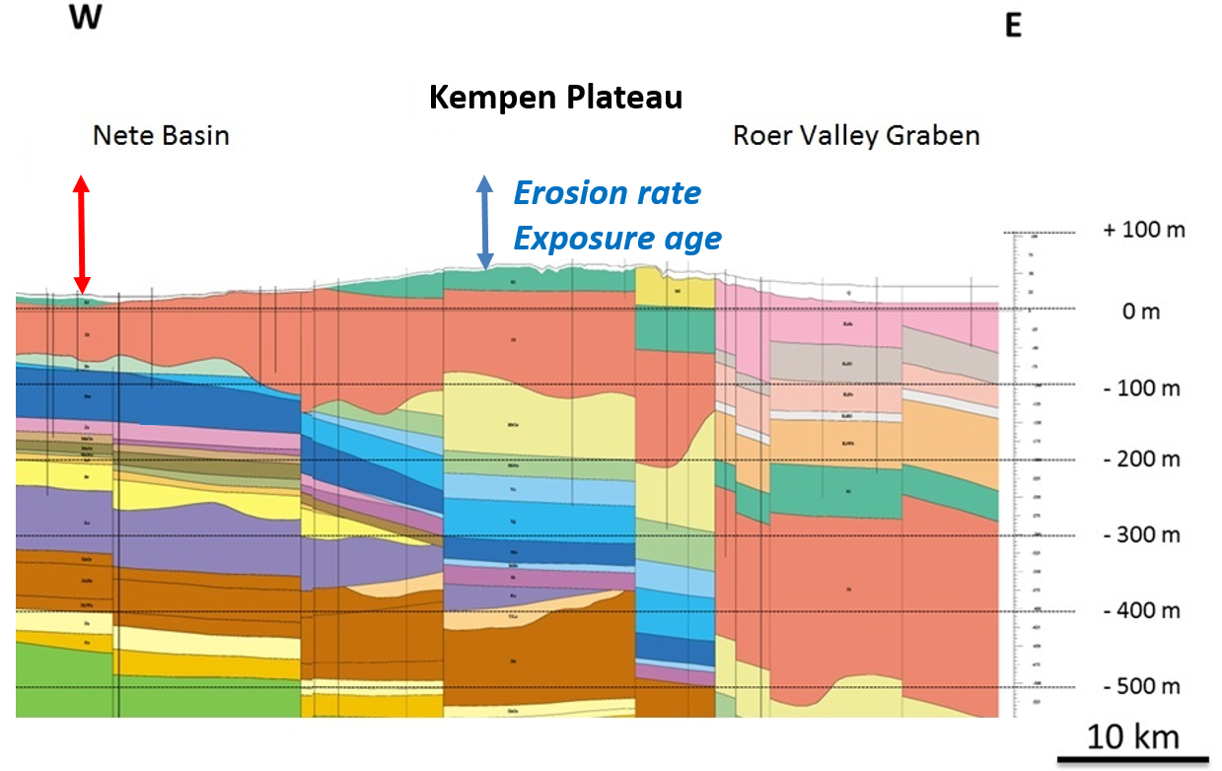


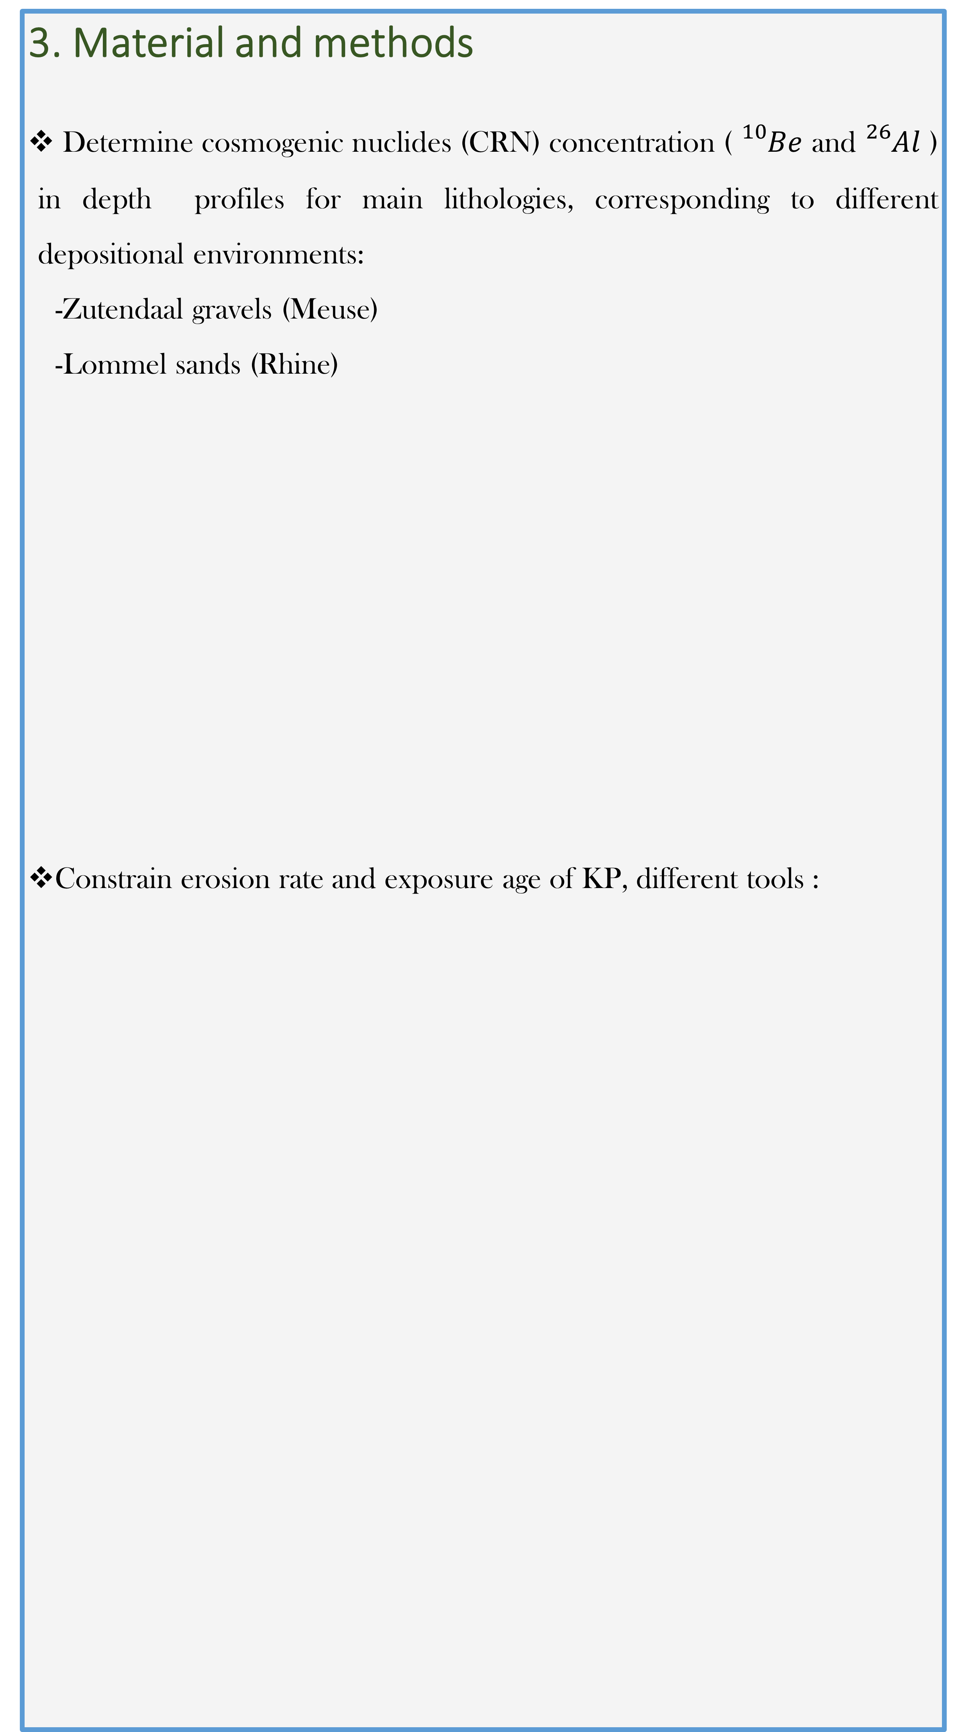
Constraining exposure age and erosion rates of the Kempen Plateau (Belgium)
over the last 1 Ma
N. Vandermaelen*; K. Beerten**; V. Vanacker*; M. Christl***
*Earth and life institute, University of Louvain, Place Louis Pasteur 3, 1348 Louvain-la-Neuve, Belgium
**SCK-CEN, Boeretang 200, 2400 Mol, Belgium
***Laboratory of Ion Beam Physics, ETH Zürich, Vladimir-Prelog Weg 1-5/10, 8093 Zürich, Switzerland
Introduction
Kempen area (KA) in erosive regime since 0.5-1 Ma.
- Part of the N-W Europe sand belt (lowlands).
- Data on quaternary landscape erosion are almost non-existant
Kempen plateau (KP) = high standing plateau (Rhine+Meuse sediments).
- Resulting from relief inversion due to differential erosion
- Proxy to reconstruct topographic evolution of the Kempen region
Main objective: Constrain surface exposure age and quantify past erosion rates, along with episodic burial events, of the KP over the last 1Ma, to give insights on the long-term landscape evolution of NE Belgium.
3. Material and methods
Determine cosmogenic nuclides (CRN) concentration ( ${}_{}^{10}{Be}$ and ${}_{}^{26}{Al}$ ) in depth profiles for main lithologies, corresponding to different depositional environments:
  -Zutendaal gravels (Meuse)
  -Lommel sands (Rhine)
Constrain erosion rate and exposure age of KP, different tools :
2. Study area
Kempen plateau located in NE Belgium.
KA is an erosion resistant feature
Fig.3. Depth profile sampled in Lommel sands (left) and Zutendaal gravels (right).
Fig.4. Main lithologies on the KP and former river pattern of Meuse (red-yellow-blue-grey) and Rhine (greens). (Source: Beerten, Under review).
  Data measurement: CRN concentration as a function of depth based on in situ depth profiles (>10 samples)
  Forward Modelling: comprises several CRN production pathways, dynamically adjusting CRN accumulation as function of denudation, burial and exposure duration.
  Bayesian inversion: Infer average erosion rate/surface exposure age using Monte Carlo simulation on depth profiles.
  Comparison: Use these techniques to compare erosion/exposure age in Meuse (N-W) and Rhine (S-E) deposits.
Fig.1. The Kempen plateau stands remarkably out of its environment (left map). It is a triangular geomorphic feature delimited abruptly by the Meuse valley in the East, the Nete Basin in the Northwest and the Feldbiss fault on its Northeastern side.
Fig.5. Forward Model. The layer in grey accumulates CRN’s, which concentration (blue curve) decreases (exponentially) with depth. Erosion removes the uppermost layer (dashed blue) and fresh material is provided in the bottom. Burial (yellow box) layers are added at some point.
Past denudation rates of KP are needed to constrain landscape evolution of Nete basin
Roer valley graben = tectonic influence (east of KP).
4. Prospects
Determine exposure age and erosion rates of KP over the last 1Ma.
Infer constraints for landscape evolution of NE Belgium.
Test various hypotheses of landscape evolution of lowland Belgium related to opening of the English Channel, and uplift of Ardennes Massif
Fig. 2. Geological underground of the Kempen area.
Author: Nathan Vandermaelen
Place Louis Pasteur, 3, office B.413.
Nathan.vandermaelen@uclouvain.be

