Slide 1
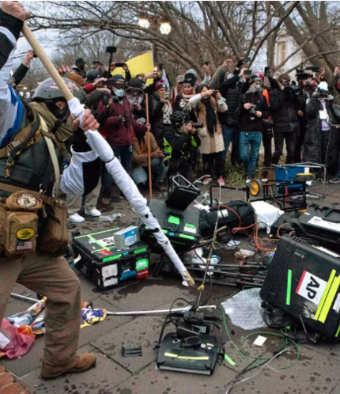
To what extent can the erosion of trust in news media undermine trust in democratic institutions?
Olivier Standaert, UCLouvain (Belgium)
Washington DC, January 2021. Pro-Trump rioters broke Associated Press television equipment (AP)
Seminar series on Evidence and Democracy in Times of Crises – Oslo, 9th December 2021

Slide 2

Defining trust in (news) media
Trust in public institutions
Trust in Journalism as an institution
The belief that the perceived institutional performance conforms to the individual’s expectations” (Muller 2013)
“The greater the level of trust within a community, the greater the likelihood of cooperation. And cooperation itself breeds trust” (Putnam 1993)
“The willingness of the audience to be vulnerable to news content based on the expectation that the media will perform in a satisfactory manner” (Hanitzsch et al. 2018)
Trust in news media incorporates four dimensions: topic selectivity, evidence selectivity, belief in accuracy, and faith in the information relevance (Robinson et al. 2021)
Notes:
Trust is perhaps the most important mechanism in helping people deal with the risk of an open future.
Other mechanisms are, for example, contracts or planning. Trust enables people to
compensate for the risk of giving up control to someone else. By trusting, the complexity
of the future is reduced; the trusting actor (the trustee) acts as if the future
only held certain possibilities. In this instance, trust replaces
knowledge.
PROCESS, RISK, Modern societies are characterized by enormous complexity so we can’t control everything, we don’t have a omniscient or intergal knowledge, so we have to believe others actors and rely on them

Slide 3
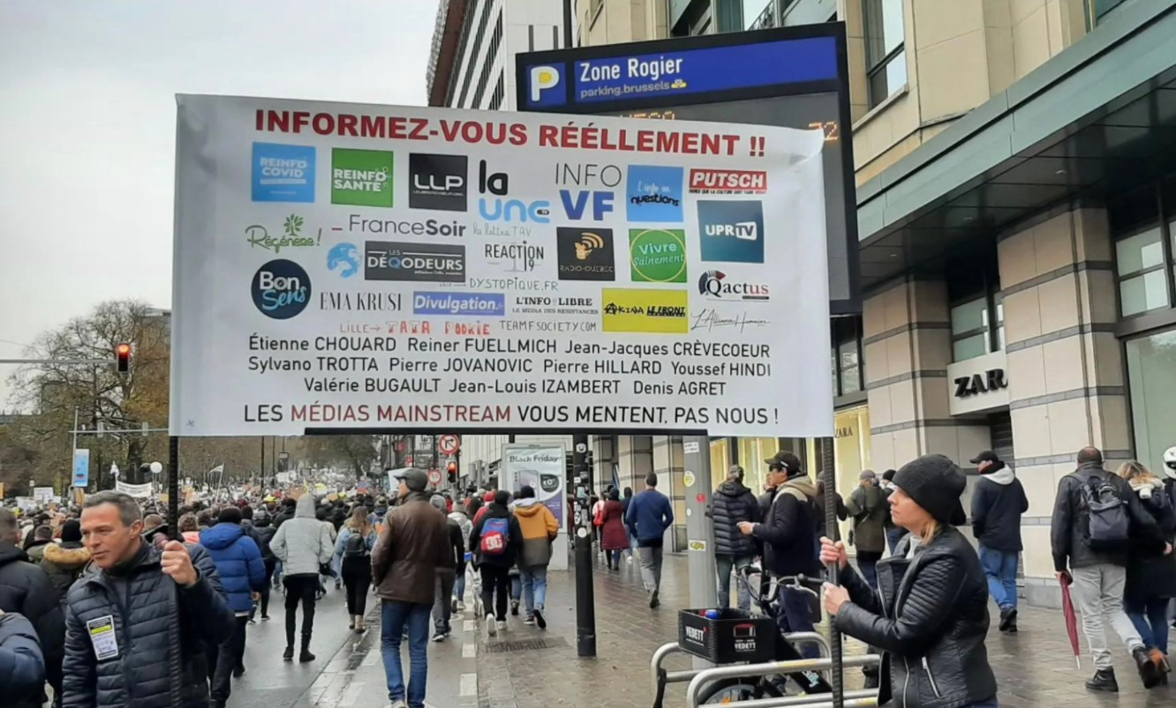
Symptoms of a crisis of confidence
Low and declining rates of trust in news and news media around the world, especially in mature democracies
Behind this trend, journalism’s very relevance comes to be increasingly questioned → epistemologies, practices and roles as an institution
Attacks and disqualifying discourses come from the top (authorities) and from different part of the (fragmented) audiences → sound box of social media
Brussels, November 2021. Demonstration against the reinforcement of health measures (Belga)

Slide 4
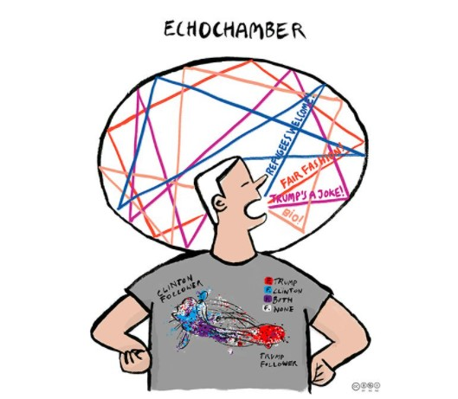
The responsibilities
Responsibilities from a media perspective: cynicism and negativity in reporting; media scandals; competition and the obsession of speed/revenues; the lack of representativeness
From a broader point of view: external actors create antipathy; general skepticism against institutions and their authority; the decisive role of platforms and social media in the distribution of content; conversations, opinions and news ways of reaching audiences
The issue of echo chambers has been largely discussed as a cause of polarisation of the public debate (Alexandra Klobouk)
Notes:
such negative reporting may actually backfire, and negatively affect trust in the news media

Slide 5
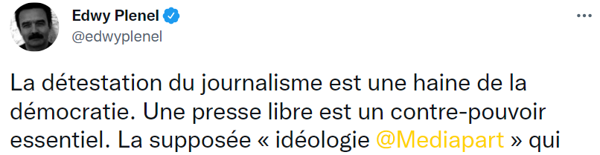
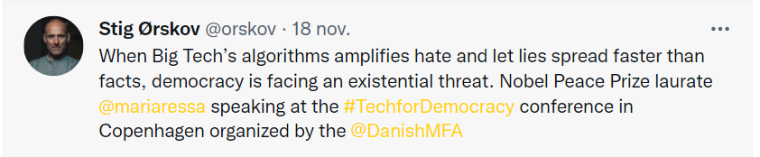
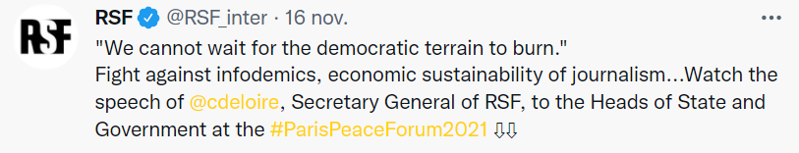
Undermining trust in news (media): which effects on democratic processes?
“The lack of a shared set of facts (…) led directly to the domestic terrorism and insurgency on Jan. 6, 2021 at the U.S. Capitol” (Carlson et al. 2021)
Disinformation acts/campaings affect elections (USA 16, Brexit, EU 2019)
If people do not trust news and media, how can they make decisions for their lives and their future on a strong basis?
The erosion of media trust may go hand in hand with a decline in political trust
Notes:
The erosion of media trust may go hand in hand with a decline in political trust or even a more general disenchantment with social institutions.

