Slide 1
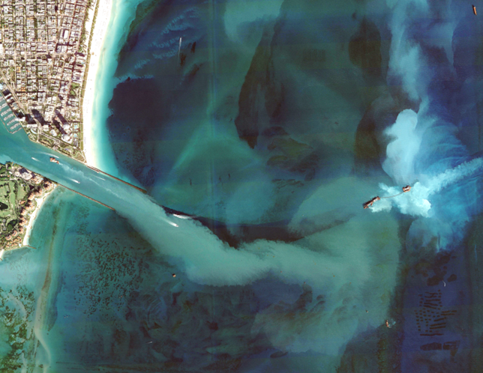

Investigating the link between the Port of Miami dredging and the onset of the stony coral tissue loss disease epidemics
Thomas Dobbelaere, Daniel Holstein, Lew Gramer,
Lucas McEachron, Emmanuel Hanert

Slide 2
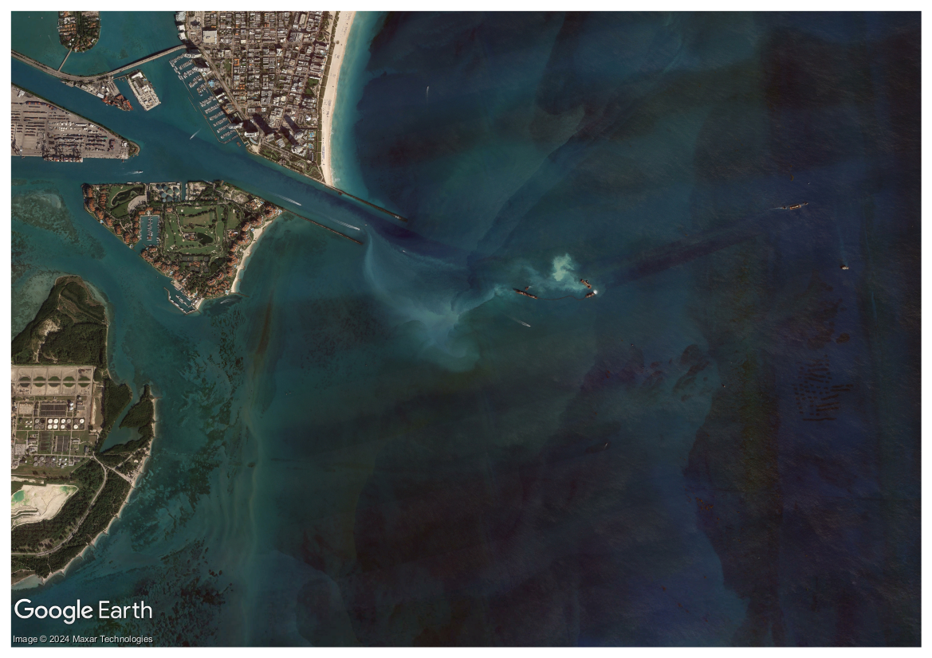
The PortMiami Deep Dredge Project (PMDDP) was conducted from November 20, 2013 to March 16, 2015
Shipping channel deepened from 12.8 to 15.2 meters
4.4 ×10⁶ m³ of sediments removed
Non-conventional “rock chopping” with suction mechanism turned off between Dec 2013 and May 2014
Sediment plumes covered up to 11 km² of coral area¹ and contributed to death and burial of >560,000 coral colonies²
¹Barnes et al (2015); ²Cunning et al (2019)
1

Slide 3
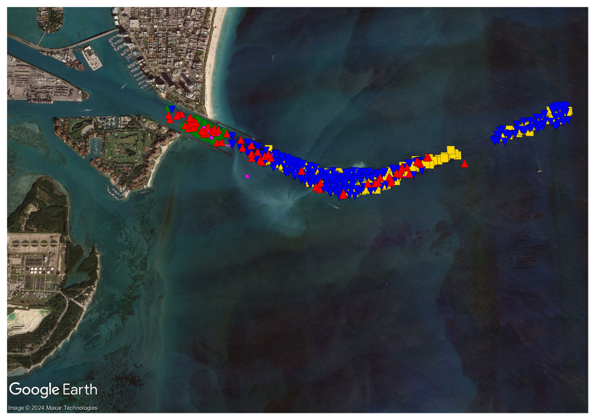
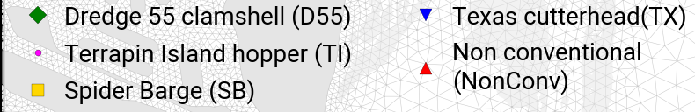
The PortMiami Deep Dredge Project (PMDDP) was conducted from November 20, 2013 to March 16, 2015
Shipping channel deepened from 12.8 to 15.2 meters
4.4 ×10⁶ m³ of sediments removed
Non-conventional “rock chopping” with suction mechanism turned off between Dec 2013 and May 2014
Sediment plumes covered up to 11 km² of coral area¹ and contributed to death and burial of >560,000 coral colonies²
¹Barnes et al (2015); ²Cunning et al (2019)
1

Slide 4
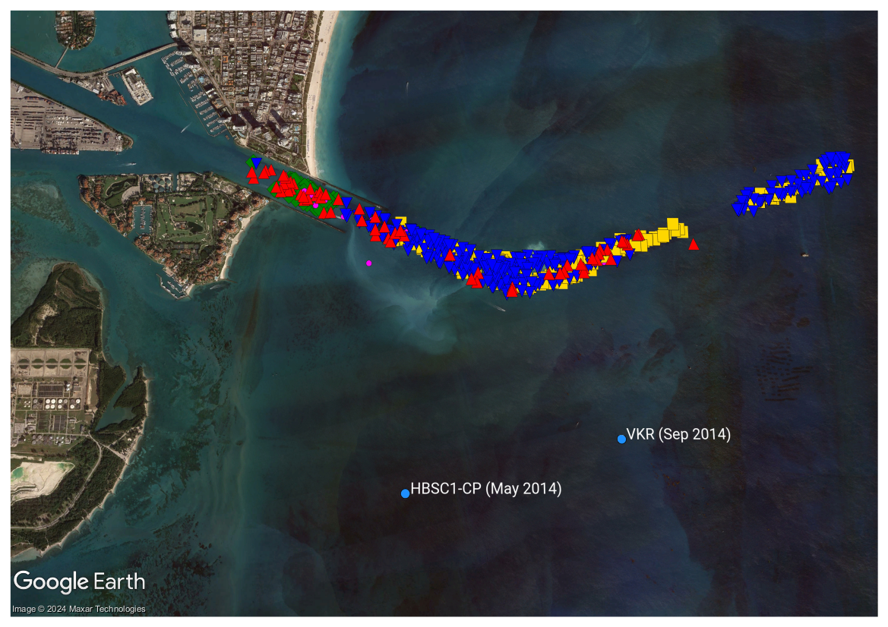
The PortMiami Deep Dredge Project (PMDDP) was conducted from November 20, 2013 to March 16, 2015
Shipping channel deepened from 12.8 to 15.2 meters
4.4 ×10⁶ m³ of sediments removed
Non-conventional “rock chopping” with suction mechanism turned off between Dec 2013 and May 2014
Sediment plumes covered up to 11 km² of coral area¹ and contributed to death and burial of >560,000 coral colonies²
¹Barnes et al (2015); ²Cunning et al (2019)
1

Slide 5
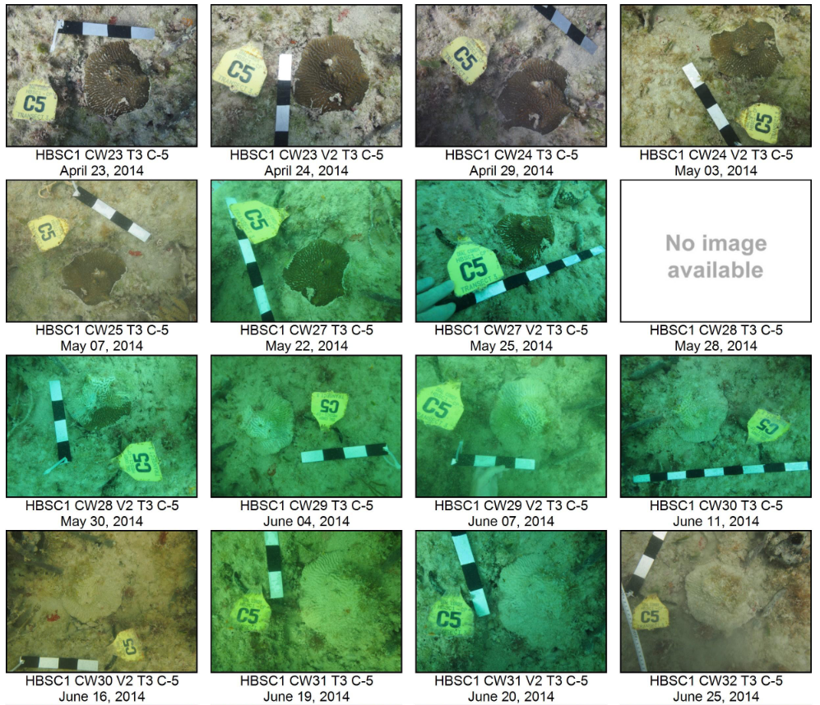
The PortMiami Deep Dredge Project (PMDDP) was conducted from November 20, 2013 to March 16, 2015
Shipping channel deepened from 12.8 to 15.2 meters
4.4 ×10⁶ m³ of sediments removed
Non-conventional “rock chopping” with suction mechanism turned off between Dec 2013 and May 2014
Sediment plumes covered up to 11 km² of coral area¹ and contributed to death and burial of >560,000 coral colonies²
¹Barnes et al (2015); ²Cunning et al (2019)
1

Slide 6
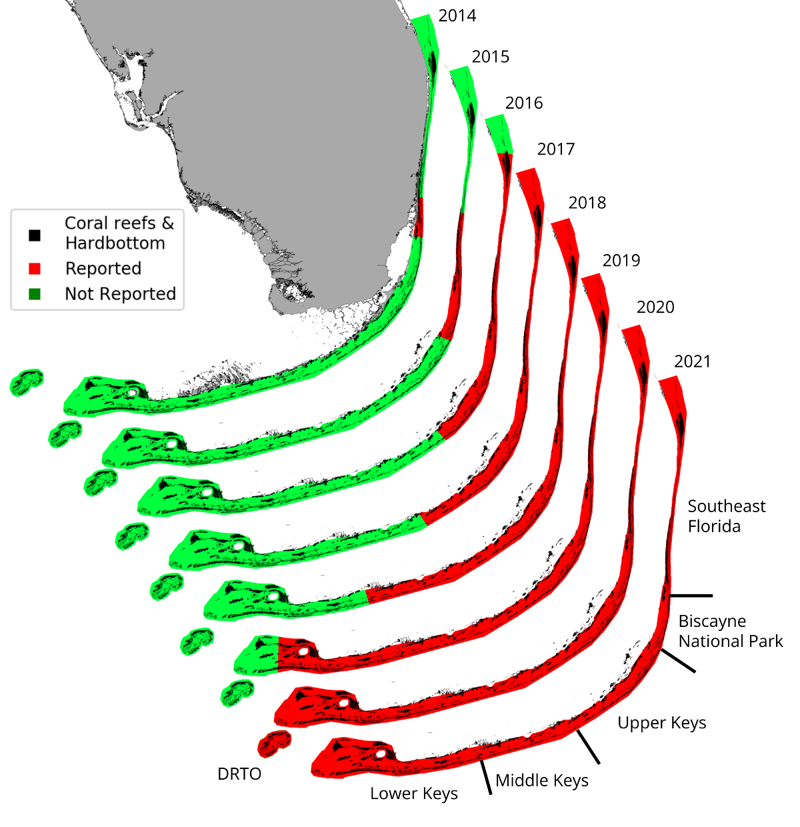
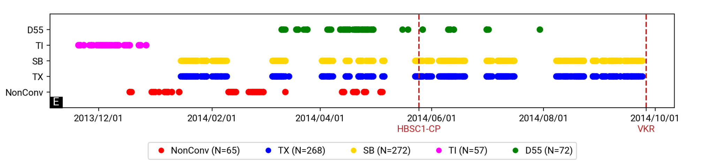
Stony coral tissue loss disease (SCTLD) was first observed near the dredged channel in 2014
Worst coral disease outbreak on record in the Caribbean
Unidentified causative agent
Evidence of waterborne and sediment-mediated disease transmission
2

Slide 7

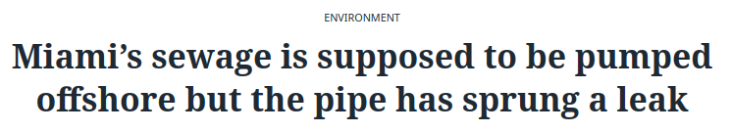

A leaking discharge pipe was also reported the first affected reef sites
Wastewater leaking from the Miami Central District Municipal Wastewater Treatment Plant (WWTP) discharge pipe
Leak reported in 2017 but possible that this poorly maintained pipe:
Was already leaking in 2014¹ ?
Had other leaks ?
¹As suggested by Gintert at al. (2019)
3

Slide 8



We investigated various transmission scenarios to elucidate the origins of the SCTLD outbreak
Our goal was to identify the pathways through which the disease could have spread to the first affected sites. We investigated:
The impact of sediments dispersed by the PMDDP
The contamination from leaking wastewater
The potential for waterborne disease transmission
4

Slide 9

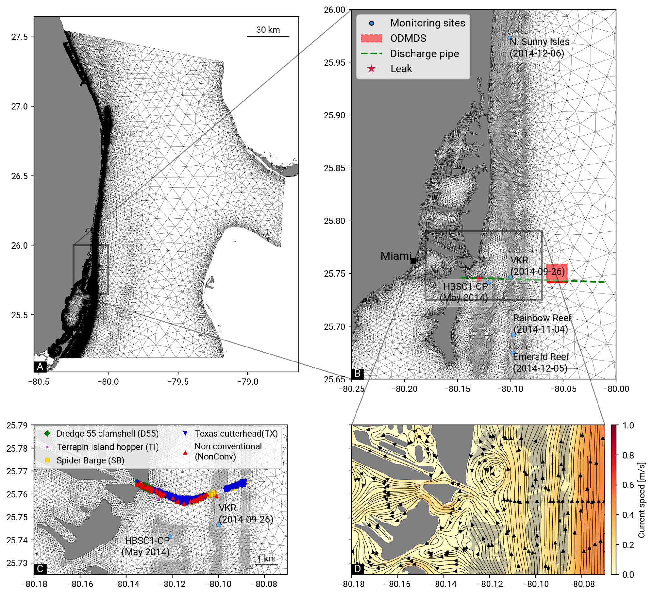
We simulated the dispersal of sediments, wastewater and disease agents using the unstructured-mesh coastal ocean model
Sediment dispersal modeled using a LPT with a quasi-3D approach: 2D velocity with vertical log profile
Sediment particles released from dredging locations during a whole day
5 grain size classes but focus on the two finest ones: 5-50 µm (silt) and 50-100 µm (very fine sand)
Impact of sediments on corals estimated through plumes and deposition
5

Slide 10
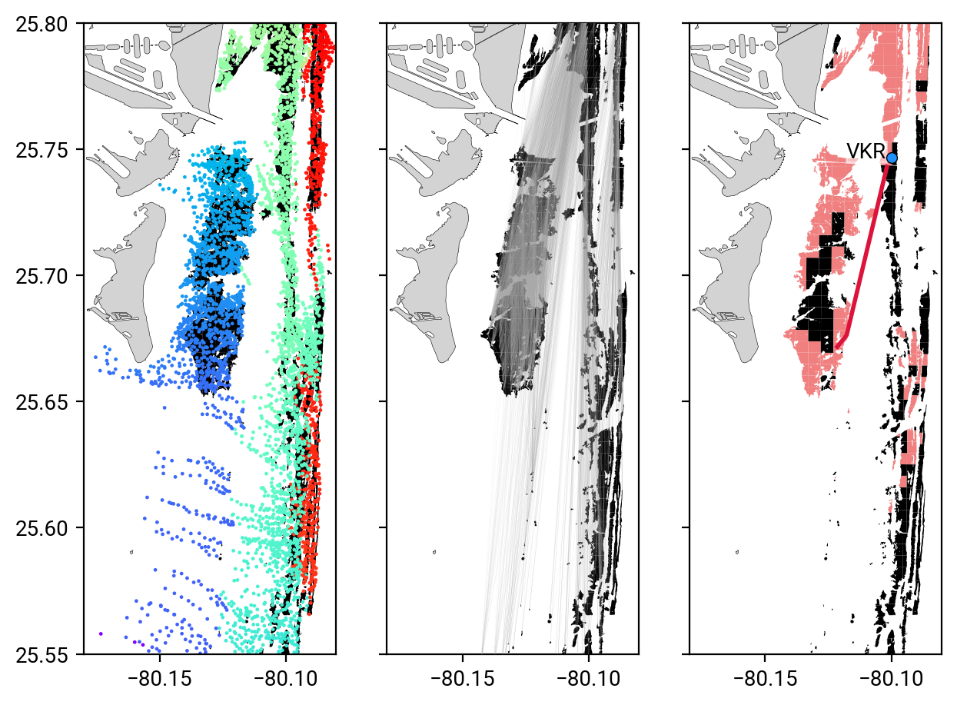
We simulated the dispersal of sediments, wastewater and disease agents using the unstructured-mesh coastal ocean model
Wastewater modeled as positively buoyant particles and backtracked from affected sites
Disease agents released from the reefs impacted by the dredged sediments
Infection pathways identified as shortest paths to VKR in connectivity networks¹
¹Same approach as Dobbelaere et al. (2022)
6

Slide 11
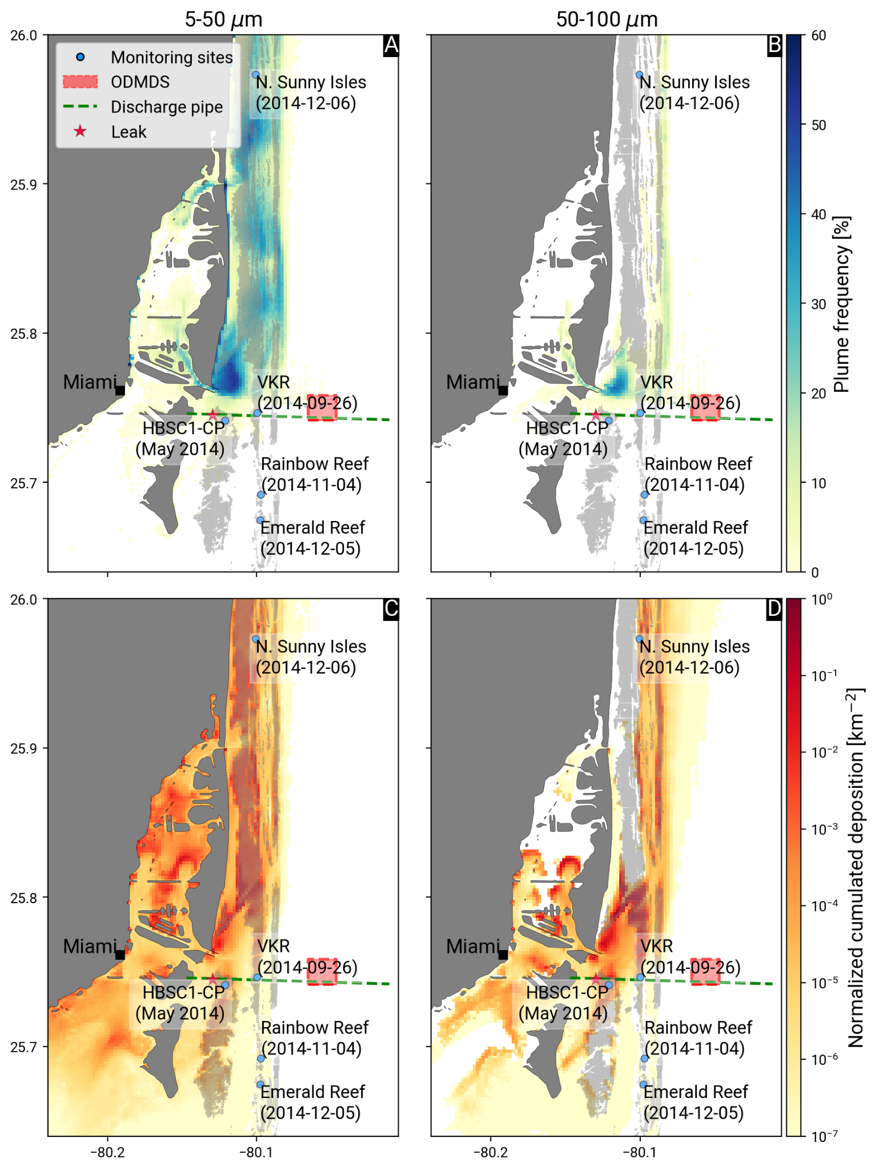
Our study confirms previous findings on the extensive impacts of the PMDDP
Total plume area of ~205 km²
Plumes mostly occurred within 1.5 km north of the dredged channel, between the coast and the reefs
Best agreement with remote sensing plume observations for grain sizes of 5-50 µm
Deposition predominantly over coral reefs, including first affected sites, mostly on onshore reefs for grain sizes <50 µm, and offshore reefs for grain sizes >50 µm
7

Slide 12
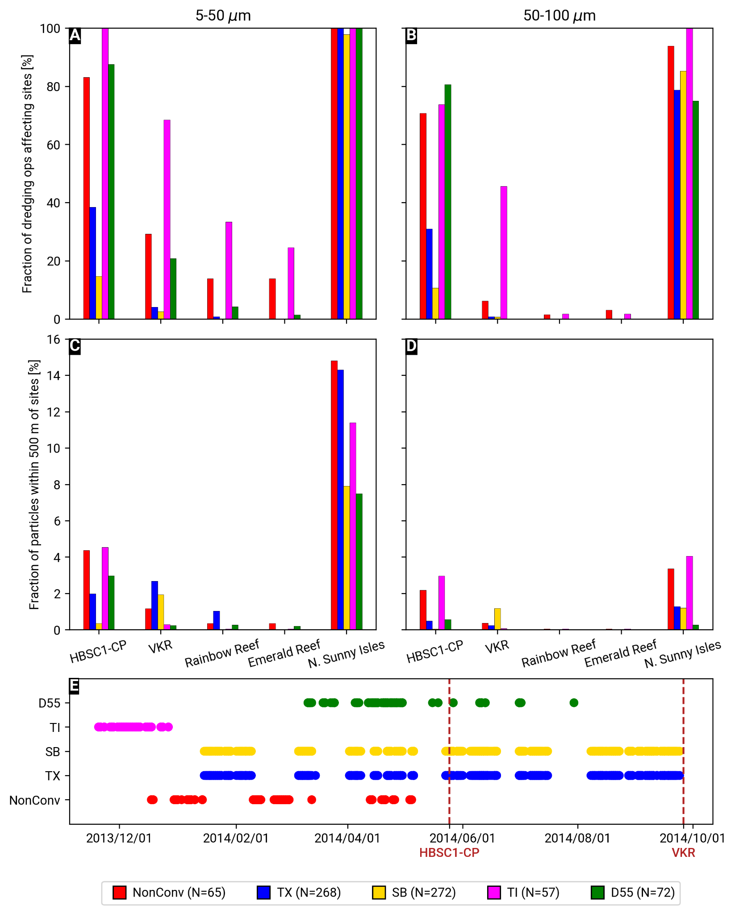
HSC1-CP and VKR were affected by fine sediments produced by (non-conventional) dredging
Most affected reef site located north of the dredged channel
HBSC1-CP and VKR were resp. affected by up to 43% and 12.4% of all dredging operations, and up to 83% and 29% of the non-conventional dredging operations
Impact of non-conventional dredging might be underestimated in our study
8

Slide 13
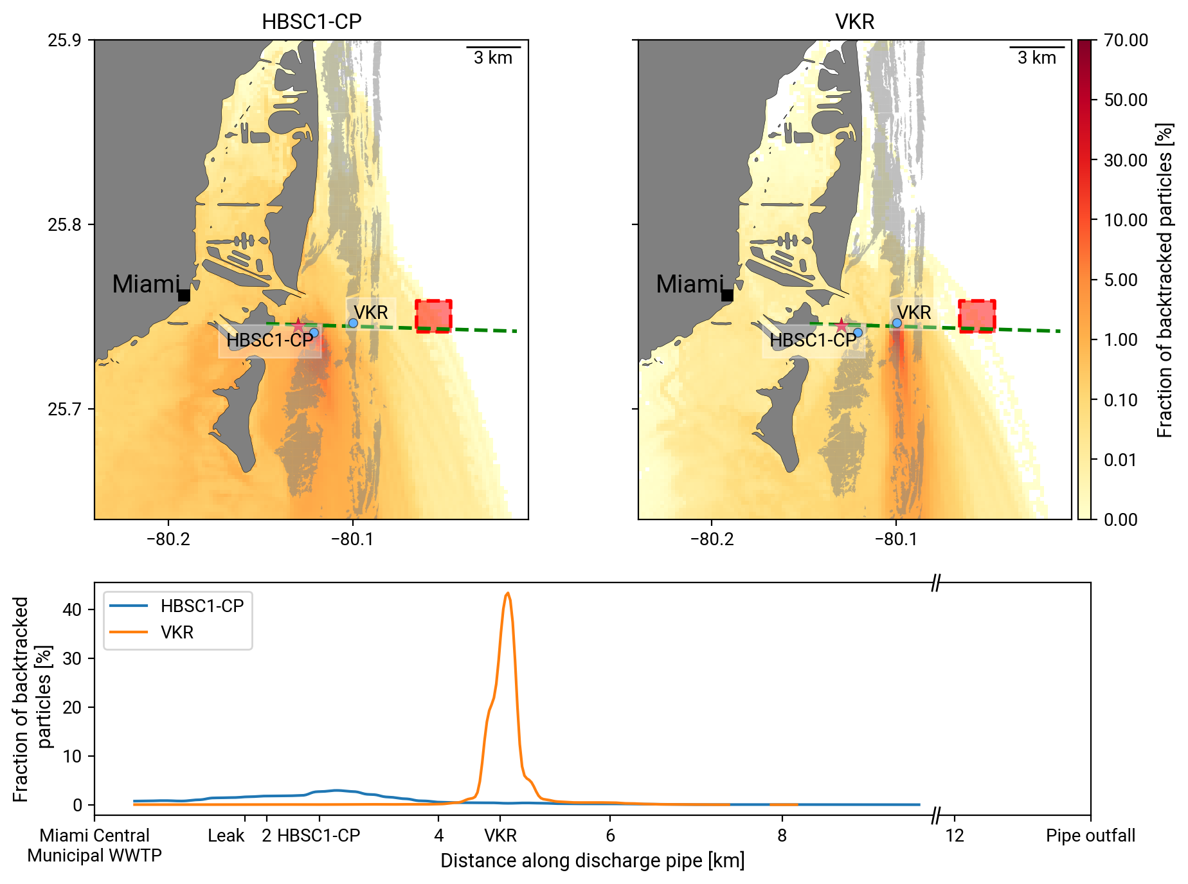
Contamination by wastewater was unlikely, unless the leakage occurred within a few hundreds of meters of the reef sites
Most likely sources of contaminant within narrow “cones” directly south of the sites
Probability to be reached by wastewater from the leak reported in 2017 is 0.02% for VKR and 1.6 % for HBSC1-CP
9

Slide 14
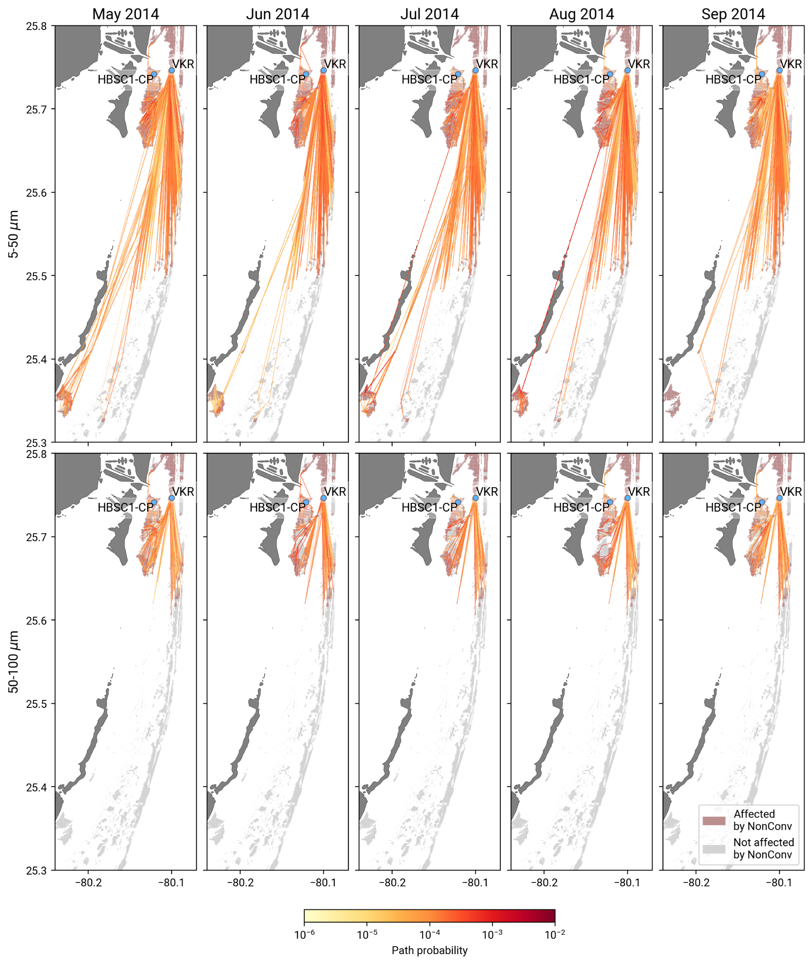
We found connectivity pathways to VKR from May to Sep 2014
Continuous potential for waterborne disease propagation from reefs affected by dredging during these months
Multistep pathways with southern reefs as stepping stones ⇒ disease could have taken several months to reach VKR
Average transmission time of 5-10 days¹
Consistency of pathway structure due to stable hydrodynamic conditions
¹Aeby et al. (2019,2021); Meiling et al (2021)
10

Slide 15
In brief
A non-negligible fraction of the sediments produced by the (non-conventional) dredging operations reached the reef sites were SCTLD was first reported
Contamination by wastewater was improbable unless the leak was located within hundreds of meters of the reef sites
There was an uninterrupted possibility of waterborne disease transmission to VKR from reefs affected by dredged sediments during 5 months
11

Slide 16
In brief
A non-negligible fraction of the sediments produced by the (non-conventional) dredging operations reached the reef sites were SCTLD was first reported
Contamination by wastewater was improbable unless the leak was located within hundreds of meters of the reef sites
There was an uninterrupted possibility of waterborne disease transmission to VKR from reefs affected by dredged sediments during 5 months
Either directly or indirectly, the PMDDP had the potential to deliver disease agents to the reefs suspected to have experienced the first SCTLD outbreaks
For more details: Dobbelaere, T., Holstein, D. M., Gramer, L. J., McEachron, L., & Hanert, E. (2024). Investigating the link between the Port of Miami dredging and the onset of the stony coral tissue loss disease epidemics. Marine Pollution Bulletin, 207, 116886.
11

