Slide 1
Welcome & Wonder
The Sponge Manifesto
Sophie Thunus & Maya Duverdier
January 2025
Care, Aesthetics and Repair
CERC, Care Ethics Research Consortium, Utrecht

Slide 2
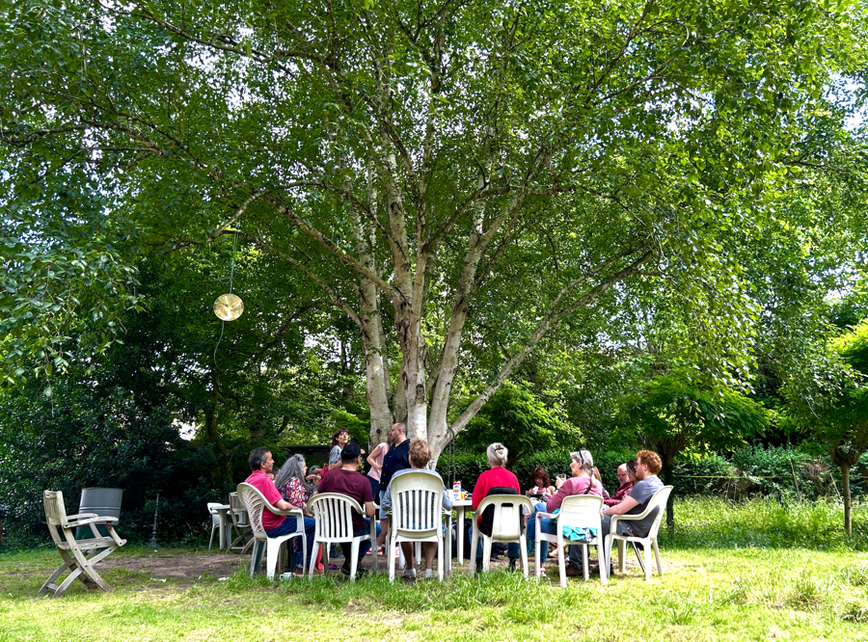
a short documentary film on Brussels’ Places for Connection
this presentation
brief definition of PfCs
research & creation project
screening
discussion: in your perception, how does the film resonate with your own experience/understanding of care?
  the film as a witness of care/caretaker
  the process underlying the research and creation project
… towards the Sponge Manifesto

Slide 3
intro
Places for Connection (PfCs) are co-managed facilities established in Brussels to enable people with and without mental health problems to reconnect with themselves and with the community
they promote an alternative look at social institutions and mental health”
their development had been accelerated following the COVID-19 pandemic, to tackle social isolation. Today, there are about 20 PfCs in Brussels.
in these places, everyone is welcomed and considered a member.
PfCs intend to be as inclusive as possible by voluntarily de-emphasizing social and diagnostic categories in everyday interactions.
they are “open to the public (…) mostly centrally situated and accessible to anyone passing by, regardless of their mental health history” (Walker &Thunus 2020).
they do not “provide psychiatric or medical treatment but allow for opportunities to develop ties within a local community through the organization of collective, social and cultural activities” (idem).

Slide 4
intro
2022: a research & creation project to understand PfCs and their mode of operation, and to find a way to share how they could care for their members and the society at large
  on the occasion of a previous project (2017-19), we felt that much of what we experienced in the places, which seemed fundamental to mental health, resisted being articulated and shared through using standard social science research methods
  in addition, as researchers with no experience of psychiatric institutions, we could not claim to have the same experience of these places as their members
the short film: a step in the research & creation project leading to a documentary film (spring 2025)
  the research-creation project included three interrelated elements: design workshops, cinematographic work, and participatory research
  today we’ll focus on cinematographic work and participatory research

Slide 5
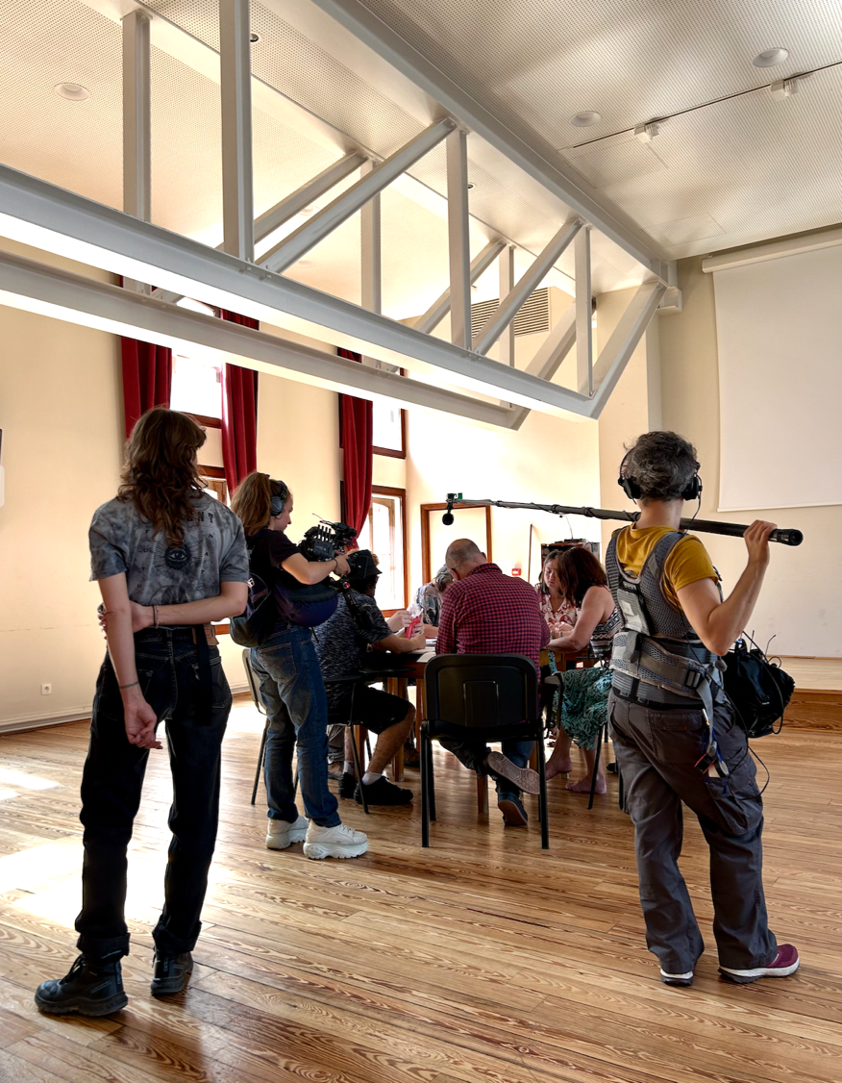
lieux de lien
https://vimeo.com/manage/videos/939566100

Slide 6
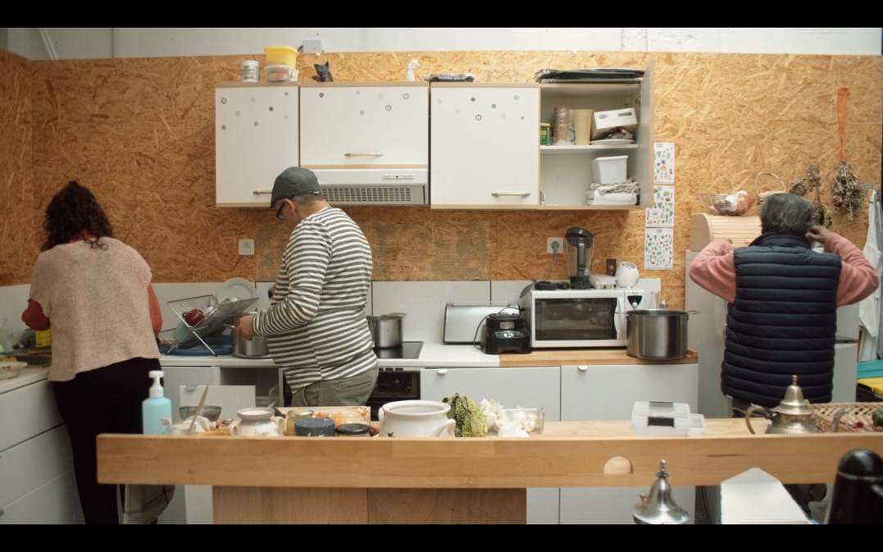
discussion in your perception, how does the film resonate with your own experience/understanding of care?

Slide 7
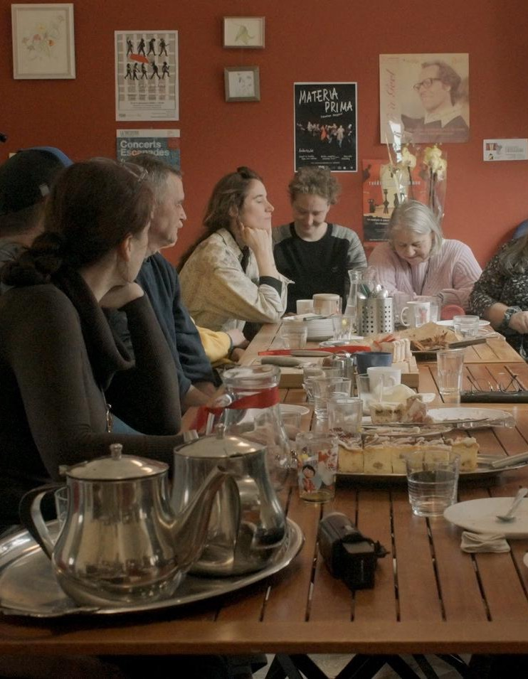
witness of care
the short film bears witness to the care that exists between members, as embodied in collective and daily life
here: cake distribution at Club 55
care lies in the warm atmosphere that emanates from a shared meal…
in the harmonious coexistence of community members, some of whom are active and others resting

Slide 8
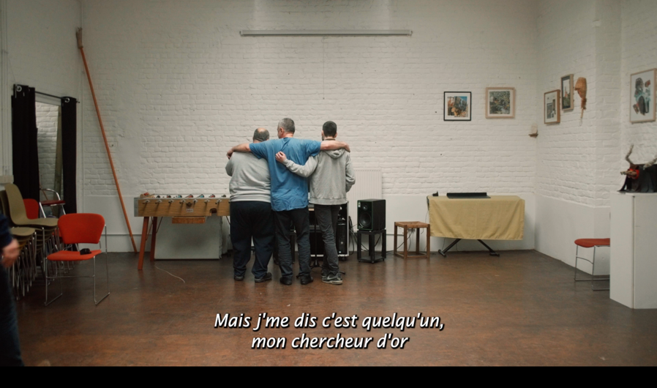
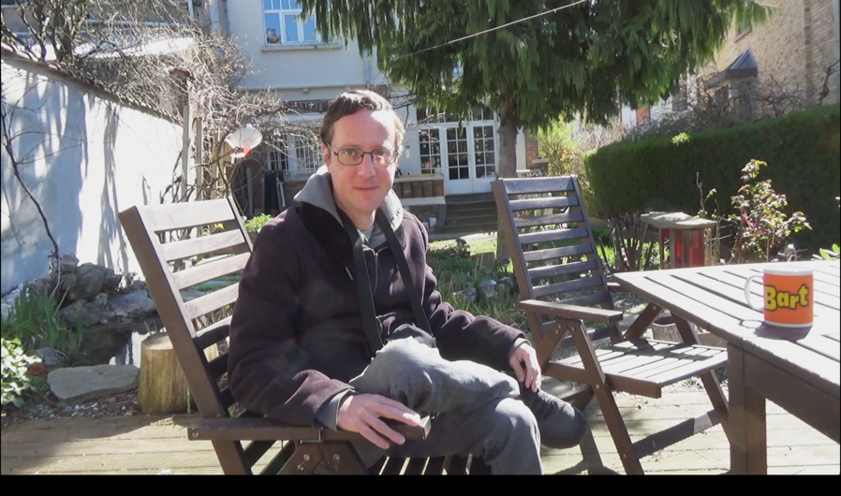
a sense of complicity and joy is shared by three men singing together
Fred’s dream: the intimacy of a moment of confession and listening

Slide 9
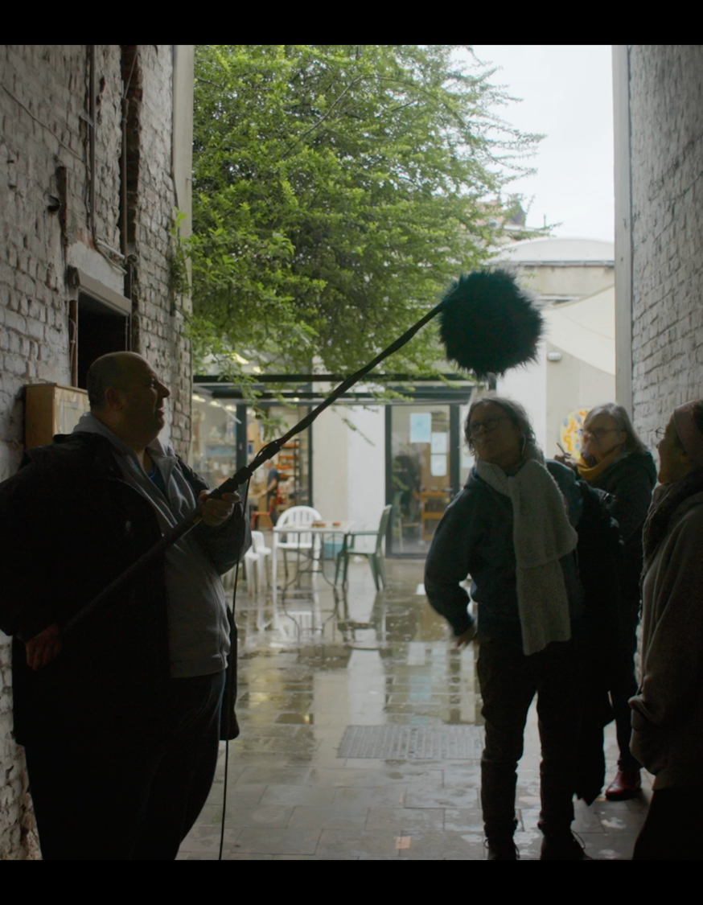
caretaker: challenging the organization of the social world
the roles of researchers, filmmakers and members roles are redistributed: members were invited to use a camera DV, while researchers and filmmakers were welcomed in the places as members
here: Aliekber interviewing Josiane, Monique and Leïla

Slide 10
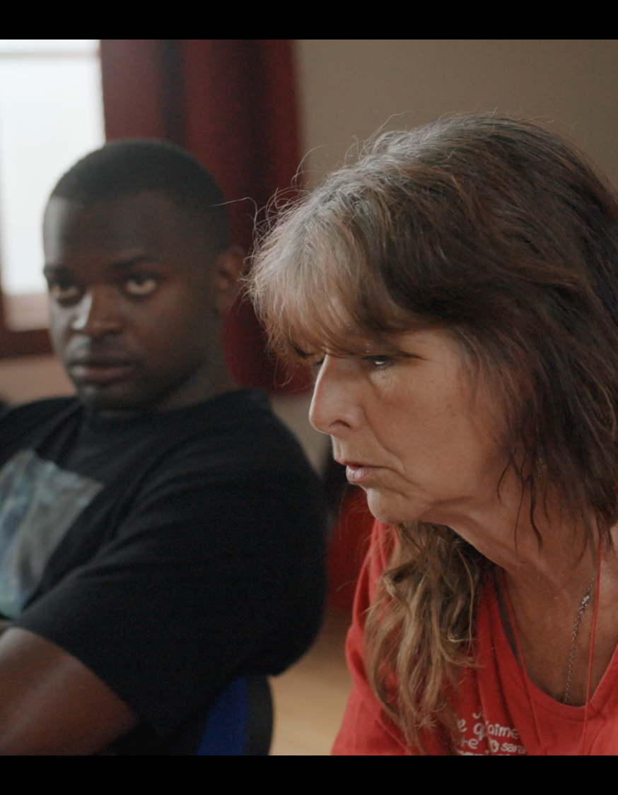
caretaker: challenging the organization of the social world
the frame of the camera creates a space time for members to express themselves and make their voice heard
at the group level, we see that people listen to each other attentively and respectfully, which reveal the shared dimension of speech
a collective thought develops as the exchanges unfold: a talking stick, an invisible torch, is being passed between people

Slide 11
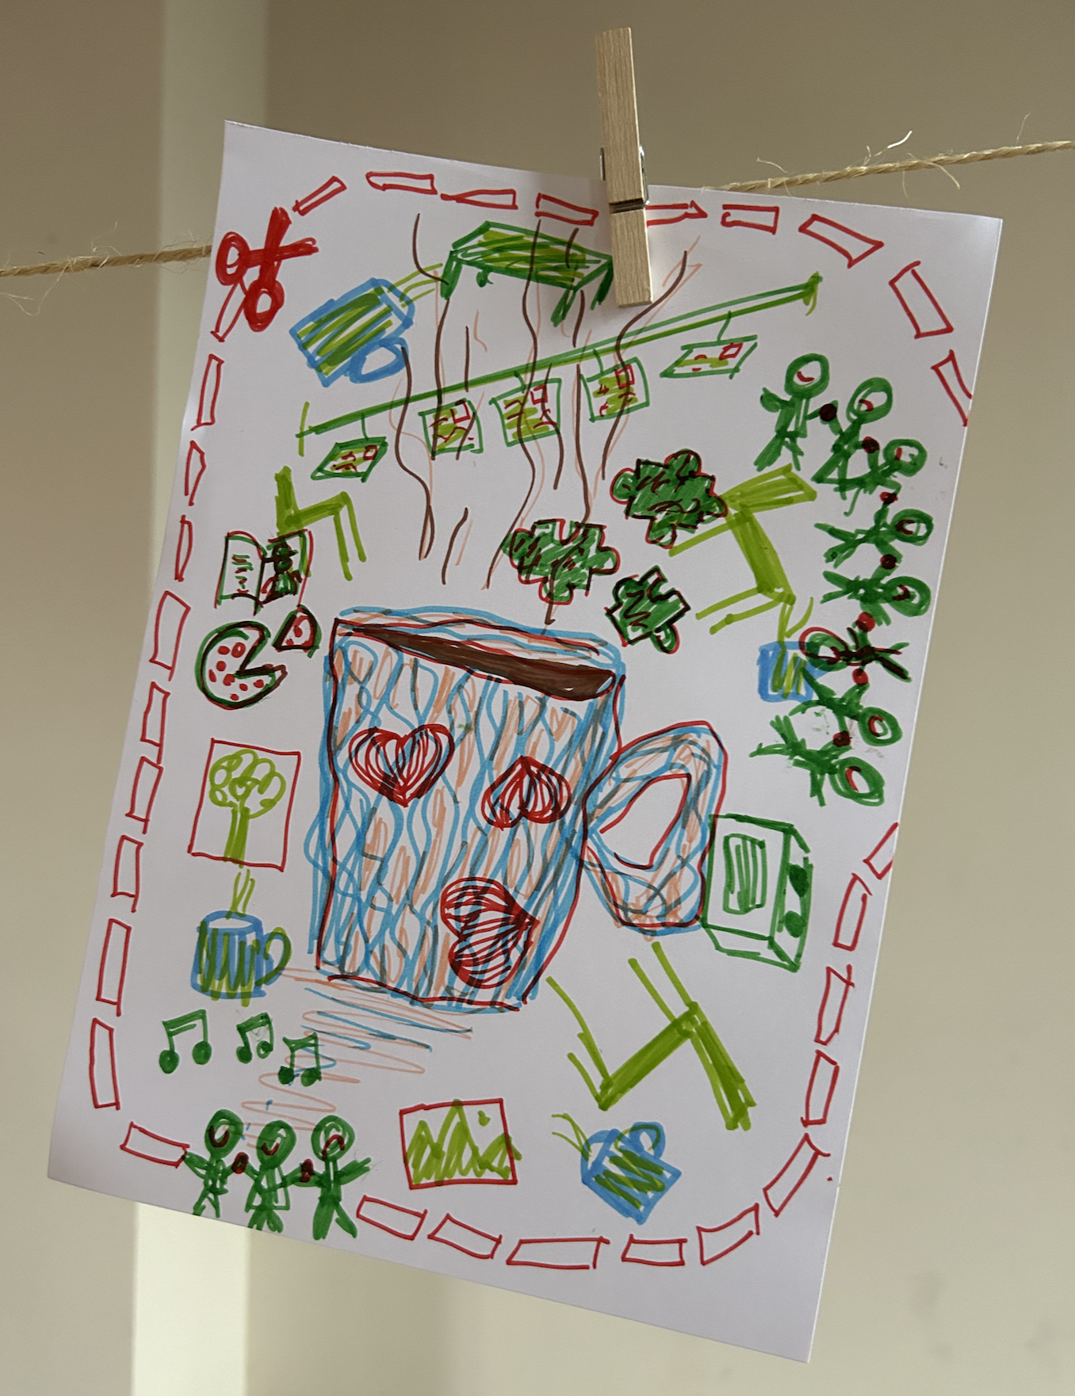
process – towards the Sponge Manifesto
when we began to reflect on the process underlying the research-creation project, we came up with key moments and characteristics that were systematically related to places for connection:
  our project had, almost unwittingly, absorbed the human and organizational dynamics specific to the places/ the places had transcended our disciplinary norms
some of the key moments at which the places insinuated themselves into our practices, breathing new life into them.

Slide 12
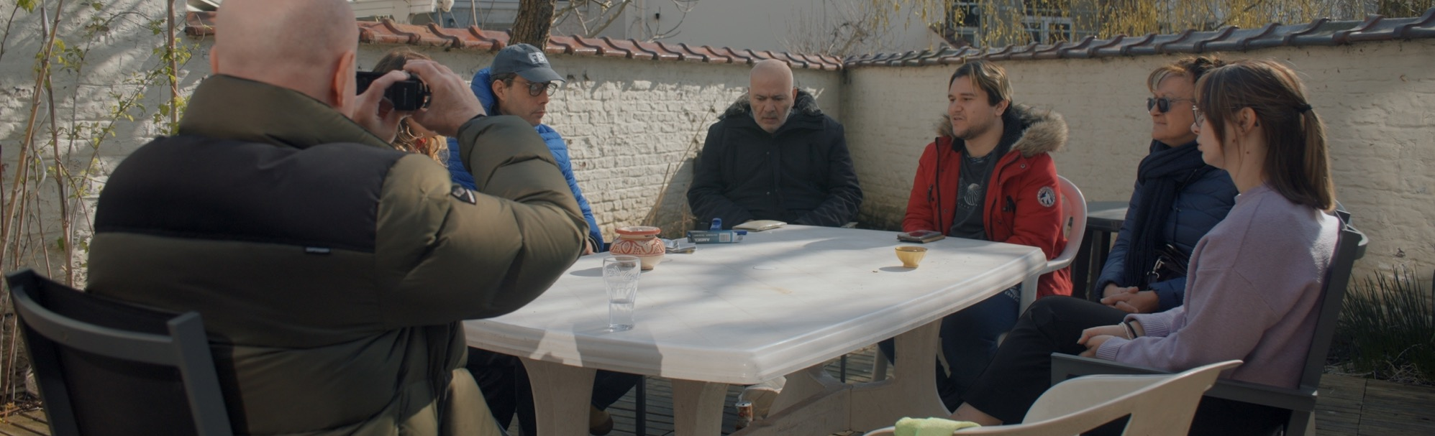
process – example 1
what we expected: a single location to facilitate our “immersion” in the placed and to create a unity of location facilitating the narrative
what happened: 4 places applied to participate in the project and we gave up the unity of location and took the risk of doing the film without central characters
the distance we took from these norms (unity of location & central characters) seemed to strengthen the community that was being created through the project and provide the members of the places with greater ease to find their place within it

Slide 13
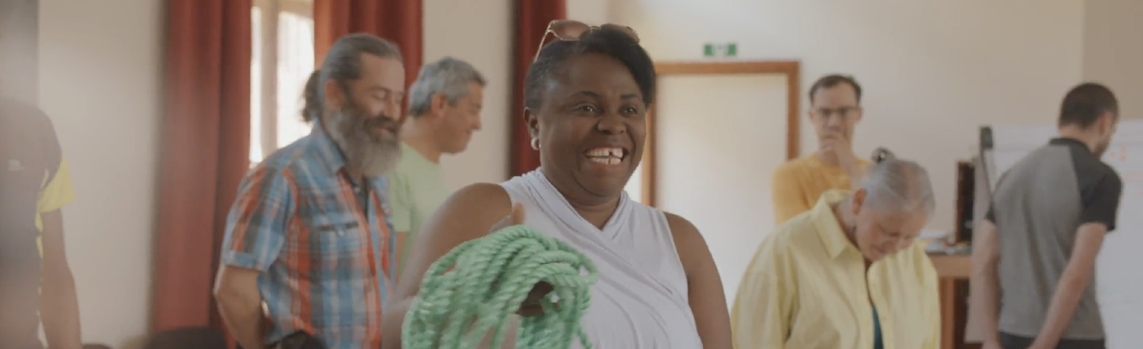
process – example 2
the research & creation project’s activities (film, research, design workshops, etc.) were included in the monthly schedules of the PfCs, often sent out as a newsletter.
anyone interested in the activities we proposed could decide to participate
other activities were unfolding at the same time
members could choose their preferred activities, but also to do nothing at all
as a result, both cinema and research appeared « desacralized »

Slide 14
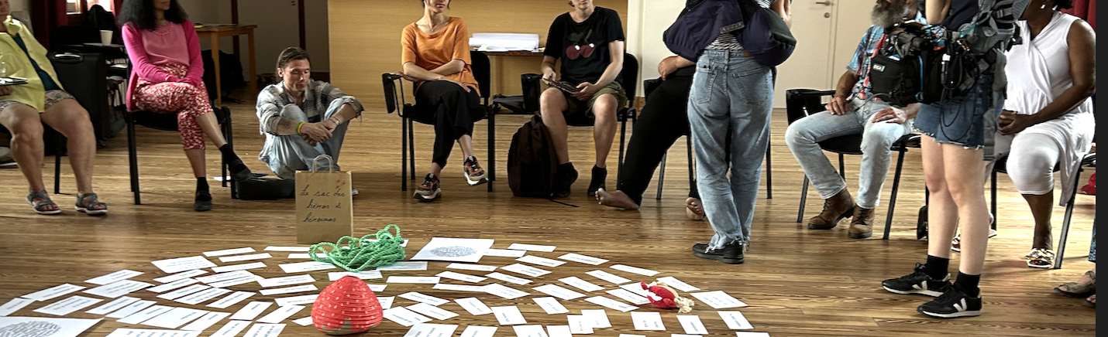
process – example 3
at first, when the team proposed research activities, researchers worried about attendance and about research sampling, so they tried to confirm people’s participation in advance.
after realizing that people would attend, irrespective of whether they had promised to or not, the research team just announced an activity and stopped soliciting commitments
the project thus absorbed PfCs’ modes of operation (no appointment is necessary) and researchers gradually and unconsciously suspended conventional approaches to ensuring participation: not only did they accept that their sampling would vary from one research activity to another, but they also found that their desire to control participation gradually gave way to a feeling of trust.

Slide 15
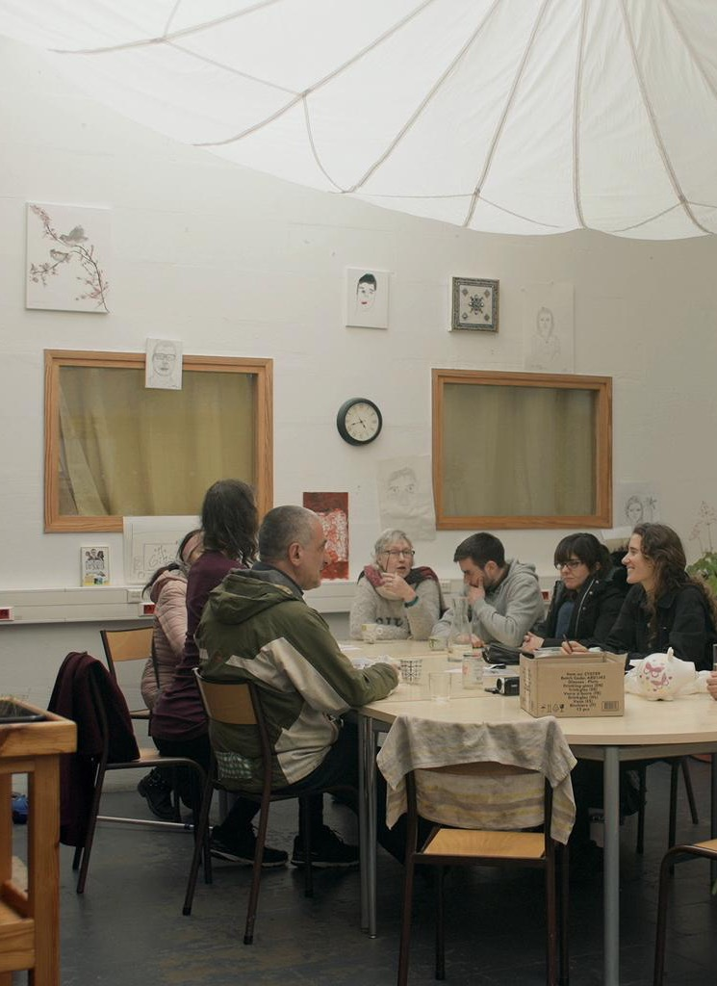
conclusion
The sponge emerged as an image to describe our project as a living creature: a permeable material able to absorb and metabolize unforeseen, unexpected, sometimes unknown and confusing modes of operation
with the places and within the team: experimenting transdisciplinarity led us to take part in all activities (research or film), to design them and to discuss the results together: no one was no longer an expert of anything, but everyone learnt and the boundaries between disciplines were blurred
These modes of doing research and cinema made perfect sense and were absolutely necessary within the places, which have tacitly opposed resistance to disciplinary conventions, making us shift form a desire to control to a desire to believe in and trust the process
towards a Sponge Manifesto – attentiveness, trust, time, reciprocity; coming along with a film and a collective book

