Slide 2

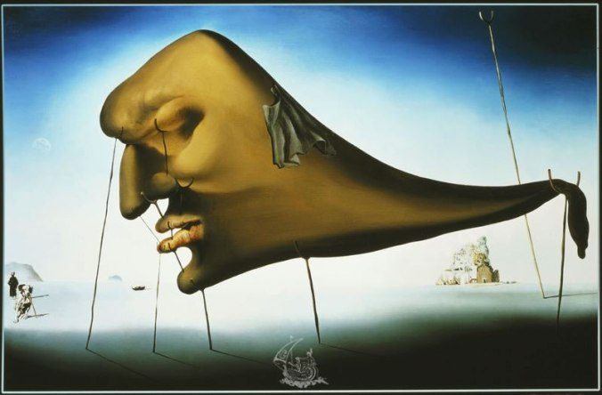
God’s Nose in LXX-Pentateuch:
An Anthropomorphism Avoided or Metaphor Installed?
Ellen De Doncker EABS Siracusa 13 /7/2023

Slide 3
Overview
Introduction
Translating God’s « nose »
  Translating metaphors in LXX
  The question of heat
  The question of anthropomorphisms
Living, moribund, dead metaphors
Conclusion

Slide 4
Introduction

Slide 5

Introduction
Bodies & Anthropomorphism
  God’s nose : an anthropomorphism
    Anthropomorphism? The attribution of human-like body parts to God and, by extension, the attribution of human-like emotions and activities
  Question of “anti-anthropomorphism” in LXX
    Fritsch: LXX avoids at times anthropomorphisms
    = anti-anthropomophic tendency
אף : body part or emotion?
  Double meaning of אף: physical / emotional
    Plural: probably physical!
  Use of אף in metaphor and as metonymy
  God’s אף: God’s « nose » or God’s « anger »?
    In LXX: rendered by form of ὀργή or θυμός : anger

Slide 6
Introduction
Goal: how is God’s אף translated in LXX-Pentateuch?
  Differences MT – LXX
    What imagery?
    Repercussion on identity of God? Repercussion on understanding of anger?
  Anti-anthropomorphism present?
  Translating metaphors
    Clues to interpreting corporeal metaphors
    Evolution living – moribund –dead metaphors

Slide 7
Translating
God’s « nose »

Slide 8
A. Translating metaphors in LXX
Different techniques used (Austin)
What technique was used to translate God’s nose?
Did the translator understand it as metaphor?
Was the “burning nose” a “dead metaphor” to the translator?
What factors point to the interpretation of the translator?
Is there still a metaphor present in LXX? If yes, which one?

Slide 9
A. Translating metaphors in LXX
An overview of the translation of the “nose” in LXX-Pentateuch
Anti-anthropomorphism?
No heat imagery?
Overconsistency?

Slide 10
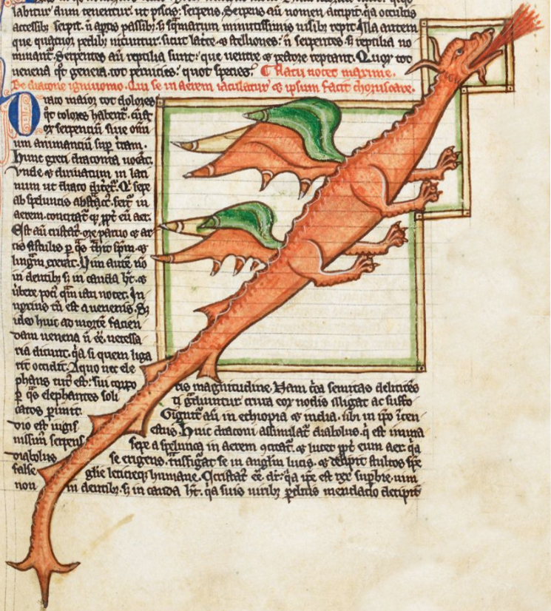
B. Question of heat
  Use of אף (singular) in metaphor and as metonymy
    burning nose (חרה + אף) («dragon» Kim&Trimm)
    « anger is the heat of fluid in a container »
    אף by itself can denote anger
  Consistent translation (human & God) with form of ὀργή or θυμός
  = eradication of heat-image? (Hartman «appiattimento semantico»)
MS Harley 3244 (ca. 1260 AD)

Slide 11
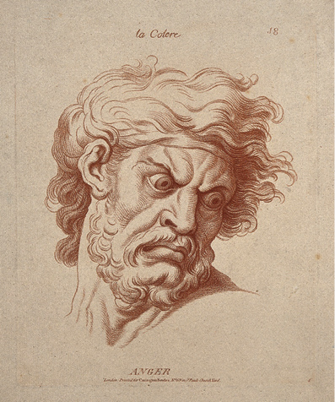
B. Question of heat
  Conceptual metaphor « anger is the heat of fluid in a container » :
  Less present
    BUT: heat imagery still there!
    Heat assoicated with anger in Greek literature
    Aristotle De anima I.403a29-30:
    διαφερόντως δ'ἂν ὀρίσαντο φυσικός τε καὶ διαλεκτικὸς ἕκαστον αὐτῶν, οἷον ὀργὴ τί ἐστίν· ὁ μὲν γὰρ ὄρεξιν ἀντιλυπήσεως ἤ τι τοιοῦντων, ὁ δε ζέσιν τοῦ περὶ καρδίαν αἵματος ἤ θερμοῦ
    But every such attribute would be differently defined by the physicist and the dialectician. Anger, for instance, would be defined by the dialectician as desire for retaliation or the like, but the physicist as a ferment of the blood or heat which is about the heart.
    Num 11:1 :
W. Hebert, La Colère, c.1770

Slide 12
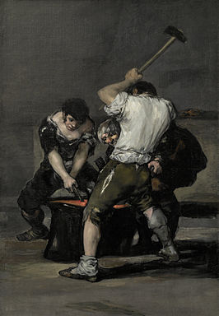
B. Question of heat
  BUT: heat imagery still there!
    Deut 29:19
    ἐκκαίω (to burn, inflame cf. SamP): 5 x Pentateuch: 1 x natural fire (Ex 22:5), Num 11:1.4: πῦρ παρὰ κυρίου Deut 29:19, 32:22: God’s anger
    κολλάω (to glue, to join to cf. 1QS): Herodotos, Historiae, 1.25: κόλλησις σιδήρου = welding iron
    -> Are the curses “welded” through the heat of the anger?
לֹא-יֹאבֶה יְהוָה, סְלֹחַ לוֹ--כִּי אָז יֶעְשַׁן אַף-יְהוָה וְקִנְאָתוֹ בָּאִישׁ הַהוּא, וְרָבְצָה בּוֹ כָּל-הָאָלָה הַכְּתוּבָה בַּסֵּפֶר הַזֶּה; וּמָחָה יְהוָה אֶת-שְׁמוֹ, מִתַּחַת הַשָּׁמָיִם | οὐ μὴ θελήσῃ ὁ θεὸς εὐιλατεῦσαι αὐτῷ, ἀλλ̓ ἢ τότε ἐκκαυθήσεται ὀργὴ κυρίου καὶ ὁ ζῆλος αὐτοῦ ἐν τῷ ἀνθρώπῳ ἐκείνῳ, καὶ κολληθήσονται ἐν αὐτῷ πᾶσαι αἱ ἀραὶ τῆς διαθήκης ταύτης αἱ γεγραμμέναι ἐν τῷ βιβλίῳ τοῦ νόμου τούτου, καὶ ἐξαλείψει κύριος τὸ ὄνομα αὐτοῦ ἐκ τῆς ὑπὸ τὸν οὐρανόν·
The Lord will not be willing to pardon him, but then the anger of the Lord and His jealousy shall be kindled against that man, and all the curse that is written in this book shall lie upon him, and the Lord shall blot out his name from under heaven; | God will not want to pardon him, but the Lord's anger and his zeal will then blaze out against that person. And all the imprecations of this covenant, written in the book of this law will attach themselves to him, and the Lord will blot out his name from what is beneath the sky.
Goya, La fragua, c. 1817

Slide 13
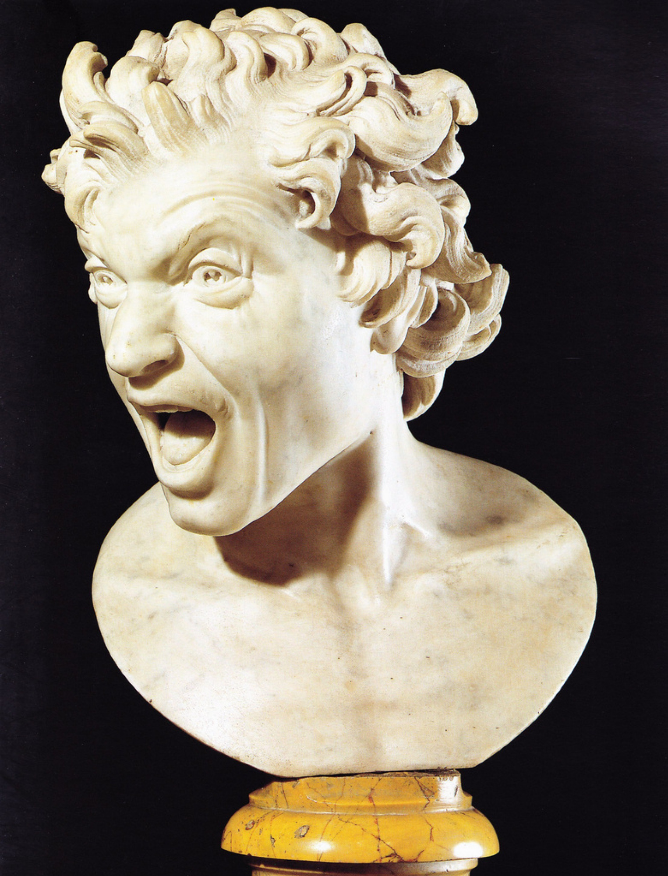
B. Question of heat
  Conceptual metaphor « anger is the heat of fluid in a container » BUT: another nuance appears:
    « Anger is a destructive force »
    Use of prepositions
      Num 12:9: καὶ ὀργὴ θυμοῦ κυρίου ἐπ̓ αὐτοῖς
      « Anger is like a physical force resting on top of them » (Wevers)
    Ex 32:10-12 as example
Bernini, Anima dannata, 1619
variatio on the theme of anger : θυμωθεὶς ὀργῇ (v. 10); θυμοῖ ὀργῇ (v. 11); τῆς ὀργῆς τοῦ θυμοῦ σου (v. 12)
Use of dative: anger as “instrument” ( = Greek tragedies “angry in/with thumos”); dative to stress the verbal idea (extreme anger)
V. 12: “stop the anger of your rage” (nets, παῦσαι τῆς ὀργῆς τοῦ θυμοῦ)
  παύω suprises: שוב usually translated by ἀποστρέφω
  PGM IX 12–13 (4th – 5th c. CE)

Slide 14
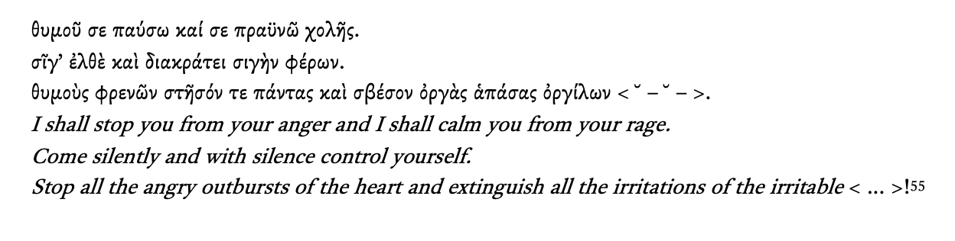
B. Question of heat
  Conceptual metaphor « anger is the heat of fluid in a container »
  BUT: another nuance appears:
    « Anger is a destructive force »
    Ex 32:10-12 as example
V. 12: “stop the anger of your rage” (nets, παῦσαι τῆς ὀργῆς τοῦ θυμοῦ)
  παύω suprises: שוב usually translated by ἀποστρέφω
  PGM IX 12–13 (4th – 5th c. CE) : metrical incantation to “stop your θυμός” (Faraone)
  = curative magic formula : “I stop (παύω) person X (acc.) from disease Y (gen.)”
anger appears as an almost pathological force, with destructive consequences that needs to be “stopped” or controlled

Slide 15
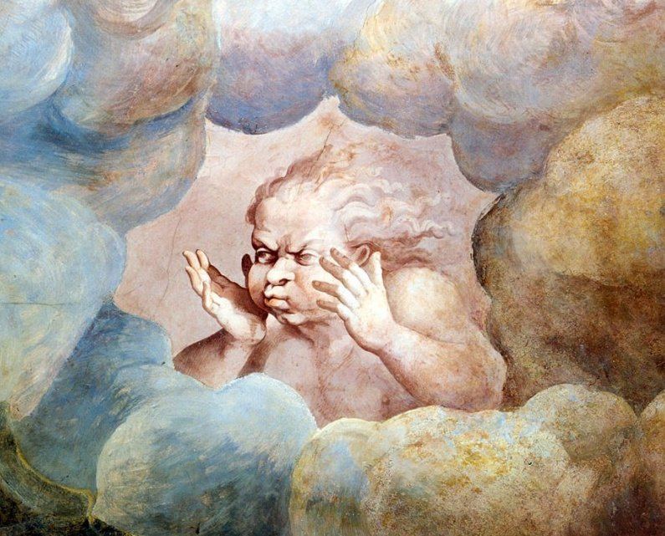
C. Anti-anthropomorphism?
  Is God’s nose avoided? Plural (physical) אפים Ex 15:8 and Deut 33:10
  Ex 15:8 « the breath of your wrath »
    Avoidance of nostrils (Wevers, Fritsch, Gera) or dead metaphor (Thomas) ?
    Greek translators of the Pentateuch were familiar with physical sense of the plural אף!
καὶ διὰ πνεύματος τοῦ θυμοῦ σου διέστη τὸ ὕδωρ· ἐπάγη ὡσεὶ τεῖχος τὰ ὕδατα, ἐπάγη τὰ κύματα ἐν μέσῳ τῆς θαλάσσης. | וברוח אפיך נערמו מים נצבו כמו נד נזלים קפאו תהומת בלב ים
Through the breath of your wrath the water separated; the waters were congealed like a wall; the waves were congealed in the midst of the sea. | And with the blast of your nostrils the waters were piled up--the floods stood upright as a heap; the deeps were congealed in the heart of the sea.
use of μυκτήρ as “sneering” or “sarcasm” -> was the literal translation not used because of this “negative” use of μυκτήρ?
θυμός : good translation choice: relates to “breath” in its wider sense: thumos is stormy wind
Giulio Romano, Sala dei Giganti, detail of the “wind”, 1532–35,

Slide 16
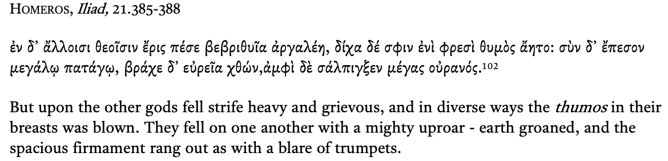
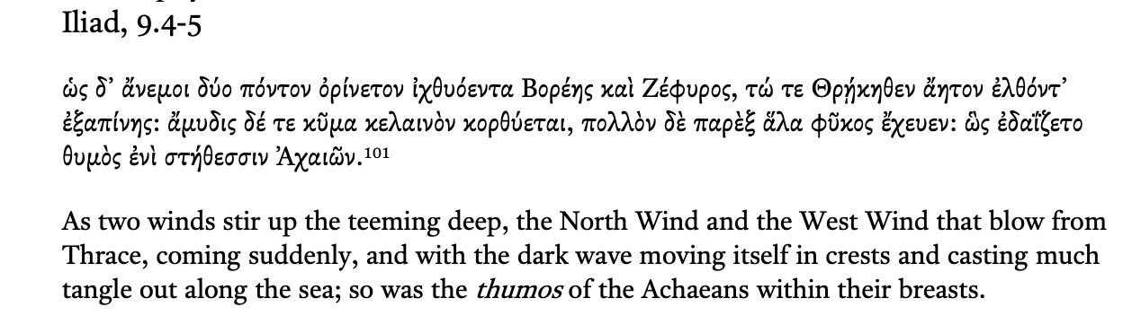
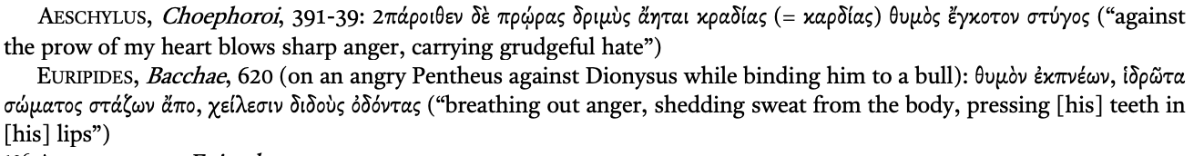
καὶ διὰ πνεύματος τοῦ θυμοῦ σου διέστη τὸ ὕδωρ· ἐπάγη ὡσεὶ τεῖχος τὰ ὕδατα, ἐπάγη τὰ κύματα ἐν μέσῳ τῆς θαλάσσης. | וברוח אפיך נערמו מים נצבו כמו נד נזלים קפאו תהומת בלב ים
Through the breath of your wrath the water separated; the waters were congealed like a wall; the waves were congealed in the midst of the sea. | And with the blast of your nostrils the waters were piled up--the floods stood upright as a heap; the deeps were congealed in the heart of the sea.
C. Anti-anthropomorphism?
  Ex 15:8 « the breath of your wrath »
    θυμός : good translation choice: relates to “breath” in its wider sense: thumos is stormy wind
-> the Greek translation
= not an anti-anthropomorphism
= creative use of widespread image of θυμός as wind
= same ambiguity (anger or breathing?) the Hebrew text presents

Slide 17
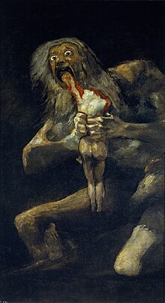
δηλώσουσιν τὰ δικαιώματά σου τῷ Ιακωβ καὶ τὸν νόμον σου τῷ Ισραηλ· ἐπιθήσουσιν θυμίαμα ἐν ὀργῇ σου διὰ παντὸς ἐπὶ τὸ θυσιαστήριόν σου. | יורו משפטיך ליעקב ותורתך לישראל ישימו קטרה באפך וכליל על מזבחך
They shall show Iakob your statutes and Israel your law; they shall place incense in your wrath continually on your altar | They shall teach Jacob your ordinances, and Israel your law; they shall put incense “in your nose”, and whole burnt-offering upon your altar.
C. Anti-anthropomorphism?
  Is God’s nose avoided? Ex 15:8 and Deut 33:10
  Deut 33:10 « incense in your wrath »
    Avoidance of nostrils (Fritsch) or consistency (Wevers:
    “The Hebrew word ‘ap, “nostril” came to mean “anger”. The Gk thus translates the word by orgè and thymos, “anger, wrath”. Thus the rendering in Dt 33:10 is not the result of a conscious anti-anthropomorphism, but rather the result of a consistency of translation.”)
    BUT: Num 11:20: literal translation « nostril » (μυκτήρ): why not here?
    Not clear why
  Expansion of metaphorical network: appetitive power of anger!
Goya, Saturno devorando a su hijo, c. 1820

Slide 18
Living, moribund, dead metaphors

Slide 19
Metaphors
  The Greek translation of אַף is probably best categorised as:
  Questions:
    Intention behind change of metaphor?
    Consistency
    The understanding of the translator: perhaps a metaphor is still « alive » in the source language, but « moribund » to the translator
    Ex 15:8 & Deut 33:10: Is there, in the Hebrew of these verses a metaphor present? Nonmetaphor by metaphor!
Hatch | Labahn | van der Louw | Toury | Austin
Metaphor is added | New metaphors due to intratextual references | Rendering non-figurative language by a metaphor | Translating a nonmetaphor into a metaphor | Translation of Nonmetaphors with Metaphors
 | New original metaphors |  | Adding a metaphor where there is no equivalent in the source text | Merging metaphors

Slide 20
Metaphors
  Need of elaboration of categories for translation of nonmetaphor into figurative language
  Questions:
    Why figurative language?
      « contamination » : unconscious translation through consistent translation by standard equivalent
      Avoidance of nonmetaphorical image
      Lack of understanding of the nonmetaphor
      Metaphorical image fits style and context better
    When can we speak of a dead metahpor?
      Study of the word: when used both lit. & fig. –> metaphor is probably not dead, no crystallisation
      Diveristy of imagery used; diversity simulates the life of metaphors
    Metaphor network?
      How does the metaphorical translation of nonmetaphors broaden the scope of other metaphors?
      What image/identity do these metaphors convey?
Hatch | Labahn | van der Louw | Toury | Austin
Metaphor is added | New metaphors due to intratextual references | Rendering non-figurative language by a metaphor | Translating a nonmetaphor into a metaphor | Translation of Nonmetaphors with Metaphors
 | New original metaphors |  | Adding a metaphor where there is no equivalent in the source text | Merging metaphors

Slide 21
Conclusion

Slide 22
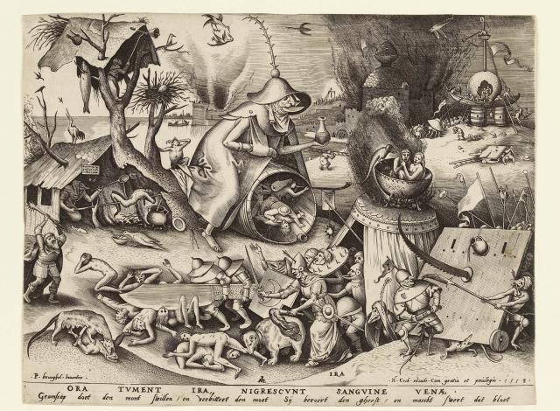
Conclusion
Singular אף
  Consistent translation
  Human = God
  “Anger is a destructive force” -> instrument of God
  “Thumos is a stormy wind”
  No anti-anthropomorphism present
2. Plural אפים
  God =/= Human
    God: nonmetaphor (nostrils) by figurative language (anger)
    Different image of God: His anger can split the sea, His anger « digests »! How should we imagine this?
  How and when do translators distinguish nonmetaphors from metaphors?
    Need for criteria!
    Intentional or not?
  We can only speak of avoidance if we know the translator understood the text as containing an anthropomorphism!
3. Need for further study & integration within treatment of God’s anger in LXX-Pentateuch
  How is the metaphorical network expanded?

Slide 23
Thank you!

