Slide 1
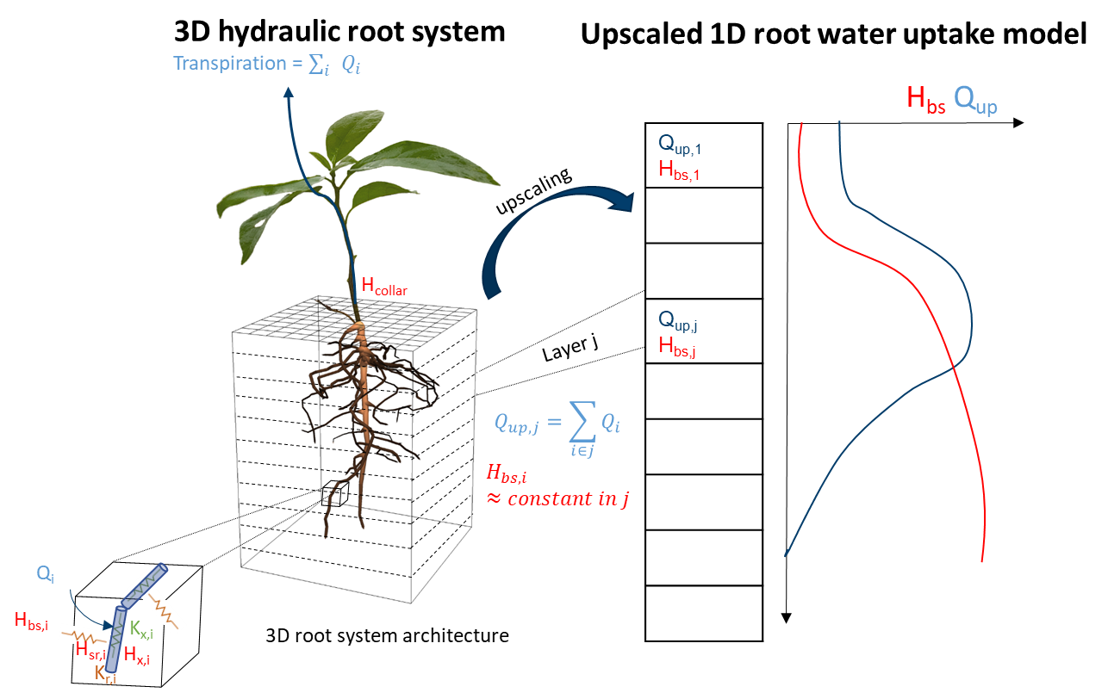
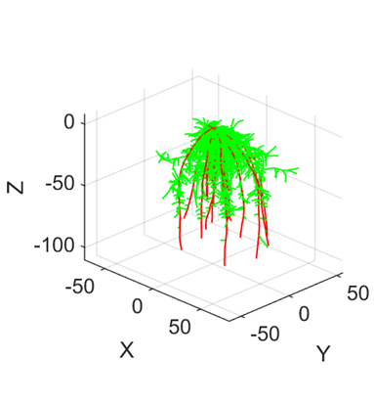
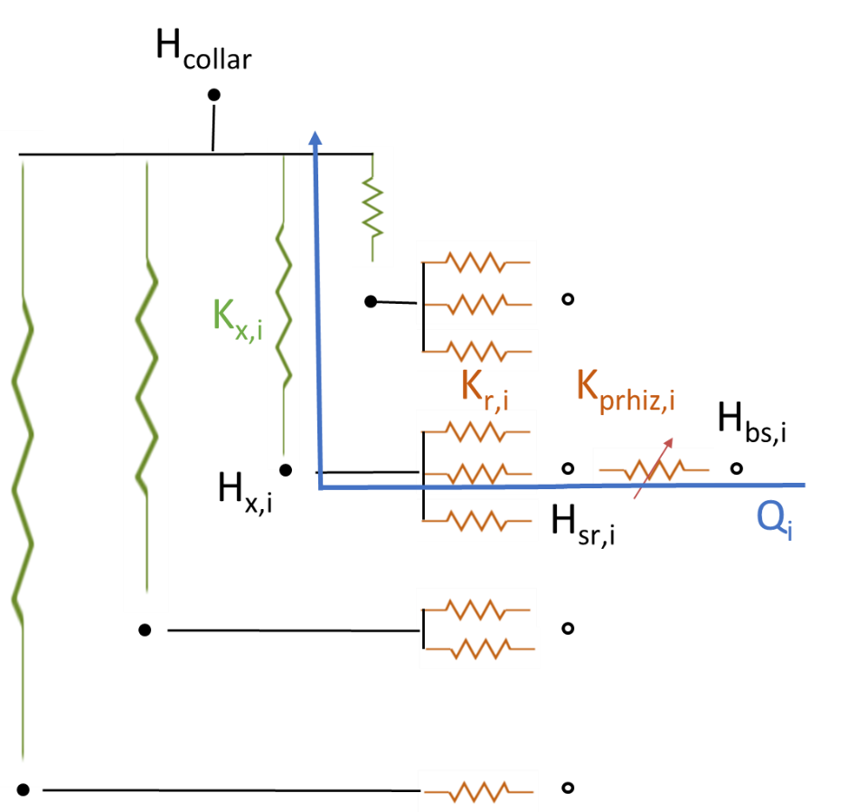
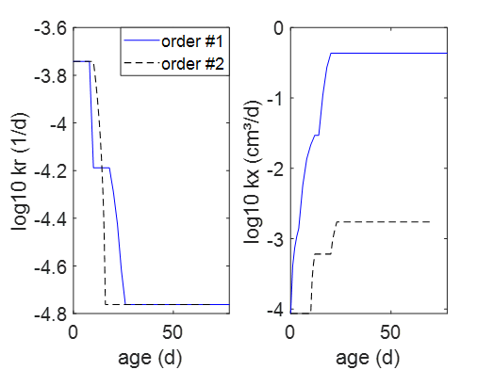
Mechanistic root water uptake functions derived from soil and root hydraulic properties
Jan Vanderborght¹, Andrea Schnepf¹, Daniel Leitner¹, Valentin Couvreur², Mathieu Javaux^{1,2}
¹ Agrosphere Institute, IBG-3, Forschungszentrum Jülich GmbH, Germany
² Earth and Life Institute, UC Louvain, Belgium
From 3D hydraulic root systems to upscaled 1D RWU
Mechanistic root water uptake functions
Redefine α :
α does not depend on demand (T_{p}) but on soil and root properties!
Redefine ω:
Redefine ω_{c}:
ω_{c} depends on demand and root system conductance!
[4]
Goal: Develop a function f that describes root water uptake Q as a function of bulk soil water potentials H_{bs} and potential transpiration T_{p}, and that uses parameters p that can be derived directly from soil and root properties:
Uptake for ω < ω_{c} (supply < demand; total uptake = max total supply)
Empirical root water uptake functions
Uptake for ω ≥ ω_{c} (max supply > demand; total uptake = T_{p})
approximate while we assume K_{srs}(H_{collar}) = K_{srs}(H_{wilt})
Q_{i} can be different from zero and can be negative (second term of right hand side) also when T_{p} = 0 → hydraulic redistribution is simulated
[1]
α
T_{act}/T_{p}
1
1
0
H_{wilt}
H_{crit}(T_{plow})
H_{crit}(T_{phigh})
H_{bs}
0
ω_{c}
ω
Simulation example
For homogeneous H_{bs}:
Mechanistic macroscopic root water uptake model
3D hydraulic root system architecture
Upscaled 1D parallel root model
[2,3]
References
Soil-root system conductance K_{srs} is a non linear function of H_{bs}, can be calculated directly from soil and root hydraulic properties, and varies with soil depth
[1] Simunek, J., & Hopmans, J. W. (2009). doi:10.1016/j.ecolmodel.2008.11.004
[2] Vanderborght, J. et al. (2021). doi: 10.5194/hess-25-4835-2021
[3] Vanderborght, J. et al. (2023). doi: 10.1002/vzj2.20273
[4] Jarvis, N. J. (2011). doi:10.5194/hess-15-3431-2011

