Slide 2


A Nosy Translator?
The LXX-Translation of the Divineאַף
Between Tradition and Innovation
Ellen De Doncker

Slide 3
Overview
Introduction
Translating God’s « nose » : Overconsistency?
  Heat?
  Anti-anthropomorphism
  The choice for θυμός
Μακρόθυμος
Conclusion

Slide 4
Introduction

Slide 5

Introduction
Bodies & Anthropomorphism
  God’s nose : an anthropomorphism
    Anthropomorphism? The attribution of human-like body parts to God and, by extension, the attribution of human-like emotions and activities
  Question of “anti-anthropomorphism” in LXX
    Fritsch: LXX avoids at times anthropomorphisms
    = anti-anthropomophic tendency
אף : body part or emotion?
    Plural: probably physical!
    God’s אף: God’s « nose » or God’s « anger »?
    In LXX: rendered by form of ὀργή or θυμός : anger
Baldessari, God’s Nose, 1965

Slide 6
Introduction
Goal: how is God’s אף translated in LXX?
  Differences MT – LXX (Pentateuch): what imagery?
    Focus on one particular element: μακρόθυμος
  Anti-anthropomorphism present?
  What does the language of LXX show?
    How does it relate to Classical Greek?
    Influence on later Greek?

Slide 7
Translating
God’s « nose »:
Overconsistency?

Slide 8
A. Overconsistency?
An overview of the translation of the “nose” in LXX-Pentateuch
Anti-anthropomorphism?
No heat imagery?
Overconsistency?

Slide 9
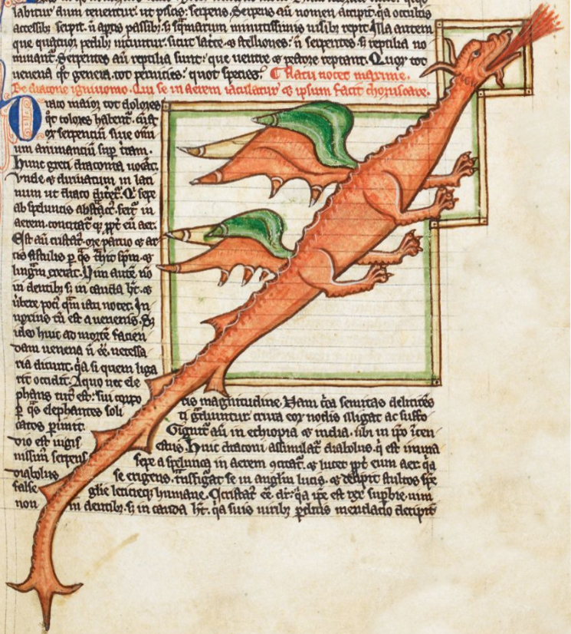
A. Overconsistency and heat
  Use of אף (singular) in metaphor
    burning nose (חרה + אף) («dragon» Kim&Trimm)
    « anger is the heat of fluid in a container »
  Consistent translation (human & God) with form of ὀργή or θυμός
  = eradication of heat-image? (Hartman «appiattimento semantico»)
MS Harley 3244 (ca. 1260 AD)

Slide 10
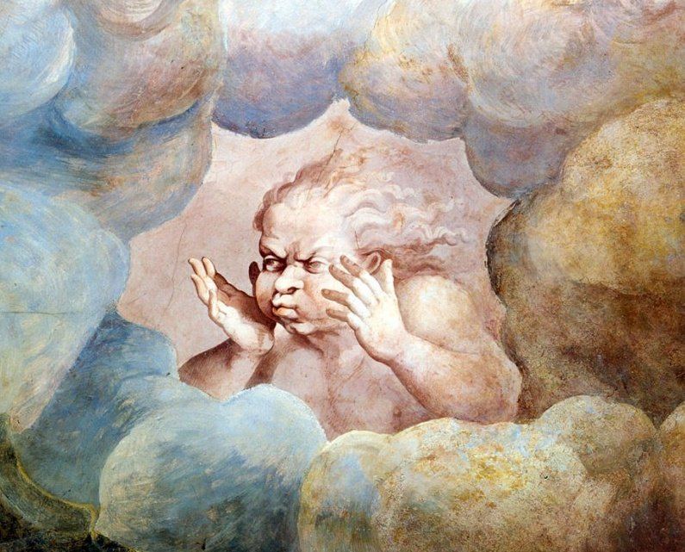
B. Overconsistency and anti-anthropomorphism
  Is God’s nose avoided? Plural (physical) אפים Ex 15:8 and Deut 33:10
  Ex 15:8 as example: « the breath of your wrath »
    Avoidance of nostrils (Wevers, Fritsch, Gera) or dead metaphor (Thomas) ?
    Greek translators of the Pentateuch were familiar with physical sense of the plural אף!
καὶ διὰ πνεύματος τοῦ θυμοῦ σου διέστη τὸ ὕδωρ· ἐπάγη ὡσεὶ τεῖχος τὰ ὕδατα, ἐπάγη τὰ κύματα ἐν μέσῳ τῆς θαλάσσης. | וברוח אפיך נערמו מים נצבו כמו נד נזלים קפאו תהומת בלב ים
Through the breath of your wrath the water separated; the waters were congealed like a wall; the waves were congealed in the midst of the sea. | And with the blast of your nostrils the waters were piled up--the floods stood upright as a heap; the deeps were congealed in the heart of the sea.
use of μυκτήρ as “sneering” or “sarcasm” -> was the literal translation not used because of this “negative” use of μυκτήρ?
θυμός : good translation choice: relates to “breath” in its wider sense: thumos is stormy wind
Giulio Romano, Sala dei Giganti, detail of the “wind”, 1532–35,

Slide 11
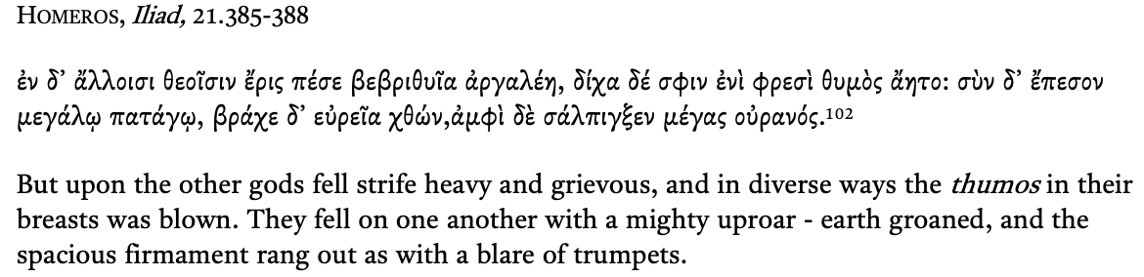
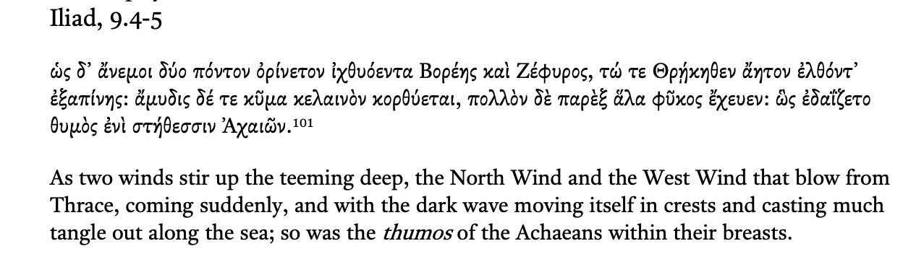
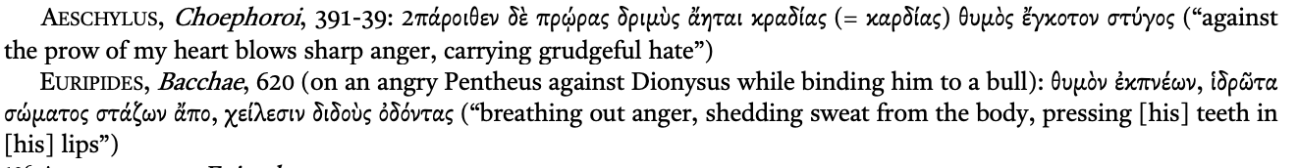
καὶ διὰ πνεύματος τοῦ θυμοῦ σου διέστη τὸ ὕδωρ· ἐπάγη ὡσεὶ τεῖχος τὰ ὕδατα, ἐπάγη τὰ κύματα ἐν μέσῳ τῆς θαλάσσης. | וברוח אפיך נערמו מים נצבו כמו נד נזלים קפאו תהומת בלב ים
Through the breath of your wrath the water separated; the waters were congealed like a wall; the waves were congealed in the midst of the sea. | And with the blast of your nostrils the waters were piled up--the floods stood upright as a heap; the deeps were congealed in the heart of the sea.
C. Overconsistency and θυμός
  Ex 15:8 « the breath of your wrath »
    θυμός : good translation choice: relates to “breath” in its wider sense: thumos is stormy wind
-> the Greek translation
= not an anti-anthropomorphism
= creative use of widespread image of θυμός as wind/breath
= same ambiguity (anger or breathing?) the Hebrew text presents

Slide 12
« Long nostrils »:
μακρόθυμος

Slide 13
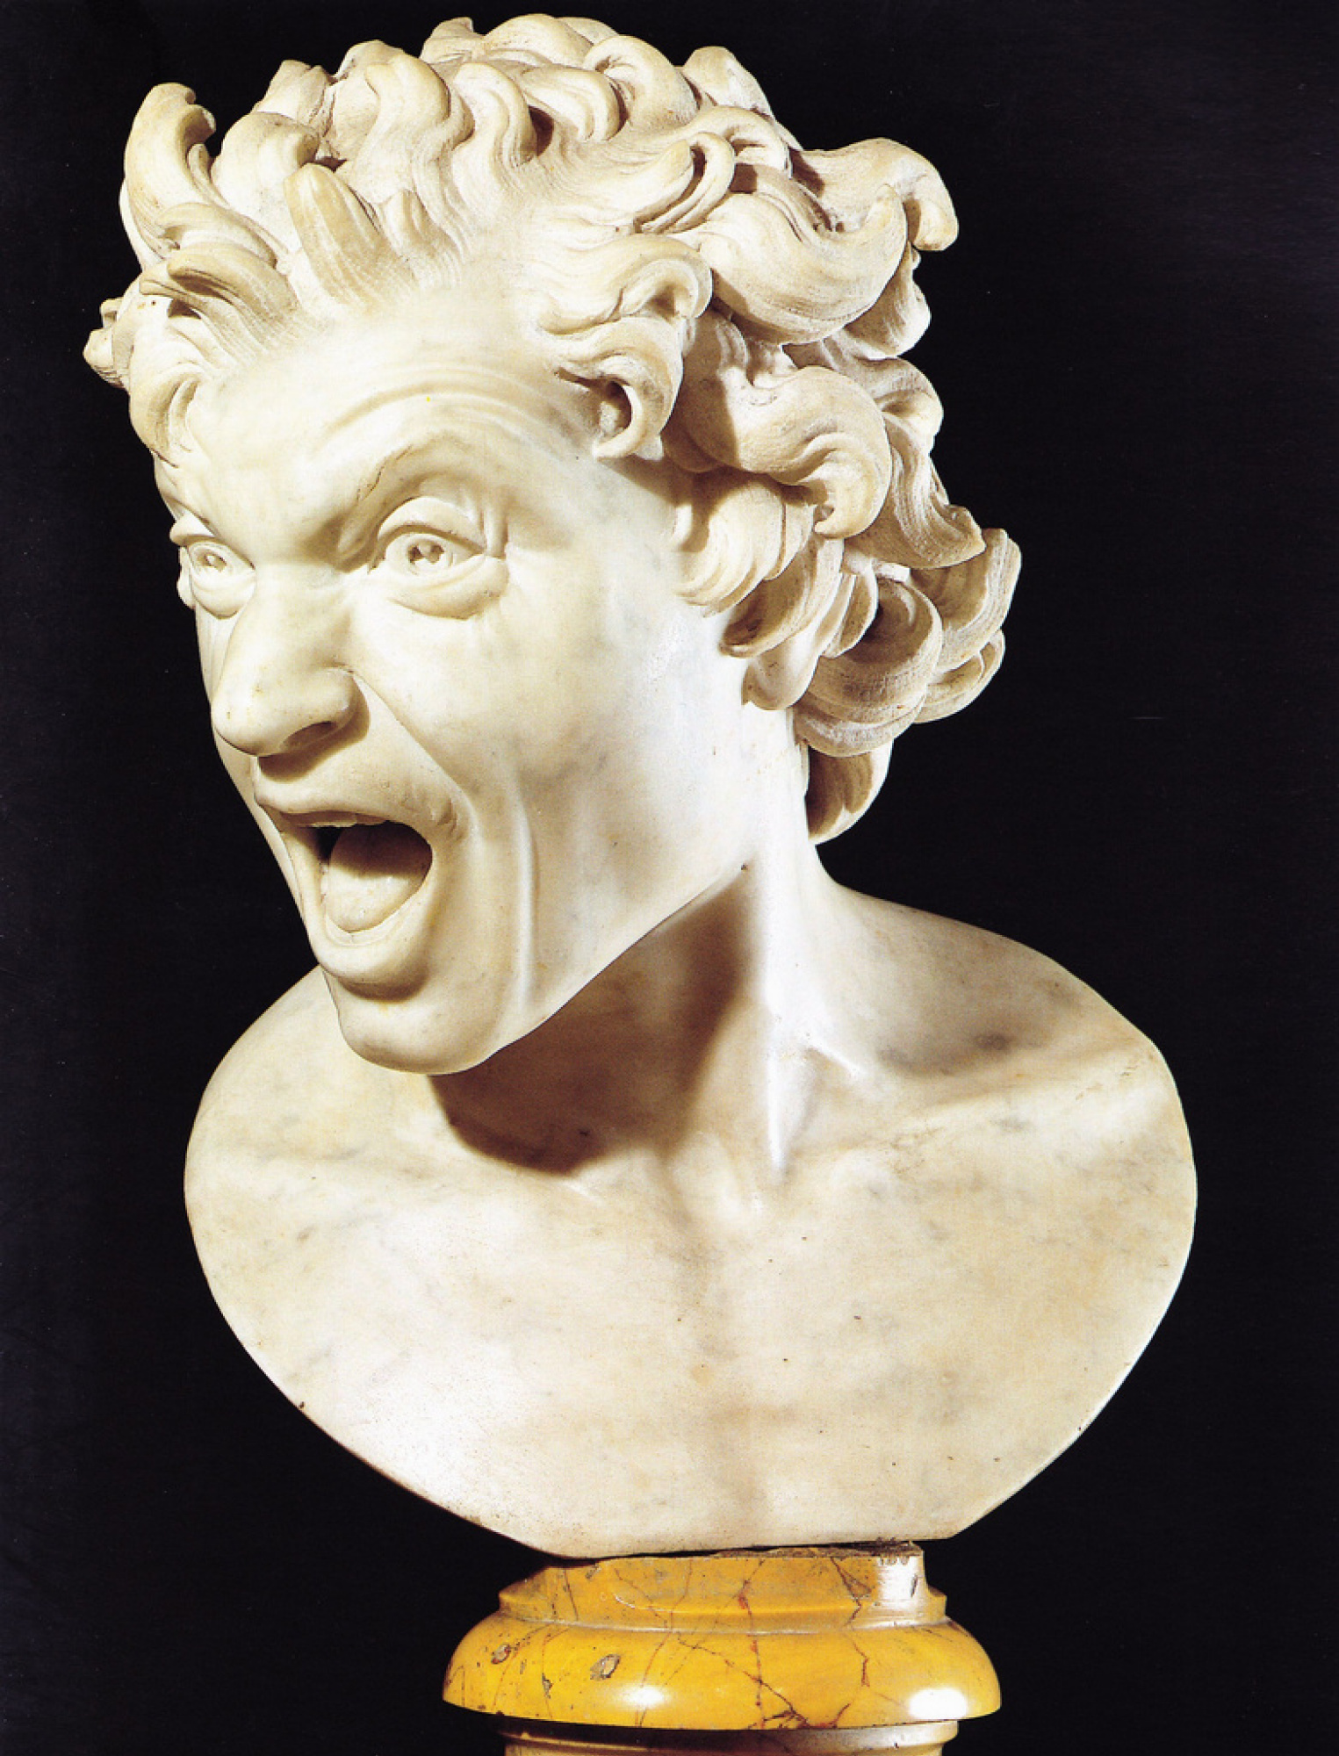
μακρόθυμος
  μακρόθυμος :
    « lengthy of wrath? »
      μακρός + θυμός
    Neologism (Tov, 1999), compound word (Aitken, 2013)
      Enters in Greek at relatively late stage
    To render the « length-metaphor »
      LENGTH = PATIENCE
      Lengthy breath through nostrils = calm (J. Atwood)
      ארך אפים
        Long nostrils? = lengthy breathing
        Long anger? = it takes a long time to get angry
      ארך רוח
      LXX: Quantitatively perfect equivalent, also qualitative?
        Cf. A. Bellantuono
Bernini, Anima dannata, 1619

Slide 14
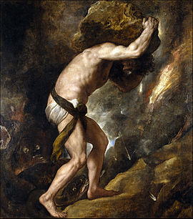
μακρόθυμος
  μακρόθυμος in non-Biblical Greek (Horst, Bellantuono):
    Other words with θυμός
      Homer: μεγάθυμος
      Tragic poets: ὀξύθυμος
      BUT: not μακρόθυμος
    The root μακρόθυμ- appears relatively late + rare
      Menander, Strabo, Artemides, Aretius, Plutarch
      Not used by Stoics!
      Used as « perseverence », verb often in military context
      Human quality
      Θυμός as self, volition
Tiziano Vecelli, Sisyphus, 1549

Slide 15
μακρόθυμος
  Μακρόθυμ- in non-Biblical Greek: two examples (Horst, Bellantuono)
  Menander, Fr. 549: Ἄνθρωπος ὢν μηδέποτε τὴν ἀλυπίαν αἰτοῦ παρὰ θεῶν, ἀλλὰ τὴν μακροθυμίαν. ὅταν γὰρ ἄλυπος διὰ τέλους εἶναι θέλῃς, ἢ δεῖ θεόν σ’ εἶναί τιν’ ἢ τάχα δὴ νεκρόν (As a man, never ask the gods for freedom from pain, but for makrothumia. In fact, if you want to be completely free of suffering, you'd have to be a God, or perhaps a dead man).
  Plutarch, Lucullus, 32.4: καί τοι πολλὰ προσελιπάρει Λεύκολλος, ἀξιῶν αὐτοὺς μακροθυμίαν ἐμβαλέσθαι ταῖς ψυχαῖς (However, Lucullus urged them [= soldiers who wanted to leave] to arm their souls with makrothumia)
  Endurance, perseverance, specifically human

Slide 16
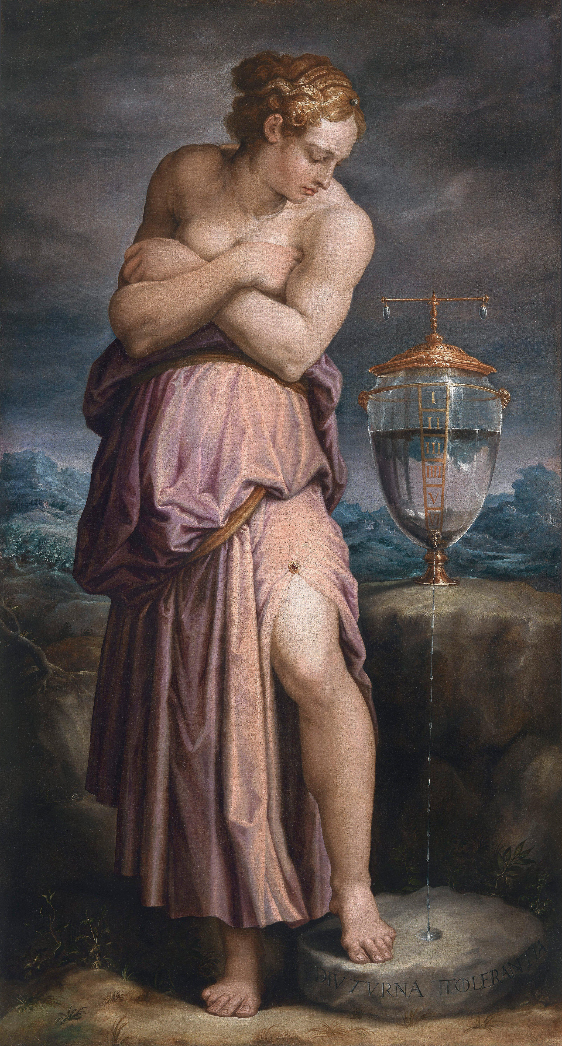
μακρόθυμος
  μακρόθυμος in Biblical Greek:
    Used for man and God
    « slow to anger » (no longer perseverance)
      Temporal aspect
      Also in later texts (vs. Bellantuono)
        see the antonyms of μακρόθυμος!
    Θυμός as anger, perhaps still related to breathing (Onians, Caswell)
      Iliad, 522-523: ὃ δ᾽ ὕπτιος ἐν κονίῃσι κάππεσεν ἄμφω χεῖρε φίλοις ἑτάροισι πετάσσας θυμὸν ἀποπνείων
      “backwards, he fell in the dust and stretched out both of his hands towards his beloved comrades, breathing out his θυμός”
      Greek translation μακρόθυμος = apt translation for ארך אפים:
      both elements of the Hebrew
      No avoidance of God’s nose (also for humans!)
Vasari, Allegory of Patience, 1552

Slide 17
μακρόθυμος
μακρόθυμος in Biblical Greek: some examples
  In Pentateuch: divine epiteth (Ex 34, Num 14)
  In Wisdom literature: notion of temporality still present!
Sir. 1:23 ἕως καιροῦ ἀνθέξεται μακρόθυμος, Sir. 35:19 καὶ ὁ κύριος οὐ μὴ βραδύνῃ
καὶ ὕστερον αὐτῷ ἀναδώσει εὐφροσύνη· οὐδὲ μὴ μακροθυμήσῃ ἐπ̓ αὐτοῖς,
    Widsom literature: also for humans
Prov. 14:29 μακρόθυμος ἀνὴρ πολὺς ἐν φρονήσει,
ὁ δὲ ὀλιγόψυχος ἰσχυρῶς ἄφρων.
opposition μακρόθυμος and ὀλιγόψυχος
Prov. 15:18 ἀνὴρ θυμώδης παρασκευάζει μάχας,
μακρόθυμος δὲ καὶ τὴν μέλλουσαν καταπραΰνει.
notion of anger/control!; opposition μακρόθυμος and θυμώδης
Prov. 16:32 κρείσσων ἀνὴρ μακρόθυμος ἰσχυροῦ,
ὁ δὲ κρατῶν ὀργῆς κρείσσων καταλαμβανομένου πόλιν.
notion of anger/control!
    Also in Psalms: notion of anger retention somewhat present
Psa. 7:12 ὁ θεὸς κριτὴς δίκαιος καὶ ἰσχυρὸς καὶ μακρόθυμος
μὴ ὀργὴν ἐπάγων καθ̓ ἑκάστην ἡμέραν.

Slide 18
μακρόθυμος
  The development of μακρόθυμος :
    LXX supplements μακρόθυμος (except. 1 Macc 8:4) with the idea of anger retention
      Cf. Egyptian ethics of anger retention (Horst, I. Köhler)
whnnꜣy⸗kčnrtmbiꜣ҆.t⸗kḳnṭ.ø{r}wpi.̯t⸗k
“Control your temperament so that your angry behaviour does not condemn you”
Teaching of Ani B 22:8–9
      Cf. particular use of παύω in Ex 32:12 (“stop the anger of your rage” (παῦσαι τῆς ὀργῆς τοῦ θυμοῦ) παύω for שוב
    Further influence of LXX-Greek? (cf. Turner)
      Bellantuono: “patience & magnanimity” over “temporal aspect”
      But: aspect of “slowness to anger” is not lost!
      Three examples
Human subject | God and human
“Perseverance” | “Slow to anger” = temporality & control!
Volition, self | Breathing, anger

Slide 19
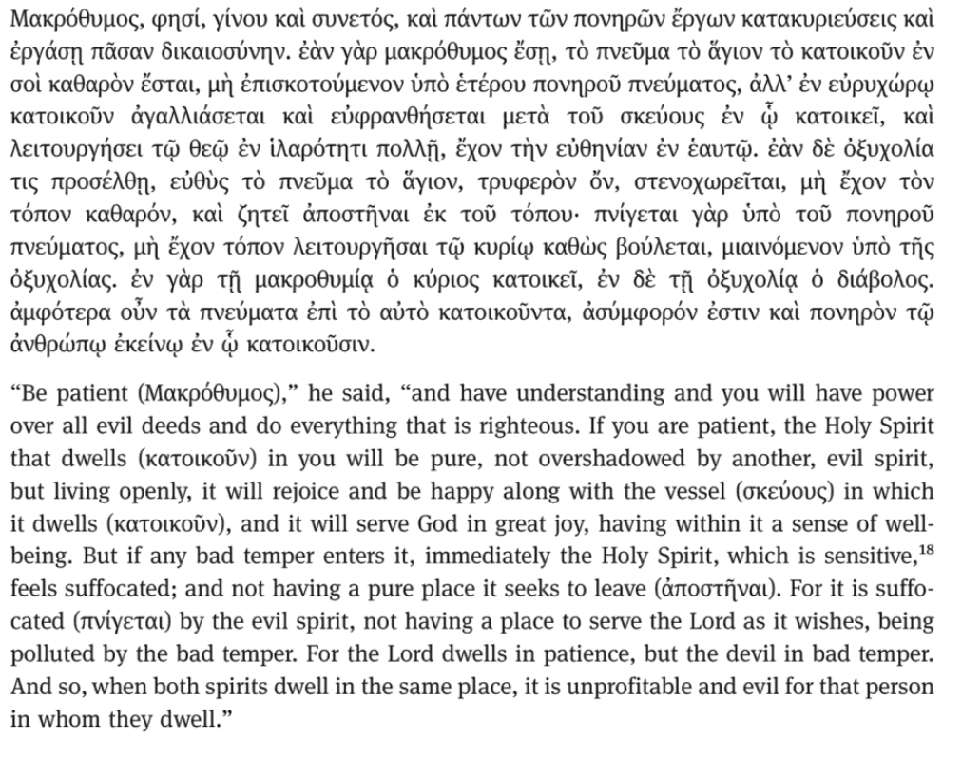
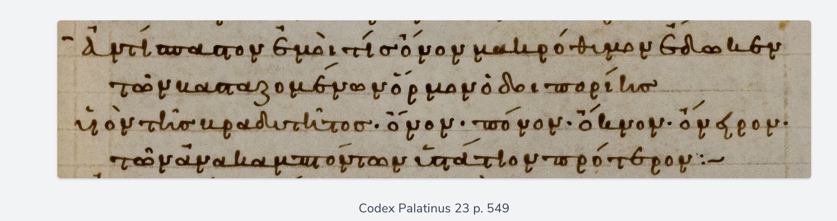

μακρόθυμος
  The development of μακρόθυμος :
    Three examples
    Anth. Pal. 11.317 (4th c. CE)
    Slowness!
    Temporality!
    2. Shepherd of Hermas, Mand. 5.1.1-4
    Notion of control over anger
    Same notion in e.g. Test. Dan!
    “Breathing” aspect here?
Ἀντίσπαστον ἐμοί τις ὄνον μακρόθυμον ἔδωκεν, … υἱὸν τῆς βραδυτῆτος ὄνον, πόνον, ὄκνον, ὄνειρον | Someone gave me a long-suffering donkey that moves backwards … ; a donkey, the son of slowness, a labour, a delay, a dream

Slide 20
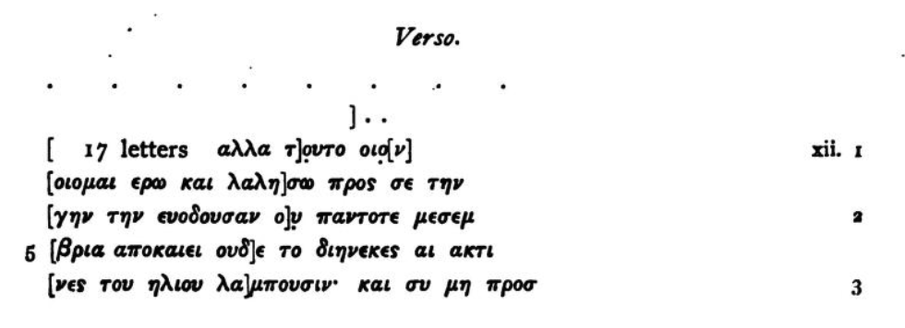
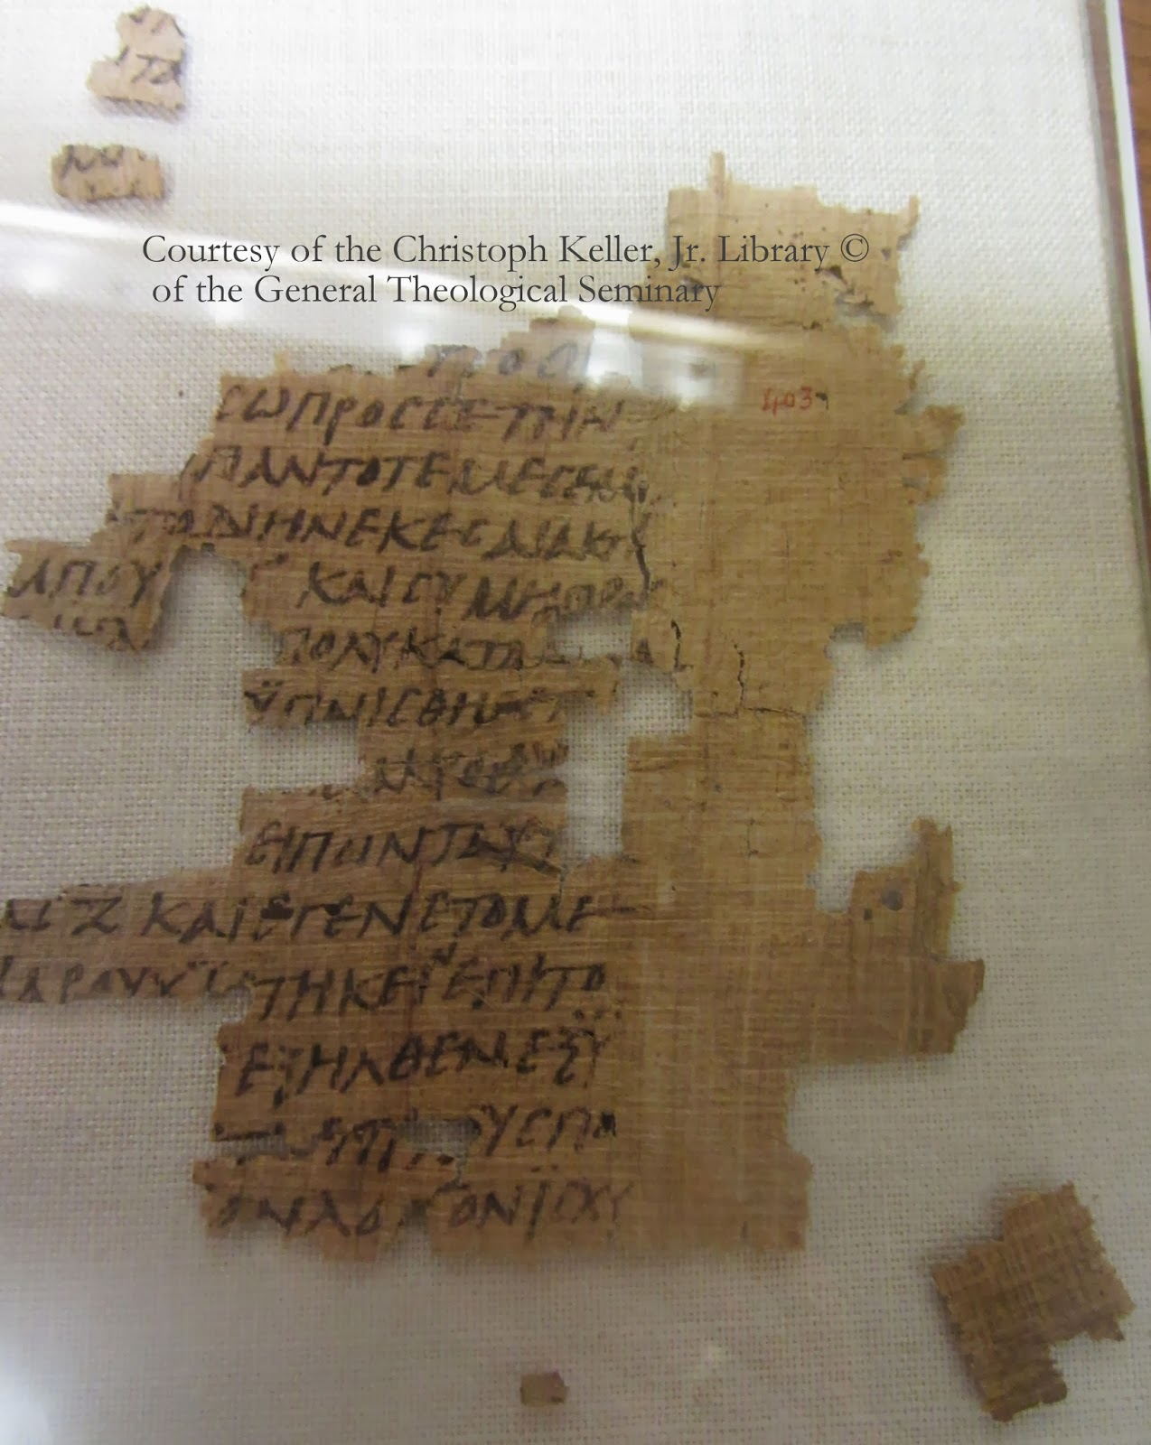
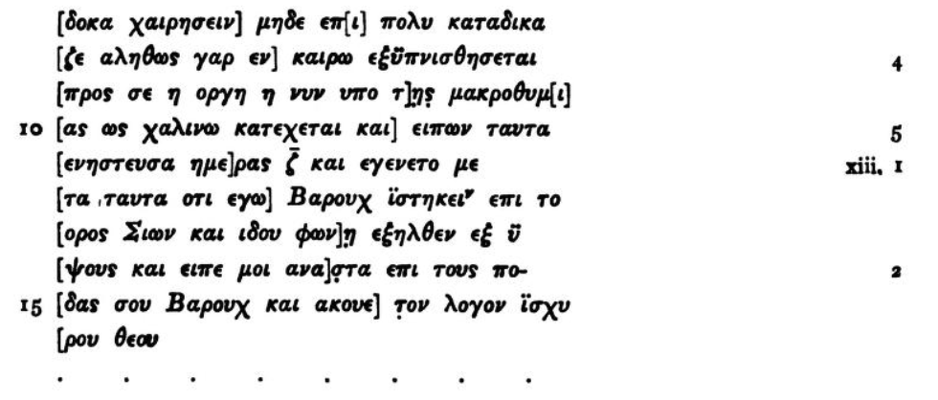
μακρόθυμος
  The development of μακρόθυμος :
    Three examples
    3. Pap. Oxyrhynchus 3.403 (Egypt, 4th c. CE)
    2 Baruch: late 1st c. text (ed. Grenfell & Hunt)
    Temporality!
    Control of anger
…. (8-10) For assuredly in its season shall the (divine) wrath be awakened against you, Which is now restrained by long-suffering as it were by a rein. …

Slide 21
Conclusion

Slide 22
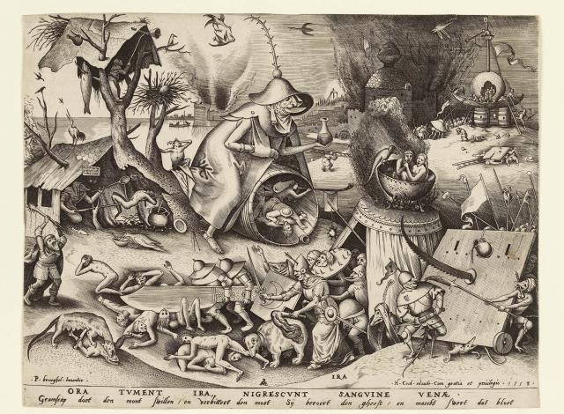
Conclusion
Singular אף
  Consistent translation
  Human = God
  No heat?
  No anti-anthropomorphism present
2. Plural אפים
  God =/= Human
    God: nonmetaphor (nostrils) by figurative language (anger)
  “Thumos is a stormy wind”
  « Long nostrils »
3. The neologism μακρόθυμος
  Development: expansion from Classical Greek use
  Trace in later Greek
  Temporality and control play a role
  Does -θυμός still refer to wind/breathing?
  The translator uses past imagery, reinvents and leaves a trace
  A translator between tradition and innovation

Slide 23
Thank you!

