Slide 2
Promoting speaking of learners of German as foreign language
through digital game-based learning
Bailing He & Clara Dauby
June 2024
FIAL/IL&C/TeAMM research group
Teaching and Acquiring Multilingualism and Multiliteracies

Slide 3
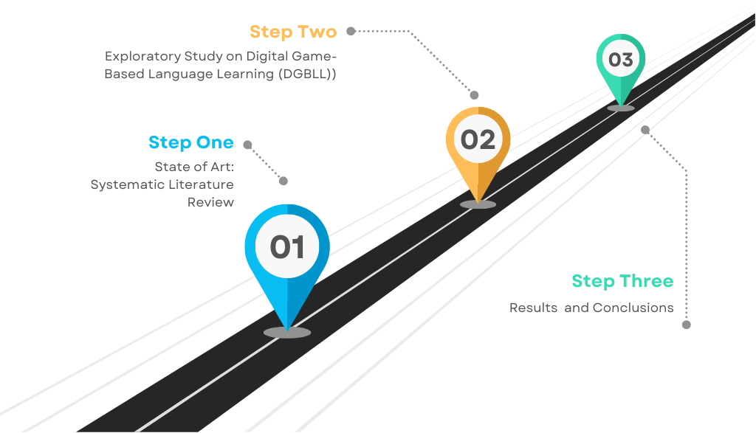
Content

Slide 4
I. State of the Art:
Systematic Review
Game-Based Learning for Enhancing L2 Speaking Ability
Bailing He & Ferran Suñer & Véronique Scheirs

Slide 5
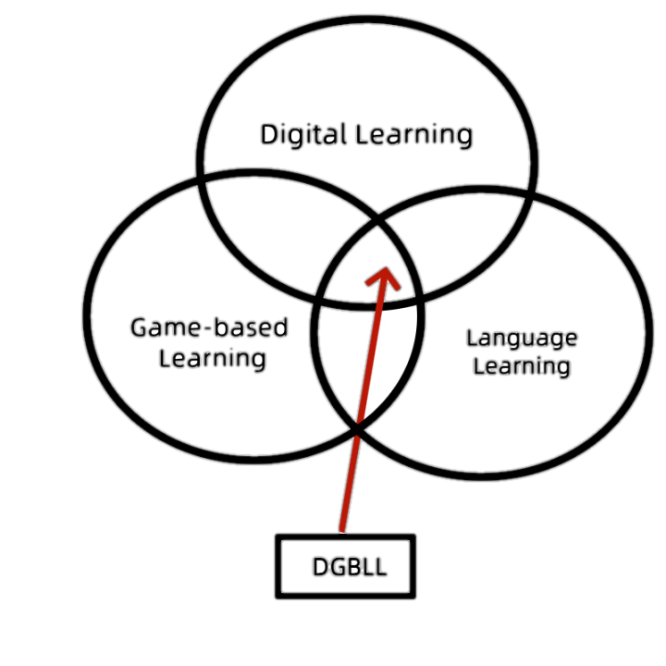
1. State of the Art
Digital game-based learning
Over the past 30 years, digital games have become increasingly popular for L2 learning and are used to enhance L2 speaking ability (Aquah et al., 2020; Thompson et al., 2020).
Advantages: immersive exposure, reduced anxiety, and increased target language use. Compared to traditional methods, they result in longer learning times, higher motivation, and increased self-efficacy (Hung et al., 2018).
Chen and Huang, 2020

Slide 6
1. State of the Art
Speaking is typically the most difficult skill for L2 learners and causes the most anxiety (Sun & Yang, 2015; Ur, 1996; Zhang, 2009; Al Hosni, 2014).
Reasons: lack of practice opportunities (Baniabdelrahman, 2013; Sun & Yang, 2015); limited interaction with native speakers; classroom dynamics discouraging participation (Dailey, 2010; Kasuya, 2008), and fear of mistakes (Wei, 2014).
To address the above-mentioned challenges, DGBLL has been increasingly implemented in or out of language classrooms to enhance learners’ L2 speaking ability.

Slide 7
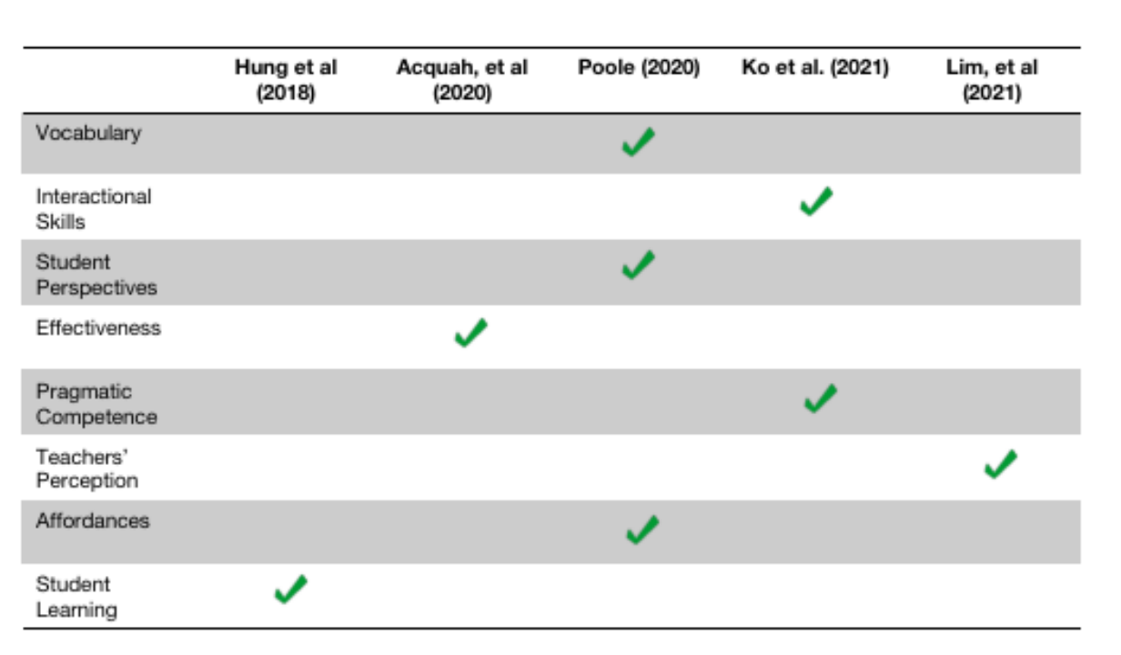
1. State of the Art
Previous Reviews
However, there is a lack of reviews on the cognitive impact of DGBLL on L2 speaking ability.

Slide 8
2. Research Questions
Is game-based learning effective for improving L2 speaking ability?
Which affective factors have been found to modulate the cognitive impact of game-based language learning?
Which types of interventions and research designs are employed to evaluate the impact of digital game-based language learning (DGBLL)?
3. Method
Scoping review and Preferred Reporting Items for Systematic Reviews and Meta-Analyses (PRISMA) 2020 checklist. (Page et al., 2021). Purpose of the review is to identify knowledge gaps, clarify concepts or to investigate research conduct.
The entire process went through four separate phases, the identification phase, screening phase, eligibility phase, and lastly, inclusion phase.

Slide 9
3. Method
Table 1. Keywords used to find related articles
Databases | Keywords
ERIC | “Digital games” Or ”game-based" OR "game-based learning" AND ”oral Language" OR "spoken language" OR "L2 " OR "L2-fluency" OR ”second language learning" OR ”speaking ability”.
Scopus | “Digital games” Or ”game-based" OR "game-based learning" AND ”oral language" OR "spoken language" OR "L2 " OR "L2-fluency" OR ”second language learning" OR ”speaking ability”.
Table 2. Inclusion and exclusion criteria
Criterion | Inclusion | Exclusion
Type of article | Journal articles | Book, book chapter, review, proceedings
Language | English | Non-English
Year | 2015-2023 | <2015
Peer review | Peer-reviewed | Non-peer-reviewed
Type of participants | Participants without speech disorder | Participants with speech disorder
Type of games | Digital | Non-digital

Slide 10
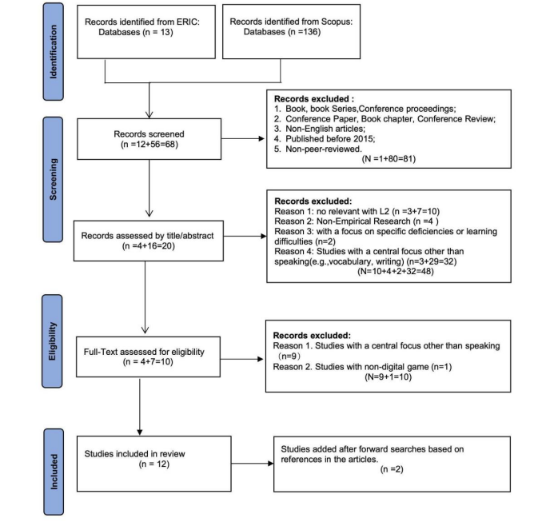
4. Results
Steps of Selection Process
Systematic literature review (PRISMA) (He, Suñer & Scheirs 2024):
Pronunciation and fluency as key indicators of speaking proficiency;
Digital games show great potential to enhance learners’ L2 speaking ability and emotional factors.
Very limited understanding of the interplay between cognitive and affective factors (speaking anxiety, agency, engagement, etc.)

Slide 11

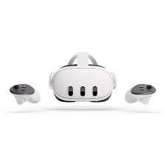

II. Exploratory Study on
Digital game-based language learning (DGBLL)

Slide 12
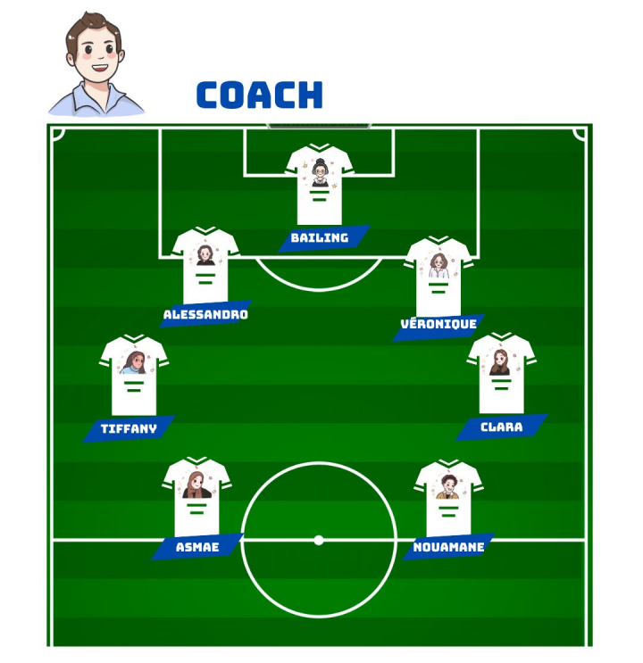
1. Our Team
We are an interdisciplinary working group from the University of Louvain, comprising members of the Linguistics Research Centre (PLIN) and the Communications Research Centre (PCOM), under the direction of Professor Ferran Suñer. Our research focuses on language learning within the context of digital games.
Bailing He, PhD student
Clara Dauby, researcher
Tiffany Libambu, researcher
Asmae Mbarek,Research Assistant
Nouamane EL Habti, Research Assistant
Véronique Scheirs, Teacher Researcher
Alessandro Cierro, Game developer
Ferran Suñer, Supervisor

Slide 13
2. Conceptual framework:
Complex Dynamics System Theory (CDST, Hiver et al. 2022, Overton & Lerner, 2014)
- everything counts and everything is connected (i.e., the relational principle)
- everything changes (i.e., the adaptive principle)
Principles of CDST Research
(a) represent and understand specific complex systems at various scales of description;
(b) identify and understand dynamic patterns of change, emergent system outcomes and behavior in the environment;
(c) trace, understand and where possible model the complex mechanisms and processes by which these patterns arise;
(d) capture, understand and apply the relevant parameters for influencing the behavior of systems.

Slide 14
3. Project goals and focus areas
Research goals:
To explore the potential of digital game-based learning to promote L2 speaking ability among students.
To better understand how cognitive and affective factors modulate the development of speaking ability in L2 German.
To provide an empirically tested pedagogical solution to promote speaking ability among students of L2 German.
One project, different Focus Areas and several teams members:
The Effect of DGBLL on Learners’ agency (Clara)
The Effect of DGBLL on L2 Speaking Fluency (Bailing)
The Effect of DGBLL on L2 Speaking Anxiety (Tiffany)

Slide 15
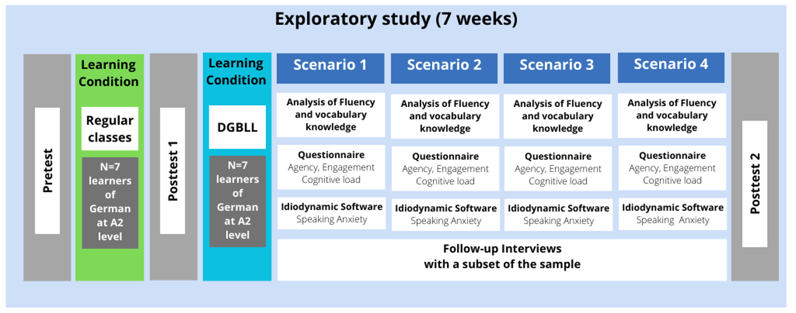
Concurrent mixed-methods study with a within-subject design

Slide 16
5. Specific research questions on agency
How does agency in DGBLL evolve over time?
What are the factors influencing the patterns of agency identified over time?

Slide 17
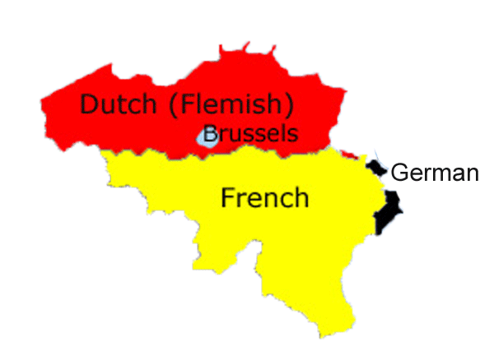

6. Sample
N=7 students of L2 German from UCLouvain
A2 level of Common European Framework of Reference for Languages (CEFR)

Slide 18
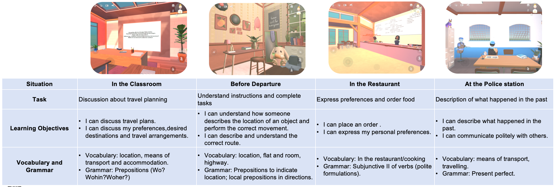
7. Materials: VR-based game "The Travel Kit"
This immersive experience facilitates collaborative language learning through action-oriented gameplay set in four distinct daily life scenarios, all centered around the same storyline.

Slide 19
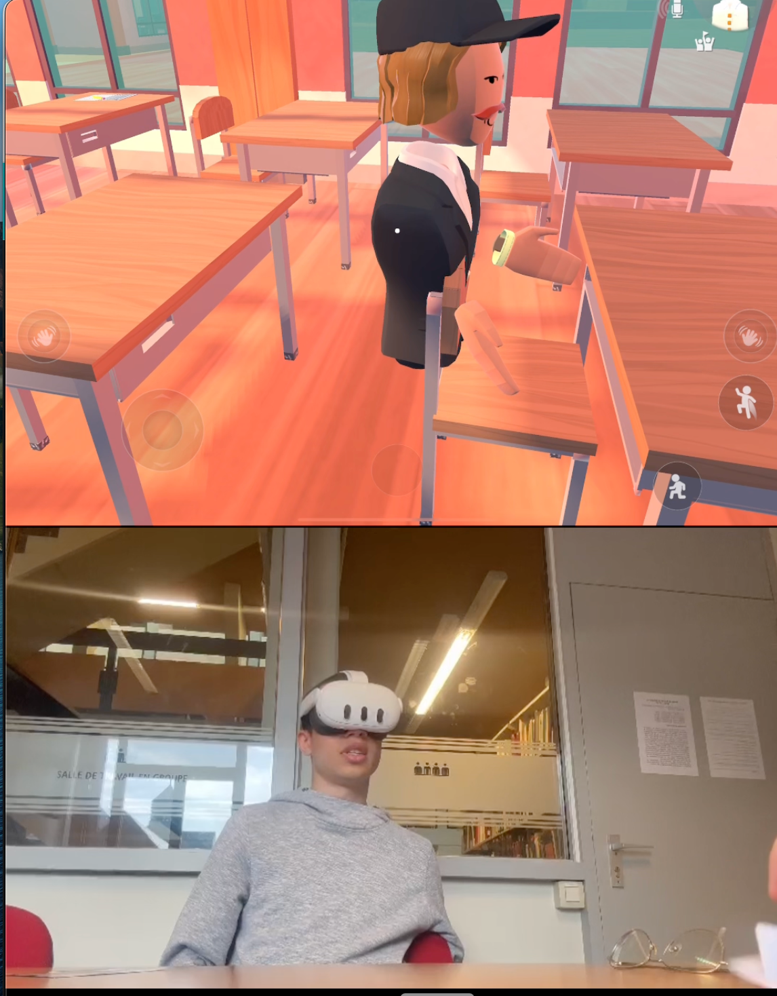
7. Materials: VR-based game "The Travel Kit"

Slide 20
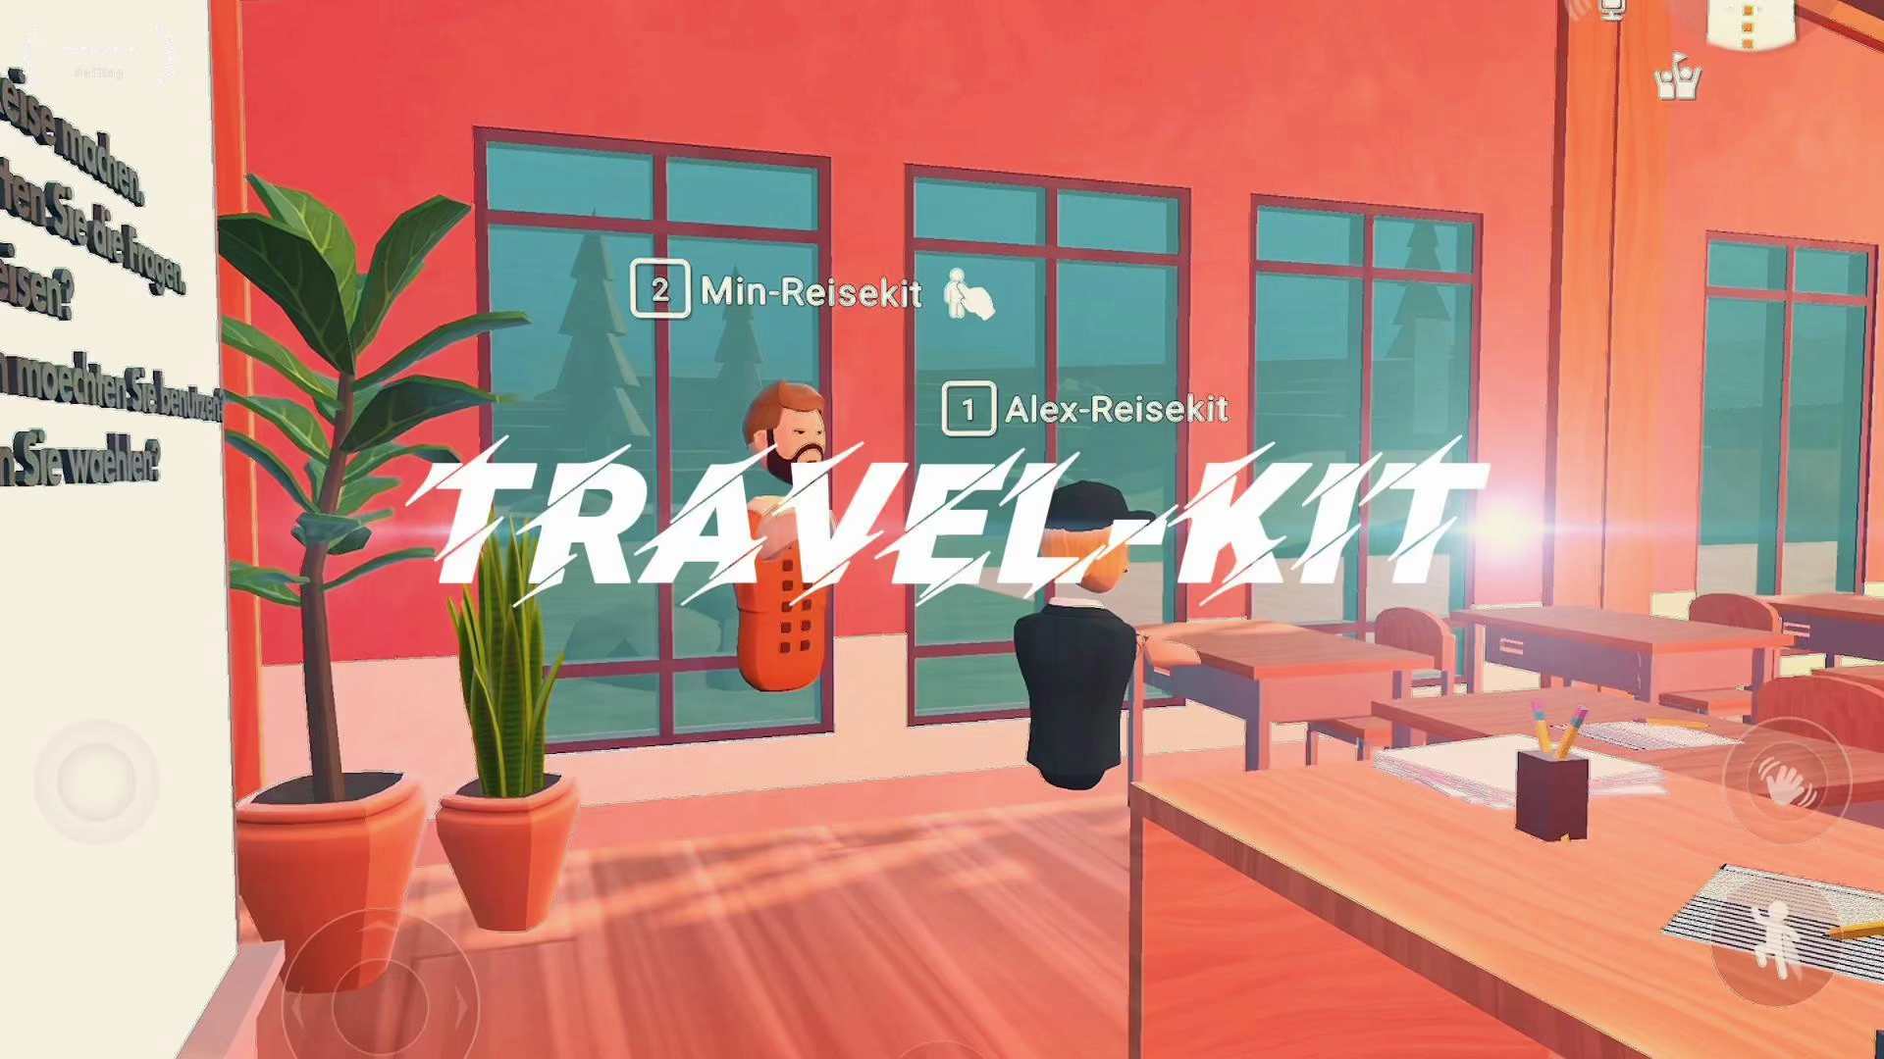
7. Materials: VR-based game "The Travel Kit"

Slide 21
8. Constructs and data collection instruments
9 Items from different standardized scales:
3 items covering (game-based) Agency, which refers to generating and controlling actions in order to act (linguistically and non-linguistically) and optimize learning conditions in an immersive environment. (Makransky & Petersen 2021, Larsen-Freeman 2019)
“Dans quelle mesure vous êtes-vous senti.e en contrôle des interactions/de l’environnement dans le jeu ?”
4 items covering cognitive and affective Engagement, defined as “constructive, enthusiastic, willing, emotionally positive and cognitively focused participation with learning activities in school” (Skinner et al. 2012)
“Dans quelle mesure vous êtes-vous senti.e intéressé.e par le contenu pendant le jeu? (affective engagement)

Slide 22
8. Constructs and data collection instruments
9 Items from different standardized scales:
1 item covering Self-efficacy, which refers to one’s perceived capabilities for learning or performing actions. (Schunk & Di Benedetto 2016, in Makransky & Petersen 2019).
“Dans quelle mesure vous êtes-vous senti.e confiant.e dans le processus du jeu ?”
1 items covering Intrinsic cognitive load, defined as the (perceived) complexity of information that must be understood and material that must be learned (Sweller 2010).
“Comment vous êtes-vous senti.e pendant le jeu?
dépassé.e - un peu confus.e - assez à l’aise - totalement à l’aise”

Slide 26
III. Results and conclusions

Slide 27
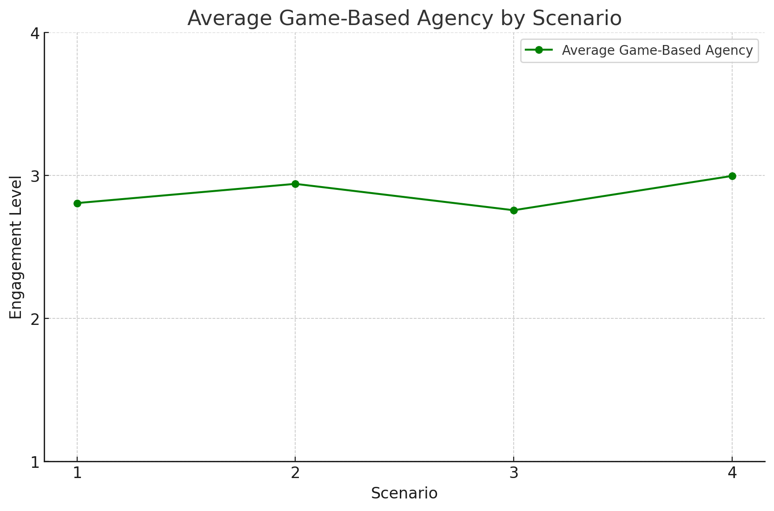
1. Results

Slide 28
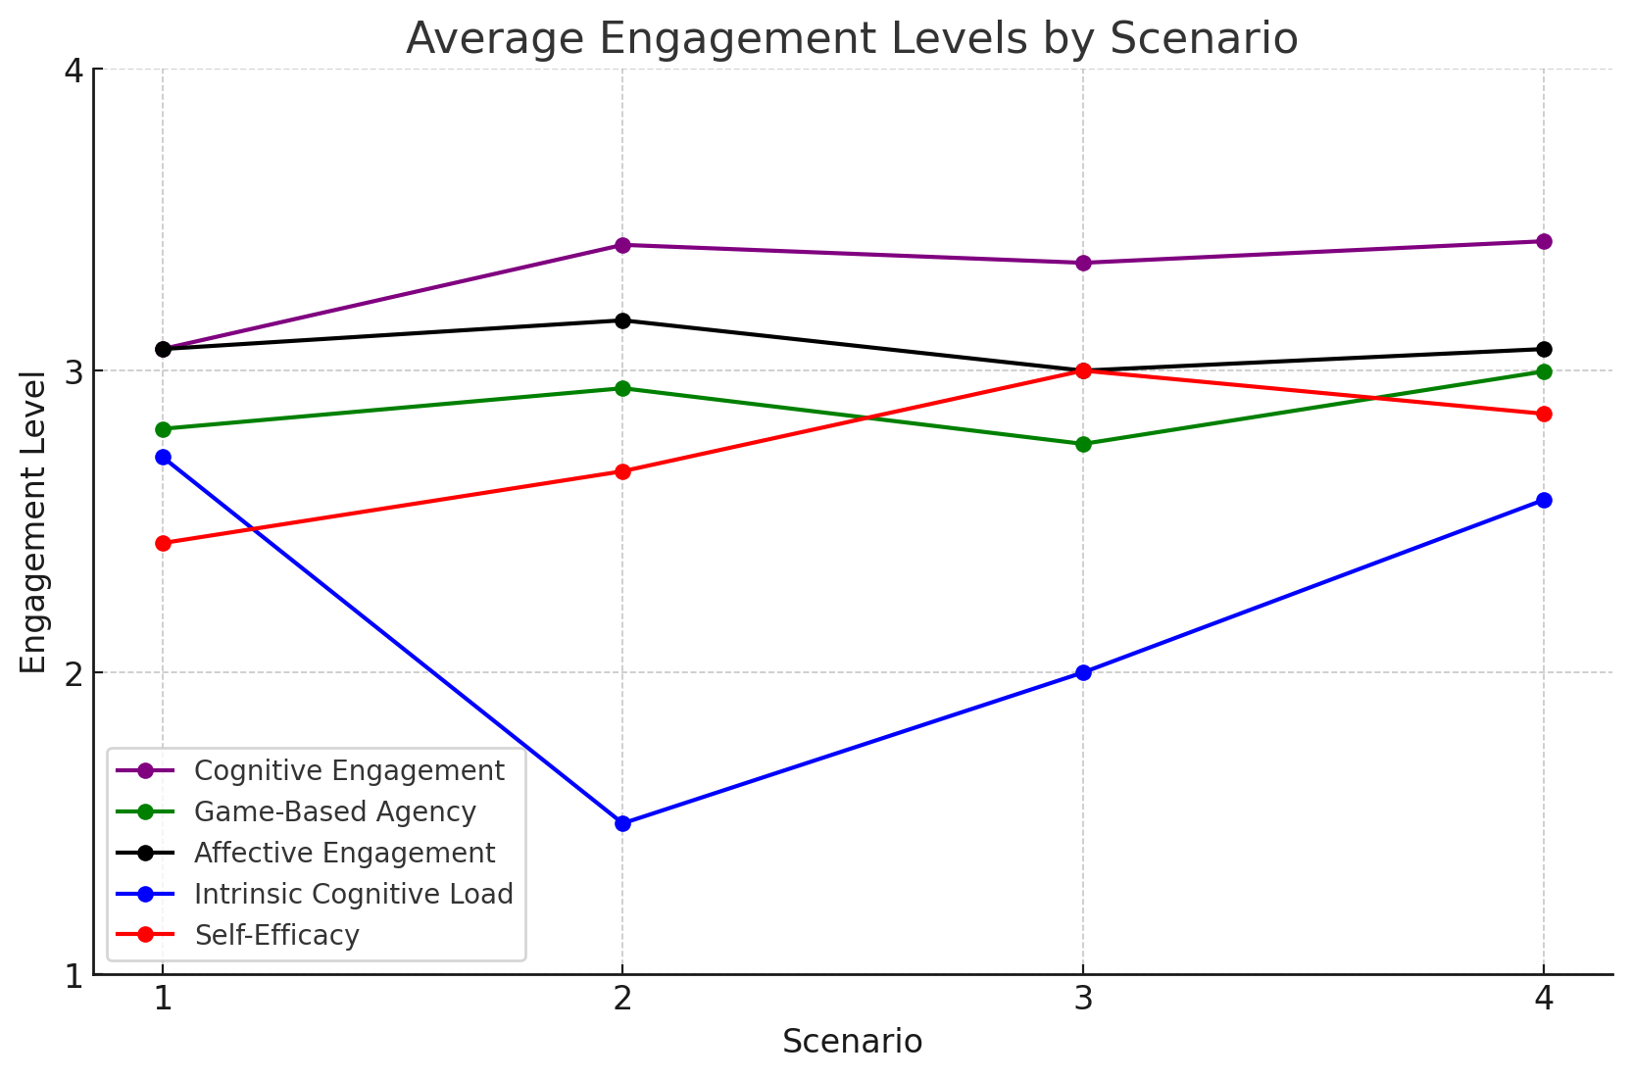
1. Results
Notes:
Game-based agency and Intrinsic cognitive load: slightly opposite trends. Potential Explanation: feeling of being confused and overwhelmed by the task and environment goes along an environment interaction decrease.
P2 (interview 1): “au début c’était le contenu qui m’avait assez perturbé, me repérer dans la classe était assez dur (…) mais je me suis rapidement adapté”.
Game-based agency, Affective engagement, and cognitive engagement: similar patterns across the scenarios and the participants.
Self-efficacy seems to increase and peak at scenario 3 before dropping slightly. Potential explanation: explained with the interviews with each participant that were conducted at scenario 1 and 4, where several of them expressed confusion about the task/scenario. This would explain why the self-efficacy levels at scenario 1 were lower than the following scenarios, and why it dropped around scenario 4 (they did not understand the task very well).
In most graphs, an increase in cognitive engagement appears to coincide with an increase in reported self-efficacy, particularly towards the final scenarios. This could suggest that as students become more cognitively engaged in the content, their self-efficacy also increased.

Slide 29
1. Results
Game-based agency and Intrinsic cognitive load: slightly opposite trends. Potential Explanation: feeling of being confused and overwhelmed by the task and environment goes along an environment interaction decrease.
P2 (interview 1): “au début c’était le contenu qui m’avait assez perturbé, me repérer dans la classe était assez dur (…) mais je me suis rapidement adapté”.
Game-based agency, Affective engagement, and cognitive engagement: similar patterns across the scenarios and the participants.
Self-efficacy seems to increase and peak at scenario 3 before dropping slightly. Potential explanation: explained with the interviews with each participant that were conducted at scenario 1 and 4, where several of them expressed confusion about the task/scenario. This would explain why the self-efficacy levels at scenario 1 were lower than the following scenarios, and why it dropped around scenario 4 (they did not understand the task very well).
In most graphs, an increase in cognitive engagement appears to coincide with an increase in reported self-efficacy. This could suggest that as students become more cognitively engaged in the content, their self-efficacy also increased.
Notes:
On average, cognitive engagement tends to increase from scenario 1 to 4 with stabilization around 3-4.
Some graphs also seem to show that increased game-based agency coincides with increased self-efficacy, although the average of all participants does not particularly reflect this.
Intrinsic cognitive load and game-based agency seem to exhibit opposite trends: when intrinsic cognitive load decreases, game-based agency seems to increase slightly. This is explained in part by the fact that some of them reported feeling more confused and overwhelmed by the task and the environment and thus interacting less with it. P2 (interview 1): “au début c’était le contenu qui m’avait assez perturbé, me repérer dans la classe était assez dur (…) mais je me suis rapidement adapté”.
Affective and cognitive engagement seem to have similar patterns on average.
Game-based agency and affective engagement also show similar patterns across the scenarios and the participants.
Self-efficacy seems to increase and peak at scenario 3 before dropping slightly. This can be explained with the interviews with each participant that were conducted at scenario 1 and 4, where several of them expressed confusion about the task/scenario. This would explain why the self-efficacy levels at scenario 1 were lower than the following scenarios, and why it dropped around scenario 4 (they did not understand the task very well).
In several graphs, an increase in cognitive engagement appears to coincide with an increase in reported self-efficacy, particularly towards the final scenarios. This could suggest that as students become more cognitively engaged in the content, their self-efficacy also increased. The opposite is also observable.

Slide 30
1. Results
Overall, participants’ intrinsic cognitive load influenced the other variables and especially game-based agency.
Some participants reported that when they felt overwhelmed or confused, they tended to interact less with the environment and felt less engaged in the content of the game.
Some factors like being tired or not feeling well might also have influenced their engagement in the game, as a few of them reported not feeling well on some days where the game took place:
“ (P7) n’était pas vraiment dans son assiette, il était fatigué (...)”.

Slide 31
2. Conclusions
In conclusion, the study highlights the dynamic interplay between various forms of engagement, cognitive load, and self-efficacy in a game-based learning environment. These findings underscore the importance of designing educational tasks that balance cognitive demands and foster game-based agency to enhance overall engagement and self-efficacy.
Next Steps：
- Further integration of data (meta-inference)
-Track learning progress through tests and badge system.
- More Kits on action-oriented gameplay set in distinct daily life scenarios.
-More ways to collect data as well as longer experimental times and larger samples.

Slide 32
References
Acquah, E. O., & Katz, H. T. (2020). Digital game-based L2 learning outcomes for primary through high-school students: A systematic literature review. Computers & Education, 143, 103667.
Al Hosni, S. (2014). Speaking difficulties encountered by young EFL learners. International Journal on Studies in English Language and Literature (IJSELL), 2(6), 22-30.
Baniabdelrahman, A. A. (2013). Effect of using Internet tools on enhancing EFL students’ speaking skill. Journal of Contemporary Research, 3(6), 79-87.
Cobb, T., & Horst, M. (2011). Does word coach coach words?. Calico journal, 28(3), 639-661.
Dailey, A. (2010). Difficulties implementing CLT in South Korea: Mismatch between the language policy and what is taking place in the classroom. University of Birmingham, 23.
Egenfeldt-Nielsen, S. (2011). Beyond edutainment: Exploring the educational potential of computer games. Lulu. com.
Ellis, N. C., Simpson‐Vlach, R. I. T. A., & Maynard, C. (2008). Formulaic language in native and second language speakers: Psycholinguistics, corpus linguistics, and TESOL. TESOL quarterly, 42(3), 375-396.
Hung, H. T., Yang, J. C., Hwang, G. J., Chu, H. C., & Wang, C. C. (2018). A scoping review of research on digital game-based language learning. Computers & Education, 126, 89-104.

Slide 33
References
Kasuya, M. (2008). Classroom interaction affected by power distance. Language Teaching Methodology and Classroom Research and Research Methods, 1-12.
Ko, S., & Eslami, Z. R. (2021). Developing Pragmatic Competence in Digital Game Worlds: A Systematic Review. TESL-EJ, 25(1), n1.
Lim, T. M., & Yunus, M. M. (2021). Teachers’ perception towards the use of Quizizz in the teaching and learning of English: A systematic review. Sustainability, 13(11), 6436.
Lantolf, J. P. (2000). Introducing sociocultural theory. Sociocultural theory and second language learning, 1, 1-26.
Page, M. J., McKenzie, J. E., Bossuyt, P. M., Boutron, I., Hoffmann, T. C., Mulrow, C. D., ... & Moher, D. (2021). The PRISMA 2020 statement: an updated guideline for reporting systematic reviews. Systematic reviews, 10(1), 1-11.
Plass, J., & Pawar, S. (2020). 10 adaptivity and personalization in game-based learning. Handbook of game-based learning, 263.
Prensky, M. (2007). How to teach with technology: Keeping both teachers and students comfortable in an era of exponential change. Emerging technologies for learning, 2(4), 40-6.
Poole, F. J., & Clarke-Midura, J. (2020). A systematic review of digital games in second language learning studies. International Journal of Game-Based Learning (IJGBL), 10(3), 1-15.

Slide 34
References
Reinhardt, J., & Thorne, S. L. (2020). 17 Digital Games as Language-Learning Environments. Handbook of game-based learning, 409.
Robinson, P., & Gilabert, R. (2007). Task complexity, the Cognition Hypothesis and second language learning and performance.
Sun, Y. C., & Yang, F. Y. (2015). I help, therefore, I learn: service learning on Web 2.0 in an EFL speaking class. Computer Assisted Language Learning, 28(3), 202-219.
Thompson, C. G., & von Gillern, S. (2020). Video-game based instruction for vocabulary acquisition with English language learners: A Bayesian meta-analysis. Educational Research Review, 30, 100332.
Ur, P. (1996). A course in Language teaching: Practice and theory. UK: Cambridge University Press.
Vasylets, O., Gilabert, R., & Manchón, R. M. (2017). The effects of mode and task complexity on second language production. Language Learning, 67(2), 394-430.
Wei, J. (2014). A study via interviews of the Chinese Bouyei college learners’ EFL classroom anxiety arousals. Journal of Language Teaching and Research, 5(2), 419-428.
Zhang, Y. (2009). Reading to Speak: Integrating Oral Communication Skills. In English teaching forum (Vol. 47, No. 1, pp. 32-34). US Department of State. Bureau of Educational and Cultural Affairs, Office of English Language Programs, SA-5, 2200 C Street NW 4th Floor, Washington, DC 20037.

Slide 35

Contact：
bailing.he@uclouvain.be
clara.dauby@student.uclouvain.be

Slide 37
2. Constructs and data collection instruments
Petersen et al. (2021) determine 6 variables that are influenced by agency:
interest (situational and individual): psychological construct that represents a relationship between an individual and a specific topic or content area, and is characterized by both affective and cognitive factors. Interest can be divided into situational or individual interest. (p.944)
intrinsic motivation
self-efficacy
embodiment: In IVR, embodiment refers to the experience of owning a virtual body (body ownership), which can be influenced by the external appearance of the body and the ability to control the actions of the body (agency). (p.946)
cognitive load: Cognitive load (CL) is posited to be caused by the cognitive demands involved in the learning task, and it is a multifaceted construct consisting of intrinsic and extraneous load. Extraneous CL is dependent on the design of the learning task based on how information is presented to the learner. A number of studies have identified CL as a specifically important component of understanding the learning process when learning in IVR.(p.946)
self-regulation

Slide 38
5. Methods
L2 Speaking fluency
Using standardized speaking tasks and a PRAAT script (Boersma & Weenink, 2007) for fluency measurement
This script allows a direct extraction of aspects such as speed, length of run, number of silent pauses, and frequency from the video-recorded speech performance of the participants (see also de Jong et al., 2012 and Kahng, 2014).
Quantitative data analysis will involve a two-way ANCOVA.
Affective factors and learners’ attitudes
13 items adapted from the Classroom Engagement Inventory (Wang et. al, 2014) regarding Cognitive Engagement (CE), and Affective Engagement (AE);
3 items on agency (i.e feeling of control of one's own actions) based on Polito et al (2013),
3 items measuring extraneous, intrinsic and germane cognitive load as proposed by Cierniak et. al (2009).

Slide 39
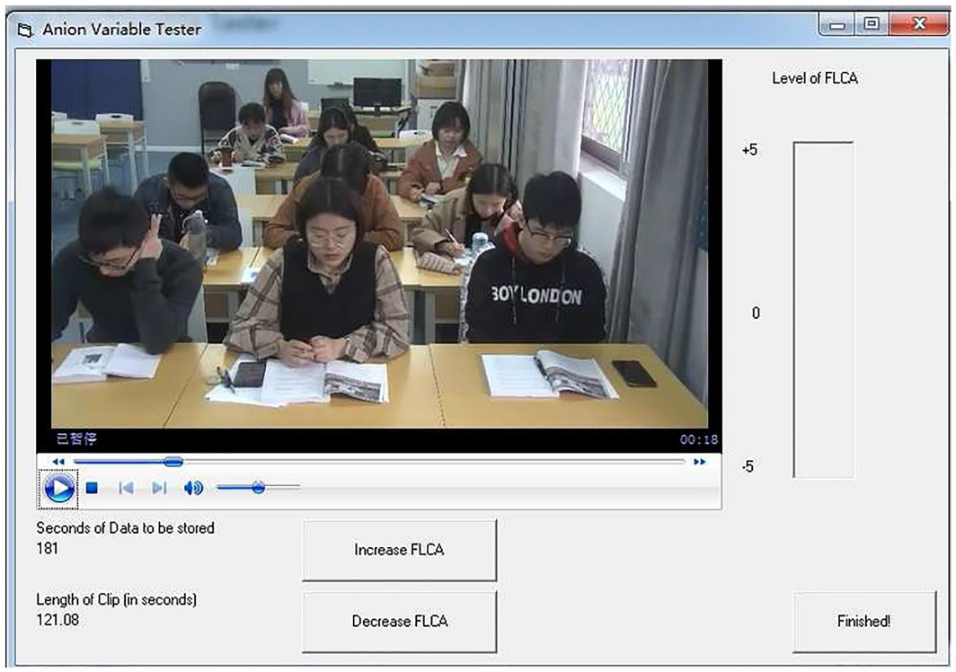
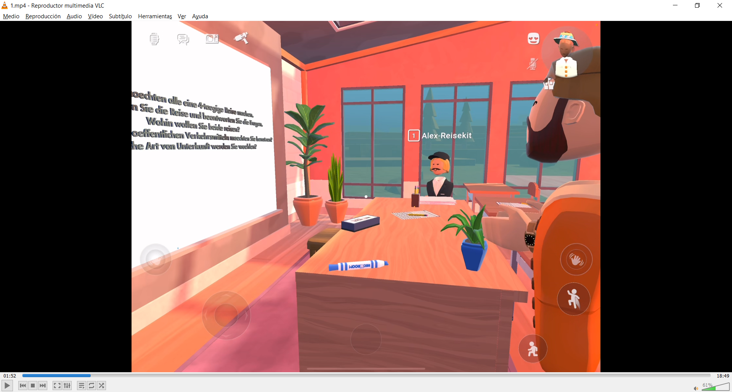
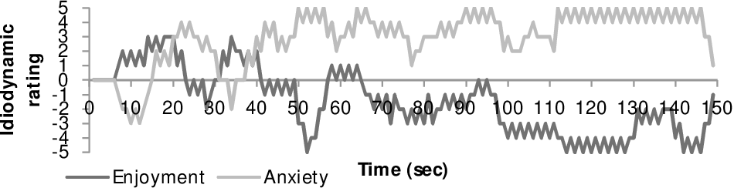
5. Methods
Speaking anxiety
Measuring the dynamics of emotions with the idiodynamic software (McIntyre 2020)

Slide 40
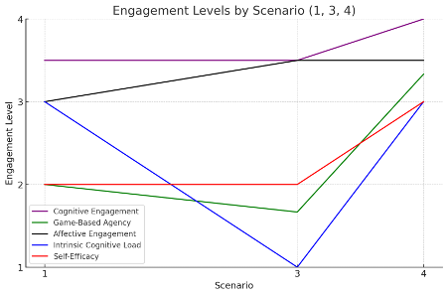
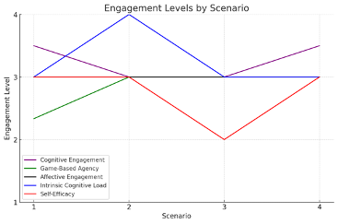
1. Results (additional information)
In several graphs, an increase in cognitive engagement appears to coincide with an increase in reported self-efficacy, particularly towards the final scenarios. This could suggest that as students become more cognitively engaged in the content, their self-efficacy also increased. The opposite is also observable.

Slide 41
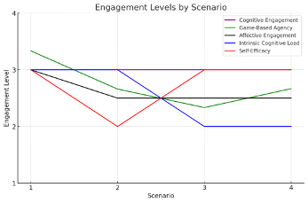
1. Results (additional information)
In several graphs, an increase in cognitive engagement appears to coincide with an increase in reported self-efficacy, particularly towards the final scenarios. This could suggest that as students become more cognitively engaged in the content, their self-efficacy also increased. The opposite is also observable:.

