Slide 1
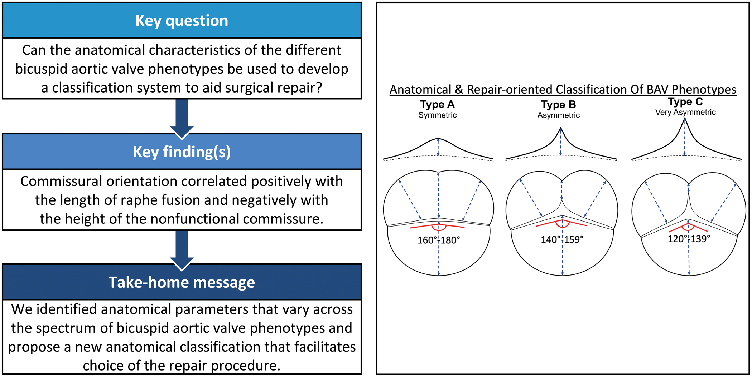

Notes:
Unless provided in the caption above, the following copyright applies to the content of this slide: © The Author(s) 2019. Published by Oxford University Press on behalf of the European Association for Cardio-Thoracic Surgery. All rights reserved.This article is published and distributed under the terms of the Oxford University Press, Standard Journals Publication Model (https://academic.oup.com/journals/pages/open_access/funder_policies/chorus/standard_publication_model)

