Slide 1




Anticipating War
How collective future thinking shapes individual defence readiness
Fierens, L., Rosoux, V., Bouchat, P.
loic.fierens@uclouvain.be
Notes:
Rajouter les financements / institutions
rajouter les auteurs du papier

Slide 2
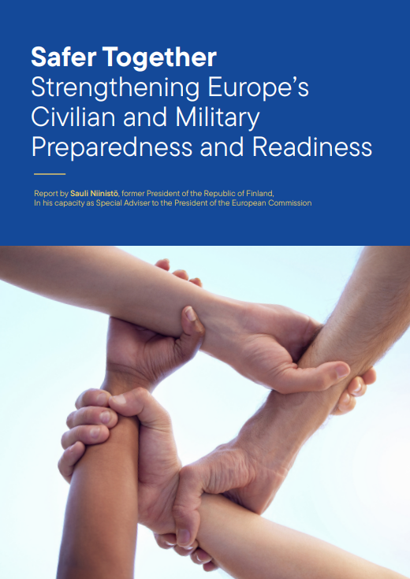
Context of the survey
Ongoing Russian aggression of Ukraine
Defence-build up in Europe, and the drive for a European defence autonomy
Return of questions relating to military reserve, military service, and the level of resilience of a population to face war and crises
Importance of a grass-root support for defence-related policies, and of a minimum of readiness to face adversity
How to understand individual positions in such an environment?

Slide 3
Purpose of the survey
Improving the conceptualization and measurement of the so-called willingness to fight
Testing theory-driven hypotheses regarding its predictors
Assessing the importance of anticipatory processes in explaining individual differences in willingness to fight
The survey was conducted in Belgium in July 2025

Slide 4
Collective Future Thinking
“The act of imagining an event that has yet to transpire on behalf of, or by, a group.” (Szpunar & Szpunar, 2016, p.318)
Research focus: typical shape of CFT, link with collective memory
Research gap: psychological effects of CFT

Slide 5
Psychological preparedness
Psychological system pushing individuals to get ready to face anticipated stimuli (Carroll et al., 2022), purpose = feeling psychologically ready
Entailing attitudinal changes, intentions, and preparatory actions
Research focus: university exams, sport performance, over- / under-preparation
Research gap: preparedness for collective future
Notes:
Example: cardiac arrest in the street
Att: finding it nice that people can do it
Intention: wanting to get train, feeling like you should do something
action: take a training

Slide 6
Willingness-to-fight
Of course, we all hope that there will not be another war, but if it were to come to that, would you be willing to fight for your country? (e.g., World Values Survey, European Values Survey)
Unclear item, biased towards pro-peace, lacking conceptualization, not contextualized
Yet: numerous studies on drivers at the individual and collective level of the willingness to fight
→ propose to reconceptualize it as defence readiness : level of perceived readiness to conduct defence-related behaviours in case a given armed conflict would erupt

Slide 7
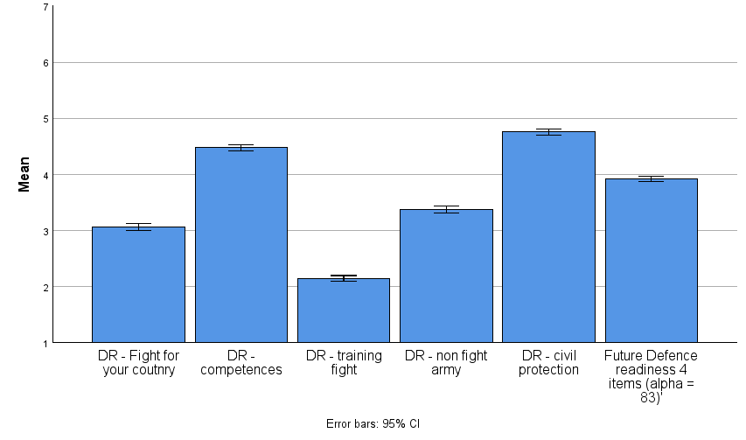
Defence readiness
Notes:
This scale has good internal consistency (α = .85). Confirmatory Factor Analysis (CFA) using JASP 0.19.0.0 showed that to reach goodness of fit (i.e., to best measure defence readiness), item three (i.e., join the military to be trained to fight) had to be removed from the scale, as it was too closely correlated to items one and two (5-items model: Comparative Fit Index (CFI) = .93, Tucker-Lewis Index (TLI) = .86, Root mean square error of approximation (RMSEA) = .174, Standardized root mean square residual (SRMR) = .044; 4-items model: CFI = .99, TLI = .97, RMSEA = .079, SRMR = .014). The four-item scale has good internal consistency (α = .83).

Slide 8
Design & methods
Anticipation of a given conflict (probability, threat, time horizon)
Psychological preparation
Defence readiness
Socio-demographics: age, gender, migration background, social status, diploma
Identification with the in-group
Peace and war attitudes
Political orientation

Slide 9
Measures used in this study
Socio-demographics: subjective social status (McArthur’s scale), gender (male, female, other), migration (yes or no), diploma (5 levels)
Peace & War attitudes (Van Der Linden et al., 2017): 10-items bi-dimensional scale
  Peace attitudes (e.g., our country’s first priority should be world peace) (M: 5.74, SD: 1.06, alpha: .72)
  War attitudes – reversed (e.g., war is sometimes the best way to solve a conflict (pro-war) (M: 5.54, SD: .97, alpha: .62)
Identity: single social identity item for Belgians and Europeans (Likert 7) (Postmes, 2013)
Political orientation: single item left-right (Likert 11)( Sanchez-Mazas et al., 2003)

Slide 10
Participants
Invitation: members of CESPOL citizen panel (N > 15 000)
Surveys received : N = 7281 (48,5%)
Surveys fully completed: N = 6213 (85%)
Passed attention check: N = 5221 (84%)
age (M = 57.12, SD = 15.12)
gender (male = 71.4%)
migration background (yes 22%)
diploma (80% higher education or university)
Eligibility criteria (age > 18): N = 5211 (99%)
Notes:
Migration //
Age: more
Gender: more man
Diploma: more educated

Slide 11
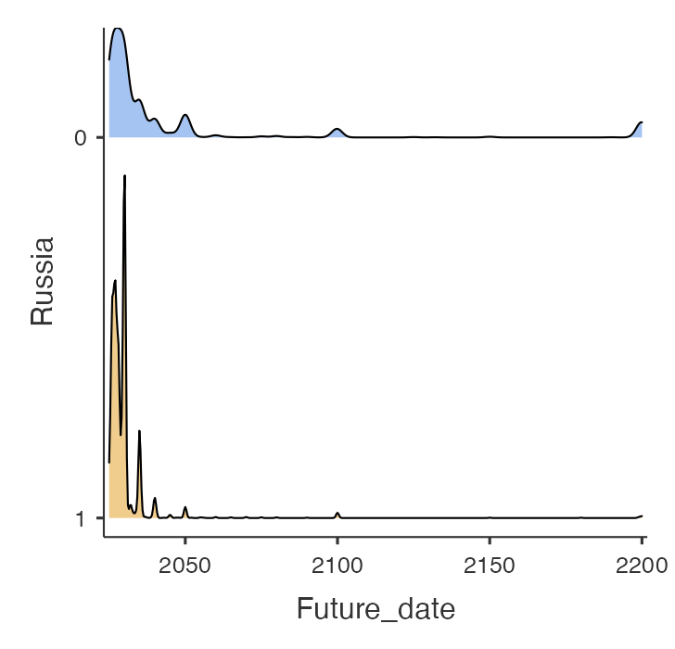
Results: Conflict anticipated & time horizon

Slide 12
Level of threat

Slide 13
Conflict probability
Notes:
Add other probabilities?

Slide 14
Multiple linear regression (nested models)
Model 1: Socio-demographics + political orientation (R²: .052)
Gender (male): +
Age: -
Right-leaning: +
Migration: n.s.
Diploma: n.s.
SSS: n.s.
Model 2: Belgian and European identity (R²: . 112)
BE: +
EU:+
Model 3: Peace and war attitudes (R²: .148)
Pro-war: +
Pro-peace: +
Model 4: Anticipation (R²: .194)
Threat: +
Proba:+
Time proximity: +
Notes:
Remove the details

Slide 15
Discussion
Threat, probability, and time proximity are important predictor of defence readiness
Empirical support for securitization theory
Challenge for military planning
Notes:
Threat, probability, and time proximity are important predictor of defence readiness
As strong as attitudes or identity !
// psychological preparedness
// temporal construct theory
Empirical support for securitization theory
Securitization apparently worked for the Russian threat (2/3 population)
More to be done to understand why 33% didn’t
Creates a window of opportunity for change
Changed not only believes but also intentions
Challenge for military planning
Long-term build-up vs proximal perception of threat
Subject to rapidly change if threat decrease
Can(not) solely rely on that effect to keep defence policy ongoing

Slide 16
Other findings
Importance of an EU identity for individual defence readiness in case of a Russian aggression
More responsibility placed upon the shoulders of a European defence than a national one
Difference between pacifism (i.e., finding peace an important objective) and anti-militarism (i.e., rejecting any use of violence for political objective)
Pacifism leads to higher DR when controlling for anti-war
The remaining variance could be interpreted as an active form of internationalism (i.e., supporting war as long as it is in line with international laws)

Slide 17
Any question, remarks, suggestion ?
Anticipation of a given conflict (probability, threat, time horizon)
Psychological preparation
Defence readiness
Socio-demographics: age, gender, migration background, social status, diploma
Identification with the in-group
Peace and war attitudes
Political orientation
Contact: loic.fierens@uclouvain.be

Slide 18
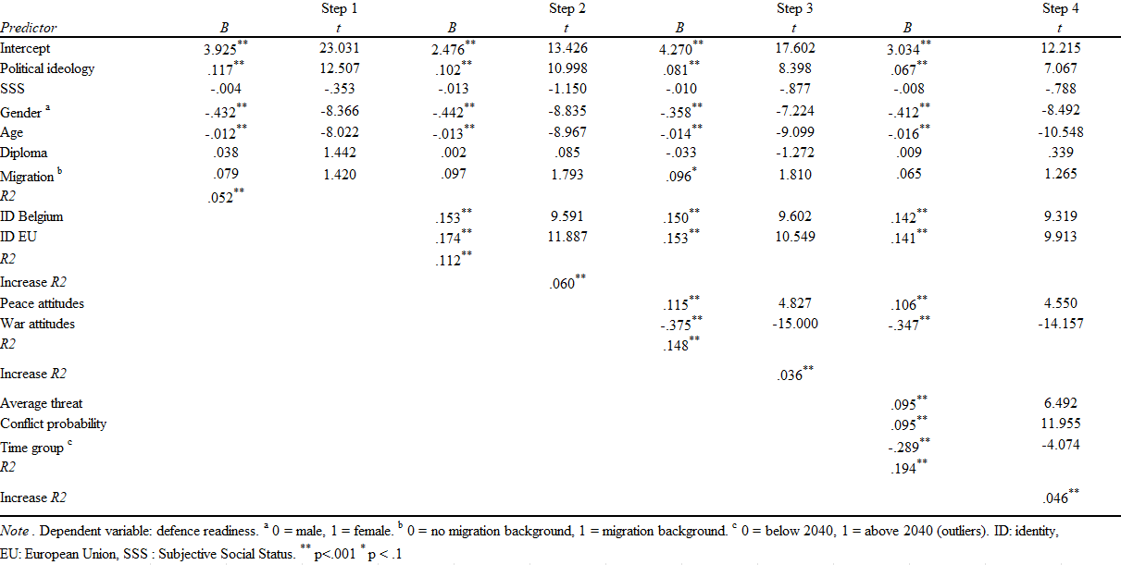
Notes:
Rewrite ANTI war attitudes

Slide 19
Collective future thinking tasks
Identify the most probable armed conflict that would directly involve Belgium in the future
Evaluate degree of probability, threat, and time horizon
Evaluate readiness to conduct 5 specific behaviours in case of the conflict’s eruption
  Join the military to fight
  Join the military in a support function
  Join the civil protection
  Contribute to the war effort (time and skills)
  Fight for your country

Slide 20
Hypotheses (subordinate)
H4.1: Higher levels of identification with Belgians and with Europeans is associated with higher defence readiness.
H4.2: Holding pro-peace and anti-war attitudes leads to lower defence readiness.
H4.3: Identifying with the right of the political spectrum leads to higher defence readiness.
H4.4: Lower subjective social status is linked with higher defence readiness.
H4.5: Being a male is associated with higher defence readiness.
H4.6: Holding a higher degree is linked with lower defence readiness.
H4.7: Having a migration background is linked with higher defence readiness.

