Slide 1


Automating the next level: high-throughput GW
M.J. van Setten
Notes:
Lausanne AAS 25 mins

Slide 2
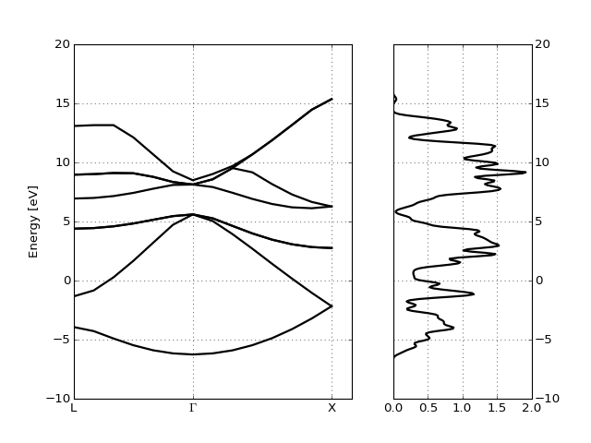
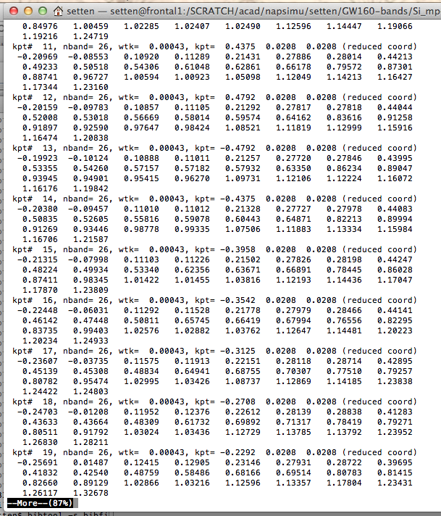
Post processing
nscf_ebands = abiopen("si_nscf_GSR.nc").ebands
gs_ebands = abiopen("si_scf_GSR.nc").ebands
nscf_ebands.plot_with_edos(gs_ebands.get_edos())

Slide 3
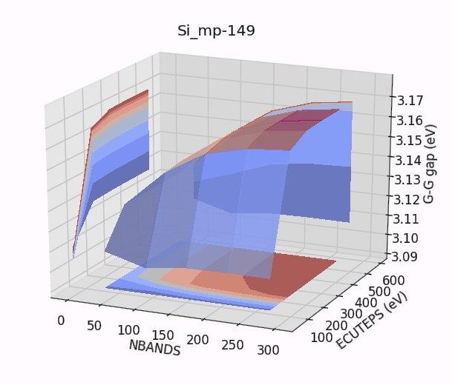
Convergence studies
Energy cutoffs
Kpoints
Smearing
Bands
….

Slide 4
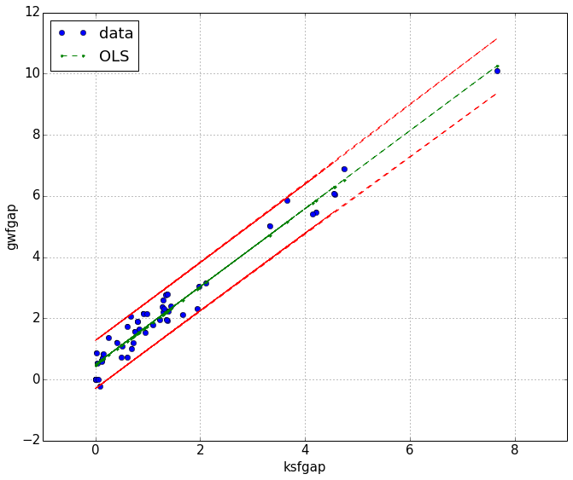
Automatically for many structures
for structure in database:
ebands_input(structure, pseudos=ONCVPSP_GGA)
for structure in database:
ebands_input(structure, pseudos=ONCVPSP_GGA)
for structure in database:
ebands_input(structure, pseudos=ONCVPSP_GGA)

Slide 5
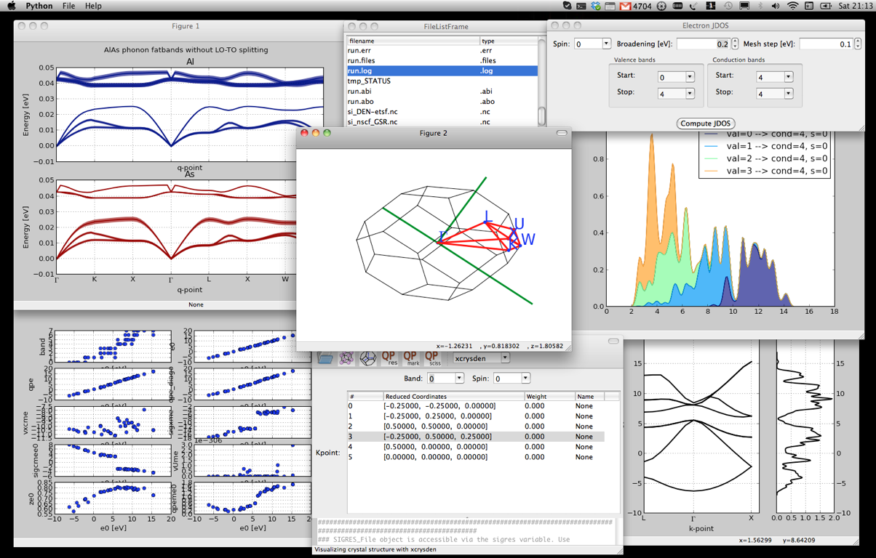
Graphical interfaces

Slide 6

Post-processing tools
Tools to generate input files
Graphical interfaces

Slide 7


Python package for:
post-processing Abinit results
generating input files automatically
creating and executing workflows (relaxations, phonons, benchmarking, convergence studies, PP testing, GW ...)
(I)Python(notebook) based tutorials
High throughput flows and high performance flows
Why python?
relatively easy to use and to learn
interactive environment (IPython, notebooks, GUIs)
excellent support for scientific applications (scipy, pandas, matplotlib...)
ecosystem
tons of other libraries

Slide 8
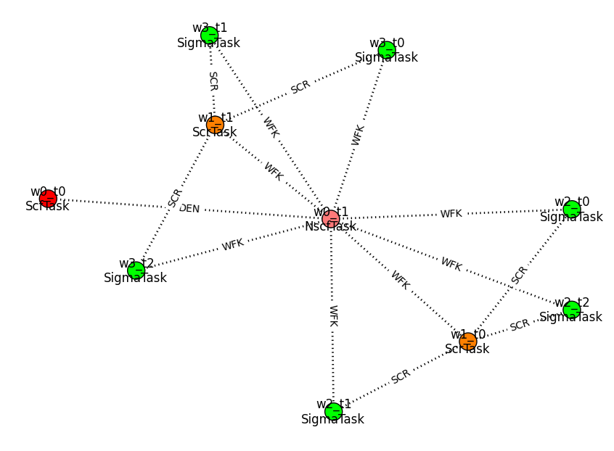
Flow generation:
GUI or scripted

Slide 9
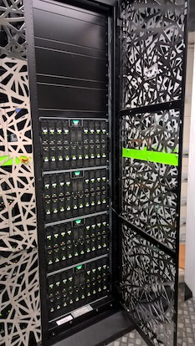
SLURM
PBSPro
Torque
SGE
…
Scheduling the flow on the cluster
Error handling (‘custodian like’)
Convergence testing

Slide 10


Interactive analysis
and presentation of
results
Storing results:
querry-able entries
+ netcdf data files
(via gridfs)

Slide 11
Storing flows in a database

Slide 12

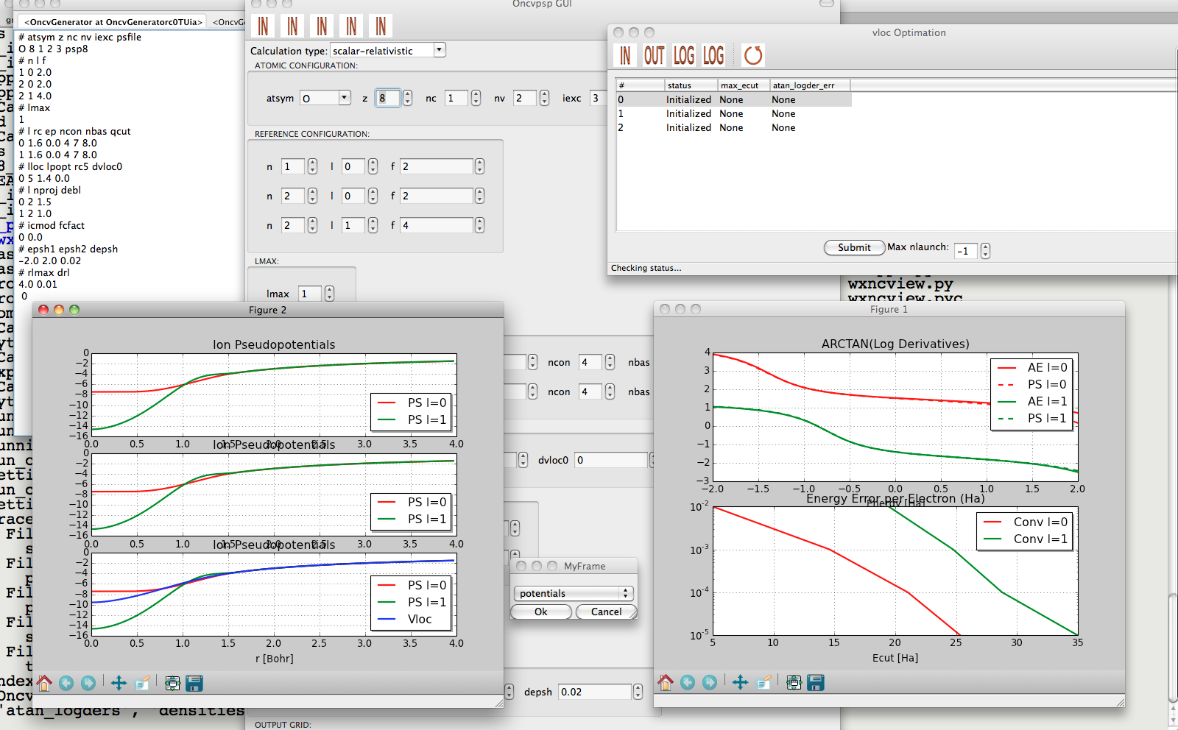
Pseudo Dojo
Optimized Norm Conserving Vanderbild Pseudo Potentials
  multiple projectors
  multiple gradient constraints
Don Hamann (PRB 88, 085117 (2013))
Package to facilitate PSP
generation
Graphical interface
Automatized testing
Log derivatives made to agree up to 8 Ha
http://www.pseudo-dojo.org/dojo.html
Notes:
Multiple projectors > more degrees of freedom to fix the scattering in the empty space
Log derivatives can be made to match the all electrons ones well beyond 8 H

Slide 13
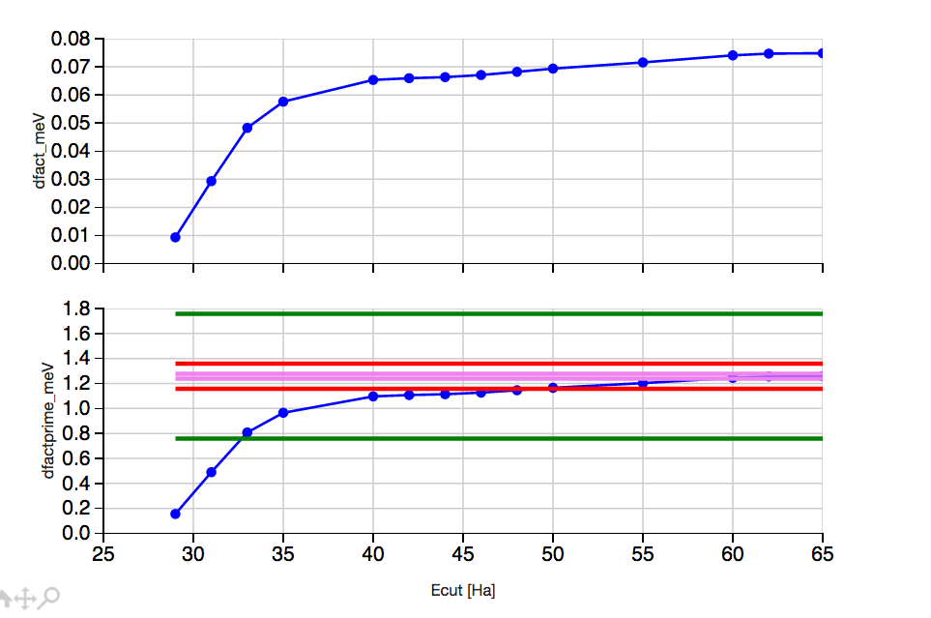

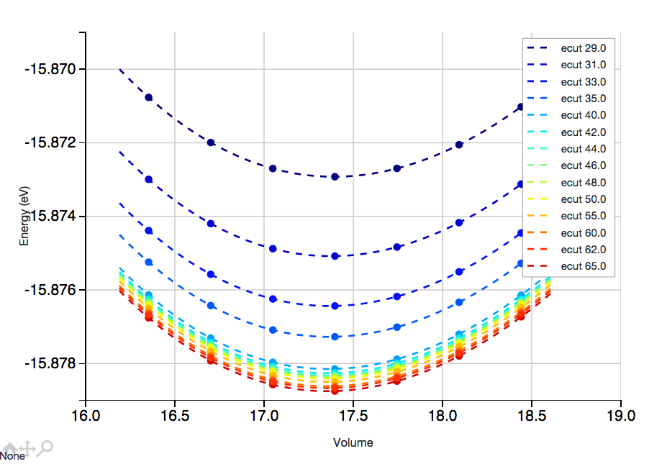
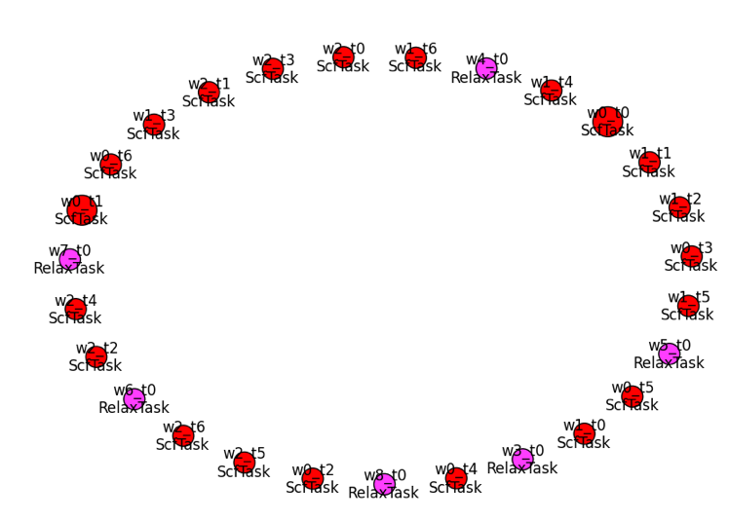
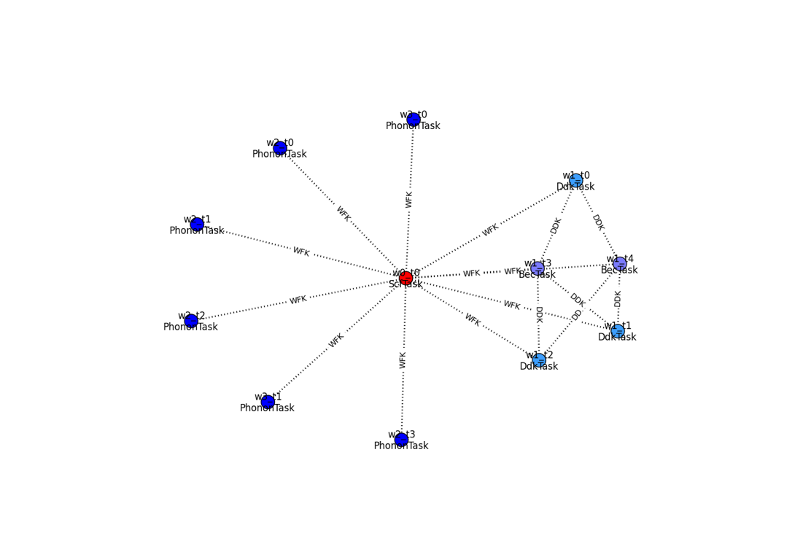
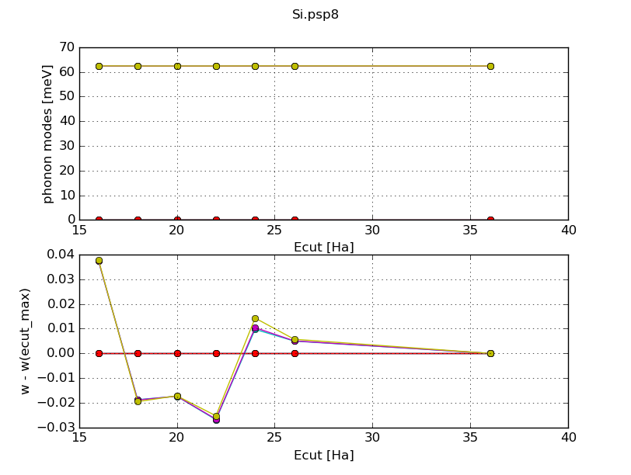
EOS
Flows
Ipython notebook with full info: H-high.ipynb

Slide 14
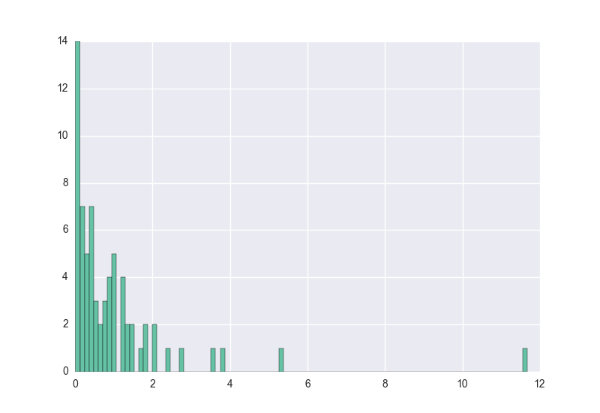
Table of ONCVPSPs
NC with/without semi-core states
Good log derivative up to 3-5 Ha
Validated with DF, GBRV tests, Phonons
Deltafactor:
1.0 meV
(best pseudo for each element, including Mn!)
1.6 meV
(all pseudos)
Mn

Slide 15
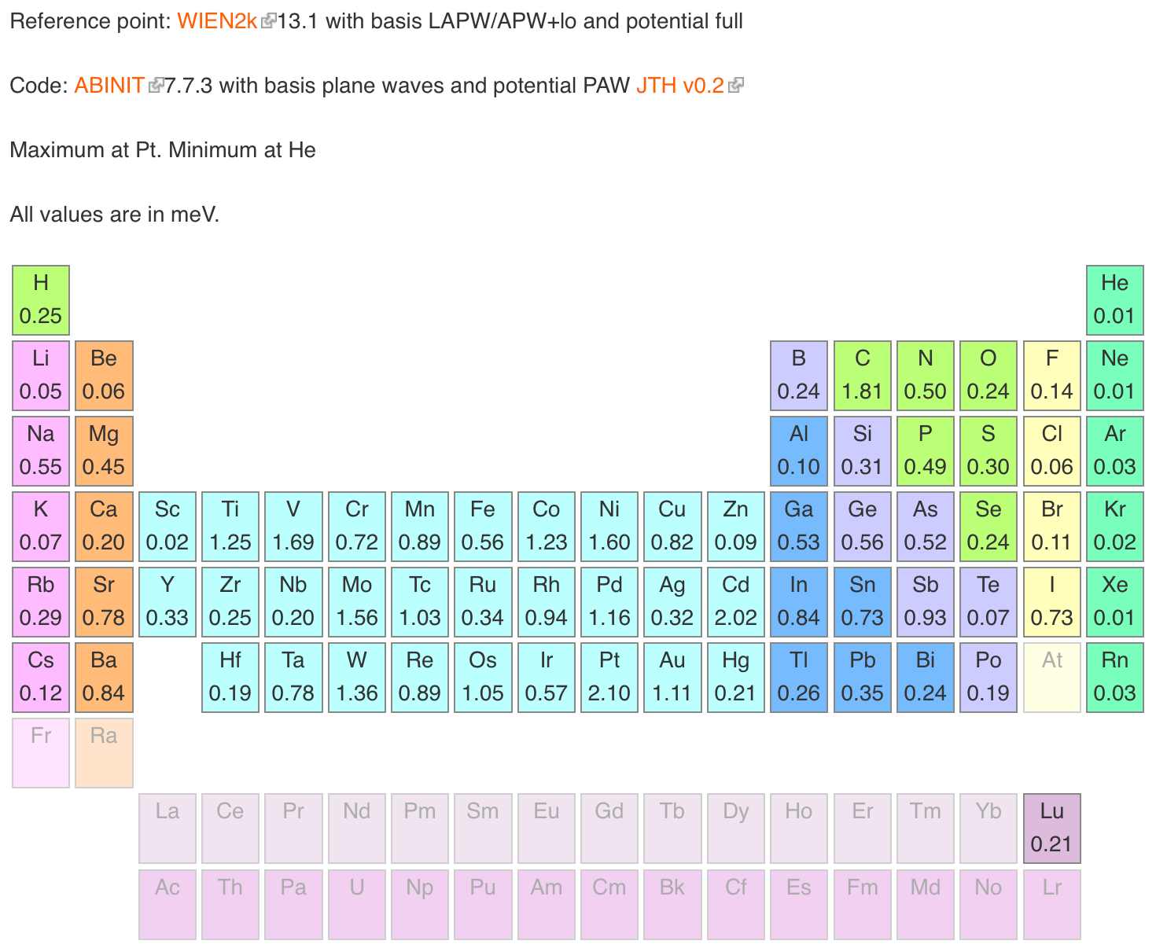

+
9.2
ONCVPSP potentials from the Pseudo-Dojo
Mn. Minimum at Ar
0.07
0.02
0.14
0.91
1.04
0.47
0.29
0.99
0.29
0.05
0.44
0.36
0.44
1.02
1.04
0.05
0.72
0.01
0.18
0.10
1.23
0.90
1.25
3.53
11.7
5.31
2.10
1.18
0.85
0.10
0.33
0.24
0.11
0.17
0.04
0.03
0.28
1.33
1.02
0.79
1.43
1.42
1.68
1.78
2.01
1.22
0.52
1.86
0.07
0.47
0.54
0.41
0.68
0.04
0.95
0.37
0.73
2.71
0.68
0.88
1.39
2.45
0.58
0.38
0.21
0.17
0.21
0.28
0.05
http://www.pseudo-dojo.org

Slide 16
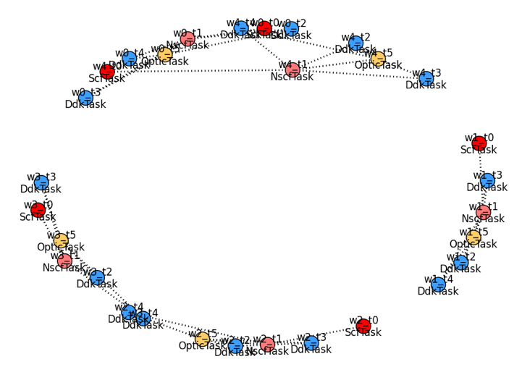
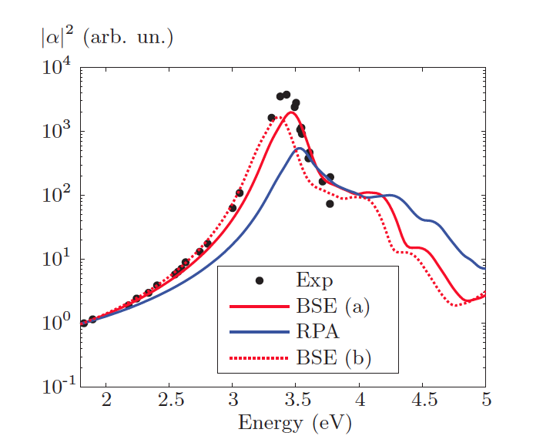
Raman with frozen phonon

Slide 17
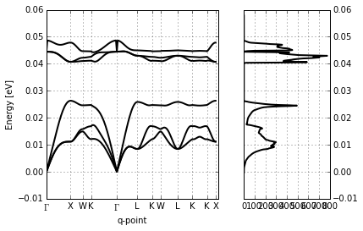
DFPT

Slide 18
GW in high throughput

Slide 19
KS v.s. Quasi-Particle equation
Electron density parameterized by KS single particle states
Greens function in spectral representation, expressed in terms of quasi-particle states leads to the quasi particle equation:
The quasi-particle energies are the electron removal and addition energies
Local exchange-correlation potential
Non-local energy dependent
non-hermitian self-energy
HEDIN Phys Rev 139, A796, HYBERTSEN and LOUIE PRB 34, 5390
Notes:
At this point all is exact, now we need a way to calculate Sigma

Slide 20
GW in High Throughput
‘additional’ difficulties as compared to DFT
  4 step calculation
  N⁴ scaling
  No ‘safe’ parameter set (converged results for all)
  No ‘safe’ computational settings (ncpu, mem, ..)
  Pseudo potentials ?
Notes:
Pseudo potentials well tested for ground state, for gw this is not so clear ..

Slide 21
2D convergence problem

Slide 22


GW in High Throughput
‘additional’ difficulties
  4 step calculation
  N⁴ scaling
  No ‘safe’ parameter set (converged results for all)
  No ‘safe’ computational settings (ncpu, mem, ..)
  Pseudo potentials ?
GW babysitting problem
Notes:
Pseudo potentials well tested for ground state, for gw this is not so clear ..

Slide 23
GW in High Throughput
‘additional’ difficulties
  4 step calculation
  N⁴ scaling
  No ‘safe’ parameter set (converged results for all)
  No ‘safe’ computational settings (ncpu, mem, ..)
  Pseudo potentials ?
GW babysitting problem
Notes:
Pseudo potentials well tested for ground state, for gw this is not so clear ..

Slide 24












GW in High Throughput
‘additional’ difficulties
  4 step calculation
  N⁴ scaling
  No ‘safe’ parameter set (converged results for all)
  No ‘safe’ computational settings (ncpu, mem, ..)
  Pseudo potentials ?
GW babysitting problem
Notes:
Pseudo potentials well tested for ground state, for gw this is not so clear ..

Slide 25
GW wrapper
Python package that wraps around the ab-initio code
Options
    What kind of GW
    Convergence tolerance
Some list of structures > ‘fully’ converged GW results

Slide 26
Convergence study
On a low k-point density (2x2x2):
  Set of single parameter ground state convergence studies
  Grid of nbands X encuteps
  For each nbands find converged encuteps
  For the converged encuteps find the converged nbands
  if not found > extend grid and retest
On the final high k-point density:
  Test derivatives.
  (in most cases the high density derivatives turn out smaller)
  Post process
  (create scissor, apply scissor, …)
(ecut, …)

Slide 27
Convergence study
On a low k-point density (2x2x2):
  Set of single parameter ground state convergence studies
  Grid of nbands X encuteps
  For each nbands find converged encuteps
  For the converged encuteps find the converged nbands
  if not found > extend grid and retest
On the final high k-point density:
  Test derivatives.
  (in most cases the high density derivatives turn out smaller)
  Post process
  (create scissor, apply scissor, …)
(ecut, …)

Slide 28
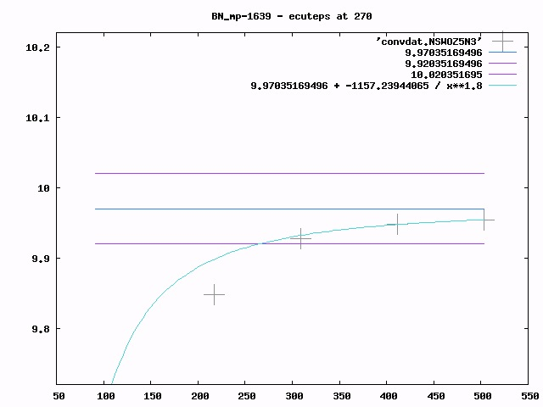
G-G
gap
(eV)

Slide 29
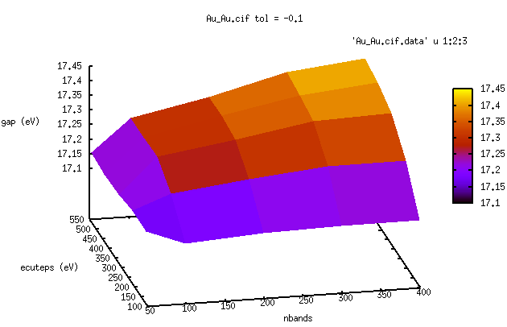
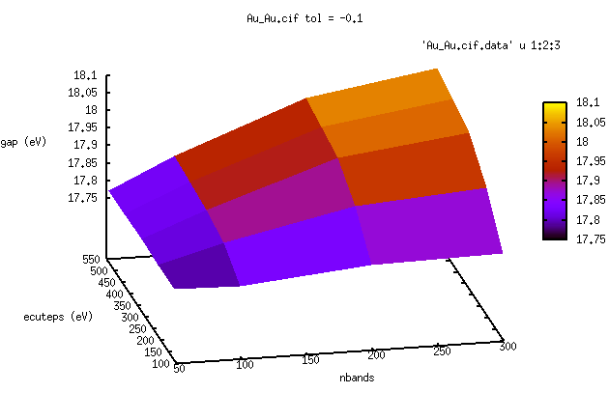
Gold
2x2x2 kpoint mesh
14x14x14 kpoint mesh
Notes:
It actually works: the shape of the surface calculated at 222 is the same as the on calculated

Slide 30
Convergence study
On a low k-point density (2x2x2):
  Set of single parameter ground state convergence studies
  Grid of nbands X encuteps
  For each nbands find converged encuteps
  For the converged encuteps find the converged nbands
  if not found > extend grid and retest
On the final high k-point density:
  Test derivatives.
  (in most cases the high density derivatives turn out smaller)
  Post process
  (create scissor, apply scissor, …)
(ecut, …)

Slide 31
First application: GW160
~ 160 solids, including the not so usual suspects
Wrapper settings:
  Godby – Needs PP
  500 kppra final mesh
  Tolerance 0.1 eV
~ 100 done at this point

Slide 32
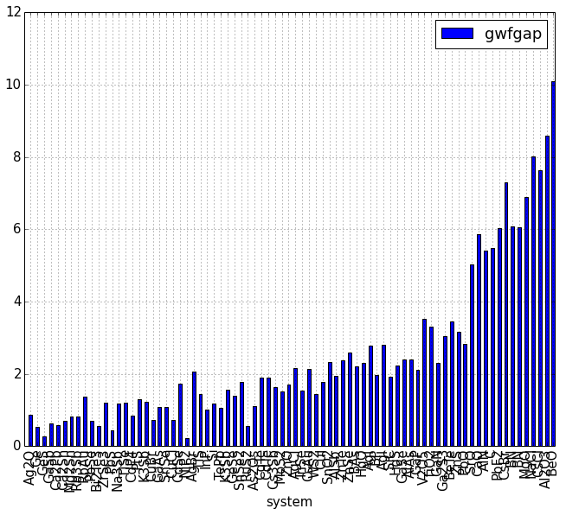

Slide 33
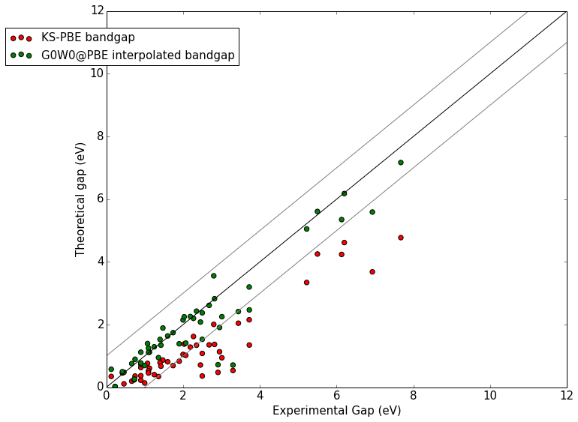

Slide 34
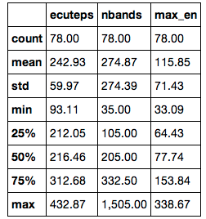
Statistics on the convergence parameters

Slide 35
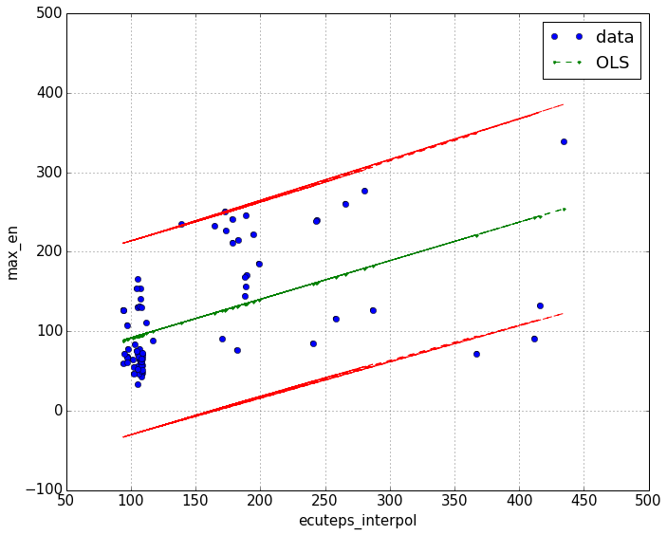
Empty states v.s. ecuteps

Slide 36
Matteo Giantomassi
Geoffroy Hautier
Gian-Marco Rignanese
Don Hamann
Xavier Gonze

Slide 37
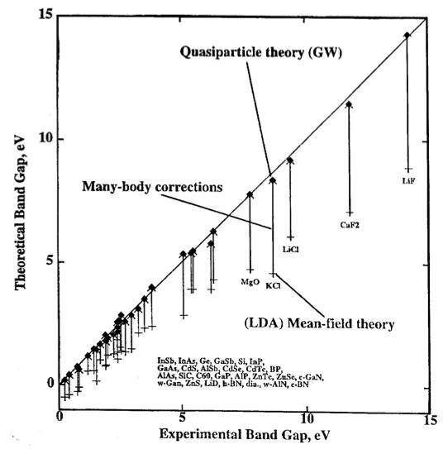

Slide 38
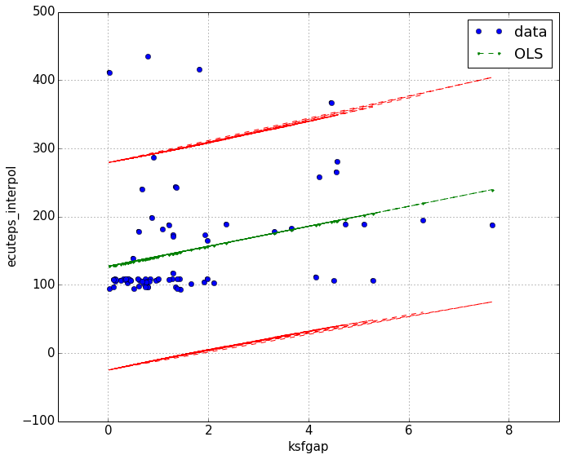
Ecuteps ?

Slide 39
Abipy for teaching
Different users

Slide 40
Problems
Paral_KGB
  Wavefunction file explosion beyond a certain system size
  Some times problem in orthonormalization of the
  trial wavefunctions
  NaN ‘s but abinit continues
  Improvements needed for really high-throughput
Memory
  GW screening is not distributed
  Segmentation faults because of earlier allocation failures
  Unsolvable system size limit (GWMEM is no solution)
Restarting / continuing
  Inability to continue from the density on a changed fft mesh
  To make efficient use of large cluster restarting is crucial

Slide 41
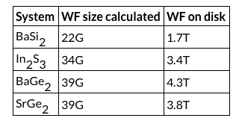
Exploding wavefunction files
Reproducible over different clusters / compilations

Slide 42
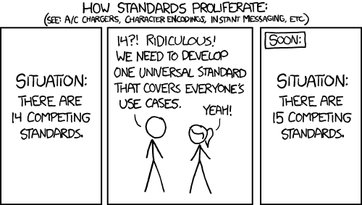

Slide 44
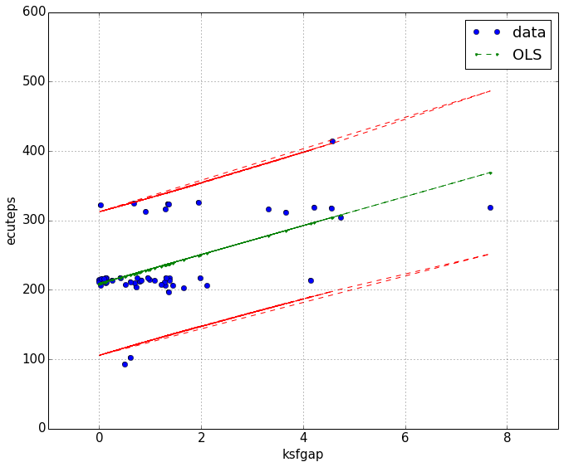

Slide 45
