Slide 1

What does inequality mean in Global Health?
Sandy Tubeuf
UCLouvain
University of Belgrade seminar – Wednesday 10th October 2023

Slide 2
Health equity : a challenge for health systems
Besides promoting population health, promoting health equity is one of the main targets of the World Health Organisation
Large differences in health status exist:
  Between countries

Slide 3
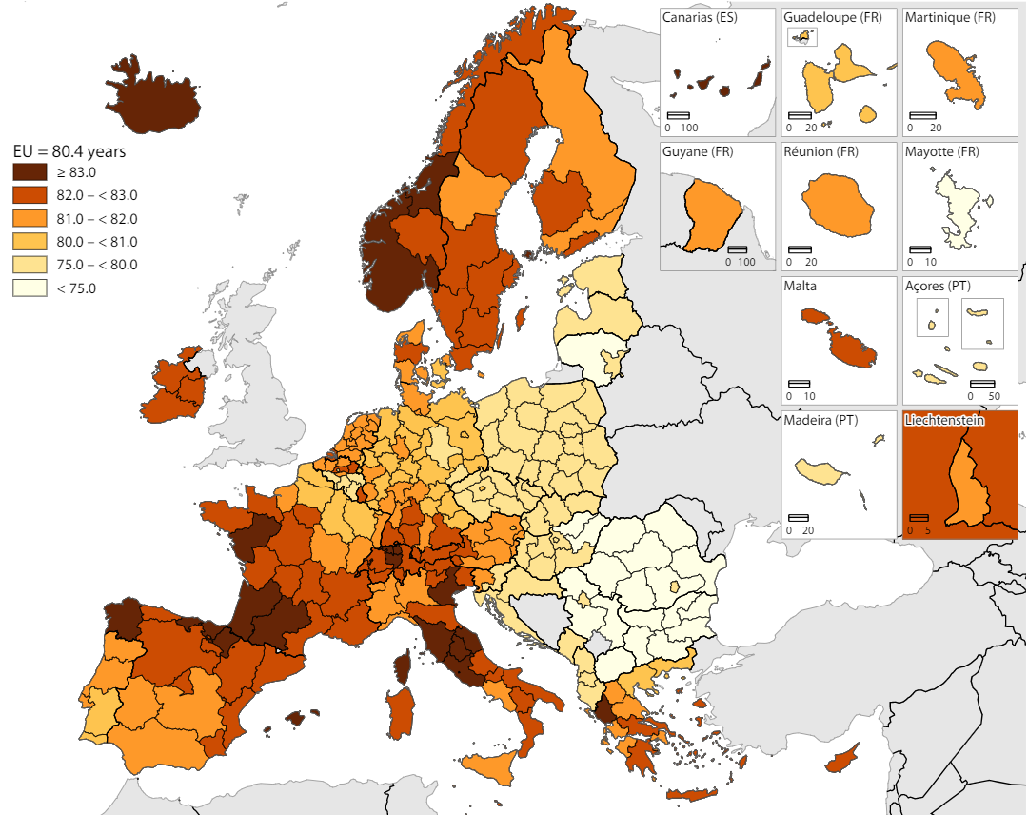
Life expectancy across countries within Europe
Source: OECD Health Statistics 2021, Eurostat.

Slide 4
Health equity : a challenge for health systems
Besides promoting population health, promoting health equity is one of the main targets of the World Health Organisation
Large differences in health status exist:
  Between countries
  Between social classes within each country
Equity refers to inequalities (differences) that are deemed to be unfair or particularly unjust
Social gradient in health : those less advantaged socially position have worse health than those who are more advantaged

Slide 5
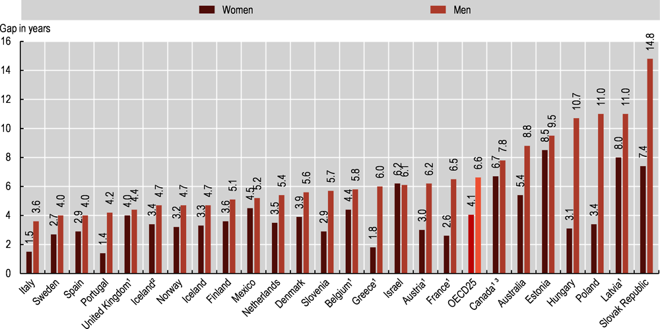
Inequality in life expectancy according to education
Source: OECD Health Statistics 2021, Eurostat.

Slide 6
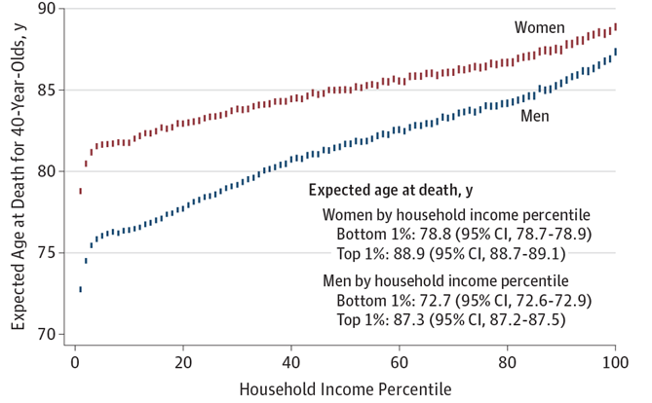
Are health inequalities explained by poverty?
Chetty et al (2016) JAMA https://jamanetwork.com/journals/jama/fullarticle/2513561

Slide 7
Horizontal equity principles
Horizontal equity refers to equal treatment of equals
  Those with equal health needs should receive equal healthcare treatment and access expenditure/treatment/access for equal need
Are health inequalities explained by inequalities in healthcare access?

Slide 8
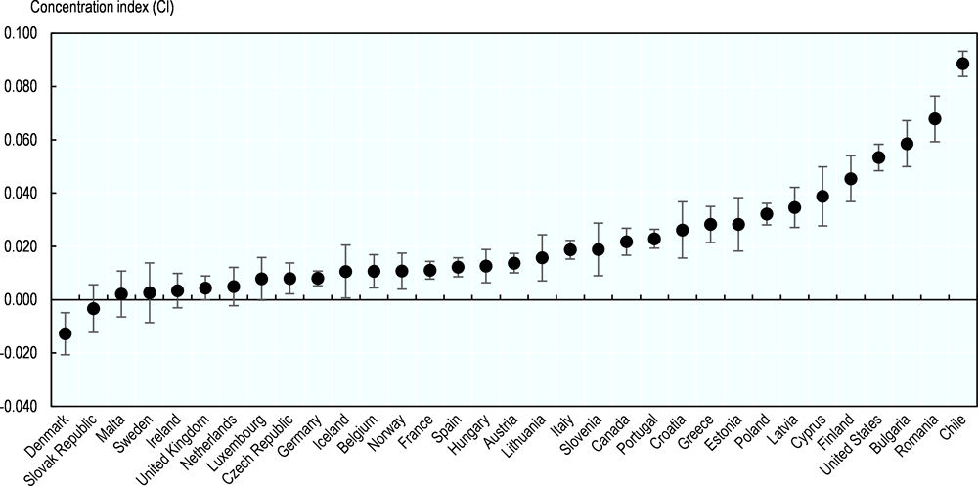
Inequality levels in the probability of a doctor visit
OECD, 2019

Slide 9
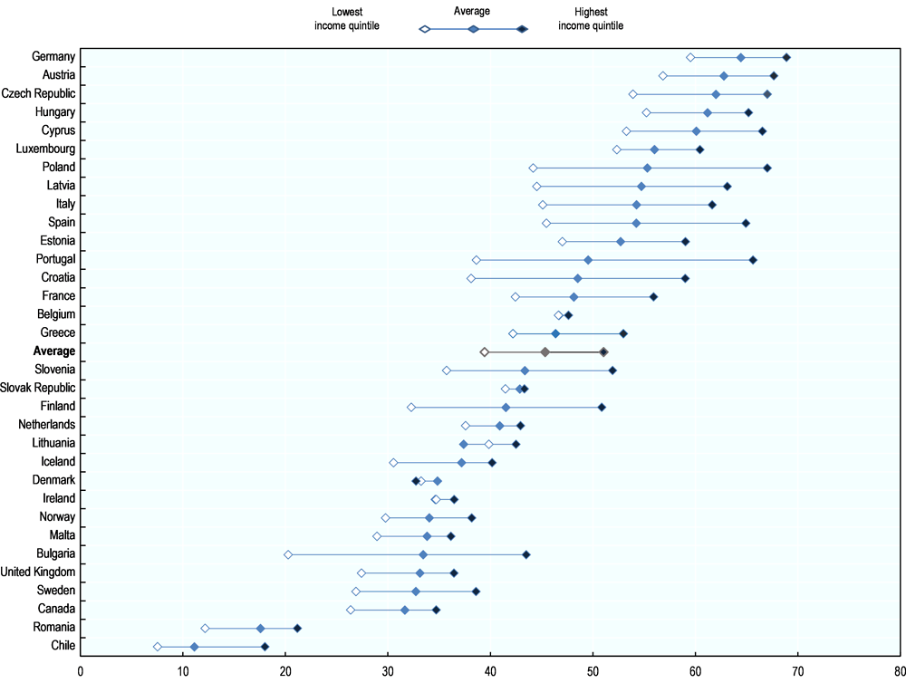
Inequalities in the probability to visit a specialist
Probability to visit a specialist during the year according to income (adjusted by age, sex, health)
OECD, 2019

Slide 10
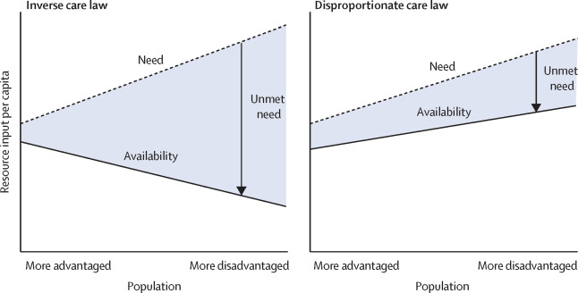
Cookson et al. (2021) The Lancet
https://www.thelancet.com/journals/lancet/article/PIIS0140-6736(21)00243-9/fulltext
The inverse care law
Socially disadvantaged people receive less, and lower-quality, health care despite having greater needs
Socially disadvantaged people receive more health care but of worse quality and insufficient quantity to meet their additional needs

Slide 11
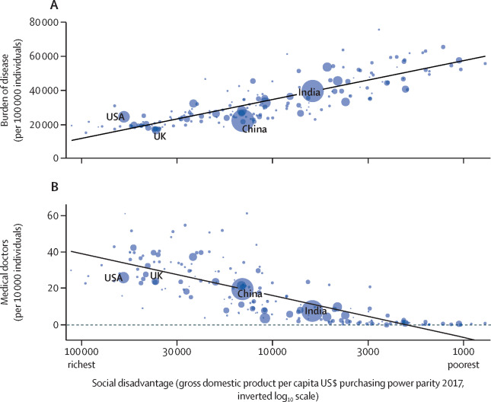
Cookson et al. (2021) The Lancet
https://www.thelancet.com/journals/lancet/article/PIIS0140-6736(21)00243-9/fulltext
The global inverse care law

Slide 12
From health inequalities to inequalities of opportunity
Do all inequalities in health matter ?
Some inequalities might be more acceptable than others
  Older people have a poorer health than young people, is that unfair?
The concept of inequality of opportunity in health brought a normative understanding of health inequalities
  What are the most unjust determinants of health ?

Slide 13

Which society do you prefer to live in?
Society 1
Society 2
Society 3
Your life expectancy depends on the income of your parents
Your life expectancy depends on your healthy lifestyles
Your life expectancy depends on your genetic endowment
Hans Van Kippersluis, Rethinking Equality of Opportunity and Prevention

Slide 14
From health inequalities to inequalities of opportunity
Individuals should succeed or fail based on their efforts and not extraneous circumstances such as having well-connected parents. Equality of opportunity is central to the concept of meritocracy.
Wikipedia, 28 June 2022
The key idea of responsibility in inequality of opportunity is easy to conceptualise:
  Health inequalities are particularly unfair if they are related to determinants (Circumstances) which the individual is not responsible for
  Health inequalities are acceptable if they are due to individual effort/choices which the individual is responsible for (Effort)
Are health inequalities explained by deleterious health-related behaviours ?

Slide 15
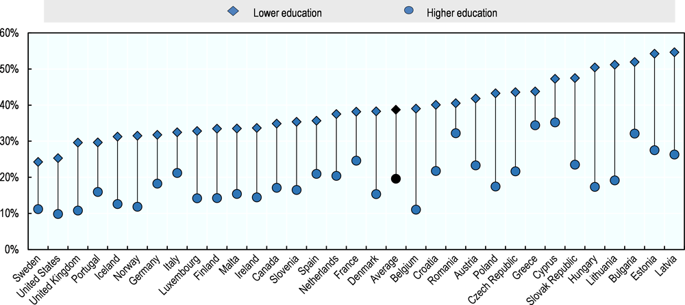
Probability of smoking by education level (men, age-standardised)
Source: OECD estimates based on national health survey data.
OECD, 2019

Slide 16
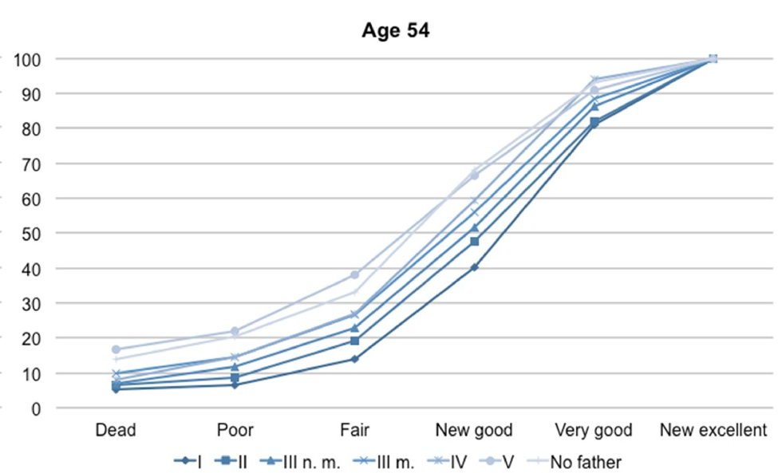
Health according to fathers’ socioeconomic status
Bricard et al. (2020) IJE
https://academic.oup.com/ije/article/49/5/1739/5917737

Slide 17
Health equity : a challenge for health systems
Multiple health and health systems interventions must be considered to promote equity in health :
  Income redistribution
  Prevention strategies
  Compensation of poor initial conditions
  Early-life interventions
  Equitable access to health care

Slide 18
Many thanks
sandy.tubeuf@uclouvain.be

