Slide 1
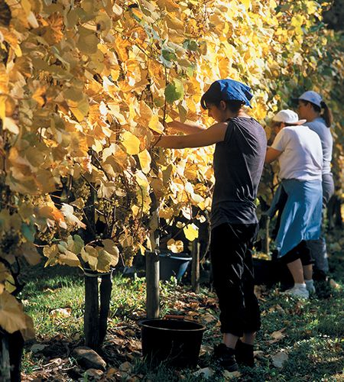
Regarding the reading of “The Vine and the Branches” by three women throughout history
EABS – Jerusalem 2023
Florence Draguet

Slide 2
Introduction
1 "I am the true vine, and my Father is the vinedresser.
2 Every branch in me that does not bear fruit he takes away, and every branch that does bear fruit he prunes, that it may bear more fruit. (John 15, 1-2)
2 πᾶν κλῆμα ἐν ἐμοὶ μὴ φέρον καρπὸν αἴρει αὐτό, καὶ πᾶν τὸ καρπὸν φέρον καθαίρει αὐτὸ ἵνα καρπὸν πλείονα φέρῃ

Slide 3
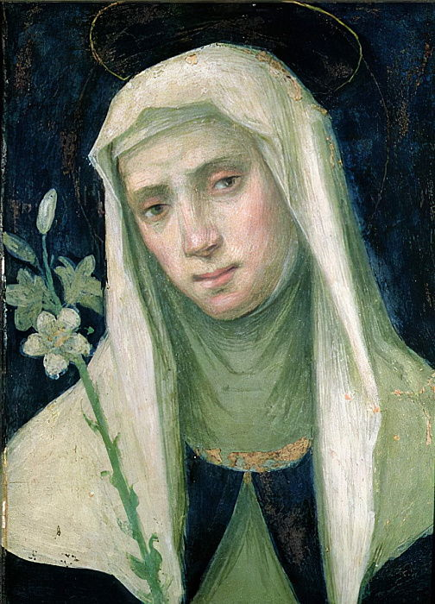
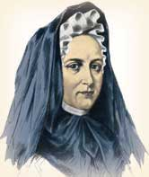
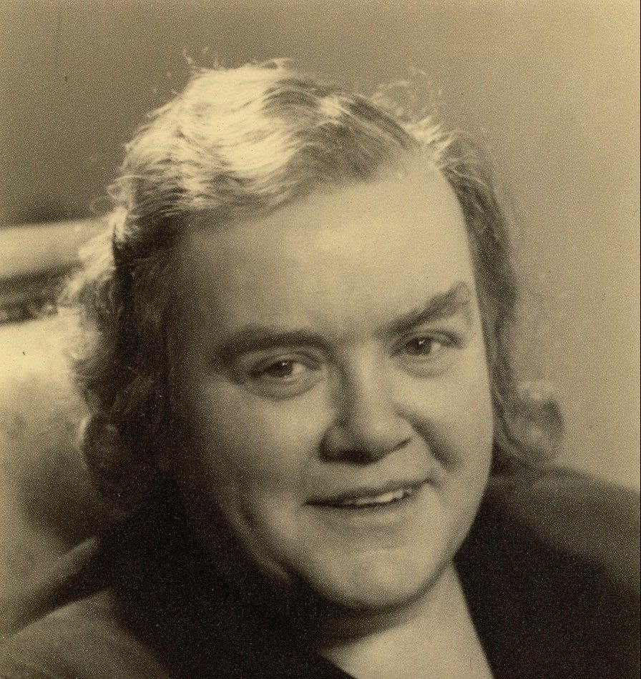
Catherine of Siena
Around 1345 in Siena - 1380 in Rome.
Laywoman of Dominican spirituality.
Known for having encouraged the Pope's return to Rome and for her mystical experiences. Cf. her major work: the Dialogue.
Jeanne Marie Guyon ("Madame Guyon“)
1648 in Montargis (France) – 1717 in Blois.
Described as a 'quietist’ ; 17th century increasingly wary of mysticism.
Numerous commentaries on the New Testament, including her explanations of the Gospel of John.
Adrienne von Speyr
1902 in La Chaux-de-Fonds – 1967 in Basel.
Physician, collaborator of the theologian Hans Urs von Balthasar.
Large number of commentaries on the Bible, including several volumes on the Gospel of John.

Slide 4
So that your fruit may be more abundant and tasty, I am pruning you through many tribulations, scoffing, insults, outrages, scorns, blame, by words, by deeds, by hunger, by thirst, according to what pleases my goodness, and according to the measure that each one is able to bear. (Catherine of Siena, 14th C., The Dialogue, ch. 145)
[The vinedresser] prunes them, trims them, cuts them incessantly through their crosses, afflictions, annoyances, dreadful calumnies. (Madame Guyon, 17th C., The Holy Gospel, p. 422)
The service that the Son renders to the Father through the work of redemption demands that he be not spared. Neither the Father must spare the Son nor the Son must allow himself to be spared by the Father. The absence of any sparing in this service will reach its climax on the cross, and it is not by chance that the Lord chooses this precise moment of impending passion and of his pure passivity to tell this parable. (Adrienne von Speyr, 20th C., The Farewell Speech, p. 8-9)

Slide 5

Why do they develop this aspect when the verse does not mention it? It only speaks of the branch being purified by the action of the vinedresser.
Could this be an interpretation specific to these three women, or even, from a gendered perspective, specific to women?
Path forward :
Analysis of comments on verse 2b from men and the three women by time period
Some observations
Questions and food for thought

Slide 6
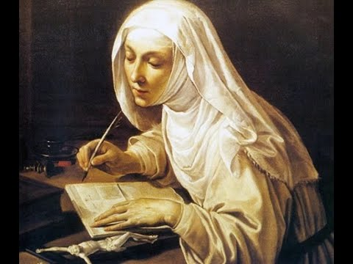
1. Readings of verse 2b
1.1. In the 14th century
Catherine of Siena
(Examples)
I am pruning you through many tribulations, scoffing, insults, outrages, scorns, blame, by words, by deeds, by hunger, by thirst.
My servants who abide in me, I mold them through much tribulation so that they may bear more and better fruit.
Tribulation is the demonstrative sign which makes one judge the perfection or imperfection of charity in a soul. The injustices and trials that I spare my servants exercise their patience and fan the fire of their charity.

Slide 7
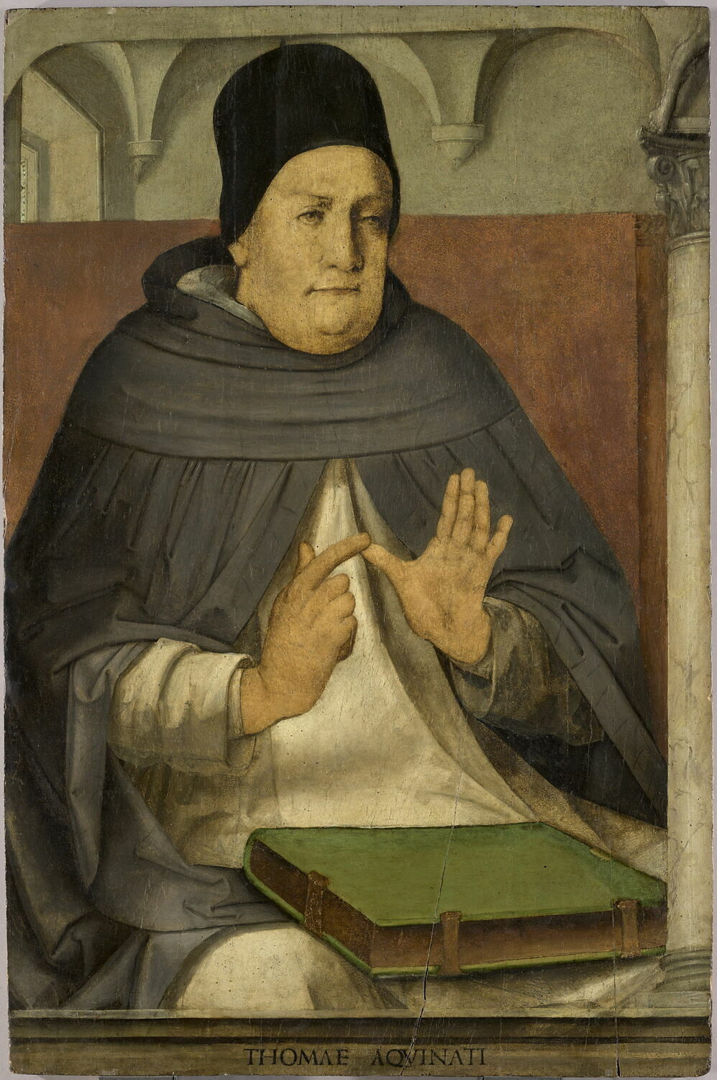
Thomas Aquinas (around 1225 – 1274)
The man who is well disposed and united to God, if he inclines his affection towards various realities, sees his virtue diminished […]. Therefore, in order for him to be fruitful, God frequently removes such limitations and "prunes" this man, sending tribulations and temptations so that, through them, he becomes stronger to act.
Tribulations not detailed – short comment
Traditional interpretation of the Church Fathers (cf. Chrysostom): it is a matter of being pruned so that strength is concentrated in charity.
Southern Lowlands School, 15th C.

Slide 8
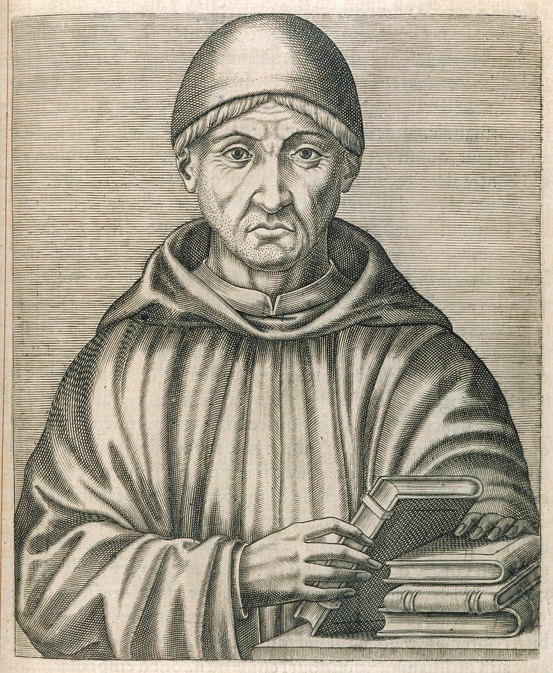
Nicholas of Lyra (around 1270-1349)
Just as in a material vine even some fruitful branches are cut off, for fear that the sap be too much dispersed [patristic interpretation], [...] so by the tribulations which wrest from the faithful the joy of the present life, their hearts are drawn away from the love of the things of the world; thus gathered into themselves, they are carried more fervently to God and produce a greater fruit of good works.
Tribulations not detailed – short comment
The function of these tribulations : to "take away
the joy of the present life from the faithful" in order
to turn them towards God”
Comments of the men "exegetes" of the time relatively brief.
“Tribulations” but no emphasis like Catherine of Siena.

Slide 9
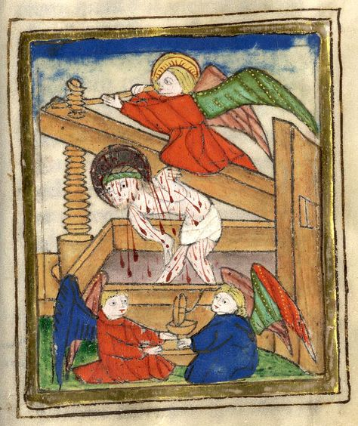
1.2. In the 17th & 18th centuries
Madame Guyon
[The vinedresser] prunes them, trims them, and cuts them off incessantly through their crosses, afflictions, adversities, and dreadful calumnies: these are the ways that this Father of the family gives to his vineyard.
What does this branch do when it is cut off? It weeps, it even seems to lose its sap. Oh no however! On the contrary, it loses what is foreign to it, its weakness, in order to receive more abundant sap from its vine.
O kind companion! This is the way to bring forth more abundant fruit. But what is the fruit of the vine? It is a fruit which is received only to be crushed and crushed under the press, and which lives only in its loss.

Slide 10
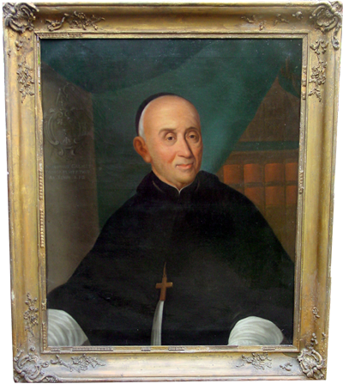
Augustin Calmet (1672-1757)
[The good vinedresser] cuts off all superfluous branches from his vine, so that those that bear fruit may be better nourished and receive more abundant sap.
No trace here of tribulation in a very short verse comment.

Slide 11
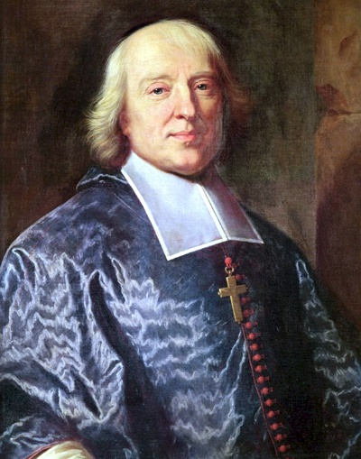
Bossuet (1627-1704)
[The heavenly labourer] prunes it, purifies it [...]. So it is with the christian. How many things must be cut out of you, christian! Do you want to bear abundant fruit? It must cost you; you must cut away that superfluous wood; that fruitfulness of evil desires; that strength which grows too much and would lose itself and dissipate. [...] Not only must we remove the bad desires, but also the excess that is often found in the good desires; the excessive activity that destroys and consumes itself; that exhausts the strength of the soul.
The traditional patristic interpretation
Not only God prunes man, it is also man who prunes his own self
No over-doing

Slide 12
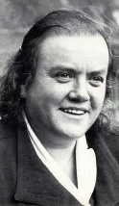
1.3. In the 20th century
Adrienne
The trial […] can be very hard; it takes place to test the resistance of the established unity and what it can bear. This is how the martyrs are tested.[…] There is always a relationship between the mission of an individual and his or her testing: the purpose of the trial is always the purification and strengthening of the mission.
Those who are already bearing fruit will be pruned by the Father. [...] The Son makes them grow and develop in his grace, he keeps them close to him, he penetrates them with his life, he lives with them in a contact that could not be closer, because the life of the vine and of the branches is one and the same, - the Father, however, prunes them. [...] freeing them not only from all impurity, but also from all superfluity, perhaps cutting them down to the substance, to the marrow of the branch. Perhaps he even cuts away what the branch considered essential, what it considered indispensable for the service of God.

Slide 13
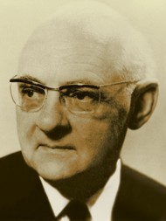
Hans Urs von Balthasar (1905-1988)
He who does not abide is cut off, is burnt up. This happens
in some way naturally, as seen in the parable of the vine
and the branches. (Lumière de la Parole)
I am the vine, you are the branches. I am the principle
of your flowering: how can you be surprised, then, that a murmur is heard, a humming that day and night awakens in you an attraction to love? to the love that wants to suffer; to the love that, together with mine, has a redeeming power? […] I am the cross, and whoever is in me cannot escape the cross.
[Father, you have given human beings, when they stretch out their arms
in love, the form of the cross, so that in the sign of the Son of Man the world
may be judged and directed towards you, and thereby saved. (Le Coeur du monde)
Unity of the vine and the branches (cf. Adrienne) ; those who are in him "cannot escape the cross“. There is no development of the theme of tribulation.

Slide 14
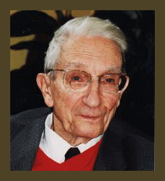
Xavier-Léon Dufour (1912-2007)
V.2 shows the vinedresser at work. Although the branches are described by Jesus as being "in me", this detail is superfluous only in appearance: it underlines that the branches exist only in the vineyard, and the personal pronoun keeps the identification of the vineyard with Jesus in the foreground; the thought is that of the ONE. The verbs "to cut off" and "to prune" describe the activities of the vinedresser that condition the fruitfulness of the plant.
Unity of the vine and the branches (cf. Adrienne)
No trace of "tribulation" or of insistence on suffering

Slide 15
2. Observations
Some major characteristics
for male commentators
The traditional interpretation of the Fathers of the Church: the believer must be freed from everything that could disperse him so that his strength is concentrated in faith and charity
Or so that, deprived of the joys of life, he seeks help in God (Thomas Aquinas, Nicholas of Lyra, Augustin Calmet, Bossuet).
The evocation of the vine and the branches can lead us to consider the mystery of suffering, particularly that of Christ (Balthasar).
Or again, emphasis on the fertility of the plant favoured by the pruning work (Xavier Léon-Dufour).

Slide 16
for female commentators
The term "tribulation" or "trial" is present in several commentators (Thomas Aquinas, Nicholas of Lyra), but not in all.
In contrast, it is used systematically by the women who develop the theme:
Lengthy comments on verse 2b
Use of adverbs or adjectives of intensification: God shapes through several or numerous tribulations (Catherine of Siena); God prunes, cuts incessantly (Madame Guyon) and not only frequently as Thomas Aquinas writes; the testing can be very harsh (Adrienne von Speyr)
The tribulations are specified by a whole range of trials: "affronts, insults, outrages, scorns, blame, by words, by deeds, by hunger, by thirst" (Catherine of Siena), "crosses, afflictions, adversities, dreadful calumnies" (Madame Guyon) or gathered under these words: the total absence of sparing, or by the lexical field of trial (Adrienne von Speyr)
Why does the theme of 'tribulations' occupy more space in women's commentaries?

Slide 17
3. Questions and answer paths
3.1. Suffering as a necessity and as a virtue for women?
3.2. An "experiential" reading?
3.3. Tribulations as communion with the sufferings of Christ

Slide 18
Conclusion
Questions and Method
Possible answers

