Slide 1




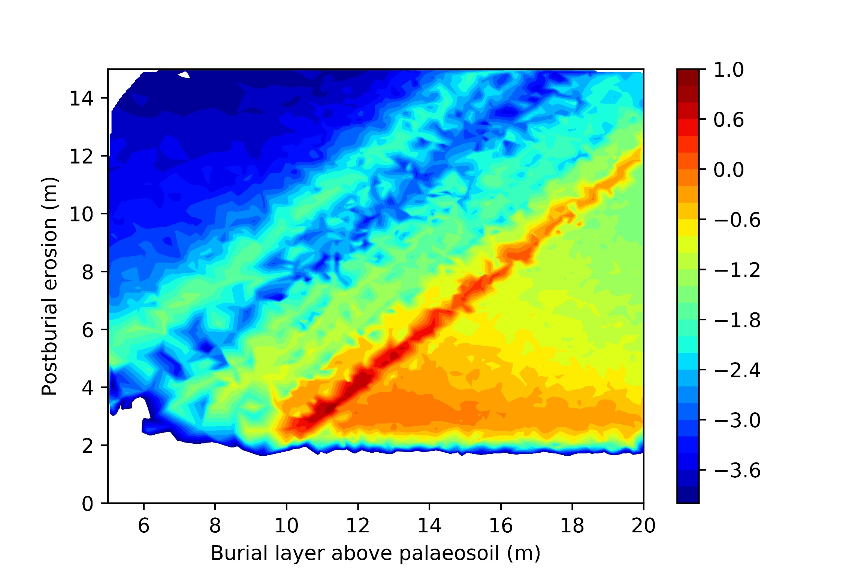
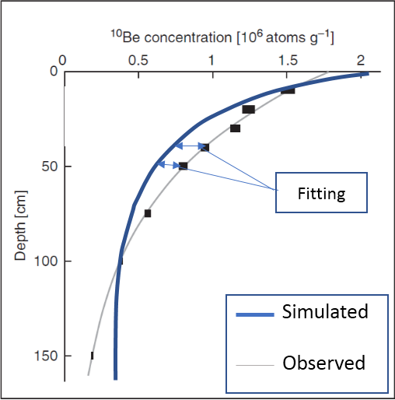
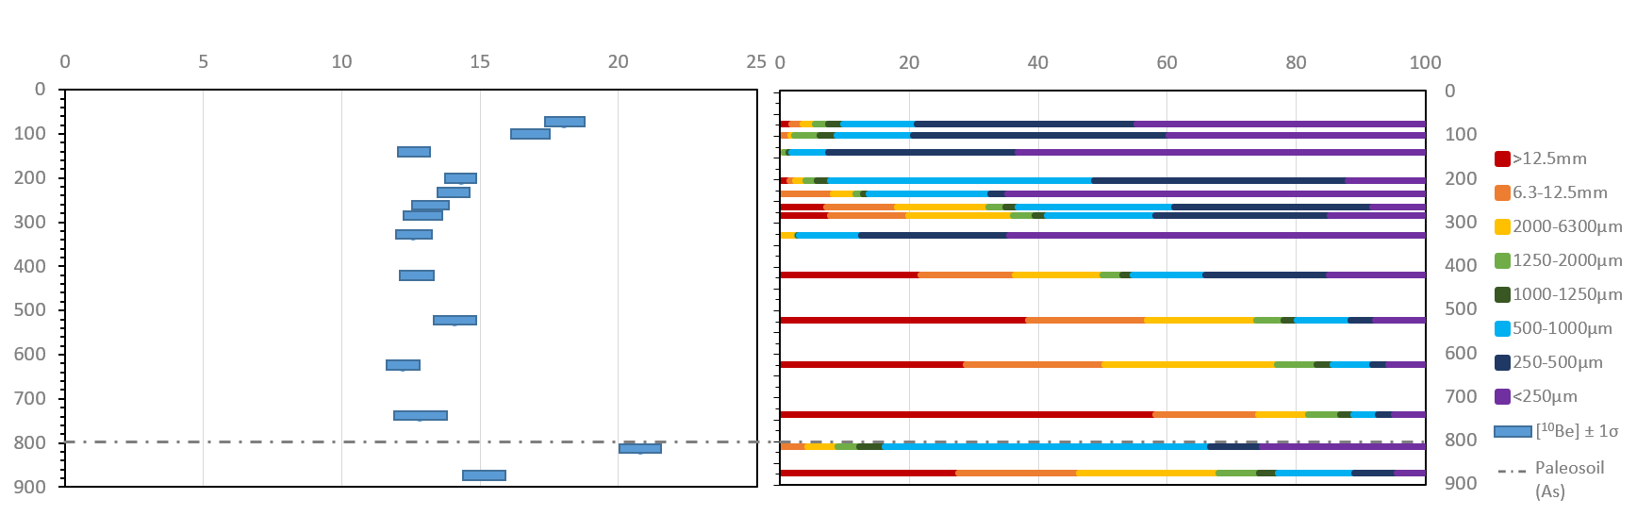
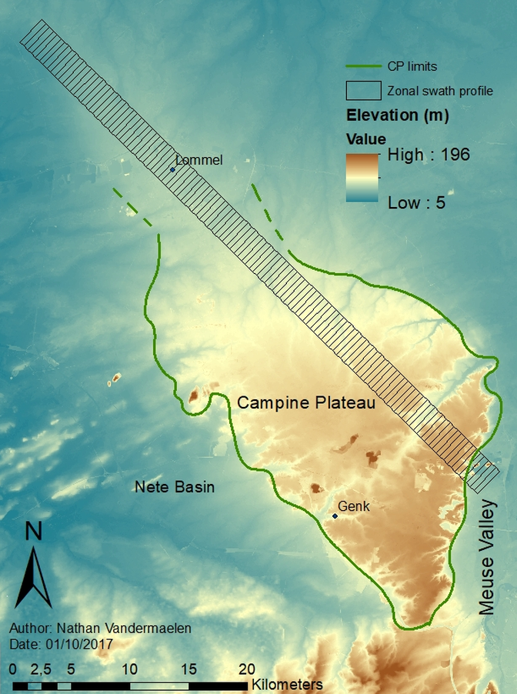
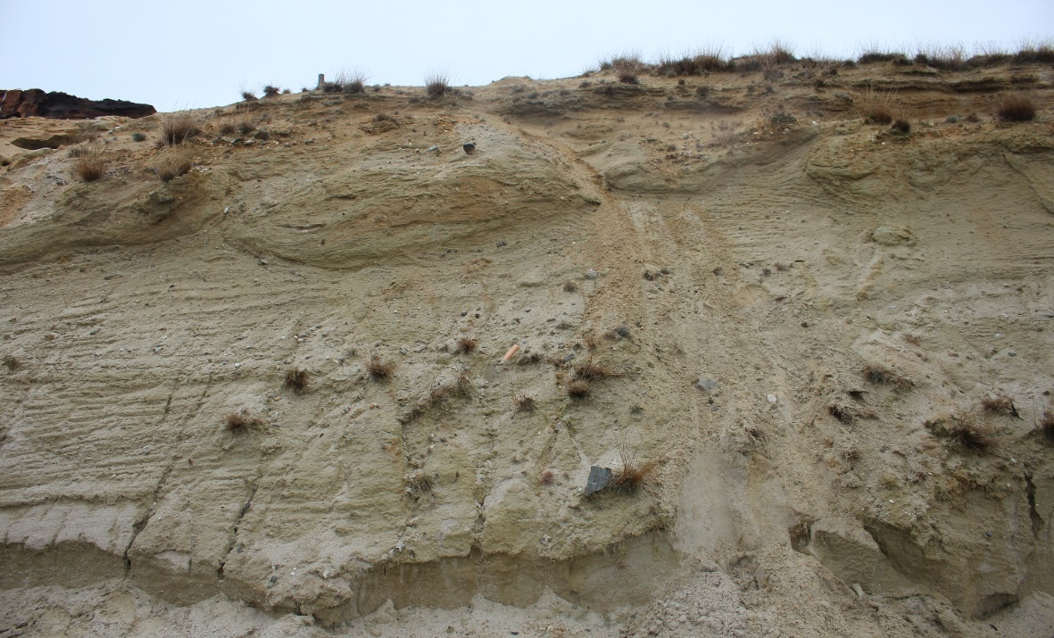
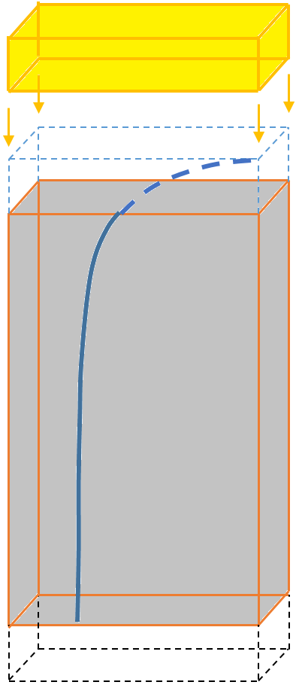
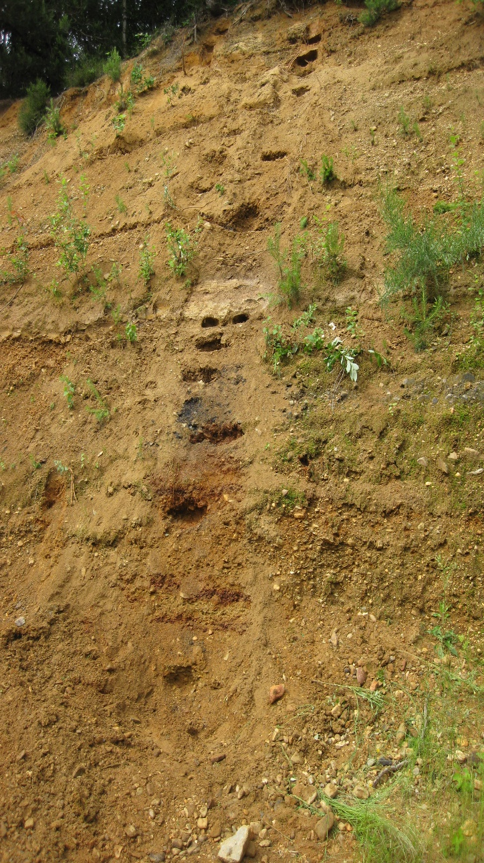
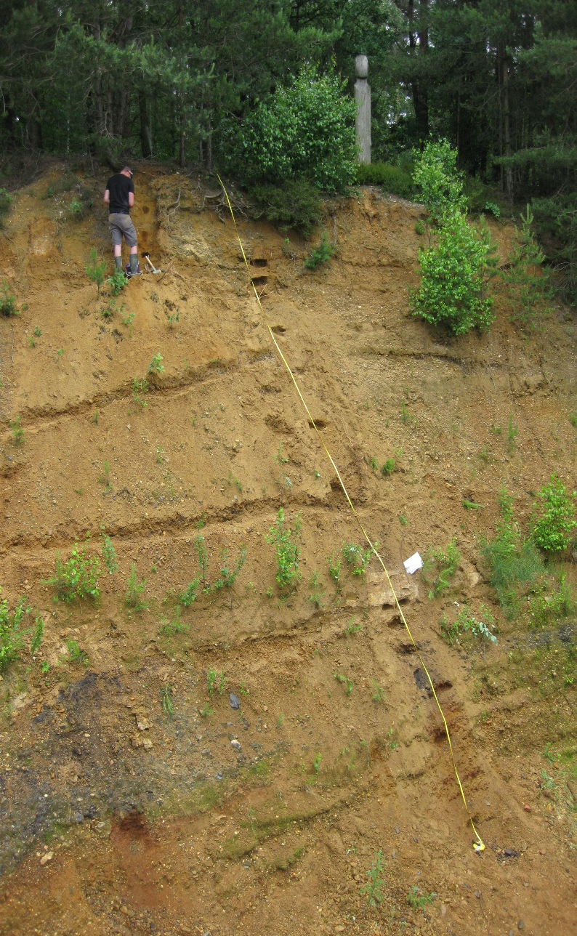

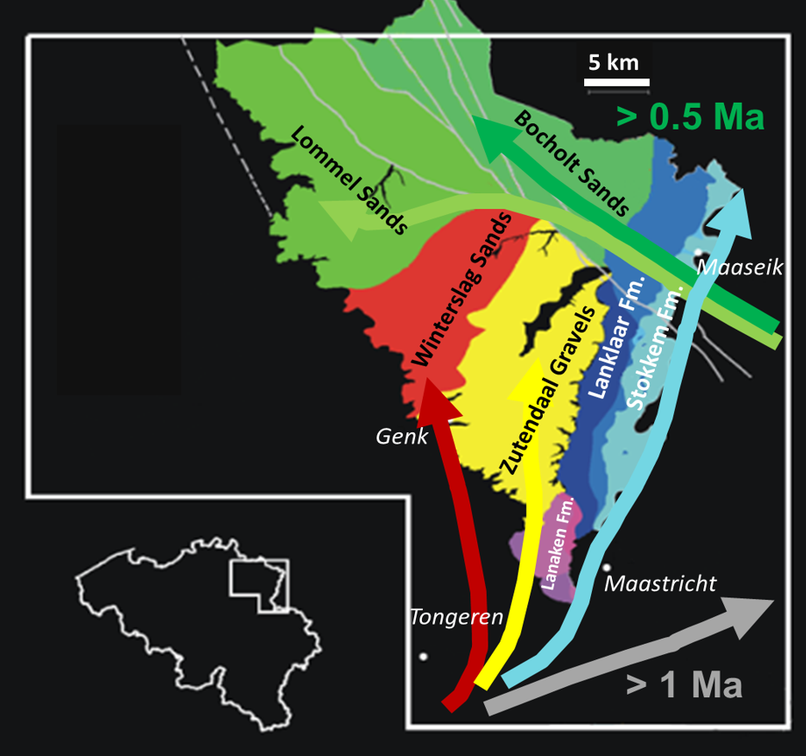
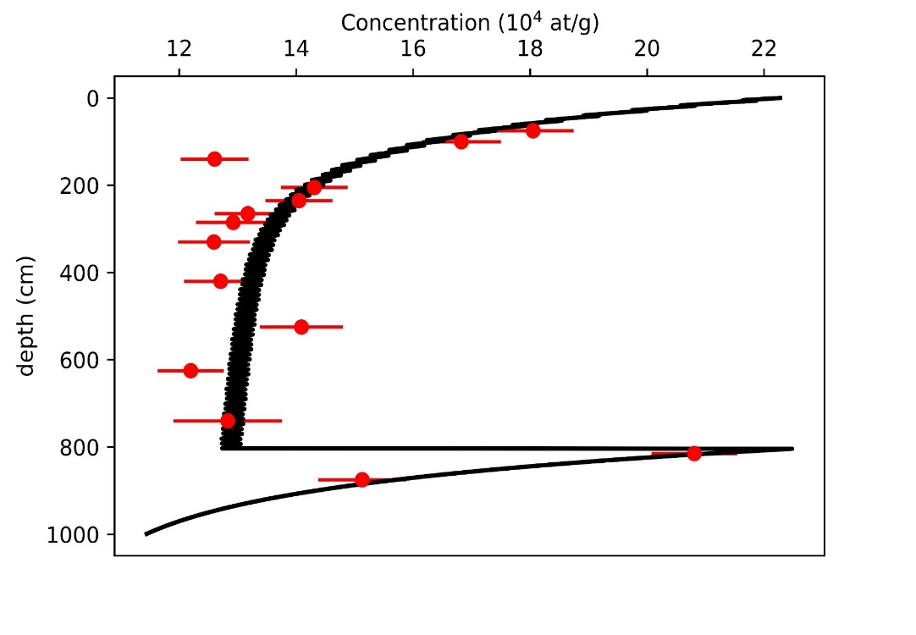
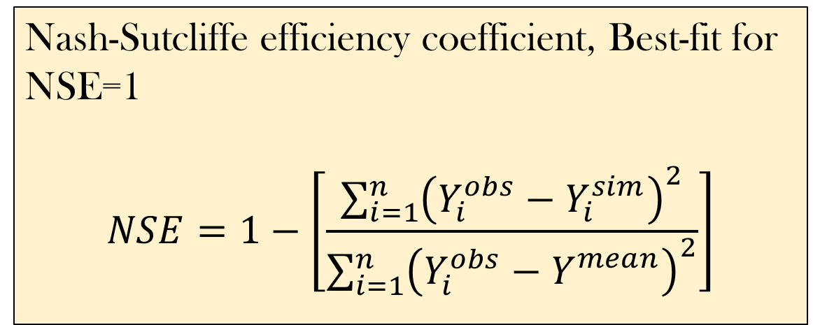
Constraining complex post-depositional history of fluvial deposits based on ¹⁰Be depth profiling and forward modelling
N. Vandermaelen (1); K. Beerten (2); V. Vanacker (1); M. Christl (3)
(1) Earth and life institute, University of Louvain, Place Louis Pasteur 3, 1348 Louvain-la-Neuve, Belgium. (2) Engineered and Geosystems Analysis, SCK-CEN, Boeretang 200, 2400 Mol. (3) Laboratory of Ion Beam Physics, ETH Zürich, Vladimir-Prelog Weg 1-5/10, 8093 Zürich, Switzerland
1.Introduction
3.Material and Methods
4. Results
Campine Plateau (CP) is a lowland plateau in N-E Belgium:
Quaternary fluvial deposits from the Rhine (sands) in the north and the Meuse (gravel) in the south. Poorly constrained deposition age and subsequent history (presumed age between 0.6 and 1 Ma) (e.g. Laloy et al., 2017)
Objective : determine post depositional evolution (erosion/burial) of Meuse sediments of CP over last 1Ma, based on ¹⁰Be depth profiling and adapted forward modelling
2.1 Cosmogenic radionuclide (CRN, ¹⁰Be) method to perform absolute dating on sediments:
¹⁰Be accumulation is a proxy for the time spent in situ by sediments, depending on:
  Exposure duration (yrs) to ¹⁰Be accumulation and natural decay
  Erosion rate (m/Myr) of sediments lowering [¹⁰Be] at surface and depth
  Production rate (at/g/yr)
4.1 Observed data:
14 samples from a depth profile (fig.1, lower pictures) in gravel deposits of CP (fig.6).
Grain size distribution and Fe staining/Mn coatings show complexity around 8m depth, which is reflected in observed [¹⁰Be] curve (fig.6).
Complexity denotes the presence of the paleosoil, so-called As Paleosoil (e.g. Borremans, 2015), showing stability in the history of the sediment column.
2. Study area
2.2 Depth profile:
Sampling at regular depth interval and agregate a curve describing observed [¹⁰Be] over min. 3m depth.
Technique allowing the determination of exposure duration and erosion rate via matching between observed and modelled ¹⁰Be concentration ([¹⁰Be]) curves (fig.2) (e.g. Anderson et al., 1996).
[¹⁰Be] (x 10⁴at/g)
Grain size distribution (%)
2.1. Geomorphic settings of the CP:
Result of a topographic inversion (CP =erosion-resistant sediments compared to surrounding environment
Gently dipping plateau from S-W to N-E
Boundered by Meuse river (S-E), Nete Bassin (S-W)
Variable lithology, from fine sands to coarse gravels
Depth (cm)
2.3 Forward modelling:
Simulates [¹⁰Be] evolution with exposure time on an in depth column, dynamically adjusting over timesteps.
Divide exposure duration in periods (fig.3) to which is respectively associated an erosion or burial rate.
Removal (erosion) or insertion (burial) of sediment layers on top of the profile (fig.4).
Matching between simulated and observed data using Nash-Sutcliffe efficiency index (NSE).
Fig.6. Depth profile results and grain size distribution. While the curve reasonably evolves as an exponentially decreasing curve, around 800 cm depth, significantly higher ¹⁰Be concentrations are observed. This should be observed in parallel to grain size distribution, where a very irregular layer is observed around 8m depth compared to grain size distribution from layers located above and below.
T0 Column of Meuse sediments
T1
[2;3] .10³yrs soil dvpt
T2
10⁵yrs
Burial > 5m
T3
>6.10⁵ yrs
Stability or erosion
T4
<5.10⁴yrs Erosion
Fig.2. Simulated v.s. Observed [¹⁰Be]. Equation determining [¹⁰Be] over depth containes exposure duration and erosion rates as parameters. Modified after Dunaï (2010).
4.2 Complex vs. simple post depositional history:
Steady post depositional history gives best NSE (-0.2) for exposure age of 6.10⁵ yrs and [24.0-26.0]m erosion over that period
Hypothesis of complexity: Stability period (paleosoil formation) followed by a single burial episode covering one glacial period, followed by a new stability-erosion cycle(fig.7).
Exposure age
Period i
P…
Period n
Fig.7. Hypothesis of complex history: a column of Meuse sediments (yellow) remain stable (back calculated to be between 20000 and 30000yrs to develop a paleosoil (brown), is then buried under 5-20m. This column is further stable or partially eroded.
Time length
Time length
Time length
NSE
Erosion or burial rate i
…
Erosion or burial rate n
4.3 Results from complex scenarios
(1) Unlikely that the Campine Plateau was not subject to erosion over the last 1 Ma
(2) Complex post-depositional scenarios (involving burial and erosion) better fit the observed ¹⁰Be concentration-depth profile than a steady erosional scenario (e.g. fig. 9)
(3) A short phase of late and rapid postburial erosion is more likely than prolonged steady postburial erosion
(4) Most likely scenarios correspond to 10-14m burial (fig.8) followed by resp. 2-6m erosion
Erosion and burial rate vector
Nash-Sutcliffe efficiency coefficient, Best-fit for NSE=1
$$NSE=1−\left[\frac{\sum_{i=1}^{n}{{\left(Y_{i}^{obs}−Y_{i}^{sim}\right)}^{2}}}{\sum_{i=1}^{n}{{\left(Y_{i}^{obs}−Y_{}^{mean}\right)}^{2}}}\right]$$
Fig.4. Fluvial deposit column (grey). Layer removal due to erosion (blue dashed line) and layer added if burial is applied (yellow). In dark blue is the effect on ¹⁰Be accumulation.
S-W
Fig.3. Model dynamical principles.
Each period of the exposure history is given a burial or erosion rate and add/remove layers in consequence, higher rate providing higher removal/ add frequencies.
2.5 Method:
Depth profiling in gravelly lithologies
Test steady and no erosion « simple » scenarios
Test complex scenarios based on observed [¹⁰Be]evolution with depth and grain size distribution
Fig.8. Nash Sutcliffe efficiency index for complex scenarios, with different burying layer and post burial erosion. A straight line is identified for scenarios where burial and erosion are compensating each other to bring back the height of the column above paleosoil to 8m.
5. Conclusion
To go further:
Use isochron dating to have better constraints on age of paleosoil.
Verify representativeness of the profile in the wider region by sampling at new locations in the northern part of the Campine Plateau
2.4 Sampling design:
14 samples sampled at regular interval over 9 m depth in Zutendaal (fine-coarse) gravels (location fig.5, picture fig.1)
Sampling location
Fig.1. The Kempen plateau stands out of its environment (left map). It is a triangular geomorphic feature delimited by the Meuse valley in the East, the Nete Basin in the Northwest and the Feldbiss fault on its Northeastern side. It is gently dipping towards N-E, from about 100m to 30 m a.s.l. (see swath profile). The Northeastern side is made of quaternary sands from river Rhine (upper picture), and the Southwestern part is essentially composed of coarser fluvial deposits (gravels) from river Meuse (lower pictures). All the sediment column was presumably built within the time inverval 0.6-1.0 Ma. (Credit: K. Beerten).
[¹⁰Be] modelled
[¹⁰Be] observed
Fig.5. Main lithologies and sampling location. Modified after K. Beerten (personal communication )
Fig.9. Matching between observed and simulated data for complex scenario incuding As paleosoil, here giving a NSE=0.86 (best result).
6. References
Anderson, R.S., Repka, J., Dick, G. (1996). Explicit treatment of inheritance in dating of depositional surfaces using in-situ ¹⁰Be and ²⁶Al. Geology, 24, 47-51.
Borremans, M. (2015). Geologie van Vlaanderen. Academia Press.
Dunaï,T. (2010). Cosmogenic Nuclides. Cambridge University Press
Laloy, E., Beerten, K., Vanacker,V., Rogiers, B., Wouters, L. (2017). Bayesian inversion of a CRN depth profile to infer Quaternary erosion of the northwestern Campine Plateau (NE Belgium). Earth surface dynamics, 5, 331-345.
Author: Nathan Vandermaelen
Place Louis Pasteur, 3, office B.438.
Nathan.vandermaelen@uclouvain.be
EGU poster presentation.
09/04/2018

