Slide 1



L’importance du style de vie en kinésithérapie musculosquelettique
Alexandre LUC – PT, OMT, PhD Student – UCLouvain (IREC)
alexandre.luc@uclouvain.be

Slide 2
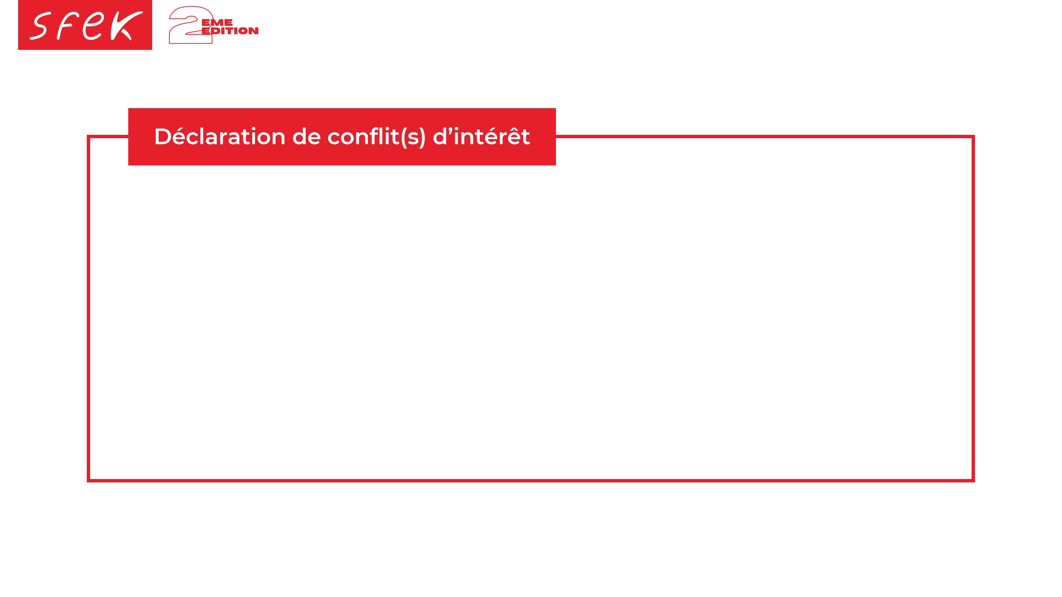
Je déclare ne pas avoir de conflit d’intérêt
en lien avec cette présentation.

Slide 3


Qu’est-ce que le style (mode) de vie ?

Slide 4
Style de vie
Lifestyle = “A style or way of living (associated with an individual person, a society, etc.); esp. the characteristic manner in which a person lives (or chooses to live) his or her life” (Oxford English dictionary)

Slide 5
Style de vie
“By definition, lifestyle is about personal responsibility; the autonomous, intentional ways in which a person or group exerts free choice to live their lives”
“‘Lifestyle interventions’, while important for supporting behavior change at the individual level, can only serve to mitigate the effects of the structural determinants of health at the population level, and may in fact widen population health inequities”
Robinson and Smith, 2022

Slide 6
Style de vie
“Behavioral determinants of health (i.e., smoking, alcohol consumption, diet, physical activity, sleep) – are important – and, as mentioned previously, supporting and empowering individuals to improve their own health through programs remains a necessary tool in the health promotion toolkit. However, such approaches must be situated in the broader context where social, cultural, economic, environmental, ecological and commercial drivers shape health behaviors”
Robinson and Smith, 2022

Slide 7
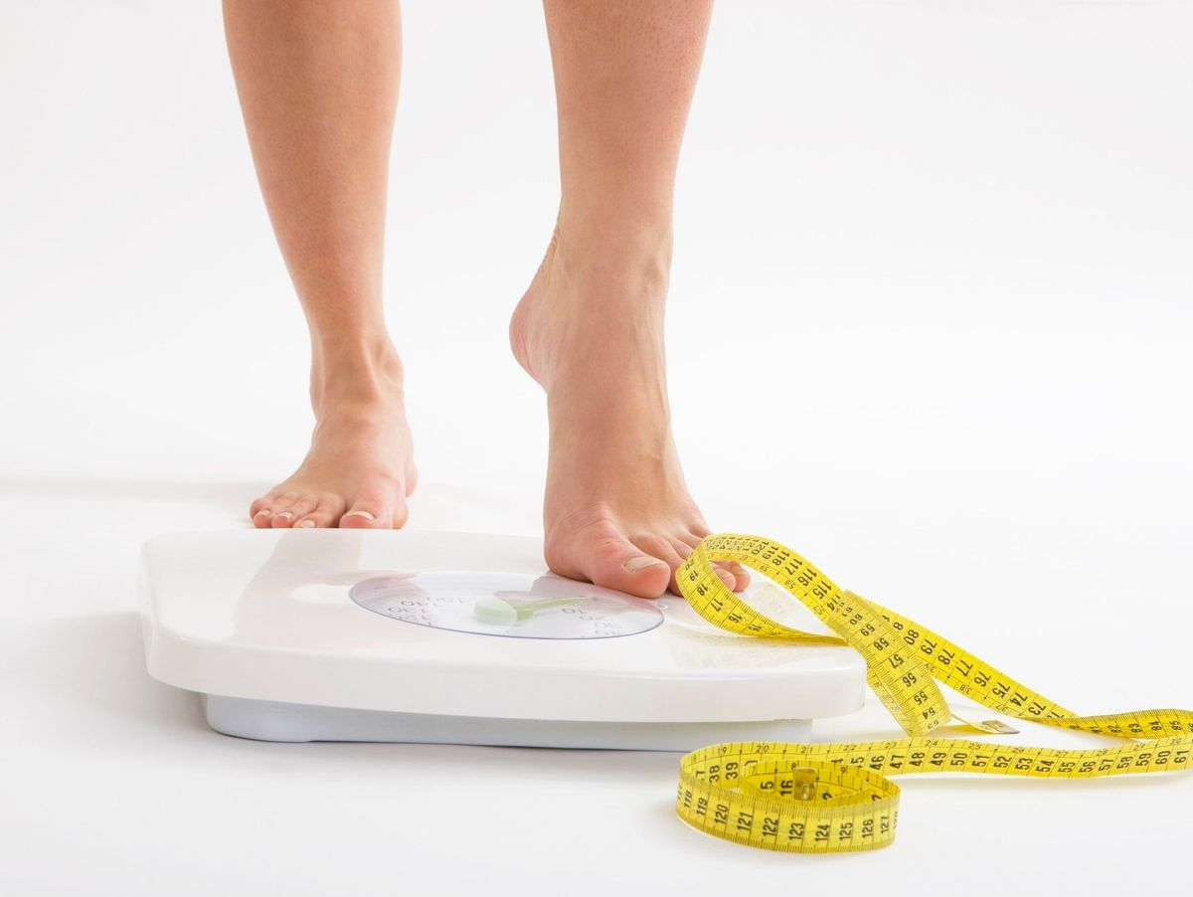
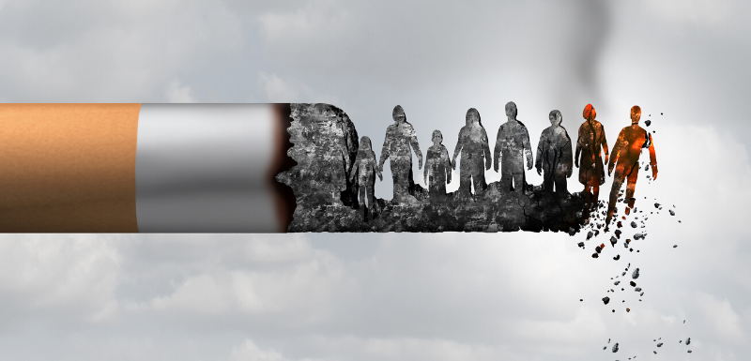
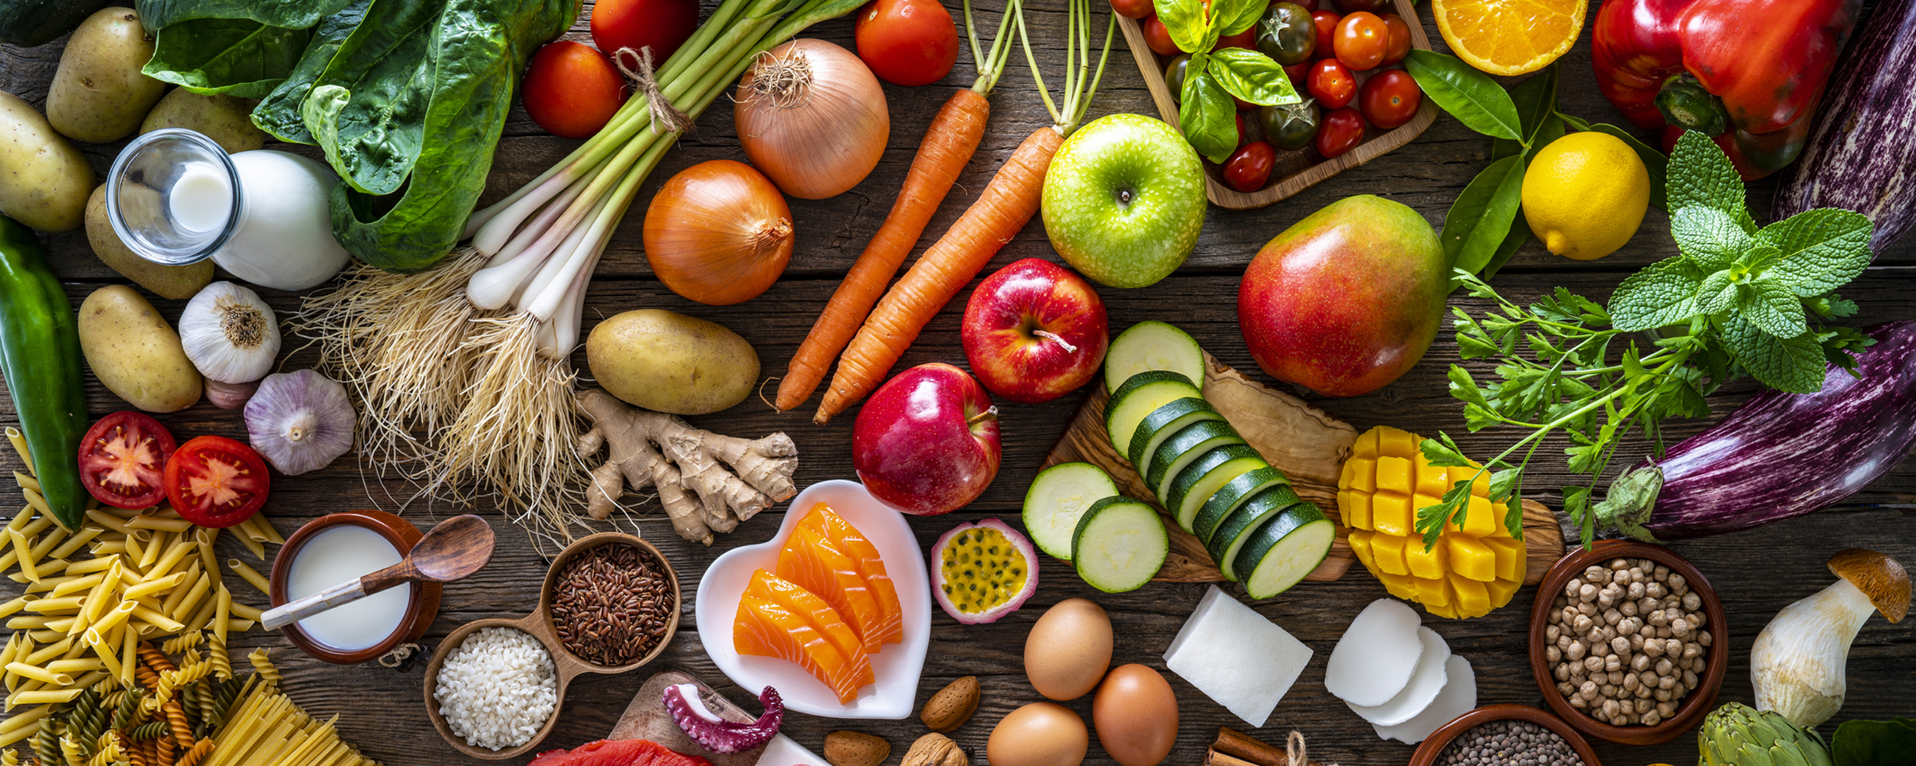
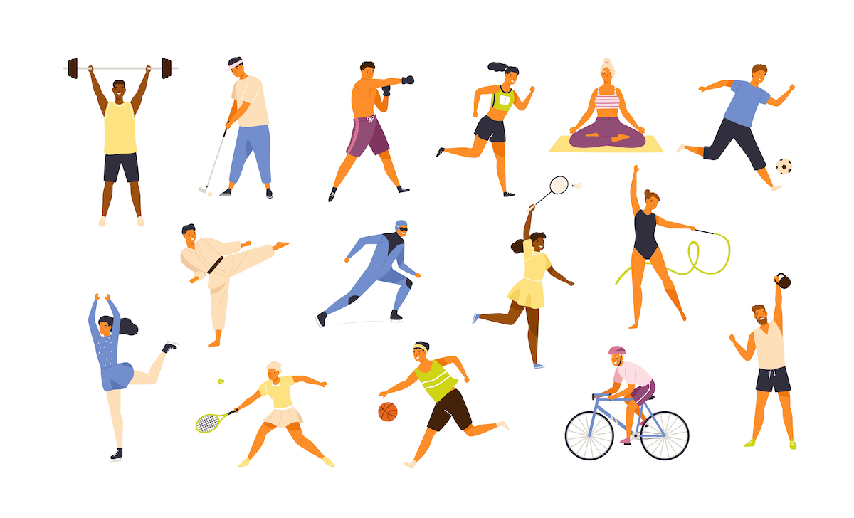
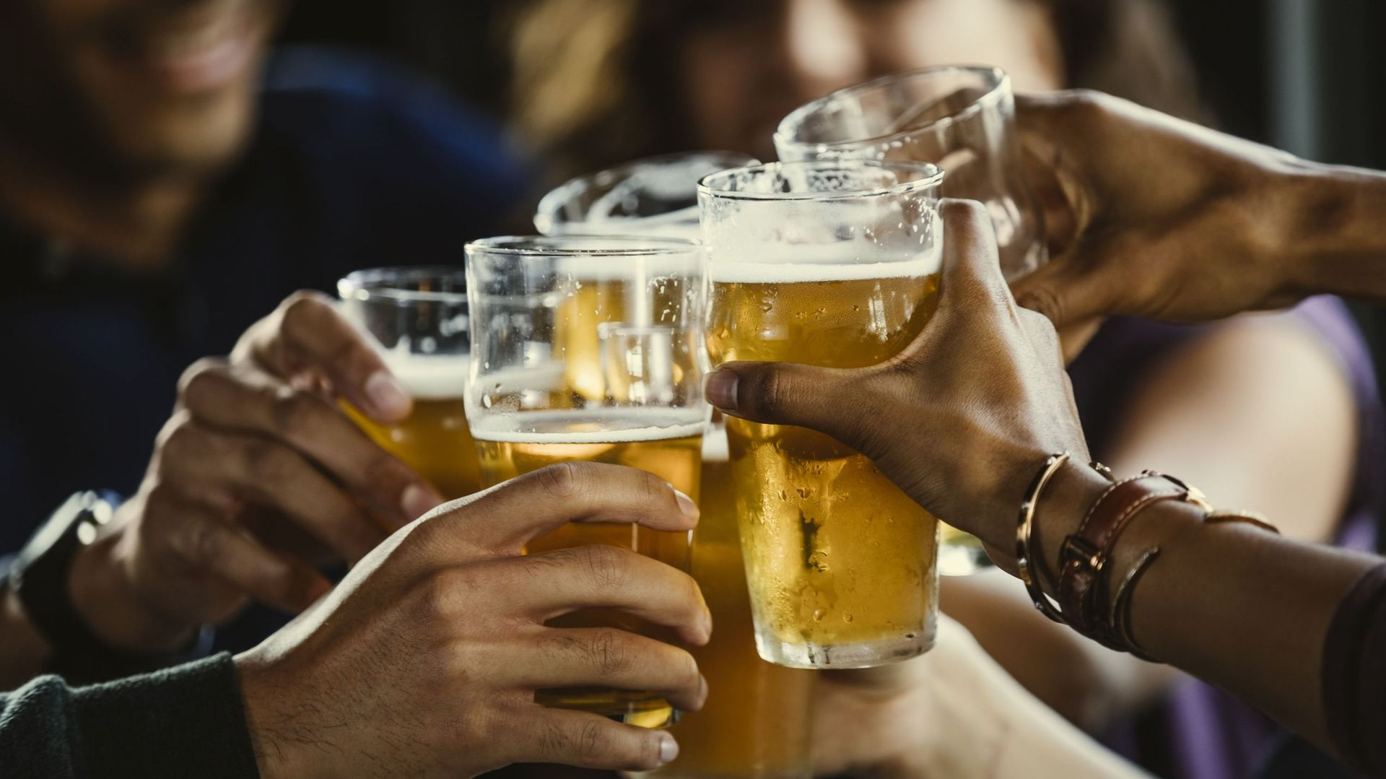
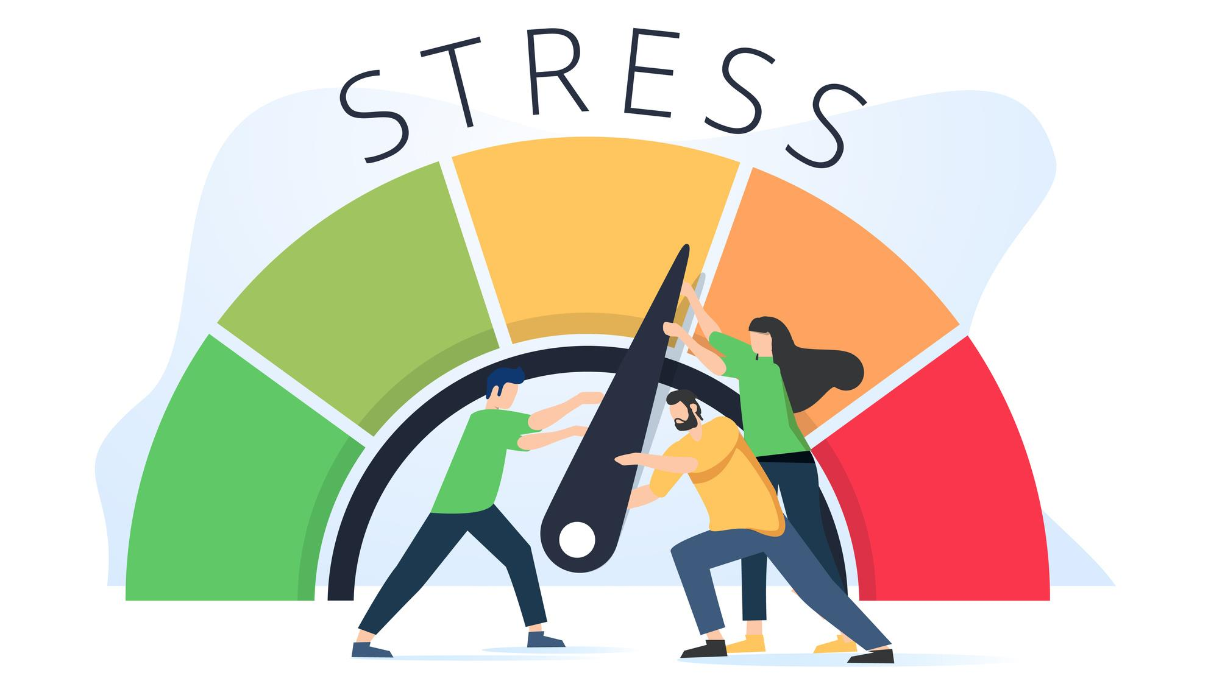
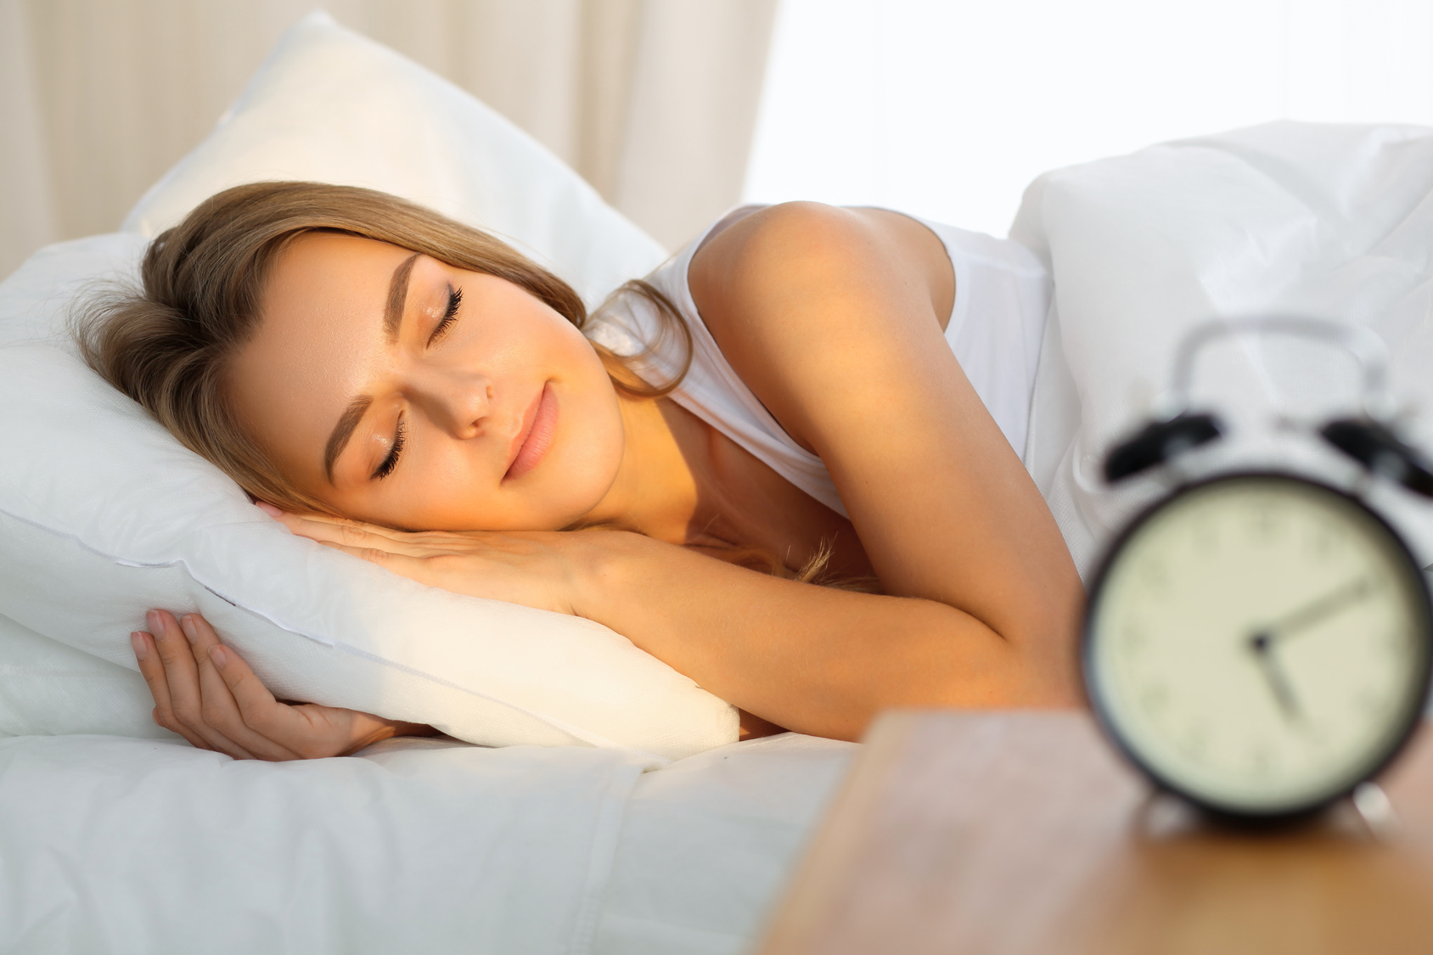
Style de vie

Slide 8

49.3% surpoids
15.9% obésité
2.9% carence pondérale
19.4%
15.4% (quotidien)
6.7% (OMS)
76.6%
14% (> 10 unités/semaine)
9.7% (quotidien)
12.7% (fruits-légumes)
Sciensano (BHIS, 2018)

Slide 9
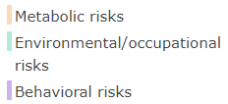
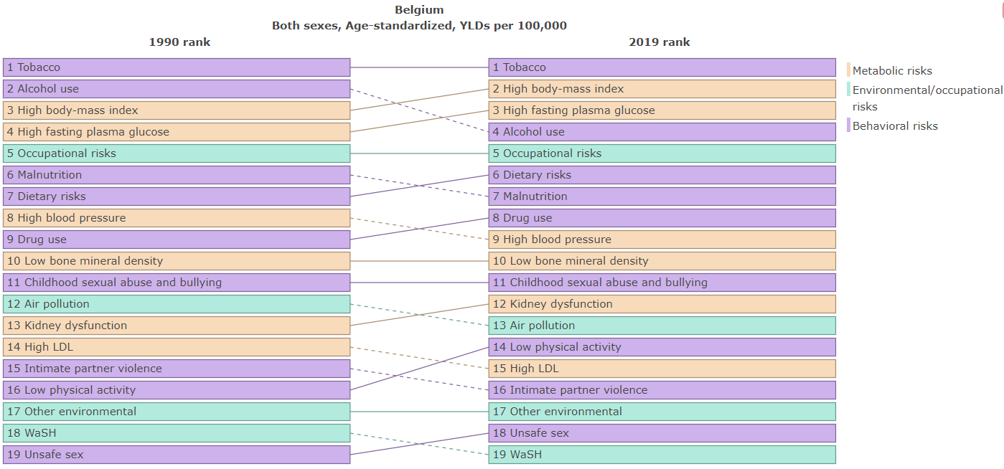
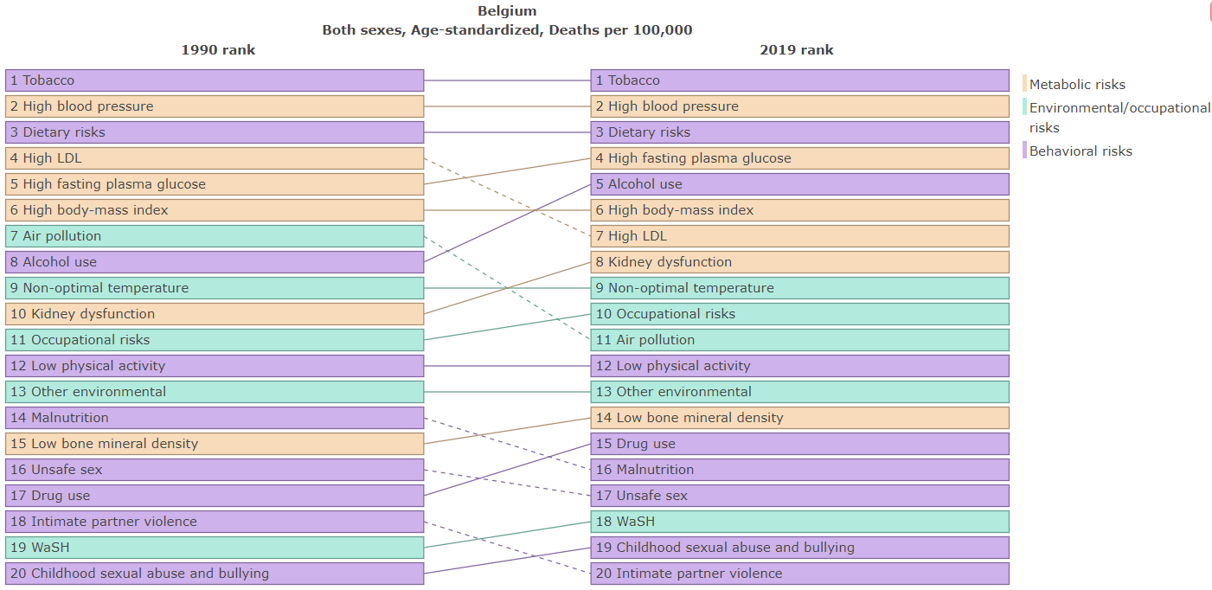
GBD, 2019

Slide 10
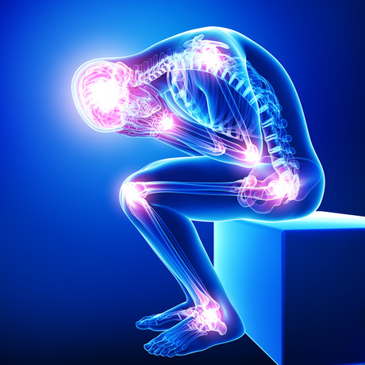
Troubles musculosquelettiques (TMS)

Slide 11
Troubles musculosquelettiques (TMS)
« Troubles qui affectent le système musculosquelettique et se caractérisent par des déficiences au niveau des muscles, des os, des articulations et des tissus conjonctifs adjacents, entraînant des limitations temporaires ou permanentes du fonctionnement et de la participation » (OMS)

Slide 12

Troubles musculosquelettiques (TMS)
1ère cause d’années vécues avec incapacité au monde (tout âge)
Touchent plus de 1.7 milliard de personnes au monde
Problèmes de santé liés au travail les plus coûteux et prévalents en UE (45 millions de travailleurs)
Souvent associés à d’autres pathologies non-transmissibles et augmentent leur risque de se développer
Williams et al, 2018 ; GBD, 2019 ; Gorasso et al, 2022

Slide 13
Troubles musculosquelettiques (TMS)
Prévalence :
  > 1 TMS (LBP, NKP, OST, RHE) : 2.5 millions en 2018 (> 15 ans)
  Augmente avec l’âge
  Touchent surtout chez les adultes d’âge moyen et les femmes
Coûts annuels si >/= 1 TMS :
  Directs : 3 milliards d’euros
  Indirects : 2 milliards d’euros
Gorasso et al, 2022

Slide 14
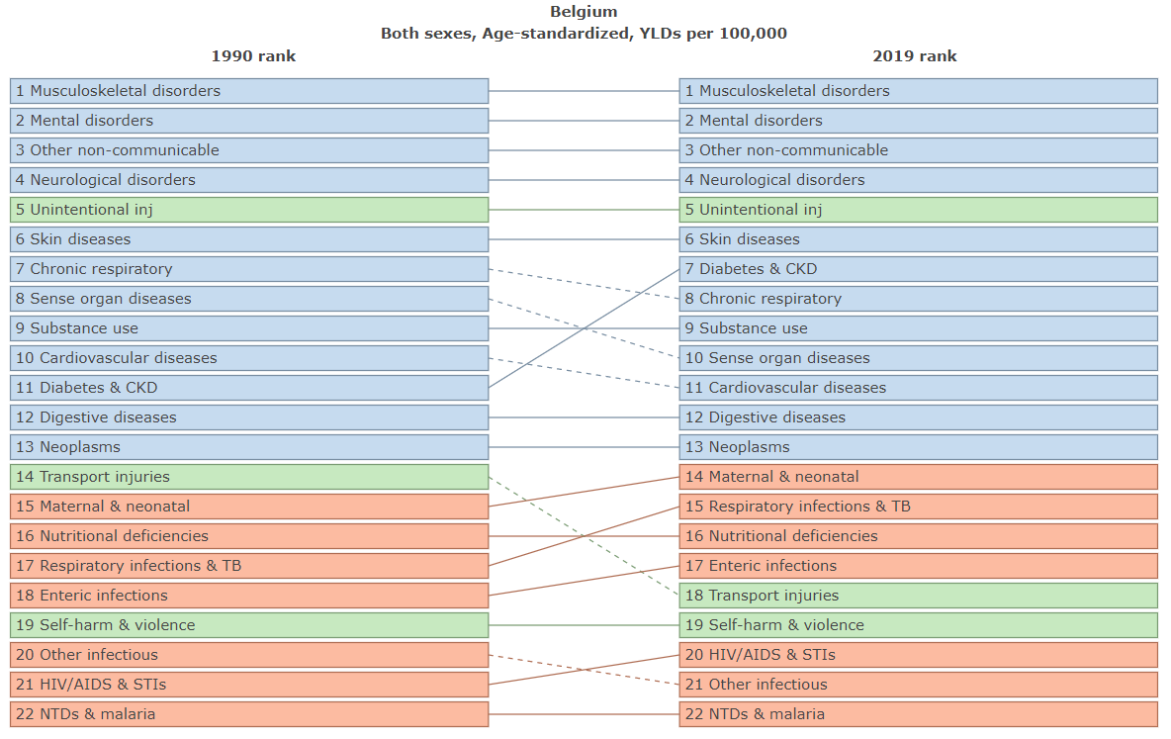
GBD, 2019

Slide 15
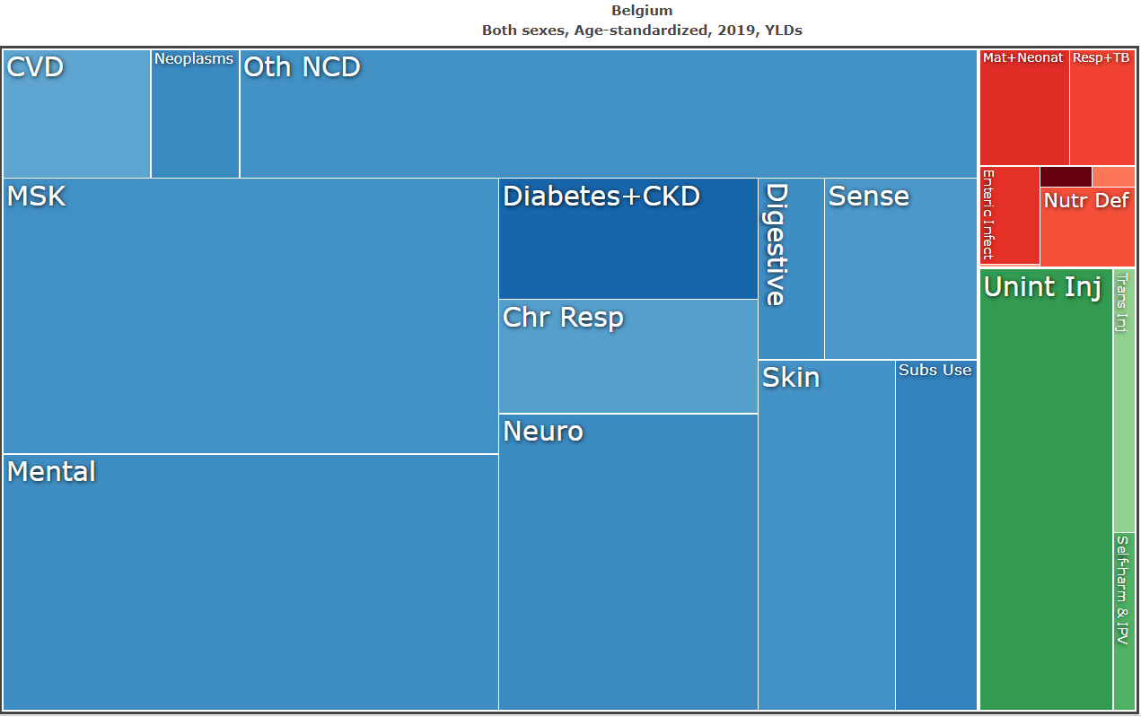
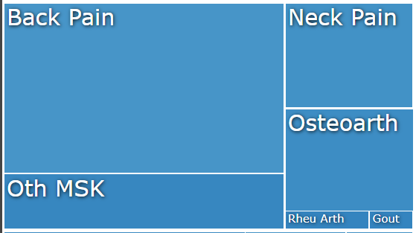
GBD, 2019

Slide 16
Troubles musculosquelettiques (TMS)
Besoin d’agir sur les facteurs de risque pour diminuer l’impact sanitaire et économique des TMS !
Gorasso et al, 2022

Slide 17
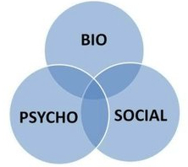
Troubles musculosquelettiques (TMS)
Facteurs de risque (apparition et persistance) :
  Physiques (mouvements répétés, charge de travail élevée,…)
  Personnels/Individuels (âge, sexe, antécédents de TMS,…)
  Psychosociaux (satisfaction au travail, support social, kinésiophobie, frustration,…)
Taylor et al, 2014 ; Silverwood et al, 2015 ; Blanpied et al, 2017

Slide 18
Pourquoi évaluer le style de vie en kinésithérapie?

Slide 19
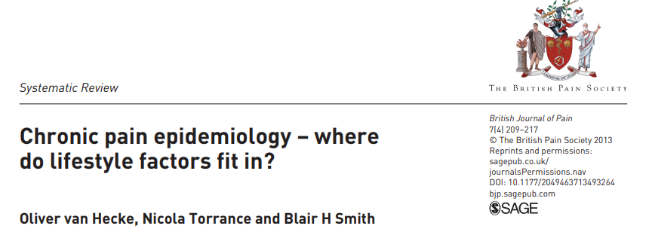
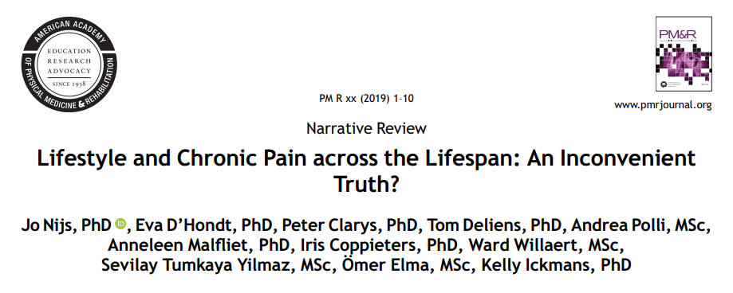
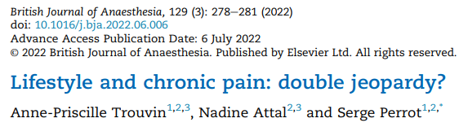

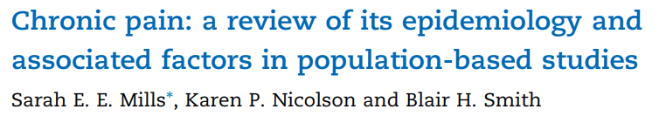
Relation style de vie – douleur (chronique)

Slide 20
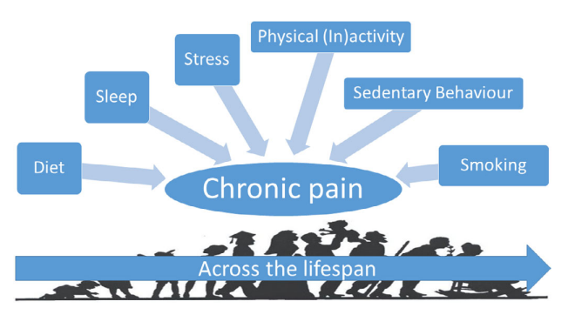
Nijs et al, 2019

Slide 21
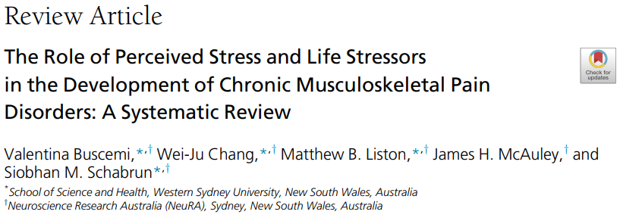
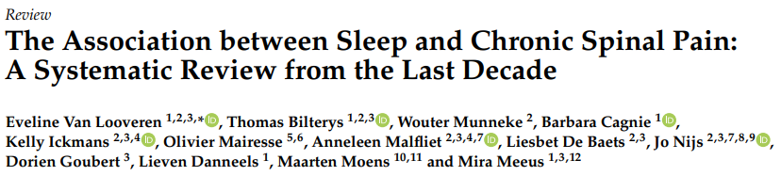
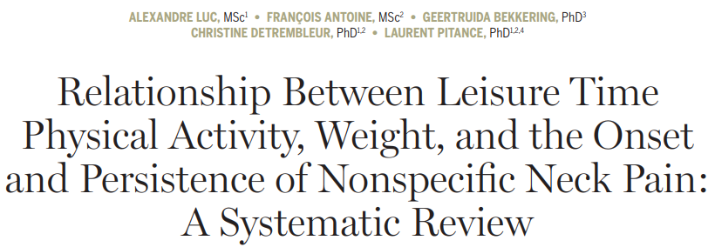
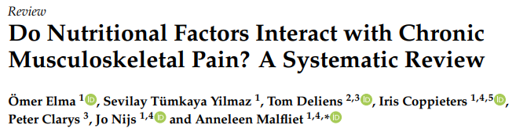
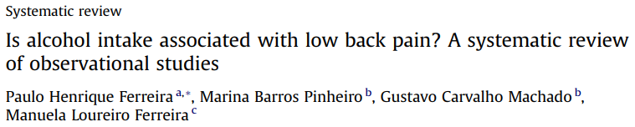
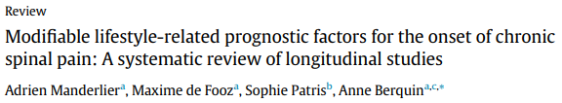
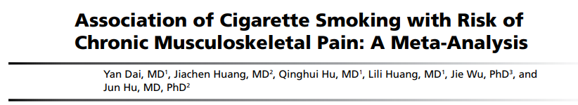

Slide 22
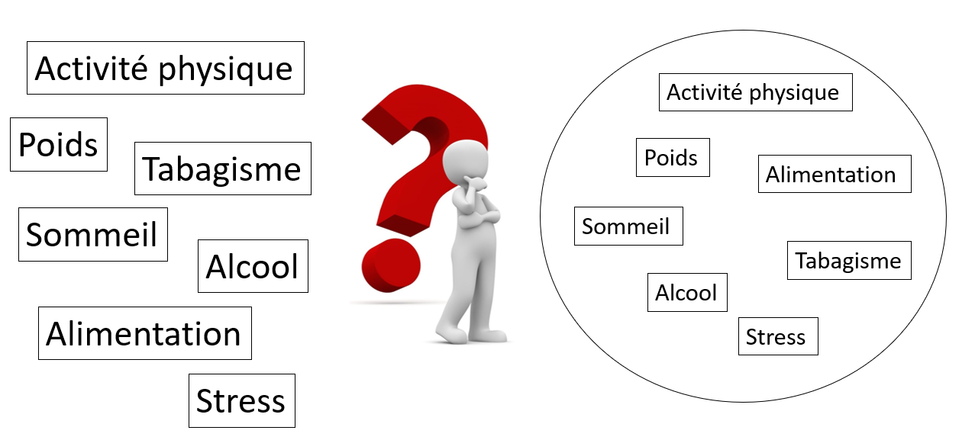
Combinaison de facteurs ou facteur seul ?

Slide 23
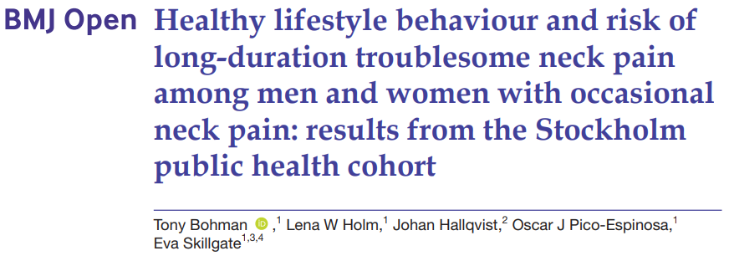
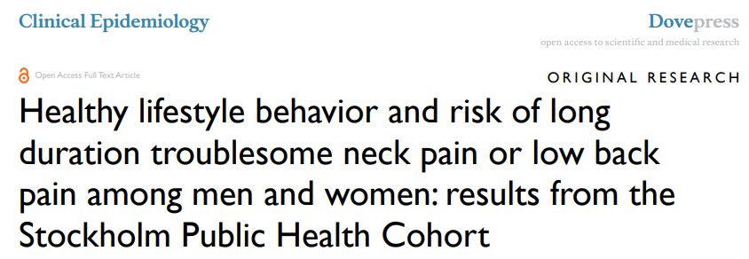
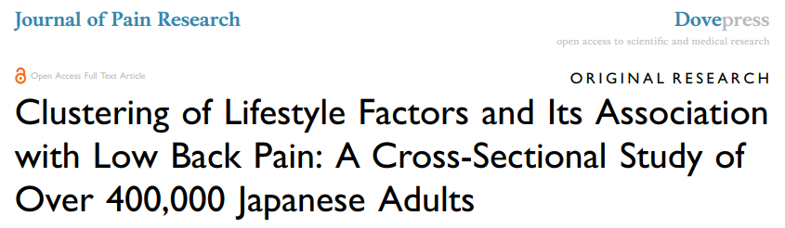
Combinaison de facteurs ou facteur seul ?

Slide 24
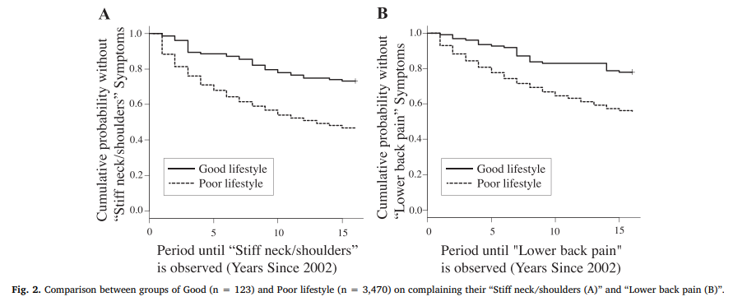
Combinaison de facteurs ou facteur seul ?
Tani et al, 2020

Slide 25
Pourquoi évaluer le style de vie en kinésithérapie?
DOULEUR
STYLE DE VIE
TMS

Slide 26
Troubles musculosquelettiques (TMS)
Facteurs de risque (apparition et persistance) :
  Physiques (mouvements répétés, charge de travail élevée, etc.)
  Personnels/Individuels (âge, sexe, antécédents de TMS, etc.)
  Psychosociaux (satisfaction au travail, support social, kinésiophobie, frustration, etc.)
Taylor et al, 2014 ; Silverwood et al, 2015 ; Blanpied et al, 2017

Slide 27
Troubles musculosquelettiques (TMS)
Facteurs de risque (apparition et persistance) :
  Physiques (mouvements répétés, charge de travail élevée, etc.)
  Personnels/Individuels (âge, sexe, antécédents de TMS, etc.)
  Psychosociaux (satisfaction au travail, support social, kinésiophobie, frustration, etc.)
  Comportementaux (style de vie) → Modifiables !
Taylor et al, 2014 ; Silverwood et al, 2015 ; Blanpied et al, 2017

Slide 28
Qu’en est-il du traitement ?

Slide 29
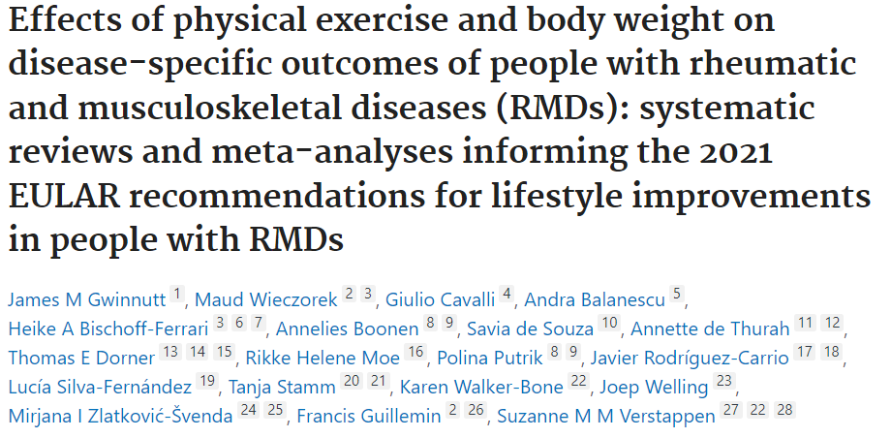
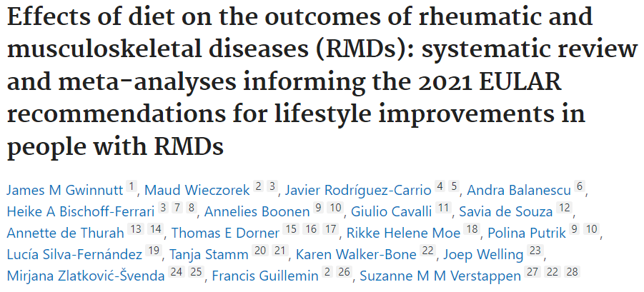
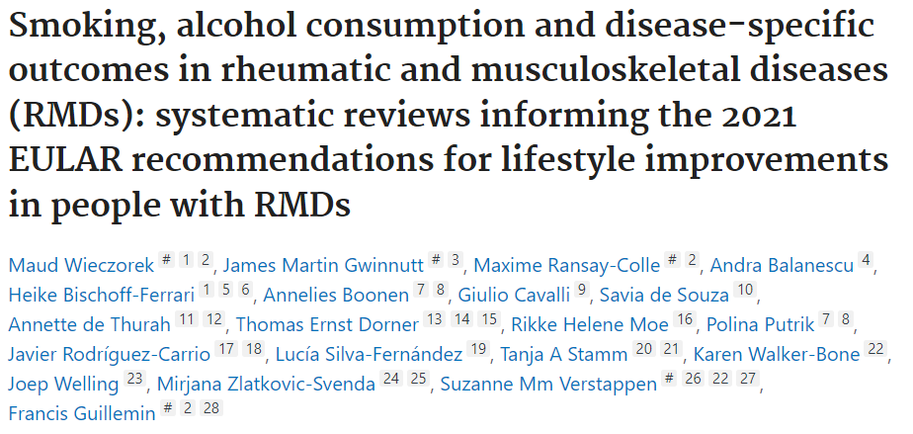
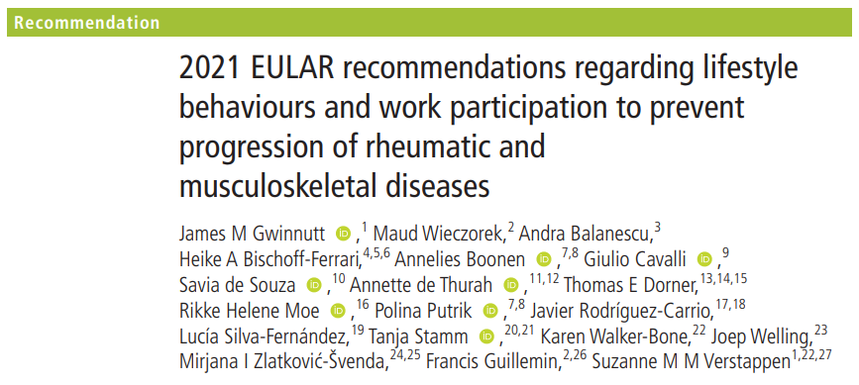

Slide 30
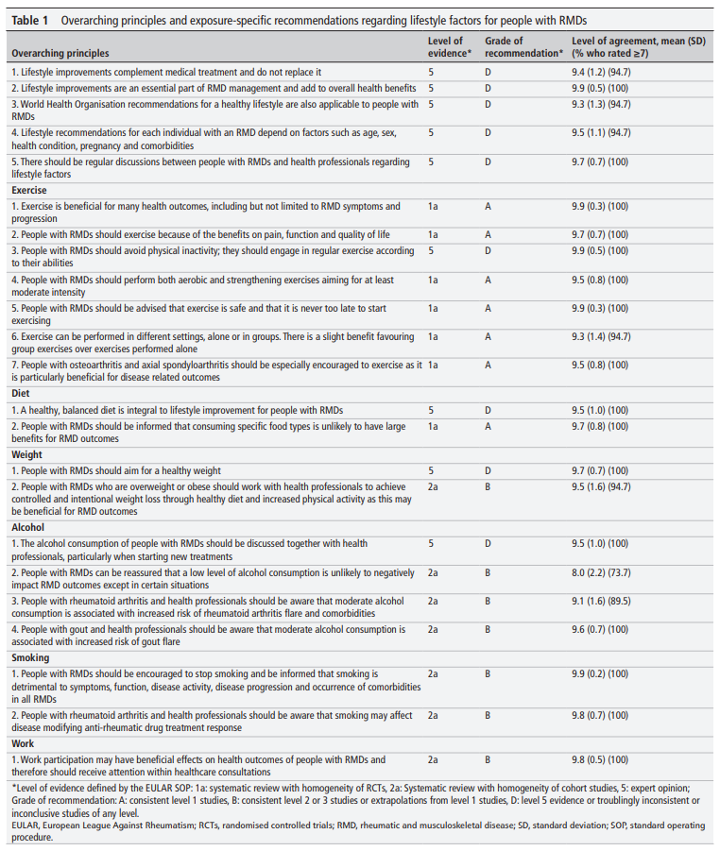
Gwinnutt et al, 2022

Slide 31
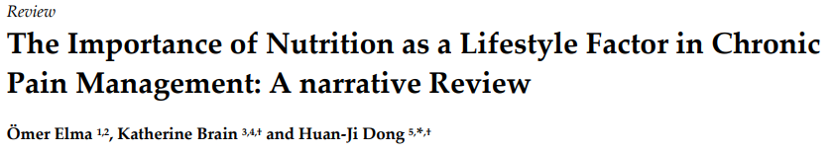
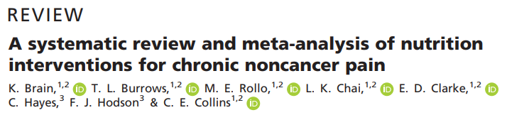
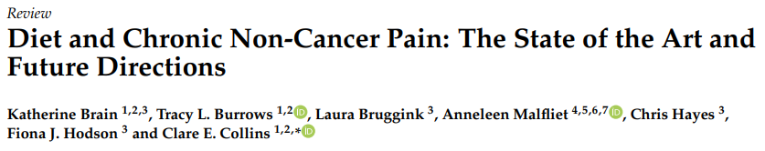

Slide 32
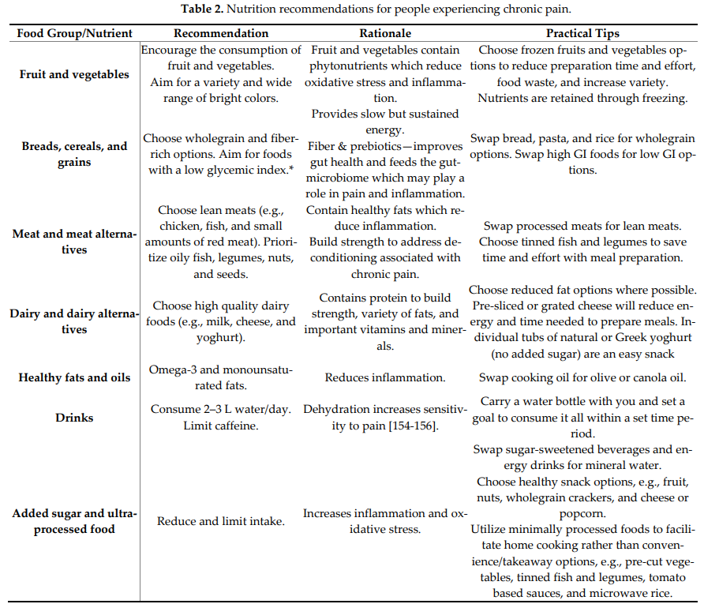
Elma et al, 2022

Slide 33
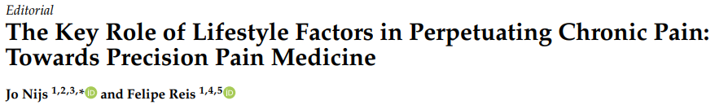
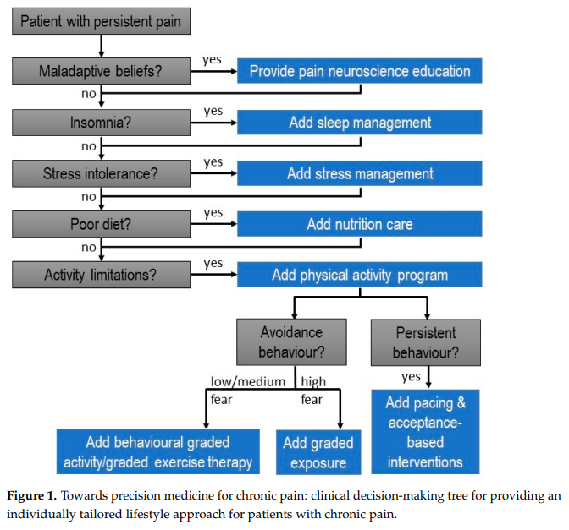
Nijs et Reis, 2022

Slide 34
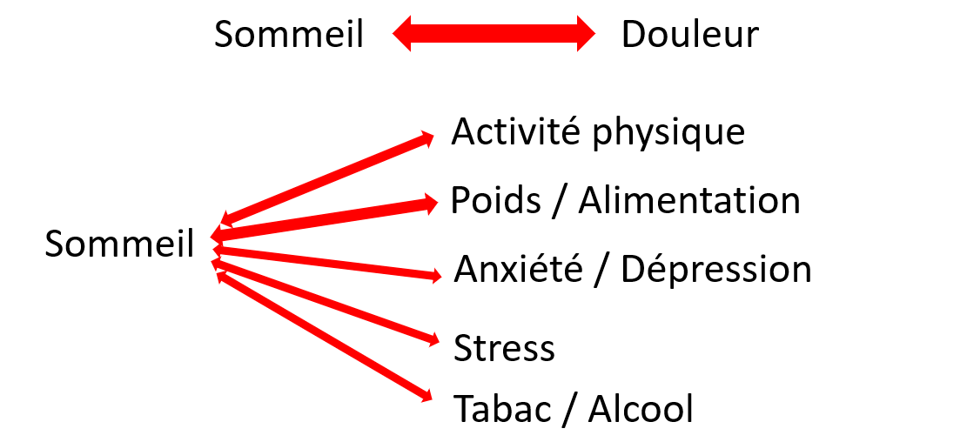
Complexité et interconnectivité : Exemple du sommeil

Slide 35
En résumé
Style de vie = Responsabilité personnelle + Problème de santé publique
Rôle important dans de nombreuses maladies chroniques
Peut jouer un rôle dans l’apparition et la persistance de la douleur (mécanismes sous-jacents encore peu compris)
Peut augmenter ou diminuer le risque de TMS (apparition et persistance)
Peut améliorer certains résultats cliniques sous forme de traitement
Nécessité d’évaluer et de traiter une combinaison de facteurs
Besoin d’autres études scientifiques

Slide 36


Slide 37
Bibliographie
L. Gisle, S. Drieskens, R. Charafeddine, S. Demarest, E. Braekman, D. Nguyen, J. Van der Heyden, F. Berete, L. Hermans, J. Tafforeau. Enquête de santé 2018 : Style de vie.
Robinson, M. and Smith, J.A. (2023), The lazy language of ‘lifestyles’. Health Promot J Austral, 34: 3-5. https://doi.org/10.1002/hpja.677
Nijs, J., D'Hondt, E., Clarys, P., Deliens, T., Polli, A., Malfliet, A., Coppieters, I., Willaert, W., Tumkaya Yilmaz, S., Elma, Ö., & Ickmans, K. (2020). Lifestyle and Chronic Pain across the Lifespan: An Inconvenient Truth?. PM & R : the journal of injury, function, and rehabilitation, 12(4), 410–419. https://doi.org/10.1002/pmrj.12244
van Hecke, O., Torrance, N., & Smith, B. H. (2013). Chronic pain epidemiology - where do lifestyle factors fit in?. British journal of pain, 7(4), 209–217. https://doi.org/10.1177/2049463713493264
Nijs, J., & Reis, F. (2022). The Key Role of Lifestyle Factors in Perpetuating Chronic Pain: Towards Precision Pain Medicine. Journal of clinical medicine, 11(10), 2732. https://doi.org/10.3390/jcm11102732
Tani, N., Ohta, M., Higuchi, Y., Akatsu, J., & Kumashiro, M. (2020). Lifestyle and subjective musculoskeletal symptoms in young male Japanese workers: A 16-year retrospective cohort study. Preventive medicine reports, 20, 101171. https://doi.org/10.1016/j.pmedr.2020.101171
Trouvin, A. P., Attal, N., & Perrot, S. (2022). Lifestyle and chronic pain: double jeopardy?. British journal of anaesthesia, 129(3), 278–281. https://doi.org/10.1016/j.bja.2022.06.006

Slide 38
Bibliographie
Holtermann, A., Krause, N., van der Beek, A. J., & Straker, L. (2018). The physical activity paradox: six reasons why occupational physical activity (OPA) does not confer the cardiovascular health benefits that leisure time physical activity does. British journal of sports medicine, 52(3), 149–150. https://doi.org/10.1136/bjsports-2017-097965
Gwinnutt, J. M., Wieczorek, M., Rodríguez-Carrio, J., Balanescu, A., Bischoff-Ferrari, H. A., Boonen, A., Cavalli, G., de Souza, S., de Thurah, A., Dorner, T. E., Moe, R. H., Putrik, P., Silva-Fernández, L., Stamm, T., Walker-Bone, K., Welling, J., Zlatković-Švenda, M., Guillemin, F., & Verstappen, S. M. M. (2022). Effects of diet on the outcomes of rheumatic and musculoskeletal diseases (RMDs): systematic review and meta-analyses informing the 2021 EULAR recommendations for lifestyle improvements in people with RMDs. RMD open, 8(2), e002167. https://doi.org/10.1136/rmdopen-2021-002167
Gwinnutt, J. M., Wieczorek, M., Cavalli, G., Balanescu, A., Bischoff-Ferrari, H. A., Boonen, A., de Souza, S., de Thurah, A., Dorner, T. E., Moe, R. H., Putrik, P., Rodríguez-Carrio, J., Silva-Fernández, L., Stamm, T., Walker-Bone, K., Welling, J., Zlatković-Švenda, M. I., Guillemin, F., & Verstappen, S. M. M. (2022). Effects of physical exercise and body weight on disease-specific outcomes of people with rheumatic and musculoskeletal diseases (RMDs): systematic reviews and meta-analyses informing the 2021 EULAR recommendations for lifestyle improvements in people with RMDs. RMD open, 8(1), e002168. https://doi.org/10.1136/rmdopen-2021-002168
Wieczorek M, Gwinnutt JM, Ransay-Colle M, et alSmoking, alcohol consumption and disease-specific outcomes in rheumatic and musculoskeletal diseases (RMDs): systematic reviews informing the 2021 EULAR recommendations for lifestyle improvements in people with RMDsRMD Open 2022;8:e002170. doi: 10.1136/rmdopen-2021-002170
Gwinnutt, J. M., Wieczorek, M., Balanescu, A., Bischoff-Ferrari, H. A., Boonen, A., Cavalli, G., de Souza, S., de Thurah, A., Dorner, T. E., Moe, R. H., Putrik, P., Rodríguez-Carrio, J., Silva-Fernández, L., Stamm, T., Walker-Bone, K., Welling, J., Zlatković-Švenda, M. I., Guillemin, F., & Verstappen, S. M. M. (2023). 2021 EULAR recommendations regarding lifestyle behaviours and work participation to prevent progression of rheumatic and musculoskeletal diseases. Annals of the rheumatic diseases, 82(1), 48–56. https://doi.org/10.1136/annrheumdis-2021-222020

Slide 39
Bibliographie
Manderlier, A., de Fooz, M., Patris, S., & Berquin, A. (2022). Modifiable lifestyle-related prognostic factors for the onset of chronic spinal pain: A systematic review of longitudinal studies. Annals of physical and rehabilitation medicine, 65(6), 101660. https://doi.org/10.1016/j.rehab.2022.101660
https://www.who.int/news-room/fact-sheets/detail/musculoskeletal-conditions
Williams, A., Kamper, S. J., Wiggers, J. H., O'Brien, K. M., Lee, H., Wolfenden, L., Yoong, S. L., Robson, E., McAuley, J. H., Hartvigsen, J., & Williams, C. M. (2018). Musculoskeletal conditions may increase the risk of chronic disease: a systematic review and meta-analysis of cohort studies. BMC medicine, 16(1), 167. https://doi.org/10.1186/s12916-018-1151-2
Silverwood, V., Blagojevic-Bucknall, M., Jinks, C., Jordan, J. L., Protheroe, J., & Jordan, K. P. (2015). Current evidence on risk factors for knee osteoarthritis in older adults: a systematic review and meta-analysis. Osteoarthritis and cartilage, 23(4), 507–515. https://doi.org/10.1016/j.joca.2014.11.019
Mills, S. E. E., Nicolson, K. P., & Smith, B. H. (2019). Chronic pain: a review of its epidemiology and associated factors in population-based studies. British journal of anaesthesia, 123(2), e273–e283. https://doi.org/10.1016/j.bja.2019.03.023
Gorasso, Vanessa and Van der Heyden, Johan and De Pauw, Robby and Pelgrims, Ingrid and De Clercq, Eva and De Ridder, Karin and Vandevijvere, Stefanie and Vansteelandt, Stijn and Vaes, Bert and De Smedt, Delphine and Devleesschauwer, Brecht, The Health and Economic Burden of Musculoskeletal Disorders in Belgium from 2013 to 2018. Available at SSRN: https://ssrn.com/abstract=4166618 or http://dx.doi.org/10.2139/ssrn.4166618
GBD 2019 Diseases and Injuries Collaborators (2020). Global burden of 369 diseases and injuries in 204 countries and territories, 1990-2019: a systematic analysis for the Global Burden of Disease Study 2019. Lancet (London, England), 396(10258), 1204–1222. https://doi.org/10.1016/S0140-6736(20)30925-9
GBD 2019 Risk Factors Collaborators (2020). Global burden of 87 risk factors in 204 countries and territories, 1990-2019: a systematic analysis for the Global Burden of Disease Study 2019. Lancet (London, England), 396(10258), 1223–1249. https://doi.org/10.1016/S0140-6736(20)30752-2

Slide 40
Bibliographie
Taylor, J. B., Goode, A. P., George, S. Z., & Cook, C. E. (2014). Incidence and risk factors for first-time incident low back pain: a systematic review and meta-analysis. The spine journal : official journal of the North American Spine Society, 14(10), 2299–2319. https://doi.org/10.1016/j.spinee.2014.01.026
Zale, E. L., Maisto, S. A., & Ditre, J. W. (2015). Interrelations between pain and alcohol: An integrative review. Clinical psychology review, 37, 57–71. https://doi.org/10.1016/j.cpr.2015.02.005
Coenen, P., Willenberg, L., Parry, S., Shi, J. W., Romero, L., Blackwood, D. M., Maher, C. G., Healy, G. N., Dunstan, D. W., & Straker, L. M. (2018). Associations of occupational standing with musculoskeletal symptoms: a systematic review with meta-analysis. British journal of sports medicine, 52(3), 176–183. https://doi.org/10.1136/bjsports-2016-096795
Coenen, P., Huysmans, M. A., Holtermann, A., Krause, N., van Mechelen, W., Straker, L. M., & van der Beek, A. J. (2020). Towards a better understanding of the 'physical activity paradox': the need for a research agenda. British journal of sports medicine, 54(17), 1055–1057. https://doi.org/10.1136/bjsports-2019-101343
Coenen, P., Huysmans, M. A., Holtermann, A., Krause, N., van Mechelen, W., Straker, L. M., & van der Beek, A. J. (2018). Do highly physically active workers die early? A systematic review with meta-analysis of data from 193 696 participants. British journal of sports medicine, 52(20), 1320–1326. https://doi.org/10.1136/bjsports-2017-098540
Holtermann, A., & Stamatakis, E. (2019). Do all daily metabolic equivalent task units (METs) bring the same health benefits?. British journal of sports medicine, 53(16), 991–992. https://doi.org/10.1136/bjsports-2017-098693
Shala R. (2022). 'I'm active enough in my job.' Why is occupational physical activity not enough?. British journal of sports medicine, 56(16), 897–898. https://doi.org/10.1136/bjsports-2021-104957

Slide 41
Bibliographie
Elma, Ö., Brain, K., & Dong, H. J. (2022). The Importance of Nutrition as a Lifestyle Factor in Chronic Pain Management: A Narrative Review. Journal of clinical medicine, 11(19), 5950. https://doi.org/10.3390/jcm11195950
Elma, Ö., Yilmaz, S. T., Deliens, T., Coppieters, I., Clarys, P., Nijs, J., & Malfliet, A. (2020). Do Nutritional Factors Interact with Chronic Musculoskeletal Pain? A Systematic Review. Journal of clinical medicine, 9(3), 702. https://doi.org/10.3390/jcm9030702
Brain, K., Burrows, T. L., Bruggink, L., Malfliet, A., Hayes, C., Hodson, F. J., & Collins, C. E. (2021). Diet and Chronic Non-Cancer Pain: The State of the Art and Future Directions. Journal of clinical medicine, 10(21), 5203. https://doi.org/10.3390/jcm10215203
Brain, K., Burrows, T. L., Rollo, M. E., Chai, L. K., Clarke, E. D., Hayes, C., Hodson, F. J., & Collins, C. E. (2019). A systematic review and meta-analysis of nutrition interventions for chronic noncancer pain. Journal of human nutrition and dietetics : the official journal of the British Dietetic Association, 32(2), 198–225. https://doi.org/10.1111/jhn.12601

