Slide 1




Graphene Biosensors – Biomarker Detection with Chitosan Functionalized Field-Effect Transistors
R. Villarreal, D. F. Jaramillo Calderon, S. Melinte, O. Nyabi, J.-L. Gala
UCLouvain, Louvain-la-Neuve, 1348, Belgium
Renan Villarreal
UCLouvain, Louvain-la-Neuve, 1348, Belgium
renan.villarreal@uclouvain.be
MRS Fall Meeting 2025, December 1, 2025

Slide 2
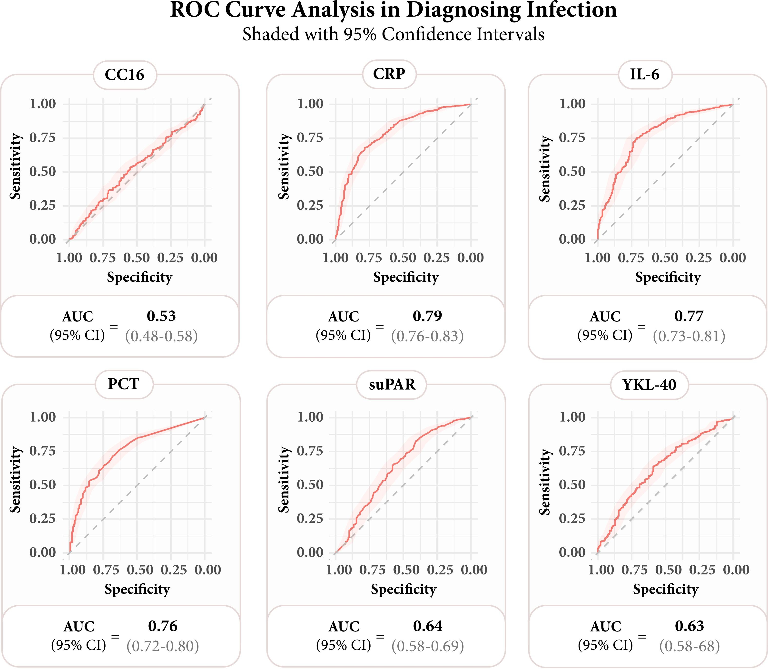
Motivation: Fast diagnostics
Our objectives:
  Fast detection
  Portable and simple testing units
  Avoid complex microfluidics
Diagnosing infections is vital for prompt and optimal patient care:
  Appropriate treatment
  Preventing disease deterioration
  Reducing adverse events
  Reducing development of antimicrobial resistance
R. Bruhn et al., Clinical Biochemistry 110943 (2025)
Notes:
We are interested in developing a bio sensing platform that can provide fast diagnostics for different bio markers associated to infections. We want this to be a portable and simple testing unit, avoiding complex microfluidics.
Here, I show you the receiver operating characteristic (ROC) curves of some examples of relevant serological biomarkers. These curves display sensitivity and specificity that are used to evaluate performance
These biomarkers are e.g., procalcitonin (PCT), C-reactive protein (CRP), interleukin-6 (IL-6), soluble urokinase plasminogen activator receptor (suPAR), Club Cell protein (CC16), human chitinase 3-like 1 (YKL-40),
It is important to understand that the levels of these biomarkers vary during an acute inflammatory response, and the time since the onset of symptoms should be taken into account in evaluating their diagnostic value
e.g., the value of CRP has a delayed dynamic response to bacterial infections… and elevation in non-infectious inflammatory conditions.
While Procalcitonin (PCT) is typically elevated on the day of symptoms onset of a bacterial infection. (but not viral infections) however not all studies agree on its effectiveness in predicting treatment response
ROC curves are often summarized by the area under the ROC curve (AUC) where an AUC of 0.5 means that the diagnostic test is not better than chance in predicting the categories, whereas values larger than 0.5 indicate a result better than chance

Slide 3
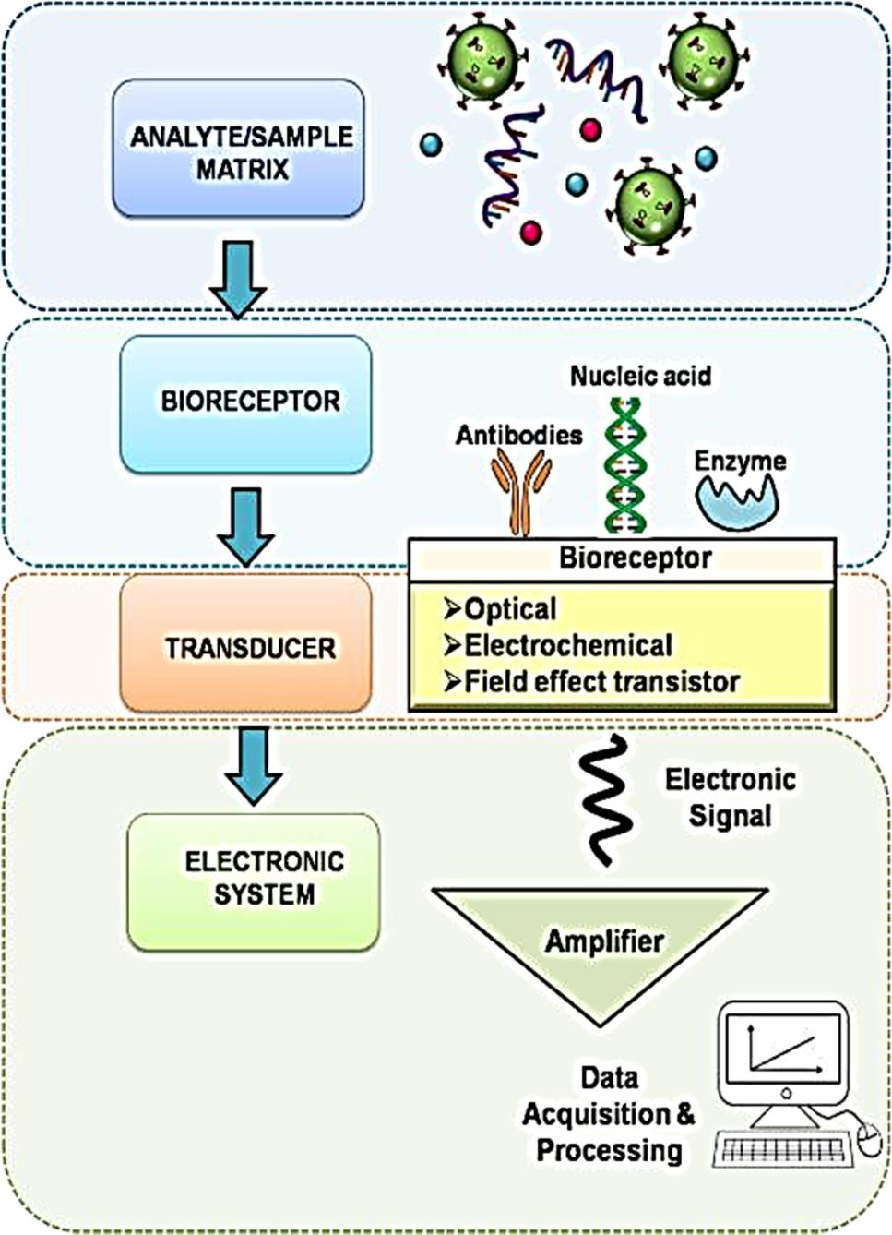
Methodology: Biosensors
Biomarker (IL-6, CC16, CRP, PCT, suPAR, YKL-40, etc…)
Biotin-binding Protein + Aptamer antibody
Commercial graphene field effect transistor (GFET) from Graphenea - Functionalized with Chitosan
Custom electronic board + EmStat Pico Development Kit
W.Y. Lim et al., Biosensors 11, 434 (2021)
Notes:
The biotin binding protein is part of the receptor complex (intermediate), used to capture the actual recognition receptor
Chitosan is a carbohydrate

Slide 4
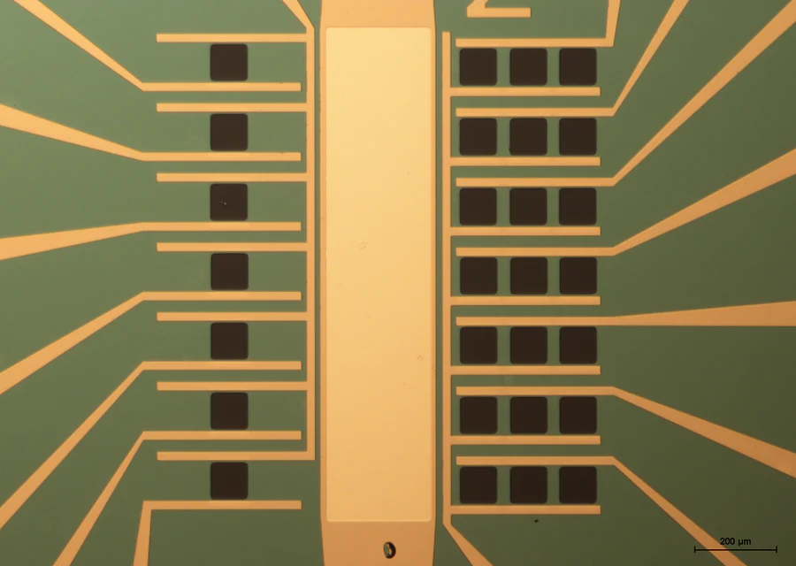
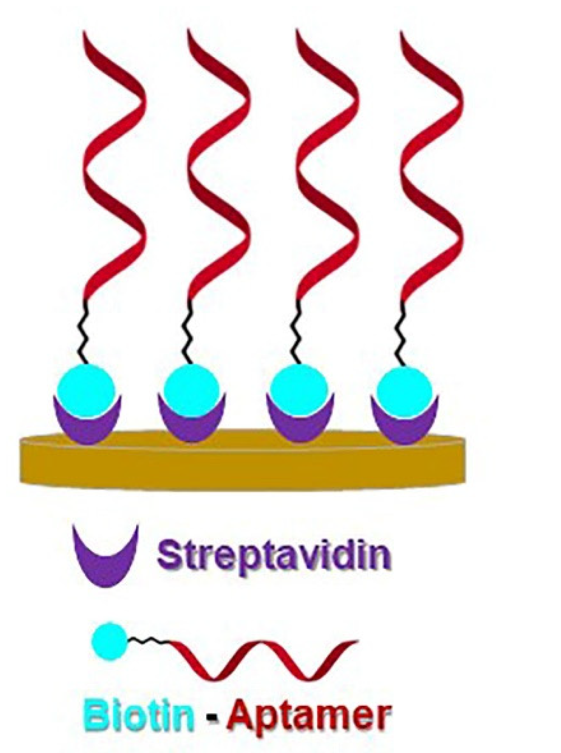
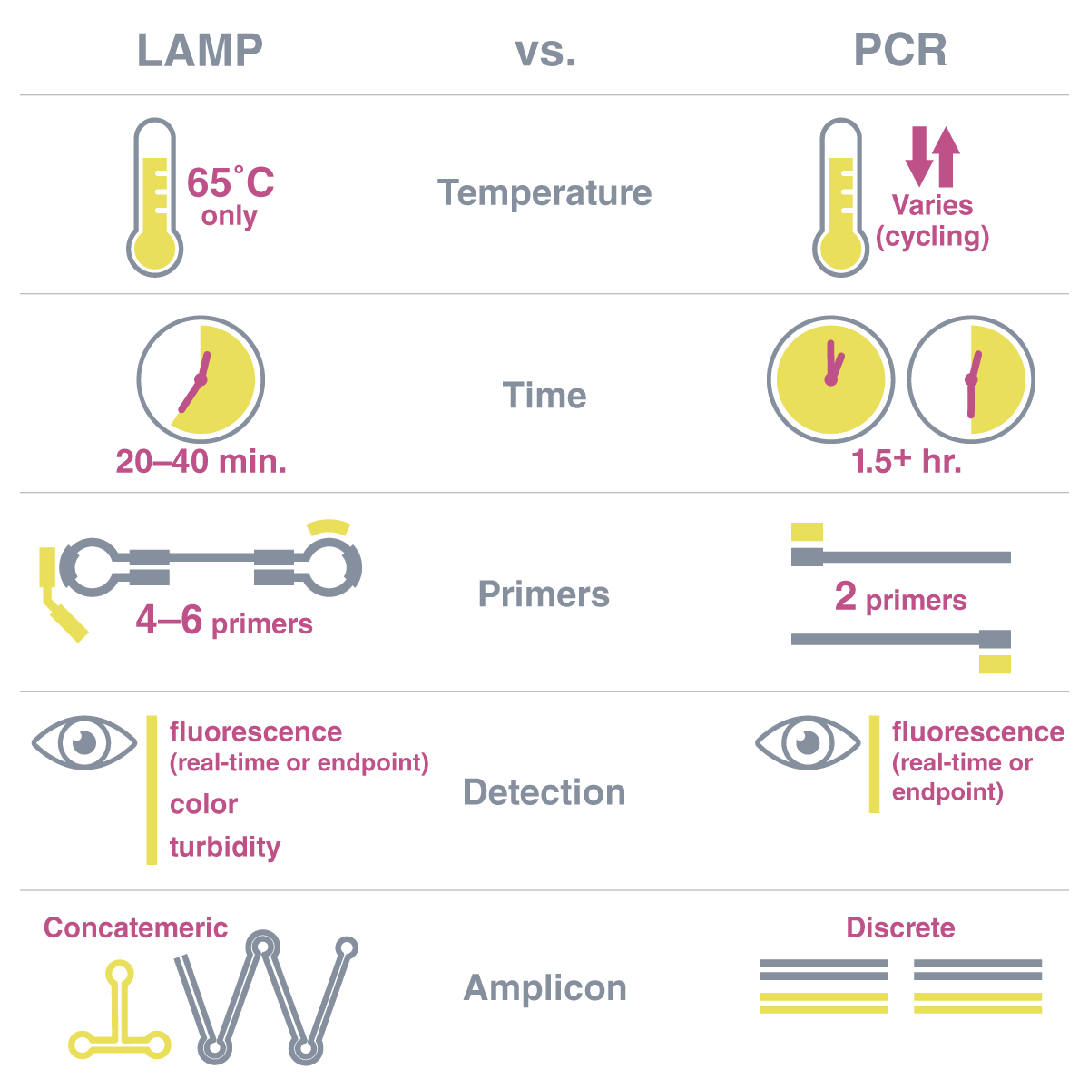
Methodology: Overview
Graphenea’s chip:
14 transistors per chip: 7 single channel + 7 triple channel
Functionalized proteomics and genomics
Size of channel: 90 x 90 µm²
Do Prado Ferreira et al., Biosensors 13(3), 336 (2023)
Notes:
Functionalized proteomics and genomics

Slide 5
Methodology: Electrical measurements and metrics
Transfer curve: Dirac point (V_{DP})
I_{DS}
I_{DS}
Before sample incubation: p-type doped
n-type doping
(-ΔV_{DP})
p-type doping
(+ΔVDP)
V_{G}
V_{G}
Notes:
https://pubs.rsc.org/en/content/articlehtml/2021/an/d0an01661f

Slide 6
State-of-the-art: Procalcitonin (PCT) detection with graphene based biosensors
Reference | Functionalization | Bioreceptor | LOD | Metric | Biosensor | Channel size
Chen et al., Talanta 268, 125308 (2024) | Chitosan | Anti-PCT antibodies | 0.82 ag/mL | ΔVDP | FET | 10 000 mm²
Selimoglu et al. Materials Chemistry and Physics 297, 127339 (2023) | Silver nanoparticles |  | 0.55 ng/mL | EIS | Electrochemical | Dispersion
Huang et al., Talanta 238, 122991 (2022) | 3D carbonised wood / cMWCNT / Au@Co3O4 nanosphere / Au N-doped graphene |  | 0.014 pg/mL | EIS | Electrochemical | Dispersion
Li et al., Sensors and Actuators B: Chemical 323, 129702 (2020) | PtCo-CuFeO4 @ rGO |  | 0.0021 pg/mL | EIS | Electrochemical | /
Abbas et al., Sensors 20(1), 148 (2020) | CuWO4 nanospheres @ rGO |  | 0.15 pg/mL | PEC | Electrochemical | /
Liu et al., Biosensors and Bioelectronics 126, 543 (2019) | Au NPs @ rGO |  | 0.1 pg/mL | EIS | Electrochemical | /
Our work | Chitosan | Biotin-binding protein + Biotin-coupled aptamer | ? | ΔV_{DP} | FET | 0.0243 mm²
Notes:
To modify for different biomarkers using GFETs

Slide 7
Protocol: Functionalization
1
2
3
4
2 h
2 h
2 h
Overnight
Step 1: Chitosan
Step 2: Glutaraldehyde
Step 3: NeutrAvidin
Step 4: BSA
Carbohydrate with amine functional groups (-NH2)
Crosslinker
Tetrameric biotin-binding protein with amine functional groups (NH2)
Blocking layer
Transfer curves
Notes:
- Chitosan’s dominant functional site is amine groups (-NH2).
- Glutaraldehyde is used in biochemistry applications as an amine-reactive homobifunctional crosslinker and fixative to make covalent bonds between amino rich groups

Slide 8
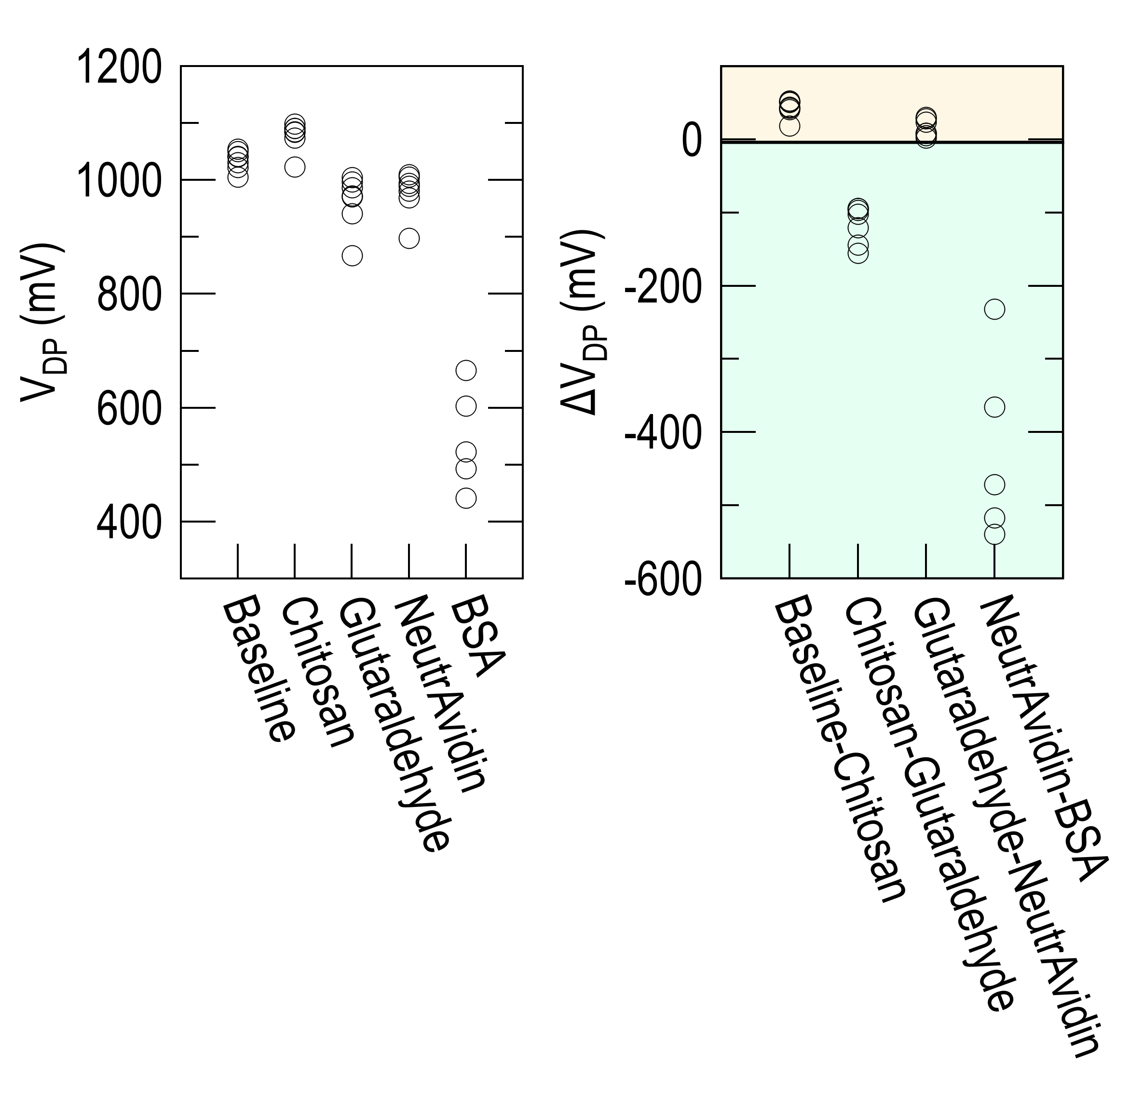
Results: Functionalization
Notes:
This is one example of a chip. We measure the 7 triple channel FETs in every functionalization step. We can see that the DP shifts reproducibly in all transistors after each step. These shifts are shown in the plot on the right. In the first and third steps, involving the chitosan and the neutravidin incubations, respectively, the shifts correspond to a p-type electronic doping of graphene while the other two steps: the glutaraldehyde and the BSA incubations lead to an n-type electronic doping of graphene. This trend is observed in most of the chips. The chips that don’t follow this trend are discarded from the following detection results

Slide 9
Methodology: Biosensors
Biotin-coupled procalcitonin
Biotin-binding Protein + Aptamer antibody
Commercial graphene field effect transistor (GFET) from Graphenea + Functionalized with Chitosan
Custom electronic board + EmStat Pico Development Kit
W.Y. Lim et al., Biosensors 11, 434 (2021)

Slide 10
Protocol: Detection
1
2
3
4
2 h
Step 1: Baseline
Step 2: Wash
Step 3: Incubation
Step 4: Detection
Buffer
Biomarker
Transfer curve
Transfer curve
Biomarker (non-specific):
Procalcitonin – 20 ng/μL (negative sample)
Biomarker (specific):
Biotin-coupled Procalcitonin – 20 ng/μL (positive sample)

Slide 11
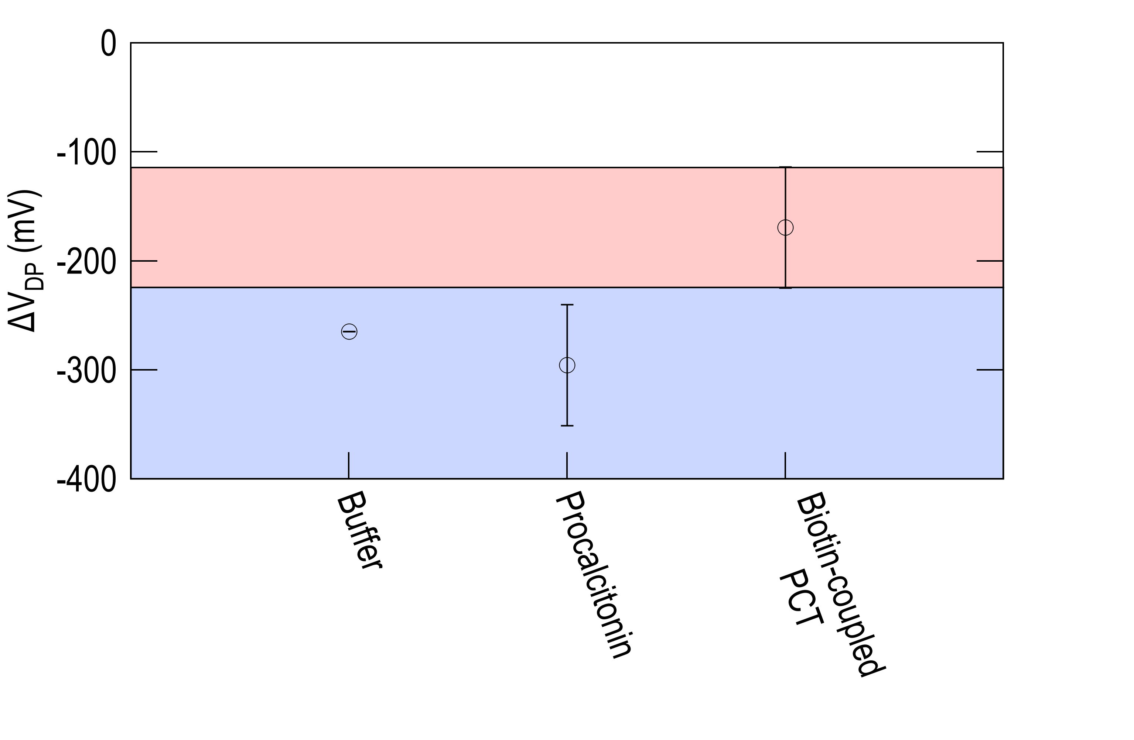
Results: Detection
110 mV < |ΔV_{DP}| < 220 mV indicates positive sample.
|ΔV_{DP}| > 220 mV indicates negative sample.
Notes:
During the detection protocol, we tested four different cases: not functionalized chips with biotin coupled PCT targets, and the other three cases functionalized with biotin coupled PCT targets, the buffer and the “normal” PCT. As you can see, the not functionalized cases exhibit a relatively minor DP shift. While when we compare the functionalized cases: the biotin coupled PCT exhibits a DP shift between 100-200 mV compared to the other two cases which exhibit larger DP shifts.

Slide 12
Outlook
Different concentrations of biotin-coupled procalcitonin
  To understand the detection of limit (LOD)
Biotin-coupled aptamers (as receptors) targeting other biomarkers
  To understand if this platform can be extended to diverse biomarkers of interest and what are their LODs
Characterise the surface of graphene through the functionalization steps
  To understand how to optimise the functionalization protocol

Slide 13
Thank you for your attention !
renan.villarreal@uclouvain.be

