Slide 1





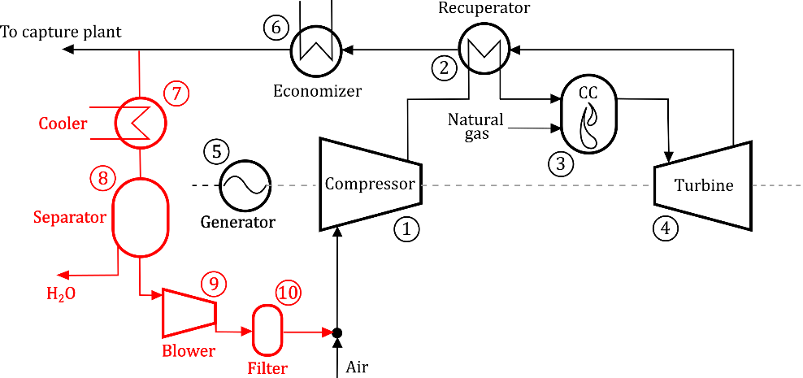
JOURNEE SCIENTIFIQUE DU POLE HAINUYER -19 avril 2016
Développement de nouveaux modes
de combustion propre et à haut rendement
à partir de différents types de carburants non conventionnels
Simone Giorgetti^{a,c}, Maxime Pochet^{b,d}, Steven Tipler^{a,b}, Axel Coussementª, Ward De Paepe^{b},
Laurent Bricteux^{c}, Hervé Jeanmart^{d}, Francesco Contino^{b}, Alessandro Parenteª
ªUniversité Libre de Bruxelles, Aero-Thermo-Mechanical Department, Franklin Rooseveltlaan 50, 1050 Brussels, Belgium
^{b}Vrije Universiteit Brussel, Dept. of Mechanical Engineering (MECH), Pleinlaan 2, 1050 Brussels, Belgium
^{c}Université de Mons, Faculté Polytechnique, rue du Joncquois 53, B-7000 Mons, Belgium
^{d}Université catholique de Louvain, SST/IMMC/TFL, Building Stévin, Place du Levant 2 bte L5.04.03, 1348 Louvain-la-Neuve
Efficient energy conversion is a key for an sustainable economy
In the Energy roadmap (2050) the European countries agreed to improve the efficiency of the energy production and of the buildings. Several solution exist to improve efficiency and energy efficiency rhythms with a reduced amount of produced power.
For that reason, efficiency is a keystone to develop a sustainable economy, relying on fuel savings, reduced pollutants formation and alternative fuels as the fossil fuels will soon come to lack as predicted by the oil and energy industry.
Air
water
Excess renewable
electricity
Plastic and foam
scraps
H2 & NH3
CH4 & CH3OH
Diesel & Gasoline
OPEC forecast
HCCI
mGT
RCCI
100
2013
90 Mbd
BP forecast
CO2
Three projects are being led in the above mentioned universities where energy efficiency, fuel flexibility and pollution prevention are integrated in each time a specific technology that is dedicated to a specific place in the energy sector
Energy and climate change, World energy
Outlook Special Report, International Energy Agency
Millions barrels
per day (Mbd)
IEA forecast
ELECTRICITY
+ HEAT
0
1950
2030
2300
17 juin 2010:
European council Agreement: UE2020
Greenhouse effect gases -20%
Energy final consumption -20%
Energetic efficiency +20%
December 2015:
21st Conference of the Parties (COP21) Agreement: +2 ºC until 2100
Emission target level: net-zero emissions in 2050
Renewable fuel HCCI engine
used as a cogeneration unit
hydrogen, methane, ammonia, methanol
Fuel made from waste in a RCCI engine used as a cogeneration unit
These fuels are obtained from water electrolysis and can easily be stored up to several month. HCCI engines (homogeneous charge compression ignition) can operate with all of these fuels or mixing thereof. Research is being led to maintain the usual performance of HCCI engine (45% efficiency, 20 ppm NOx) with blends of the four fuels above mentioned, thanks to intake temperature and exhaust gas recirculation controlling.
Such fuel flexibility ensures safety of energy supply and is an asset regarding the economical interest of renewable fuel storage option. This is of crucial importance knowing that the actual renewable growth is restrained by the lack of storage possibilities, especially at a seasonal time scale.
Conversion of micro gas turbines to “CO2 Capture” facilities
The Phoebus project was accepted for funding end of 2013 by the Walloon region. The goal of this project is to burn a fuel obtained from plastics wastes transformed in a chemical reactor installed at Comet Treatement. The chemical process was developed in collaboration with the Certech.
The fuel will power a cogeneration unit based on a piston engine supplied by Coretec engineering. This engine will run under Reactivity Controlled Compression Ignition, a high-efficiency combustion process.
The carbon dioxide in the exhaust must be captured, but its low concentration is disadvantageous from a Carbon Capture (CC) point of view. Exhaust Gas Recirculation (EGR) is one of the technologies used to increase the CO2 concentration in the gas turbine flue gas and it is a potentially effective method to reduce the high energy-penalty caused by the capturing.
Wastes
Heat
Electricity
Diesel-like fuel
Gasoline-like fuel
High efficiency combustion
in a stationary engine

