Slide 1

First Waves CoVid 19 pandemic, what have we learned?
Feedback from experience
Dr GIRARD Aurore, MD
Société scientifique de médecine générale, SSMG
Bruxelles, Belgique

Slide 2
Déclaration des liens d’intérêts
Aucun

Slide 3
Context
How does it happen in Belgium?
1st wave to end of confinement 04th February 2020 to 03th May 2020
Testing/tracing and 2sd wave 04th March 2020 to 31th December 2020
Vaccination and 3rd wave 01th January 2021 to 30th June 2021
4th and 5th waves 01th July 2021 to 15th March 2022

Slide 4
Context
How many in Belgium?
3 707 561 confirmed cases (on 23th March 2022)
30 529 deaths due to COVID-19 (on 23th March 2022)
21 860 deaths due to COVID-19 from March 2020 to February 2021 (71,3%)
31,4 % (9 595) during first wave
1 % (316) between first and second wave
39,13 % (11 949) during second wave
Sciensano, COVID-19_THEMATIC REPORT_SURVEILLANCE DE LA MORTALITE COVID-19 EN BELGIQUE_0, 09-2021

Slide 5
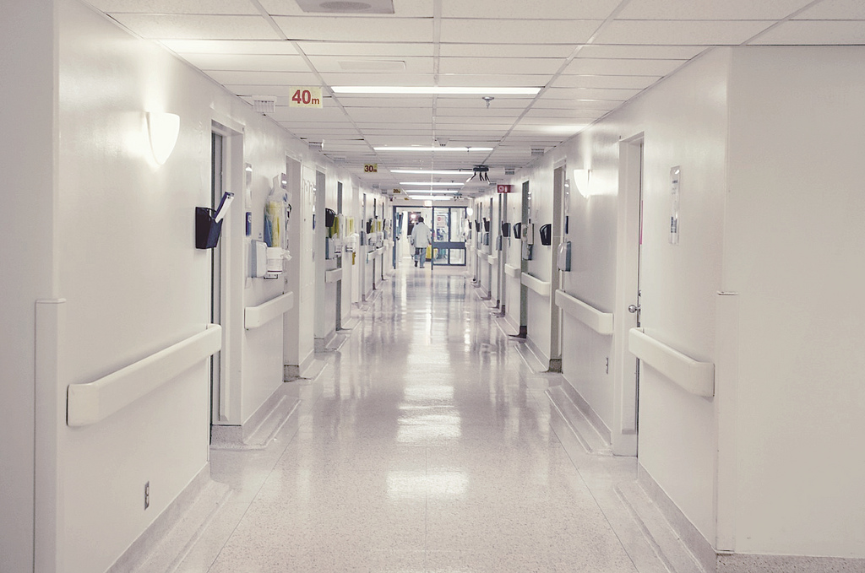
Context
Where ?
56,5 % in hospitals
42,7 % in structures for elderly people
0,8 % others (home or any other structure)
Cette photo par Auteur inconnu est soumis à la licence CC BY
Sciensano, COVID-19_THEMATIC REPORT_SURVEILLANCE DE LA MORTALITE COVID-19 EN BELGIQUE_0, 09-2021

Slide 6
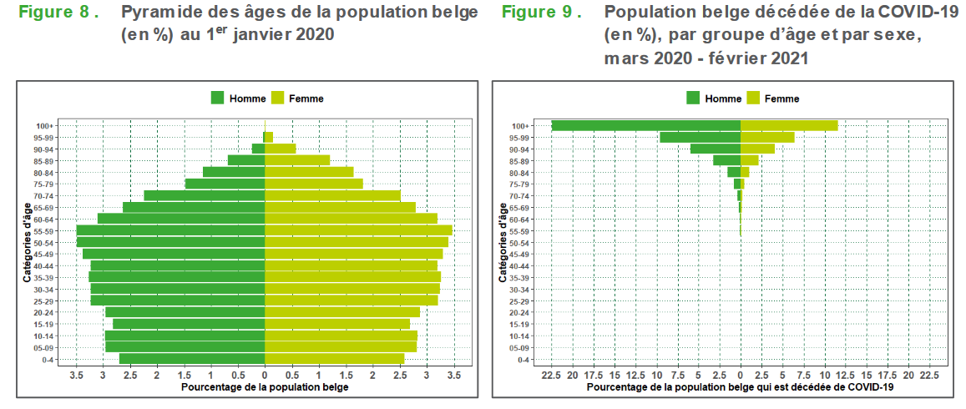
Context
Who ?
53,2 % aged more than 84 years old
40,7 % aged
between 65 and 84 years old
6,1% aged less than 65 years old
Sciensano, COVID-19_THEMATIC REPORT_SURVEILLANCE DE LA MORTALITE COVID-19 EN BELGIQUE_0, 09-2021

Slide 7
Does something change ?
In one week in March 2020
  Declaration of pandemic situation
  Confinement of population
  Federal autorisation of phone consultation
In one month
  Transformation of « College de la Médecine Générale (CMG)» from a group of discussion to a scientific collective group with production
7/13

Slide 8
Does something change ?
First wave
Increasing availability hours
Reduction / closure of physical acces to GP
Creation of digital medecine - Phone consultation
Development of digital tools (eg prescription)
Testing limited to hospitalised people
Creation of testing center 17th March 2020
8/13

Slide 9
Does something change ?
Tracing and 2th wave
Distribution of protection material for GP
Testing after contact with a GP and elaboration of an e-form
Organisation of testing center
Development of govermental tracing in May 2020
Elaboration of recommendations by scientic group of CMG transfer to federal public health institute (Sciensano)
9/13

Slide 10
Does something change ?
3th wave & vaccination
Vaccine not available for GP
Opening of federal vaccination center
Implication of GPs in vaccination
Vaccinations by waves
  1st : Caregiver
  2sd : Elderly people and chronic patients
  3th : All population
10/13

Slide 11
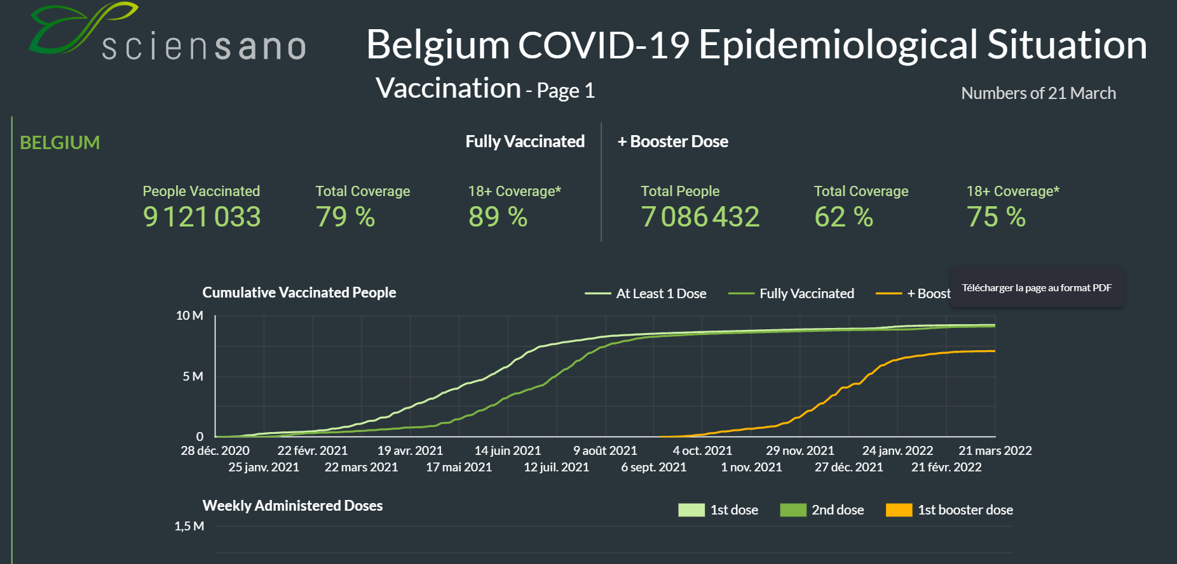
Vaccination
11/13

Slide 12
Difficulties ?
Report of trauma GP by crisis gestion in elderly people institutions
Difficulties with
  Frequent changes of « CoVid possible case »
  Frequent changes of decision trees
Delayed prevention
Delayed cares
Under represention of GP and first line care in governemental institutions
12/13

Slide 13
References
www.sciensano.be
www.belgiqueenbonnesante.be
Belche JL, Joly L, Crismer A, Giet D. Résilience et réactivité de la médecine générale durant la pandémie COVID-19 [Resilience and responsiveness of general practice during the COVID-19 pandemic]. Rev Med Liege. 2020 Sup;75(S1):29-37.
Minguet C, CoVid et médecine générale, Louvain Medical, 139, n°5-6, 283-289, mai 2020
Jamar H et al, La première vague de CoVid en Belgique et les soins primaires, Revue médicale suisse, 713, novembre 2020

