Slide 1
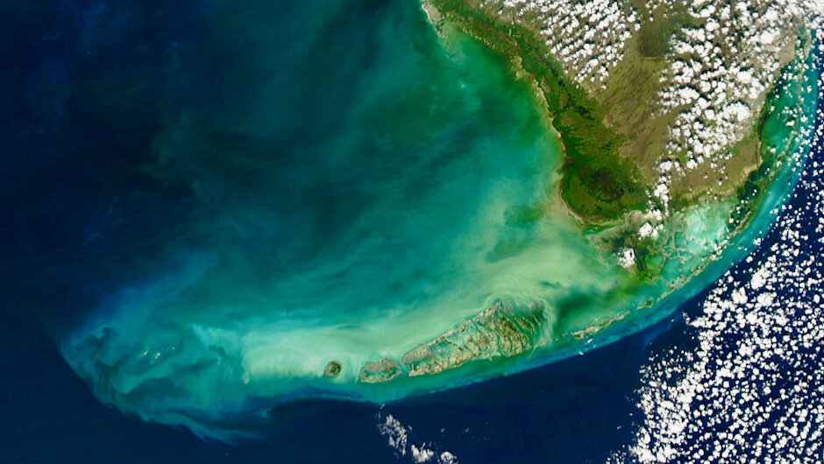
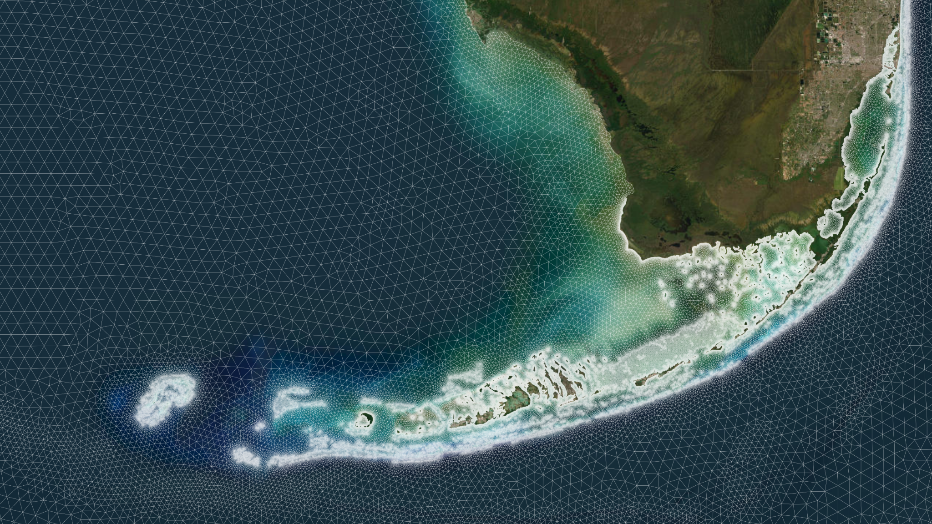
Assessing inter-annual, inter-specific and hurricane-induced connectivity variability in Florida's Coral Reef and its impact on restoration site selection
Thomas Dobbelaere, Apolline Dekens, Joana Figueiredo,
Daniel Holstein, Emmanuel Hanert

Slide 2
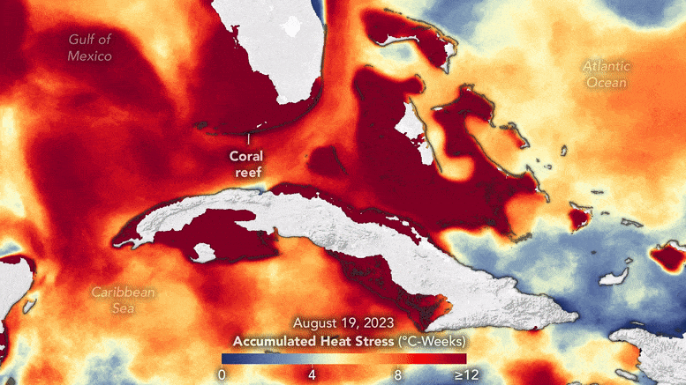
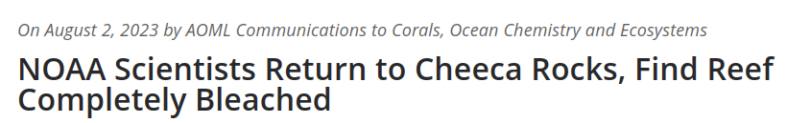
Florida’s coral reef has suffered a massive decline
NASA Earth Observatory animation by Wanmei Liang
Live coral cover in Florida has declined by 50-80 % since the 1970s under the combined effects of climate change, disease outbreaks and local anthropogenic stressors…
1

Slide 3
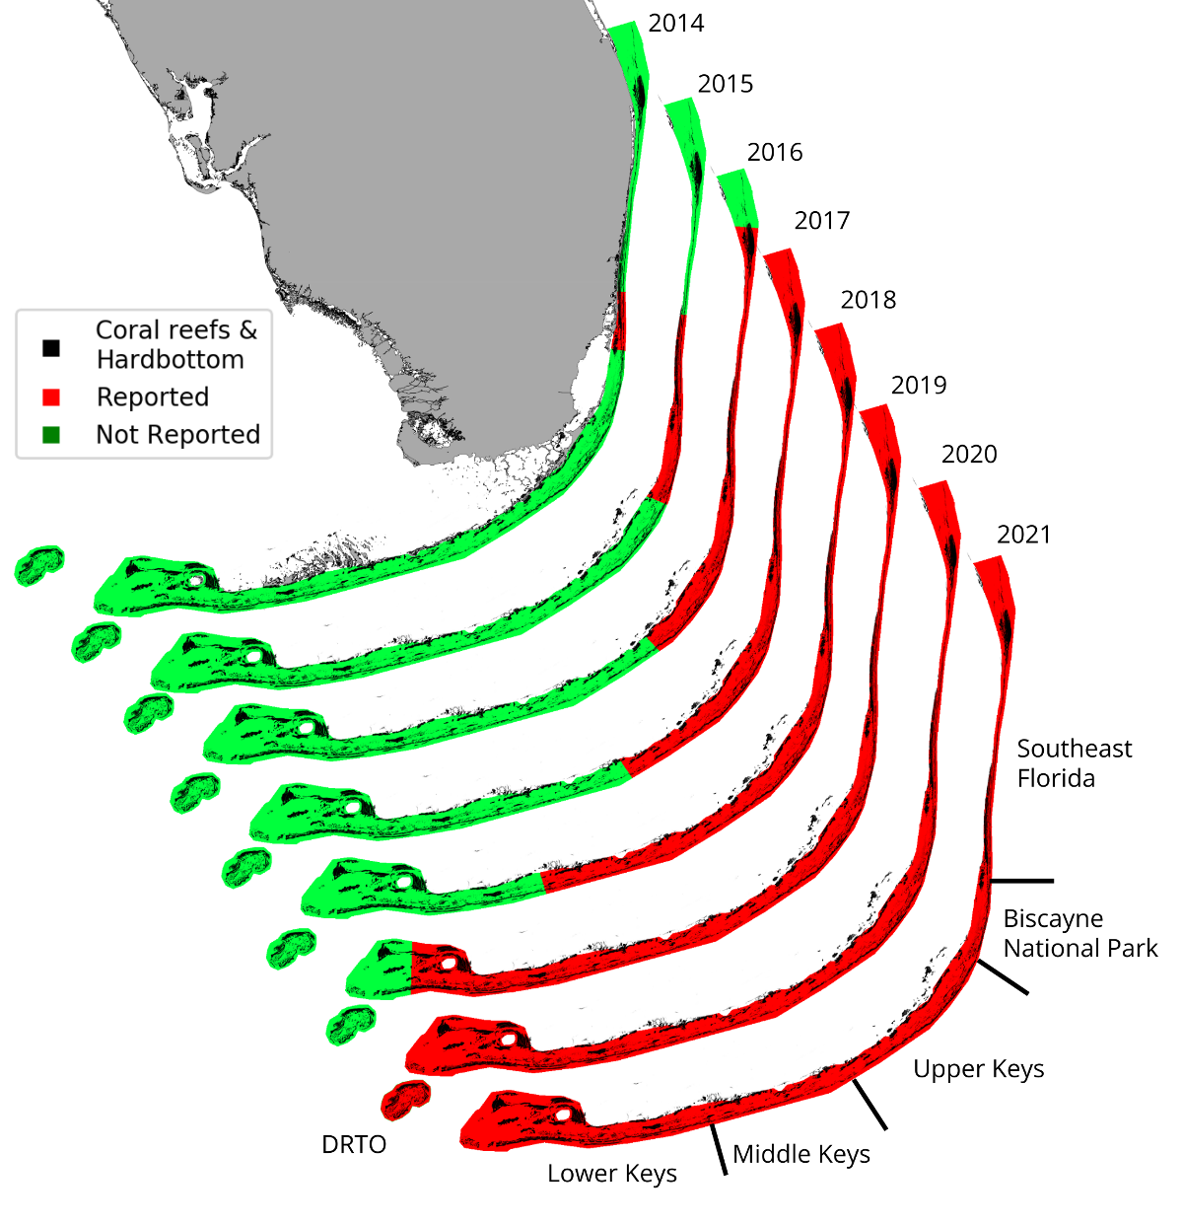
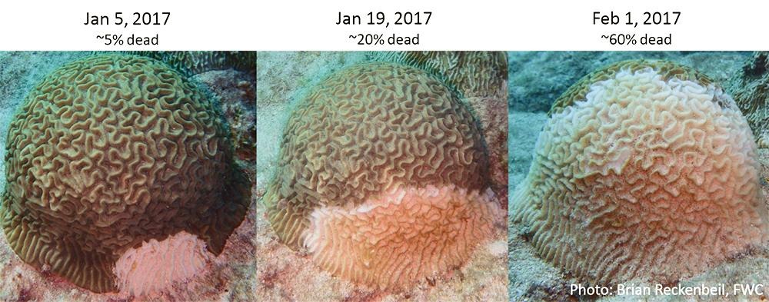
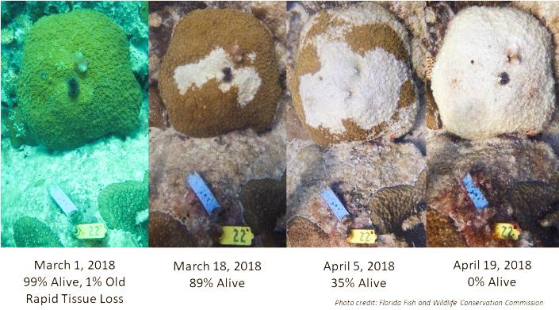
Since 2014, SCTLD has been decimating corals in the Caribbean
Stony Coral Tissue Loss Disease (SCTLD)
= Worst coral disease outbreak on record in the Caribbean
At least 22 coral species affected
∼60 % decline in living coral tissue area on impacted reefs.
Evidence of waterborne and sediment-mediated transmission
2

Slide 4
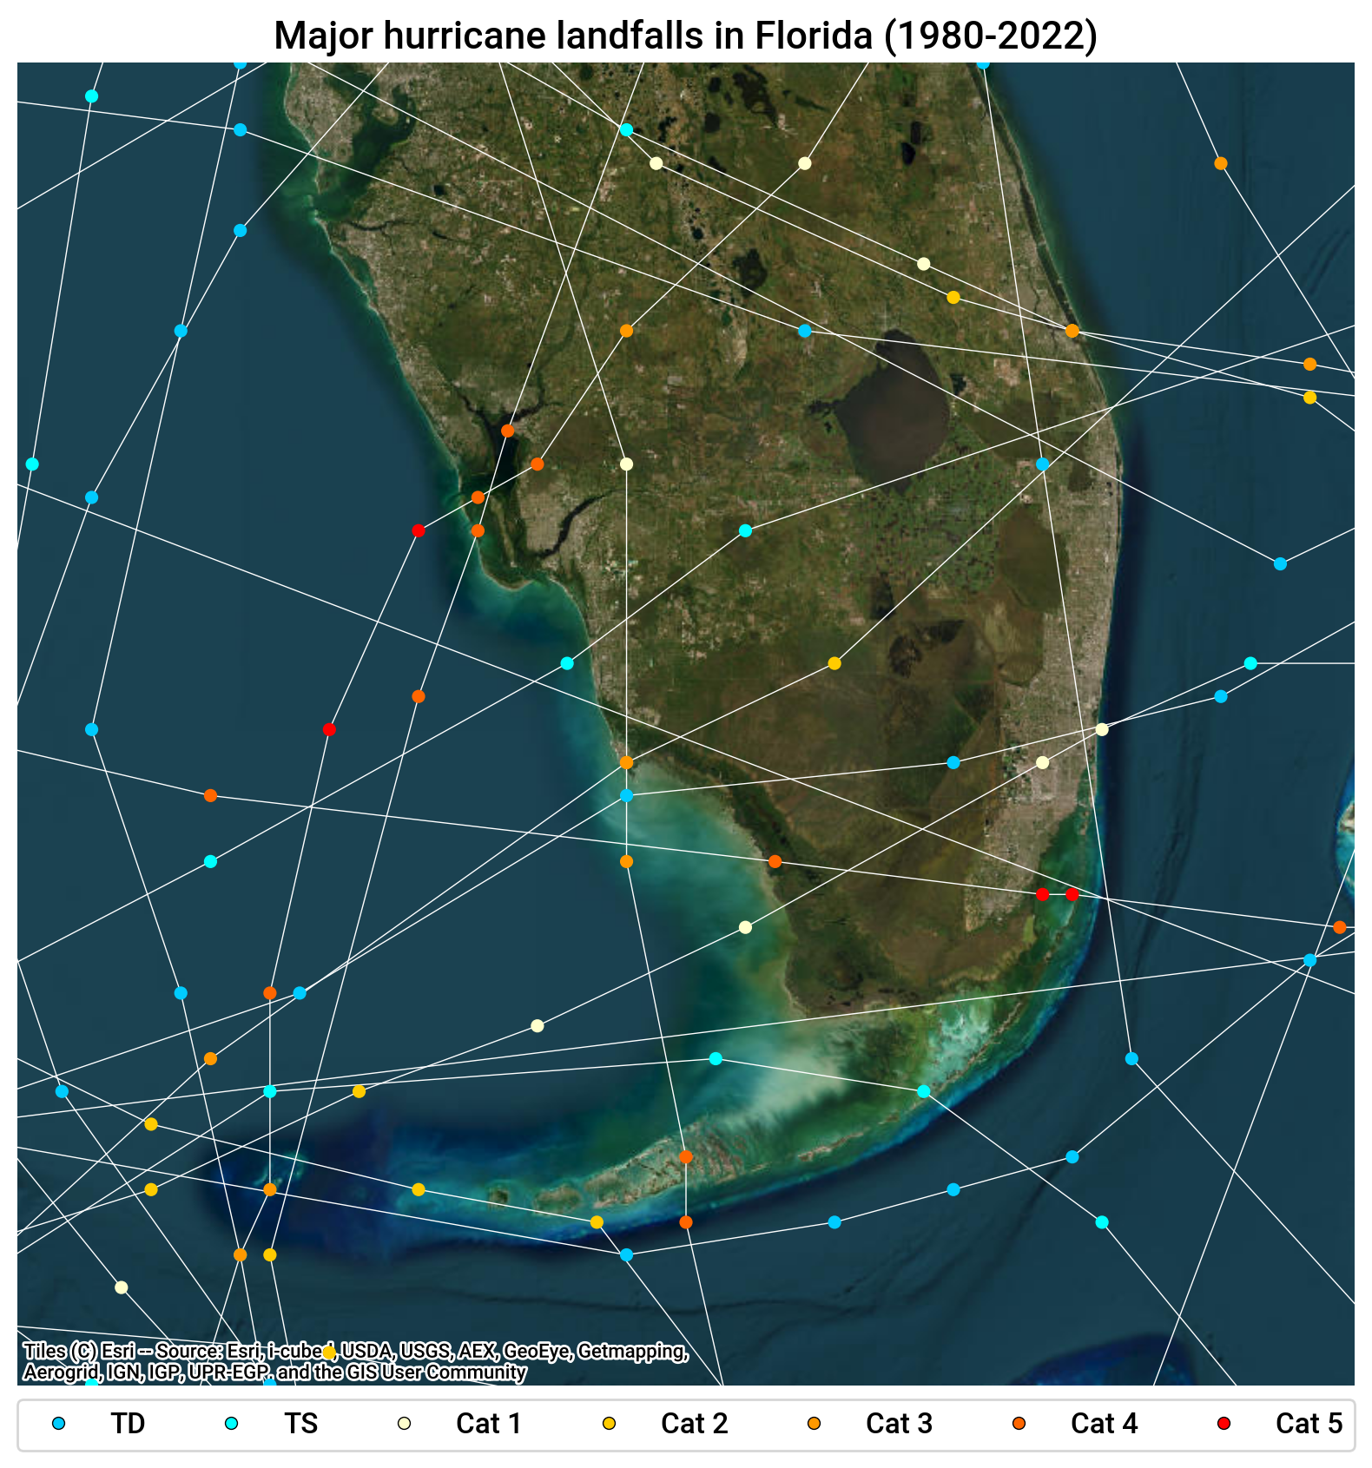
Florida is also a prime landfall target for hurricanes
Hurricanes can damage reefs and bury corals under resuspended sediments
Storm waves interact nonlinearly with currents and significantly alter ocean circulation
Hurricanes are expected to become more intense with climate change
3

Slide 5

Florida is also a prime landfall target for hurricanes
Hurricanes can damage reefs and bury corals under resuspended sediments
Storm waves interact nonlinearly with currents and significantly alter ocean circulation
Hurricanes are expected to become more intense with climate change
Irma (2017)
3

Slide 6
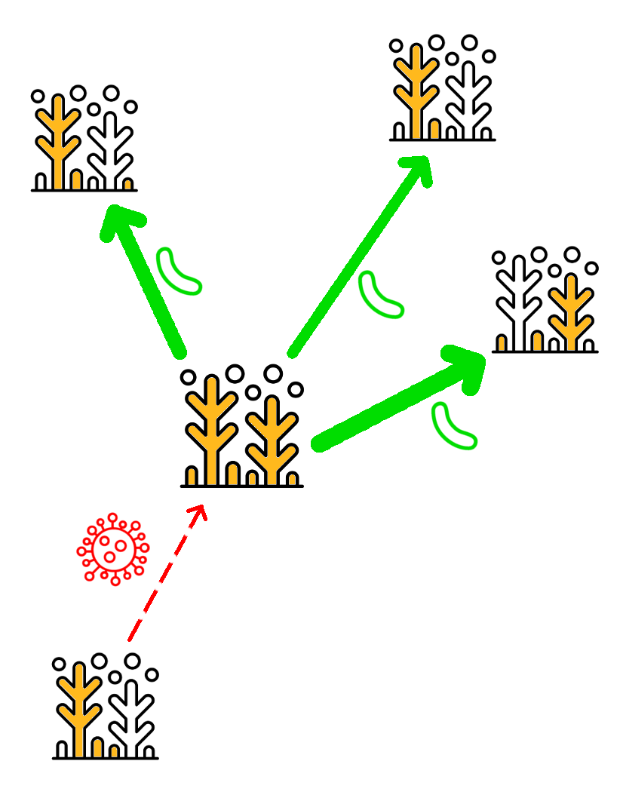
It is thus urgent to restore reefs to support coral recovery
However, coral restoration:
is implemented at the local scale
is expensive
requires important manpower
Restoration sites must thus be thoughtfully selected in order to maximize the effect of restoration to the whole reef system
This is performed using connectivity estimates
4

Slide 7
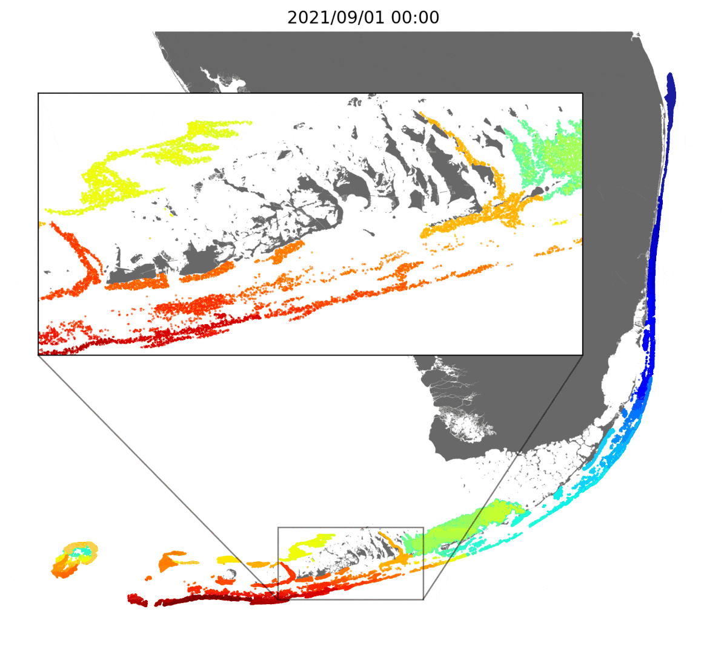

Connectivity is estimated by simulating the dispersal of virtual particles
Coral larvae and disease agents are modeled using particles with a biological state released over all reefs
The exchanges of particles between reefs are recorded in connectivity matrices
5

Slide 8
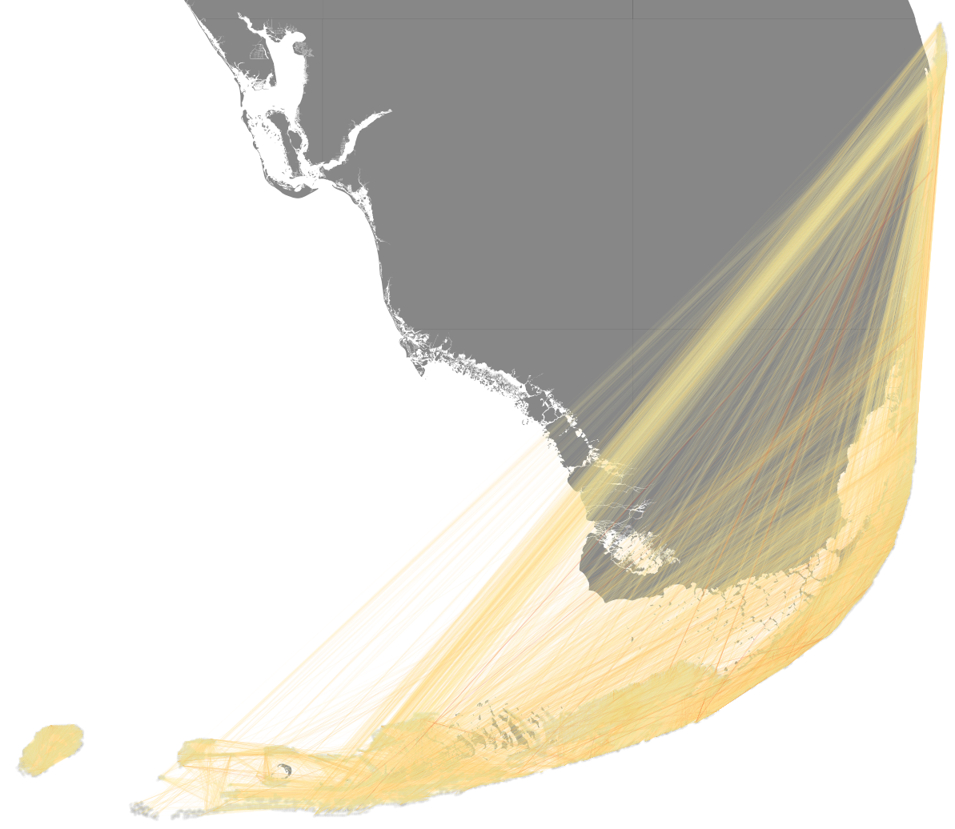
Connectivity is estimated by simulating the dispersal of virtual particles
Coral larvae and disease agents are modeled using particles with a biological state released over all reefs
The exchanges of particles between reefs are recorded in connectivity matrices
5

Slide 9
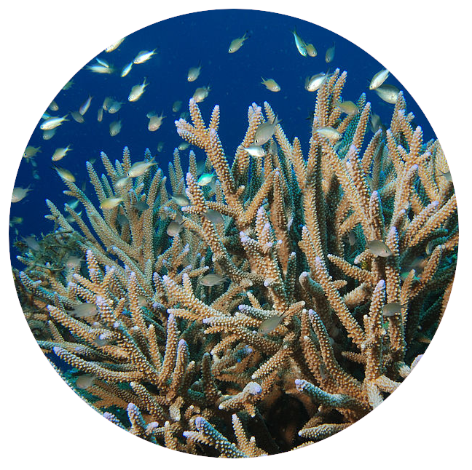
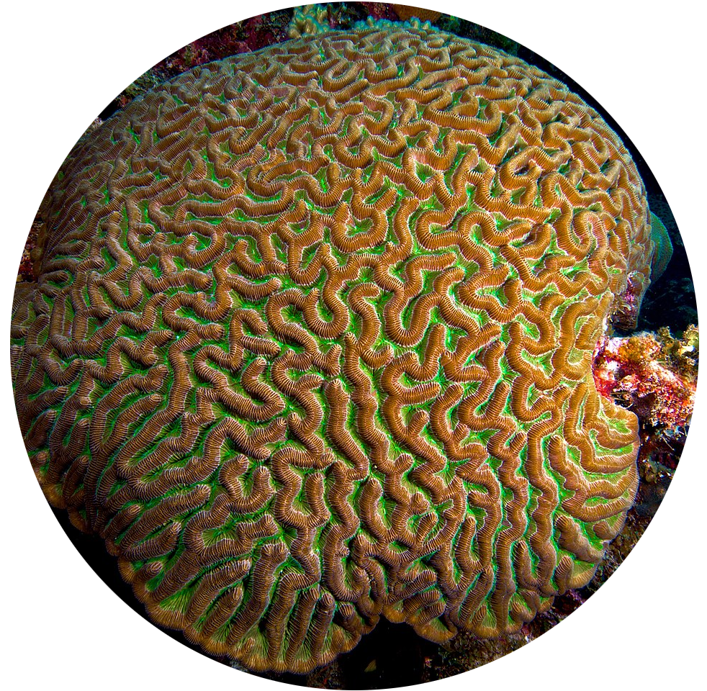
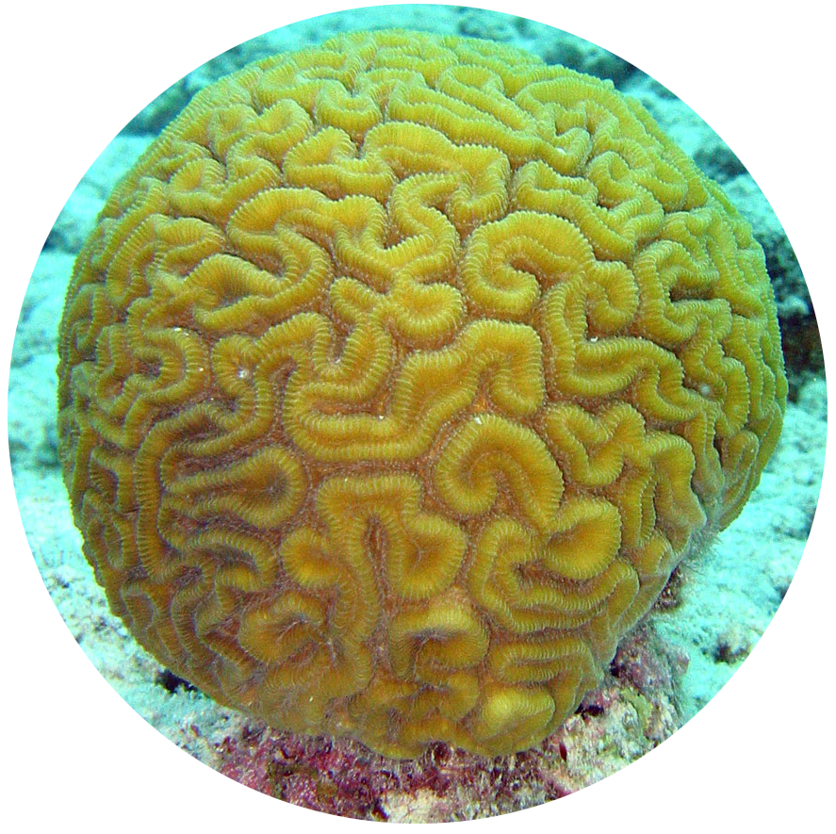
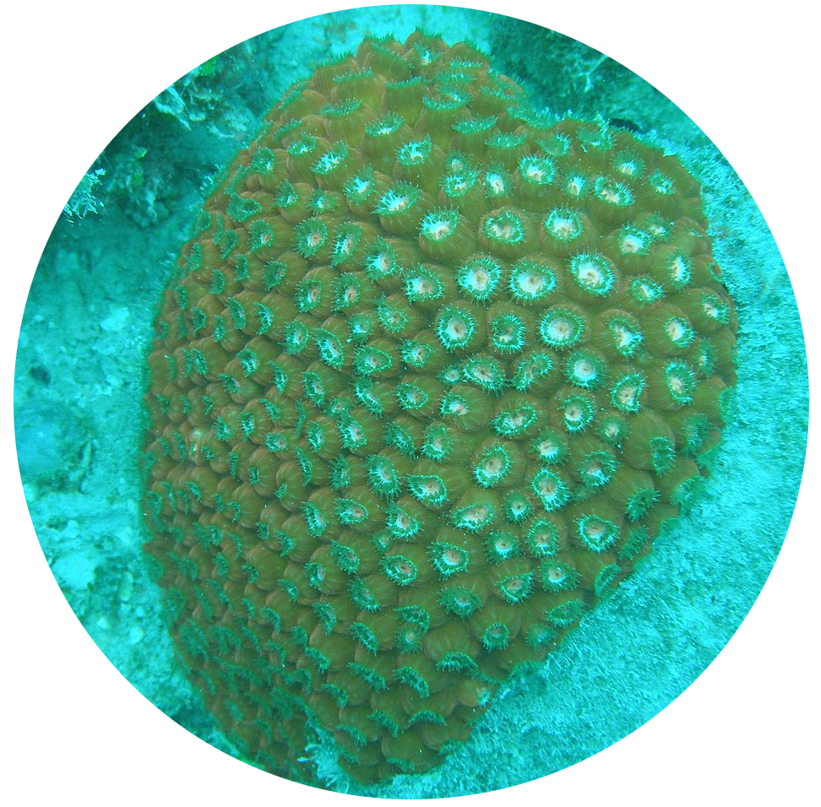
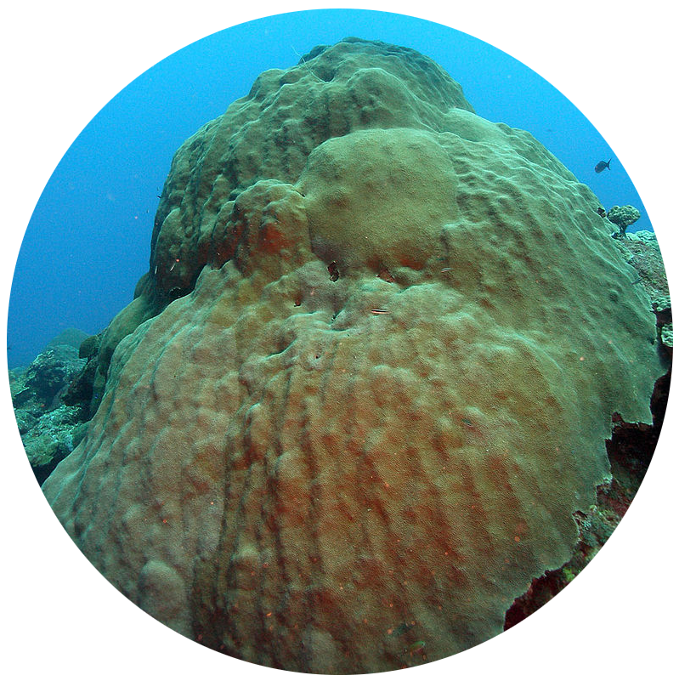
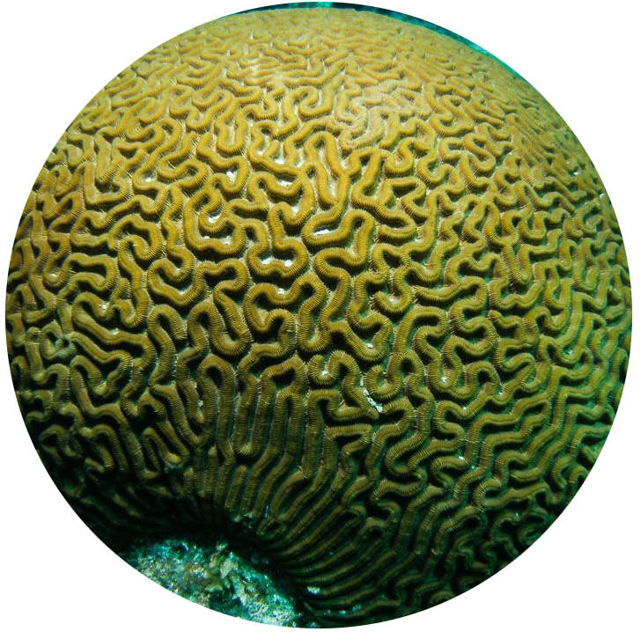
Our connectivity estimates capture inter-annual and inter-specific variability
Connectivity studies often consider a small number of coral species over a limited number of spawning events due to the import computational cost of biophysical models.
To capture inter-annual and inter-specific variability, we modeled the larval dispersal of 6 coral species over 10 years (2012-2021)
Acropora cervicornis
Acer
Colpophyllia natans
Cnat
Diploria labyrinthiformis
Dlab
Montastrea cavernosa
Mcav
Orbicella faveolata
Ofav
Pseudodiploria strigosa
Pstr
6

Slide 10

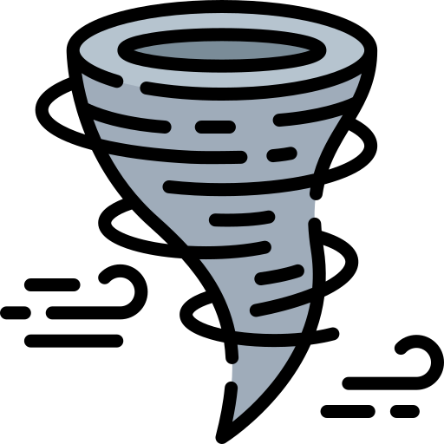
The 2 objectives of the day
Build connectivity indicators taking inter-annual and inter-specific variability into account to inform the selection of restoration sites
Evaluate the impact of Hurricane Irma (2017) on the dispersal of coral larvae and the propagation of SCTLD
7

Slide 11
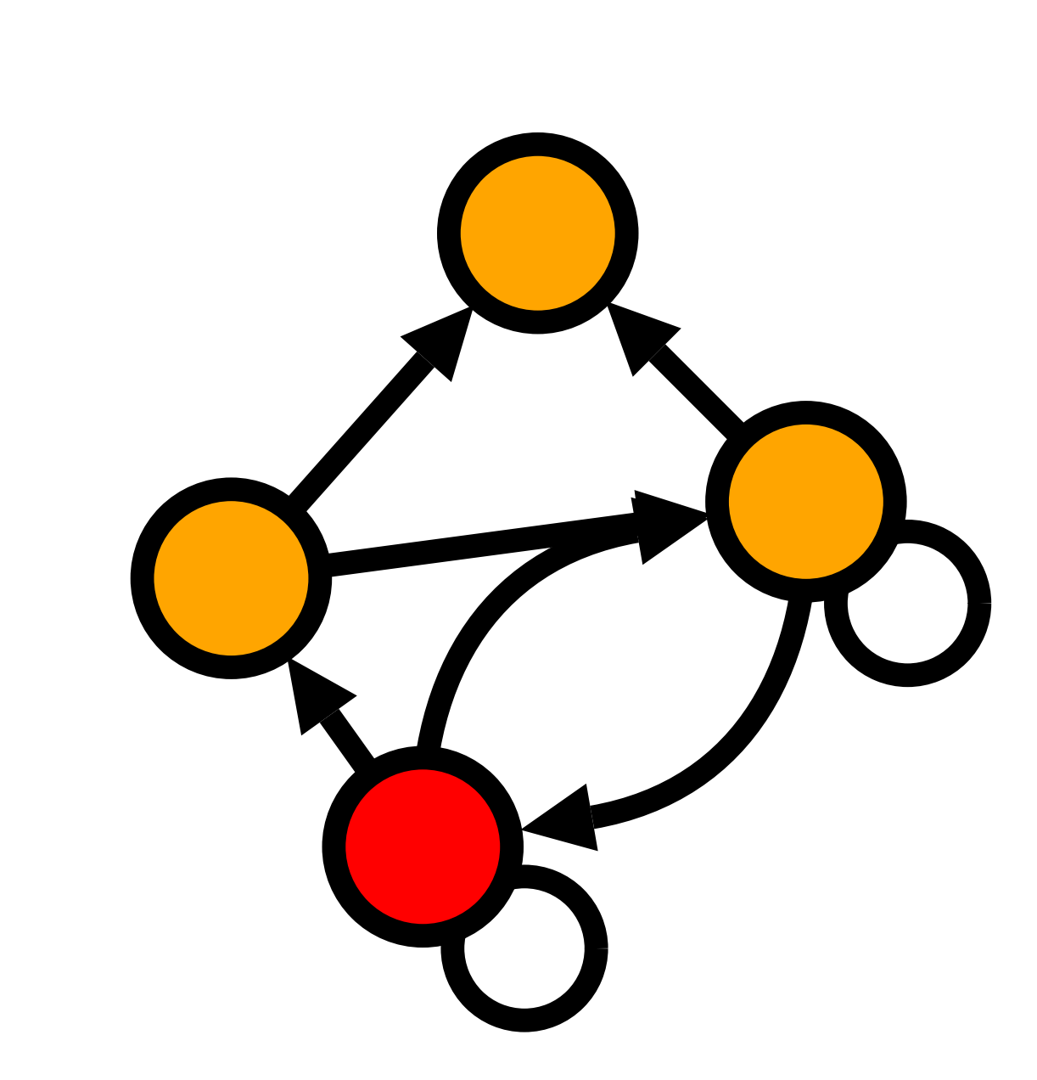
The obtained networks are analyzed using connectivity indicators
Indicator | Description | What it shows
Weighted in-degree | Strength and number of incoming connections to reef | Potential to receive larvae
Weighted out-degree | Strength and number of outgoing connections from reef | Potential to export larvae
Local retention | Proportion of larvae released on reef that settle on that reef | Self- replenishment potential
Self- recruitment | Portion of larvae settling on a reef that originated on that reef | Reef isolation
8

Slide 12
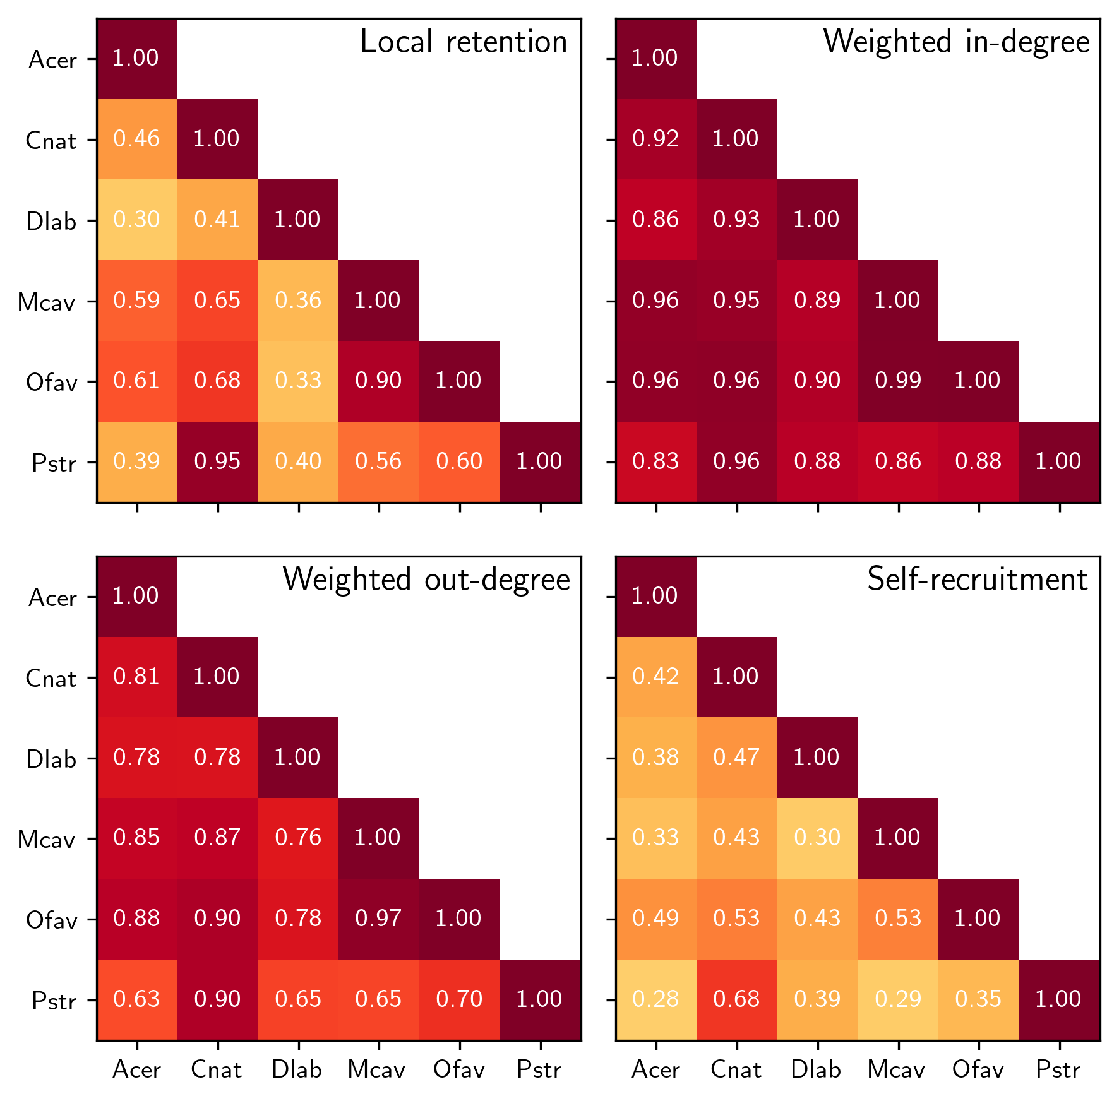
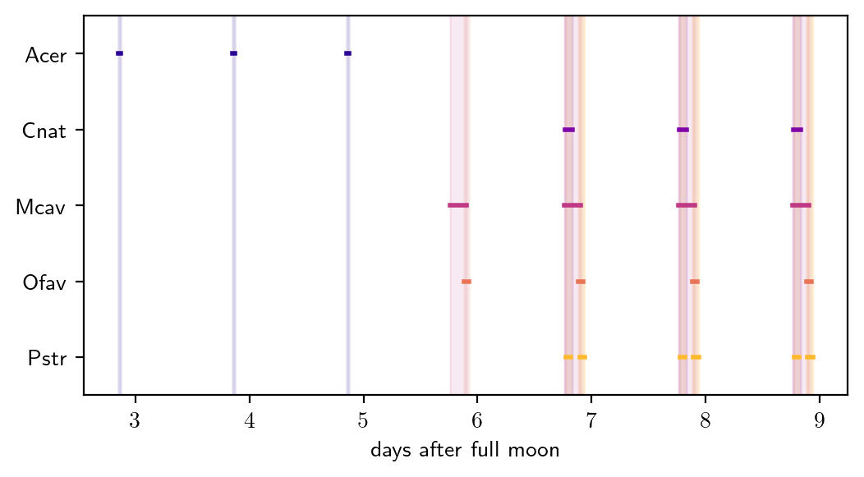
We evaluated the potential for coupled restoration by identifying highly correlated species connectivities
Weighted degrees tend to be more correlated than local retention and self-recruitment
Species with similar spawning windows have more strongly correlated connectivities
Cnat-Pstr, Mcav-Ofav
Most weakly correlated species are Acer and Dlab
9

Slide 13
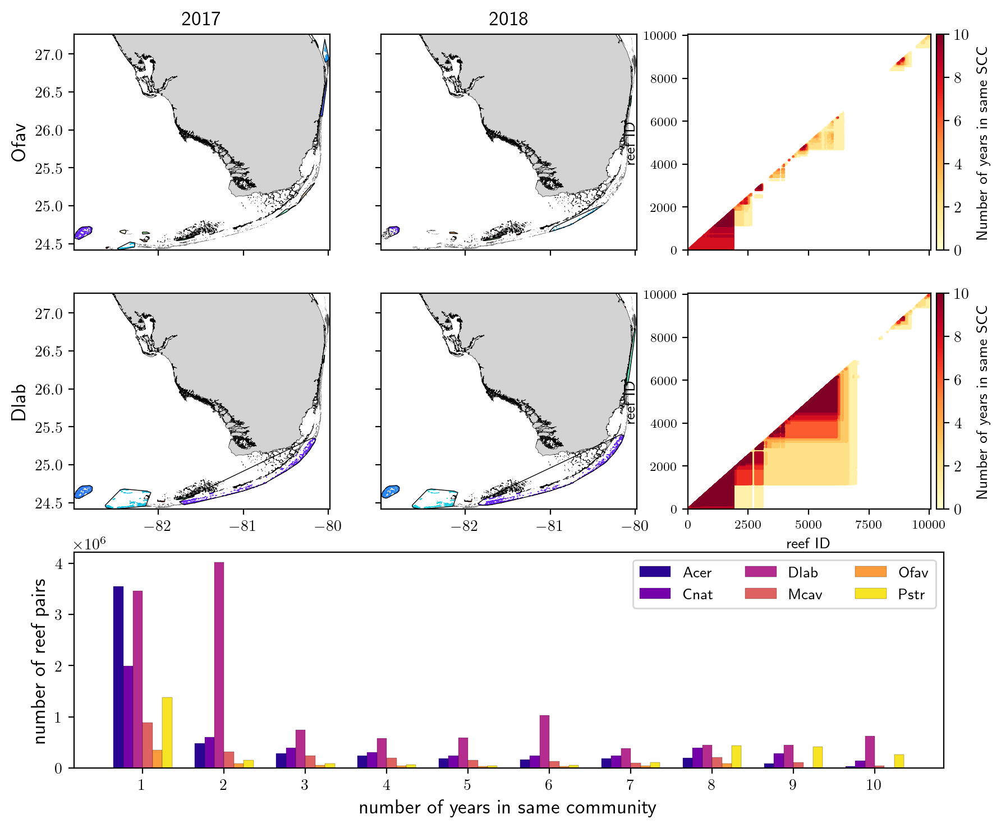
We evaluated the stability of the communities in the connectivity network
Strongly Connected Components algorithm identify group of reefs with numerous bidirectional connections
→ genetically well mixed
Dlab and Pstr present the largest number of reef pairs that remained in the same SCC during the 10 simulated years.
We can identify invariant components of the SCC
10

Slide 14
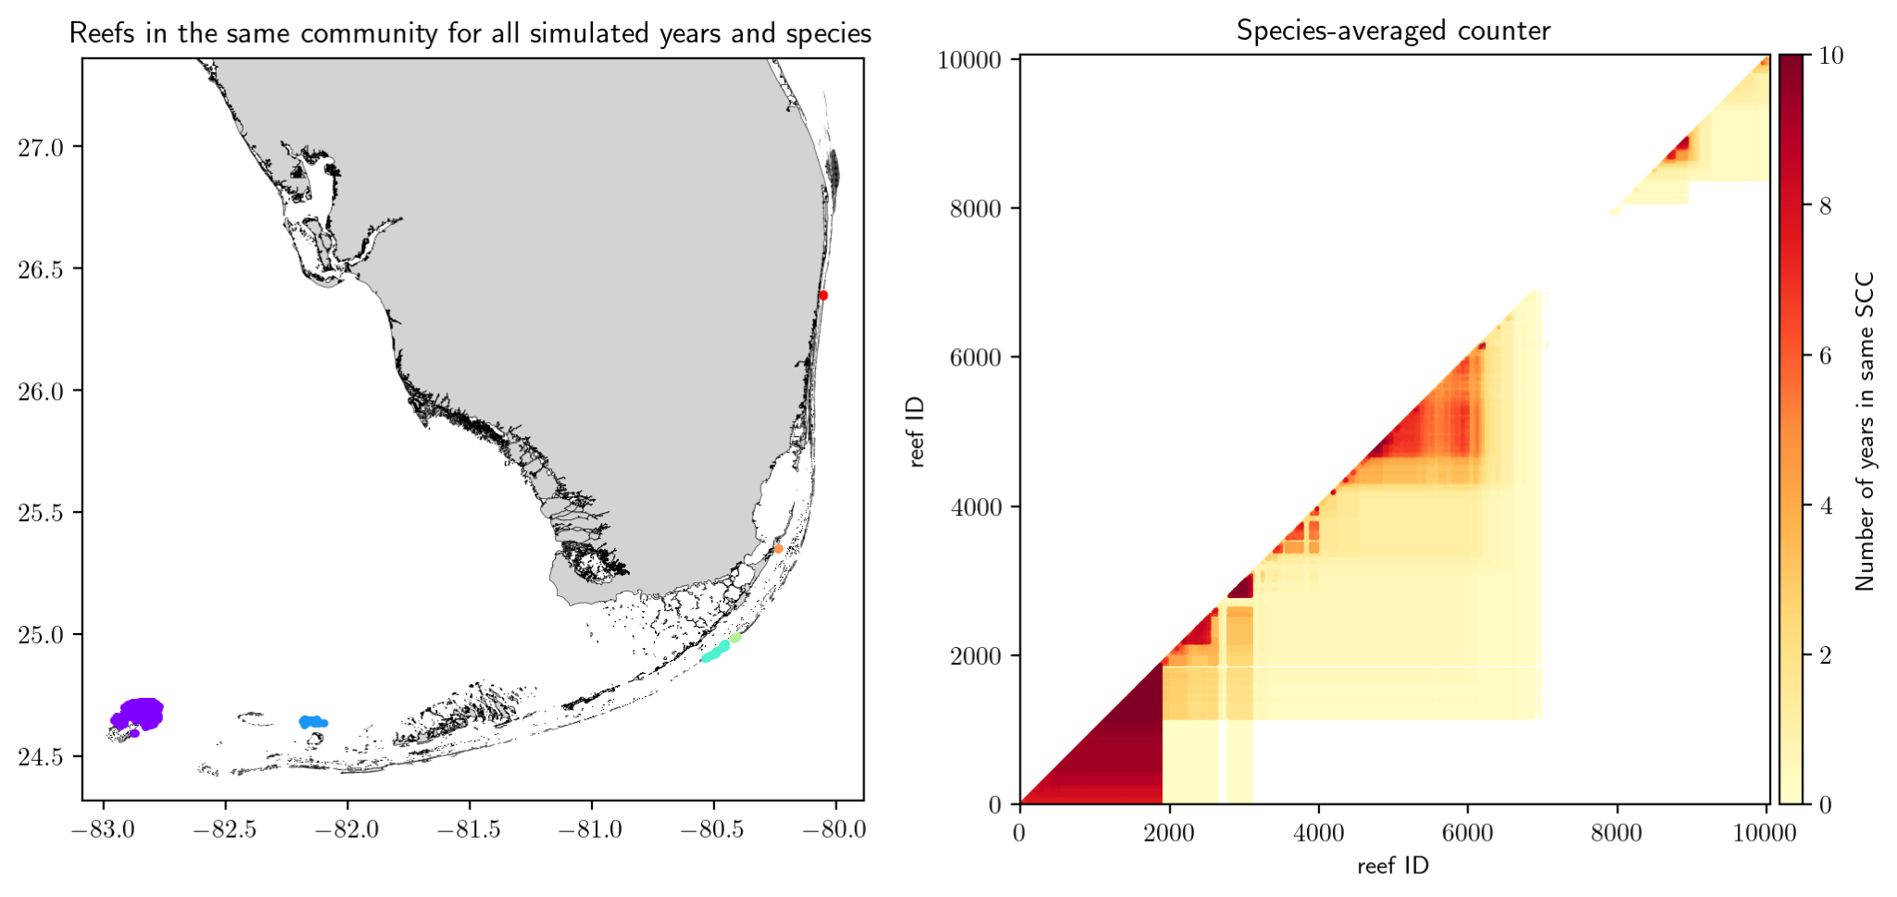
We evaluated the stability of the communities in the connectivity network
Strongly Connected Components algorithm identify group of reefs with numerous bidirectional connections
→ genetically well mixed
Dlab and Pstr present the largest number of reef pairs that remained in the same SCC during the 10 simulated years.
We can identify invariant components of the SCC
10

Slide 15
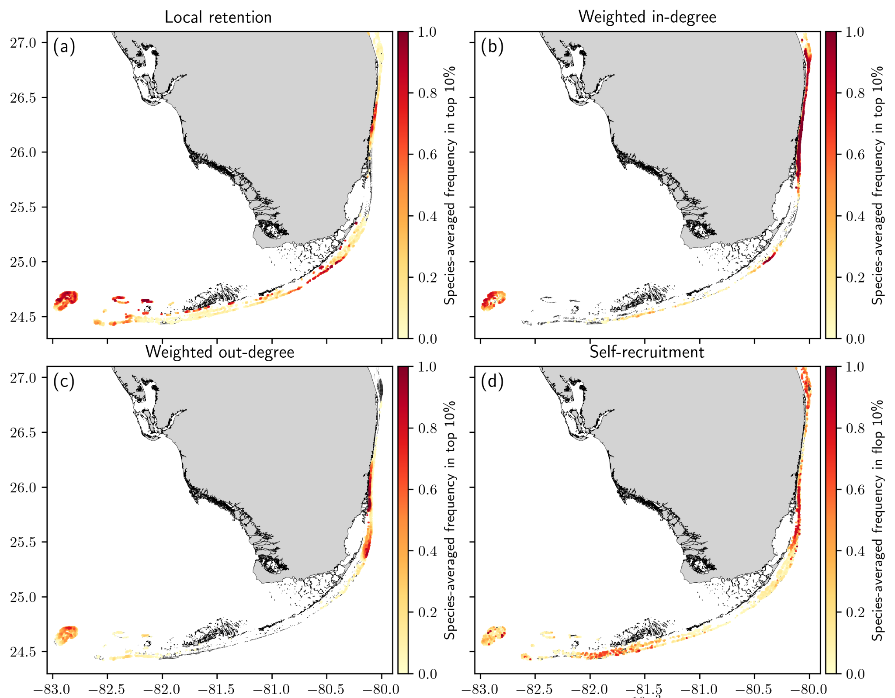
We developed an indicator to identify reefs with high restoration potential
Assumption: restoration sites should be:
good importer/exporters of larvae
able to self-replenish
not isolated
We computed the number of years in top/flop 10 % for the associated connectivity indicators
By combining these frequencies , we identify 3 clusters of good candidates for restoration
11

Slide 16
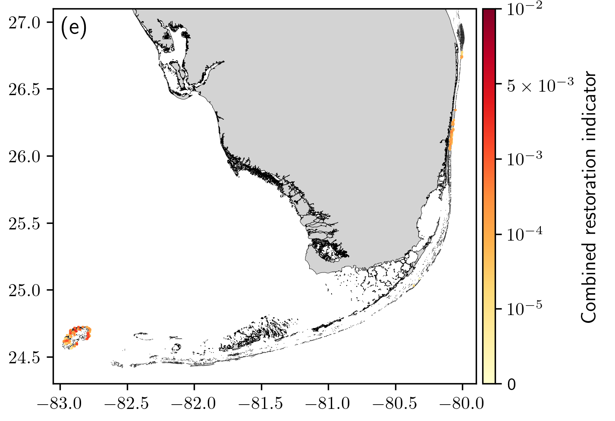

We developed an indicator to identify reefs with high restoration potential
Assumption: restoration sites should be:
good importer/exporters of larvae
able to self-replenish
not isolated
We computed the number of years in top/flop 10 % for the associated connectivity indicators
By combining these frequencies , we identify 3 clusters of good candidates for restoration
* These results are based solely on potential connectivity and should be combined with environmental data
11

Slide 17
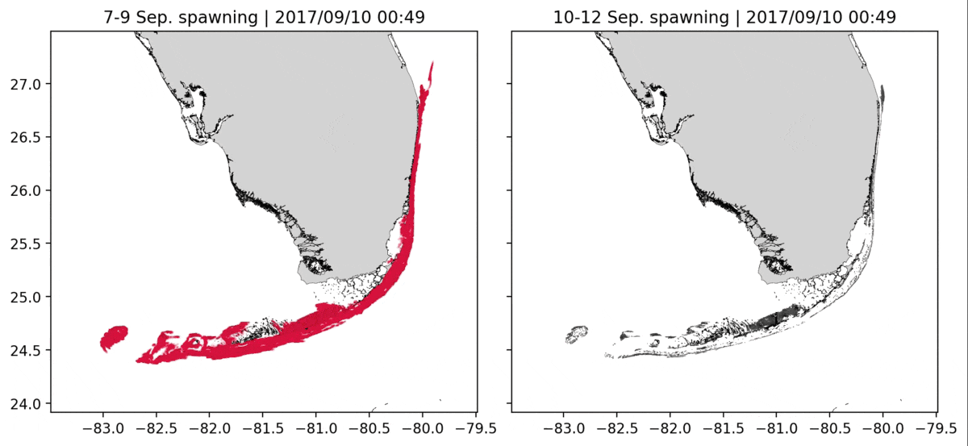
We simulated the dispersal of coral larvae and disease agents before and after the landfall of hurricane Irma
We then computed connectivity matrices with and without the influence of the hurricane, and compared them to evaluate the impact of Irma on disease propagation and larval dispersal
12

Slide 18
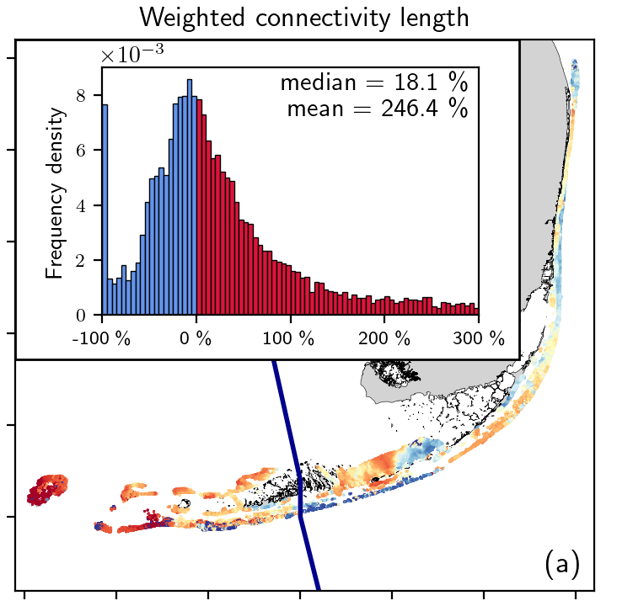
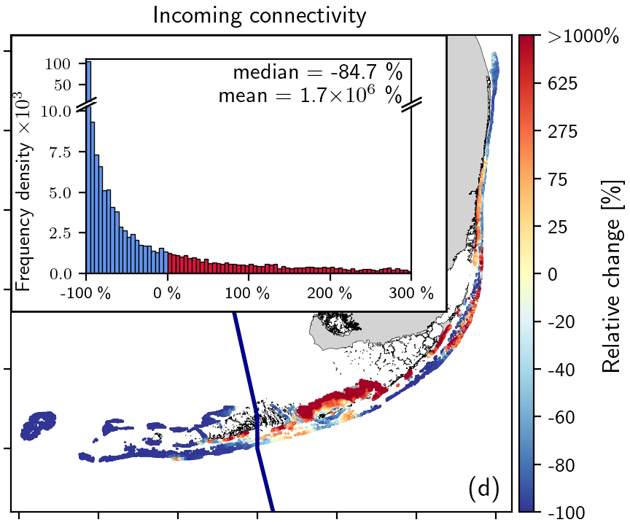
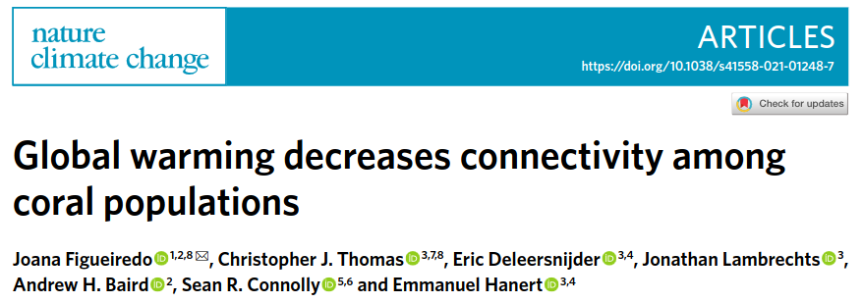
Irma locally promoted longer but weaker connections while reducing the larval supply of most reefs
The impact of Irma varied on either side of its track
Longer connections might partly counteract the expected effect of ocean warming on larval connectivity
13

Slide 19
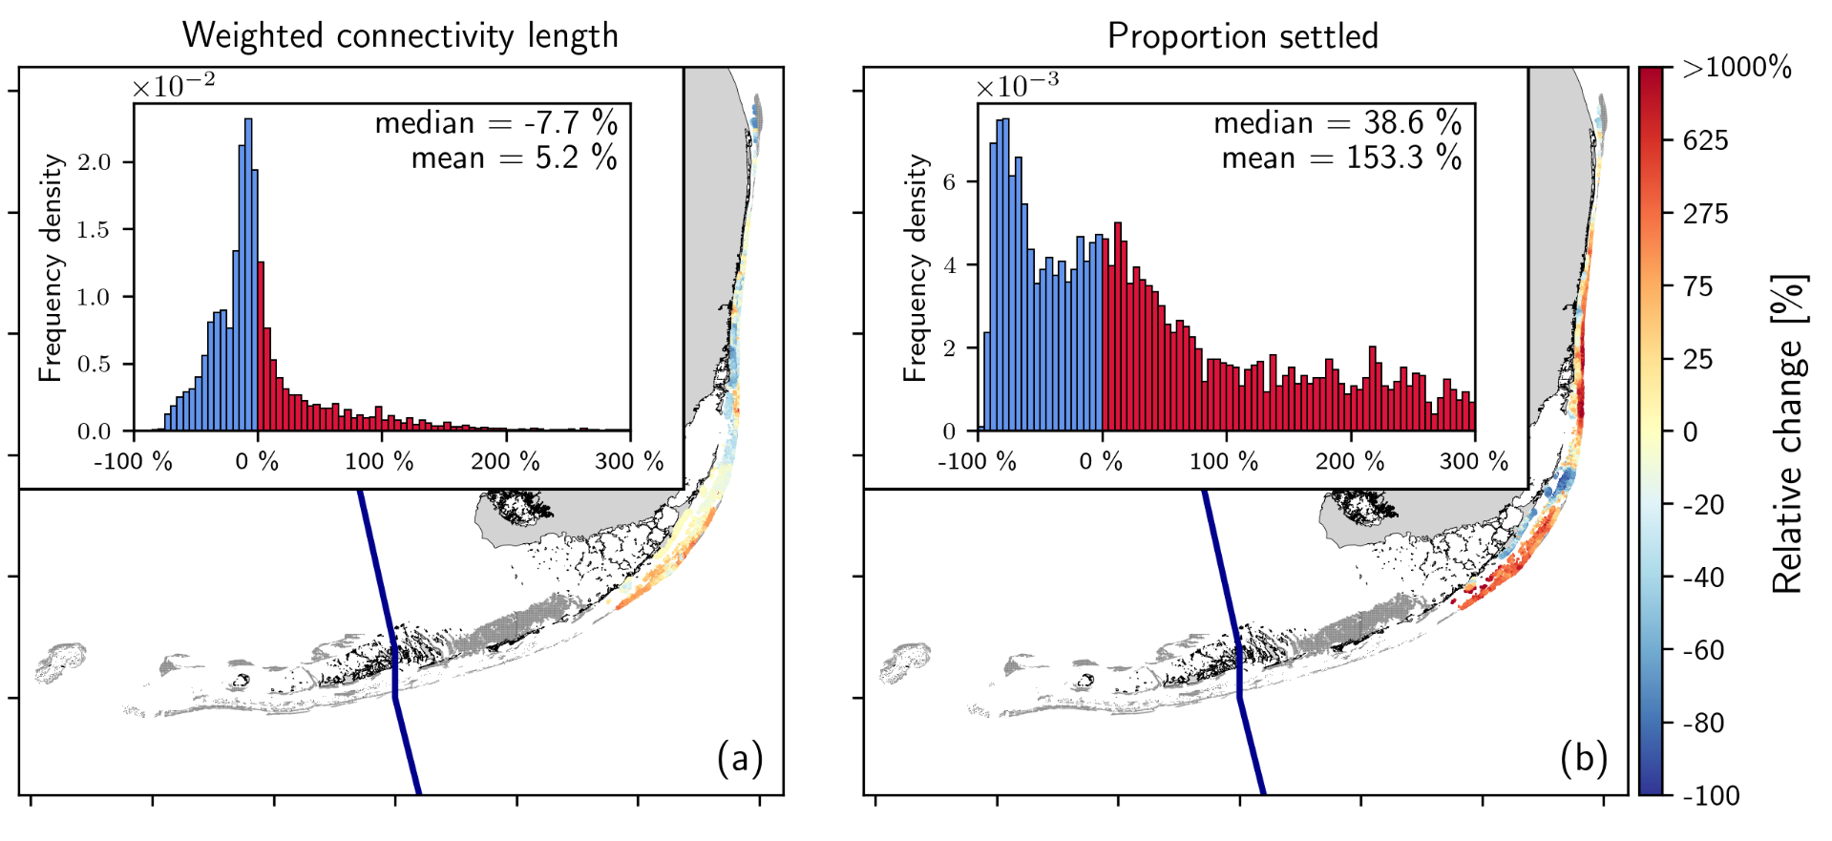
Irma likely acted as a superspreader event for SCTLD
Under the effect of the hurricane, agents released from the disease front reached reefs located further away and were more likely to settle
14

Slide 20
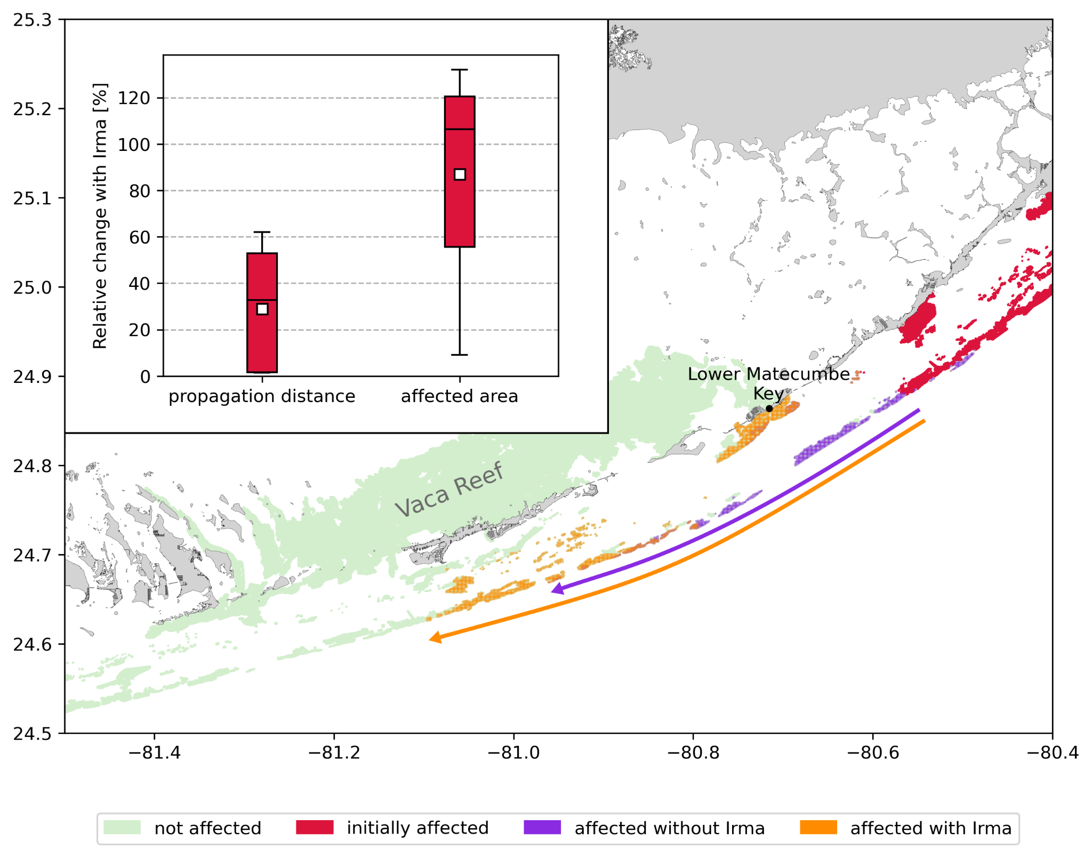
Epidemiological modeling suggests that Irma might have accelerated the propagation of SCTLD by up to 50 %
The connectivity matrices were given as input to a previously validated coupled epidemiological model
This model was run with different infection threshold values consistent with the observed spread of the disease
On average, the impact of Irma is equivalent to 25 days of disease propagation
15

