Slide 1


Emotional Intelligence Attenuates the Harmful Effects of Parental Perfectionism and Emotional Suppression on Parental Burnout: A Moderated Mediation Model
2021 Association for Psychological Science Virtual Convention
May, 2021
Gao-Xian Lin ¹ and Dorota Szczygieł ²
¹ Psychological Sciences Research Institute, Catholic University of Louvain, Belgium.
² Faculty in Sopot, SWPS, Poland.

Slide 2
1.
A Brief Introduction
2.
Research Design
Moderated mediation model
Perfectionism, Emotional Suppression, Emotional Intelligence, and Parental burnout
3.
Method & Result
4.
Take-Home Message

Slide 3

INTRODUCTION
The origin of the current research
The global increase of competitive individualism
Perfectionism
(Curran & Hill, 2019)
(Stober & Gaudreau, 2017)
(Santos et al., 2017)
Curran, T., & Hill, A. P. (2019). Perfectionism is increasing over time: A meta-analysis of birth cohort differences from 1989 to 2016. Psychological Bulletin, 145(4), 410–429.
Santos, H. C., Varnum, M. E. W., & Grossmann, I. (2017). Global Increases in Individualism. Psychological Science, 28(9), 1228–1239.
Stoeber, J., & Gaudreau, P. (2017). The advantages of partialling perfectionistic strivings and perfectionistic concerns: Critical issues and recommendations. Personality and Individual Differences, 104, 379–386.

Slide 4

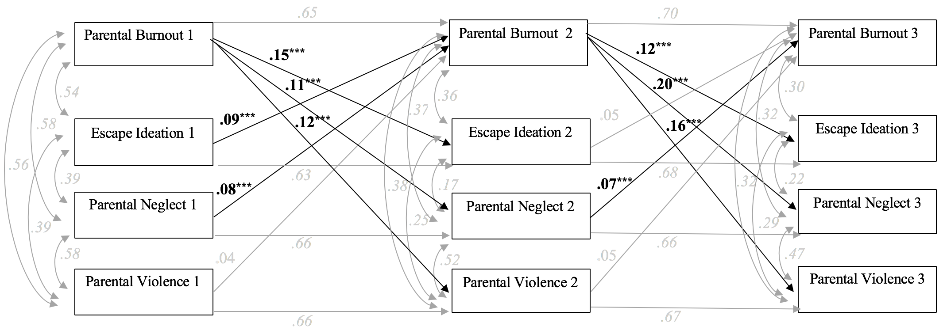
INTRODUCTION
Parenting perfectionism is required to be paid more attention
Parenting perfectionism
Perfectionism contextualized in parenting context
(Snell, 2005)
Perfectionistic strivings
Perfectionistic concerns
(e.g., Hubert & Aujoulat, 2018)
Parental burnout
A globally widespread psychological syndrome encompassing four key dimensions…
Exhaustion
Emotional distancing
Feeling of being fed up
Contrast with prior parental self
(see Roskam et al., 2018, 2021)
(e.g., Mikolajczak et al., 2019)
Hubert, S., & Aujoulat, I. (2018). Parental Burnout: When Exhausted Mothers Open Up. Frontiers in Psychology, 9.
Mikolajczak, M., Gross, J. J., & Roskam, I. (2019). Parental Burnout: What Is It and Why Does It Matter? Clinical Psychological Science, 7(6), 1319–1329.
Roskam et al. (2021). Parental Burnout Around the Globe: A 42-Country Study. Affective Science.
Roskam, I., Brianda, M.-E., & Mikolajczak, M. (2018). A Step Forward in the Conceptualization and Measurement of Parental Burnout: The Parental Burnout Assessment (PBA). Frontiers in Psychology, 9.
Snell, W. E., Overbey, G. A., & Brewer, A. L. (2005). Parenting perfectionism and the parenting role. Personality and Individual Differences, 39(3), 613–624.

Slide 5
INTRODUCTION
Parenting perfectionism-Parental burnout (PP-PB link) is robust across cultures
Western context
(Sorkkila & Aunola, 2020; Szczygieł, et al., 2020)
Eastern context
(Furutani et al., 2020)
Parenting perfectionism
Parental burnout
Perfectionistic concerns
Preoccupation with self-criticism including concern over mistakes and doubts about own behaviors
(Kawamoto et al., 2018; Lin et al., 2021)
Furutani, K., Kawamoto, T., Alimardani, M., & Nakashima, K. (2020). Exhausted parents in Japan: Preliminary validation of the Japanese version of the parental burnout assessment. New Directions for Child and Adolescent Development, 174. https://doi.org/10.1002/ cad.20371.
Kawamoto, T., Furutani, K., & Alimardani, M. (2018). Preliminary validation of Japanese version of the parental burnout inventory and its relationship with perfectionism. Frontiers in Psychology, 9. https:// doi.org/10.3389/fpsyg.2018.00970.
Lin, G.-X., Szczygieł, D., Hansotte, L., Roskam, I., & Mikolajczak, M. (2021). Aiming to be perfect parents increase the risk of parental burnout, but emotional competence mitigates it. Current Psychology. https://doi.org/10.1007/s12144-021-01509-w
Sorkkila, M., & Aunola, K. (2020). Risk factors for parental burnout among Finnish parents: The role of socially prescribed perfectionism. Journal of Child and Family Studies, 29(3), 648–659. https:// doi.org/10.1007/s10826-019-01607-1.
Szczygieł, D., Sekulowicz, M., Kwiatkowski, P., Roskam, I., & Mikolajczak, M. (2020). Validation of the polish version of the parental burnout assessment (PBA). New Directions in Child and Adolescent Development, 174, 137–158. https://doi.org/10.1002/ cad.20385.

Slide 6

INTRODUCTION
What is the mechanism underlying PP-PB link?
Parenting perfectionism
Parental burnout
Perfectionistic concerns
Preoccupation with self-criticism including concern over mistakes and doubts about own behaviors
Expressive suppression
(Kawamoto et al., 2018; Lin et al., 2021)
Furutani, K., Kawamoto, T., Alimardani, M., & Nakashima, K. (2020). Exhausted parents in Japan: Preliminary validation of the Japanese version of the parental burnout assessment. New Directions for Child and Adolescent Development, 174. https://doi.org/10.1002/ cad.20371.
Kawamoto, T., Furutani, K., & Alimardani, M. (2018). Preliminary validation of Japanese version of the parental burnout inventory and its relationship with perfectionism. Frontiers in Psychology, 9. https:// doi.org/10.3389/fpsyg.2018.00970.
Lin, G.-X., Szczygieł, D., Hansotte, L., Roskam, I., & Mikolajczak, M. (2021). Aiming to be perfect parents increase the risk of parental burnout, but emotional competence mitigates it. Current Psychology. https://doi.org/10.1007/s12144-021-01509-w
Sorkkila, M., & Aunola, K. (2020). Risk factors for parental burnout among Finnish parents: The role of socially prescribed perfectionism. Journal of Child and Family Studies, 29(3), 648–659. https:// doi.org/10.1007/s10826-019-01607-1.
Szczygieł, D., Sekulowicz, M., Kwiatkowski, P., Roskam, I., & Mikolajczak, M. (2020). Validation of the polish version of the parental burnout assessment (PBA). New Directions in Child and Adolescent Development, 174, 137–158. https://doi.org/10.1002/ cad.20385.

Slide 7
INTRODUCTION
Expressive suppression during parent-child interaction explains the PP-PB link
Expressive suppression
Involves the conscious and effortful inhibition of overt emotional expression, when one is emotionally aroused
(see Gross, 2014; Karnilowicz et al., 2019; Le & Impett, 2016)
Parenting perfectionism
Parental burnout
Perfectionistic concerns
(e.g., Newman et al., 2019)
(see Huppertz et al., 2020)
Expressive suppression
Gross, J. J. (Ed.). (2014). Handbook of Emotion Regulation. The Guilford Press.
Karnilowicz, H. R., Waters, S. F., & Mendes, W. B. (2019). Not in front of the kids: Effects of parental suppression on socialization behaviors during cooperative parent–child interactions. Emotion, 19(7), 1183–1191.
Le, B. M., & Impett, E. A. (2013). When Holding Back Helps: Suppressing Negative Emotions During Sacrifice Feels Authentic and Is Beneficial for Highly Interdependent People. Psychological Science, 24(9), 1809–1815.
Newman, B. N., Strickler, J. G., O’Brien, C., Lui, T., & Lynch, M. (2019). Deconstructing perfectionism in college students: Patterns of behavior, emotion, and cognition. Personality and Individual Differences, 145, 106–111.

Slide 8
INTRODUCTION
The Balance Between Risks and Resources (BR²) Theory of Parental Burnout
Parenting perfectionism
Perfectionistic concerns
Emotional intelligence
Expressive suppression
Stressor
Stressor
Resource
Resource
Stressor
Stressor
Balance in Parenting Context
Parentalité « ordinaire »
Lasts For a chronic period
Mikolajczak, M., & Roskam, I. (2018). A Theoretical and Clinical Framework for Parental Burnout: The Balance Between Risks and Resources (BR(2)). Frontiers in Psychology, 9.

Slide 9
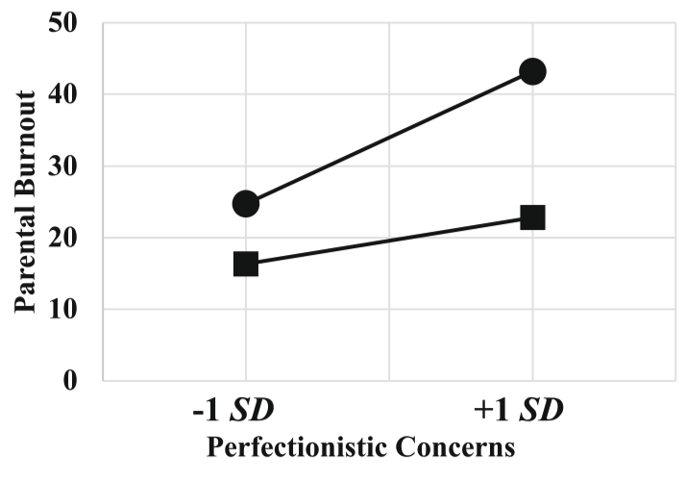
INTRODUCTION
Expressive suppression during parent-child interaction explains the PP-PB link
Emotional Intelligence
The extent to which individuals can identify, express, understand, regulate, and use their own and others’ emotions
(see Mayer & Salovey, 1997; Petrides et al., 2016)
(see Lin et al., 2021)
Emotional intelligence
Perfectionistic concerns
Parental burnout
Lin, G.-X., Szczygieł, D., Hansotte, L., Roskam, I., & Mikolajczak, M. (2021). Aiming to be perfect parents increase the risk of parental burnout, but emotional competence mitigates it. Current Psychology.
Mayer, J. D., & Salovey, P. (1997). What is emotional intelligence? In P. Salovey & D. J. Sluyter (Eds.), Emotional development and emotional intelligence: Educational implications (pp. 3–31). Basic Books.
Petrides, K. V., Mikolajczak, M., Mavroveli, S., Sanchez-Ruiz, M.-J., Furnham, A., & Pérez-González, J.-C. (2016). Developments in Trait Emotional Intelligence Research. Emotion Review, 8(4), 335–341.

Slide 10
INTRODUCTION
Expressive suppression during parent-child interaction explains the PP-PB link
Emotional Intelligence
The extent to which individuals can identify, express, understand, regulate, and use their own and others’ emotions
(see Mayer & Salovey, 1997; Petrides et al., 2016)
Emotional intelligence
(e.g., Bechtoldt et al., 2011)
Perfectionistic concerns
Expressive suppression
Parental burnout
Bechtoldt, M. N., Rohrmann, S., De Pater, I. E., & Beersma, B. (2011). The primacy of perceiving: Emotion recognition buffers negative effects of emotional labor. Journal of Applied Psychology, 96(5), 1087–1094.
Mayer, J. D., & Salovey, P. (1997). What is emotional intelligence? In P. Salovey & D. J. Sluyter (Eds.), Emotional development and emotional intelligence: Educational implications (pp. 3–31). Basic Books.
Petrides, K. V., Mikolajczak, M., Mavroveli, S., Sanchez-Ruiz, M.-J., Furnham, A., & Pérez-González, J.-C. (2016). Developments in Trait Emotional Intelligence Research. Emotion Review, 8(4), 335–341.

Slide 11

INTRODUCTION
PP-PB link: Expressive suppression as a mediator & emotional intelligence as a buffer
(1) Does expressive suppression mediate the association of perfectionistic concerns with parental burnout?
(2) Does emotional intelligence buffer both direct and indirect effects of perfectionistic concern on parental burnout through expressive suppression?
Emotional intelligence
Perfectionistic
concerns
Parental burnout
Expressive suppression

Slide 12
RESEARCH METHOD
Cross-sectional Data Collection
Participants: 439 Polish parents (65.1% mothers)
Analysis Strategy
Regression-based analysis (PROCESS macro 3.5)
(Hayes, 2018)
Measurements
α | Construct | Example Item
.97 | Parental burnout | I felt exhausted while caring for my children.
.71 | Perfectionistic concerns | As a parent, if I failed in part, it’s as bad as if I failed completely
.88 | Emotional intelligence | Expressing my emotions with words is not a problem for me
.85 | Expressive suppression | How often do you suppress rage when interacting with their child(ren) in the past 3-4 weeks
(PBA; Roskam et al., 2018)
(Lin et al., 2021)
(TEIQue-SF; Petrides, 2009; Polish version by Szczygieł et al., 2015)
Hayes, A. F. (2018). Introduction to mediation, moderation, and conditional process analysis: A regression-based approach (Second). Guilford Press.
Lin, G.-X., Szczygieł, D., Hansotte, L., Roskam, I., & Mikolajczak, M. (2021). Aiming to be perfect parents increase the risk of parental burnout, but emotional competence mitigates it. Current Psychology.
Petrides, K. V. (2009). Psychometric Properties of the Trait Emotional Intelligence Questionnaire (TEIQue). In J. D. A. Parker, D. H. Saklofske, & C. Stough (Eds.), Assessing Emotional Intelligence: Theory, Research, and Applications (pp. 85–101). Springer US. https://doi.org/10.1007/978-0-387-88370-0_5
Roskam, I., Brianda, M.-E., & Mikolajczak, M. (2018). A Step Forward in the Conceptualization and Measurement of Parental Burnout: The Parental Burnout Assessment (PBA). Frontiers in Psychology, 9. https://doi.org/10.3389/fpsyg.2018.00758
Szczygieł, D., Jasielska, A., & Wytykowska, A. (2015). Psychometric properties of the Polish version of the Trait Emotional Intelligence Questionnaire-Short Form. Polish Psychological Bulletin, 46(3), 447–459.

Slide 13
METHOD AND RESULT
Q1. Does expressive suppression mediate the association of perfectionistic concerns with parental burnout in their parenting?
Perfectionistic
concerns
B = 0.19**
B = 9.36***
Parental burnout
Expressive suppression
B = 6.12***
Indirect effect | Estimate | Bootstrapped SE | Bootstrapped 95% CI
Indirect effect | Estimate | SE | LL | UL
Perfectionistic concerns→ Parental burnout | 1.81 | 0.74 | 0.42 | 3.38
Note. This model was tested with perfectionistic strivings controlled
A1. Parents with higher tendency to perfectionistic concerns will adopt more expressive suppression, which in turn increases the risk to parental burnout
Yet, the positive direct effect remains significant

Slide 14
METHOD AND RESULT
Q2. Does emotional intelligence buffer both direct and indirect effects of perfectionistic concerns on parental burnout through expressive suppression?
Emotional intelligence
Index of moderated mediation = -1.29
with bootstrapped SE = 0.70 and 95% CI = [-2.92, -0.21]
Perfectionistic
concerns
Parental burnout
Expressive suppression
Conditional Indirect effect (Perfectionistic concerns→ Parental burnout) | Estimate | Bootstrapped SE | Bootstrapped 95% CI
Indirect effect | Estimate | SE | LL | UL
1 SD higher emotional intelligence | 0.79 | 0.44 | 0.06 | 1.74
1 SD lower emotional intelligence | 2.08 | 0.84 | 0.53 | 3.81
Note. This model was tested with perfectionistic strivings controlled
A2. A higher tendency of emotional intelligence buffers the indirect effect of perfectionistic concerns on parental burnout via expressive suppression.

Slide 15
METHOD AND RESULT
Q2. Does emotional intelligence buffer both direct and indirect effects of perfectionistic concerns on parental burnout through expressive suppression?
Emotional intelligence
Perfectionistic
concerns
Parental burnout
Expressive suppression
Conditional direct effect (Perfectionistic concerns→ Parental burnout) | Estimate | Bootstrapped SE | Bootstrapped 95% CI
Indirect effect | Estimate | SE | LL | UL
1 SD higher emotional intelligence | 1.13 | 1.65 | -2.11 | 4.36
1 SD lower emotional intelligence | 6.99 | 1.52 | 3.99 | 9.98
Note. This model was tested with perfectionistic strivings controlled
A higher tendency of emotional intelligence buffers the direct effect of perfectionistic concerns on parental burnout

Slide 16
CONCLUSION
Take-home message
Emotional intelligence
Perfectionistic
concerns
Parental burnout
Expressive suppression
It puts forward on previous research showing that it may be parents’ emotion regulation that explains the robust association of the trait—perfectionistic concerns with burnout.
It provide direct evidence in support of the BR² theory of PB, which predicts that risk factors can be compensated by equally weighty resources.
(Mikolajczak & Roskam, 2018)
An intervention to improve EI maybe be a substitute for a program to prevent PB.

Slide 17
Thank You!

