Slide 1



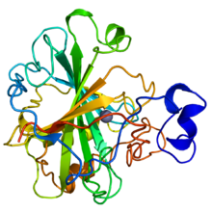
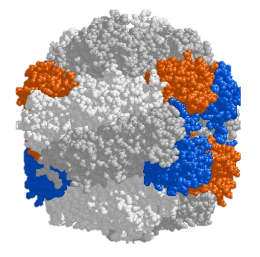

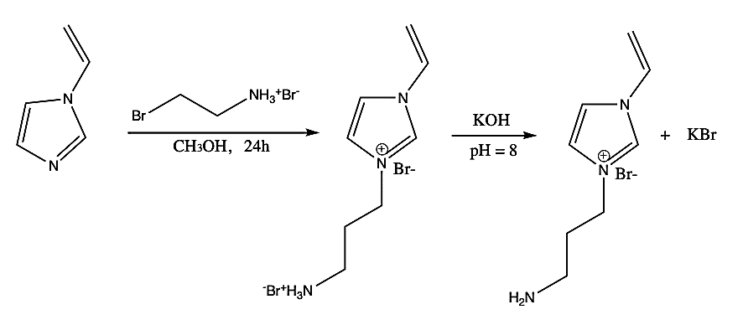

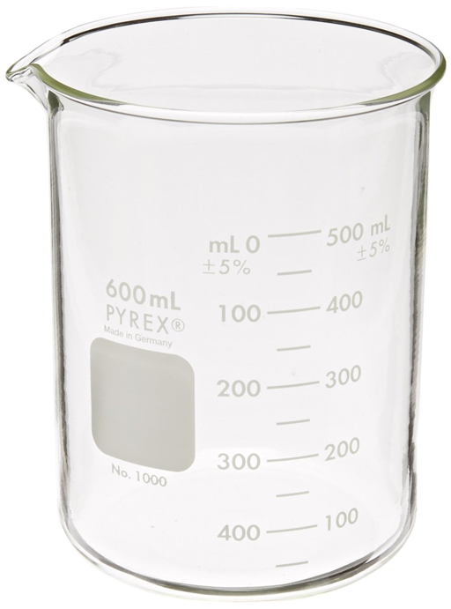
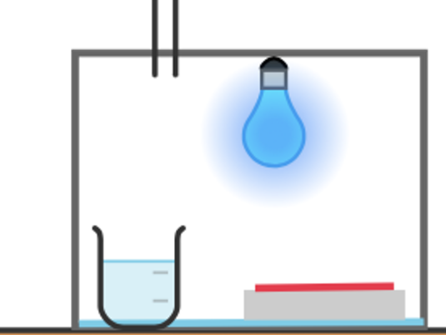

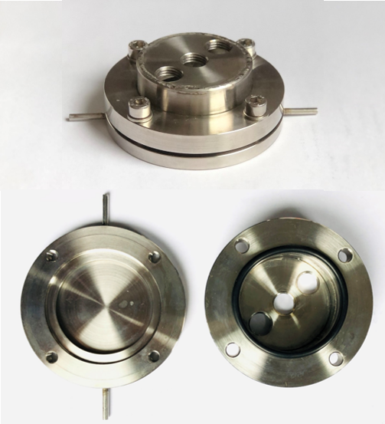
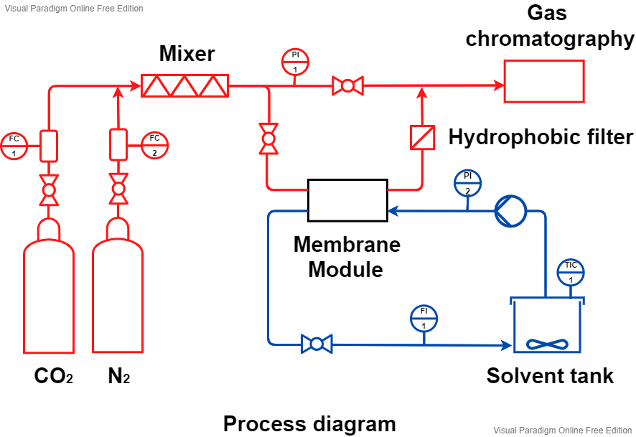
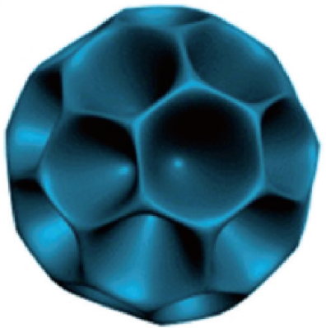

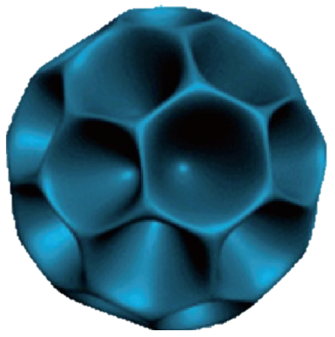



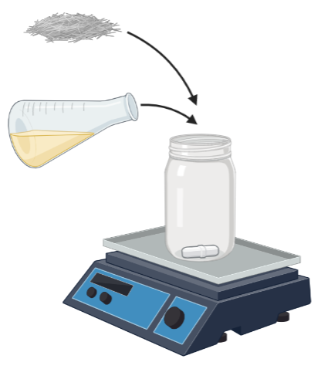


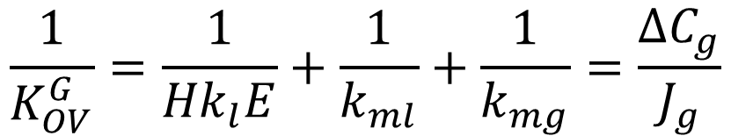










Polyionic liquid deposited biocatalytic membrane contactor for intensified CO₂ capture and conversion into bicarbonate
Kamyll Dawn Cocon¹, Kimberly Gonçalves Santos,
Cristhian Molina-Fernandez², Patricia Luis¹
¹ Institute of Mechanics Materials and Civil Engineering, IMAP, Université catholique de Louvain, Belgium
² Department of Chemical Engineering, Université de Liège, Belgium
UCLouvain
kamyll.cocon@uclouvain.be, patricia.luis@uclouvain.be
Proposal
Nature-inspired (cyanobacteria)
Context
Results and Discussion
HCO₃⁻
X
CO₂
CO₂
+ RUBP
3-PGA
+
-
+
-
Ionic liquid monomer composition
Porous membrane
CO₂
+
-
+
+
-
PVDF
PVDF - PDA
Problem
Carbonic
anhydrase
RuBisCO
Polyionic liquid
Solution
IL absent
Liquid
Liquid film
Gas film
Gas
Gas-phase
0.10 g/mL
0.25 g/mL
0.35 g/mL
Increase CO₂ transfer
CO₂
Monomer
CO₂
CO₂
$$C_{A,l}$$
$$C_{A,ml}$$
$$C_{A,m}$$
$$P_{A,mg}$$
$$P_{A,g}$$
CO₂
HCO₃⁻
Chitosan
1.5 %w/v
2.0 %w/v
3.0 %w/v
$$\frac{1}{k_{l}}$$
$$\frac{1}{k_{ml}}$$
$$\frac{1}{k_{mg}}$$
$$\frac{1}{k_{g}}$$
$$\frac{1}{K_{OV}^{G}}=\frac{1}{{Hk}_{l}E}+\frac{1}{k_{ml}}+\frac{1}{k_{mg}}=\frac{ΔC_{g}}{J_{g}}$$
Liquid-phase
Increasing IL monomer concentration resulted in increased viscosity and denser PIL coating
The objective is to increase CO₂ absorption in a benign, aqueous-based liquid absorbent by improving the overall mass transfer coefficient via: (1) catalyzing CO₂ conversion into HCO₃⁻ using carbonic anhydrase, (2) supporting the reaction by increasing CO₂ concentration near CA by using high-CO₂ affinity IL.
Increasing chitosan concentration resulted in decreased enzyme activity, probably due to reduced available amino groups for enzyme binding
Methodology
Enzyme immobilization
Imidazolium-based PIL layer preparation
IL monomer solution
Tris-HCl solution
50 mM,
pH 8.5
[VApIm][Br]: 0.1 – 0.35 g/mL
Chitosan: 0.3 – 0.5 %wt/v
2-hydroxy-2-methylpropiophenone
(1 %w/w)
[VApIm][Br] quaternary reaction
Dopamine: 2 mg/mL
Increasing glutaraldehyde concentration allowed more enzyme to be immobilized up to a point, and then results in lower activity due to stearic hindrance.
Increasing pH allows the enzyme to exhibit negative charge (pI = 5.9¹) that supports surface binding. At high pH (pH = 10), the enzymes suffers from denaturation
Tris-HCl,
50 mM
pH 8.5
+ + +
A
A
A
A
A
PIL layer
Tris-HCl solution
50 mM,
pH 8.5
- - -
Porous membrane
Polyvinylidenefluoride
Amino-functionalized
membrane
PIL-deposited membrane
CO₂ absorption test
Surface modification
+ 300%
Contact 2 h, 25 °C
Rinsing isopropanol
Drying 12h, 25 °C
Enzyme immobilization
Glutaraldehyde: 0.67 – 1.67 %v/v
B
B
+ 237%
B
B
B
N₂
Tris-HCl solution
50 mM,
pH 8.5
Enzyme solution
0.5 – 0.8 mg/mL,
pH 6 – 10
A
A
A
A
A
Reference
Enzyme immobilization
Biocatalytic membrane
PIL deposited biocatalytic membranes significantly increased overall CO₂ mass transfer coefficient. PIL synthesized in this work ([VApIm][Br]) showed better performance than in literature ([VEpIm][Br]).
UV-polymerization
2 h, N₂ rich environment
Neutralization
0.1 M Na₂CO₃, 2 h
Shaking 24 – 48 h, 25 °C
Wash Ultrapure Water
CO₂ absorption test
Reusability
Absorption conditions:
Gas flow-rate: 0.4 Ln/min
(15% CO_{2,} 85% N₂)
Liquid flow-rate: 0.6 L/min
(0.5 M Na₂CO₃)
25°C, 1 h
Cycle 0
Cycle 4 (post)
(c)
PIL deposited biocatalytic membrane was stable under the conditions studied (4 cycles).
Conclusion
Future work
The best IL monomer concentration (0.25 g/mL) and chitosan concentration (2.0 %w/v) was one that yielded smooth, well coated surface.
The best immobilization conditions resulted in optimum crosslinker concentration (1.0% v/v) for the available PIL amino binding group, under a pH condition (pH 9.0) that was optimal for electrostatic binding between the enzyme and PIL coated surface.
[VApIm][Br] that allowed covalent immobilization of CA resulted in up to 300% increased CO₂ capture performance relative to pristine PVDF membrane, and is reusable up to 4 times.
Improve enzyme loading:
Intensified CO₂ conversion:
Nanobiocatalyst³
Improve eco-friendliness:
Bio-based membranes
Dendritic nanoparticles
PLA
Center-radial
Pore²
Solvent
References
Acknowledgements
¹ Molina-Fernández, C. & Luis, P. Immobilization of carbonic anhydrase for CO2 capture and its industrial implementation: A review. J Co2 Util 47, 101475–101475 (2021).
² Du, X. & Qiao, S. Z. Dendritic Silica Particles with Center-Radial Pore Channels: Promising Platforms for Catalysis and Biomedical Applications. Small 11, 392–413 (2015).
³ Misson, M., Du, X., Jin, B. & Zhang, H. Dendrimer-like nanoparticles based β-galactosidase assembly for enhancing its selectivity toward transgalactosylation. Enzyme Microb Tech 84, 68–77 (2016).
This work is supported by the Communauté française de Belgique under the context of FRIA scholarship grant; and previously supported by the European Research Council, ERC starting grant.

