Slide 1





Effects of alcohol abstinence on a rapid recovery of social cognition
Bigot, A., Bukowski, H., Salavrakos, M., Samson, D. and De Timary, P.
BIGOT Alix
In collaboration with
Notes:
So I’m gonna present to you our results regarding SOD abilities, and more precisely recovery, in a sample of patients with severe alcohol use disorder

Slide 2


Introduction: SAUD and abstinence
SAUD
Depression
Anxiety
Cognitive functions
abstinence
Presence and quality of daily social interactions
= HC
Andersohn & Kiefer, (2004); Cordovil et al. (2010); Petit et al. (2017); Leclercq et al., (2014); de Timary et al., (2013)
Kaskuta et al. (2002); Kelly, et al. (2012); Kelly, et al. (2009); Mihókgéczi & Hatos (2019); Rupp, et al. (2017); Zywiak, et al. (2002)
Notes:
For starters, and to give you more context, we know that this disorder is often accompanied by high level of depression, anxiety, and are also characterized with impairments in terms of general cognitive functioning
However, we can see that following withdrawal, this different symptoms tend to reduce, and for a majority of patients, they reach levels that are comparable to HC
What’s interesting for today’s study is that the ability to remain abstinent after hospital discharge is predicted by the presence and quality of daily social interactions
These qualtive social interactions are hence a key leverage in order to maintain abstinence and recovery
While severe alcohol disorder is associated with cravings but also symptoms of depression and anxiety, all of them tend to descrease after detoxification and reach levels comparable to HC
Most of the alcohol craving symptoms reduce or disappear during alcohol withdrawal (Andersohn & Kiefer, 2004; Cordovil et al 2010; Petit et al 2017) and are generally accompanied by a reduction of symptoms of depression and anxiety (Petit et al, 2017; Leclercq et al, 2014; de Timary et al, 2013), and more generally negative affects (Cordovil et al, 2010a). In the majority of individuals with sAUD, these symptoms decrease after detoxification to levels comparable to those observed in healthy controls (Petit et al., 2017).
The ability to remain abstinent after hospital discharge is predicted by the presence and quality of daily social interactions (Kaskutas, Bond, & Humphreys, 2002; Kelly, Hoeppner, Stout, & Pagano, 2012; Kelly, Magill, & Stout, 2009; Mihókgéczi & Hatos, 2019; Rupp, Derntl, Osthaus, Kemmler, & Fleischhacker, 2017; Zywiak, Longabaugh, & Wirtz, 2002).

Slide 3
Introduction: social cognition in SAUD
SAUD
Social cognition deficits
Presence and quality of daily social interactions
Facial emotions recognition
Understanding social situations
Mentalizing
Interpersonal problems
Social isolation
Bora & Zorlu (2016); Maurage et al. (2015); Maurage et al. (2017); Thoma et al. (2013); Schmidt et al. (2016); Chou et al. (2011); Levola et al. (2014)
Notes:
But to engage and benefit from good social interactions, socio cognitive skills are required
And we know that this disorder is associated with various deficits on that level
For instance, in facial emotions recognition, understanding social situations by tracking and understanding social cues, and also mentalizing so understand the beliefs, thoughts, and intentions of someone else’s
Without surprise, these specific different impairments are hence related to interpersonal problems and social isolation in this population
So in light of the beneficial effects of detoxification on cognitive functioning and negative affects, and the importance of good socio cognitive skills for recovery, we wondered if and how detoxification would impact their recovery
Some studies have investigated facial emotions recognition after abstinence, and gave inconsistent results, but to our knowledge, understanding social situations and specifically mentalizing have not been investigated. And it’s this last facet that we want to focus on

Slide 4
Introduction: social cognition recovery in SAUD
SAUD
?
Social cognition deficits
Facial emotions recognition
Understanding social situations
Mentalizing
Foisy et al. (2007); Erol et al. (2017); Rupp et al. (2021)
?
Bora & Zorlu (2016); Maurage et al. (2015); Maurage et al. (2017); Thomas et al. (2013); Schmidt et al. (2016); Chou et al. (2011); Levola et al. (2014)
Notes:
But to engage and benefit from good social interactions, socio cognitive skills are required
And we know that this disorder is associated with various deficits on that level
For instance, in facial emotions recognition, understanding social situations by tracking and understanding social cues, and also mentalizing so understand the beliefs, thoughts, and intentions of someone else’s
Without surprise, these specific different impairments are hence related to interpersonal problems and social isolation in this population
So in light of the beneficial effects of detoxification on cognitive functioning and negative affects, and the importance of good socio cognitive skills for recovery, we wondered if and how detoxification would impact their recovery
Some studies have investigated facial emotions recognition after abstinence, and gave inconsistent results, but to our knowledge, understanding social situations and specifically mentalizing have not been investigated. And it’s this last facet that we want to focus on

Slide 5
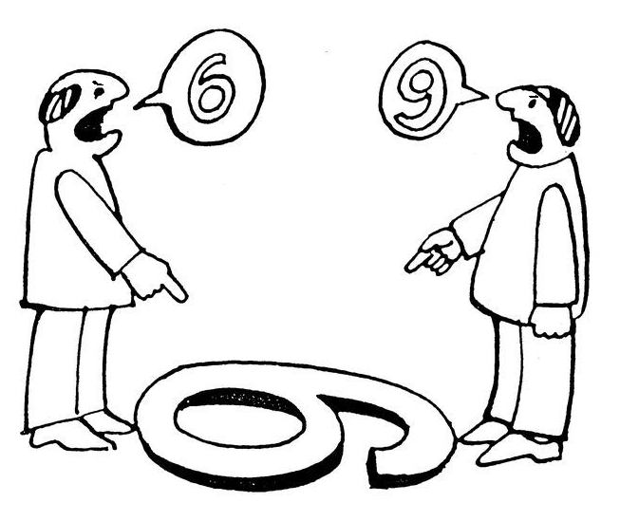
Introduction: Perspective-taking
- The cognitive and socio-emotional capacity to adopt another person’s point of view.
- It enables individuals to distinguish their own representations from those of others and to recognize that perspectives may differ.
SELF
OTHER
Notes:
In order to tackle this facet, we will focus on perspective taking which refers to the cognitive and socio-emotional capacity to adopt another person’s point of view, that is, to infer what others perceive, think, or feel in a given situation. It enables individuals to distinguish their own representations from those of others and to recognize that perspectives may differ.
To assess perspective taking skills, we have two dimensions
First, we have the self-other priority dimension, which refers to the extent one would focus more on the self perspective, or on the other perspective. In other words, in a social context, you are usually confronted with different individuals, and so with different perspectives that are available. The self-other priority dimension measures the extent your attention is going to be focused on your own perspective, what you perceive or feel, or what the other is seeing or feeling.
The second dimension is the self-other distinction dimension. It reflects the ability to inhibit an interference stemming from an irrelevant perspective. For instance, in this exemple, you can see that you see a 6. If you attempt to adopt the perspective of the other, but fail, you would probably project an egocentric interference, and argue that the other is also seeing a 6. It could also be the other way around, by focusing on the other, you could receive an interference coming from the other, and believe that you see a 9 although it’s incorrect. This ability to disentangle between conflicting perspectives hence reflect your capacity to distinguish yourself from others.
The ability to inhibit the irrelevant and conflicting perspective is recognized as a central ability or mechanism in social cognition (in empathy, ToM, and perspective taking), (Lamm, Bukowski, & Silani, 2016; Quesque & Rosseti, 2020)
Another strand of research has demonstrated that successfully inferring the other person’s mental state requires not only inhibiting the self-perspective but also being sufficiently attentive or sensitive to other people, particularly their social cues (Samson et al., 2005; Samson, Apperly, & Humphreys, 2007). This additional central component in social cognition, named self-other priority, refers to the extent to which one prioritizes the self-perspective over the other person’s perspective.

Slide 6
Introduction: Perspective-taking
SELF-OTHER PRIORITY
Attentional focus on the self or the other’s perspective
SELF-OTHER DISTINCTION
Ability to inhibit interferences from an irrelevant perspective
SELF
OTHER
Notes:
In order to tackle this facet, we will focus on perspective taking which refers to the cognitive and socio-emotional capacity to adopt another person’s point of view, that is, to infer what others perceive, think, or feel in a given situation. It enables individuals to distinguish their own representations from those of others and to recognize that perspectives may differ.
To assess perspective taking skills, we have two dimensions
First, we have the self-other priority dimension, which refers to the extent one would focus more on the self perspective, or on the other perspective. In other words, in a social context, you are usually confronted with different individuals, and so with different perspectives that are available. The self-other priority dimension measures the extent your attention is going to be focused on your own perspective, what you perceive or feel, or what the other is seeing or feeling.
The second dimension is the self-other distinction dimension. It reflects the ability to inhibit an interference stemming from an irrelevant perspective. For instance, in this exemple, you can see that you see a 6. If you attempt to adopt the perspective of the other, but fail, you would probably project an egocentric interference, and argue that the other is also seeing a 6. It could also be the other way around, by focusing on the other, you could receive an interference coming from the other, and believe that you see a 9 although it’s incorrect. This ability to disentangle between conflicting perspectives hence reflect your capacity to distinguish yourself from others.

Slide 7
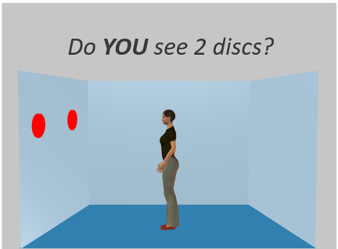
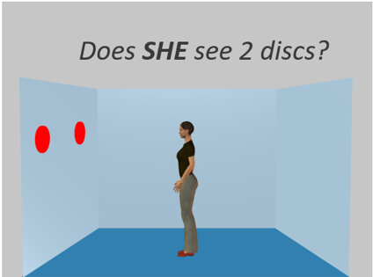
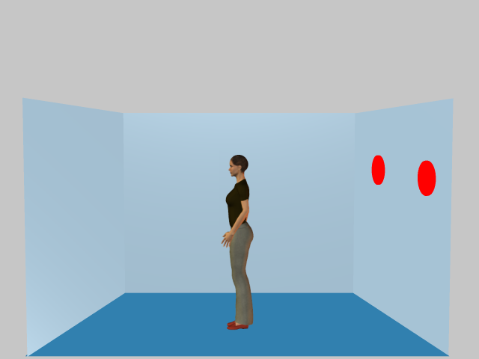
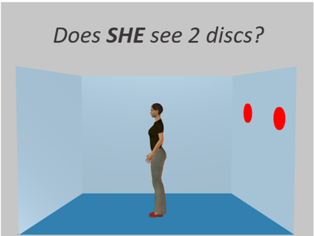
Introduction: VPT level 1
SELF-OTHER PRIORITY (SOP)
Samson et al., 2010
Self-Perspective
Other-Perspective
SOD:
Incongruent vs. Congruent
SOP:
Other-perspective vs. self-perspective
BIS scores:
mean(Z* Response time and Z* accuracy)
*Z transformation based on M and SD of HC
Size of the interference
Congruent
SELF-OTHER DISTINCTION (SOD)
Do YOU see 2 discs?
Incongruent
Notes:
To objectively assess these 2 dimensions, we use the visual perspective taking task level 1
In this task, as a participant, you are facing a screen on which is displayed a scene with an avatater in the middle of a room. It’s either looking at the right or left wall, on which can appear up to 3 red discs.
In this trial, you can see that you and the avatar are perceiving the same number of discs, so the perspectives are congruent as there is no conflict
We also have incongruent trials, where both perspectives are in conflict, which can create interferences when you try to adopt a perspective
When you compare the performance in terms of response time and accuracy, you obtain the self-other distinction index, so to what extent are you faster and more accurate to respond when there is no conflict compared to when there is.
What is important to say is that this SOD score reflects the extent of the interference, so a higher score reflects a poorer SOD, so more interference that you fail to inhibit.
In both these trials, you can see that the instructions is asking whether YOU see 2 discs; it’s the SELF condition trial
We also have OTHER-condition trials, when you have to respond based on the other’s perspective.
By comparing the performance between self and other trials, regardless of the presence of conflict, you can measure the self-other priority index, so to what extent are you faster and more accurate to respond for the self or the other perspective.
To combine response time and accuracy and account for trade-off effect, we computed bis scores based on Z transformation from each modality.

Slide 8
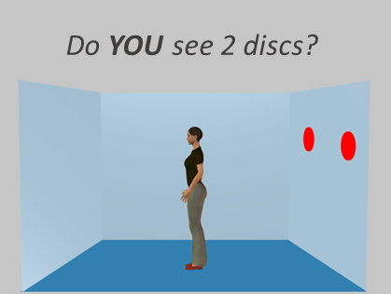
Sample and procedure:
2 distinct samples (St Luc Hospital)
  20 SAUD and 20 HC → 19 SAUD at T2
    Matched on age gender and education (ts (38) < .369), ps > .713)
  52 SAUD and 16 HC → 49 SAUD and 11 HC at T2
    Matched on age gender but not education (t_{age}(69) = .711), p = .484; t_{educ}(69) = .159, p < .001; HC > SAUD)
4/5 days of abstinence before testing
T1
1 to 4 days post admission
T2
12 to 16 days post admission
abstinence
Visual
perspective-taking
Visual
perspective-taking
Notes:
Patients were tested once 1 to 4 days after admission to an alcohol abstinence program and again 12-16 days later.
The sAUD patients were diagnosed according to the DSM-IV criteria in the Saint Luc University Hospital and were part of an alcohol abstinence program (they did not present any Axis I comorbidity).

Slide 9
Sample and procedure:
T1
1 to 4 days post admission
T2
12 to 16 days post admission
abstinence
Visual
perspective-taking
Visual
perspective-taking
Study 1 | 20 SAUD and 20 HC |  | 19 SAUD and 20 HC
 | Matched on age gender and education (ts (38) < .369), ps > .713)
Study 2 | 52 SAUD and 16 HC |  | 49 SAUD and 11 HC
 | Matched on age gender but not education (t_{age}(69) = .711), p = .484; t_{educ}(69) = .159, p < .001; HC > SAUD)
Notes:
Regarding the sample and the procedure, we collected data on patients from St luc hospital in brussels
They were first tested 1 to 4 days post admission, and they did not consume alcohol for 4 to 5 days before admission.
They stayed for around 2 weeks in the hospital, and were tested a second time 12 to 16 days post admission.
We used 2 distinct samples: the first one comprised 20 saud patients and 20 HC at t1, but one SAUD was not included at T2
In the second sample, we had 52 SAUD patients and 16 HC, but 49 saud and 11 HC at T2. They were all matched on age and gender, but not on education in the 2nd sample.
Patients were tested once 1 to 4 days after admission to an alcohol abstinence program and again 12-16 days later.
SOD T1 in HC correlated with educ(-) p=,018
The sAUD patients were diagnosed according to the DSM-IV criteria in the Saint Luc University Hospital and were part of an alcohol abstinence program (they did not present any Axis I comorbidity).

Slide 10
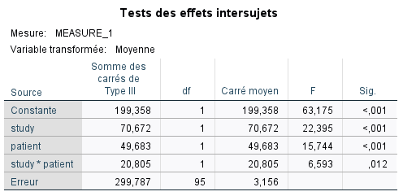
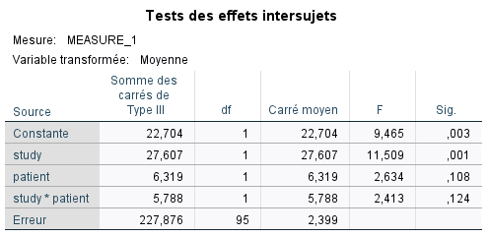
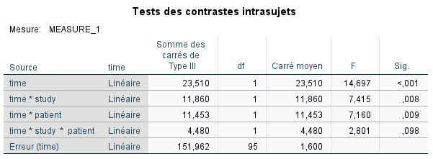
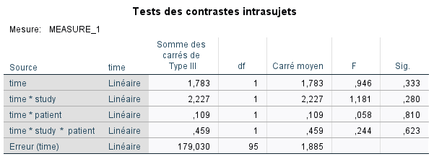
Results: studies comparability
SOD
SOP

Slide 11
Results: studies comparability
General linear models
  Group (HC vs. SAUD)***
  Study ***
    Group x Study
  Time (T1 vs. T2)***
    Time x Group**
    Time x Study**
    Time x Group x Study
SOD
F_{(1,95)} = 15,74 ; p <,001
F_{(1,95)} = 22,39 ; p < ,001
F_{(1,95)} = 20,80 ; p = ,012
F_{(1,95)} = 23,21 ; p < ,001
F_{(1,95)} = 7,16 ; p = ,009
F_{(1,95)} = 7,41 ; p = ,008
F_{(1,95)} = 2,80 ; p = ,098
***
***
*
***
**
**
Notes:
To verify the studies’ comparability, we computed 2 general linear models.
In short, we found that the participants from each study differed significantly on both SOD and SOP, indicating that we could not combine them.
Also, the computation of each model showed that there were no significant results on the SOP index besides the study effect, so we will essentially focus on the SOD index in the next slides.

Slide 12
Results: studies comparability
General linear models
  Group (HC vs. SAUD)***
  Study ***
    Group x Study*
  Time (T1 vs. T2)***
    Time x Group**
    Time x Study**
    Time x Group x Study
SOD
F_{(1,95)} = 15,74 ; p <,001
F_{(1,95)} = 22,39 ; p < ,001
F_{(1,95)} = 20,80 ; p = ,012
F_{(1,95)} = 23,21 ; p < ,001
F_{(1,95)} = 7,16 ; p = ,009
F_{(1,95)} = 7,41 ; p = ,008
F_{(1,95)} = 2,80 ; p = ,098
SOP
F_{(1,95)} = 2,63 ; p = 108
F_{(1,95)} = 11,51 ; p = ,001
F_{(1,95)} = 2,41 ; p = ,124
F_{(1,95)} = 0,95 ; p = ,333
F_{(1,95)} = 0,58 ; p = ,810
F_{(1,95)} = 1,18 ; p = ,280
F_{(1,95)} = 0,244 ; p = ,623
*
Notes:
To verify the studies’ comparability, we computed 2 general linear models.
In short, we found that the participants from each study differed significantly on both SOD and SOP, indicating that we could not combine them.
Also, the computation of each model showed that there were no significant results on the SOP index besides the study effect, so we will essentially focus on the SOD index in the next slides.

Slide 13
Results: studies comparability
General linear models
  Group (HC vs. SAUD)***
  Study ***
    Group x Study*
  Time (T1 vs. T2)***
    Time x Group**
    Time x Study**
    Time x Group x Study
SOD
F_{(1,95)} = 15,74 ; p <,001
F_{(1,95)} = 22,39 ; p < ,001
F_{(1,95)} = 20,80 ; p = ,012
F_{(1,95)} = 23,21 ; p < ,001
F_{(1,95)} = 7,16 ; p = ,009
F_{(1,95)} = 7,41 ; p = ,008
F_{(1,95)} = 2,80 ; p = ,098
SOP
F_{(1,95)} = 2,63 ; p = 108
F_{(1,95)} = 11,51 ; p = ,001
F_{(1,95)} = 2,41 ; p = ,124
F_{(1,95)} = 0,95 ; p = ,333
F_{(1,95)} = 0,58 ; p = ,810
F_{(1,95)} = 1,18 ; p = ,280
F_{(1,95)} = 0,244 ; p = ,623
*
Notes:
To verify the studies’ comparability, we computed 2 general linear models.
In short, we found that the participants from each study differed significantly on both SOD and SOP, indicating that we could not combine them.
Also, the computation of each model showed that there were no significant results on the SOP index besides the study effect, so we will essentially focus on the SOD index in the next slides.

Slide 14
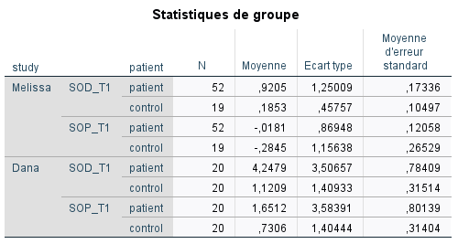
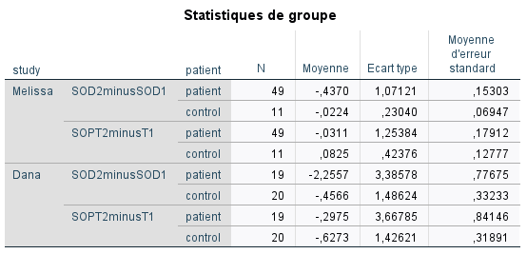
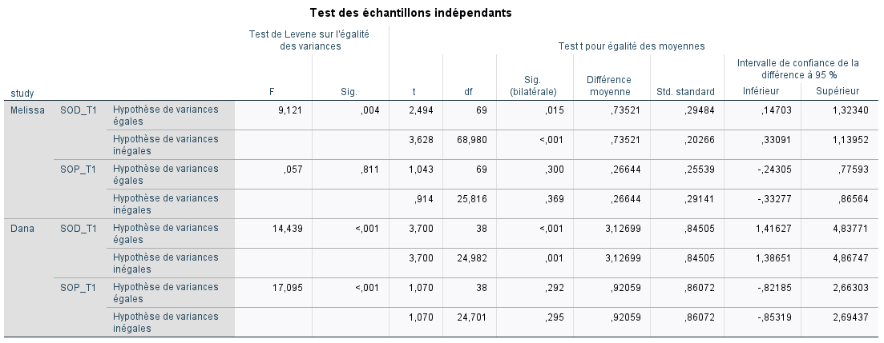
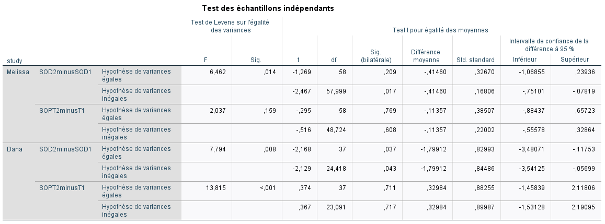
Results on SOP
No significant difference on SOP.
Notes:
Je ne sais pas si ça sert à quelque chose de rajouter cette slide après le GLM

Slide 15
Results on SOD: group comparisons
T1
1 to 4 days post admission
SAUD more interfered than HC
Study 1
SAUD > HC t(24,98) = 3,700 ; p = ,001
Study 2
SAUD > HC t(68,98) = 3,628 ; p < ,001
Notes:
We first compared performance between the SAUD and HC at T1.
In the first sample, we found that the patients were significantly more interfered than HC before detoxification.
And this result was replicated also in the 2nd sample

Slide 16
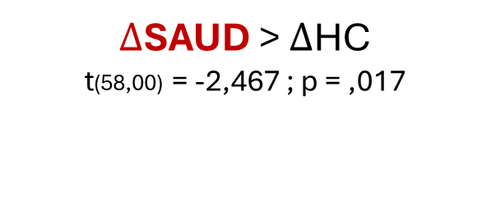
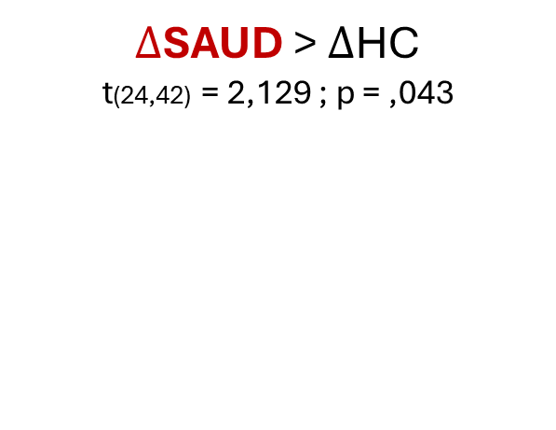
Results on SOD: group comparisons
T1
1 to 4 days post admission
T2
12 to 16 days post admission
abstinence
Improvement index: SOD T2 – T1
SAUD more interfered than HC
More improvement in SAUD than in HC
Study 1
SAUD > HC t(24,98) = 3,700 ; p = ,001
$∆$SAUD > $∆$HC t(24,42) = 2,129 ; p = ,043
Study 2
SAUD > HC t(68,98) = 3,628 ; p < ,001
$∆$SAUD > $∆$HC t(58,00) = -2,467 ; p = ,017

Slide 17
Results on SOD: group comparisons
T1
1 to 4 days post admission
T2
12 to 16 days post admission
abstinence
SAUD more interfered than HC
Improvement only in SAUD
SAUD not more interfered than HC
Study 1
SAUD > HC t(24,98) = 3,700 ; p = ,001
SAUD T1 > SAUD T2 t(18) = 2,904 ; p = ,009 HC T1 = HC T2 t(19) = -1,374 ; p = ,185
SAUD ~ HC t(37) = 1,852 ; p = ,072
Study 2
SAUD > HC t(68,98) = 3,628 ; p < ,001
SAUD T1 > SAUD T2 t(48) = 2,856 ; p = ,006 HC T1 = HC T2 t(10) = 0,323 ; p = ,753
SAUD ~ HC t(53,79) = 1,416 ; p = ,163
Notes:
Now comparing the evolution of performance before and after abstinence, we found that the patients improved over time, with a significant reduction of interference. Intersetingly, we did not find such improvement in the control group.
This evolution of performance led to a performance at T2 that was no longer different from those of the HC.
However, looking at the p-values that remained marginal, we wanted to investigate the potential variance in terms of improvement, and look at the “profiles” of evolution in our patients

Slide 18
Results on SOD: trajectories
T1
abstinence
T2
 | Mean HC | CI 95% HC |  | Mean HC | CI 95% HC
Study 1 | 1,121 | [0,0462 ; 1,780] |  | 0,664 | [0,311 ; 1,017]
Study 2 | 0,185 | [-0,035 ; 0,406] |  | 0,253 | [0,171 ; 0,334]
 | SAUD
More interfered than HC | 56,9%
Similar to HC | 38,9%
Less interfered than HC | 4,2%
 | SAUD
More interfered than HC | 38,9%
Similar to HC | 20,8%
Less interfered than HC | 34,7%
Notes:
To that end, for each of our patients, we rated whether their sod performance was comparable to those of the controls by using their confidence intervals, at each time of measurement.
At T1, we saw that almost 60% of the sample was more interfered that HC, and that this proportion reduced to less than 40% at T2, and with the rest of the sample being equivalent or even less interfered than controls
What is interesting, also, is that looking at T1, we had a quite important proportion of patients that were similar to HC, and 5% that were even less interfered, hence suggesting the existence of an important heterogeneity in terms of socio-cognitive profiles before detoxification.

Slide 19

Results on SOD: trajectories
T1
abstinence
T2
 | SAUD
Improved | 50,0%
Stable | 38,2%
Decreased | 11,8%
BDI T2
r(33) = -,407; p = ,019
BDI T1
r(34) = -,347; p = ,045
$$∆ SOD$$
 | SAUD
More interfered than HC | 56,9%
Similar to HC | 38,9%
Less interfered than HC | 4,2%
 | SAUD
More interfered than HC | 38,9%
Similar to HC | 20,8%
Less interfered than HC | 34,7%
Notes:
Overall, when looking at the specific trajectories, we found that 50% of our SAUD sample generally improved, whild 38% remained stable and almost 12% got worse over time.
One way to explain the potential predisposition for improvement in SOD over time is the depression levels of our patients, as we found negative correlations with both BDI scores at T1 and at T2 with the SOD improvement score. These negative correlations indicate that the less depressed the patient reported they were, the more they would improve between T1 and T2. In another words, the general depression levels may hinder the recovery of self-other distinction
BDI as a trait
Levels overall diminish over time
Moderation: depression level hinder the beneficts of treatments
BDI T1 and BDI T2 correlated with SOT12
→ Having less symptoms of depression is associated with better improvement and reduction and interference

Slide 20

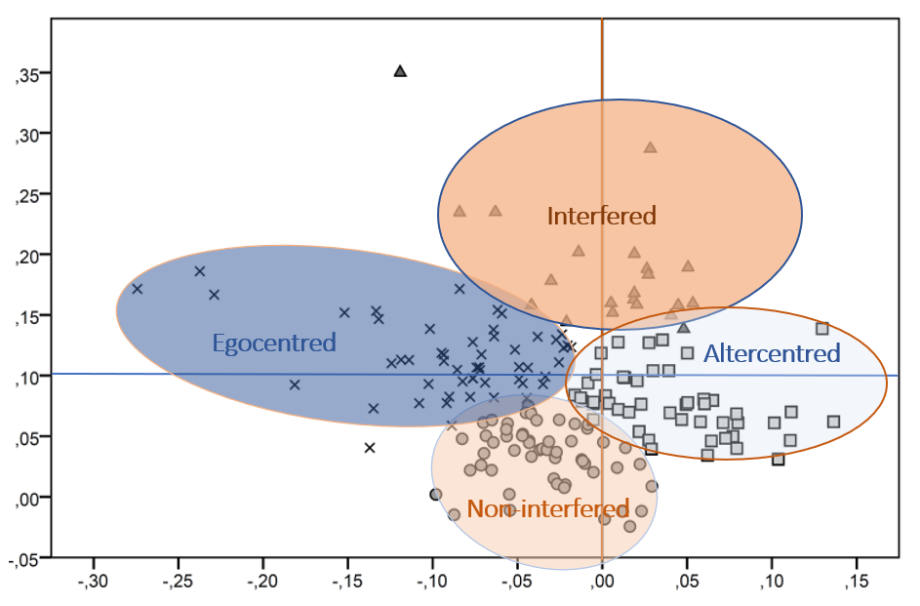
Conclusion
SAUD are more interfered than HC at the begining of treatment
SAUD reduced their interferences after 2 weeks of treatment
Mean SAUD performance reached controls’ SOD score
50% of SAUD patients improved over time
Heterogeneity of performance within groups and across time
            - Cluster/profile of performance?
            - Transdiagnostic approach?
SOP
SOD
Notes:
To conclude, we found that SAUD patients showed greater sensitivity to interferences than controls before abstinence;
however, after two weeks of detoxification, 50% of them improved,
and the group’s mean performance reached levels comparable to healthy controls.
We are still in thoughts the explanation and significance of these results, and as I am not a clinician in the field, or even at all, I really welcome any inputs regarding our results
Finally, in regard to the heterogeneity we observed, we encourage future research to examine in greater detail the potential heterogeneity of socio-cognitive profiles and trajectories, as patients with more severe impairments may benefit from more tailored interventions.

Slide 21




Thank you for your attention !
Henryk Bukowski
Dana Samson
Melissa Salavrakos
Philippe de Timary
Contact: alix.bigot@uclouvain.be

Slide 22
References
Andersohn, F., & Kiefer, F. (2004). Depressive mood and craving during alcohol withdrawal: Association and interaction. German Journal of Psychiatry, 7(2), 6–11.
Bora, E., & Zorlu, N. (2017). Social cognition in alcohol use disorder: a meta‐analysis. Addiction, 112(1), 40-48.
Chou, K. L., Liang, K., & Sareen, J. (2011). The association between social isolation and DSM-IV mood, anxiety, and substance use disorders: Wave 2 of the National Epidemiologic Survey on Alcohol and Related Conditions. Journal of Clinical Psychiatry, 72(11), 1468–1476. https://doi.org/10.4088/JCP.10m06019gry
Cordovil De Sousa Uva, M., Luminet, O., Cortesi, M., Constant, E., Derely, M., & De Timary, P. (2010). Distinct Effects of Protracted Withdrawal on Affect, Craving, Selective Attention and Executive Functions among Alcohol-Dependent Patients. Alcohol and Alcoholism, 45(3), 241–246. https://doi.org/10.1093/alcalc/agq012
de Timary, P., Cordovil de Sousa Uva, M., Denoël, C., Hebborn, L., Derely, M., Desseilles, M., & Luminet, O. (2013). The Associations between Self-Consciousness, Depressive State and Craving to Drink among Alcohol Dependent Patients Undergoing Protracted Withdrawal. PLoS ONE, 8(8). https://doi.org/10.1371/journal.pone.0071560
Kaskutas, L. A., Bond, J., & Humphreys, K. (2002). Social networks as mediators of the effect of Alcoholics Anonymous. Addiction, 97(7), 891-900.
Kelly, J. F., Hoeppner, B., Stout, R. L., & Pagano, M. (2012). Determining the relative importance of the mechanisms of behavior change within Alcoholics Anonymous: a multiple mediator analysis. Addiction, 107(2), 289–299. https://doi.org/10.1111/j.1360-0443.2011.03593.x
Leclercq, S., Matamoros, S., Cani, P. D., Neyrinck, A. M., Jamar, F., Stärkel, P., ... & Delzenne, N. M. (2014). Intestinal permeability, gut-bacterial dysbiosis, and behavioral markers of alcohol-dependence severity. Proceedings of the National Academy of Sciences, 111(42), E4485-E4493.
Levola, J., Aalto, M., Holopainen, A., Cieza, A., & Pitkänen, T. (2013). Health-related quality of life in alcohol dependence: A systematic literature review with a specific focus on the role of depression and other psychopathology. Nordic Journal of Psychiatry, 68(6), 369–384. https://doi.org/10.3109/08039488.2013.852242

Slide 23
References
Maurage, F., de Timary, P., Tecco, J. M., Lechantre, S., & Samson, D. (2015). Theory of Mind Difficulties in Patients with Alcohol Dependence: Beyond the Prefrontal Cortex Dysfunction Hypothesis. Alcoholism: Clinical and Experimental Research, 39(6), 980–988. https://doi.org/10.1111/acer.12717
Maurage, P., de Timary, P., & D'hondt, F. (2017). Heterogeneity of emotional and interpersonal difficulties in alcohol-dependence: A cluster analytic approach. Journal of Affective Disorders, 217, 163-173.
Mihókgéczi, I.-M.-T., & Hatos, A. (2019). The Risk of Relapse following Abstinence in Case of Alcohol Abuse Disorder: the Importance of Relational and Normative Support. Postmodern Openings/Deschideri Postmoderne, 10(2).
Petit, G., Luminet, O., Cordovil De Sousa Uva, M., Zorbas, A., Maurage, P., & De Timary, P. (2017). Differential spontaneous recovery across cognitive abilities during detoxification period in alcohol-dependence. PLoS ONE, 12(8), 1–18. https://doi.org/10.1371/journal.pone.0176638
Rupp, C. I., Derntl, B., Osthaus, F., Kemmler, G., & Fleischhacker, W. W. (2017). Impact of Social Cognition on Alcohol Dependence Treatment Outcome: Poorer Facial Emotion Recognition Predicts Relapse/Dropout. Alcoholism: Clinical and Experimental Research, 41(12), 2197–2206. https://doi.org/10.1111/acer.13522
Schmidt, T., Roser, P., Juckel, G., Brüne, M., Suchan, B., & Thoma, P. (2016). Social cognition and social problem solving abilities in individuals with alcohol use disorder. Journal of Clinical and Experimental Neuropsychology, 38(9), 974–990. https://doi.org/10.1080/13803395.2016.1180346
Thoma, P., Winter, N., Juckel, G., & Roser, P. (2013). Mental state decoding and mental state reasoning in recently detoxified alcohol-dependent individuals. Psychiatry Research, 205(3), 232–240. https://doi.org/10.1016/j.psychres.2012.08.042
Zywiak, W. H., Longabaugh, R., & Wirtz, P. W. (2002). Decomposing the relationships between pretreatment social network characteristics and alcohol treatment outcome. Journal of Studies on Alcohol, 63(1), 114–121.

Slide 24
Results on SOD: conclusions
T1
1 to 4 days post admission
T2
12 to 16 days post admission
St Luc Hospital
St Luc Hospital
Visual
perspective-taking
SOD T2-T1
Visual
perspective-taking
SAUD are more interfered than HC before abstinence
Over recovery time, SAUD improve more their performance than HC
More specifically, SAUD reduce the interferences while HC remain stable
Homogeneous evolution ?

Slide 25
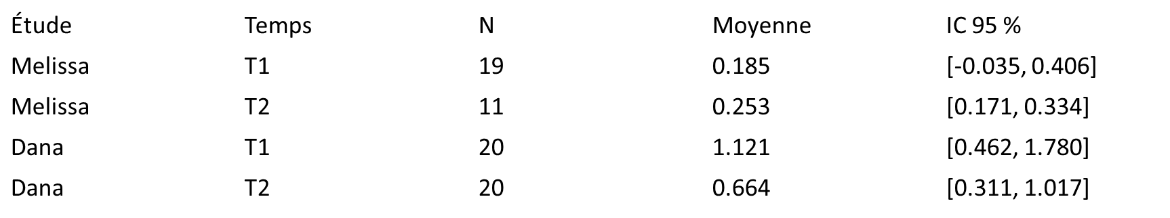
Results on SOD: trajectories
trajectories
patient |  |  | Fréquence | Pourcentage | Pourcentage valide | Pourcentage cumulé
patient | Valide | remains less interfered | 1 | 1,4 | 1,5 | 1,5
 |  | less interfered to equal | 1 | 1,4 | 1,5 | 2,9
 |  | less interfered to more interfered | 1 | 1,4 | 1,5 | 4,4
 |  | equal to less interfered | 17 | 23,6 | 25,0 | 29,4
 |  | remains equal | 4 | 5,6 | 5,9 | 35,3
 |  | becomes more interfered | 6 | 8,3 | 8,8 | 44,1
 |  | more interfered to less interfered | 7 | 9,7 | 10,3 | 54,4
 |  | more interfered to equal | 10 | 13,9 | 14,7 | 69,1
 |  | remains more interfered | 21 | 29,2 | 30,9 | 100,0
 |  | Total | 68 | 94,4 | 100,0
 | Manquant | Système | 4 | 5,6
 | Total |  | 72 | 100,0
control | Valide | remains less interfered | 5 | 12,8 | 16,1 | 16,1
 |  | less interfered to equal | 2 | 5,1 | 6,5 | 22,6
 |  | equal to less interfered | 5 | 12,8 | 16,1 | 38,7
 |  | remains equal | 8 | 20,5 | 25,8 | 64,5
 |  | becomes more interfered | 4 | 10,3 | 12,9 | 77,4
 |  | more interfered to less interfered | 4 | 10,3 | 12,9 | 90,3
 |  | more interfered to equal | 1 | 2,6 | 3,2 | 93,5
 |  | remains more interfered | 2 | 5,1 | 6,5 | 100,0
 |  | Total | 31 | 79,5 | 100,0
 | Manquant | Système | 8 | 20,5
 | Total |  | 39 | 100,0

Slide 26
Results on SOD: heterogeneity
compSODall_SODT2
patient |  |  | Fréquence | Pourcentage | Pourcentage valide | Pourcentage cumulé
patient | Valide | less interfered than HC | 25 | 34,7 | 36,8 | 36,8
 |  | similar to HC | 15 | 20,8 | 22,1 | 58,8
 |  | more interfered than HC | 28 | 38,9 | 41,2 | 100,0
 |  | Total | 68 | 94,4 | 100,0
 | Manquant | Système | 4 | 5,6
 | Total |  | 72 | 100,0
control | Valide | less interfered than HC | 14 | 35,9 | 45,2 | 45,2
 |  | similar to HC | 11 | 28,2 | 35,5 | 80,6
 |  | more interfered than HC | 6 | 15,4 | 19,4 | 100,0
 |  | Total | 31 | 79,5 | 100,0
 | Manquant | Système | 8 | 20,5
 | Total |  | 39 | 100,0
compSODall_SODT1
patient |  |  | Fréquence | Pourcentage | Pourcentage valide | Pourcentage cumulé
patient | Valide | less interfered than HC | 3 | 4,2 | 4,2 | 4,2
 |  | similar to HC | 28 | 38,9 | 38,9 | 43,1
 |  | more interfered than HC | 41 | 56,9 | 56,9 | 100,0
 |  | Total | 72 | 100,0 | 100,0
control | Valide | less interfered than HC | 8 | 20,5 | 20,5 | 20,5
 |  | similar to HC | 21 | 53,8 | 53,8 | 74,4
 |  | more interfered than HC | 10 | 25,6 | 25,6 | 100,0
 |  | Total | 39 | 100,0 | 100,0

Slide 27
Conclusions
Results in SOD go in the same direction in each studies
  SOD worse in patients than in controls at T1
  Better improvement between T1 and T2 in patients than in controls
  More specifically, controls remain stable while patients improve, although not enough to be equivalent to controls.
Trajectories:
  XX% patients improved over time, less interfered
  XX% remained stable
  XX% decreased and became more interfered
  !! Heterogeneity within patients AND controls: clustering and transdiagnostic approach
Notes:
In combined study, the difference on T2-T1 between patients and controls is at ,061.

