Slide 1
Do ICTs improve deliberative quality of constitutional reform?
Raphael Kies; Alina Ostling, Norbert Kersting, Visvaldis Valtenberg; Marie Dufrasne

Slide 2
Background : Cost project on constitution making and deliberative democracy
General objectives of Cost projet
1) To gather and organize information about all deliberative democracy experiments related to constitution-like issues;
2) To make this information widely available and widely used;
3) To promote interaction between actors involved in this area, and also interested actors who are not yet involved
Objectives of Working group 3 « e-constitutinal deliberative making »
Review and analyse the possible usages of the ICTs for promoting a more inclusive, deliberative, and legitimate participative consultations on constitutional like issues.

Slide 3
Theoretical considerations
Main challenge : To promote a consultation process that is at the same time inclusive and deliberative
Solution so far… Combination of Mini-Publics - for deliberation - with referendum - for inclusion. (ex: Iceland, Ireland, Luxembourg)
Problems
Large public remains excluded from qualitative deliberation
Referendum does not guarantee informed participation.
Mini publics still criticized to influence the process: Why? limited representation and accountability

Slide 4
What could be the contribution of ICTs to face these problems?
ICTs can be used:
to initiate new constitutional reforms (in countries where e-petition is introduced);
to inform citizens about the consultative process (transparency),
to inform and involve the citizens during the drafting of the constitution (engagement),
to inform the citizens during the referendum campaign.
Notes:
ICTs have hardly been analyzed as a potential method to influence promote a better inclusion and deliberation of the process…

Slide 5
Research questions
RQ1: To what extent were ICTs used to involve the general public in the constitutional reform processes.
RQ2: to what extent are ICTs used to promote the transparency of the process (e.g. through social media).
RQ3: Did the usage of ICTs promote a deliberative form of participation?
RQ4: More generally did the ICTs contribute to improve the perceived legitimacy of the constitutional related reforms process.
RQ5: For all these questions do we observe significant differences according to the initiator of the consultations. In particular if it was initiated by the State (top-down) or by the citizens/civil society (bottom-up)

Slide 6
Case studies
 | Process initiator | agenda setting of reforms | Mini-public | elected citizens assembly | Referendum.s | outcome
Icelandic reform (2009-2011) | top-down | mixed (experts and citizens) | yes (National assembly of 950 people to make general proposal) | yes (25 citizens to draft new constituion) | yes (non binding) | no
Irish reform (2012-2014 and 2016-2018) | top-down | politicians | yes (citizens/politicans to discuss pre-defined topics) | no | yes (binding) | yes several referendums
Luxemburgish constitutional reform (2014-) | top-down | Mixed (politicans and limited influence of citizens) | yes (but experimental to test process and opinions) | no | yes (binding) | no
Estonian citizens assembly (2013) | Mixed/bottom-up | mixed (politicians, civil society) | yes (deliberation: to make proposal on one of predifined 5 topics discussed through crowdsourcing plarform) | no | no | limited outcome (4 of 15 initial deliberation day proposals - but not the ones on constitution)
My voice e-petition (Lavia) (2014-2019) | bottom-up | citizens | no | no | no | yes the article has been changed but after 5 years
Constitutional review in Northrhine-Wesphalia (2013-2016) | top-down | politicians /parliament | no (hearings of experts to which citizens could contribute online) | no | no | no
Notes:
1) These different cases studies have in common that 1) concern constitutional reform; 2) that they attempt to involve citizens.
2) These different caracteristics should be taken into consideration to evaluate the usage of ICTs to inform and involve the public.

Slide 7
Preliminary findings
ICTs often used at preliminary phase whether to protest (ex: Iceland) or to initiated a constitutional reform (ex: My voice Latvia)
In general a conscious and planned usage of ICT is absent or limited to just one phase of the consultative process (ex: drafting/discussing content Iceland and Estonia; or initiating in Latvia)
When usage of ICTs planned, it is generally just superficially. Ex: in Iceland no clear rules how to process proposals from citizens)
Participants to the online process were the usual suspects (well educated men interested in politics) and deliberative usage of ICTs, is understudied but appear to be very limited (Exception Estonia).
In several cases fair amount of thoughtful proposals emerging from ICTs (ex. Estonia; iceland).
Conclusion
IN certain cases (ex: Iceland) ICTs contributed to reinforce citizens’ perceived legitimacy of the process but improvements can take place at almost all the levels: transparency of the process, drafting, information, referendum campaign

Slide 8
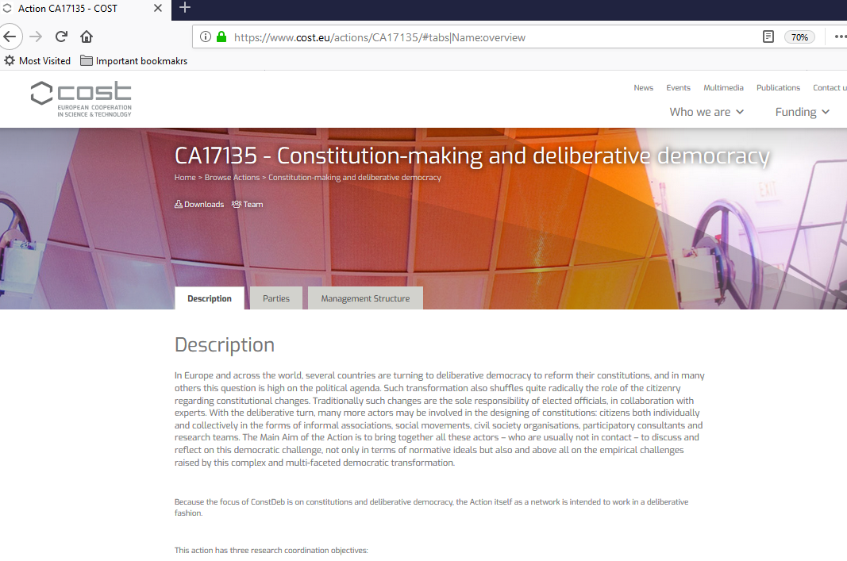
More information… you are welcome to join the project!

Slide 9

Merci pour votre attention
Des questions?

