Slide 1

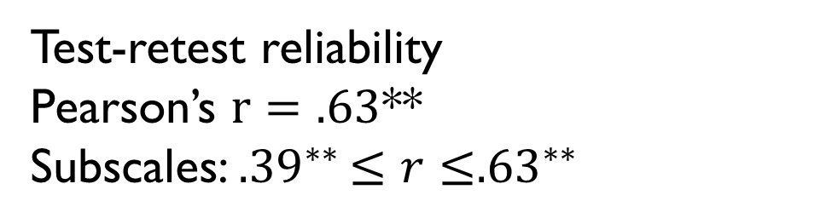



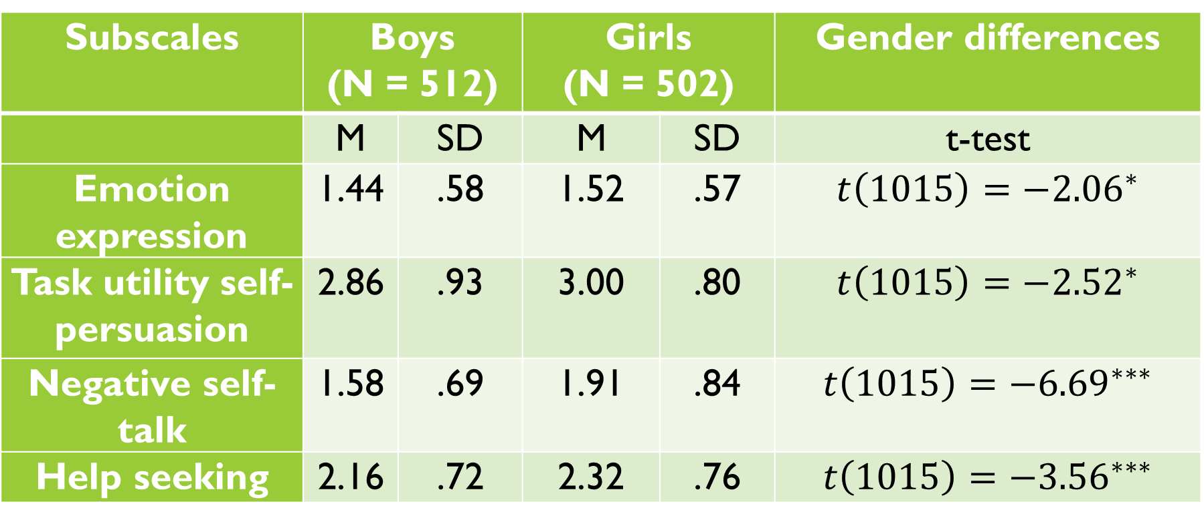
Children’s Emotion Regulation Scale in Mathematics (CERS-M): Development and Validation of a Self-reported Instrument
1. Introduction
- Emotions play a crucial role in learning and academic achievement. Emotions influence students’ attention, choice of learning strategies, source of regulation, motivation to learn and their interactions with peers and teachers (Pekrun, 2014; Schutz & Pekrun, 2007).
Mathematics, and especially, problem-solving tasks, are particularly concerned by the issue of emotion (e.g., Ahmed, van der Werf, Kuyper, & Minnaert, 2013; Kim & Hodges, 2012; Op’t Eynde, De Corte & Mercken, 2004). In such tasks, nervousness, frustration, hopelessness, worry, shame, anger and boredom are frequently felt by students (D’Mello & Graesser, 2011; Op’t Eynde et al., 2004; Prawat & Anderson, 1994). Moreover, according to a study conducted by De Corte, Depaepe, Op’t Eynde and Verschaffel (2011), students between the ages of 14 and 16 have a poor track record of emotion regulation when solving mathematical problems.
→ Students must be supported in the regulation of their emotions.
This presupposes:
* awareness of the strategies used by students to regulate their negative emotions in the context of problem-solving tasks;
* an adequate and valid instrument of measure.
However, in addition to being scarce, existing tools display several limitations:
→ There is a lack of an instrument that simultaneously reflects elementary and secondary students’ reality, that assesses emotion regulation strategies in context, and that
considers the variety of the theoretical approaches used to investigate this subject.
Vanessa Hanin (vanessa.hanin@uclouvain.be) and Catherine Van Nieuwenhoven
IACCHOS – Institute for the Analysis of Change in Contemporary and Historical Societies
The CERQ-kids (Garnefski, Rieffe, Jellesma, Terwogt et al., 2007) | The Flemish version of the COPE-questionnaire (De Corte, et al., 2011)
+ Children of 9-12 years - Context-less - Same scales as the one for adults - Based on a single theoretical approach (i.e., the literature on stress and coping) | + Secondary students + School-related mathematical activities - Same scales as the one for adults - Based on a single theoretical approach (i.e., the literature on stress and coping)
2. Theoretical framework
3. Study 1
Gross’s (1998) emotion-generative process and Mikolajczak’s (2009) theoretical model of emotion regulation strategies embraces the 3 main research traditions, i.e. psychoanalytic, stress and coping, and emotion regulation.
1) First draft of the questionnaire (N=63)
- Based on students’ interviews, Mikolajczak’s model and existing instruments
- 19 dimensions, 57 items
2) Exploratory factor analysis (N = 561)
- Oblimin rotation with Kaiser normalization (Field, 2009)
- Parallel analysis (Hayton, Allen & Scarpello, 2004)
Emotion expression (EV = 11.4)
Task utility self-persuasion (EV= 4.2)
Negative self-talk (EV = 2.4)
Help-seeking (EV= 2.2)
Brief attentional relaxation (EV = 1.7)
Dysfunctional avoidance (EV= 1.6)
3) Confirmatory factor analysis (N=568)
}
Family of strategies (Gross, 1998) | Functional strategy | Dysfunctional strategy
Situation selection | - Functional confrontation | - Dysfunctional avoidance - Procrastination
Situation modification | - Direct modification - Indirect modification | - Learned helplessness
Attentional deployment | - Positive distraction | - Negative distraction - Rumination
Cognitive change | - Positive reappraisal - Acceptance | - Catastrophizing - Blaming others
Response modulation | - Relaxation | - Emotion deletion
Emotion expression | - Social sharing | - Unsuitable expression - Verbal aggression - Social withdrawal
6 factors accounting for 41.2% of the total variance
- High modification indices
- Low items factor loadings
(Byrne, 2016)
→
6 dimensions,
18 items
Model | χ²/df | RMSEA | SRMR | CFI | AGFI
Model 1 (exploratory analysis) | 1,934 | .046 | .052 | .940 | .927
Model 2 (Mikolajczak’s complete theoretical model) | 1.144 | .054 | .077 | .723 | .749
Model 3 (Mikolajczak’s short model) | 2.166 | .045 | .082 | .825 | .812
Model 4 (Gross’s theoretical model) | 2.746 | .055 | .153 | .712 | .756
4. Study 2
2) Evidence of the CERS-M’s differential validity
It is the lack of observed difference that should be problematic and
question the quality of a test and not the opposite (Laveault & Gregoire, 2014).
Note. N = Sample size ; M = mean; SD = standard deviation. ${}_{}^{ ∗∗∗}{p≤0.001; {}_{}^{∗∗}{p≤0.01; {}_{}^{∗}p}}≤0.05.$
3) Evidence of the CERS-M’s discriminant validity
- Pearson correlations between the CERS-M and a variable that is not
supposed to correlate with given the nature of the concept that is, verbal skills
(syntactico-semantic test E.C.O.S.S.E; Lecocq, 1996): $r={−.09}^{∗∗}$
- 2 scales concerned: « negative self-talk » and « dysfunctional avoidance »
1) Evidence of the CERS-M’s reliability (N=1014)
4) Evidence of the CERS-M’s convergent validity
Pearson correlations between the CERS-M and a measure of a similar construct, i.e., the Flemish version of the COPE-questionnaire (De Corte et al., 2011): ${r=.52}^{∗∗}$
5) Evidence of the CERS-M’s criterion validity
● Math tasks anxiety
- Positive correlation between the CERS-M global score and math tasks anxiety $(r= {.48}^{∗∗};r={.56}^{∗∗}$)
- « Negative self-talk » is the strongest predictor (share 27% to 31% of the common variance)
● Problem-solving performance
- Tenuous and negative relation between the CERS-M and performance $(r={.18}^{∗∗})$
- « Negative self-talk » is the strongest predictor, (marginal explanation of 4%)
● Global math performance
« Negative self-talk » is the strongest predictor, (marginal explanation of 2%)
● Ability of the CERS-M to account for additional variance in the prediction of anxiety and performance, over and above the COPE-questionnaire scores
Cronbach’s alpha
CERS-M: $α=.70$
Subscales: $.62≤α≤.77$
Test-retest reliability
Pearson’s $r=.63$**
Subscales: ${.39}^{∗∗}≤r≤{.63}^{∗∗}$
Subscales | Boys (N = 512) |  | Girls (N = 502) |  | Gender differences
 | M | SD | M | SD | t-test
Emotion expression | 1.44 | .58 | 1.52 | .57 | $$t\left(1015\right)={−2.06}^{∗}$$
Task utility self-persuasion | 2.86 | .93 | 3.00 | .80 | $$t\left(1015\right)={−2.52}^{∗}$$
Negative self-talk | 1.58 | .69 | 1.91 | .84 | $$t\left(1015\right)={−6.69}^{∗∗∗}$$
Help seeking | 2.16 | .72 | 2.32 | .76 | $$t\left(1015\right)={−3.56}^{∗∗∗}$$
Criterion variable | Forced hierarchical order | Predictor variable | R | Individual R² | F change
Problem-solving anxiety | 1 | COPE total score | .366 | .133 | 156.95***
 | 2 | CERS-M total score | .500 | .116 | 157.26***
Problem-solving performance | 1 | COPE total score | .092 | .008 | 9.83**
 | 2 | CERS-M total score | .179 | .022 | 27.99***
- Both studies highlighted that fifth and sixth graders discriminate between six strategies of emotion regulation in the context of math problem-solving.
- Students are more likely to deal with unpleasant emotions in a “colder” way (“task-utility self-persuasion”) than in a “hot” way (“brief attentional relaxation”; “emotion expression”).
- “Emotion expression” is considered as dysfunctional.
→ Supports the idea that there is no place for the learner’s feelings in mathematics and thereby the necessity to teach emotional competencies in class.

