Slide 1


Advancing GW
A benchmark set for molecules
High throughput methods for solids
Michiel van Setten

Slide 2
GW
Density functional theory
  Maps the many particle problem into a single particle problem
  Scalar effective potential V_{xc}(r)
  Applicable to large systems: > 2000 atoms
  Broadly used across many fields of sciences
  Description of electronic levels (charge transfer), long range interactions, and band gaps not accurate enough
GW-method
  Replace the potential by a self-energy matrix: V_{xc}(r) → Σ(r,r’,E)
  Becoming increasingly available for bulk solids
  Starts to gain terrain for calculations on molecules
  Significantly improved description of electronic levels (charge transfer), long range interactions, and band gaps
  Complex and expensive calculations

Slide 3
A benchmark set for molecules
GW100

Slide 4
Benchmark set for molecules: GW100
Collaboration KIT Karlsruhe, FHI Berlin and
Berkeley Lab US DoE
  TURBOMOLE:
  Gaussian basis sets, spectral representation via Casida
  FHI-Aims:
  numerical local orbitals, analytic continuation
  BerkeleyGW:
  plane waves, plasmon pole and real frequency integration
  5 different ways to evaluate the self-energy
Strictly converged all electron reference values for IP and EA

Slide 5
Hard to converge

Slide 6
Problems when solving the QPE
x

Slide 7
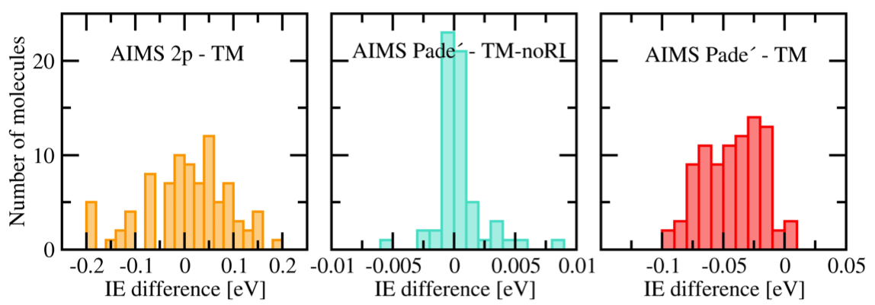
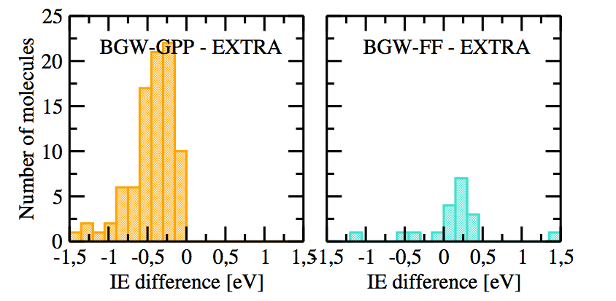
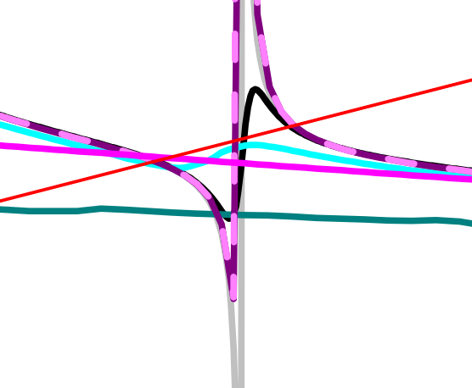
Self-Energies

Slide 8
Some numbers
0.65 eV overestimation by plasmon pole
0.32 eV underestimation at QZVP level for the LUMO
0.12 eV underestimation at QZVP level for the HOMO
0.12 eV error by two pole analytic continuation
0.10 eV error by introducing a
150 eV cutoff on empty states and a
544 eV cutoff on the dielectric matrix
0.05 eV overestimation by RI auxiliary basis functions
0.05 eV error by introducing a 400 eV cutoff on the spectral representation of the response function

Slide 9



Collaborators
Florian Weigend (KIT Karlsruhe)
Ferdinand Evers (KIT Karlsruhe)
Fabio Caruso (FHI Berlin)
Patrick Rinke (FHI Berlin)
Sahar Sharifhades (Berkeley Lab)
Jeffey Neaton (Berkeley Lab)

Slide 10
High throughput GW for solids
from a structure
without any human intervention
to converged GW results
?

Slide 11


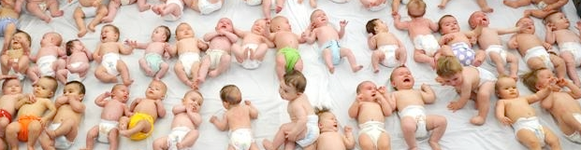
GW in High Throughput
‘additional’ difficulties
  4 step calculation
  N⁴ scaling
  No ‘safe’ parameter set (converged results for all)
  No ‘safe’ computational settings (ncpu, mem, ..)
DFT babysitting problem

Slide 12








GW in High Throughput
‘additional’ difficulties
  4 step calculation
  N⁴ scaling
  No ‘safe’ parameter set (converged results for all)
  No ‘safe’ computational settings (ncpu, mem, ..)
GW babysitting problem

Slide 13

GW wrapper
Python package that wraps around the ab-initio code
Options
    Vasp / Abinit
    What kind of GW
    (currently fixed) K-point density
    Convergence tolerance
Some list of structures > ‘fully’ converged GW results

Slide 14
Convergence study
On a low k-point density (2x2x2):
  Set of single parameter ground state convergence studies
  Grid of nbands X encuteps
  For each nbands find converged encuteps
  For the converged encuteps find the converged nbands
  if not found > extend grid and retest
On the final k-point density (500):
  Test if the converged values have comparable derivatives to those calculated in the lower density grid.
  (in most cases the high density derivatives turn out smaller)
  Post process (create scissor, apply scissor, …)
(ecut, …)

Slide 15
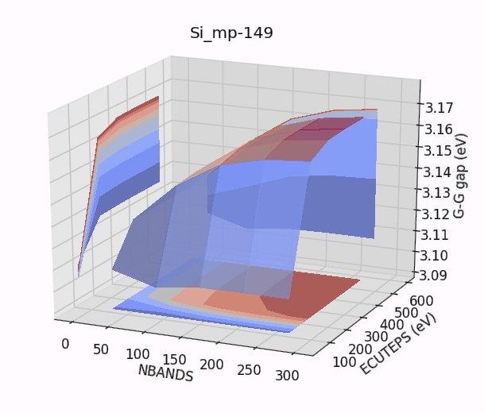

Slide 16
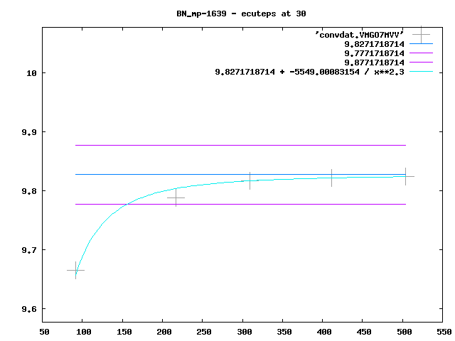
G-G
gap
(eV)

Slide 17
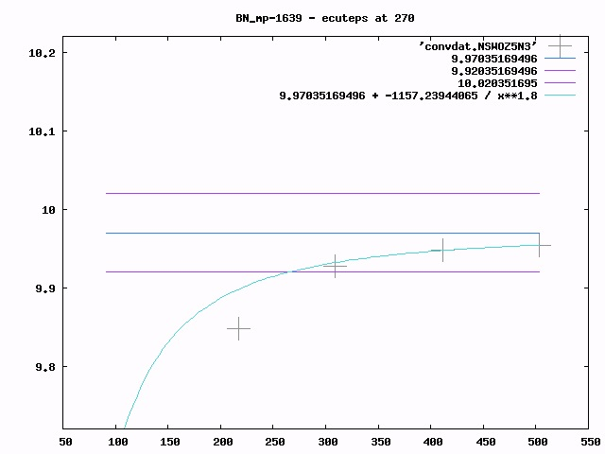
G-G
gap
(eV)

Slide 18
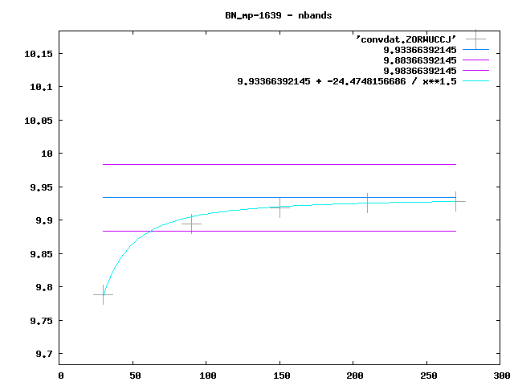
G-G
gap
(eV)

Slide 19
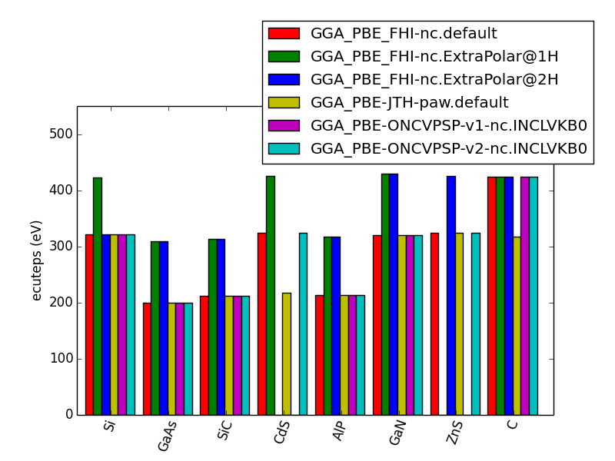
dielectric matrix cutoff

Slide 20
@ converged parameters
Test at high KP-density by comparing derivatives
Store results in a database,
create scissor operators,
…
… do some actual physics

Slide 21
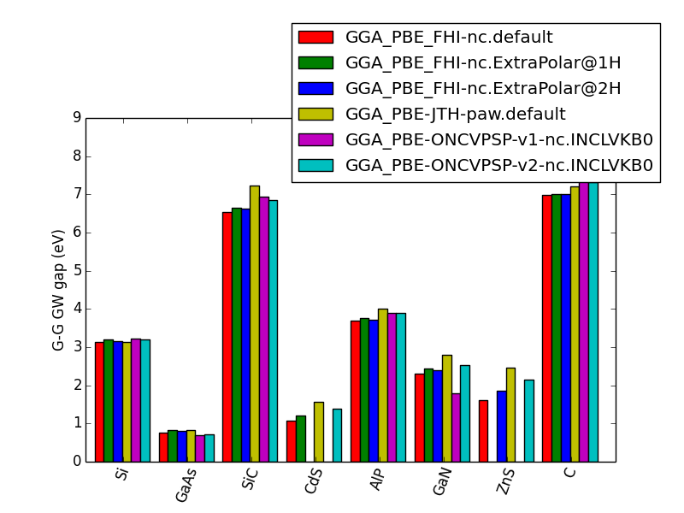
Pseudo Potentials …

Slide 22

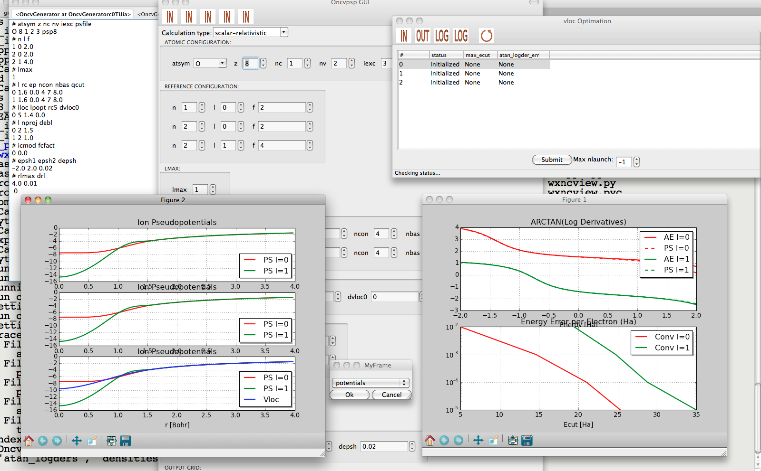
ONCVPSP
Optimized Norm Conserving Vanderbild Pseudo Potentials
  multiple projectors
  multiple gradient constraints
Don Hamann (PRB 88, 085117 (2013))
Package to facilitate PSP
generation
Graphical interface
Automatized testing
http://www.pseudo-dojo.org/dojo.html

Slide 23
Collaborators
Matteo Giantomassi
Geoffroy Hautier
Gian-Marco Rignanese
Jean-Michel Beuken
http://pymatgen.org
AbiPy
https://github.com/gmatteo/abipy

Slide 24
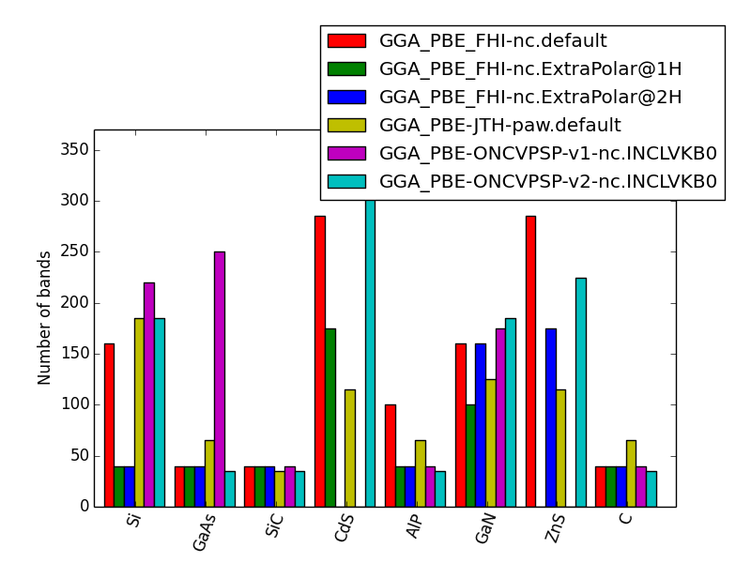
Band convergence

Slide 26
independent sub-’Packages’
Error parser / handler for scheduler related job terminations.
Convergence tester
    Determine asymptotic value even for a low number of data points

Slide 27
Pseudo Dojo
Automatic testing and training of PSPs
Connections to PSP generator codes via an graphical interface.
Flexible tests, automatic PSP improvement

Slide 28
PseudoDojo current status
Automatic testing with Abinit
  DeltaFactor Elemental Solids
  Energy cutoff convergence of DF for ES
  Energy cutoff convergence of Total Energy for ES
  Lattice parameter FCC and BCC solids
Testing against precalculated All Electron results @ specified parameters

Slide 29
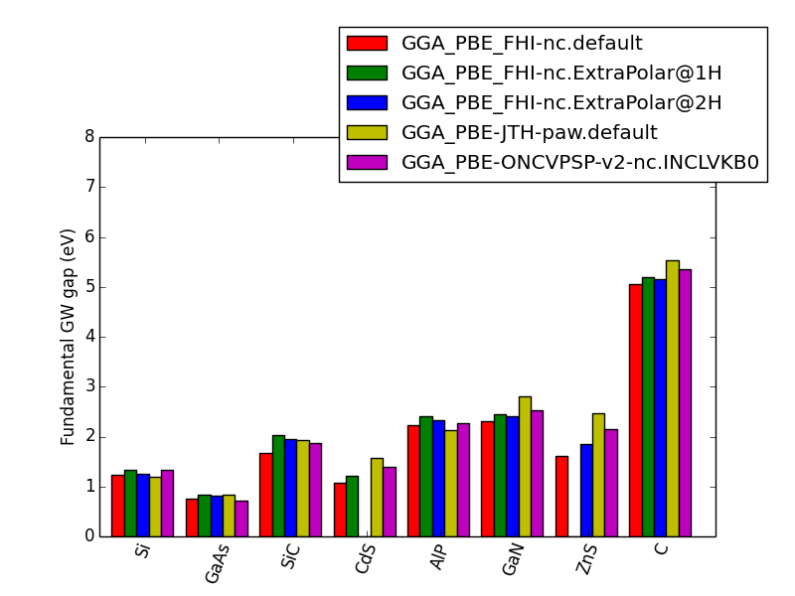
Pseudo Potentials …

Slide 30
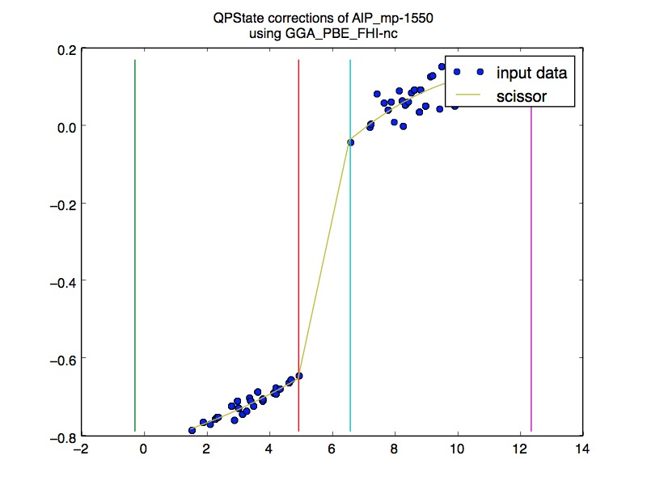
Energy dependent scissor

Slide 31
Old stuff

Slide 32
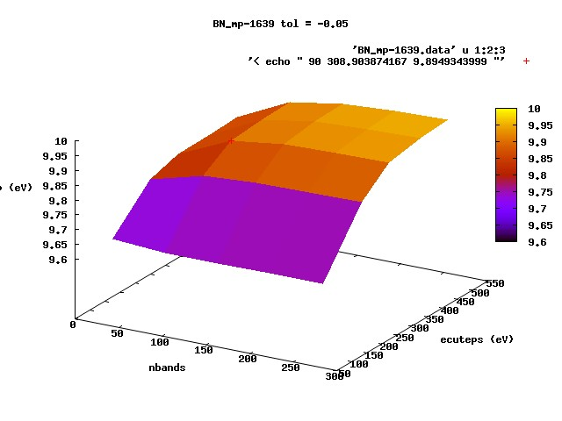
G-G
gap
(eV)

Slide 33
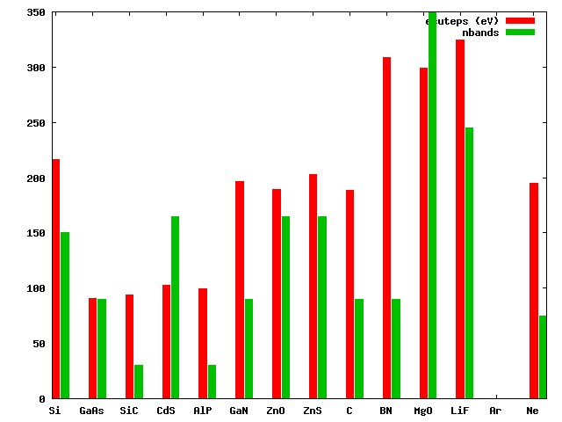
PAW

Slide 34
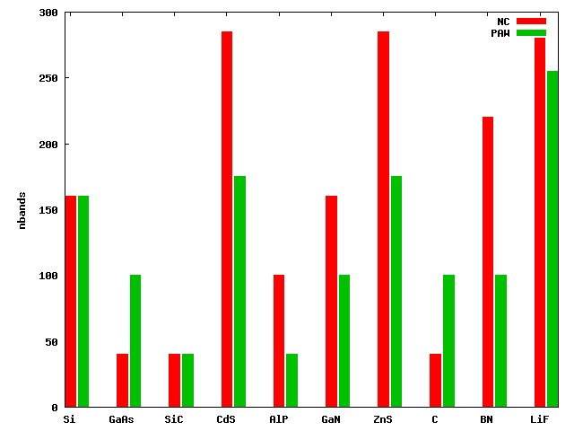

Slide 35
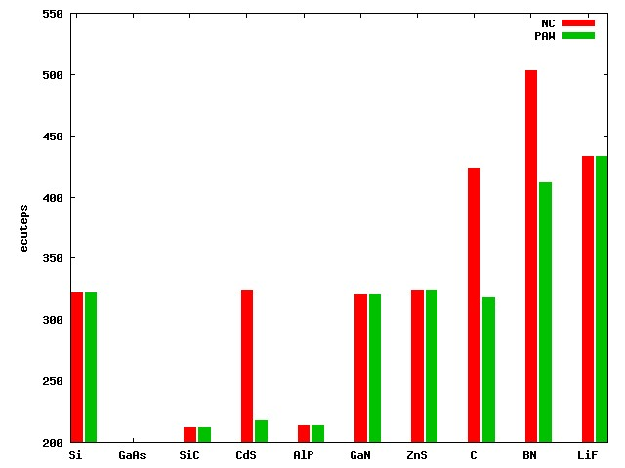
(eV)

Slide 36
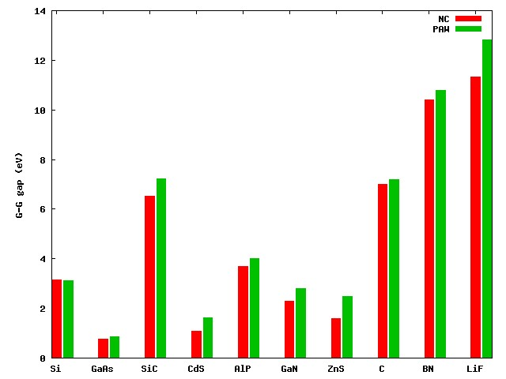

Slide 37
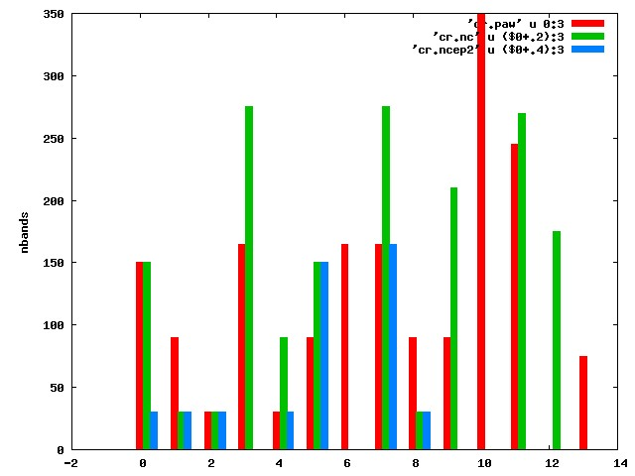

Slide 38
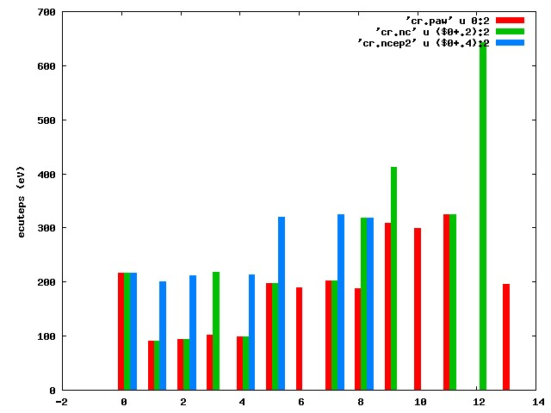

Slide 39
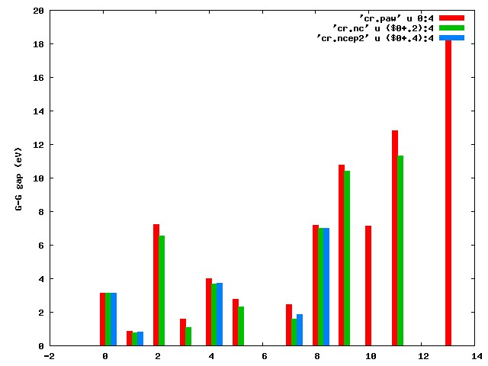

Slide 40
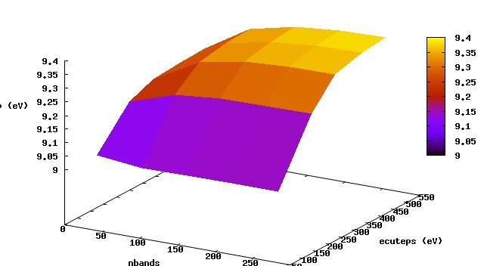

Slide 41
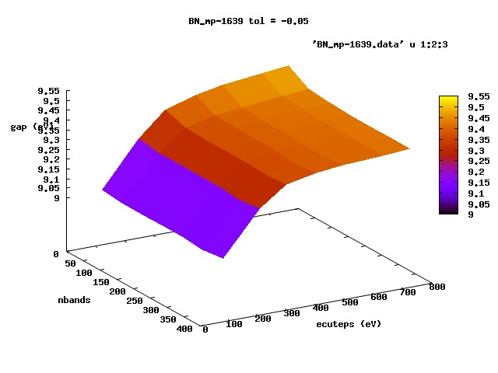

Slide 42
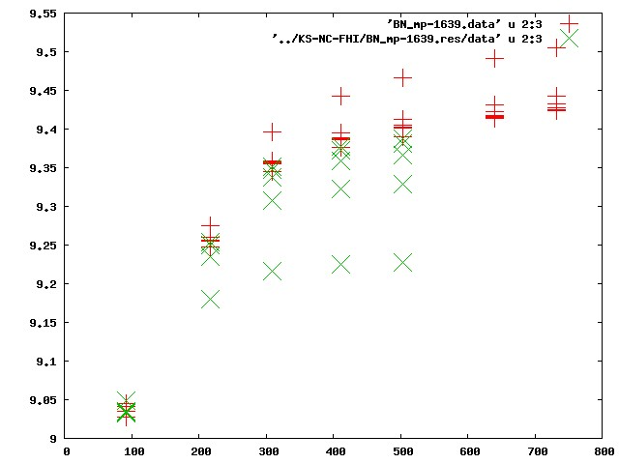

Slide 43
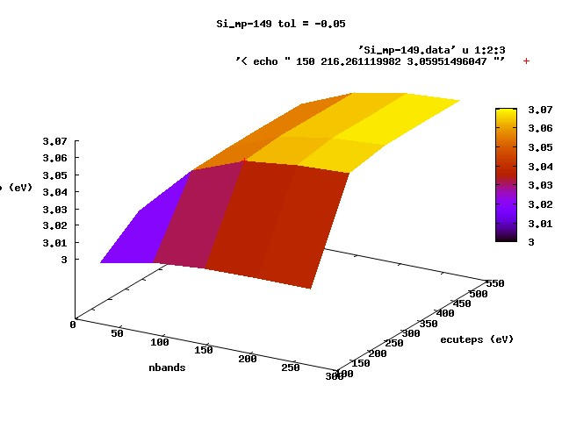
G-G
gap
(eV)

Slide 44
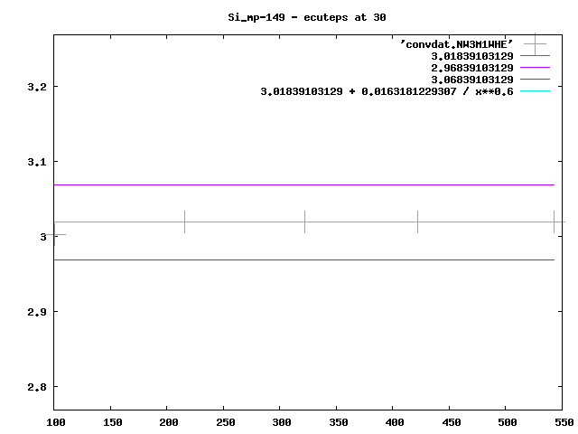
G-G
gap
(eV)
ENCUTGW (eV)

Slide 45
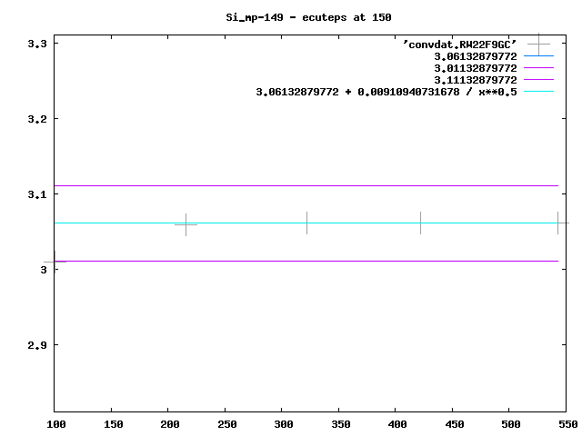
G-G
gap
(eV)

Slide 46

G-G
gap
(eV)

Slide 47
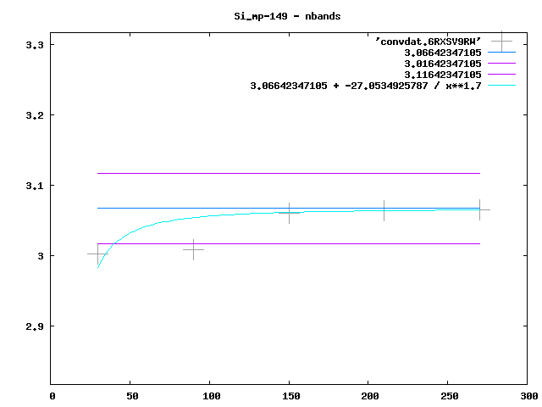
G-G
gap
(eV)

Slide 48
G-G
gap
(eV)

Slide 49
GWSpec
  Systems (list of structures or files)
  Functional
  Code (ABINIT, VASP)
  Precision , kpdens
  Kind of GW
  Mode (input, input with jobfiles, fw)

Slide 50
Loop over structures
    Add special points
Loop over jobs
    Job (G0W0) > work (specified) > tasks
Create input / job structure / FW workflow

Slide 51
‘Kresse set’
Si, GaAs, SiC, CdS, AlP, GaN, ZnO, ZnS, C, BN, MgO, LiF, Ar, Ne
Vasp/abinit
Exciting is also running

Slide 55
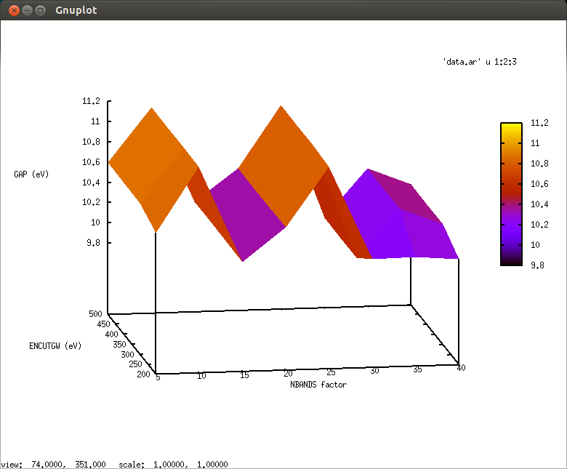
Ar
40 : 201 bands 158 eV

Slide 56
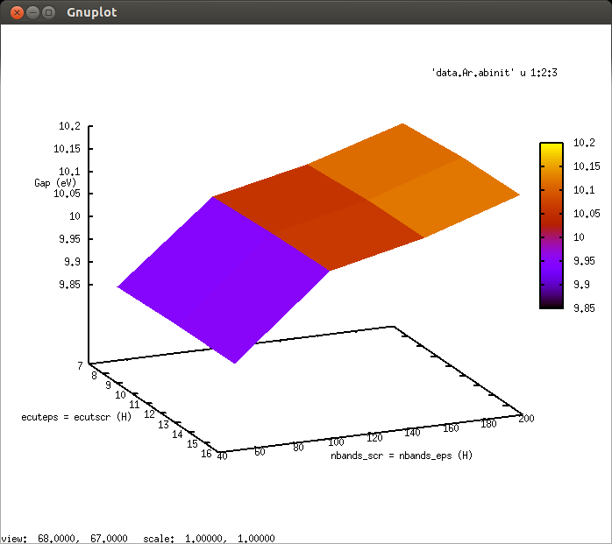
Ar

Slide 57
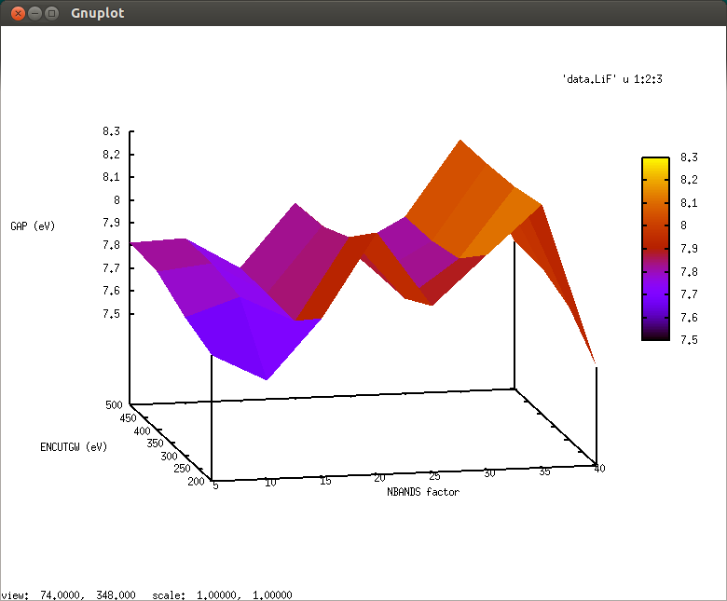
LiF
40 : 281 bands 355 eV

Slide 58
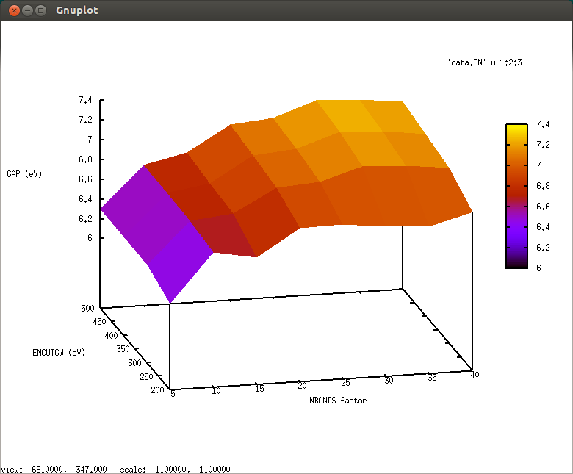
BN
40 : 241 bands 400 eV

Slide 59
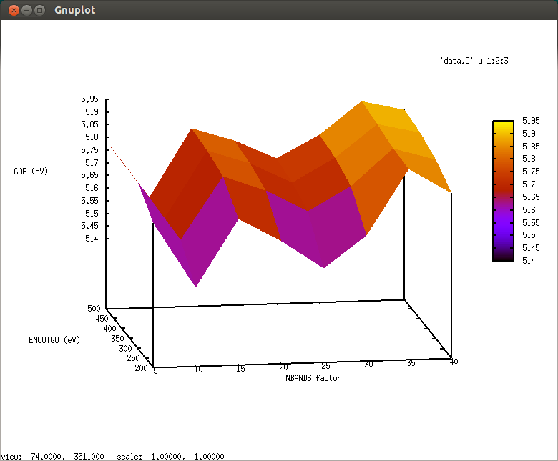
C diamond
40 : 229 bands 416 eV

Slide 60
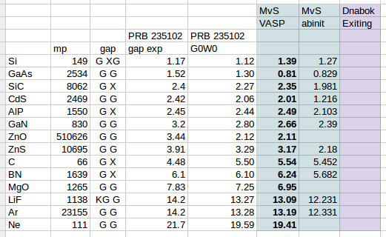

Slide 62
Other sets
P-type TCO’s
Van Schilfgaarde set
  AE data exists
Hautier set ;-)
  Much more balanced
  HSE06 and Tran Blaha data

