Slide 1
Design, characterization and cultivation of microalgae in an airlift flat panel photobioreactor
Jian Li, Clayton Jeffryes, Marisa Stamato, Eirini Velliou, Philippe Demarche, Rakesh Nair, Emna Bouhajia, Charles Junghanns and Spiros N. Agathos
This work is supported by BEMA project (Bio­-Energy from Micro-Algae, contract 6161). TWEED Cluster, Walloon Region, Belgium.
July 10th 2012

Slide 2
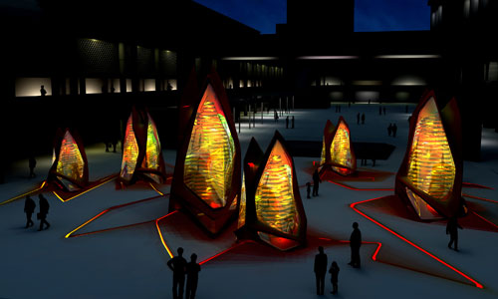
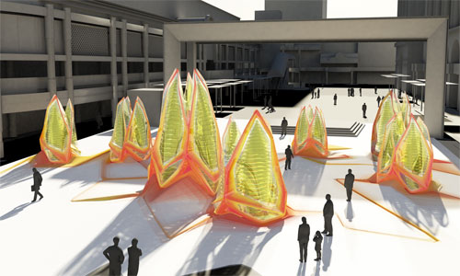
Design, characterization and cultivation of microalgae in an airlift flat panel photobioreactor
Introduction
Methods
Results
Discussion
The Photobioreactor (PBR)
The definition
The objective of this research
To develop scalable industrial photobioreactors
The rationales of this research
PBR to provide inoculum cell culture
PBR to produce high value and/or highly regulated products

Slide 3
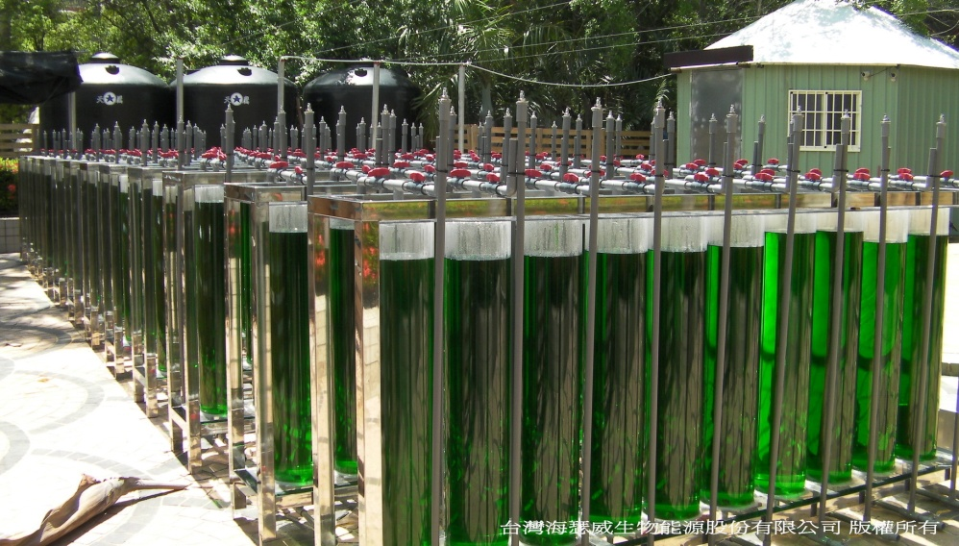
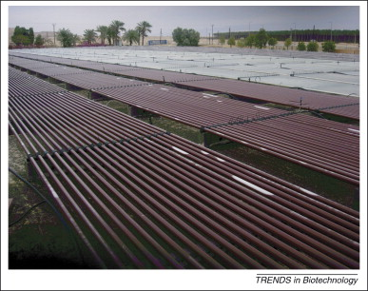
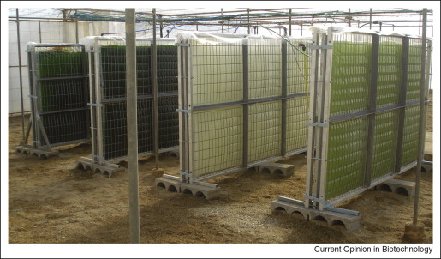
Design, characterization and cultivation of microalgae in an airlift flat panel photobioreactor
Introduction
Methods
Results
Discussion
Various of industrial PBRs
Bubble column
Flat panel
Tubular
Pros and Cons

Slide 4
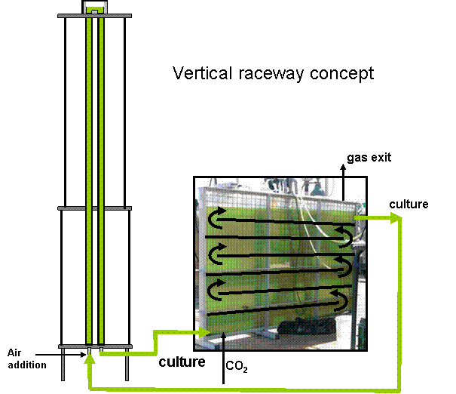
Design, characterization and cultivation of microalgae in an airlift flat panel photobioreactor
Introduction
Methods
Results
Discussion
The concept of airlift flat panel PBR

Slide 5
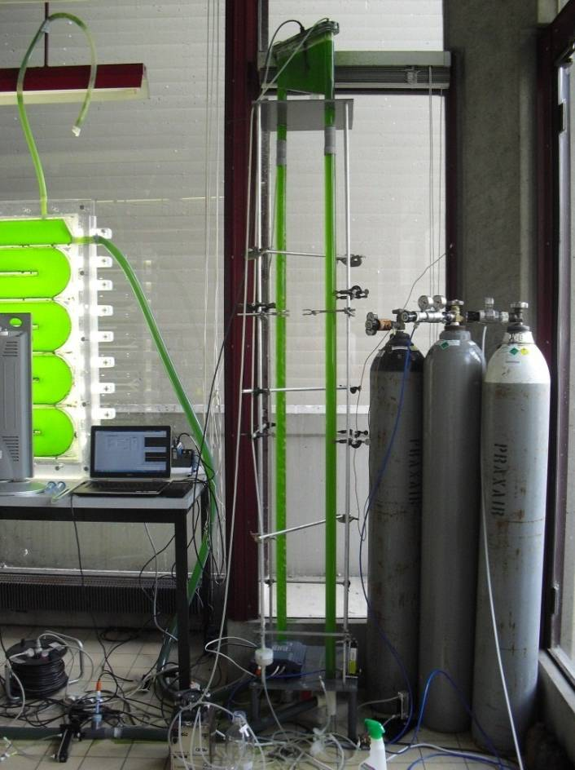
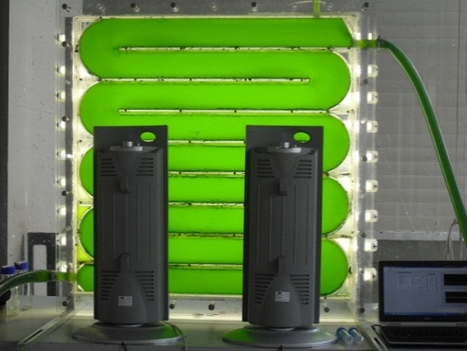
Design, characterization and cultivation of microalgae in an airlift flat panel photobioreactor
Introduction
Methods
Results
Discussion
Actual experimental setup of the photobioreactor
Design Parameters | Label | values
Height of the riser | h_{r}
Diameter of the riser | d_{r}
height of the panel
Width of the panel
Thickness of the panel
Total reactor volume |  | 48L
Number of channels
Hydrolic diameter of channels

Slide 6
Design, characterization and cultivation of microalgae in an airlift flat panel photobioreactor
Modeling of liquid flow
Introduction
Methods
Results
Discussion
Liquid flow velocity
Chisti, 1989
Gas holdup
in riser
Zuber & Findlay, 1965
Bubble slip velocity
Liao et al., 1985

Slide 7
Design, characterization and cultivation of microalgae in an airlift flat panel photobioreactor
Introduction
Methods
Results
Discussion
Modeling oxygen transfer
Volumetric oxygen transfer coefficient
Bubble size
Chisti, 1989
True oxygen transfer coefficient
Chisti, 1989

Slide 8
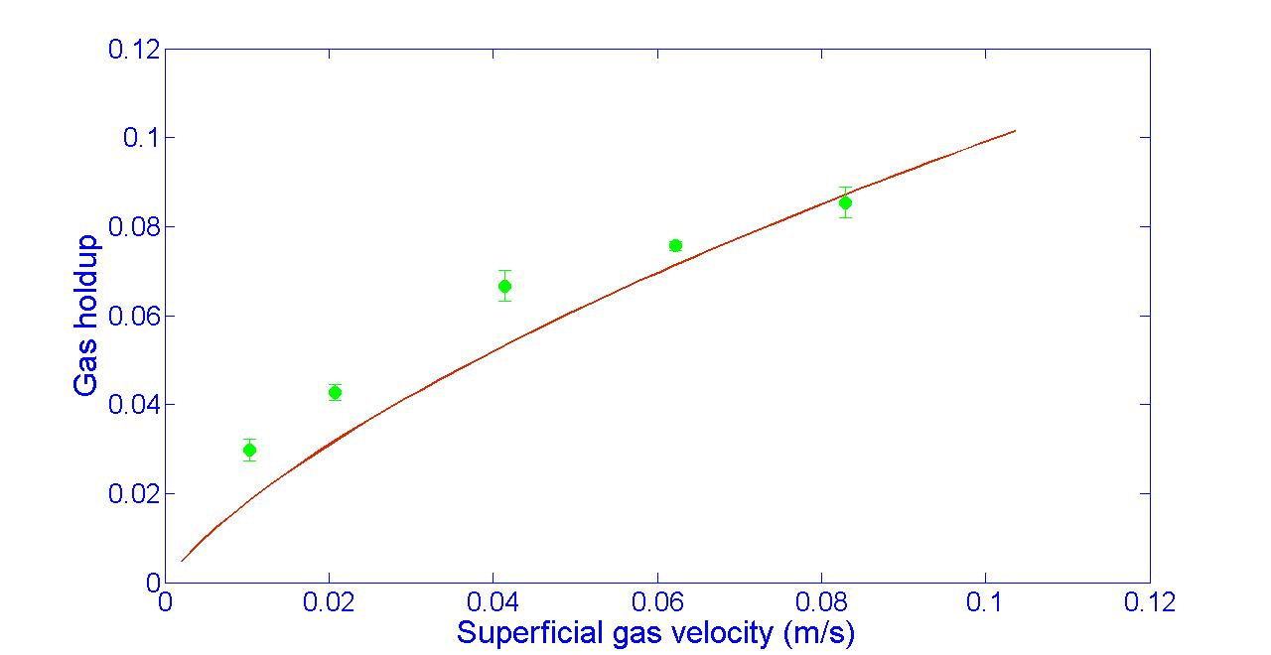
Design, characterization and cultivation of microalgae in an airlift flat panel photobioreactor
Introduction
Methods
Results
Discussion
Gas holdup measurement and predicted values

Slide 9
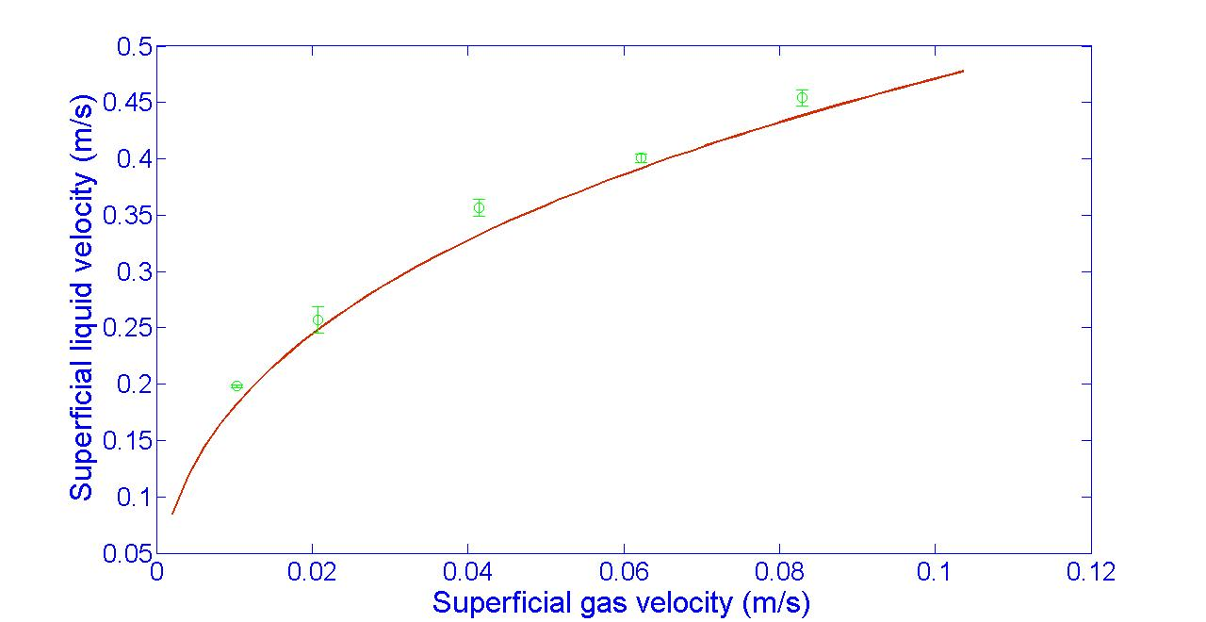
Design of, characterization of and cultivation of microalgae in an airlift flat panel photobioreactor
Introduction
Methods
Results
Discussion
Liquid flow measurement and predicted values

Slide 10
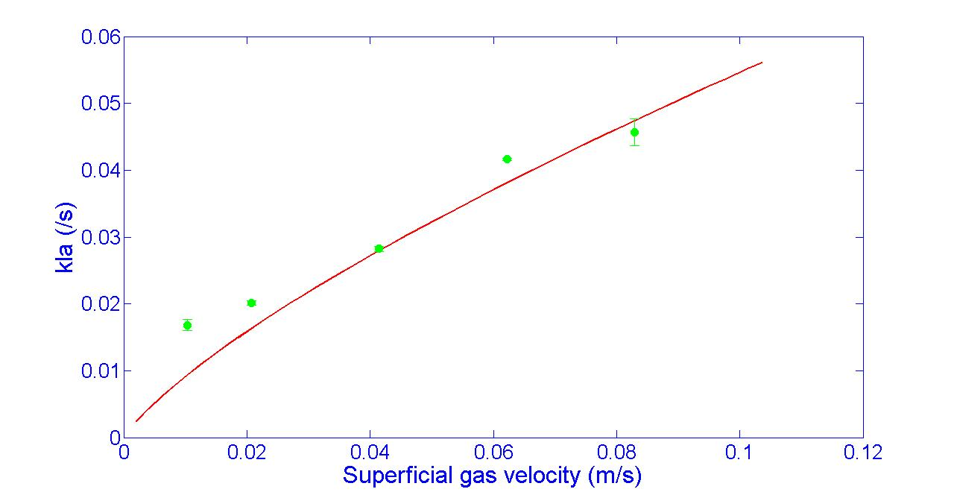
Design, characterization and cultivation of microalgae in an airlift flat panel photobioreactor
Introduction
Methods
Results
Discussion
Oxygen volumetric transfer coefficient in the riser

Slide 11
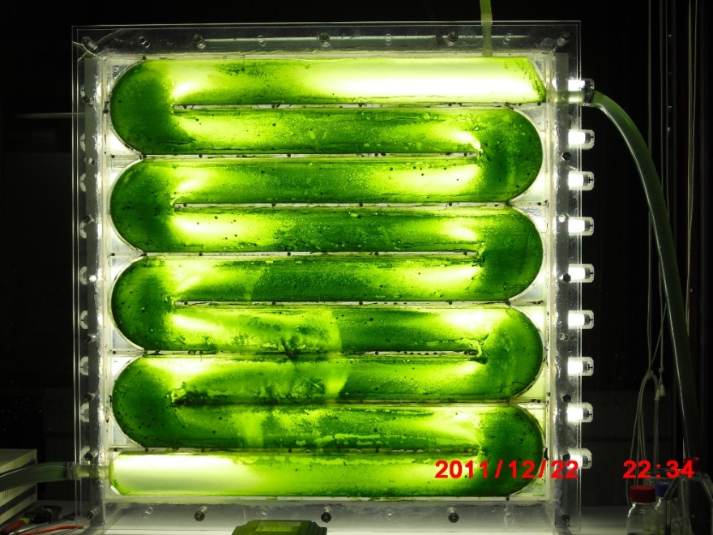

Design, characterization and cultivation of microalgae in an airlift flat panel photobioreactor
Introduction
Methods
Results
Discussion
Cultivation of microalgae in the photobioreactor

Slide 12
Design, characterization and cultivation of microalgae in an airlift flat panel photobioreactor
Introduction
Methods
Results
Discussion
Cultivation of Chlorella sorokiniana in the photobioreactor
Operation parameters | Values
Temperature | 22 °C
Light intensity | 150 µEm⁻²s⁻¹
Aeration rate | 3 Lmin⁻¹
Culture pH | 7.5
Medium | 3N BBM

Slide 13
Design, characterization and cultivation of microalgae in an airlift flat panel photobioreactor
Introduction
Methods
Results
Discussion
Cultivation of Chlorella sorokiniana in the photobioreactor

Slide 14

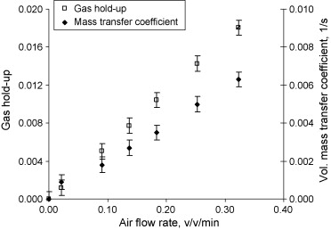
Design, characterization and cultivation of microalgae in an airlift flat panel photobioreactor
Introduction
Methods
Results
Discussion
Comparison of oxygen transfer efficiency
The airlift flat panel PBR can be about 30% more efficient than traditional flat panel PBR in oxygen removing capacity.
This research
E. Serra et al, 2008, Chem Eng J..

Slide 15
Design, characterization and cultivation of microalgae in an airlift flat panel photobioreactor
Introduction
Instruments
Methods
Results
Discussions
The airlift flat panel photobioreactor might be scaled up to large scales for industrial applications.
The industrial airlift flat panel photobioreactor might have the characteristics of both lower energy consumption and higher light utilization efficiency.
The scale up and engineering of industrial photobioreactors can be based on the set of mathematical equations employed in this research.

Slide 16
Design, characterization and cultivation of microalgae in an airlift flat panel photobioreactor
Thank you for you attention!
Questions and comments?

