Slide 2
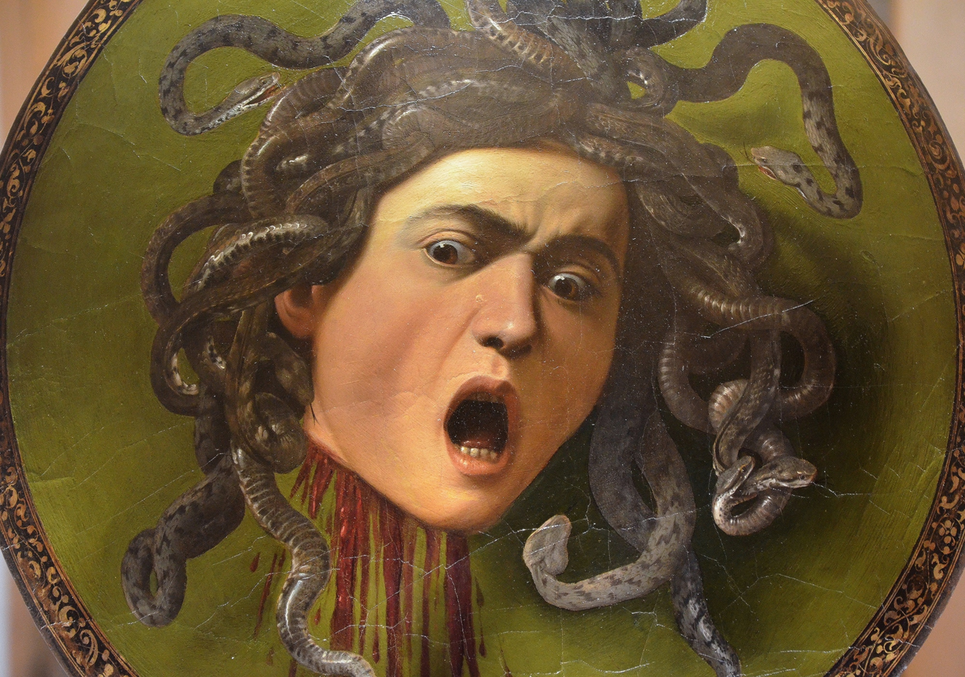

The Divine Mouth Avoided in LXX?
￼A Vorlage-Centric Analysis of Anthropomorphism with a Focus on LXX-Numbers 20:24
Ellen De Doncker Midwest Regional Meeting for Biblical Studies 16 March 2024

Slide 3
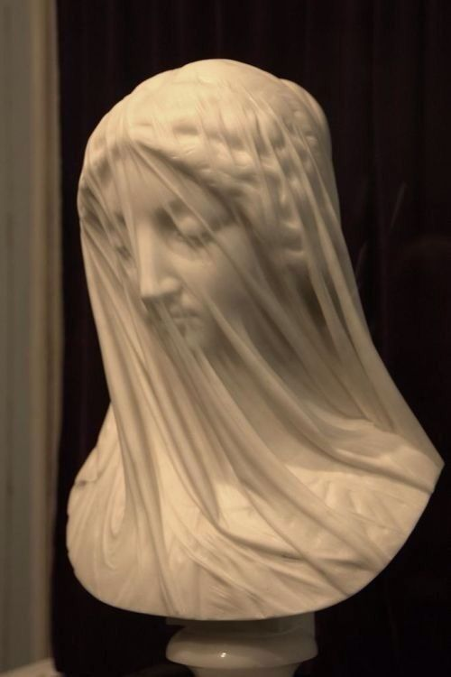
Introduction: Anti-anthropomorphism
LXX-theology? (cf. Rösel, Ausloos & Lemmelijn)
  Anthropomorphisms: instances where human-like attributes are ascribed to God
  Avoidance = part of LXX-theology
God’s mouth
  Anthropomorphism of Pentateuch
  LXX-Numbers: anti-anthropomorphic avoidance of mouth
    LXX-Num 20:24: strange translation of divine mouth = anti-anthropomorphism?
Giovanni Strazza, Vergine Velata

Slide 4
Overview
Designating the “Mouth”
Greek Equivalents for “Mouth” in the Pentateuch
Replacing an Anthropomorphism by Another One?
  Offensive mouth?
  Two anomalies
  Vorlage-centric approach
Conclusion

Slide 5
Designating the “Mouth”

Slide 6
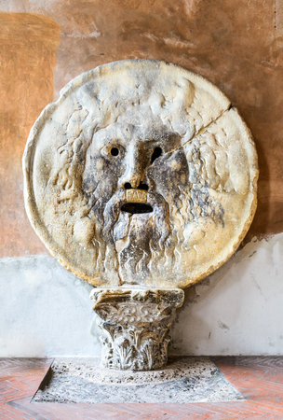
Designating the “Mouth”
Words for “mouth”
  Different words: חֵךְ, שָׂפָם, לָשׁוֹן, פֶּה
  The most common in Pentateuch (esp. Num): פֶּה
    This word: focus
Meanings and functions of פֶּה:
  Originally: physical mouth -> extension to speech & openings
  Multifunctional
    Main function: speech
    Semiprepositions
The mouth in the Septuagint?
  Equivalents align with polysemy of פֶּה
  Pentateuch: God’s mouth = στόμα (mouth), ῥῆμα (word, thing), πρόσταγμα (command), and φωνή (voice)
  στόμα as the (most) literal translation
LXX-Pentateuch: only two instances where God’s פֶּה is translated by στόμα (i.e., Num 12:8 and Deut 8:3)
Bocca della verità

Slide 7
2. Equivalents for “Mouth” in the Pentateuch

Slide 8
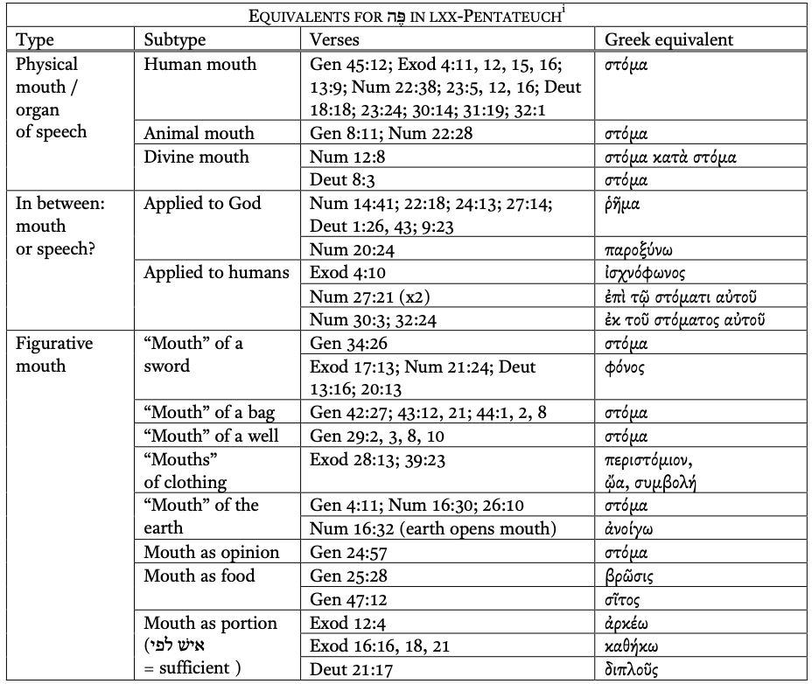
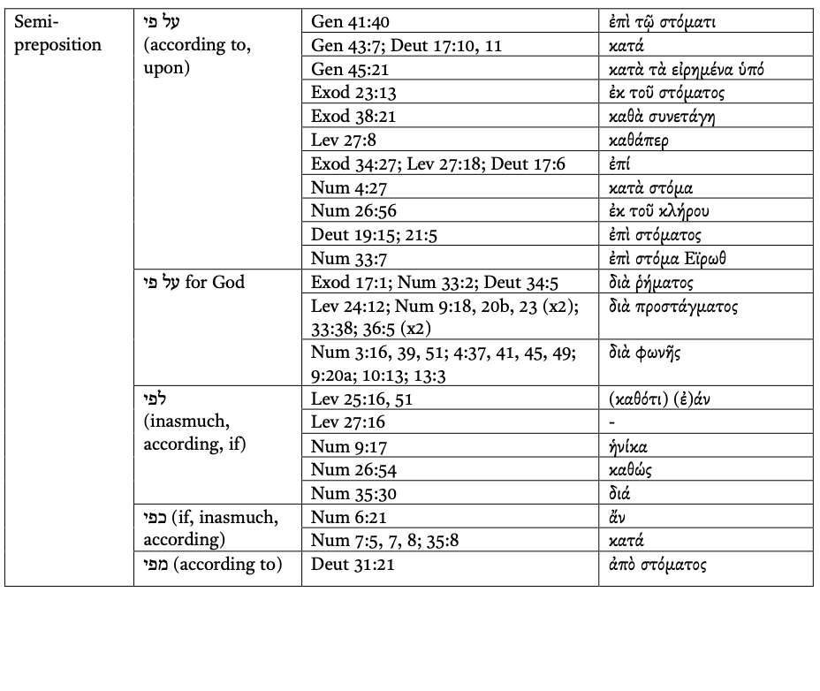
Greek Equivalents for “Mouth” in the Pentateuch
Semiprepositions
Variation
BUT: God: less literal
4 categories: a) physical mouth; b) “in between,” where it is not clear whether it refers to the organ of speech, or speech itself; c) “figurative mouth” as an opening in general; d) “semipreposition”
Physical mouth
Literal
Figurative mouth
Variation
In between
Variation
BUT: God: less literal

Slide 9
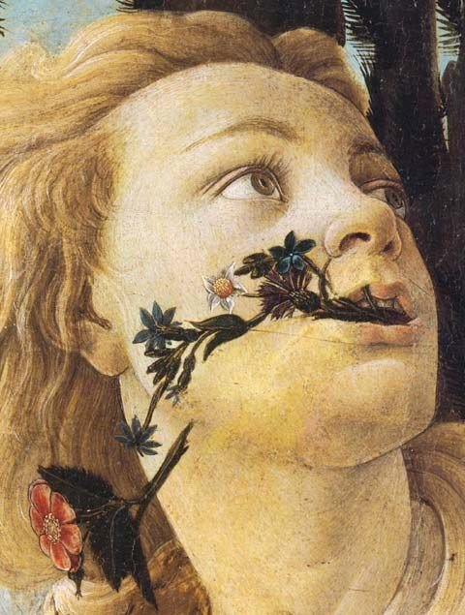
Greek Equivalents for “Mouth” in the Pentateuch
Equivalents for “mouth”
  Exception for divine mouth in semiprepositions and “in between”
LXX-Numbers:
  Some translations: unique
    Esp. Num 20:24
    Contrast with rendering of humuan mouth
  Unicity
  = anti-anthropomorphism?
  = focus on products of mouth?
Detail from Botticelli, Primavera

Slide 10
3. Replacing an Anthropomorphism
by Another One?

Slide 11
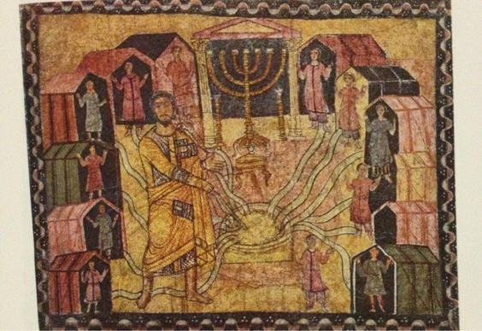
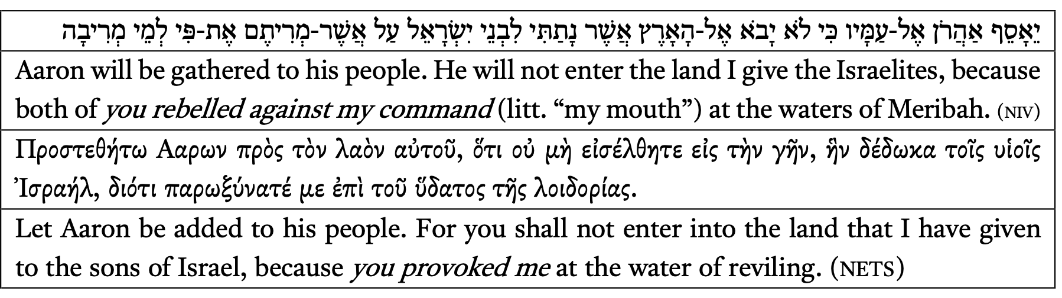
Replacing an
Anthropomorphism?
Peculiar rendering in LXX-Num 20:24!
Provocation instead of mouth
  G. Dorival: “élimination d’un anthropomorphisme [par] création d’un anthropopathisme”
Παροξύνω: provocation, used for both man and God in LXX
Why would the translator substitute an anthropomorphism by an anthropopathism?
Moses at Meriba (Dura Europos)

Slide 12
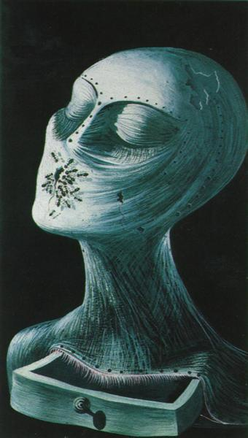
Replacing an
Anthropomorphism?
Offensive connotation avoided?
Hebrew: euphemistic usage
  פֶּה as female parts
  Part of metaphorical network: EATING IS SEXUAL INTERCOURSE
In LXX: similar euphemistic use of “mouth”
  E.g., Sir 26:10
  Also in Greek literature (στόμα stands for “opening” in general and can thus be similarly extended to the vulva)
BUT: Is the anthropopathic παροξύνω less “offensive” than God’s mouth?
Salvador Dalí, Ant Face

Slide 13
Replacing an
Anthropomorphism?
2. Two anomalies
The etiology of Meriba
Wordplay between מריבה and ריב (rebellion), or מרה (rebell)
Etiology in LXX
  Wordplay preserved in Ex 17:7 (Πειρασμὸς and πειράζειν, and Λοιδόρησις and λοιδορίαν)
  In LXX-Num: usually preserved
  In Num 20:24: no phonetic echo, no semantic link (παροξύνω only here!)
  Versus usual rendering: λοιδορέω (Num 20:13!) echoes ὕδωρ τῆς λοιδορίας, or corresponds semantically to ὕδωρ ἀντιλογίας.

Slide 14
Replacing an
Anthropomorphism?
2. Two anomalies
The translation of God’s mouth
In LXX-Pentateuch, פֶּה is never translated with personal pronoun
The expression פֶּה + מרה is never translated in the LXX by παροξύνω + personal pronoun
  Num 27:14 ; Deut 1:43: παραβαίνω + ῥῆμα (acc.); Deut 1:26; 9:23 : ἀπειθέω + ῥῆμα (dat.).
  Num 20:24: simply variatio?
    BUT: expression παρωξύνατέ με is different semantically and syntactically from preferred παραβαίνω/ἀπειθέω + ῥῆμα in LXX-Pentateuch

Slide 15
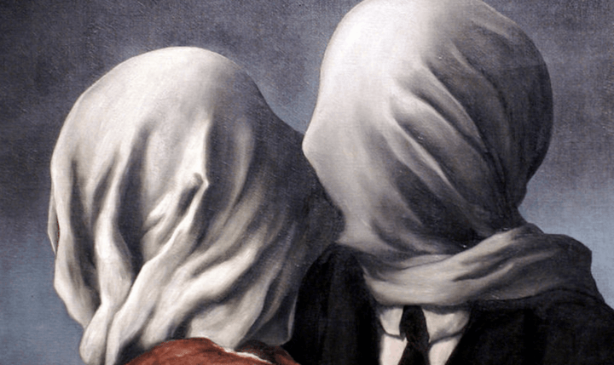

Replacing an Anthropomorphism?
2. Two anomalies
  Possibility of different Vorlage!
  Vorlage of the LXX: rather than מריתם את פי something like:
  “you rebelled against/provoked my anger.”
  παροξύνω = irritation/ provocation = combination of מרה and אַף or אנף
    2 Esd 9:14: παροξύνω renders the verb אנף
  Probable that LXX had different Vorlage
  The translation in Num 20:24 does not provide evidence of a anti-anthropomorphism, but reveals a Vorlage where God’s mouth was absent
René Magritte, Les amants

Slide 16
Replacing an
Anthropomorphism?
3. A Vorlage-centric approach
A different approach to evaluating the presence of anti- anthropomorphism in the LXX
Often a bipolar division in scholarship:
Num 20:24: possibility of a different Vorlage
  discredits the difficult theory of a substitution of an anthropomorphism by another one
  illustrates how the translator aspired to render the Hebrew into idiomatic Greek
  What scholars identify as an anti- anthropomorphism, might, for the Greek translator(s), constitute an authentic expression of what they thought their Vorlage meant
Exegesis (anti-anthropomorphism, deviation from the “correct” reading)
Minimalist ad sensum (no anti-anthropomorphism, only rendering of the meaning of X)
other factors in evaluation of translation of anthropomorphisms:
different Vorlage?
socio-historical context of the specific equivalent,
intertextual parallels,
stylistic features, etc.

Slide 17
Conclusion

Slide 18
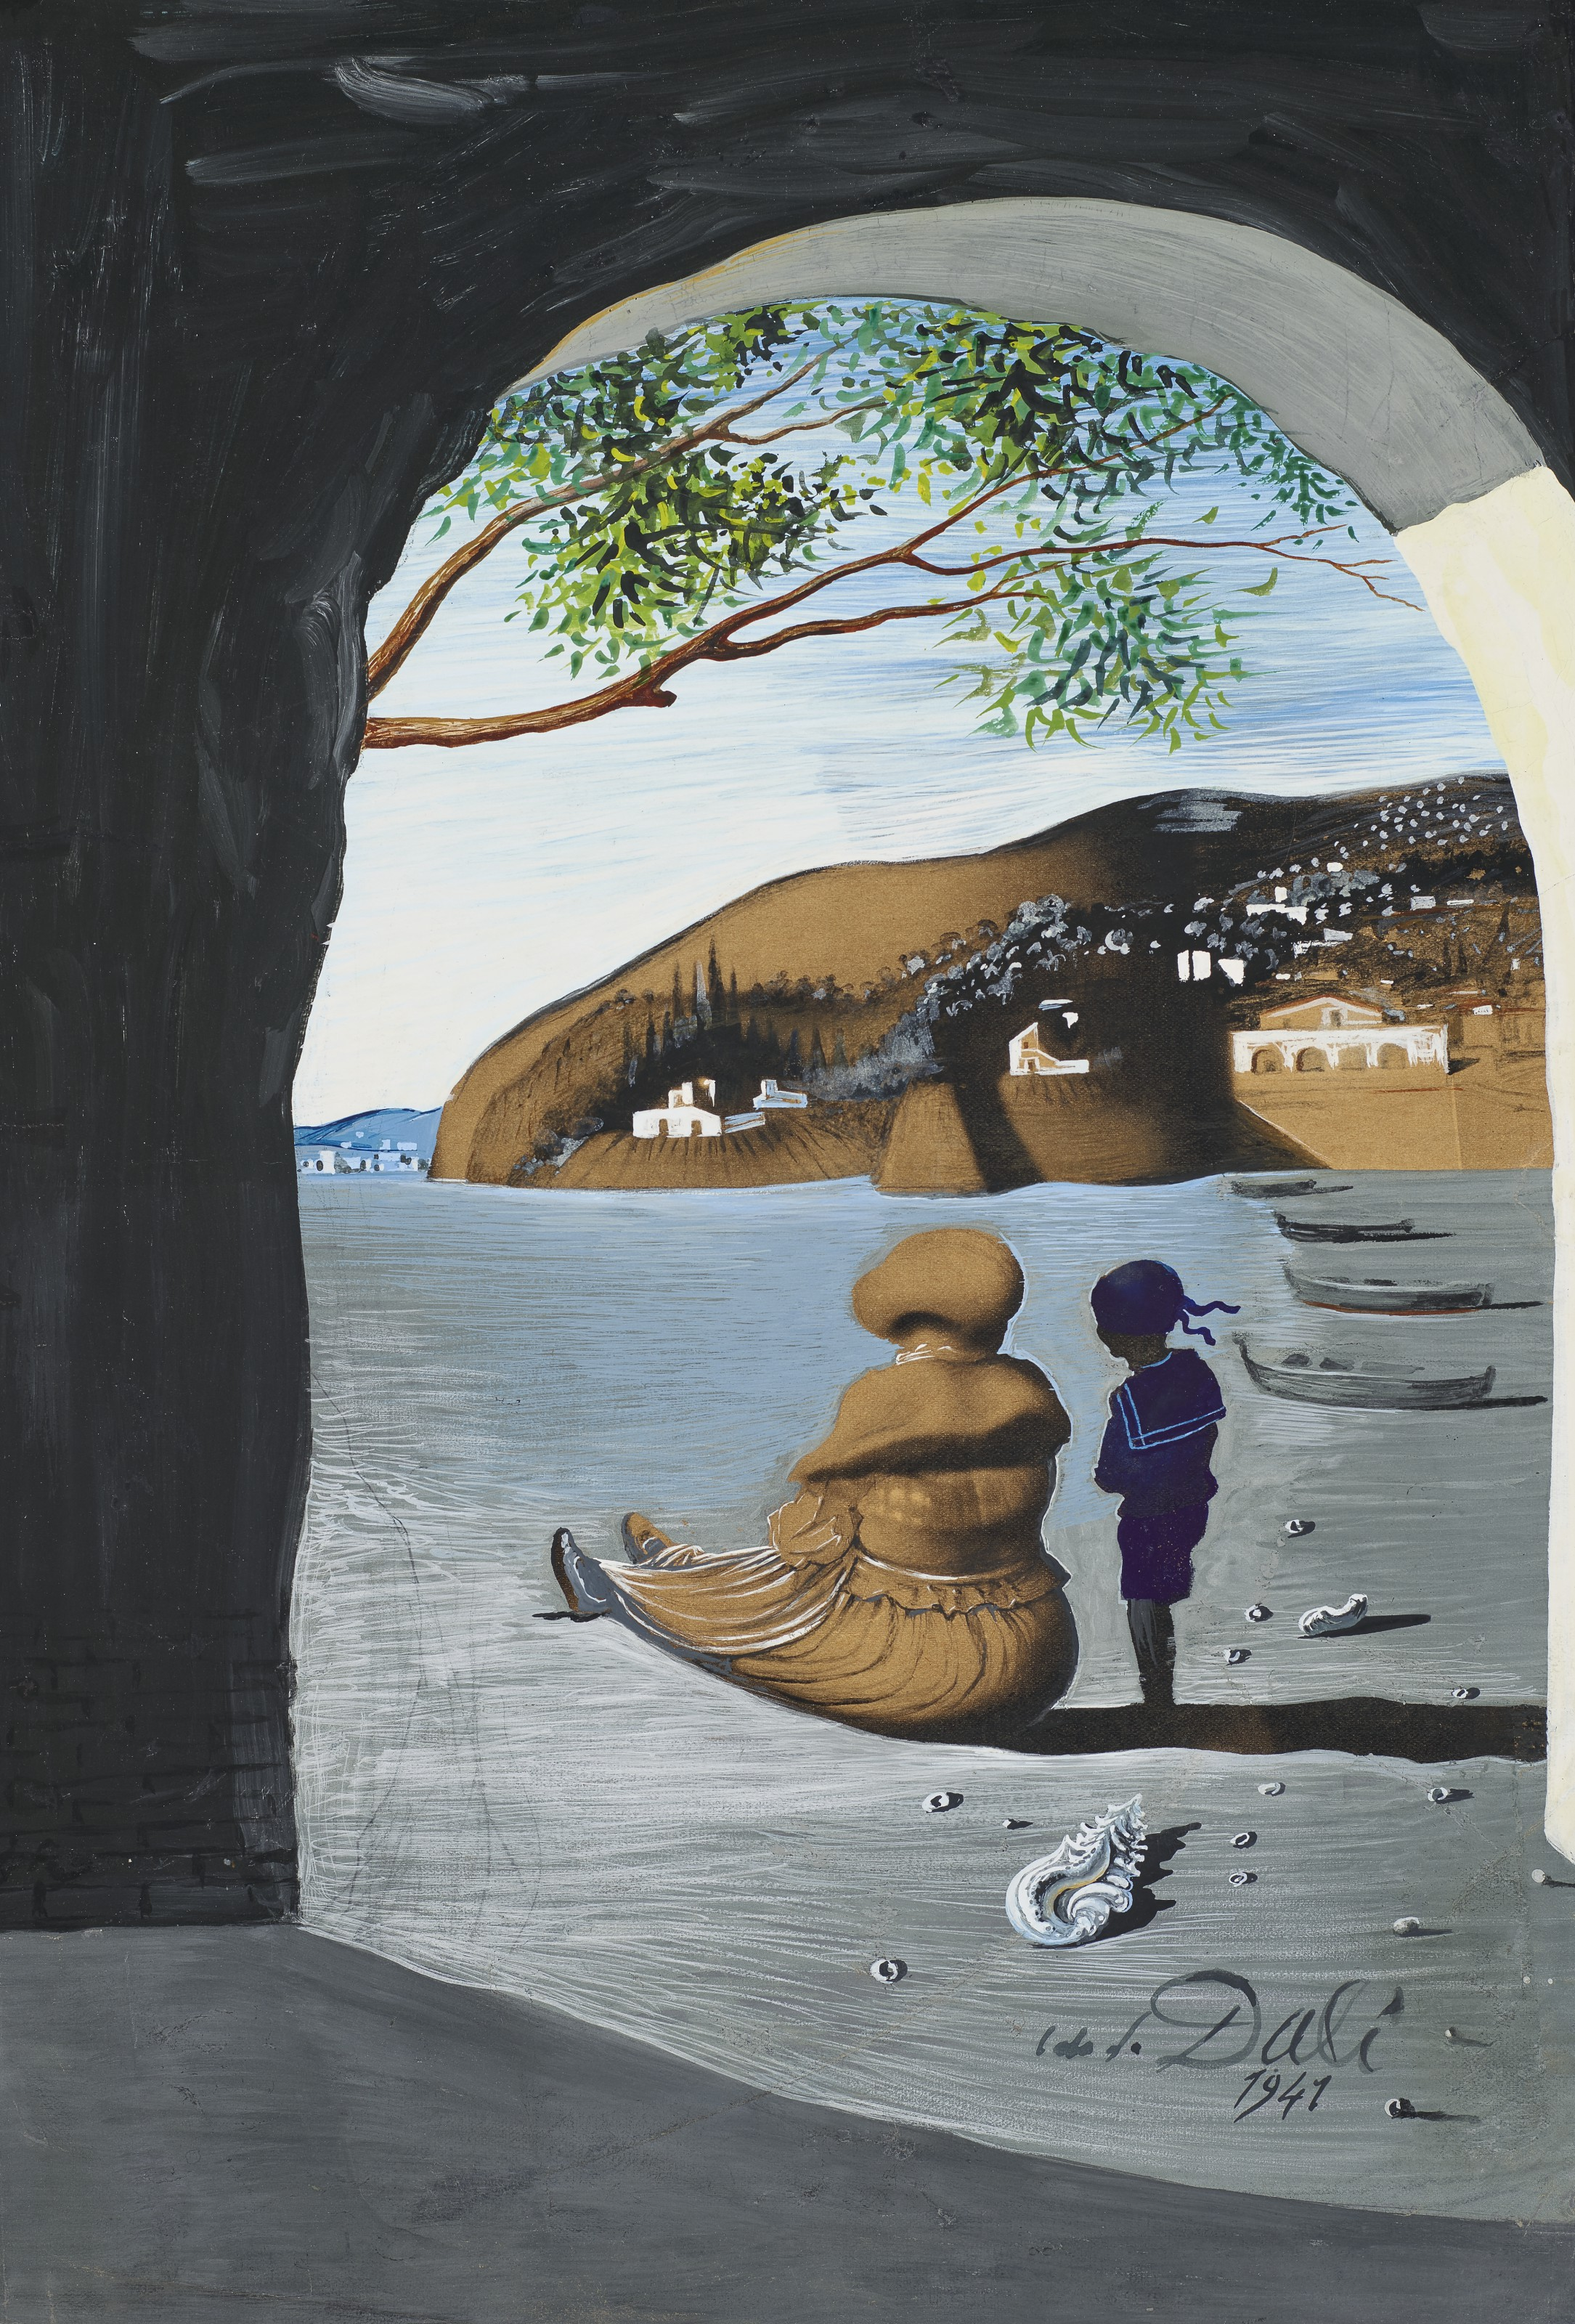
Conclusion
God’s mouth in LXX: avoided?
  LXX-Num: discrepancy human and divine mouth
  Num 20:24: different Vorlage instead of avoidance
Necessity for careful analysis of the Greek translation of anthropomorphisms!
New criteria:
  Carefulness: avoid label of anti-anthropomorphism as “easy solution” for unique rendering!
  Context: immediate and broader context of the verse: intertextual interpolations, specific idioms, cultural images, place within translation-technique of book?
  Nature of the anthropomorphism: likelihood of avoiding a particular anthropomorphism? If applicable, identify further, subtler instances of avoidance.
Salvador Dalí, Bouche mystérieuse

Slide 19
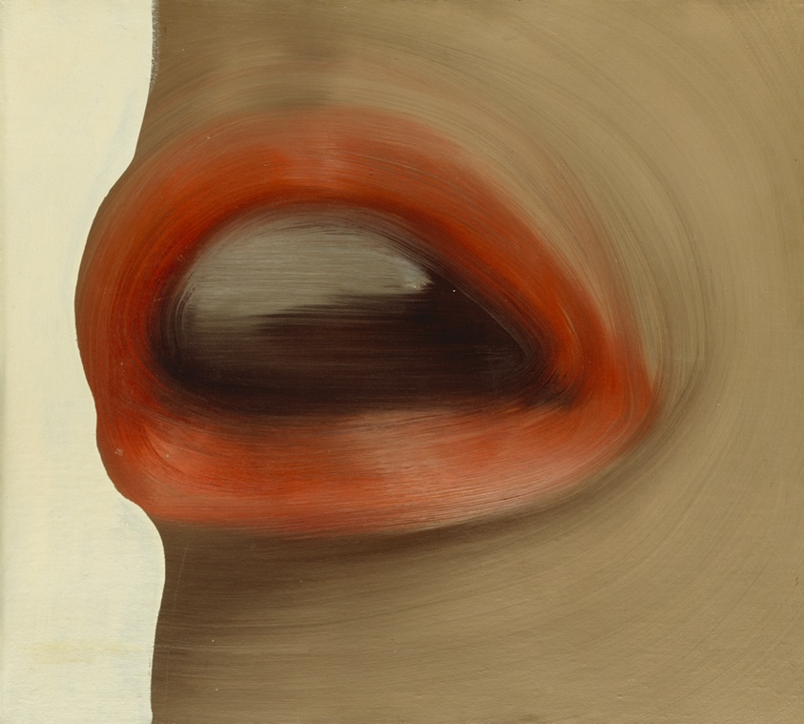
Thank you for listening!
Gerhard Richter, Mund

