Slide 1










12TH INTERNATIONAL CONFERENCE ON FLUVIAL HYDRAULICS
River morphodynamics and management
What happens downstream of a dam during a flush? Insight through laboratory experiments
R. Meurice, B. Bosseler, G. Noël, S. Soares-Frazão
UCLouvain, Belgium
LIVERPOOL, 2ND – 6TH SEPTEMBER

Slide 2


12TH INTERNATIONAL CONFERENCE ON FLUVIAL HYDRAULICS
Pressure flushing
First phase
Progressive water level decrease
Scouring of the sediment close to the dam heel
LIVERPOOL, 2ND – 6TH SEPTEMBER
3

Slide 3

12TH INTERNATIONAL CONFERENCE ON FLUVIAL HYDRAULICS
Drawdown flushing
Second phase
Open-channel flow
Erosion further upstream
LIVERPOOL, 2ND – 6TH SEPTEMBER
4

Slide 4
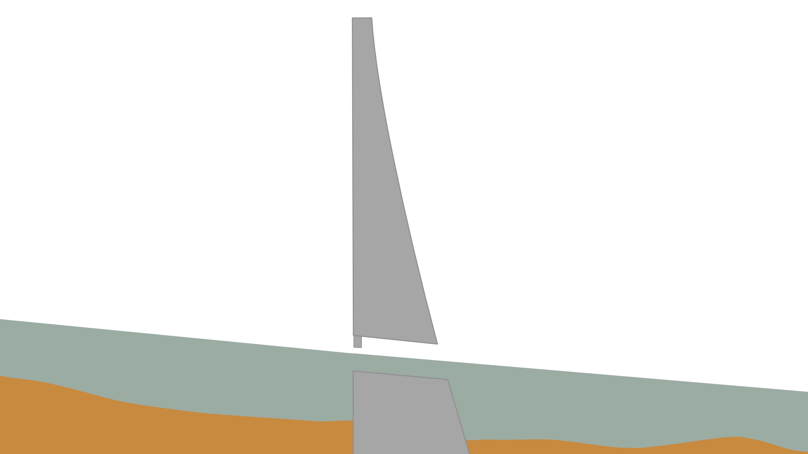
12TH INTERNATIONAL CONFERENCE ON FLUVIAL HYDRAULICS
Filling
Third phase
Lower concentrations
LIVERPOOL, 2ND – 6TH SEPTEMBER
5

Slide 5
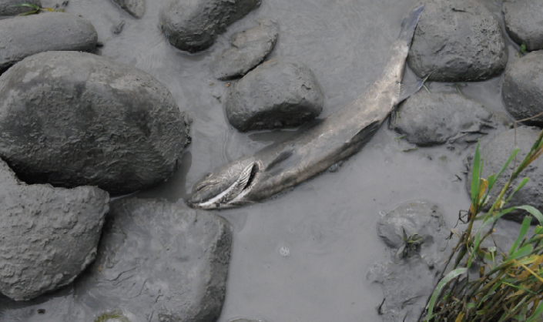
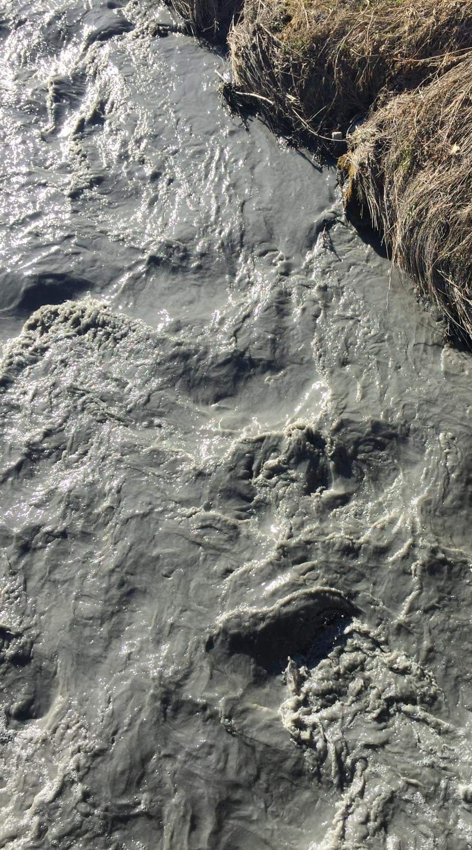
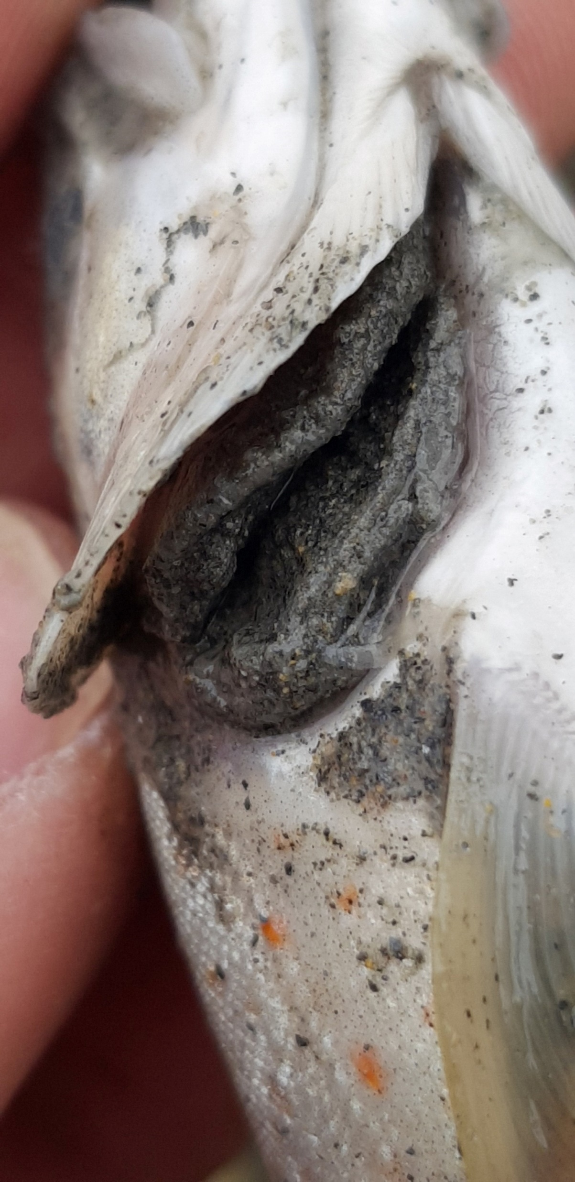
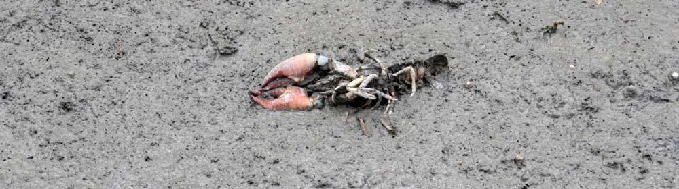
12TH INTERNATIONAL CONFERENCE ON FLUVIAL HYDRAULICS
Downstream impacts
Grimardias et al. (2012)
RTS
Rhône (2012)
Durance (2022), Fédération de Pêche des Hautes-Alpes
LIVERPOOL, 2ND – 6TH SEPTEMBER
6

Slide 6
12TH INTERNATIONAL CONFERENCE ON FLUVIAL HYDRAULICS
Presentation plan
Flume and experimental configurations
Bed level and concentration evolution methods
Results
LIVERPOOL, 2ND – 6TH SEPTEMBER
7

Slide 7
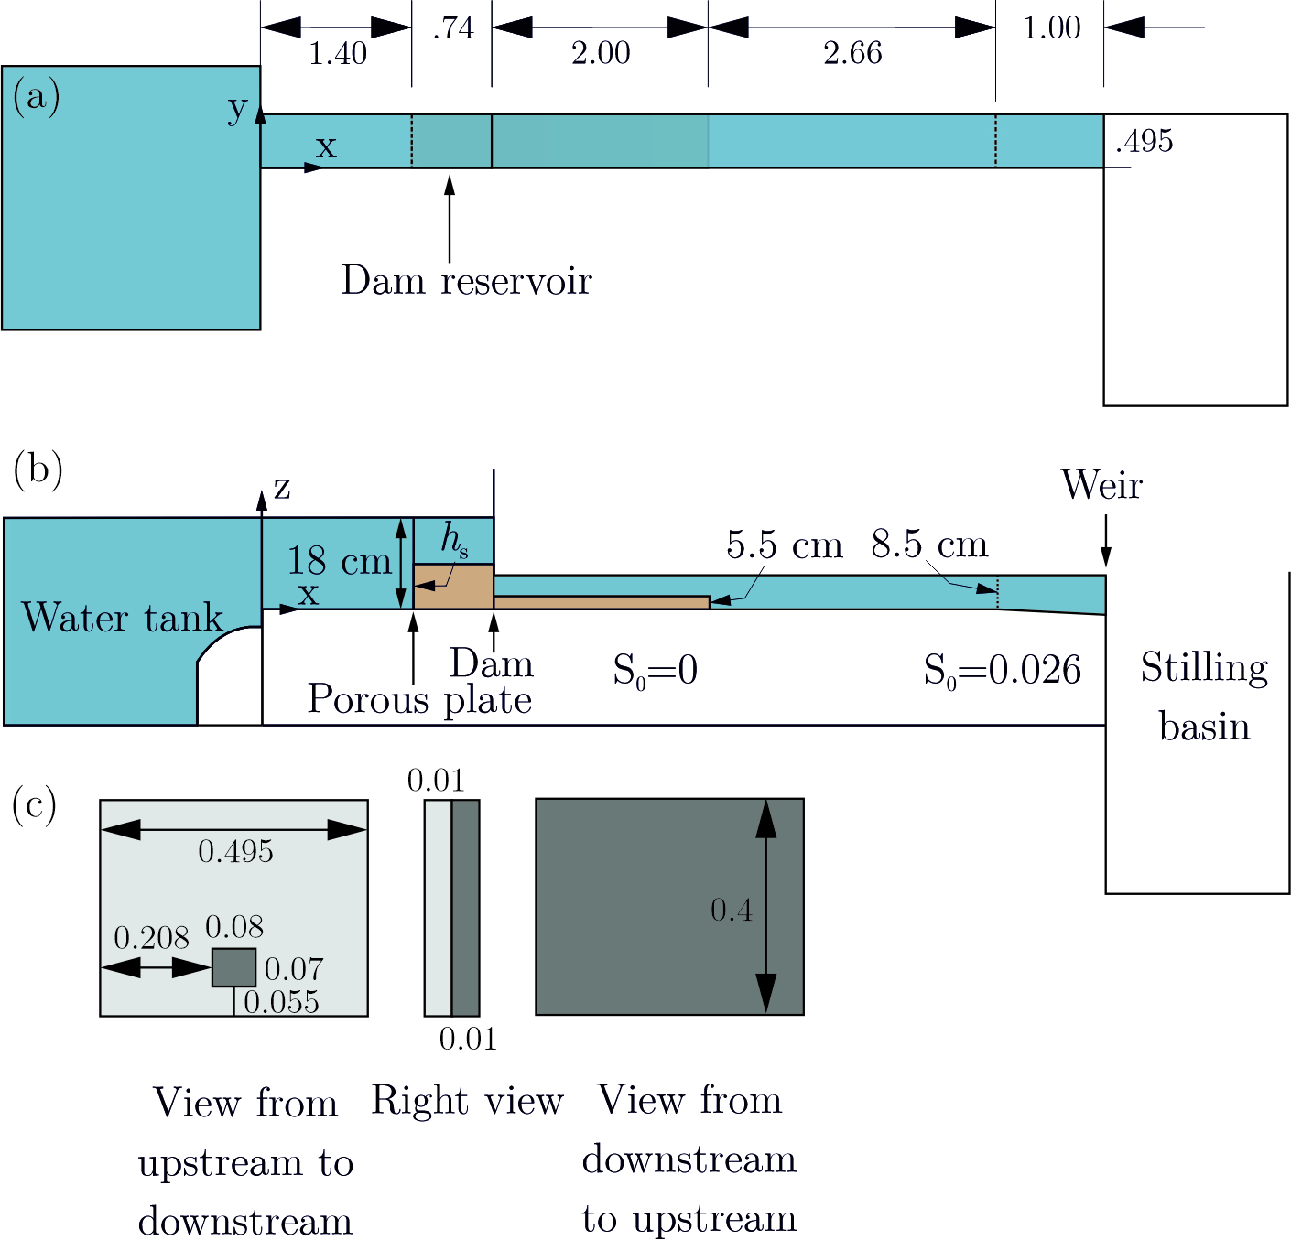
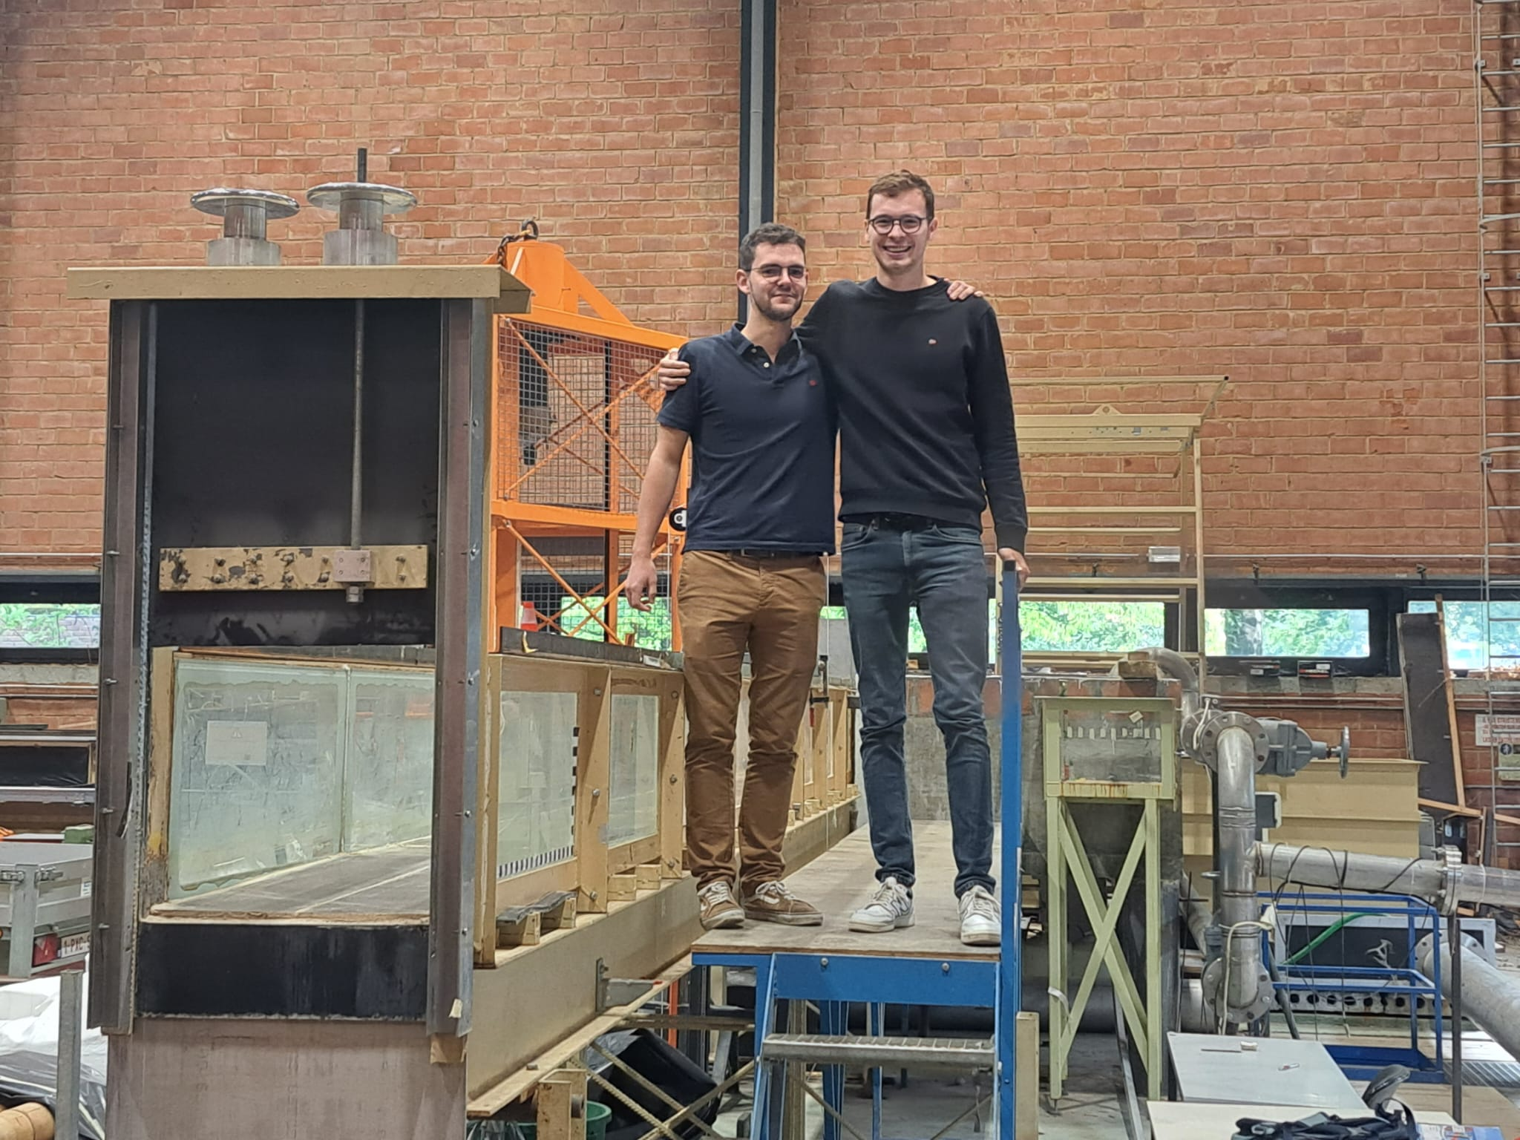
12TH INTERNATIONAL CONFERENCE ON FLUVIAL HYDRAULICS
Experimental flume
Guillaume
Brieuc
Plan view
Elevation view
50 cm
LIVERPOOL, 2ND – 6TH SEPTEMBER
8

Slide 8
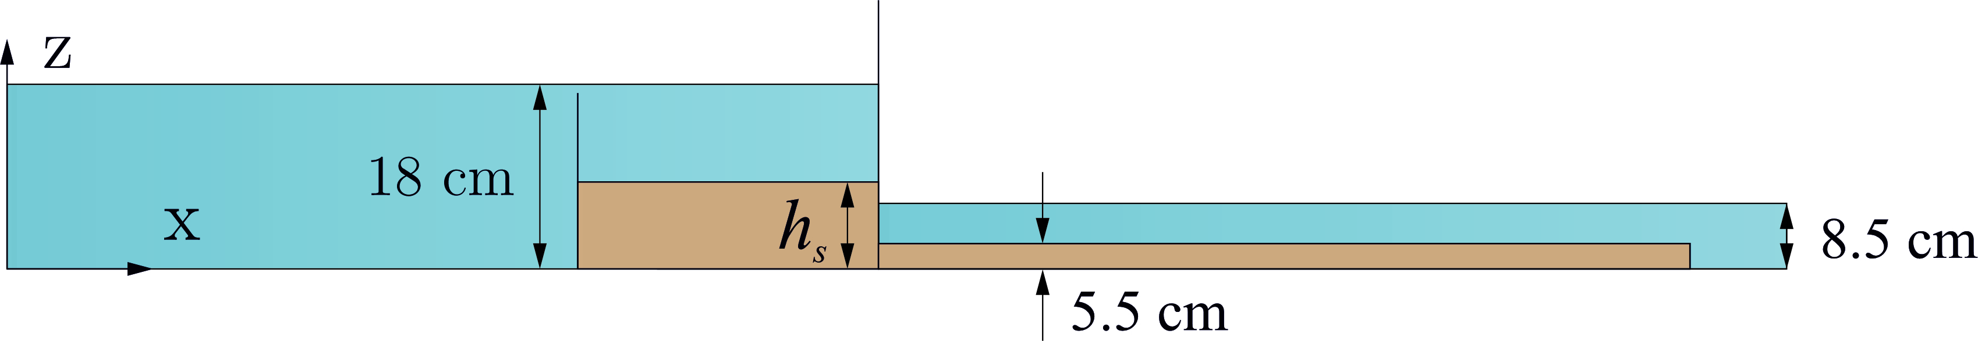
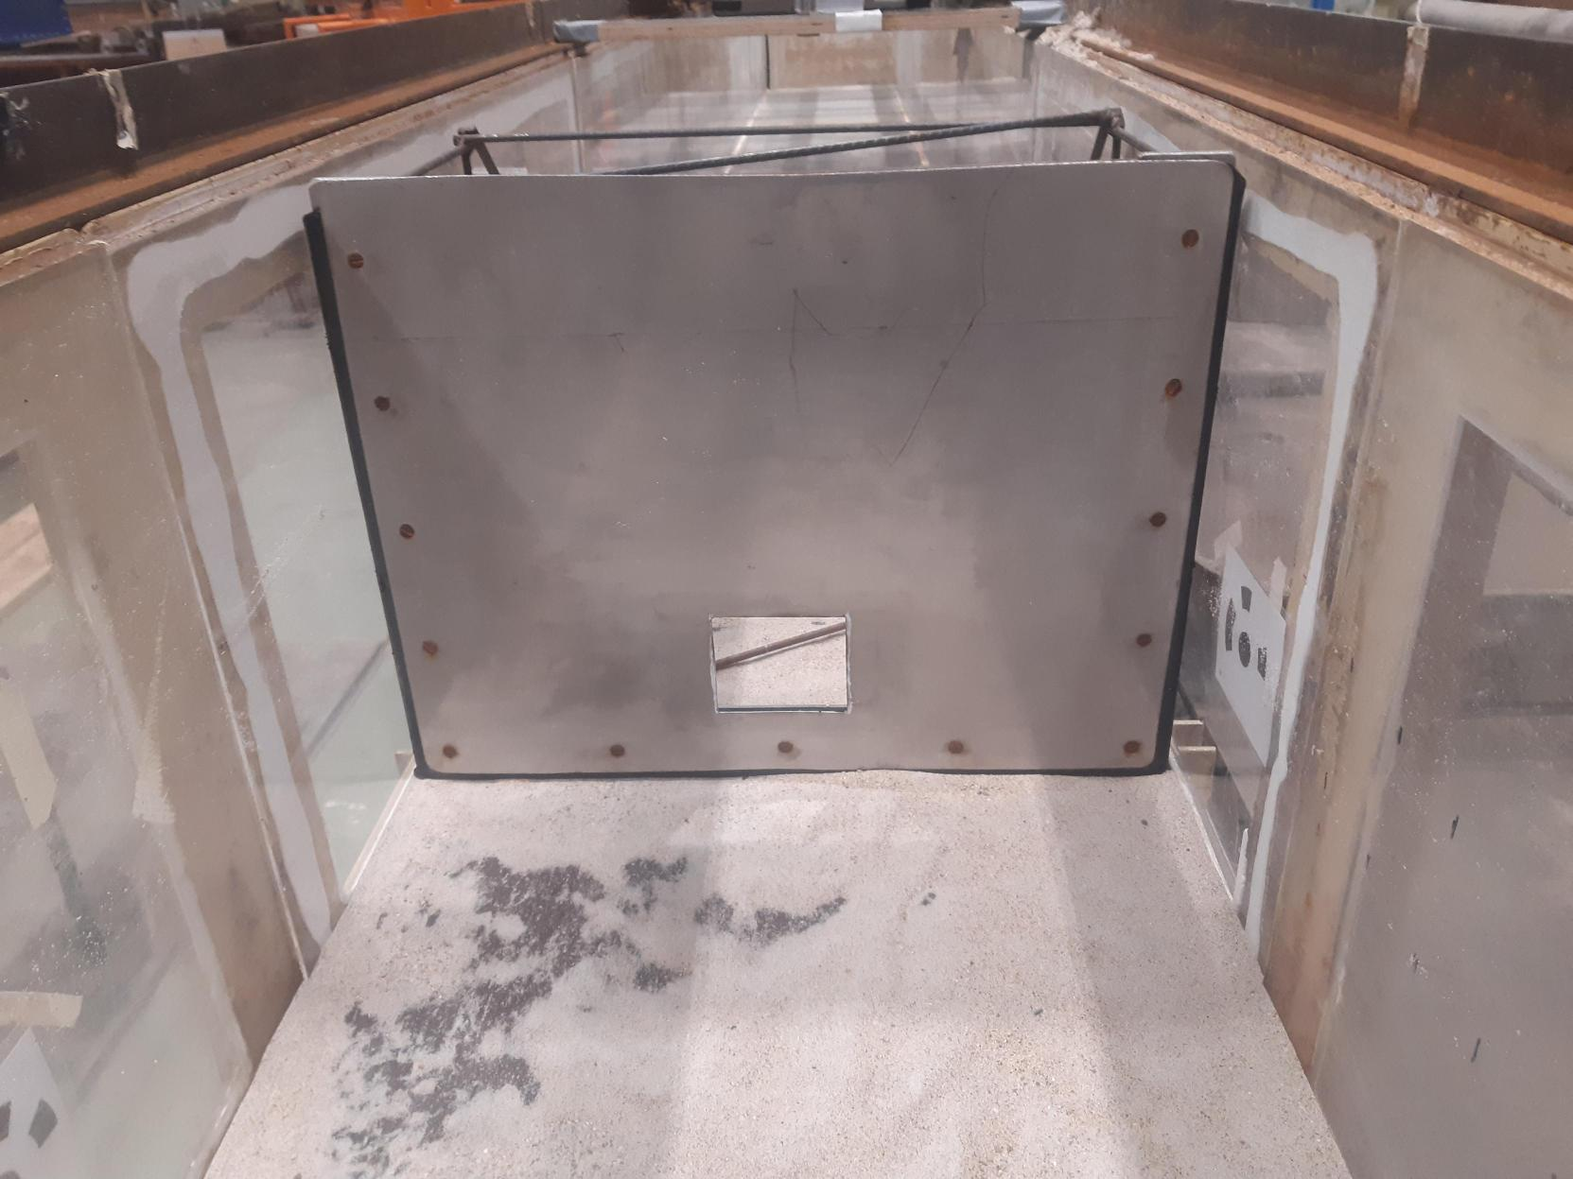
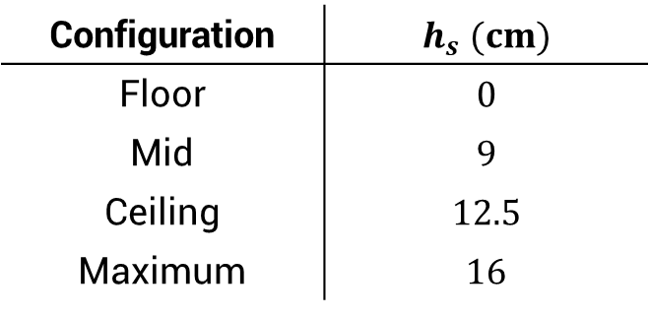
12TH INTERNATIONAL CONFERENCE ON FLUVIAL HYDRAULICS
Experimental configurations
Flow direction
Longitudinal cut
Configuration | $$h_{s} (cm)$$
Floor | $$0$$
Mid | $$9$$
Ceiling | $$12.5$$
Maximum | $$16$$
LIVERPOOL, 2ND – 6TH SEPTEMBER
9

Slide 9
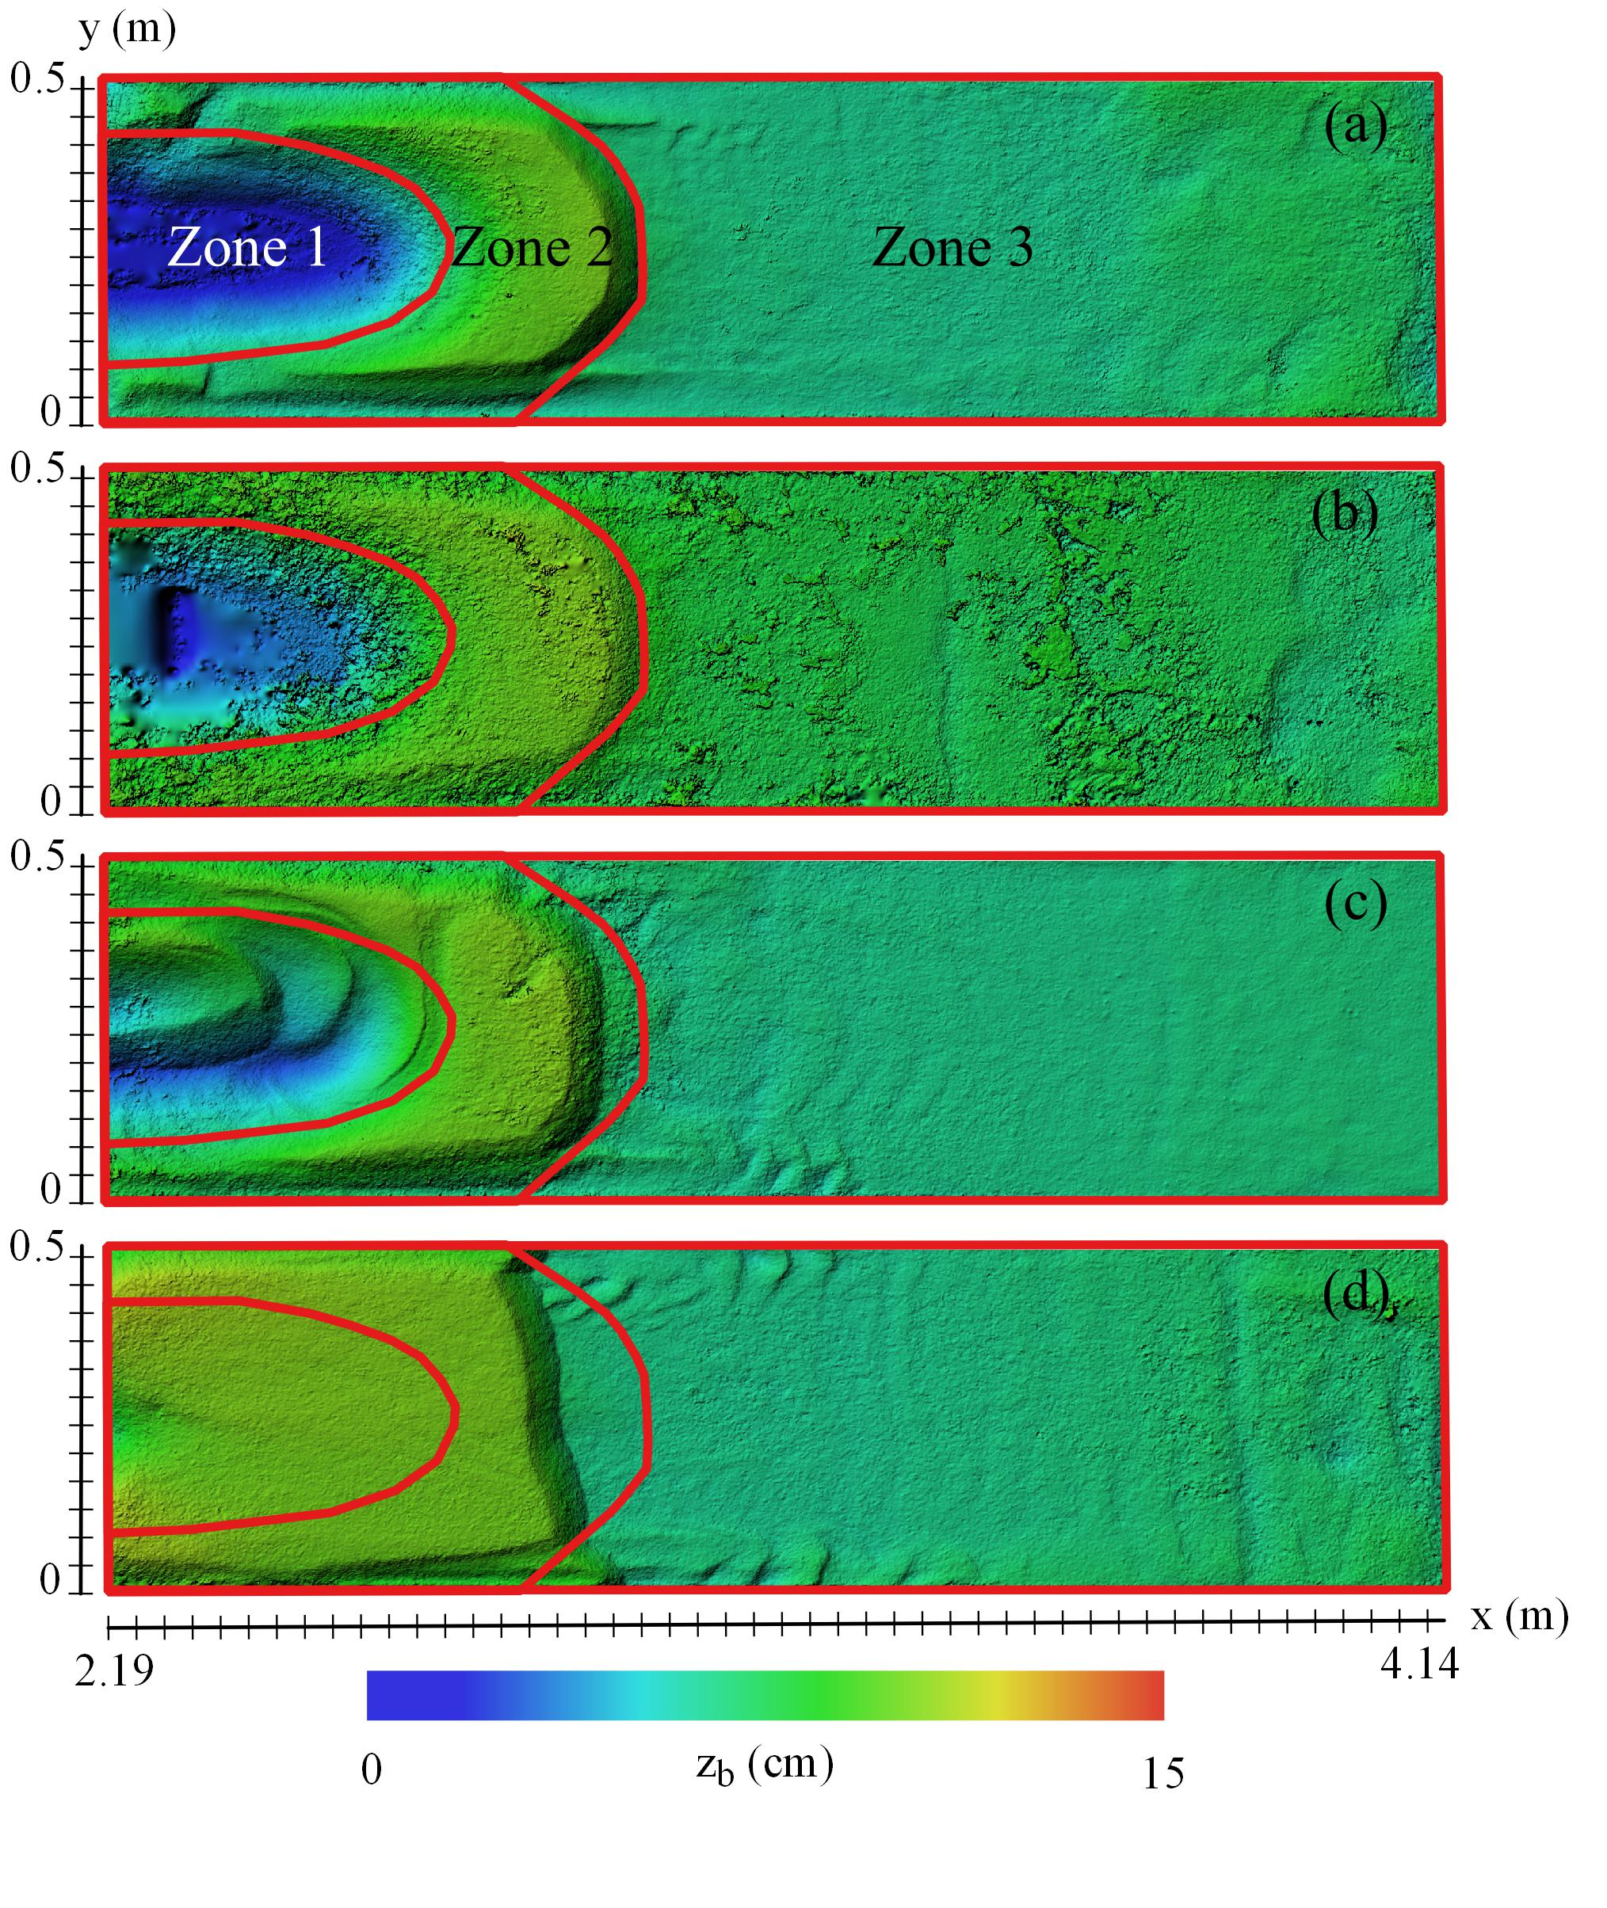
12TH INTERNATIONAL CONFERENCE ON FLUVIAL HYDRAULICS
Final topography
Floor
Ceiling
Mid
Maximum
LIVERPOOL, 2ND – 6TH SEPTEMBER
10

Slide 10
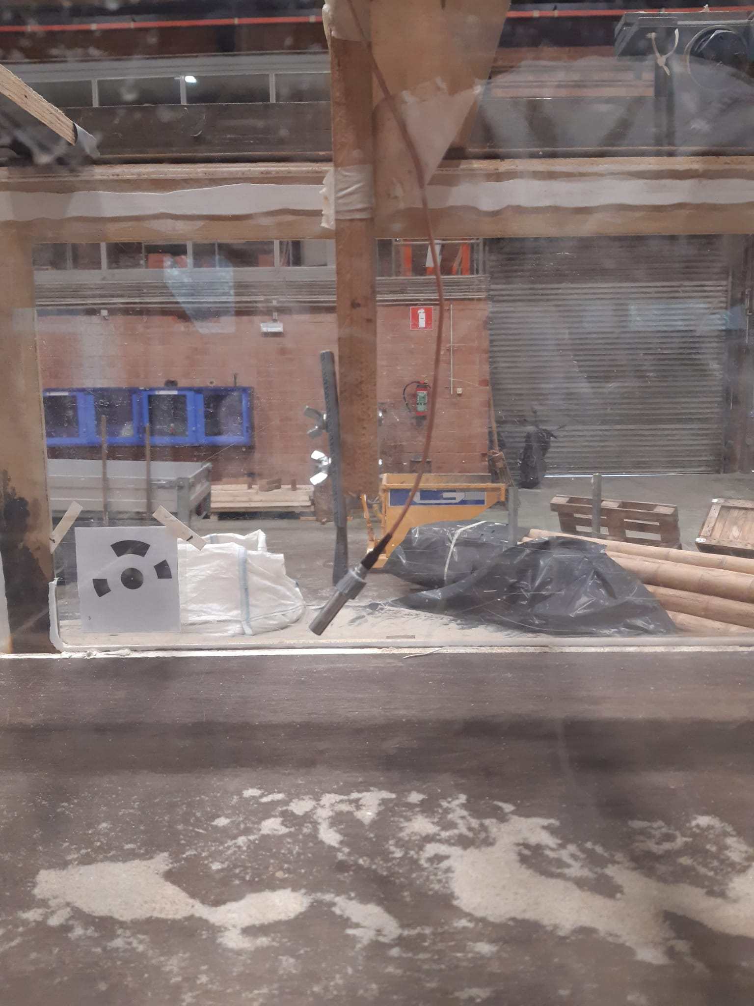
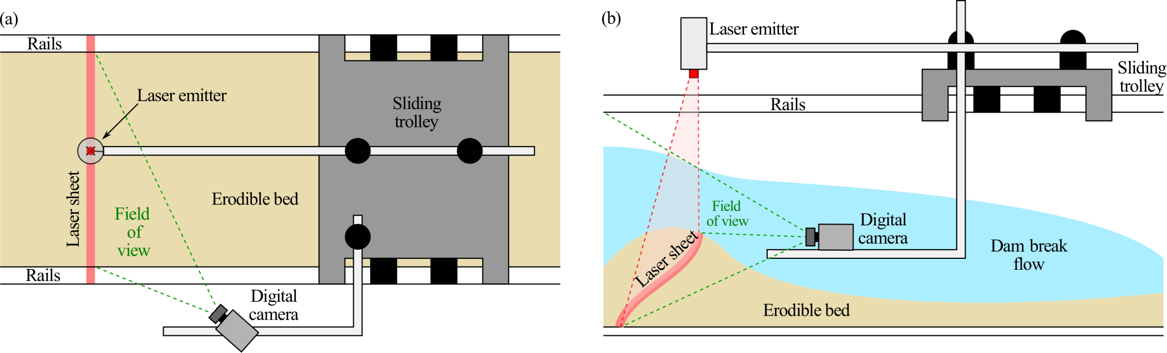
12TH INTERNATIONAL CONFERENCE ON FLUVIAL HYDRAULICS
Measuring the bed level evolution
Acoustic backscattering (ABS)
Laser profilometry
Look at the paper or my thesis!
LIVERPOOL, 2ND – 6TH SEPTEMBER
11

Slide 11
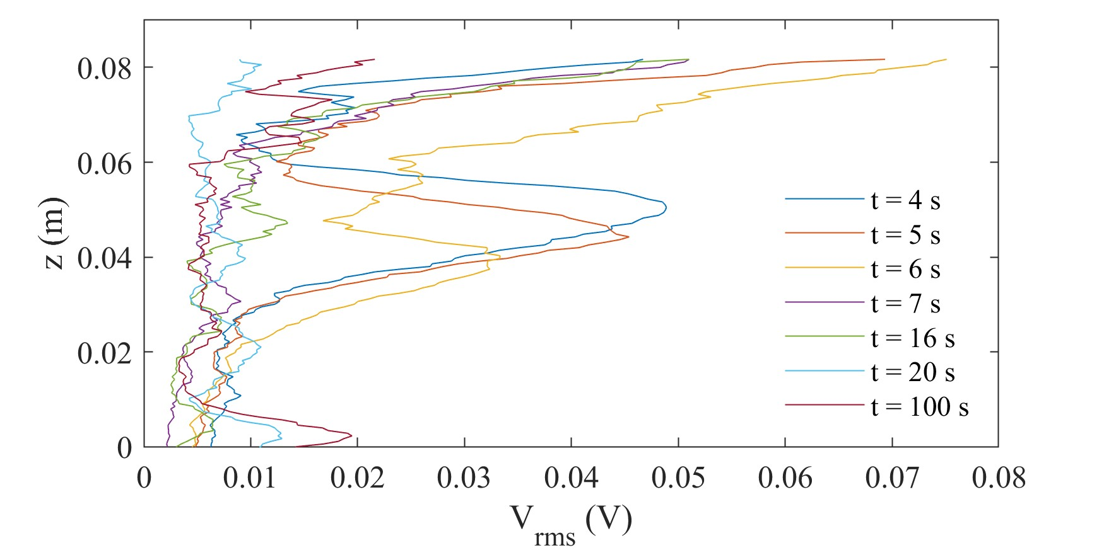
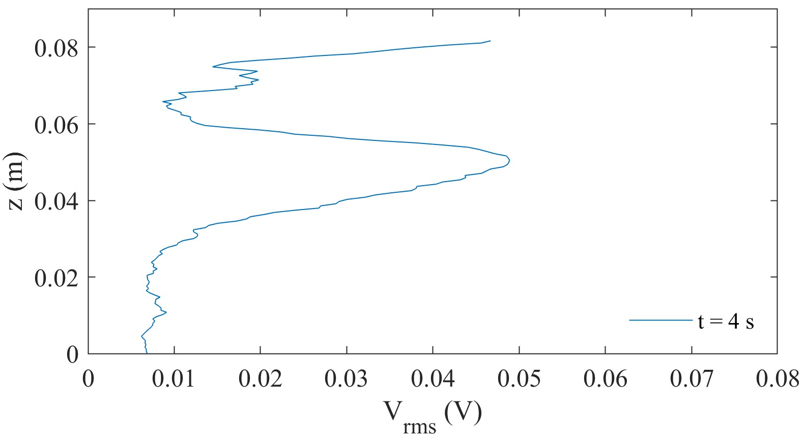
Bed level evolution – ABS
Water surface
Initial
Floor
Mid
Ceiling
Maximum
Floor
Signal weakens with depth
Signal peaks at the bed
Evolutions vary according to
The configurations
The phases
LIVERPOOL, 2ND – 6TH SEPTEMBER
12

Slide 12
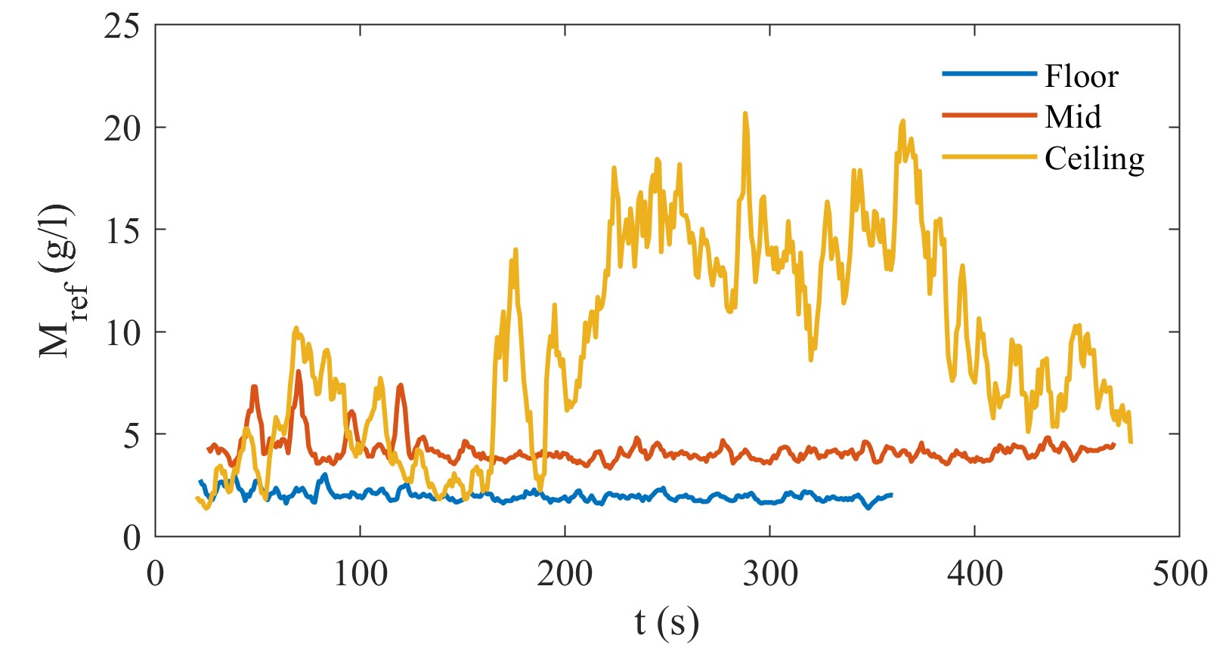
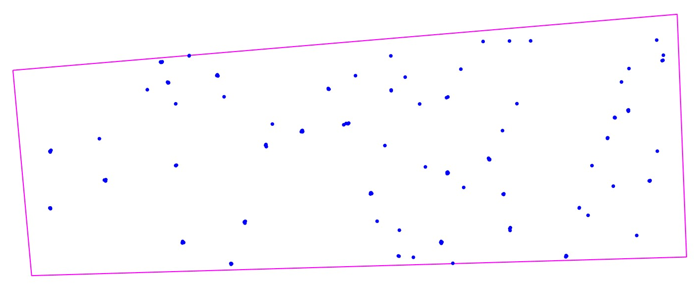
12TH INTERNATIONAL CONFERENCE ON FLUVIAL HYDRAULICS
Concentrations
LIVERPOOL, 2ND – 6TH SEPTEMBER
13

Slide 13
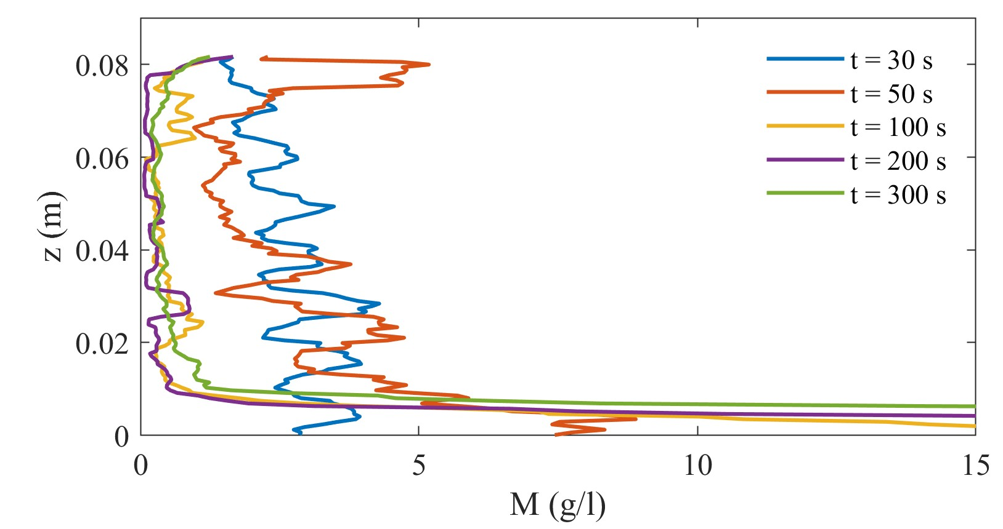
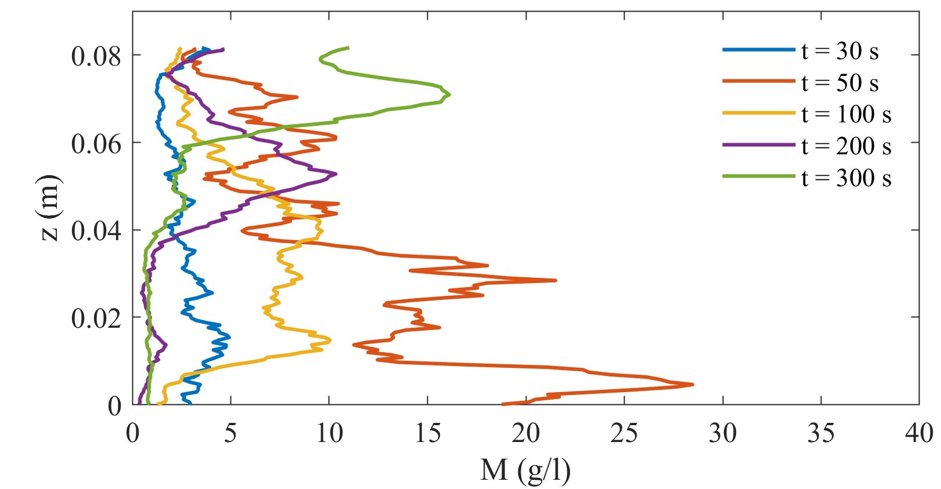
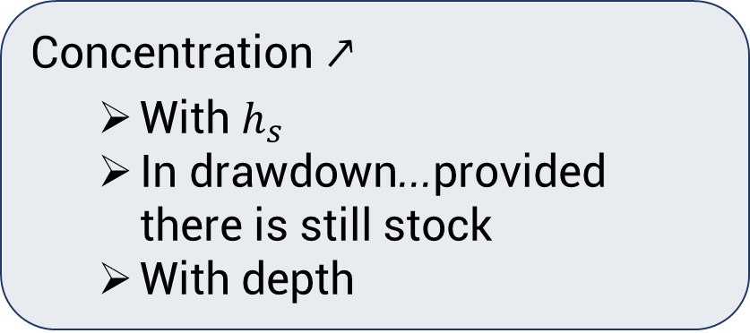
12TH INTERNATIONAL CONFERENCE ON FLUVIAL HYDRAULICS
Concentrations
Floor
Concentration ↗
  With $h_{s}$
  In drawdown...provided there is still stock
  With depth
Ceiling
LIVERPOOL, 2ND – 6TH SEPTEMBER
14

Slide 14
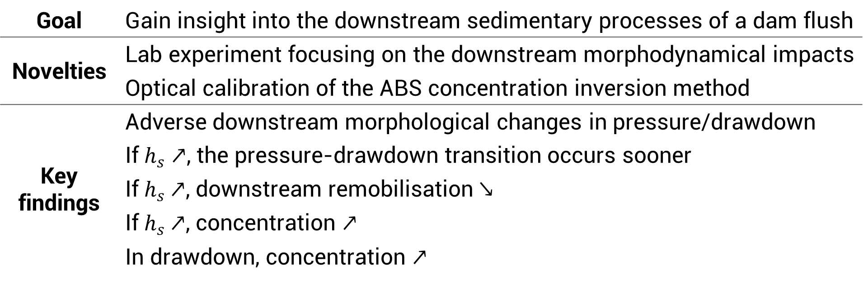
12TH INTERNATIONAL CONFERENCE ON FLUVIAL HYDRAULICS
Conclusions and future work
Goal | Gain insight into the downstream sedimentary processes of a dam flush
Novelties | Lab experiment focusing on the downstream morphodynamical impacts
 | Optical calibration of the ABS concentration inversion method
Key findings | Adverse downstream morphological changes in pressure/drawdown
 | If $h_{s}↗$, the pressure-drawdown transition occurs sooner
 | If $h_{s}$ $↗$, downstream remobilisation ↘
 | If $h_{s}$ $↗$, concentration $↗$
 | In drawdown, concentration $↗$
More experiments to come
These results advocate for regular flushes
LIVERPOOL, 2ND – 6TH SEPTEMBER
15

Slide 15

12TH INTERNATIONAL CONFERENCE ON FLUVIAL HYDRAULICS
River morphodynamics and management
What happens downstream of a dam during a flush? Insight through laboratory experiments
R. Meurice, B. Bosseler, G. Noël, S. Soares-Frazão
Conference paper in the proceedings
Contact: sandra.soares-frazao@uclouvain.be
SCAN ME
LIVERPOOL, 2ND – 6TH SEPTEMBER

Slide 17

12TH INTERNATIONAL CONFERENCE ON FLUVIAL HYDRAULICS
Sedimentation
Transport hindered
Sedimentation upstream
Morphological changes
Incision downstream
LIVERPOOL, 2ND – 6TH SEPTEMBER
2
Notes:
That’s the objective but first, let us first define what a flush is and explain why we proceed to flushes.
As you probably know, damming a river hinders sediment transport. The solid load is blocked and eventually deposes upstream of the dam, which is called sedimentation.
As time goes by, the capacity of the reservoir reduces, which may pose management issues. In some cases, the reservoir may be completely filled with sediment so that the dam becomes completely useless despite the major disturbance caused to environment.
Downstream of the dam, the reduction of the solid load often leads to incision of the bed. Besides, the composition of the bed changes because the residual solid load going through the dam is mostly made of fines as coarse particles depose faster.
Very briefly, damming a river breaks its sediment continuity.

Slide 18
Grain size distribution
LIVERPOOL, 2ND – 6TH SEPTEMBER

Slide 19
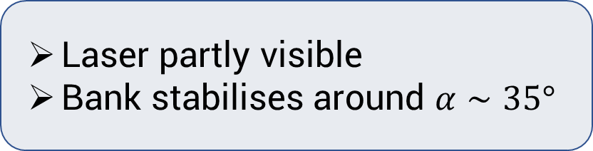
Bed level evolution – laser profilometry
12TH INTERNATIONAL CONFERENCE ON FLUVIAL HYDRAULICS
Floor
Laser partly visible
Bank stabilises around $α∼35°$
LIVERPOOL, 2ND – 6TH SEPTEMBER
12
Notes:
The ABS method is handy because it can provide bed level estimations even in turbulent and turbid conditions. But unfortunately, it gives only point information. To complement this, we projected a laser in the erosion pit, at a section of the ABS sensor which is represented by the brown square here. On the right picture, you can see a picture that was captured by the camera outside the flume. Unfortunately, only some part of the laser is visible at this moment because the lateral deposit are in the forefront. In brown, you can see the ABS sensor and in red the laser projection. The green arrow indicates the flow direction.
Provided an appropriate calibration using a chequerboard, the coordinates of the laser can be retrieved easily. On the right graph, you can see the evolution of the laser profile, and hence the bed surface with time, for the floor configuration. As mentionned before, we cannot see the whole profile but only this part here. We see that the topography quickly evolves and stabilises around 90 s. Interestingly, the bank of the erosion pit looks to stabilise around an angle of 35°, close to the friction angle. The same exercice can be done for the other configurations and I invite you to have a glance at my thesis if you are interested.

Slide 20
Laser profilomtry
Floor
Ceiling
LIVERPOOL, 2ND – 6TH SEPTEMBER

Slide 21
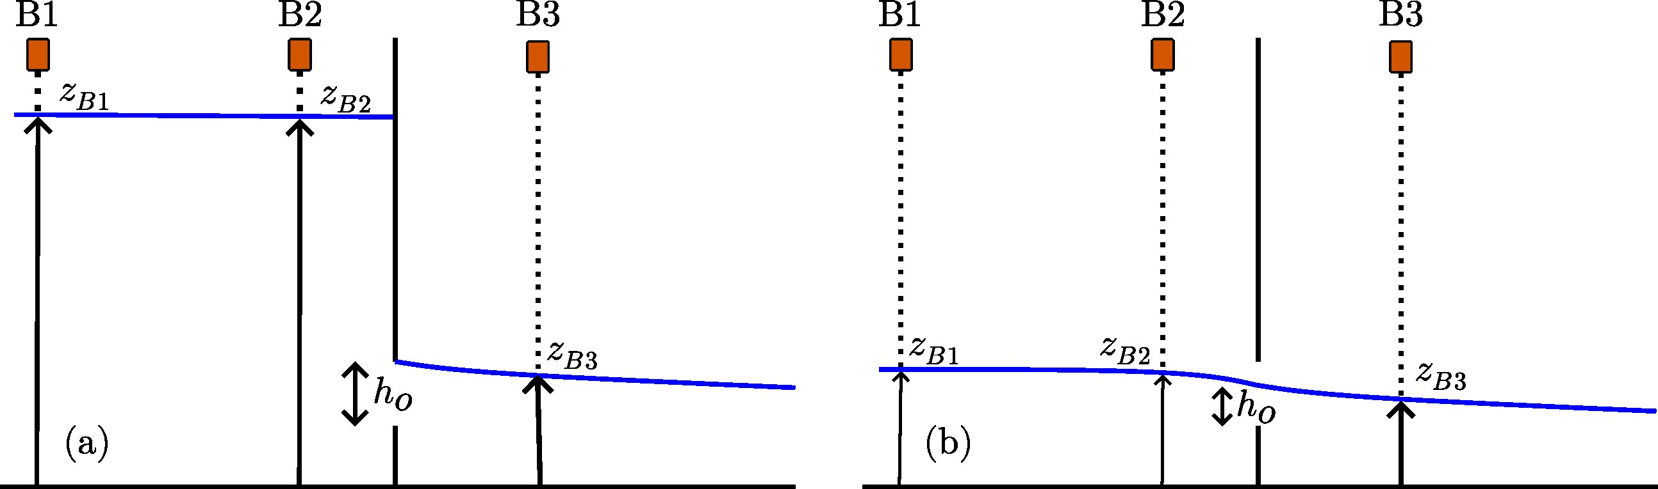

Hydrograph – measurement method
$$Q=μ_{o}w_{o}h_{o}\sqrt{2g(z_{B2}}−z_{B3})$$
LIVERPOOL, 2ND – 6TH SEPTEMBER

Slide 22
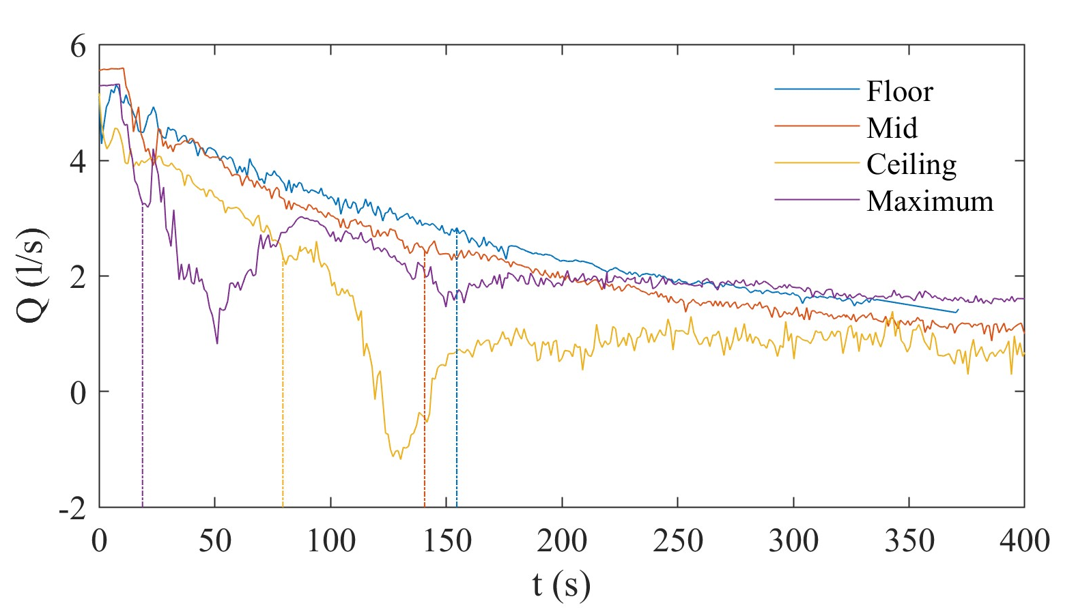
Hydrograph – results
LIVERPOOL, 2ND – 6TH SEPTEMBER

Slide 23
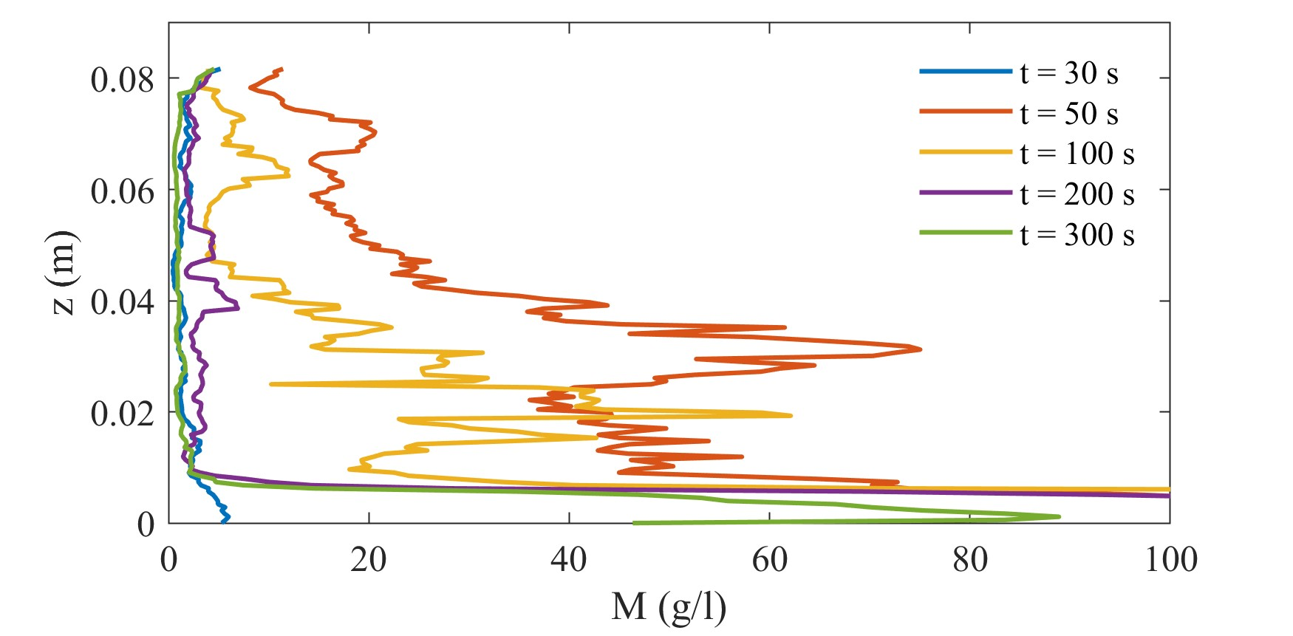
12TH INTERNATIONAL CONFERENCE ON FLUVIAL HYDRAULICS
Concentrations
Floor
Mid
Ceiling
LIVERPOOL, 2ND – 6TH SEPTEMBER
14
Notes:
By applying these reference concentrations as an upper boundary condition, it is then possible to obtain the concentration profile with depth.
In the floor configuration, we see that the concentration tends to rise closer to the bed as expected and to decline with time. In the ceiling configuration, it is a bit more tricky. We can actually also see a concentration increase closer to the bed, for example at 50 s, but we must remember that the bed level rises with time. While it is close to the wooden floor at 50s, it levels around 7 cm after 300s. Of course, the concentration level at the peak and under it are unphysical. And contrary to the floor configuration, the concentration globally rises in drawdown.
Unfortunately, this concentration measurement method could not be compared with vastly acknowledged methods and the results should be considered with caution. Yet, they look coherent and do provide some information about the evolution of the flow.

Slide 24

12TH INTERNATIONAL CONFERENCE ON FLUVIAL HYDRAULICS
Conclusions and future work
Goal | Gain insight into the downstream sedimentary processes of a dam flush
Novelties | Lab experiment focusing on the downstream morphodynamical impacts
 | Optical calibration of the ABS concentration inversion method
Key findings | Adverse downstream morphological impacts in pressure/drawdown
 | If $h_{s}↗$, the pressure-drawdown transition occurs sooner
 | If $h_{s}$ $↗$, downstream remobilisation ↘
 | If $h_{s}$ $↗$, concentration $↗$
 | In drawdown, concentration $↗$
More experiments to come
These results advocate for regular flushes
LIVERPOOL, 2ND – 6TH SEPTEMBER
15
Notes:
I am coming to the end of this presentation. With these experiments, we wanted to better understand the sedimentary processes downstream of a flushed dam. We tried to reproduce flush conditions in a laboratory flume and monitored bed levels and concentrations, using a new calibration method combining acoustic backscattering and laser profilometry.
We observed different and even adverse morphological impacts depending on the configurations and flushing phases. We noticed that, all other things being equal, the higher the upstream initial deposit depth, the sooner the pressure-drawdown transition. Consequently, the downstream sediment layer was also less remobilised by the flush in these conditions since the pressure phase essentially leads to erosion downstream. Higher hs also tended to increase the concentration downstream. Finally, it appears that the drawdown phase leads to higher concentrations provided there is enough sediment upstream to pass downstream.
These experiments were only preliminary and their results are more helpful qualitatively than quantitatively. Normally, they should be complemented this year by another Phd student. However, these observations already point towards one key take home message : if we want to limit the impacts downstream of a flushed dam that are strongly linked with the concentration, regular flushes simply appear necessary.

Slide 25
12TH INTERNATIONAL CONFERENCE ON FLUVIAL HYDRAULICS
LOGO
LOGO
Institutions/ funding councils
LIVERPOOL, 2ND – 6TH SEPTEMBER

